Slide 1

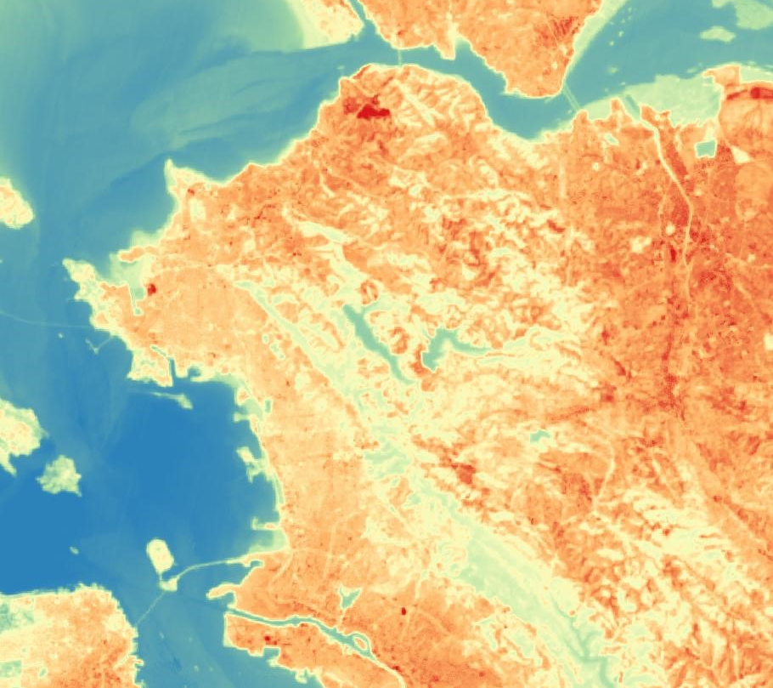

RICHMOND URBAN DEVELOPMENT
Quantifying Changes in Urban Tree Canopy Cover and Land Surface Temperature to Understand their Impacts on Neighborhoods throughout Richmond, California
Fadwa Bouhedda
Jerrold Acdan
Casey Mais
Notes:
Personal and Project Introduction Script:
Hi my name is Casey Mais.
Hello, my name is Jerrold Acdan.
And my name is Fadwa Bouhedda. We are the Richmond Urban Development team and the project we worked on this term is called “Quantifying Changes in Urban Tree Canopy Cover and Land Surface Temperature to Understand their Impacts on Neighborhoods throughout Richmond, California”

Slide 2
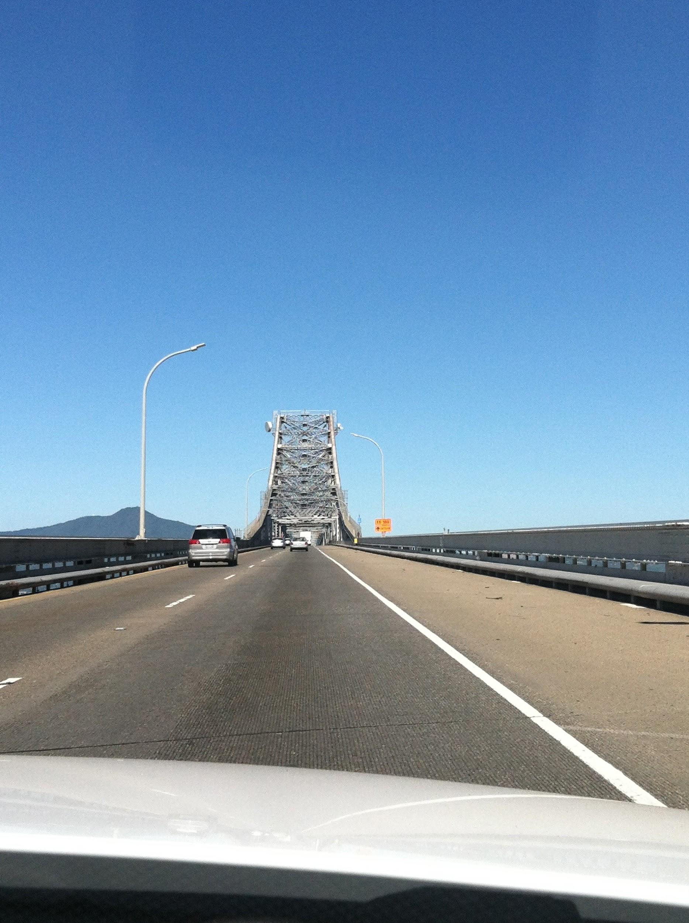
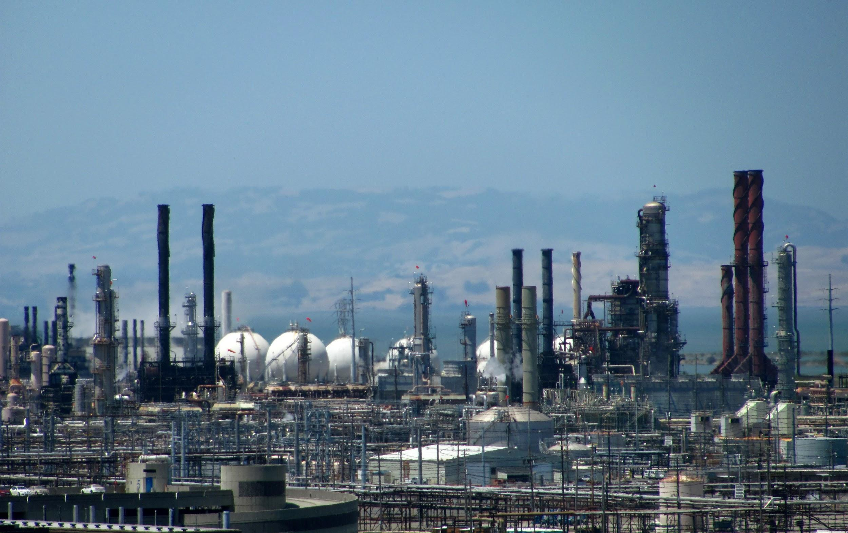
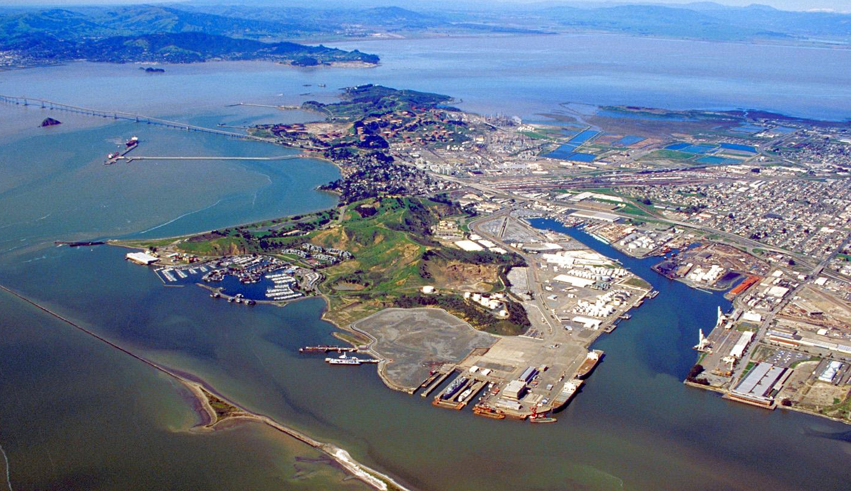
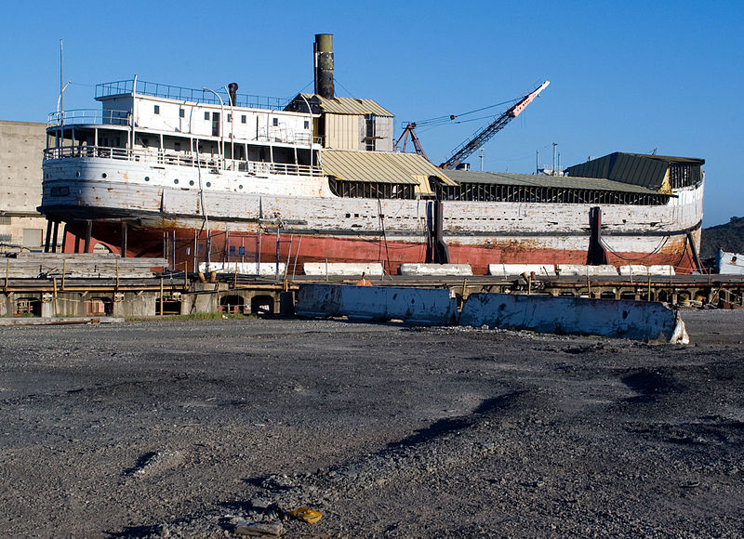
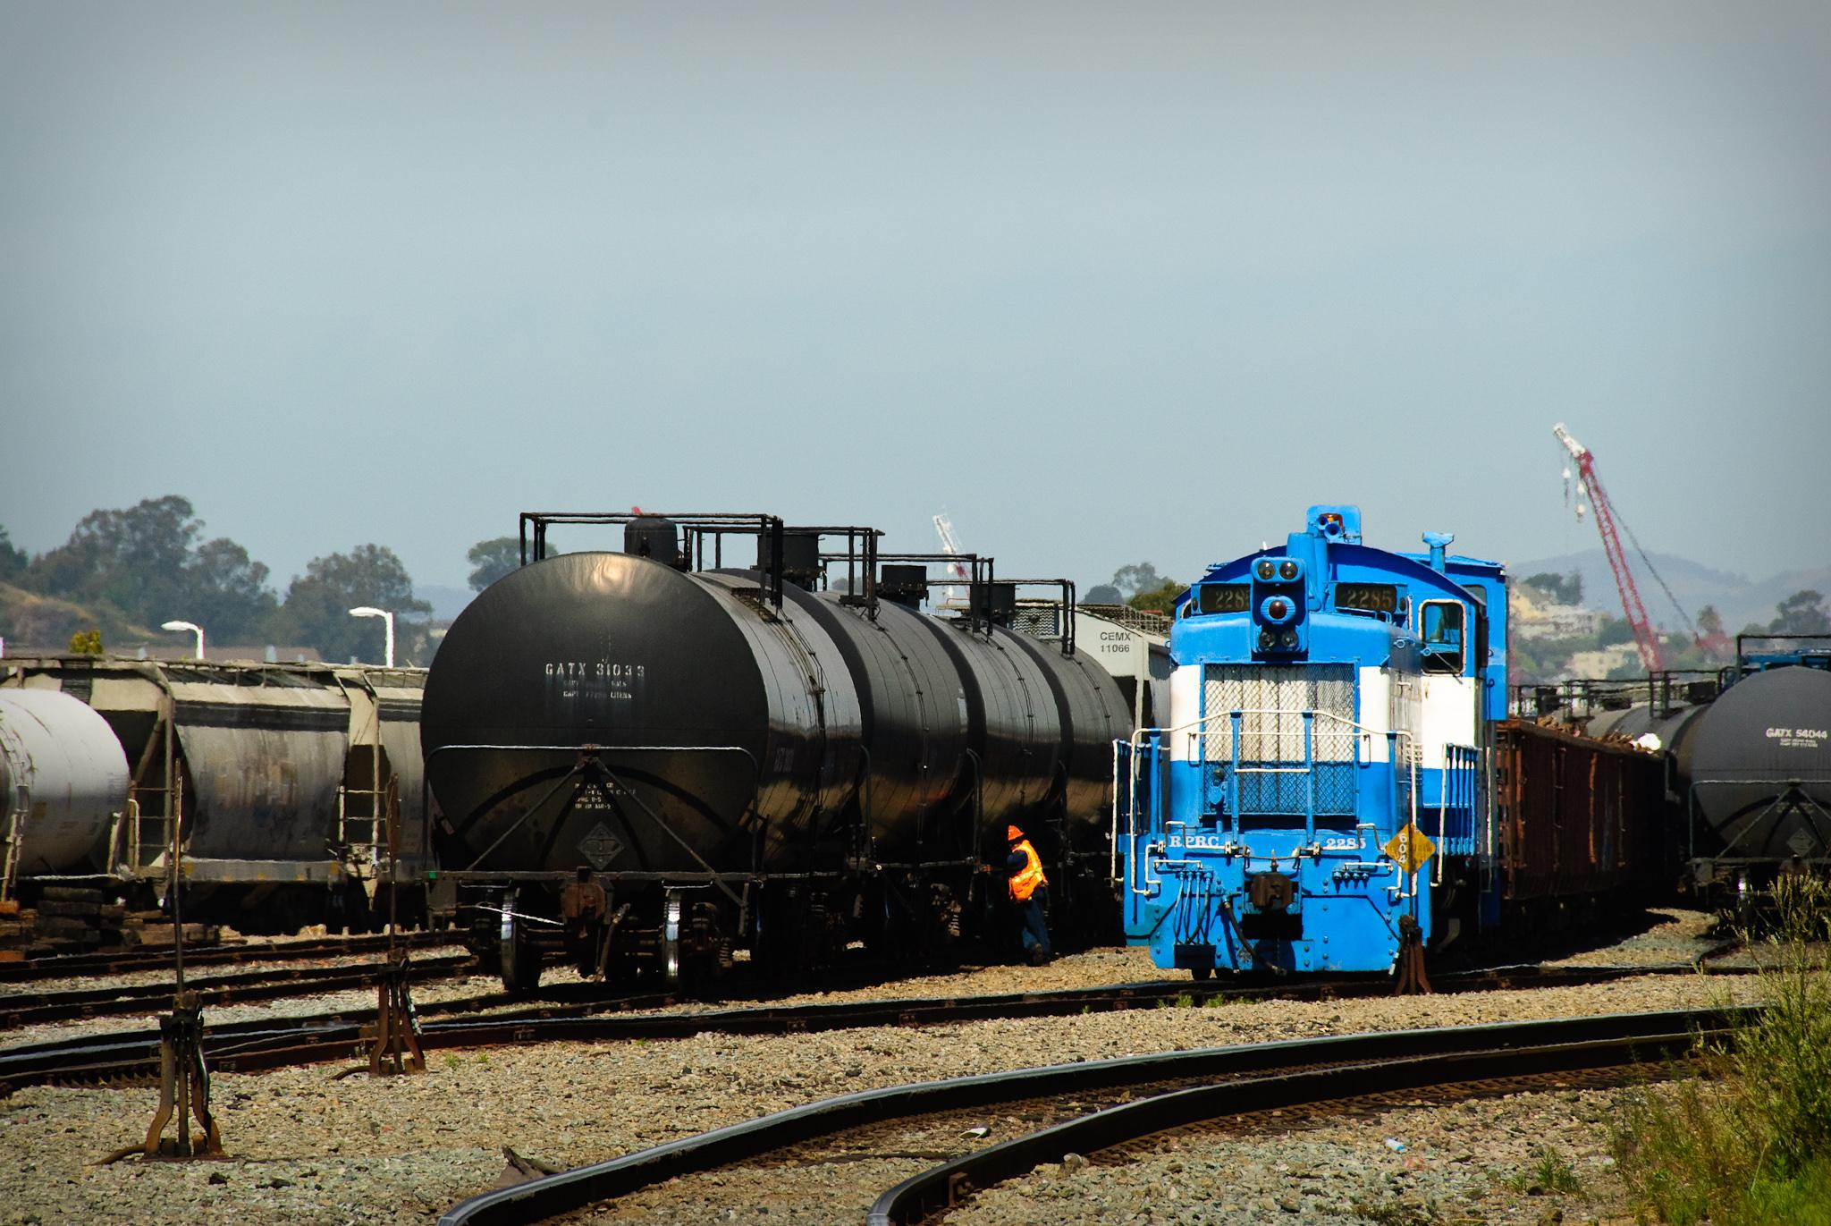
Background
Richmond, California
Oil Refineries
Highways
Marine Terminals
Railyards
Image Sources: Flickr (Jim Maurer; reneemo; Flickred!), Wikimedia
Notes:
City of Richmond Background Script:
Before we dive into the details of our project, here’s some background information about Richmond.
The city of Richmond, California is located in the East Bay Region of the San Francisco Bay Area as part of Contra Costa County.
It spans an area of 52.5 square miles, about 60% of which is land and 40% of which is water.
Historically, Richmond was founded in 1905 and remained relatively small until World War II when the industrial sector experienced a boom.
Since then, the city has experienced decades of continual urban development.
As a result, today, Richmond enclosed by oil refineries, chemical companies, rail yards, ports & marine terminals, and busy highways.
Image sources:
https://commons.wikimedia.org/wiki/File:Richmond_California_aerial_view_with_bridge.jpg
“This image or file is a work of a U.S. Army Corps of Engineers soldier or employee, taken or made as part of that person's official duties. As a work of the U.S. federal government, the image is in the public domain.”
https://commons.wikimedia.org/wiki/File:Wapama_in_richmond_shipyard.jpg
https://creativecommons.org/licenses/by-sa/3.0/deed.en
https://www.flickr.com/photos/jasonholmberg/7391528408/in/photolist-cgavSY-4YZ3ik-e4yomN-4Z3ZJh-4YYHLc-4YYJmM-4YZ3pc-4YZ3sc-4YYYkH-4Z4hsb-4Z3Z2b-4Z3YLo-4Z3YrU-4Z3Z97-4Z3ZpY-4YYJjz-4Z3YTj-4Z3YpA-4Z3Ze7-4YYHXr-4Z3Yth-4Z3YWh-4YYJ6x-4YYHyR-4Z3YnL-4Z3Z5E-4YYHJg-4YYHez-4Z3Zmb-4Z3YBS-4YYHAx-4YYHiK-4YYHfX-4Z3Z7C-4Z3Zhu-4Z3ZbY-4Z3Z3S-4Z3YJL-4Z3Zuu-4Z3ZnE-4Z3ZDj-4YYHcT-4Z3ZfW-4Z3YEd-4YYHre-4Z3ZzU-4YYJfT-4Z3YFS-4Z4fQJ-4Z4g3G
https://creativecommons.org/licenses/by-nc/2.0/
https://www.flickr.com/photos/foreternity/9151140869/in/photolist-eWDZmR-eewpep-dswyqG-edWY2T-G14zNF-x1sZrq-4JCNa6-nyNuzA-fUchjd-fDqaj9-ea6kq-pJ1ZaZ-ea5Qs-ea62X-ea5m9-ea5Bg/
https://creativecommons.org/licenses/by-nc-nd/2.0/
https://www.flickr.com/photos/schaffner/3778244137/in/photolist-6KSumi-9yJdqd-7zUpfU-5EBNbF-6KWRyo-6KWQ9L-6KSHyK-7Ai8vH-8Js8zo-6KStBc-6KWTDh-23cnAmZ-5EBCiH-6KWSco-6KSEB8-5EBHRK-6KWzD3-6KSNNt-6KSFua-6KWGRh-r3pdrz-qbPbb-9yJqw9-6KWJXG-6KSDjT-6KSGaK-221M3G5-6KWAnL-6KWL2G-6KWJx3-5EBrzP-4xPn69-6ZFcF1-dfbGCG-4nLGAH-5EFy3E-8spm91-5EBaUi-5EFNeJ-5EFLdG-5EG32E-oYdp-5EBc2a-5EBLB2-7PeoWf-7zQCXt-6KSMFF-5EBxKt-5EBKiz-5EFPDq
https://creativecommons.org/licenses/by-nc-nd/2.0/

Slide 3
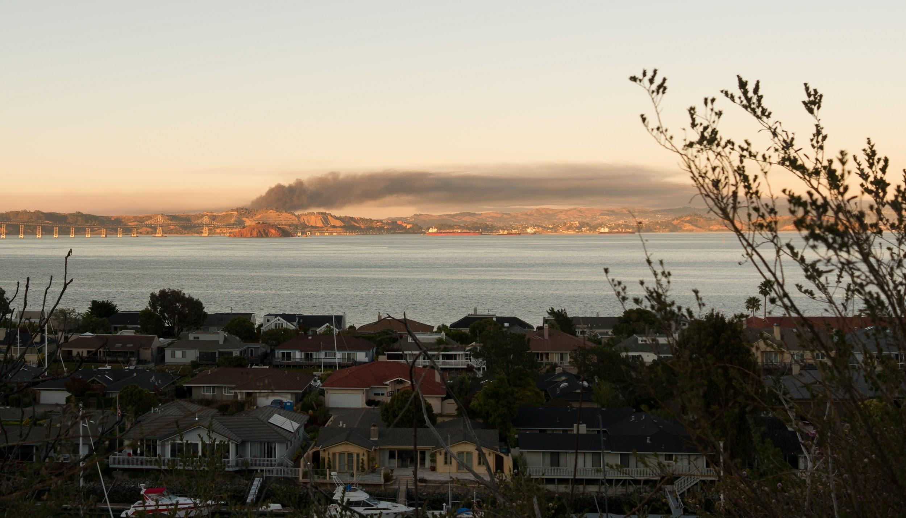
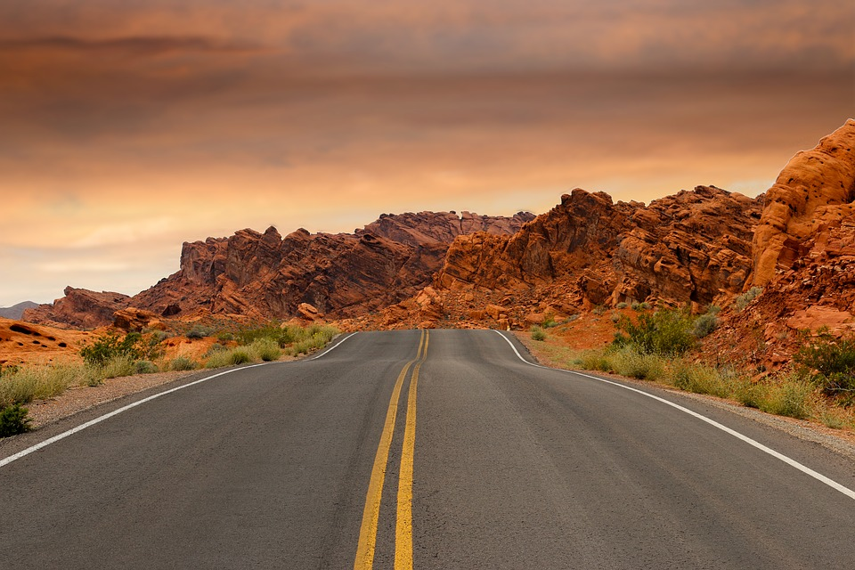
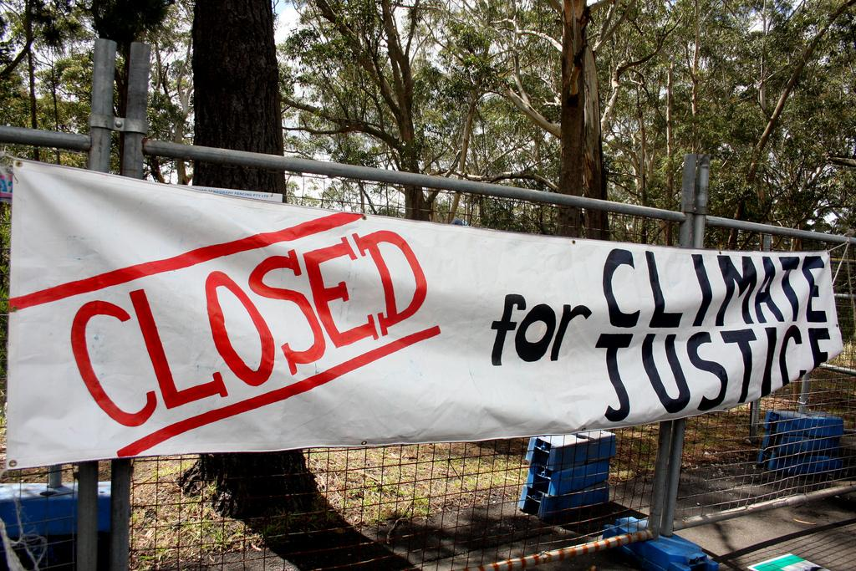
Community Concerns
Emissions from surrounding industries
Air pollution, low air quality
High rates of asthma prevalence and other health effects
Increase in impervious surfaces
Higher land surface temperatures
Exacerbation of asthmatic attacks
Environmental Justice
81% of the population is made up of ethnic minority groups
Between 2010 and 2012, 39% of residents lived in poverty
Image Sources: Wikimedia, Pixabay, Flickr (Climate Camp)
Notes:
Community Concerns Script:
Urban development, however, comes at a price and has resulted in some concerns from the community.
Probably most known well known concerns are air pollution and poor air quality. This picture (point with pointer) is a view of the Chevron Oil Refinery Fire from 2012. It is clear to see that the emissions from the surrounding industries in Richmond can have a major effect on the air that people who live in the area breathe. In fact, exposure to air pollution has both acute and chronic effects on human health, including heart disease and asthmatic attacks. It is estimated that 20.3% of people between the ages of 1 and 17 in Contra Costa, Richmond’s home county, were diagnosed with asthma between 2009 and 2012. This is more than double the national average and can partially be attributed to the local air quality.
Another community concern is the increase in impervious surfaces, such as concrete and asphalt. These types of surfaces absorb an incredible amount of the sun’s energy and re-radiate it back out as heat, resulting in high land surface temperatures. As temperatures continue to rise due to changes in Earth’s climate, the amount of heat released by impervious surfaces will also increase. This is a major problem because exposure to increased heat stress can exacerbate existing health problems like asthmatic attacks.
Finally, it has been well-established in literature that low income and minority groups have higher health risks related to climatic and environmental conditions partially due to the fact that more affordable housing is often located near polluting industrial sites. Ethnic minorities make up about 81% of Richmond’s population, and between 2010 and 2012, 39% of Richmond’s 104,000 population lived in poverty. These statistics reveal that Richmond’s environmental problems are also inherently social justice issues.
Image sources:
https://commons.wikimedia.org/wiki/File:Chevron_Richmond_Refinery_Fire_2012_-02.jpg
https://creativecommons.org/licenses/by-sa/3.0/deed.en
https://pixabay.com/en/road-mountains-sunset-path-desert-1303617/
https://creativecommons.org/publicdomain/zero/1.0/deed.en
https://www.flickr.com/photos/climatecampnsw/4007389862/in/photolist-777VoE-7nzBni-7nzwc8-7o4fxc-7nzBAg-7o7Axf-7o49Wn-7o7Akf-8YGRgQ-7o45gc-7o3FBV-7o84So-77nZVB-7o3FJB-77rJcJ-77nNjM-77nKX4-77rHhs-77rDFJ-77o3he-7o8iKJ-77rXB5-7AEH5Z-7o49Yr-7o89L1-8K1iGq-Cgq25s-7o4i4k-77rSxG-7o7AgS-7o8cUY-7o8iSL-77rwq5-7o3Fyn-77o8eM-77nAvz-aRoDRD-8v9Nnt-77rHEh-7AF8di-ccDq5q-7hMXZD-74oqeE-5GQ8w5-oT4kjo-q8ytaX-8JRJgA-p6d4N2-77rM3C-77nH2g
https://creativecommons.org/licenses/by/2.0/

Slide 4
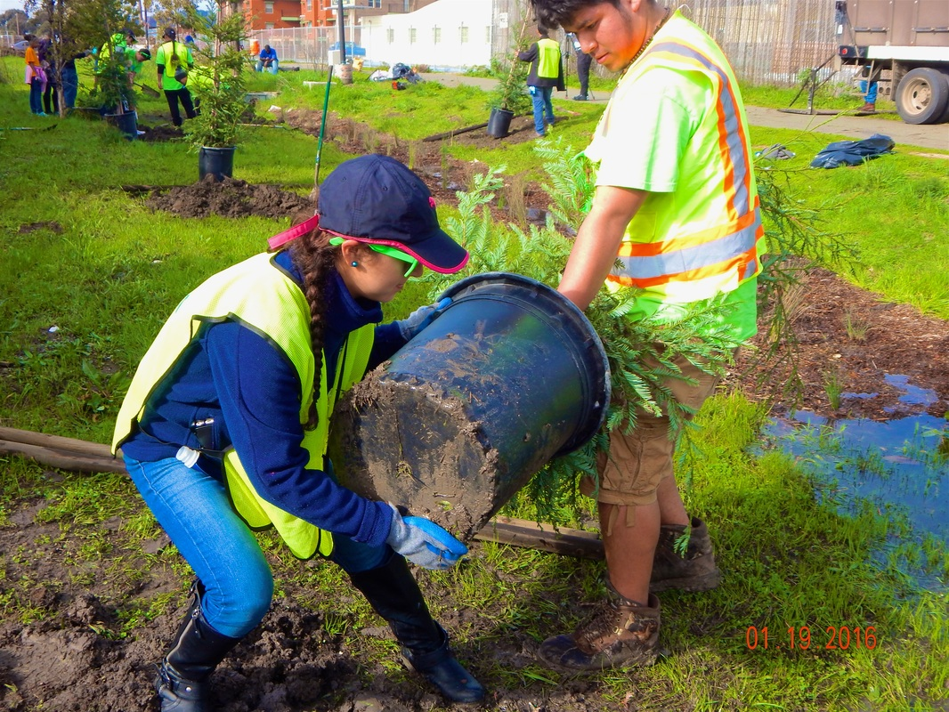
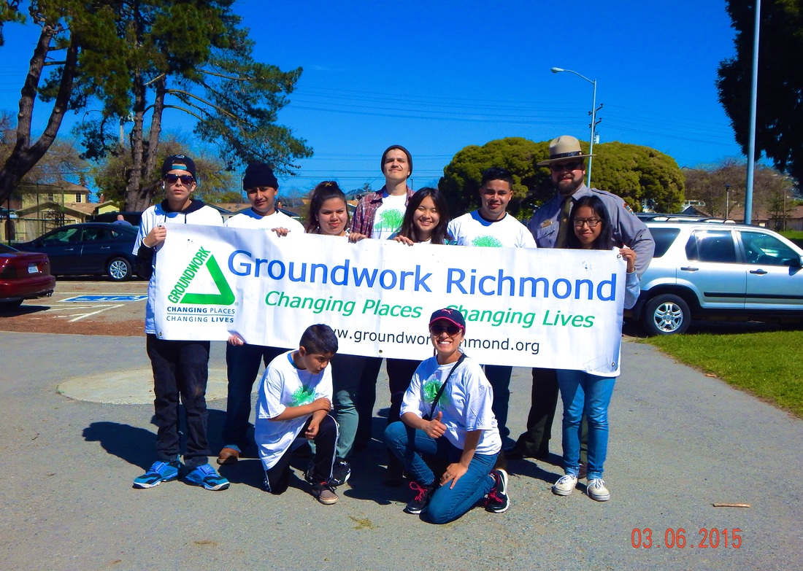
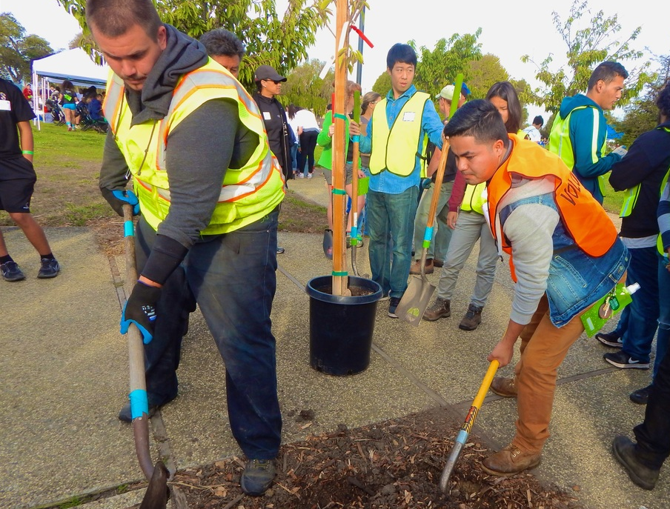
Project Partner: Groundwork Richmond, CA
Local trust of Groundwork USA
Environmental justice oriented
Community-based campaigns focused on urban greening initiatives
Science, Technology, Engineering, Arts, & Math (STEAM) leadership opportunities for youth
Image Credit: Groundwork Richmond, CA
Notes:
Project Partner Introduction Script:
The project we worked on this term came about as a result of talks between the NASA DEVELOP National program and Groundwork Richmond, CA, who is our partner for this project.
Groundwork Richmond, CA is a local trust (or chapter) of the larger Groundwork USA organization.
Groundwork Richmond adopts Groundwork USA’s mission, which is transform the natural and built environment of marginalized communities by working at the intersection of environment, equity, and civic engagement.
To address some of Richmond’s community concerns, a lot of Groundwork Richmond’s work focuses on increasing the green infrastructure of the city either by planting trees or turning vacant and derelict lands into community green spaces
Groundwork Richmond is passionate about helping the community not only via greening urban spaces, but also by introducing the local youth to science, technology, engineering, arts, and math leadership opportunities to inspire a new generation of environmentalists of color
Image Source: Groundwork Richmond, CA (taken from Groundwork Richmond, CA’s social media pages; written approval has been received)

Slide 5

Benefits of Urban Trees
Image Credit: Monet
Source: Food and Agriculture Organization of the United Nations
Notes:
Benefits of Urban Trees Script:
So, why has Groundwork Richmond decided to plant trees to address concerns regarding air pollution and increased land surface temperatures?
We found a nifty video that explains the benefits of urban trees that you all can watch courtesy of the Food and Agriculture Organization of the United Nations (play video)
Video Source: https://www.youtube.com/watch?v=iCy_m-u0VEM
Retrieved from Youtube; written approval has been received by the video producer and uploader Food and Agriculture Organization of the United Nations

Slide 6

Project Objectives
Assess and compare patterns of land cover, socioeconomic data and land surface temperatures
Locate socioeconomically disadvantaged areas that are also vulnerable to increased LST and lacking urban canopy
Provide Groundwork Richmond with educational materials incorporating project results to educate local community behind the benefits of trees
Image Source: Pixabay
Notes:
Project Objectives Script:
Through the development of this project, the main question asked was: how can NASA earth observations be used to help Groundwork Richmond’s urban greening campaigns?
After careful consideration, our team came up with a list of goals we set to accomplish.
The first set of objectives seeks to utilize satellite imagery to:
Produce a historical land cover time series of Richmond to see if the city has become more or less “green” since 1985
Analyze trends in land surface temperature to identify areas susceptible to high heat exposure
Estimate changes in current Urban Tree Canopy Cover from 2015 - 2017 to assess the quantitative impacts of Groundwork Richmond’s urban forestry projects
Our second set of objectives includes Incorporating socioeconomic data to:
First Investigate the relationship between canopy cover and quality-of-life indicators, such as crime rates, poverty level, and property values
and second, Identify under-treed, disadvantaged neighborhoods
Finally, our last set of objectives are to Provide Groundwork Richmond with:
Geospatial data that can be leveraged to gain support from the local community and potential funding sources for future campaigns
Brochures or other paper handout that incorporates project results that can be used educate youth volunteers and the local community about the science behind the benefits of trees
Image source: https://pixabay.com/en/target-dart-aim-success-goal-1414775/
https://creativecommons.org/publicdomain/zero/1.0/deed.en

Slide 7
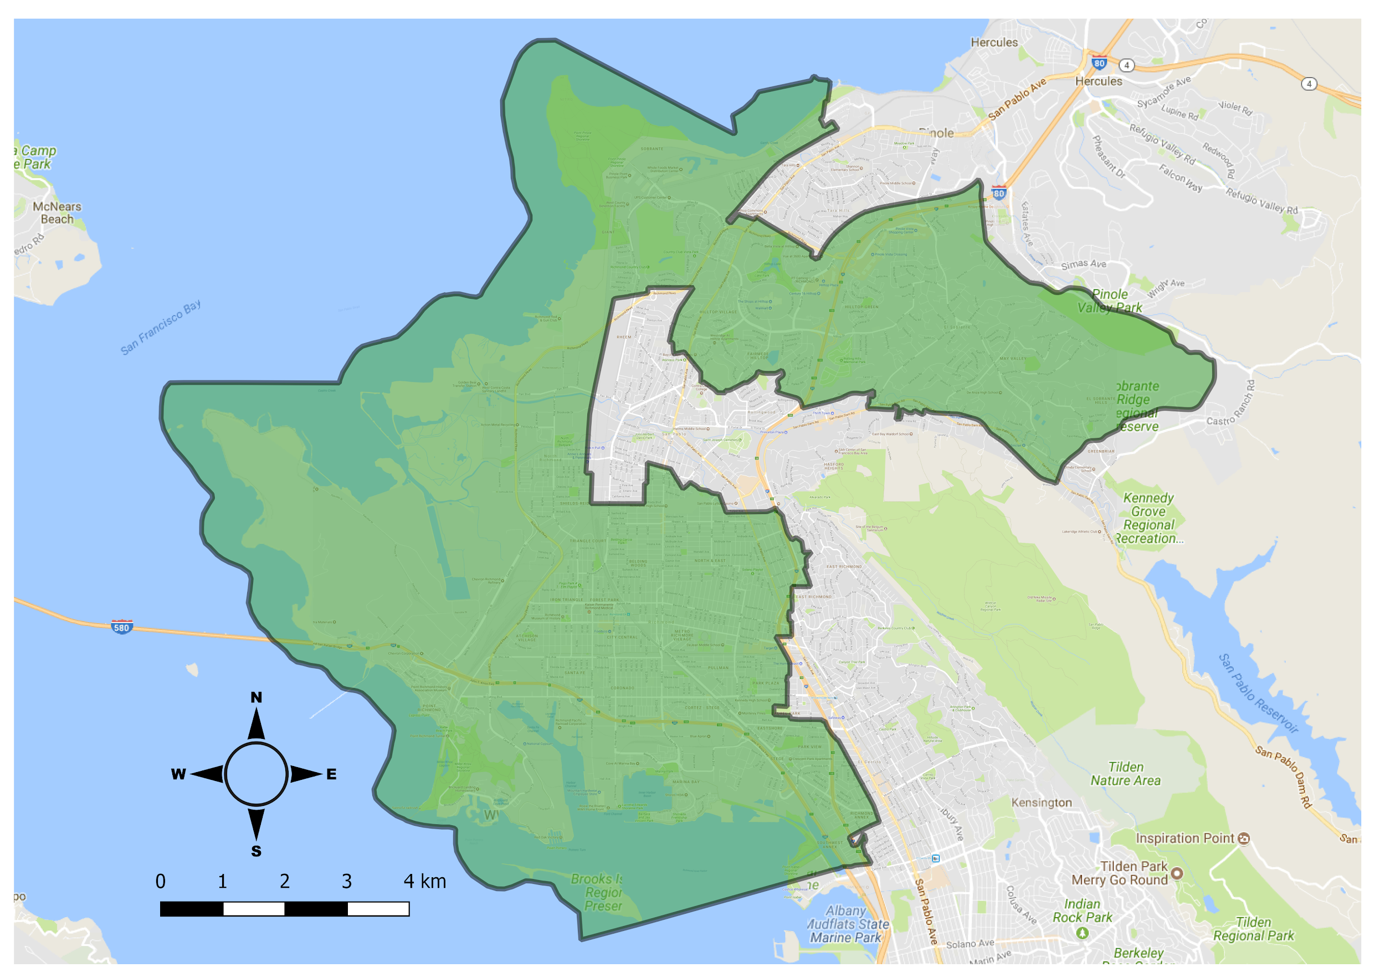
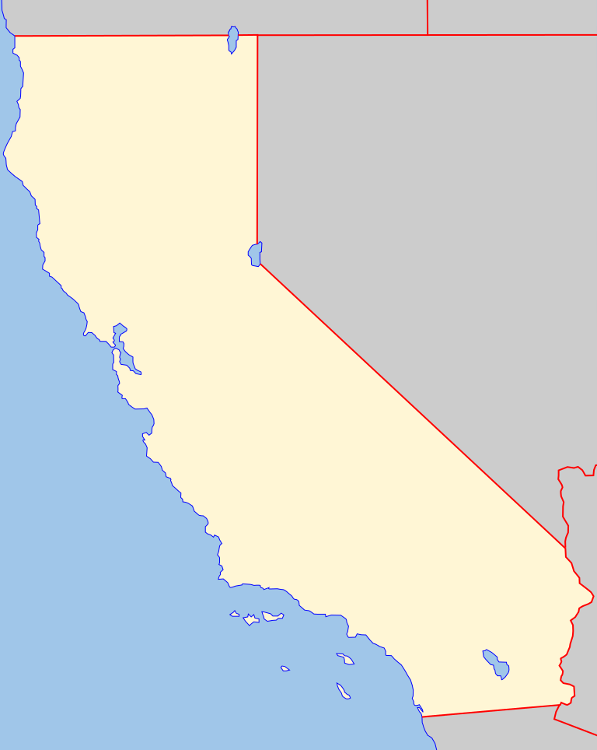
Study Area & Period
California
Historical Analysis
July 1985 to July 2015
-----------------------------------
Current Impact Analysis
July 2015 to July 2017
City of Richmond
(excluding Wildcat Regional Park)
Base Map Sources: Wikimedia; Google Maps
Notes:
Study Area & Period Script
The study area for our project included the limits of the city of Richmond as determined by 2010 US Census block groups. However, we chose to not include the large block group made up of Wildcat Regional Park because our project is primarily concerned with urban trees and not trees outside of urban spaces.
In terms of the study period, historical analyses were conducted for imagery acquired between in the month of July for the years 1985, 1996, 2005, and 2015. And for analyzing Groundwork Richmond’s current impact, imagery acquired in the month of July for the years 2015 and 2017 were used.
We chose July because in the middle of summer, grass tends to be dead and dried up while trees still have a majority of their leaves. This makes it a bit easier to delineate between when looking at low spatial resolution satellite imagery.
Base Map Sources:
https://commons.wikimedia.org/w/index.php?search=blank+map+california&title=Special:Search&go=Go&searchToken=67tnnsr36oslmh56uscgs0b5#/media/File:California_blank_map.svg
https://commons.wikimedia.org/wiki/Commons:GNU_Free_Documentation_License,_version_1.2
Google Maps street view - acquired as a base layer in QGIS

Slide 8
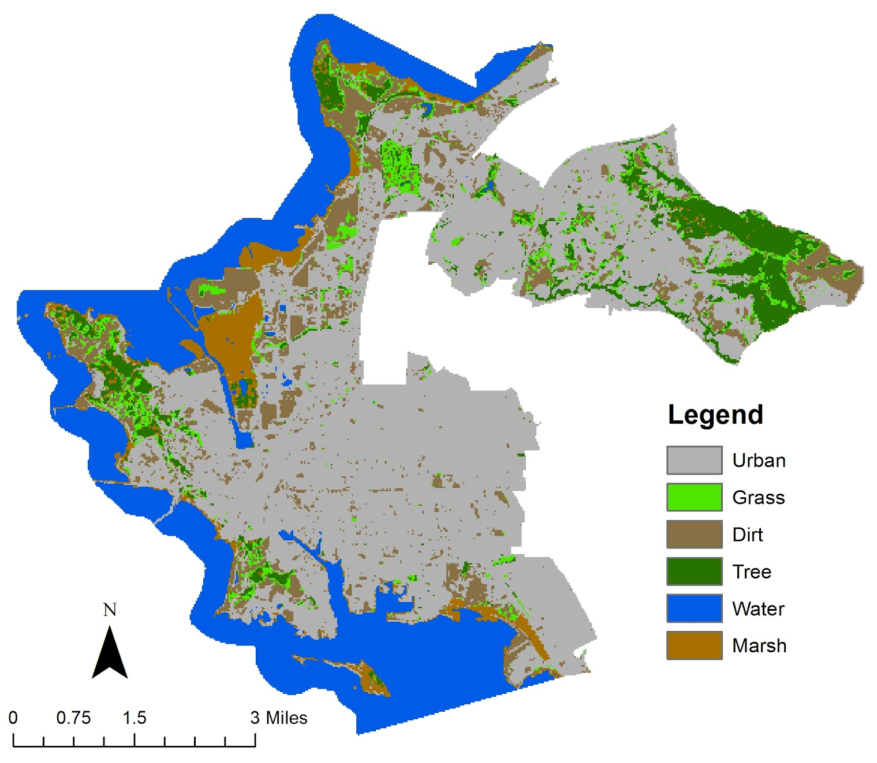
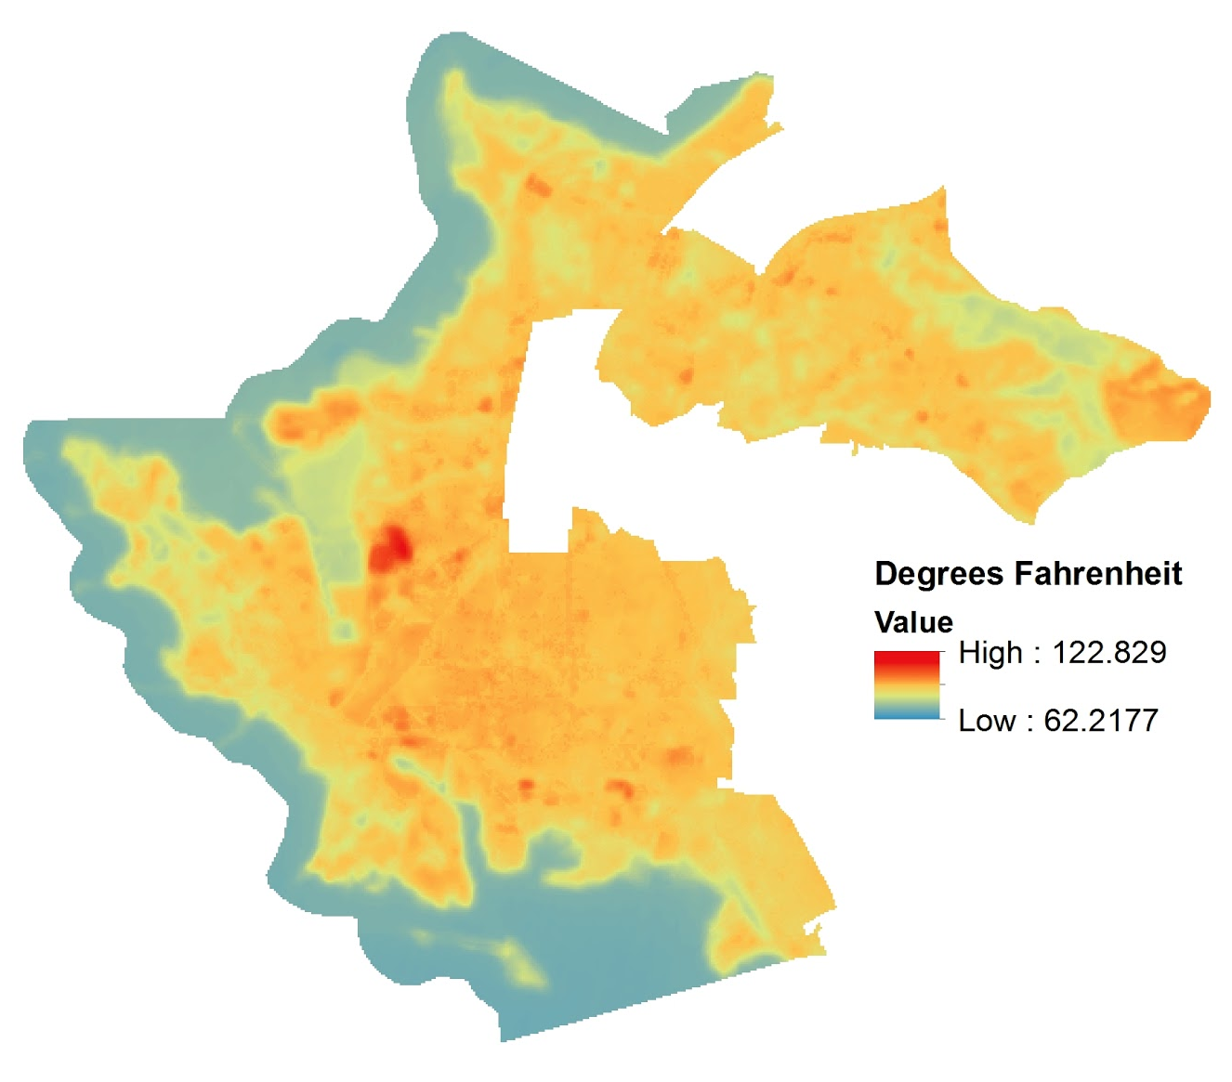
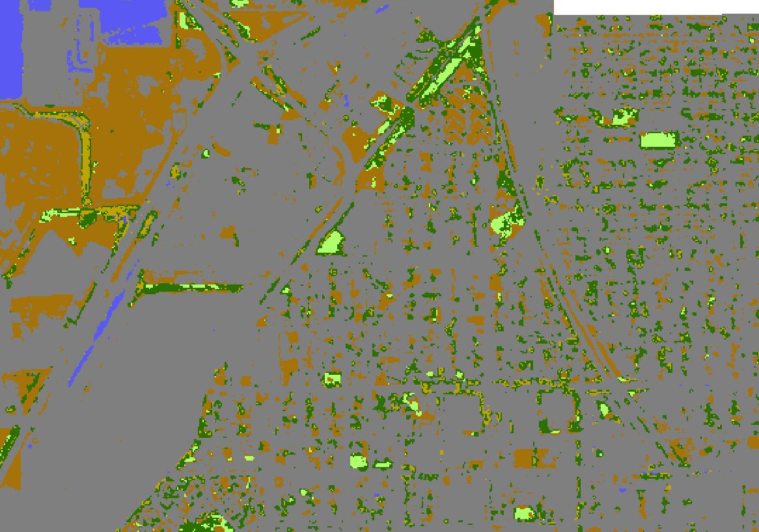
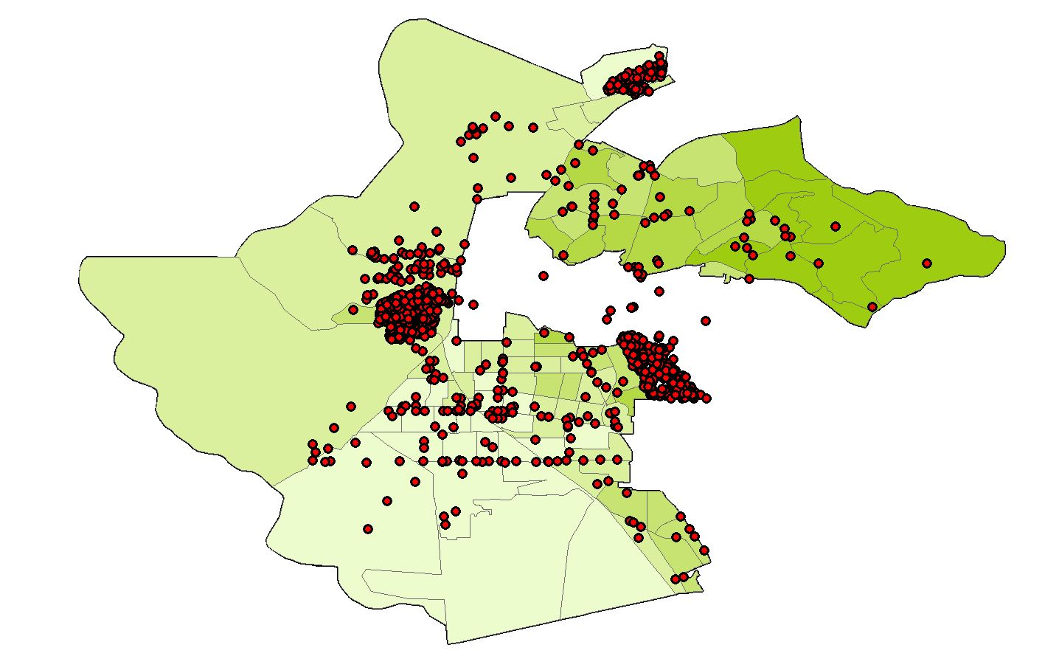
End Product Overview
Historical Land
Cover Time Series
LST
Assessment
Current Urban Tree Canopy Cover Analysis
Canopy Cover & Socioeconomic Analysis
Has Richmond become more “green” over time?
Where are hotspots located within the city?
Have Groundwork Richmond’s campaigns increased the city’s tree canopy cover?
Is there a relationship between canopy cover and quality of life indicators?
Notes:
End Product Overview Script:
In order to provide Groundwork Richmond with the results of our project, we have created 4 major end products
Through our historical land cover time series, we hoped to answer the question, has Richmond become more “green” over time?
By conducting land surface temperature assessments, we wished to find hot spots within the city that could benefit from the cooling effect of urban trees
The current urban tree canopy cover analysis seeks to see if Groundwork Richmond’s tree planting campaigns have increased the city’s canopy cove from a satellite’s point of view
Finally, our canopy cover and socioeconomic analysis

Slide 9
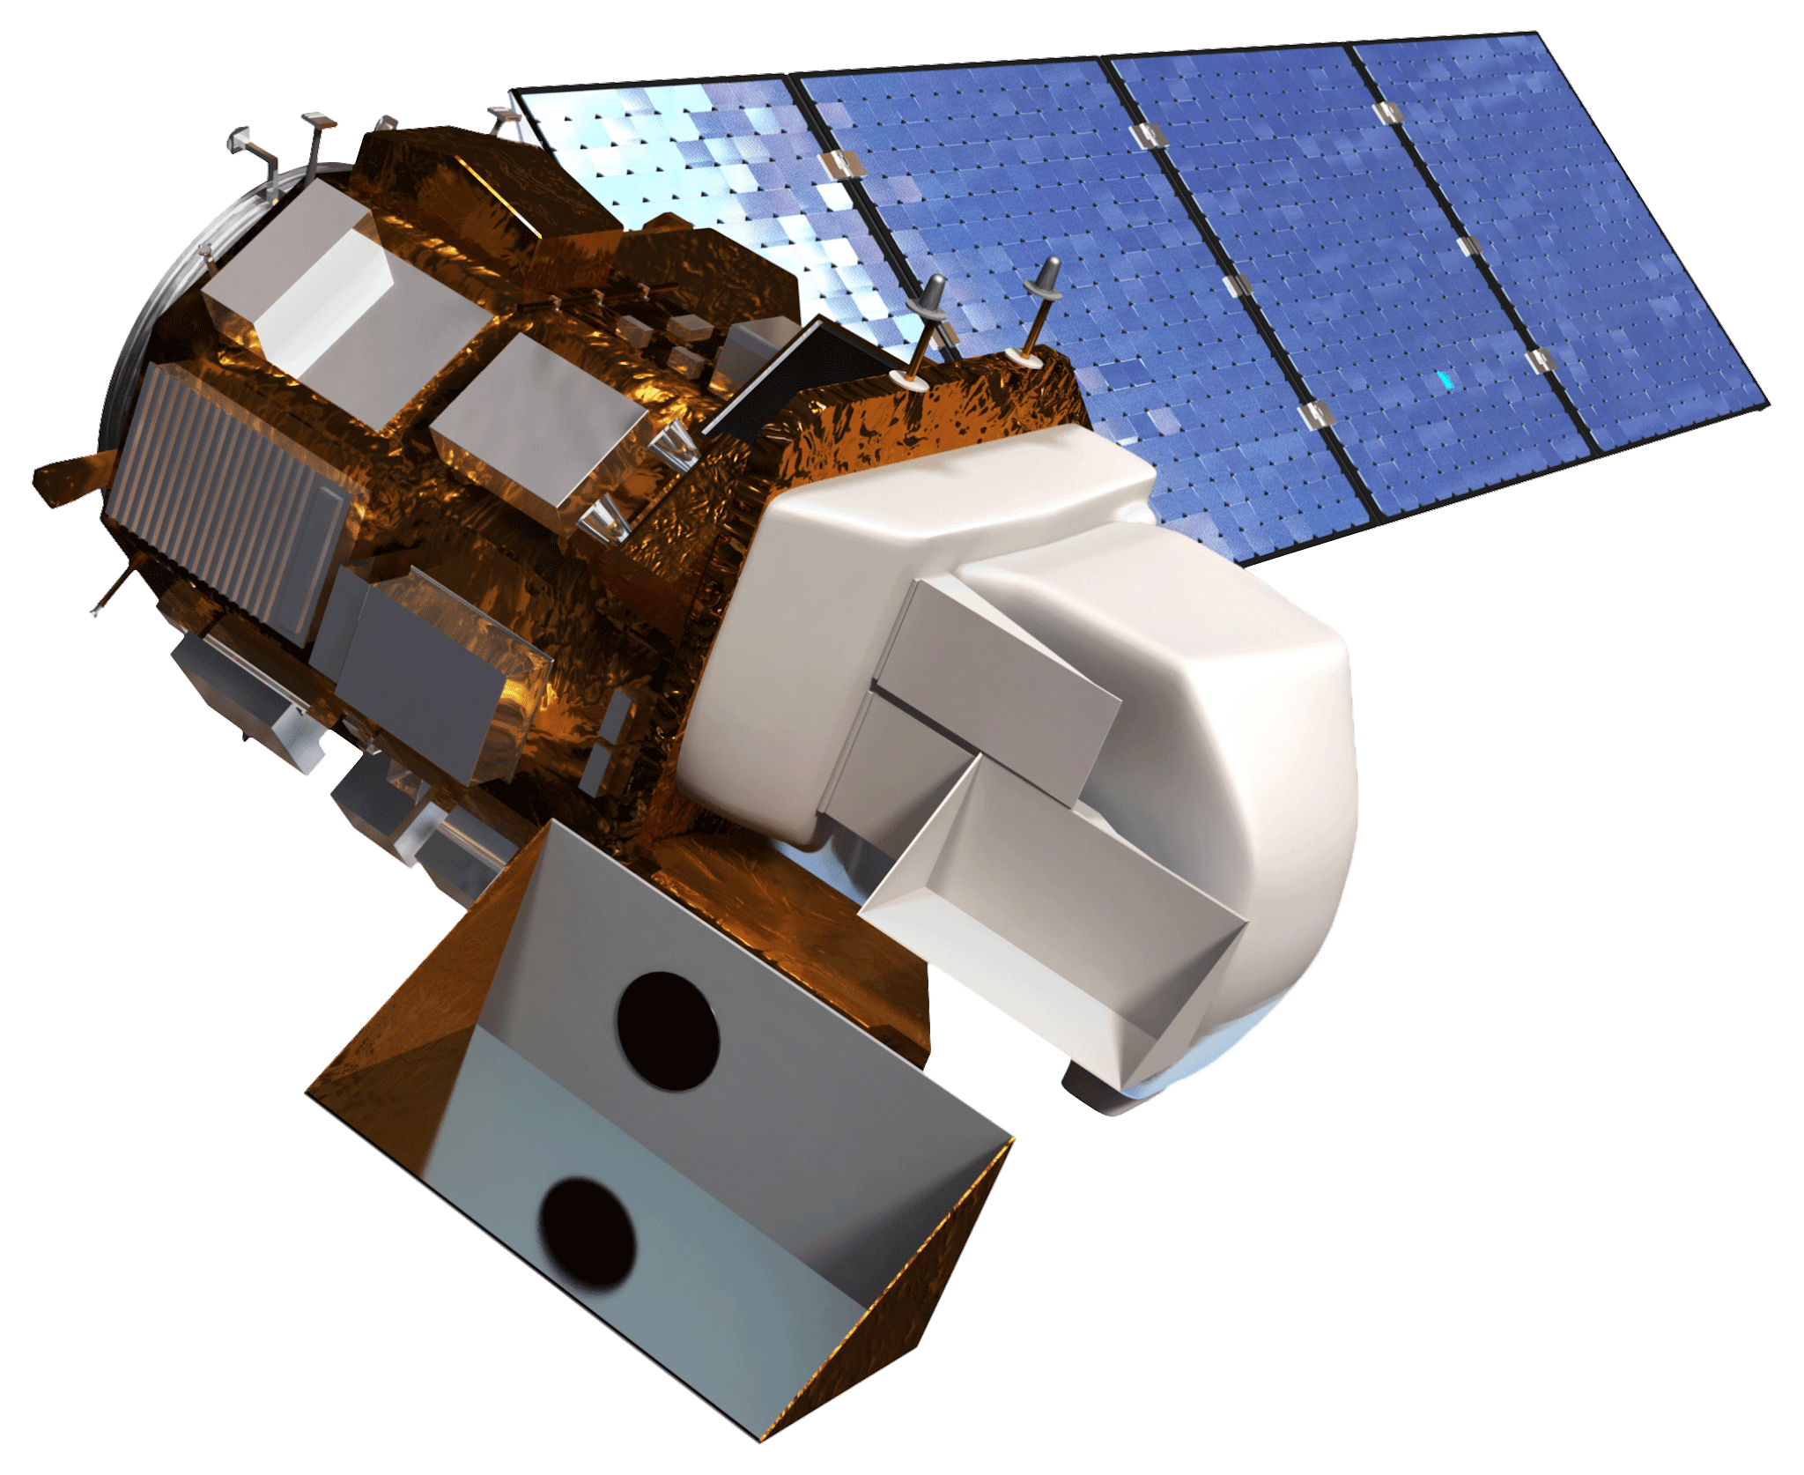
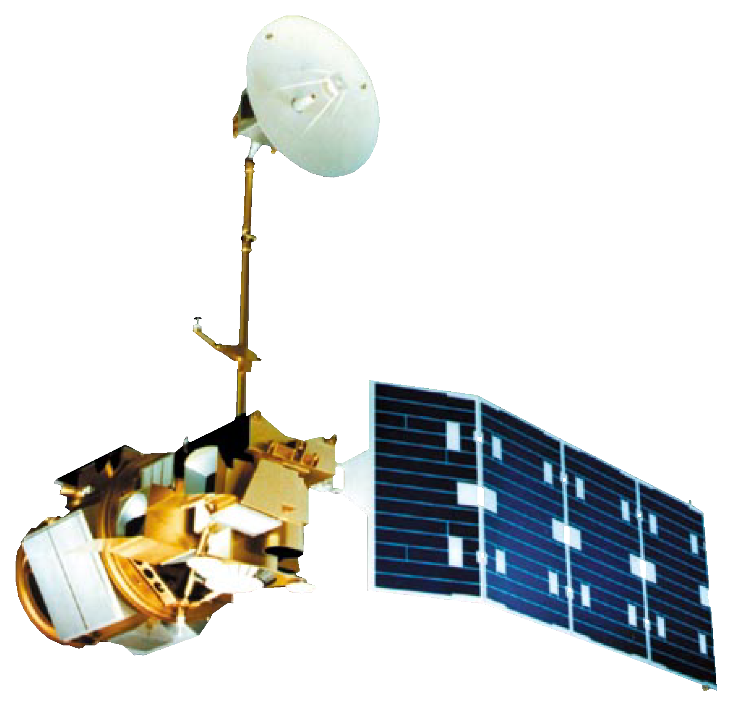
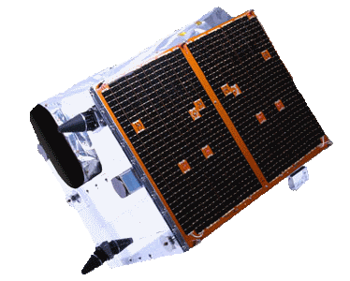
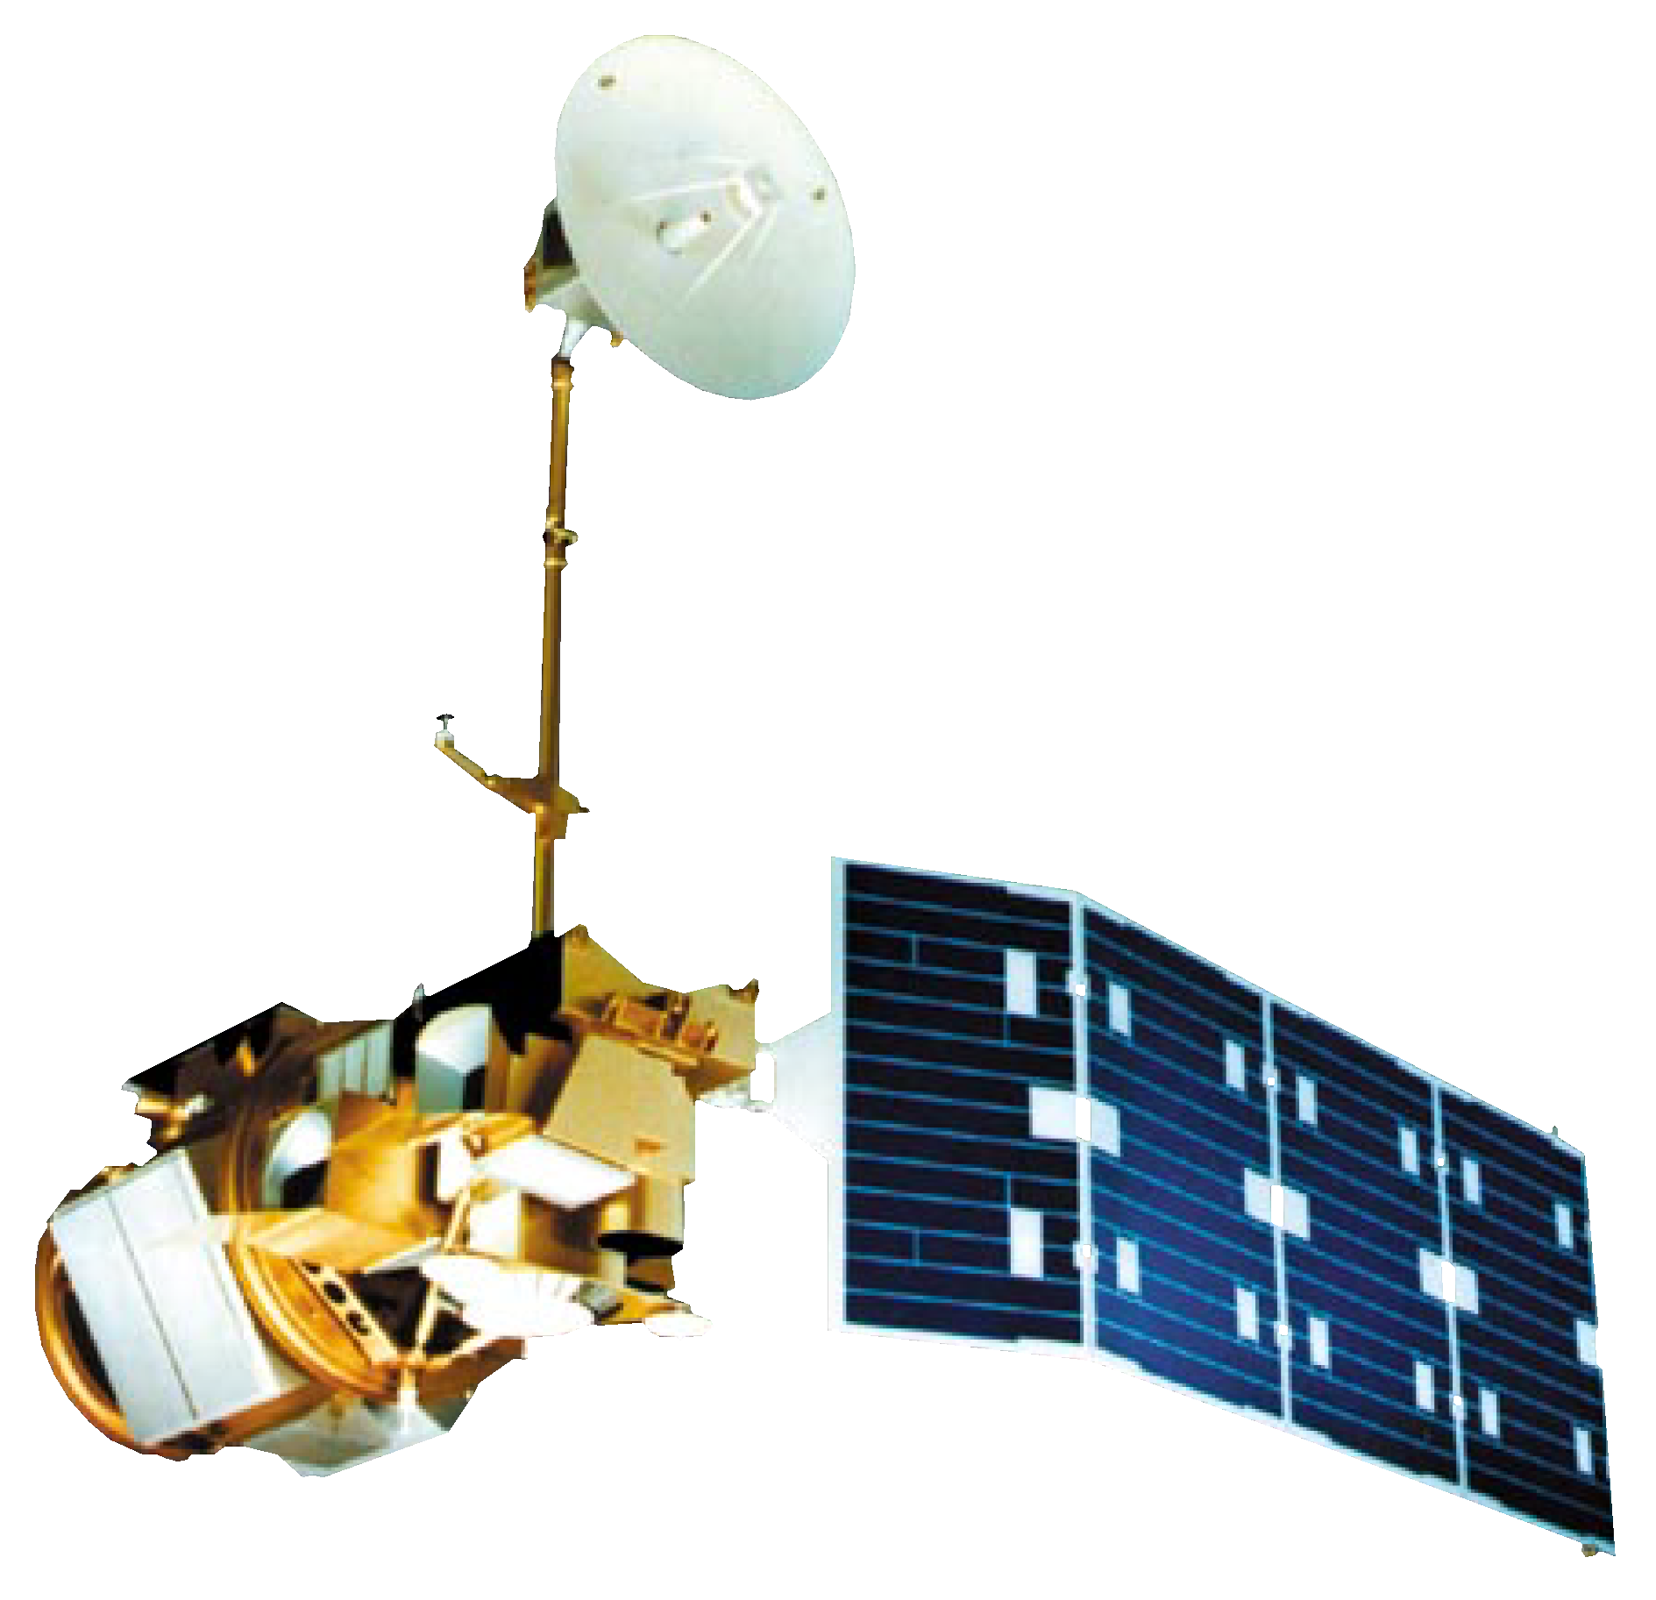
NASA Satellites & Sensors
RapidEye
Constellation
Landsat 8 OLI-TIRS
Planet Satellites
Landsat 5 TM
Notes:
Satellites & Sensors Script:
The imagery used in this project was acquired from sensors on three different satellite platforms.
We utilized Landsat 5 thematic mapper and Landsat 8 operational land imager and thermal infrared sensor imagery for historical land classifications and the derivation of land surface temperature
For current measurements of urban tree canopy cover, we used imagery from the Planet’s (a private company) RapidEye Satellite Constellation because it has a much better spatial resolution than LandSat sensors.
Landsat’s spatial resolution of 30x30 meters is way too large; RapidEye satellites have a better spatial resolution of 5x5meters, which can allow us to better detect trees within the urban environment
Image Sources:
http://www.devpedia.developexchange.com/dp/images/6/69/01_Landsat5.png
http://www.devpedia.developexchange.com/dp/images/c/c2/03_Landsat8.png
https://www.planet.com/products/planet-imagery/
Written permission to use image has been received via email from Planet

Slide 10
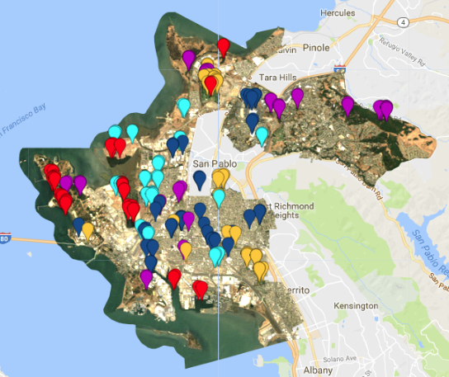
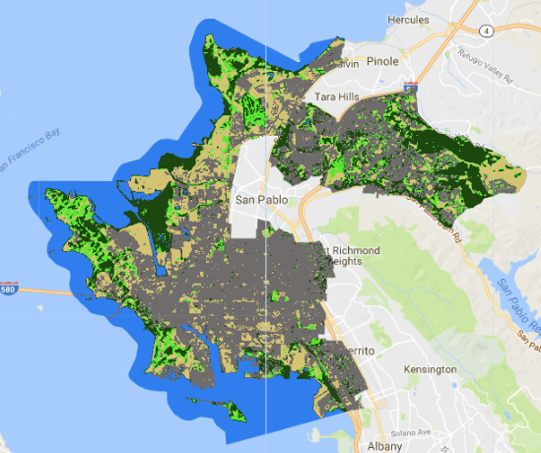
Methodology:
Historical Land Cover Classification
& Current Urban Tree Canopy Cover
Define Classes
Train Model
Select Training Sites
Assess Accuracy
Final Product
Classify
Notes:
Land Classification Methodology Script:
Land classifications for the historical time series 1985-2015 and Urban tree canopy 2015-2017 were completed in Google Earth Engine.
The first step was defining the classes that were going to be classified. the 6 classes chosen were Urban, Grass, Dirt, Trees, Water, Marsh
Being limited by coarse spatial resolution of 30m for Landsat we thought the classes chosen would give us the best results we selected the training sites on the true-color image but had an NDVI layer along with NAIP imagery to help in the decision process.
Next step was to train the model and classify the image
This was achieved with a few lines of code in GEE Along with producing a classified image Google Earth Engine was able to run an accuracy assessment to validate the selected training points
If the results from the accuracy assessment did not meet our standards then training sites were reviewed and reselected this process was repeated until accuracy reached our satisfaction

Slide 11
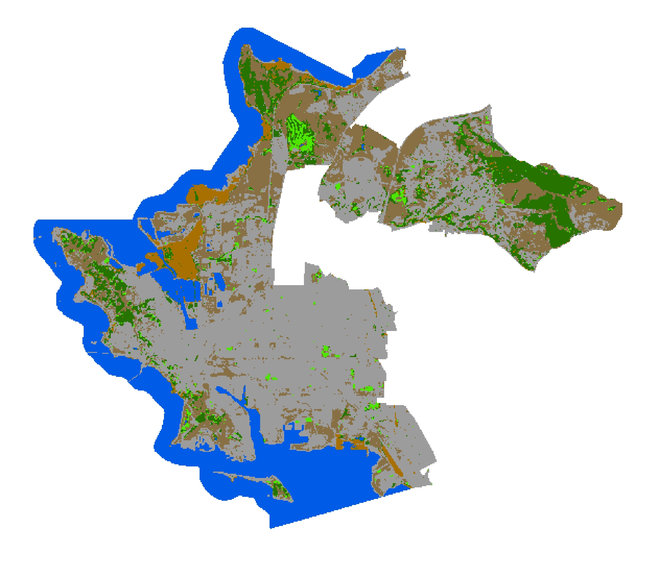
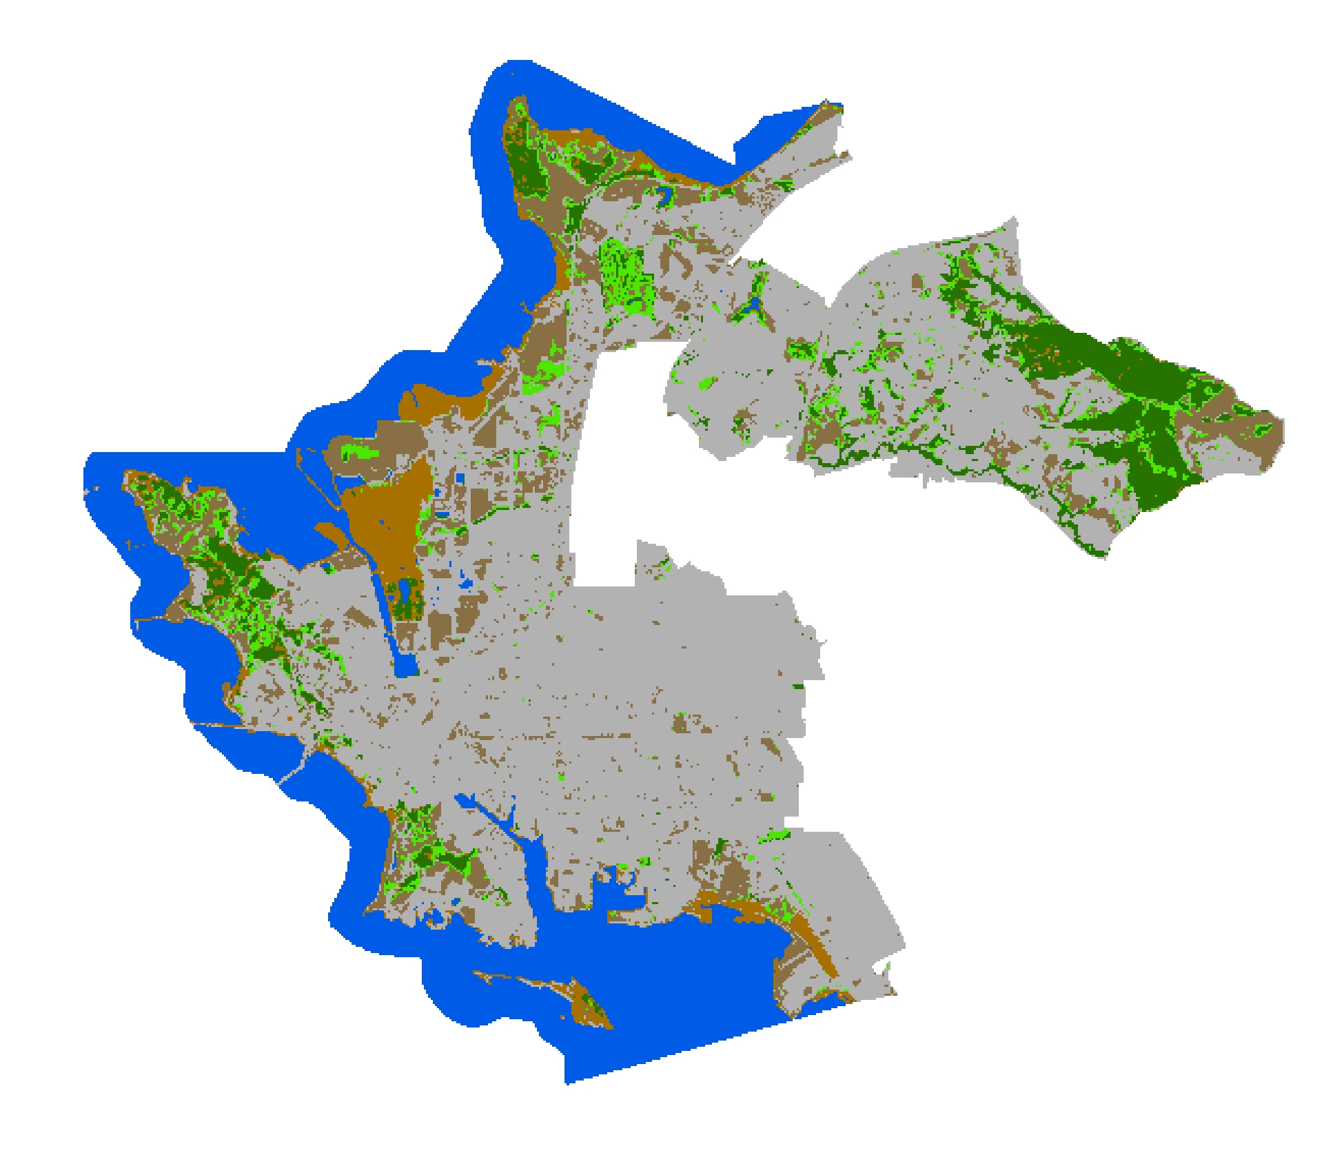

Results: Historical Land Cover Classification
1985 Land Classification
2015 Land Classification
Tree
Urban
Grass
Dirt
Water
Marsh
0
1.25
2.5
5
Kilometers
Landsat 5
Landsat 8
Notes:
Historical Land Cover Classification Script:
We were able to export our data from Google earth engine to do further analysis and to create maps in Arcmap
The Image on the left is the 1985 land classification image on the right is the 2015 land classification
Visually it is easy to see that the Urban class creates the largest portion of the image for both years.
To further back this finding we calculated area for all classes and found that Urban was the largest of the classes
Accounting for 44% in 1985 and 50% in 2015.

Slide 12
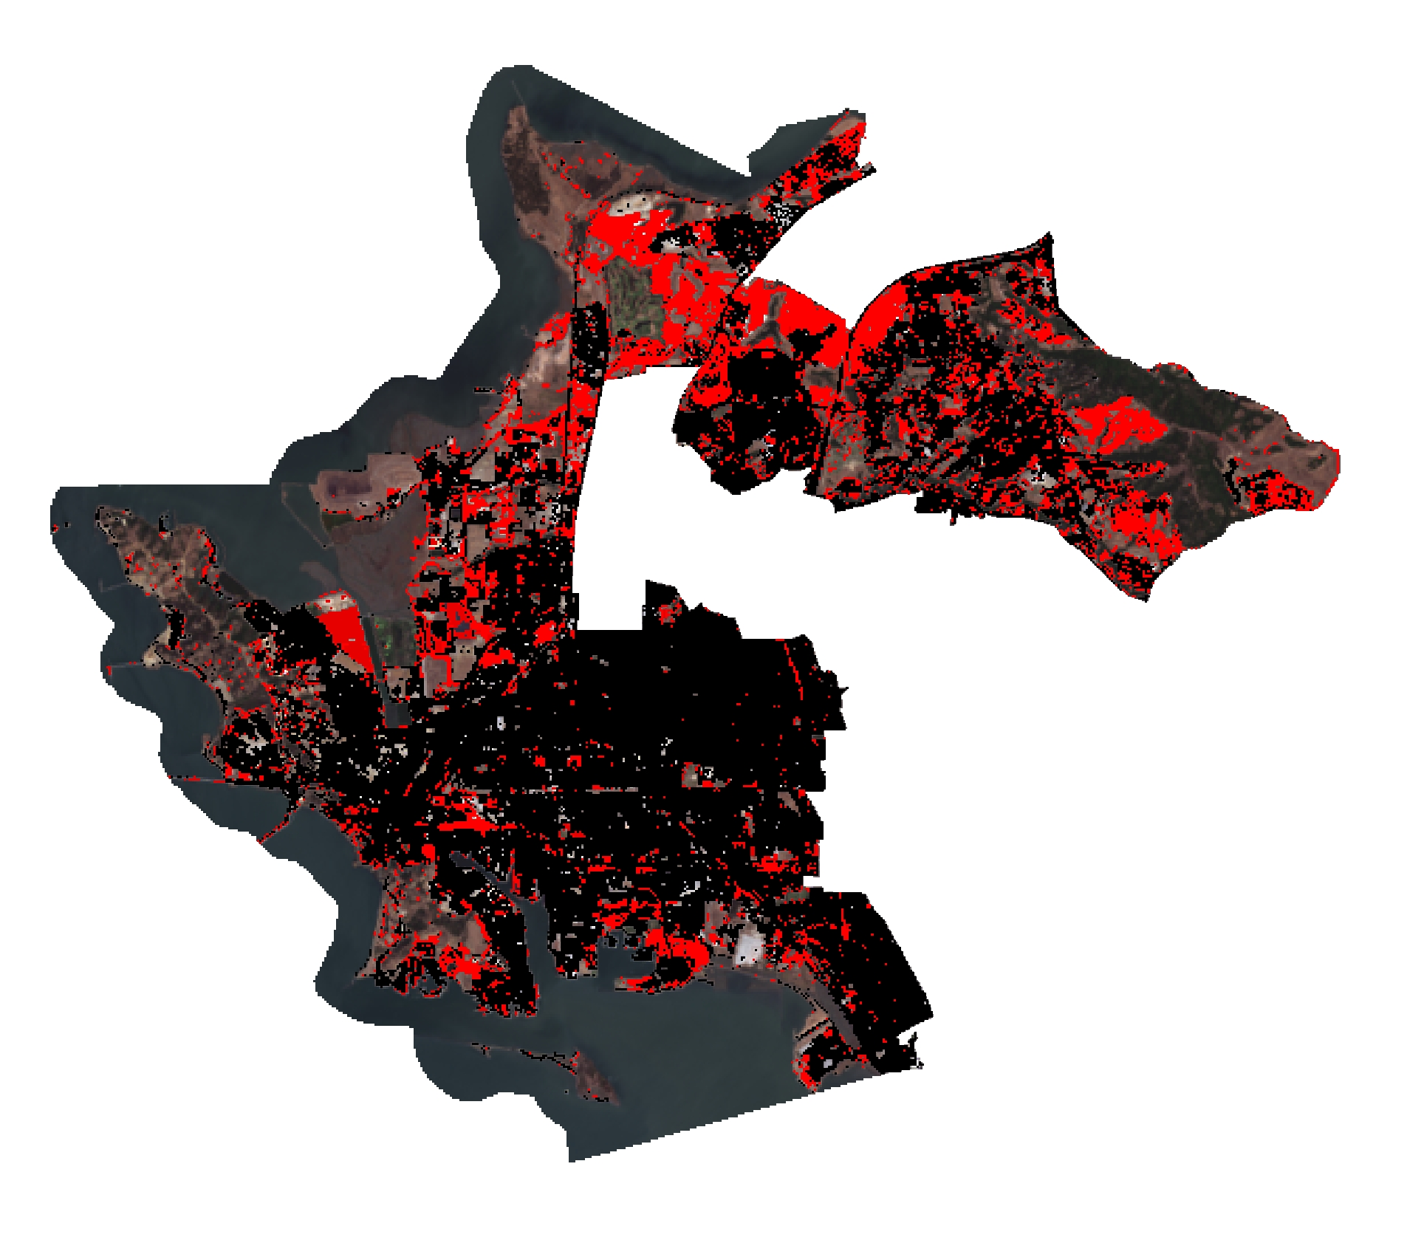
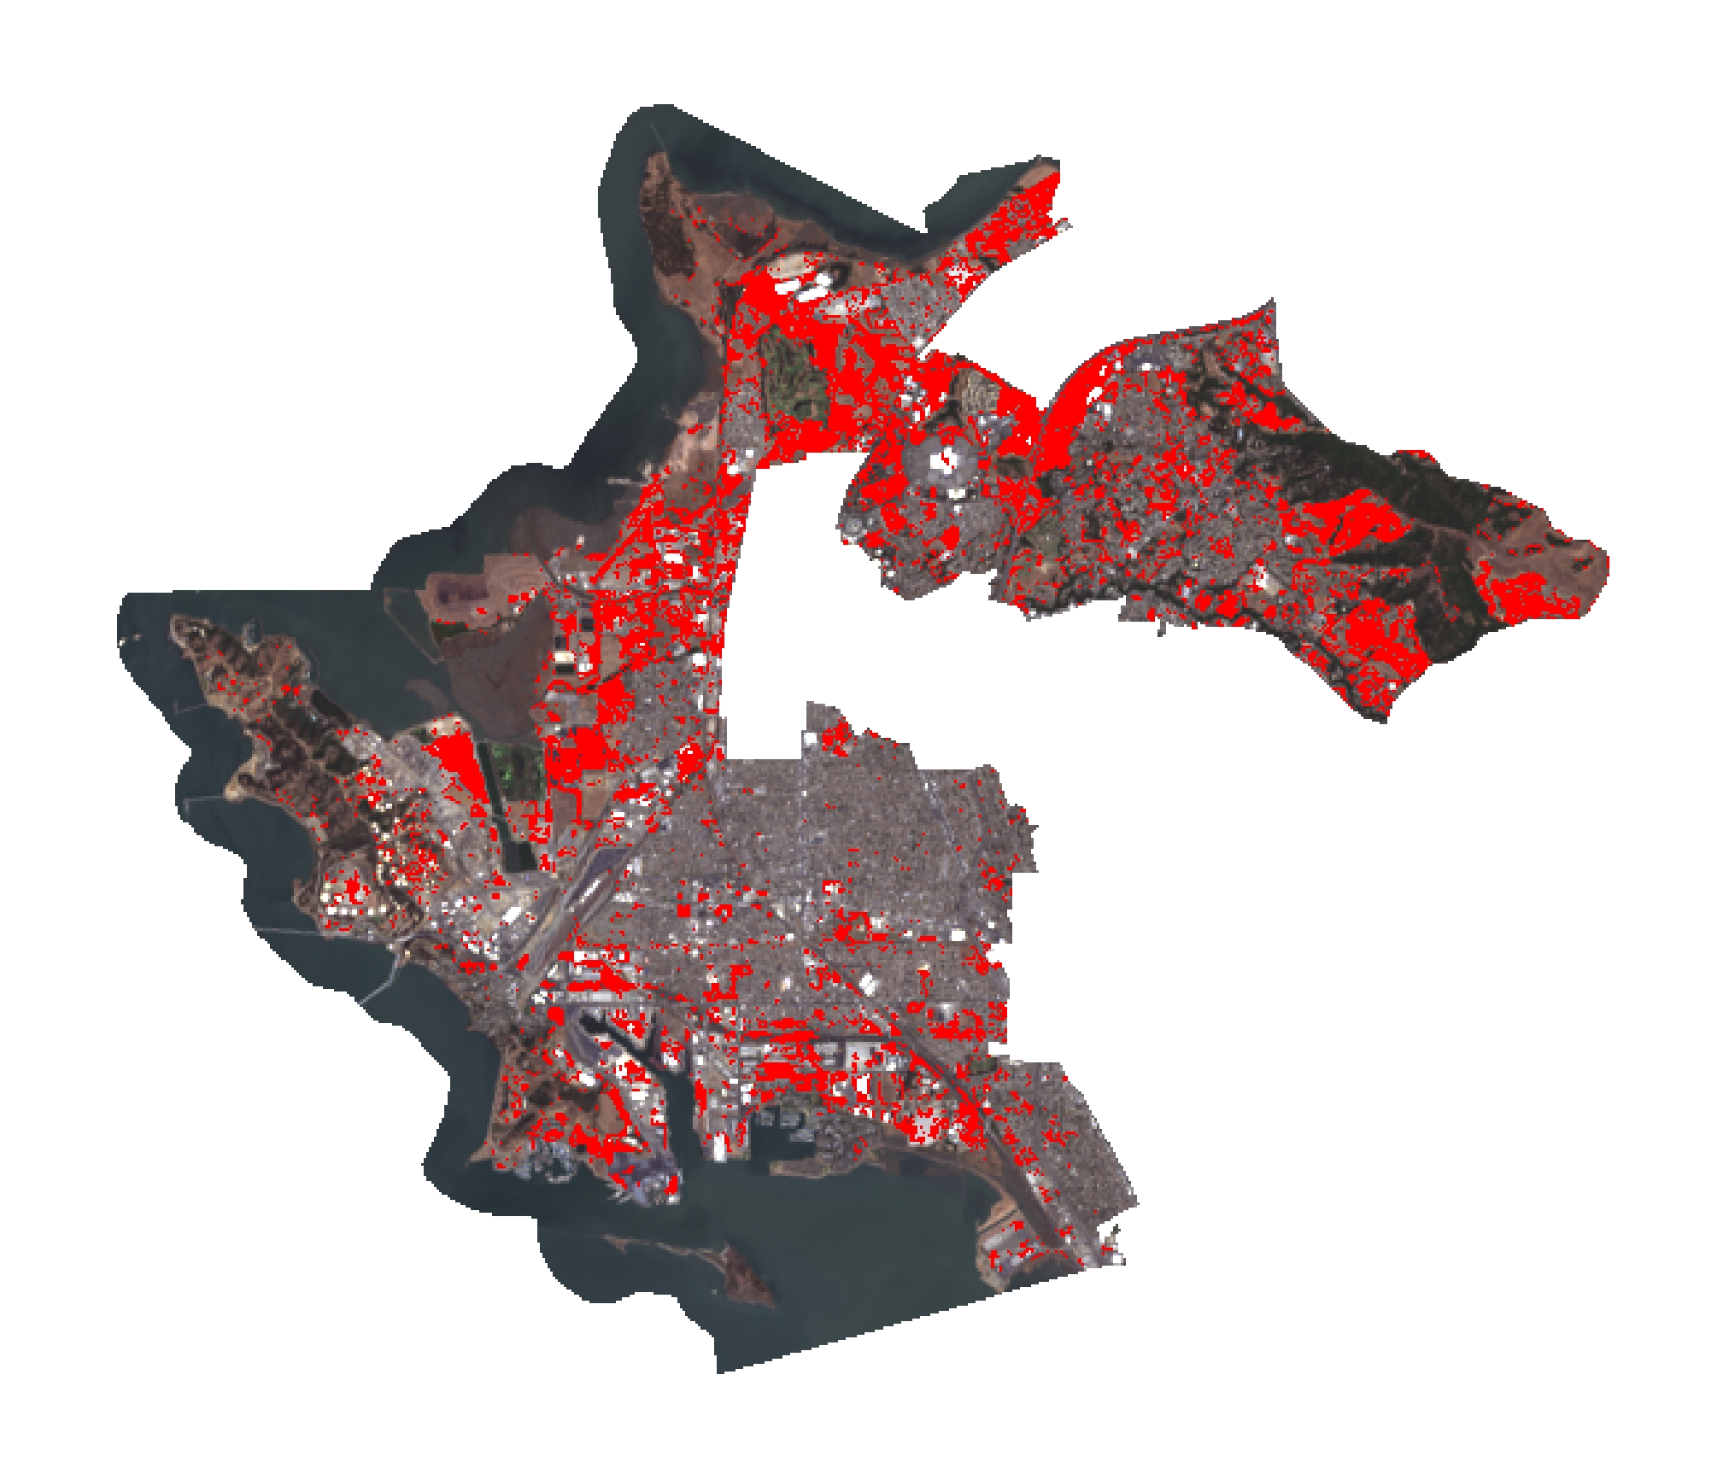
Results: Historical Land Cover Classification
Urban Expansion 1985-2015
MNDISI Difference 1985-2105
No Change Urban
Increase MNDISI
Urban Expansion
0
1.25
2.5
5
Kilometers
Notes:
Historical Land Cover Classification Script, continued:
With Urban being the largest class in all images between 1985-2015 we wanted to detect change.
This was accomplished using the combine tool in arcmap to see the difference in classes from our 1985 image to the 2015 image
We then choose to create a map showing Urban expansion between 1985-2015, with black representing no change to urban red representing urban expansion
To further assess our land classification we compared the Urban expansion map along with its change percentage with a Modified Normalized Difference Impervious Surface Index map showing the difference between 1985-2015
MNDISI is an index that highlights impervious surfaces, such as concrete and asphalt, while masking out others, such as water, vegetation, and dirt.
our results showed that there was an increase of 5.8% for the Urban Expansion and an increase of 6.09 % in MNDISI index
We found it reassuring that our percentages for the two different analysis were very similar, showing that both methods work
After finding an increase in impervious surfaces between the years we were curious on the effect it played on with land surface temperatures

Slide 13
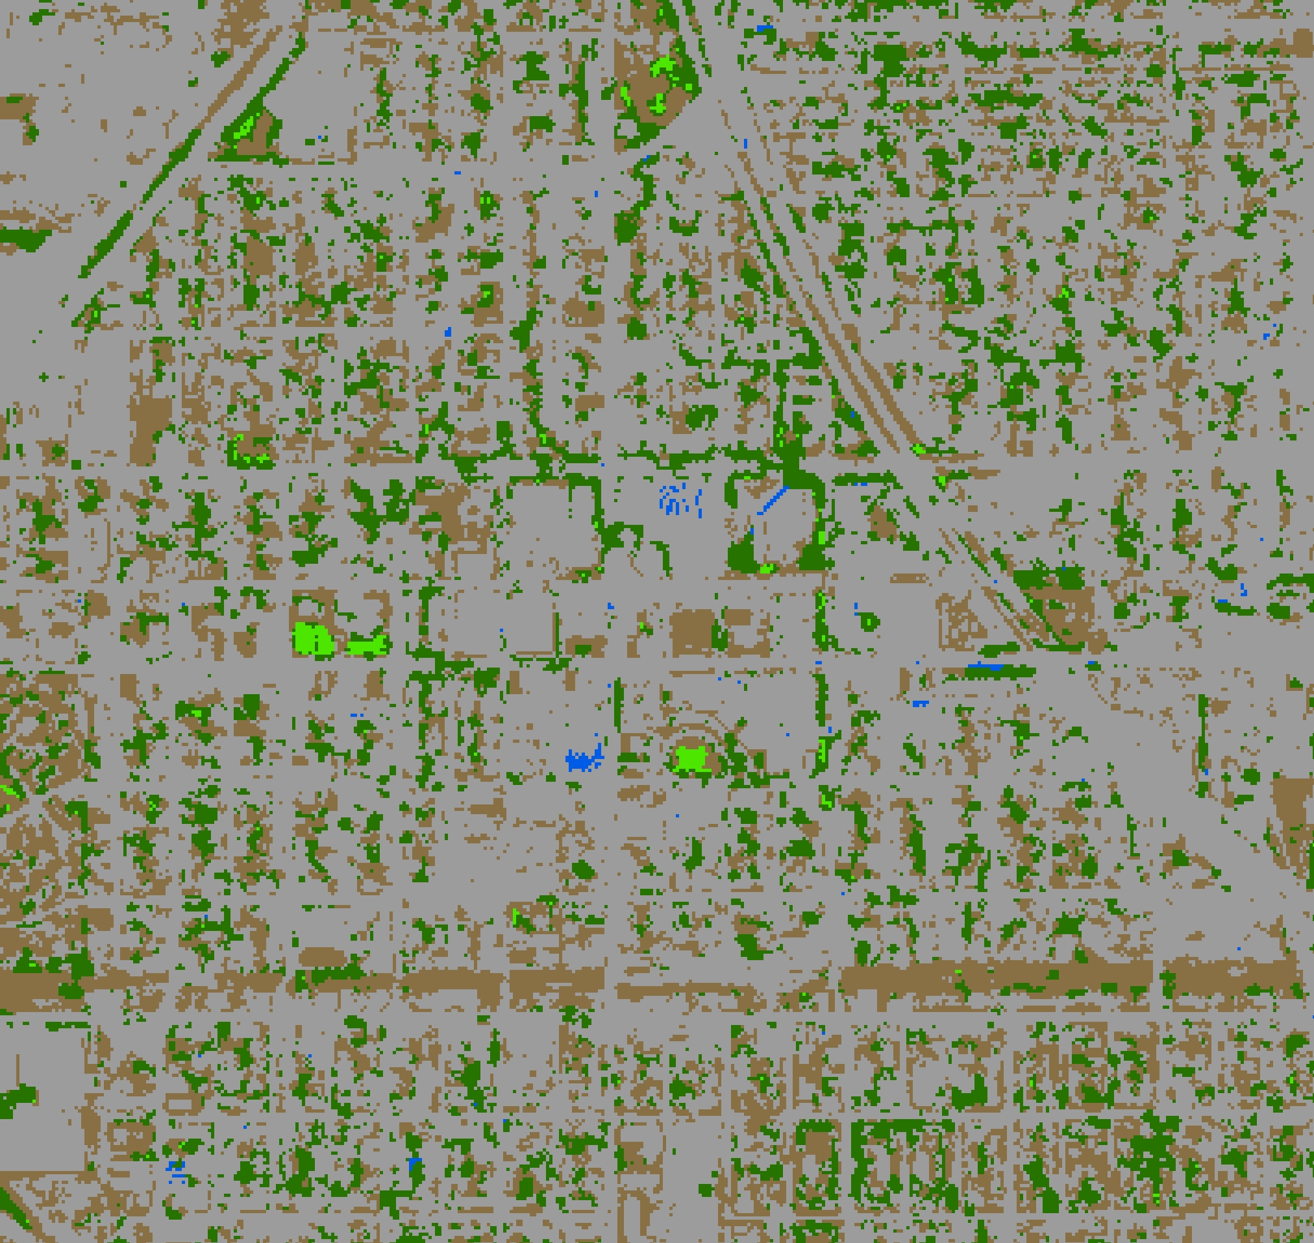
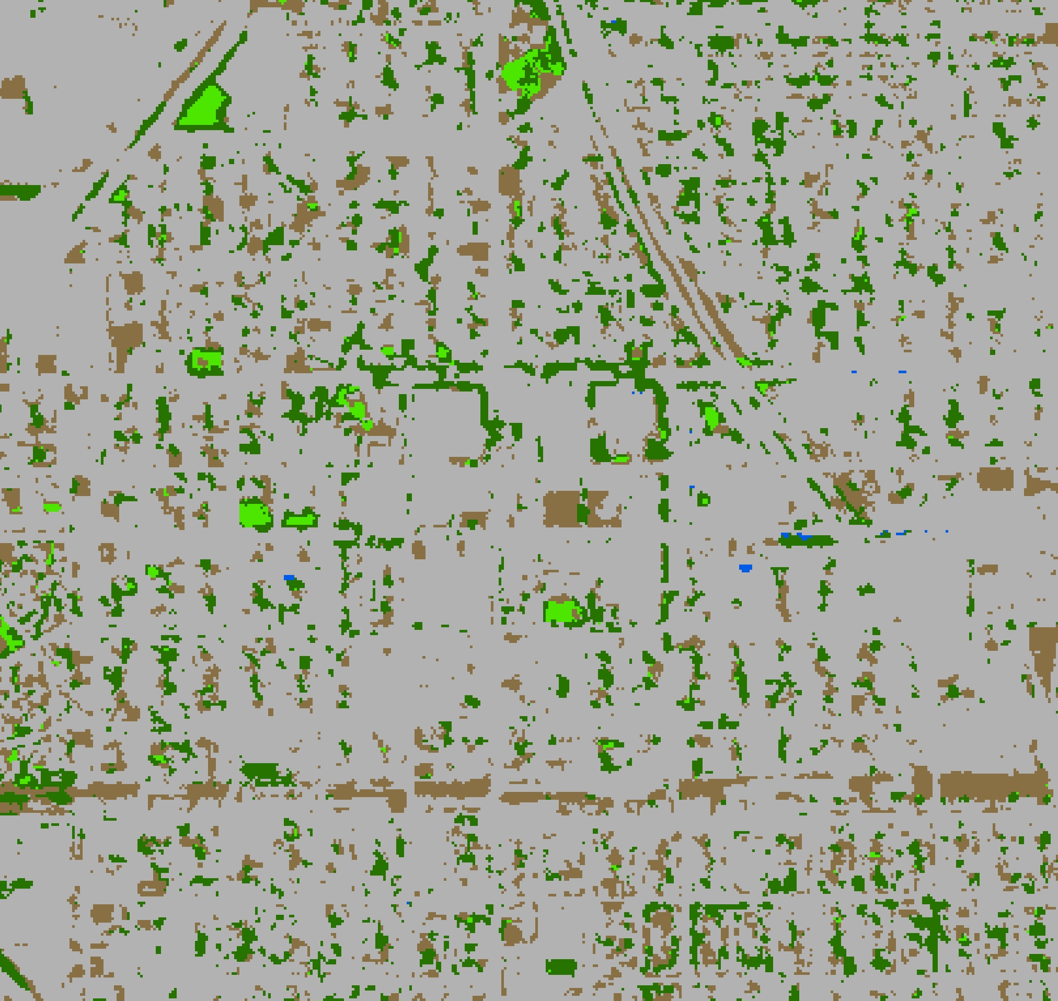
Results: Current Urban Tree Canopy Cover
2015 Land Classification
2017 Land Classification
Tree
Urban
Grass
Dirt
Water
Marsh
Planet RapidEye
Planet RapidEye
0
1.25
2.5
5
Kilometers
Notes:
Atm correction palanet
Vegetation health

Slide 14
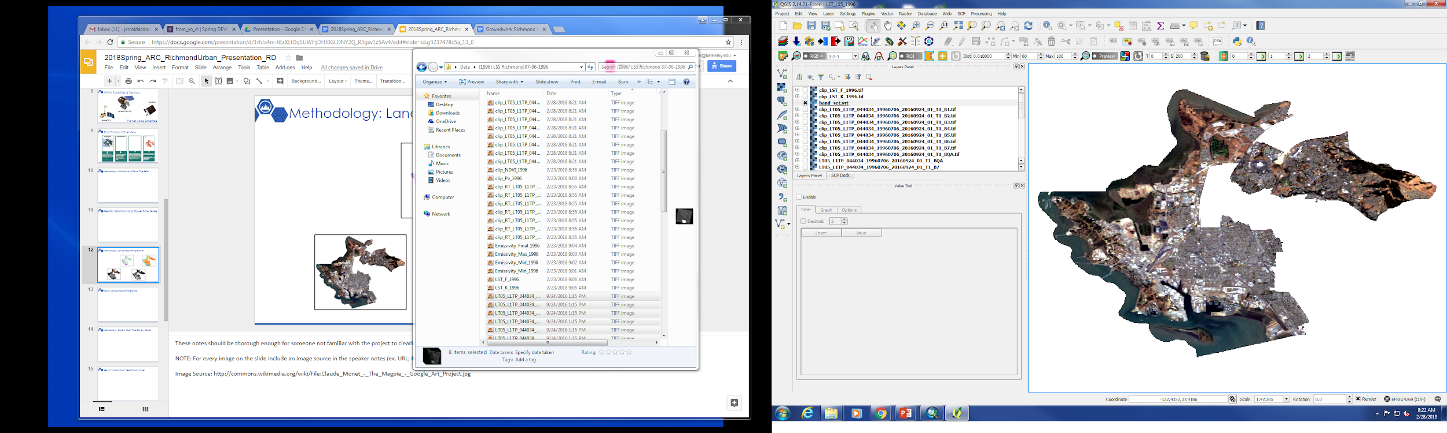
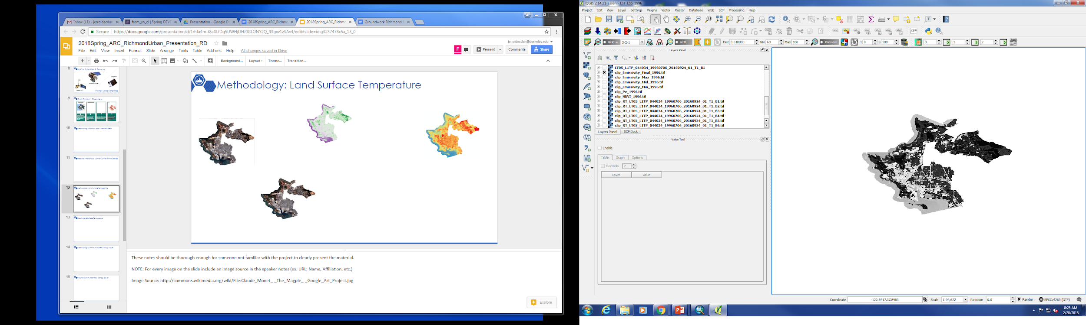
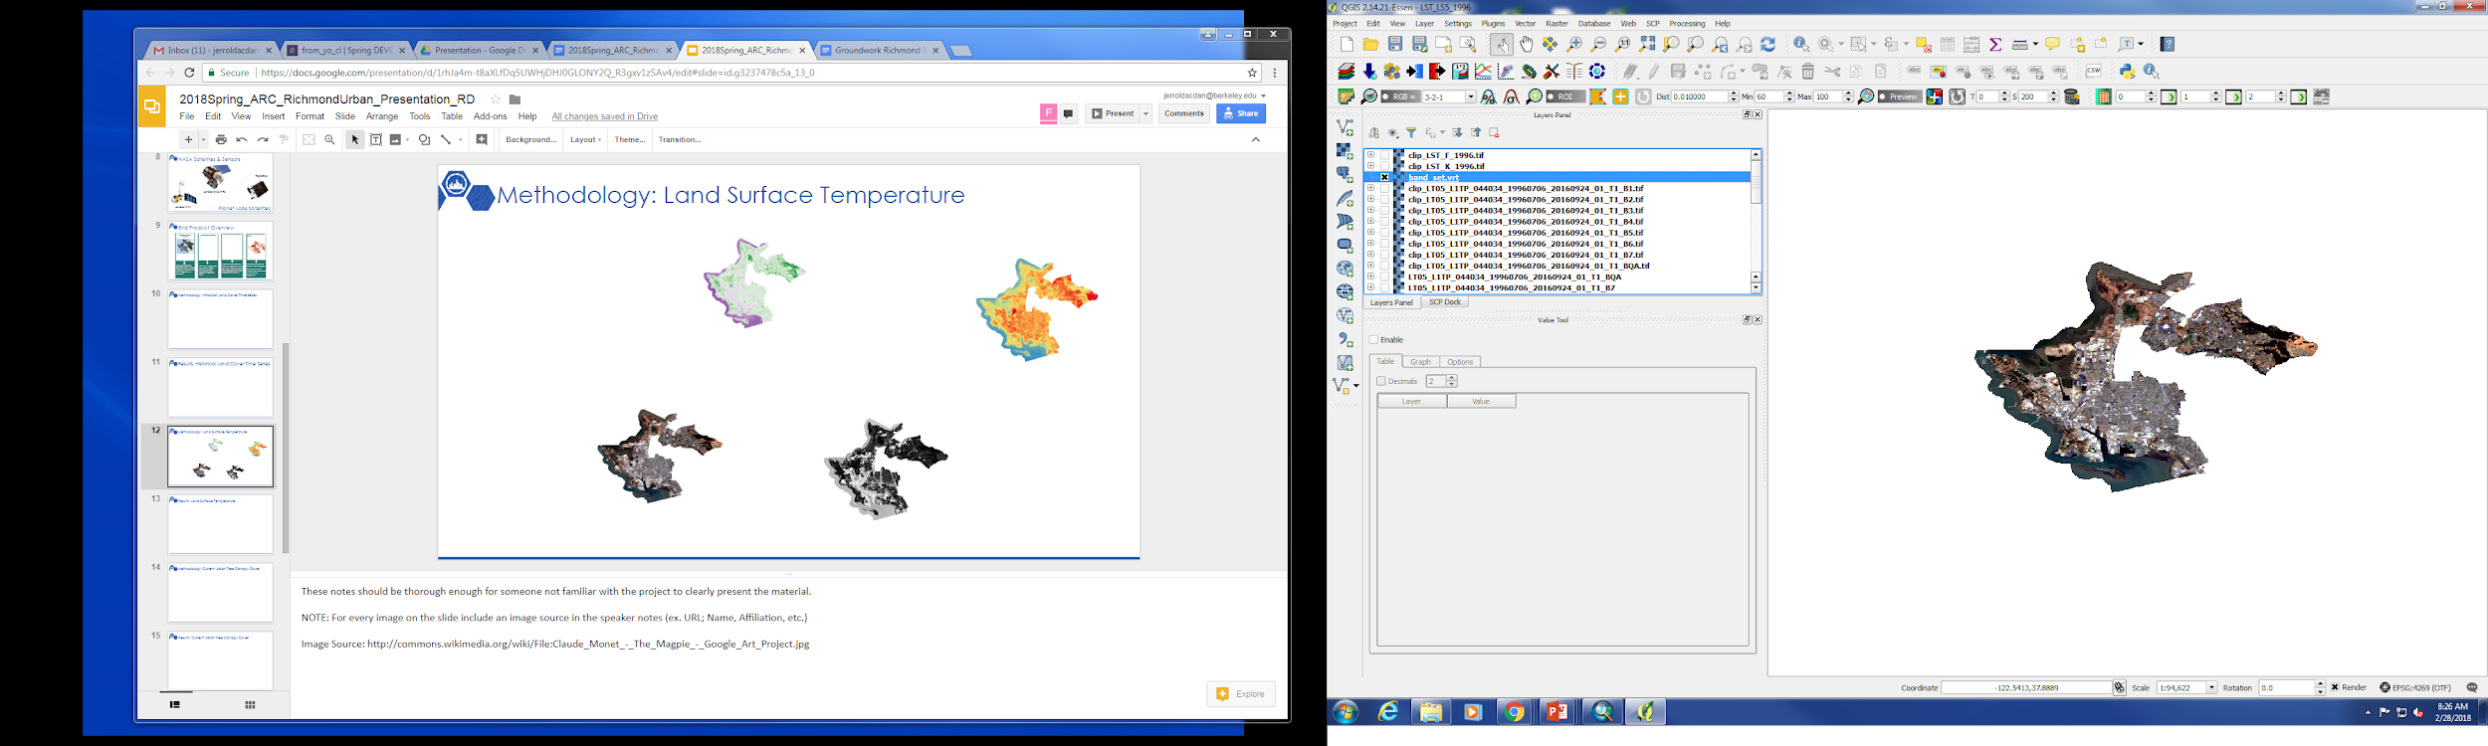
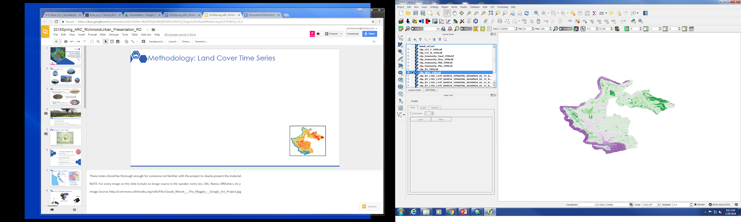
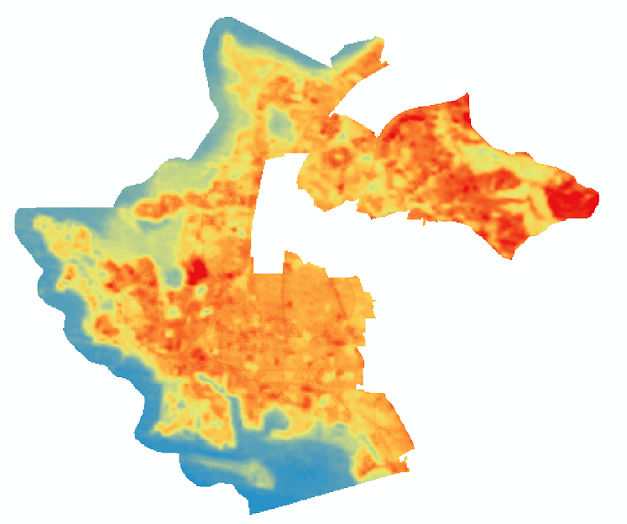
Methodology: Land Surface Temperature
Atmospheric Correction
Emissivity
START
END PRODUCT
Raw Image
Vegetation Index
Land Surface Temperature
Notes:
LST Methodology Script:
To derive Richmond’s land surface temperatures, we first started by downloading level 1 Landsat imagery acquired in the years of interest for the month of July.
The image with the least amount cloud cover was selected.
Then, the image was atmospherically corrected by the dark object subtraction method. Next, a normalized difference vegetation index layer was created, which was used to derive emissivity values.
Finally, the emissivity values were converted to land surface temperature.

Slide 15
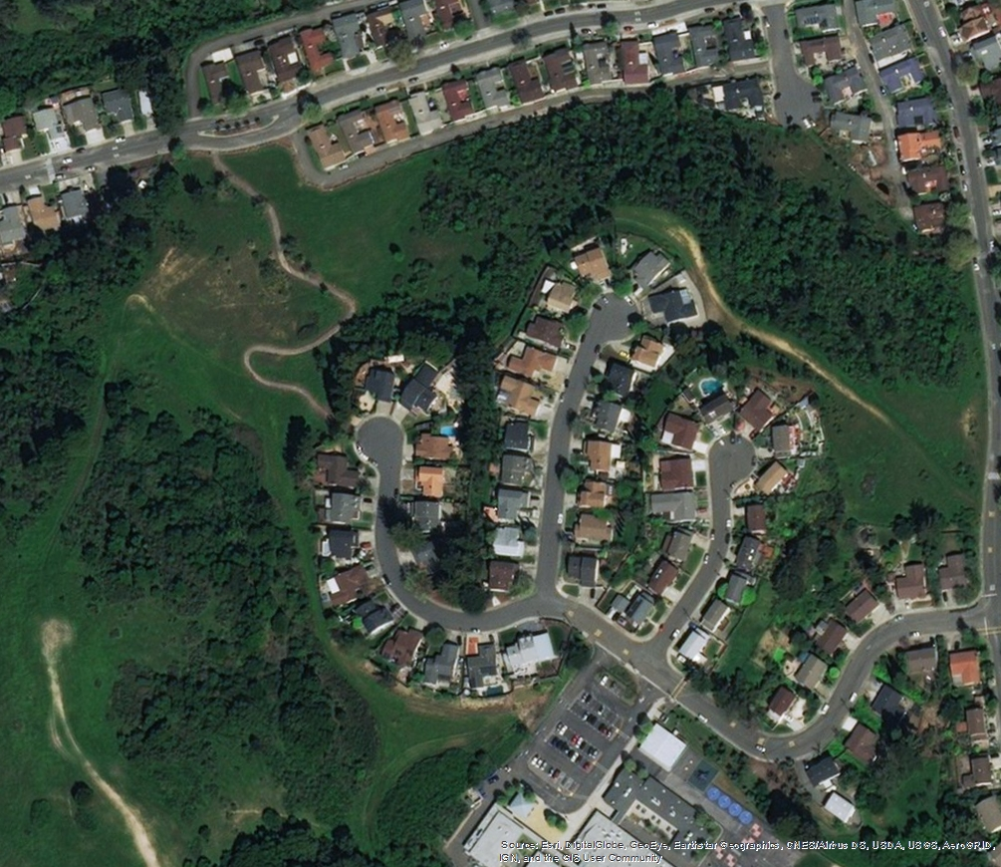
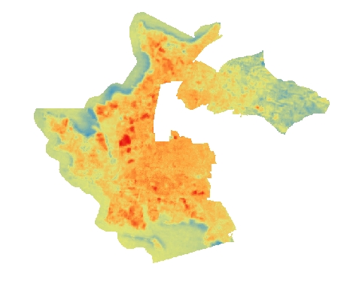
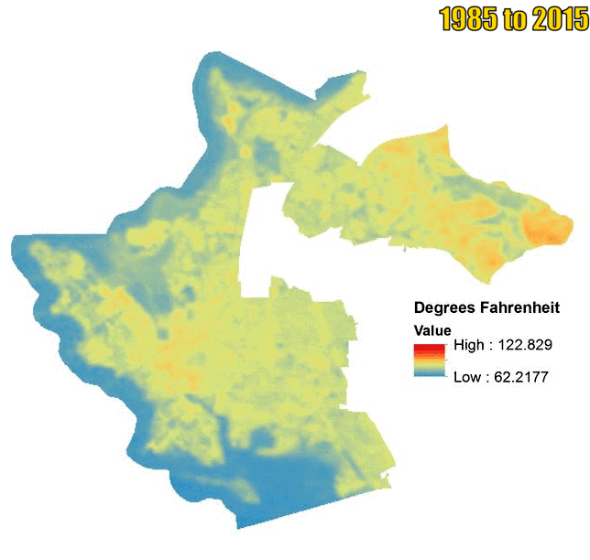

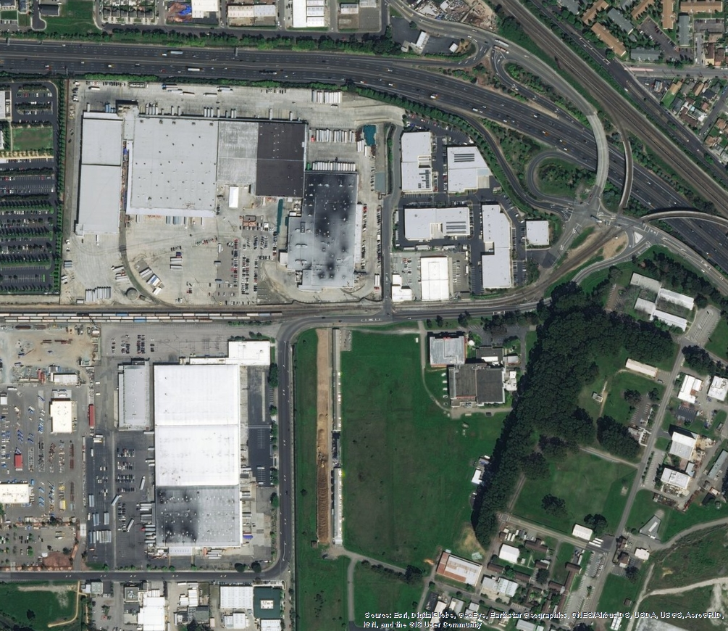
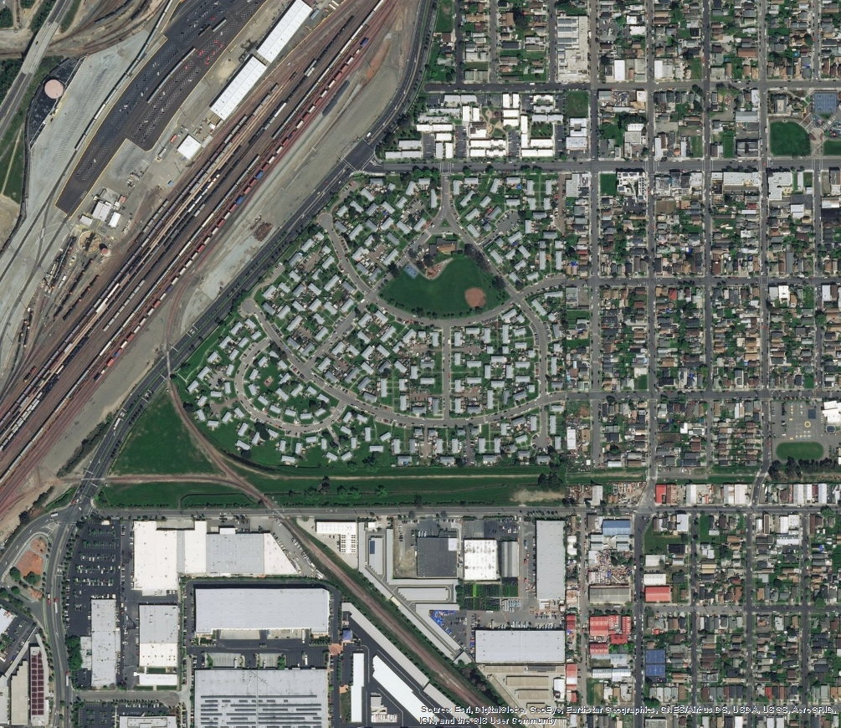
Results: Land Surface Temperature
1985 to 2015
Difference from 30-Year Mean
Temperature (ºF)
High: 122.83
Low: 62.22
Average difference in LST between 2015 & the 30-year mean is +6 ºF
Difference in average LST between 2015 and 1985 is +10 ºF
Difference (ºF)
High: 20.51
Low: -3.44
Notes:
LST Results script:
Results of LST analyses reveal two interesting facts:
The average difference in LST between 2015 and the 30-year mean is an increase in 6 degrees Fahrenheit.
The difference in average LST between 2015 and 1985 is positive 10 degrees Fahrenheit.
Take away is that Richmond’s land surface temperatures are getting hotter, which is probably due to a mix of Earth’s changing climate and the increase in impervious surfaces that make the surface warmer.
If we zoom into some different areas in the difference from 30 year mean map, we see that
On the bottom right, these two red hotspots correspond to an empty field as well as an industrial/commercial area.
While it is hard to plant trees in the developed area, perhaps trees around the field could cool it down.
To the left, we see that a neighborhood that is not surrounded by many trees and it was warmer than average in 2015.
Finally, on the upper right, we see an area that was generally cooler in 2015 than average, and it has lots of vegetation and trees around the neighborhood.
This visually shows us that trees can help reduce land surface temperatures

Slide 16
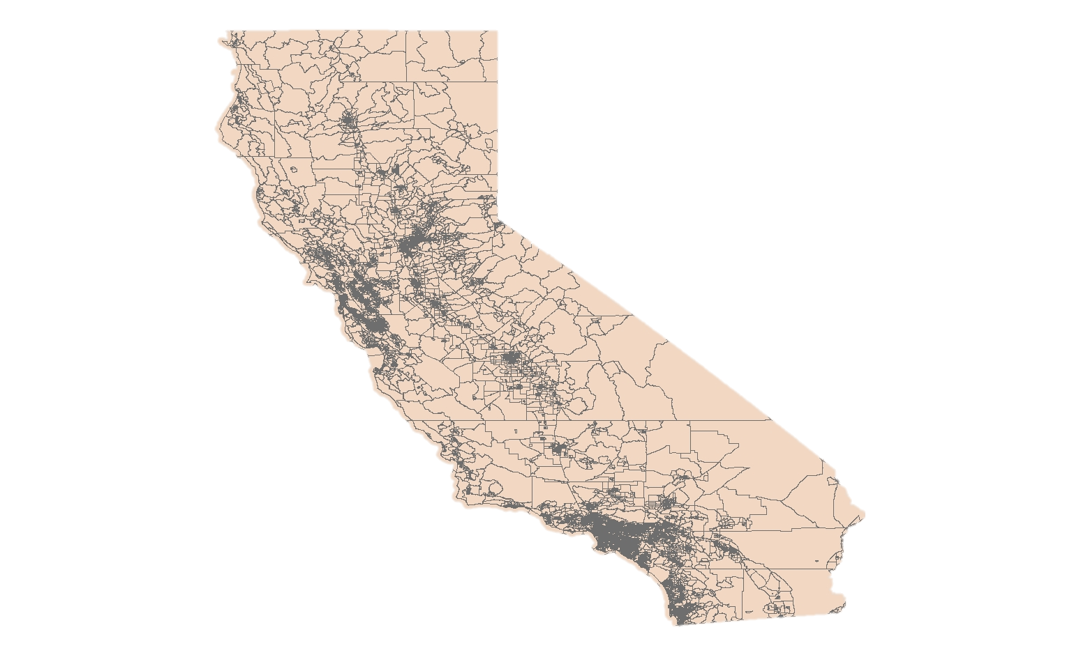

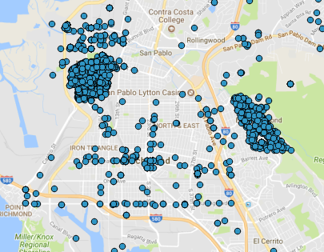
Methodology: Canopy Cover & Socioeconomic Status
END PRODUCT
TIGERLINE/Line®
Shapefiles
Current Urban Tree
Canopy Cover
American
FactFinder
American
Community Survey
Urban Canopy Cover
2015 - 2017
Data from the
City of Richmond &
Contra Costa County
Image Sources: Wikimedia
Notes:
Canopy Cover & Socioeconomic Status Script:
Census bureau data, including socioeconomic and demographic data, as well as data from the City of Richmond & Contra Costa County were turned into a series of choropleth maps that could be compared to the spatial distribution of tree canopy. This allowed us to visually investigate the relationship between socioeconomic variables and canopy cover.
Image Source:
https://commons.wikimedia.org/wiki/File:Seal_of_the_United_States_Census_Bureau.svg
“This image or file is a work of a United States Census Bureau employee, taken or made as part of that person's official duties. As a work of the U.S. federal government, the image is in the public domain.”

Slide 17
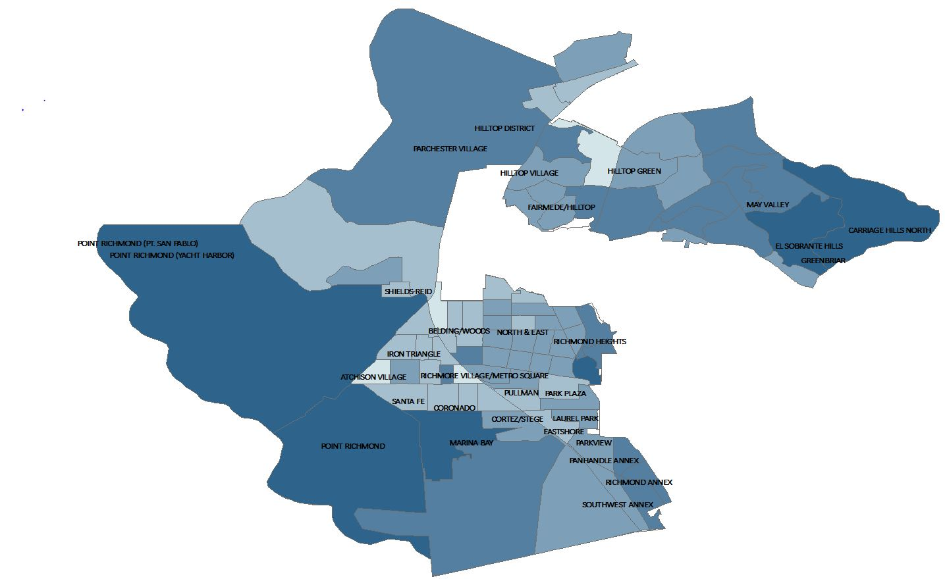
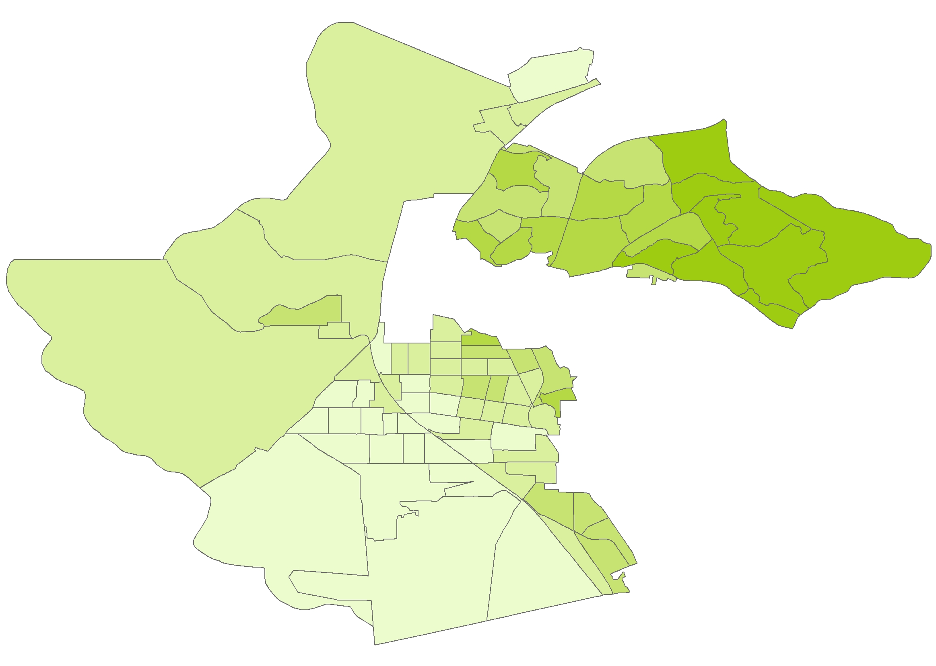
Results: Canopy Cover and Socioeconomic Status
Percent Canopy
Cover
Median Property Values
In US Dollars
7 to 14
0 to 120,000
14 to 20
120,000 to 225,671
225,670.00 to 320,660
20 to 28
320,665.00 to 450,000
0
1.25
2.5
5
Kilometers
29 to 40
450,000 to 596,700
40 to 65
Notes:
Here we see a distinct link of high canopy cover in comparison to Property Values.
(Point out to select neighborhood to compare canopy %)

Slide 18
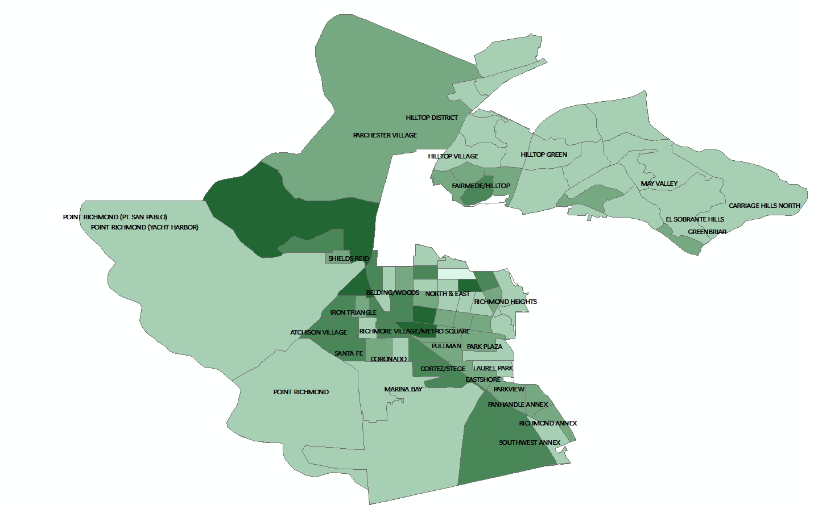
Results: Canopy Cover and Socioeconomic Status
Percent Canopy
Cover
Percent Poverty
0 to 6
7 to 14
10 to 14
14 to 20
14 to 23
20 to 28
23 to 34
0
1.25
2.5
5
Kilometers
29 to 40
35 to 47
40 to 65
Notes:
Slight correlation with canopy cover and poverty %
(Point out to select neighborhood to compare canopy %)

Slide 19
Results: Canopy Cover and Socioeconomic Status
Crime Incidents*
Canopy Cover Percentage
7 to 14
14 to 20
0
1.25
2.5
5
Kilometers
20 to 28
29 to 40
*Crime incidents as reported by the Contra Costa County Sheriff’s Office (2015 to Present )
40 to 65
Notes:
Slight correlation with canopy cover and poverty %
(Point out to select neighborhood to compare canopy %)

Slide 20
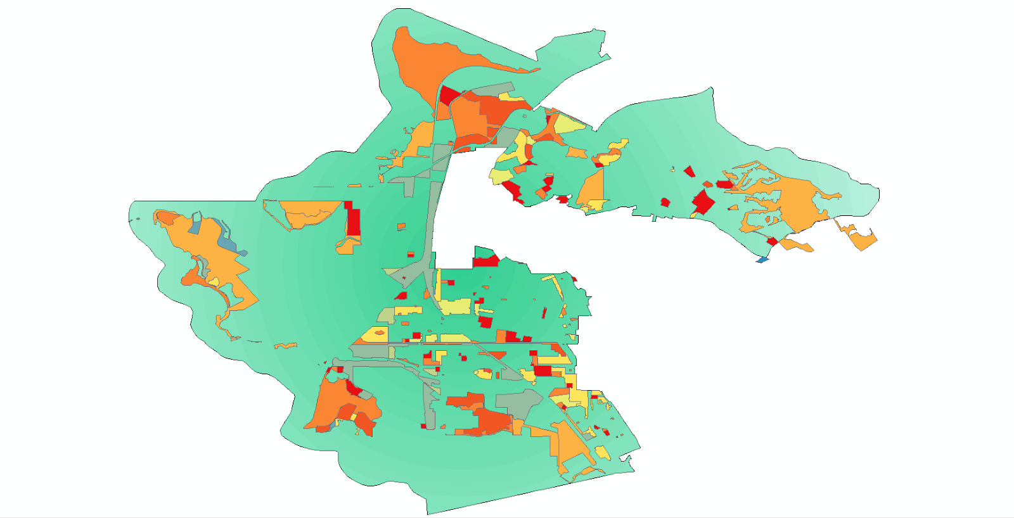
Results: Canopy Cover and Socioeconomic Status
Richmond's Zoning District Type
Agriculture
Coastal Commercial
Industrial, Light
Live/Work
High Density Residential
Multifamily Residential
0
1.25
2.5
5
Kilometers
Open Space
Parks and Recreation
Planned Area
Public, Cultural, and Institutional
Notes:
Displayed is Richmond’s current

Slide 21
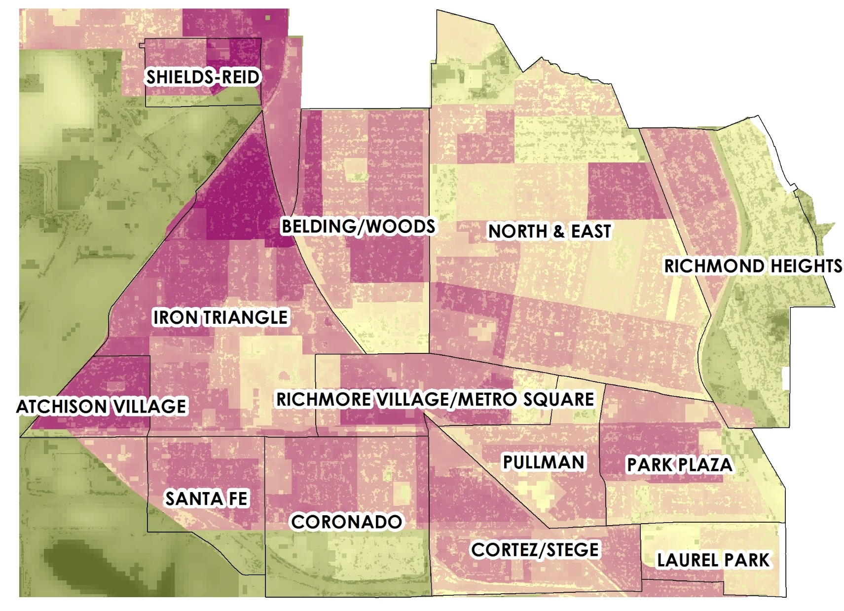

Social Vulnerability Index
High
Low
Social Vulnerability Index = LST + ISA+ Zoning Data + Poverty Level - Property Values - UTC cover
Notes:
Social Vulnerability Index Script:
In order to turn our project results into something useful for our project partners, we created a social vulnerability index that takes into account an area’s land surface temperature, poverty levels, impervious surface area, zoning data, property values, and current urban canopy cover.
Those with a high social vulnerability score are under-treed, socioeconomically disadvantaged neighborhoods that are susceptible to high land surface temperatures.
This is why we recommend places with high social vulnerability score to be potential areas of focus for future tree planting campaigns, if possible.

Slide 22

Errors & Uncertainties
Spatial resolution of Landsat imagery limits individual tree identification
RapidEye imagery not atmospherically corrected
Weather anomaly between years affect the greenness or health of vegetation
      Consideration of four-year drought
Source: Brandon Martin-Anderson//Flickr
Image Source: Pixabay
Notes:
Uncertainties and errors are inherit in most geospatial analysis – with that being said, the source of some of ours include
The low spatial resolution of Landsat imagery, which limits individual tree detection
RapidEye imagery, although it does have better spatial resolution, was not corrected for atmospheric conditions, leading to uncertainties that could have affected our classification results
Finally, year to year weather conditions differ, which can lead pixels representing grass, trees or other vegetation to be more or less green in color, affecting classification
Perhaps the 4 year drought between 2012-2016 could have affected the health of the trees in Richmond?
Image source:
https://pixabay.com/en/question-marks-punctuation-symbol-2215/
https://creativecommons.org/publicdomain/zero/1.0/deed.en

Slide 23

Conclusions
Area covered by impervious surfaces has increased by 6% between 1985 and 2015.
Average difference in temperature between 2015 and the 30-year mean is 6 degrees Fahrenheit.
Change in urban tree canopy cover between 2015 and 2017 is inconclusive.
Social vulnerability index highlights communities that are under-treed, socioeconomically disadvantaged, and vulnerable to high heat exposure, thus making them areas that could benefit the most from for future tree-planting campaigns.
Image Source: Pixabay
Notes:
Conclusion Script:
As a result of all of our analyses, we can say that:
The area covered by impervious surfaces has increased by 6% between 1985 and 2015
The average difference in temperature between 2015 and the 30-year mean is 6 degrees Fahrenheit
The change in urban tree canopy cover between 2015 and 2017 is inconclusive
Our social vulnerability index highlights under-treed, disadvantaged, heat vulnerable communities, thus making them possible areas of focus for future tree-planting campaigns.
Image source:
https://pixabay.com/en/city-urbanization-tree-aesthetic-990841/
https://creativecommons.org/publicdomain/zero/1.0/deed.en

Slide 24
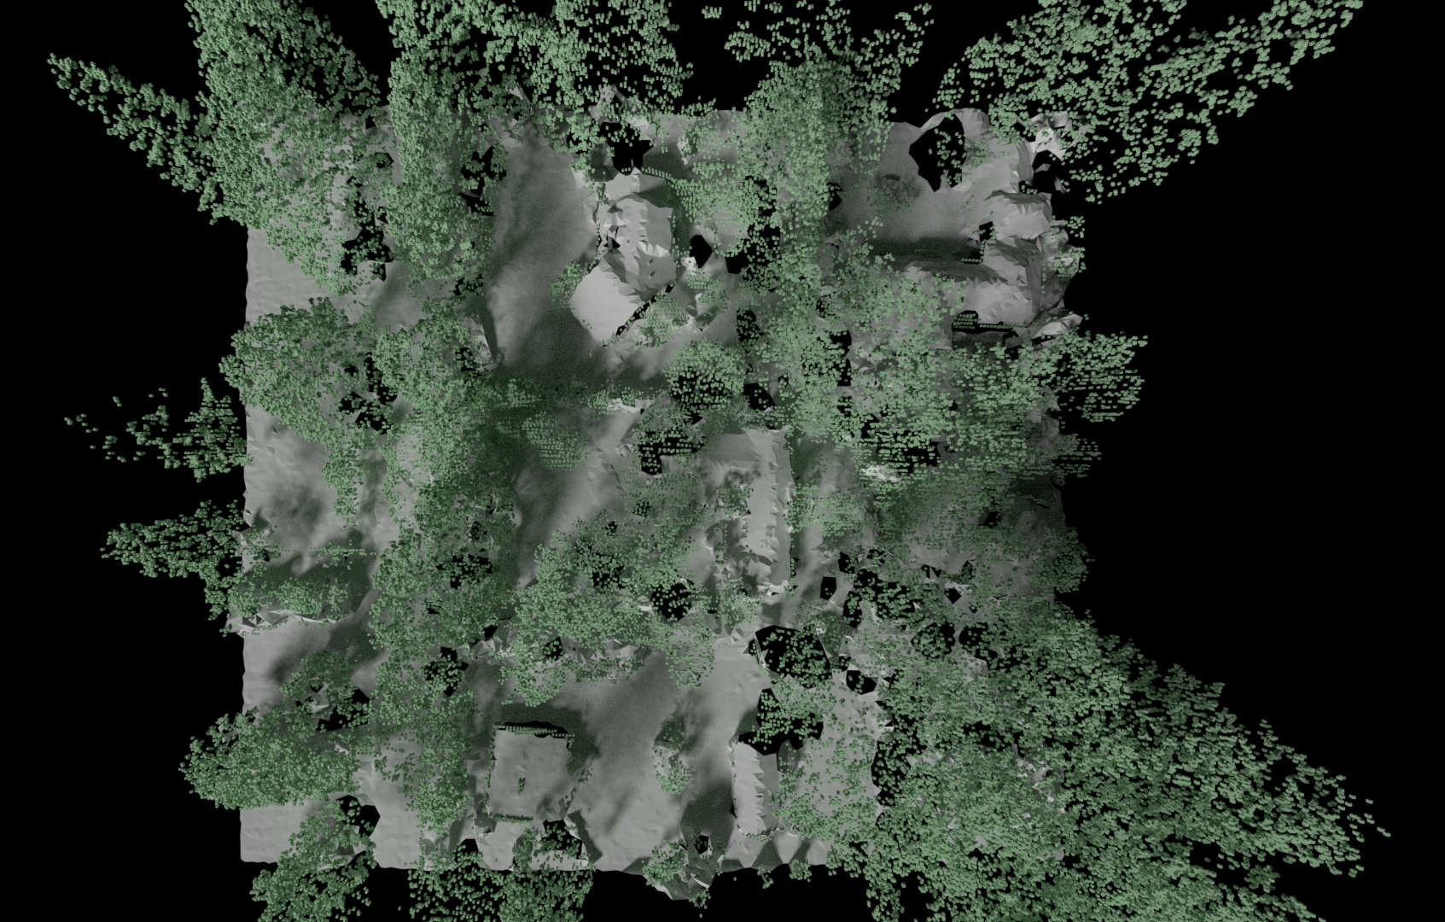
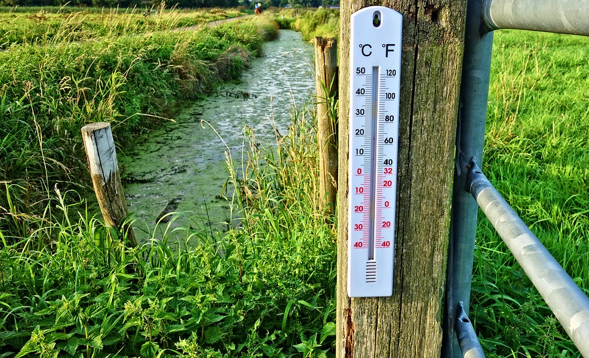
Future Work
Land classification
    Utilize higher spatial resolution imagery
    Perform atmospheric corrections
    Validate with in situ data
    Incorporate LiDAR data
Socioeconomic Data & Canopy Cover
    Run data through mathematical regression models
    Temperature
Land surface vs. ambient air
Image Sources: Flickr (Brandon Martin-Anderson); Pixabay
Notes:
Future Work Script:
To improve land classifications, areas of future work include using higher spatial resolution imagery that has been atmospherically corrected. We also recommend validating land classification with in situ data collection of spectral profile of the different classes (dirt, grass, trees, urban areas, etc.). Incorporation of LiDAR data would also help tremendously, as LiDAR can pick up both tree heigh and the shape of individual tree canopies.
To assess the correlation between socioeconomic variables, such as poverty levels, and property values, and tree canopy, the data we have collected can be run through mathematical regression models.
Finally, although land surface temperature reveals the warming trend in Richmond, ambient air temperature is what people actually feel when walking aorund. Adding in ambient air temperatures to our LST analysis would strengthen the argument that residents face higher heat exposure every year.
Image sources:
https://www.flickr.com/photos/ewedistrict/32124669445
https://creativecommons.org/licenses/by-sa/2.0/
https://pixabay.com/en/thermometer-temperature-celsius-2906817/
https://creativecommons.org/publicdomain/zero/1.0/deed.en

Slide 25
Acknowledgements
Project Partner
Sarah Calderon, Executive Director of Groundwork Richmond, CA
Science Advisor
Dr. Juan L. Torres-Pérez (Bay Area Environmental Research Institute, NASA Ames Research Center)
DEVELOP Staff at NASA Ames Research Center
Jenna Williams (Center Lead)
John Dilger (Geoinformatics Fellow)
Notes:
Acknowledgements script:
We would like to thank:
Our Project Partner, Sarah Calderon, Executive Director of Groundwork Richmond, CA
Our Science Advisor, Dr. Juan L. Torres-Pérez (Bay Area Environmental Research Institute, NASA Ames Research Center)
As well as the DEVELOP Staff here at at NASA Ames Research Center, Jenna Williams, John Dilger

Slide 26
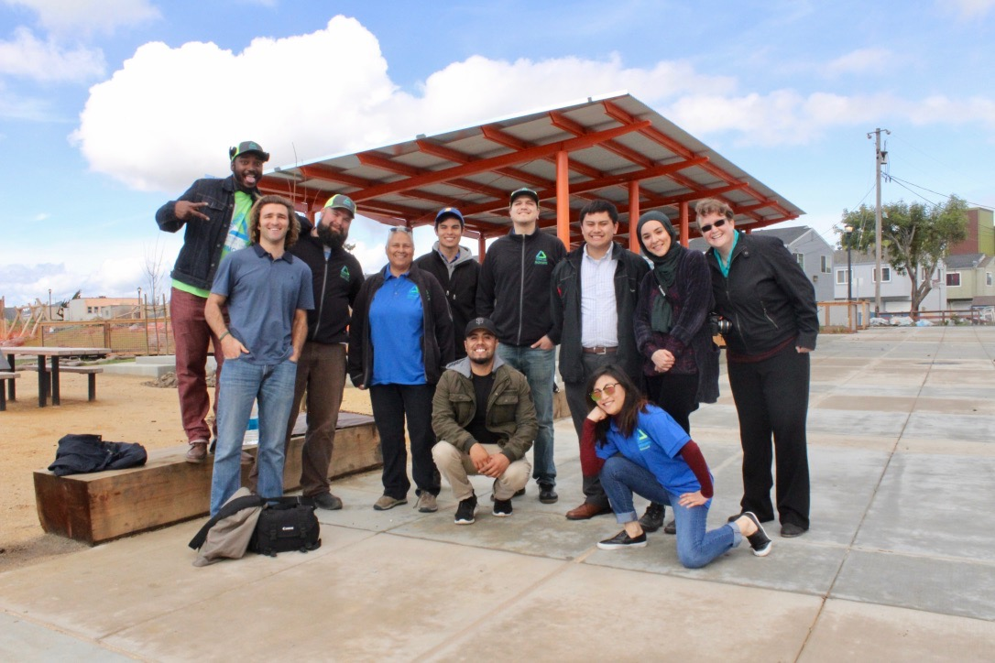
Thank You!
Notes:
A big thank you to our partner – Groundwork Richmond - and collaborator Sarah Calderon and for the rest of the GR crew that is devoting their efforts to developing Richmond into a green space!

