Slide 1
DEVELOP National Program
DEVELOP Projects:
Project Execution & Performance Metrics

Slide 2
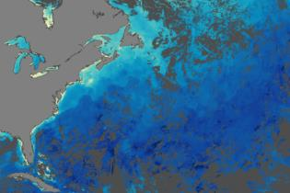
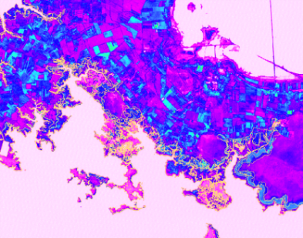
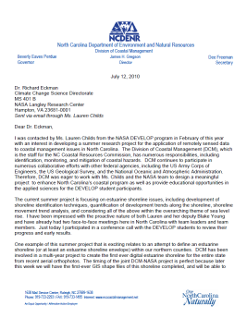
Project Characteristics
70-80 projects take place each year - at their core they share these characteristics:
Highlight the applications and capabilities of NASA Earth observations
Address community concerns relating to decision-making for real-world environmental issues
Partner with organizations who can benefit from using NASA Earth observations to enhance decision making by providing decision support tools
Align with at least one of the eight NASA Applied Sciences Program’s National Application Areas
Research is conducted by teams with diverse backgrounds under the scientific guidance of Science Advisors and mentors from NASA and partner organizations
Create a consistent set of deliverables

Slide 3
Where do Project Ideas Come From?
National
Science
Objectives
Environmental
Decision
Makers
End-User Needs
NASA
Program
Managers
State & Local
Policy
Makers
DEVELOP
Science
Advisors
DEVELOP
Center Leads & Participants
NSF
Decadal
Survey
Local
Communities &
Tribal Entities
New
NASA
Missions
Ideas can come from anywhere as long as they connect to an end user! Have an idea? Tell your Center Lead
Federal
Agencies &
Organizations

Slide 4
Project Lifecycle
Conversations w/Potential Partners to Identify Needs
Project Idea
● Submission to NPO
● NPO Reviews and Discusses with Nodes
Proposal Process
Project Execution (10 weeks)
Hand-off to Partners
&
Conference Presentations
Literature Review
Data Acquisition, Processing & Analysis
Results
Conclusion
Node drafts Proposal
NPO Review
NASA HQ Review
Creation of Deliverables

Slide 5
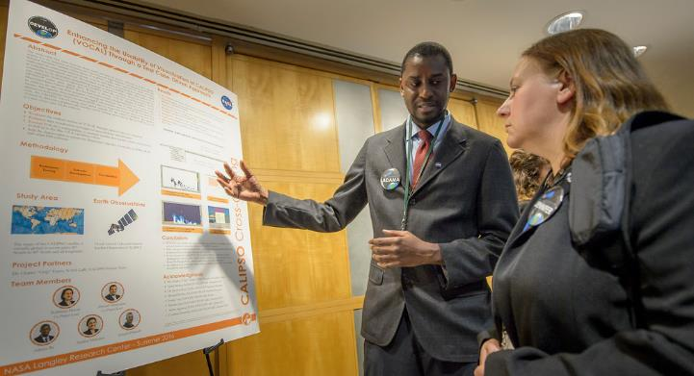
Deliverables
All projects create:
Project Summary
Study Area Shapefile
Poster
Presentation
Video & Transcript
Tech Paper
DEVELOPedia Page
Website/Booklet Image
Technical Image
Feedback Form
Some projects create:
Code
Software Release Forms (required if team desires to give partner any code, otherwise not applicable)
Tutorial (optional)
Brochure (optional)

Slide 6
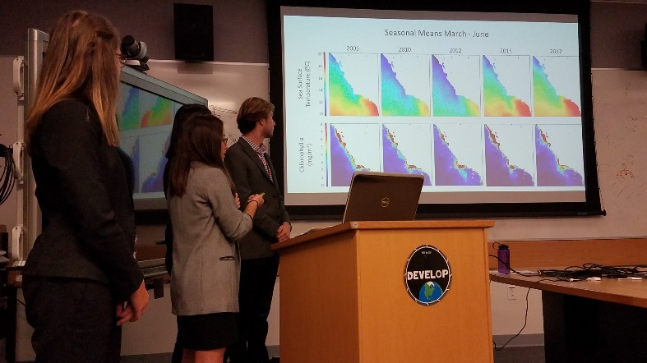
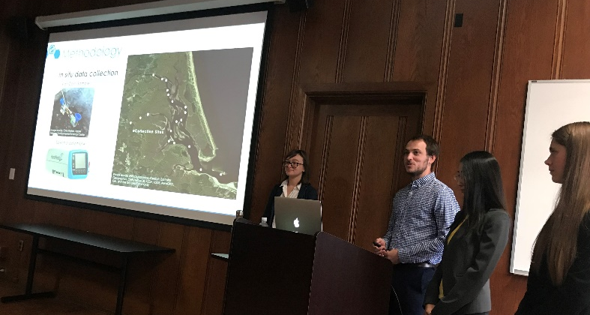
Hand-Offs
Hand-offs are an important step in transitioning results and methodologies to end users, and working towards the goal of the end user integrating NASA Earth observations in their decision making process.
Commonly Used Hand-off Styles
Email deliverables (tech paper, tutorials, presentation, etc.)
Teleconference or videoconference presenting the results and methodologies
In-person presentation of results and methodologies
Get creative in how and what you hand-off. Interesting idea? Speak to your Center Lead about it!
Depending on what you are handing off, be cognizant that you must get materials approved by NASA prior to handoff.

Slide 7
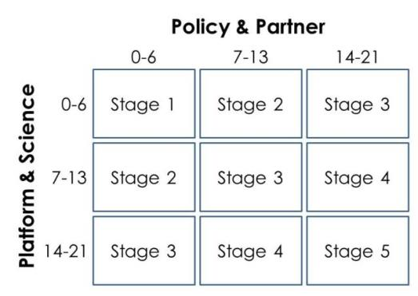
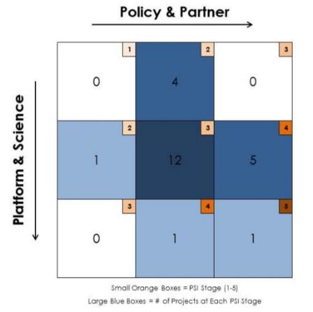
Project Assessment
DEVELOP Project Strength Index (PSI)
DEVELOP projects have consistently improved and matured over the Program’s last 15+ years. The PSI provides DEVELOP a means of objectively evaluating projects and tracking progress in two steps. The PSI Part 1 is completed after each term of a project, creating a preliminary score. The PSI Part 2 is completed ~4-6 months after the final term of the project to assess additional project characteristics such as publishing, conference presentations, and partner use of end products.
A series of questions are answered earning a total of 21 points in two sections: 1. Policy & Partner and 2. Platform & Science. The score for each category is then placed on the Index to receive the project’s current stage (1 to 5).
Stage 1: Basic Research
Stage 2: Application Concept Complete
Stage 3: Application Demonstration Successful
Stage 4: Application Verified / End User Engaged
Stage 5: Transition to End User / Decision Enhanced

Slide 8
Project Assessment – Partner Inputs
A Pre-Project Partner Form was sent out before the term to gather information about partner needs and expectations. A Post-Project Partner Form will follow the completion of the term to collect information regarding the perceptions of success of collaborating with DEVELOP.
Were the project results and methodologies useful?
Was the experience a good one?
Is the partner using the results or methodologies in their decision-making process?
Timeline: Center Leads sent out the Pre-Project survey link a couple weeks before the beginning of the term. The Post-Project survey link will be sent to partners at the end of the term. In case of a project that has multiple terms, the survey goes out following the project’s final term.
Please communicate to your partners that DEVELOP will stay in touch and send a brief survey at the end of the project’s final term.

Slide 9
2018 Fall Project Portfolio
Hampton Roads Urban Development (LaRC)
Tempe Urban Development (AZ)
Missouri River Basin Disasters (NC)
Colorado & New Mexico Disasters (CO)
Idaho Water Resources II (ID)
Lake Michigan Water Resources II (ARC)
Osa Peninsula Water Resources III (GA)
Great Bear Lake Water Resources (MA)
Wisconsin Agriculture & Food Security (CO)
Chesapeake Bay Agriculture & Food Security (GSFC)
Mojave Desert Ecological Forecasting (JPL)
Alaska Ecological Forecasting (JPL)
Intermountain West Health & Air Quality II (LaRC)
New Orleans Health & Air Quality (AL)
Ohio River Valley Transportation & Infrastructure (MSFC)
Gulf of Mexico Transportation & Infrastructure (MSFC)
Check out the Fall Preview slides on DEVELOPedia!

Slide 10
Important Things to Note
DEVELOP projects do not develop or prescribe policy. We simply demonstrate the feasibility of NASA Earth observations being integrated into decision making. Other agencies and organizations use the data and scientific results in their policy analysis and development.
NASA funds DEVELOP, thus we highlight the use of NASA Earth observations (NOAA funds the NCEI location, so they have an additional directive to highlight NOAA CDRs).

Slide 11
THANK YOU!
A lot goes into every DEVELOP project.
What will your project’s legacy be?

