Slide 1
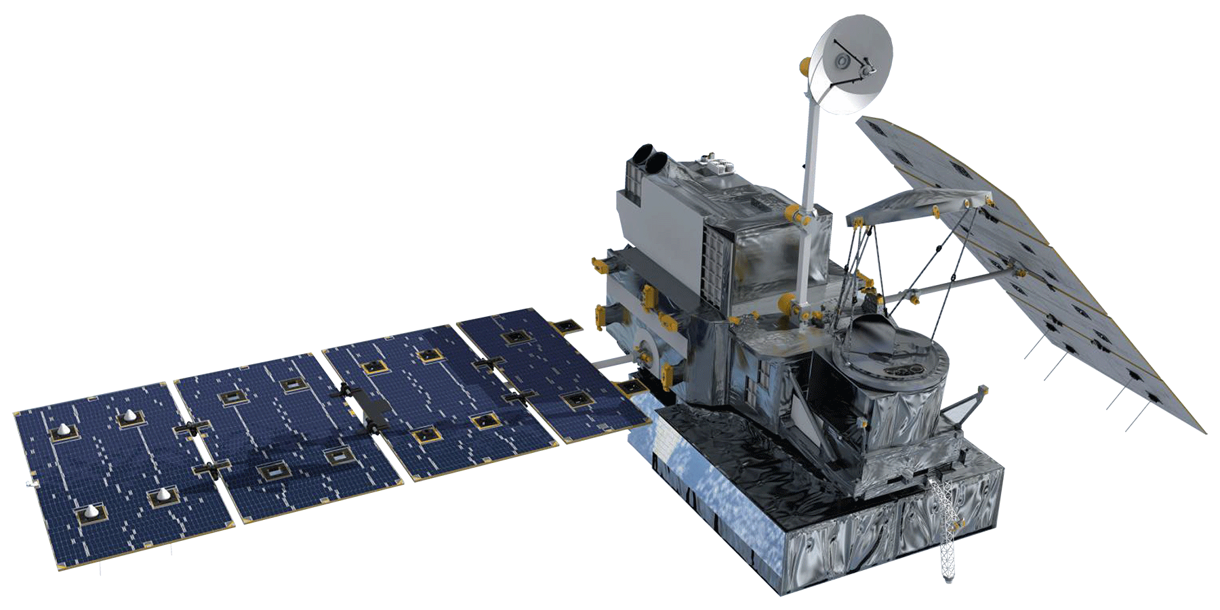
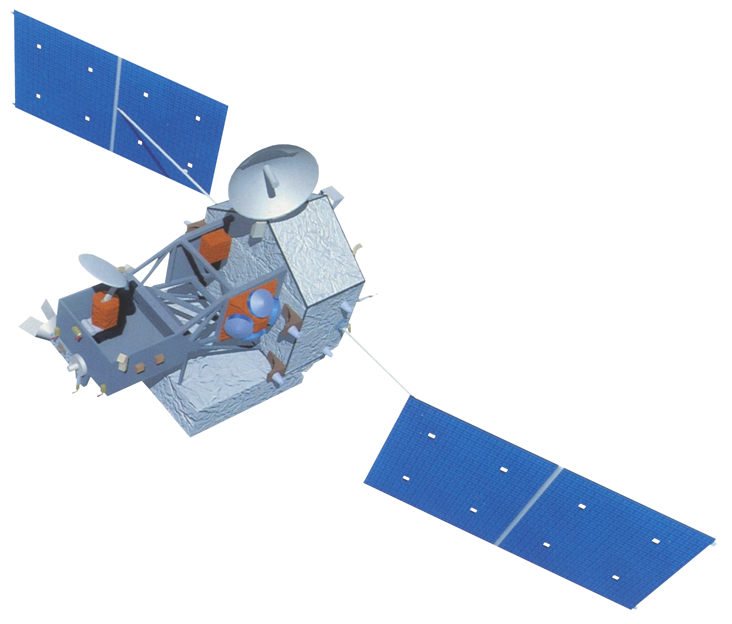
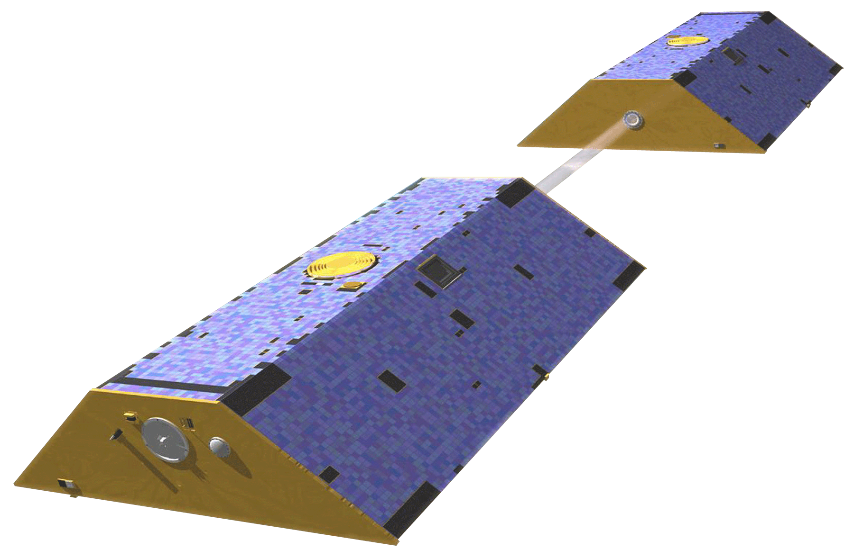
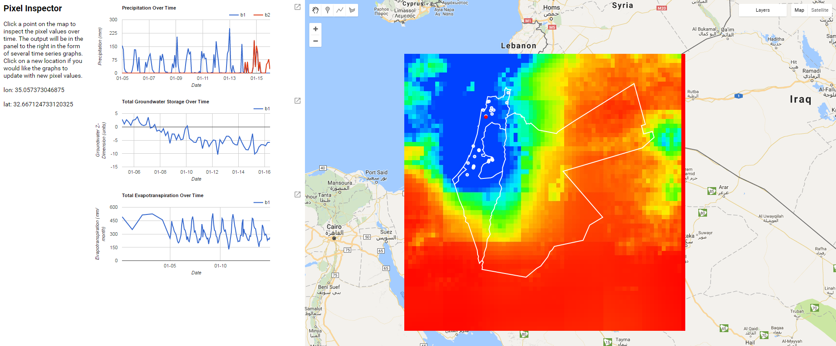
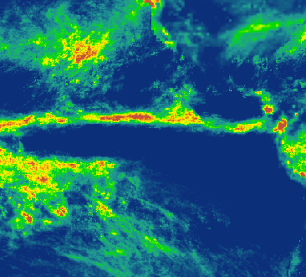
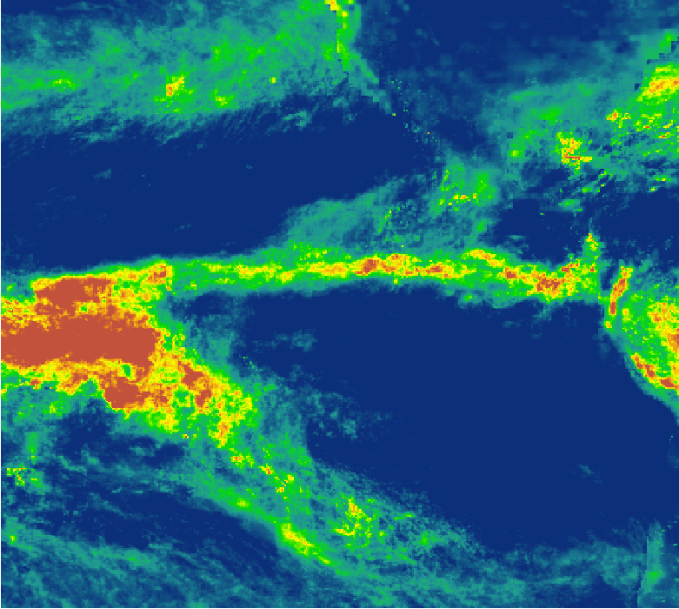
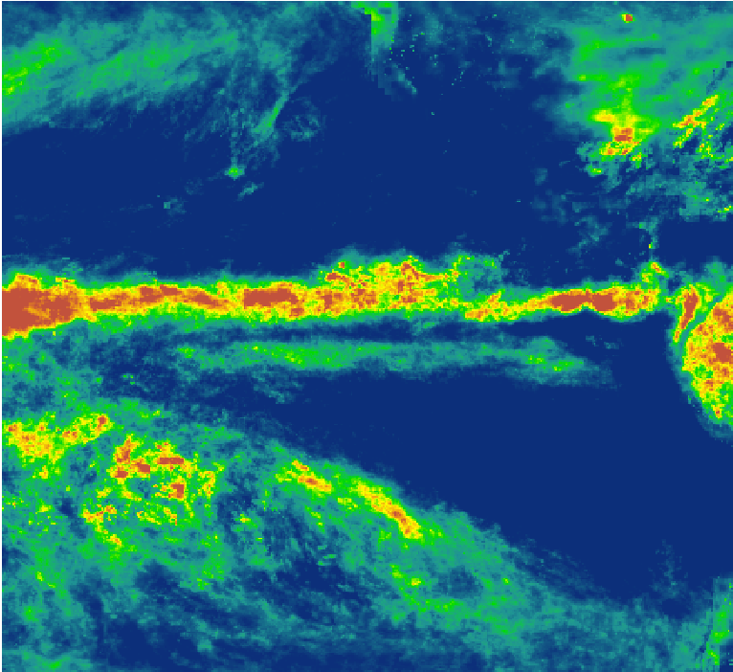
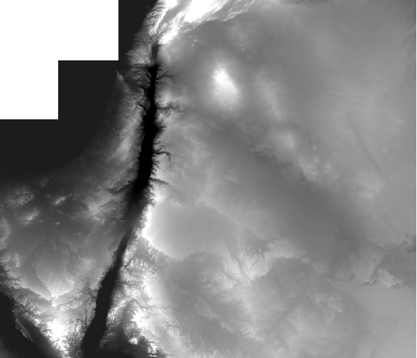
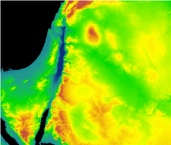
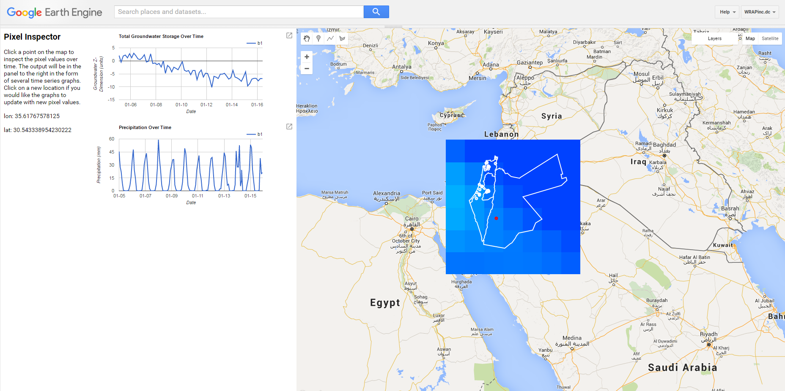
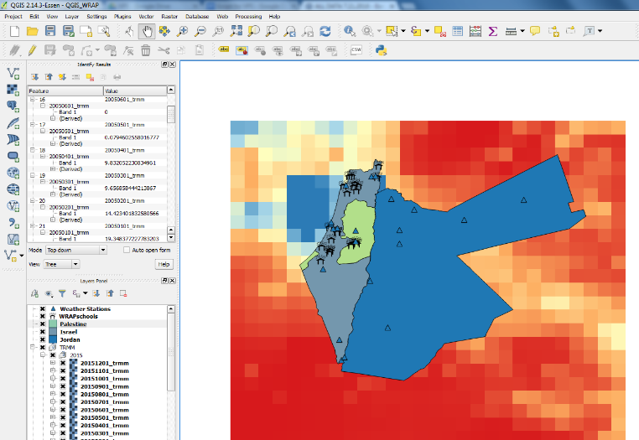
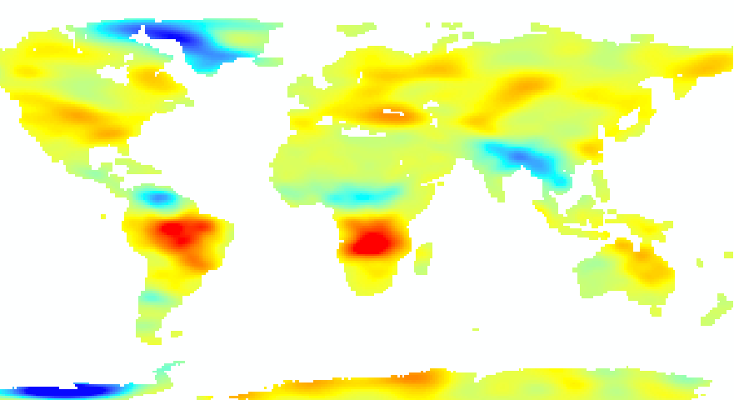
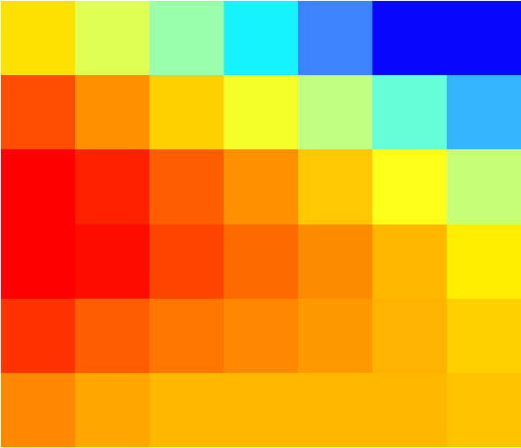
Utilizing NASA Earth Observations to Create a Precipitation Climatology of Jordan, Israel, and the West Bank to Identify Optimal Rainwater Harvesting Locations for Underserved Schools
Abstract
Earth Observations
Water resources are declining in the Middle East as a result of the combination of diminished supply from overexploitation and drought, increased demand due to growing populations, and inadequate infrastructure. Water shortages have led to sanitation issues in schools and, in severe cases, even school closures. Rainwater harvesting is an eco-friendly, low-tech and cost-effective method of collecting and storing water for local use. The Water Resources Action Project, Inc. (WRAP) provides rain barrels and cisterns to underserved schools in the region to increase their water resources for sanitation purposes. This study used data from Tropical Rainfall Measuring Mission (TRMM), Global Precipitation Measurement (GPM), and other NASA Earth observations to quantify and visualize precipitation to identify locations most suitable for rainwater harvesting. Results indicate that precipitation is greatest in the north, nearest the Mediterranean Sea, and along the Jordan Rift Valley. The team created a climatology which characterizes the precipitation regime of the region, as well as an interactive interface to help WRAP determine which schools would benefit most from their assistance. The interface will be shared with the schools to which WRAP provides rainwater harvesting systems as an educational tool that can be used to improve students’ understanding of the region’s precipitation and climate as well as Geographic Information Systems and other monitoring and analysis technologies.
Global Precipitation Measurement (GPM)
Tropical Rainfall Measuring Mission (TRMM)
Terra MODIS
Gravity Recovery and Climate Experiment (GRACE)
Shuttle Radar Topography Mission (SRTM)
Objectives
Results
Identify and analyze patterns of rainfall in Israel, Jordan, and the West Bank.
Develop an interactive interface to enhance WRAP’s decision-making process and educational resources.
WRAP can use PrIME to visualize the climatology and to determine which schools would benefit most from their assistance. They can also share the interfaces with their partner schools for use as educational tools.
Study Area
Countries
Jordan, Israel, and the West Bank together comprise 115,767 km² of arid land in the Middle East.
Palestine
Jordan
Israel
Study Period: 2005 – 2016
Middle East Water Resources
Methodology
PrIME interface created in Google Earth Engine API
Data
Processing
Results
Stations with high amounts of precipitation had an average correlation of 0.73 to the TRMM and GPM data, and an average standard error of 4.84.
Precipitation and DEM rasters
Clipped rasters to study area extent
Validation and creation of PrIME, the Precipitation Interface for the Middle East.
Stations with low amounts of precipitation had an average correlation of 0.30 to the TRMM and GPM data, and an average standard error of 3.80.
Team Members
Conclusions
The PrIME Google Earth Engine interface, because of its ease-of-use and free access, will support decision-making regarding rainwater harvesting within the region and allows the user to import new data for continuous monitoring of climatological trends in the region.
Due to time constraints, the PrIME QGIS option has limited functionality.
Hannah Rosenblum
Project Lead
Vishal Arya
Raghda El-Behaedi
Project Partner
Water Resources Action Project, Inc. (WRAP)
Acknowledgements
The Middle East Water Resources team would like to thank Brendan McGinnis of WRAP and Dr. Kenton Ross, Kathleen Moore, Emily Gotschalk, Tyler Rhodes, Jordan Vaa, and Mike Bender, of NASA DEVELOP, whose time and support made this project possible.
Any opinions, findings, and conclusions or recommendations expressed in this material are those of the author(s) and do not necessarily reflect the views of the National Aeronautics and Space Administration. This material is based upon work supported by NASA through contract NNL11AA00B and cooperative agreement NNX14AB60A.
Michael Sclater
Labreshia Mims
Bradford Schroeder
NASA Langley Research Center – Summer 2016

