Slide 1
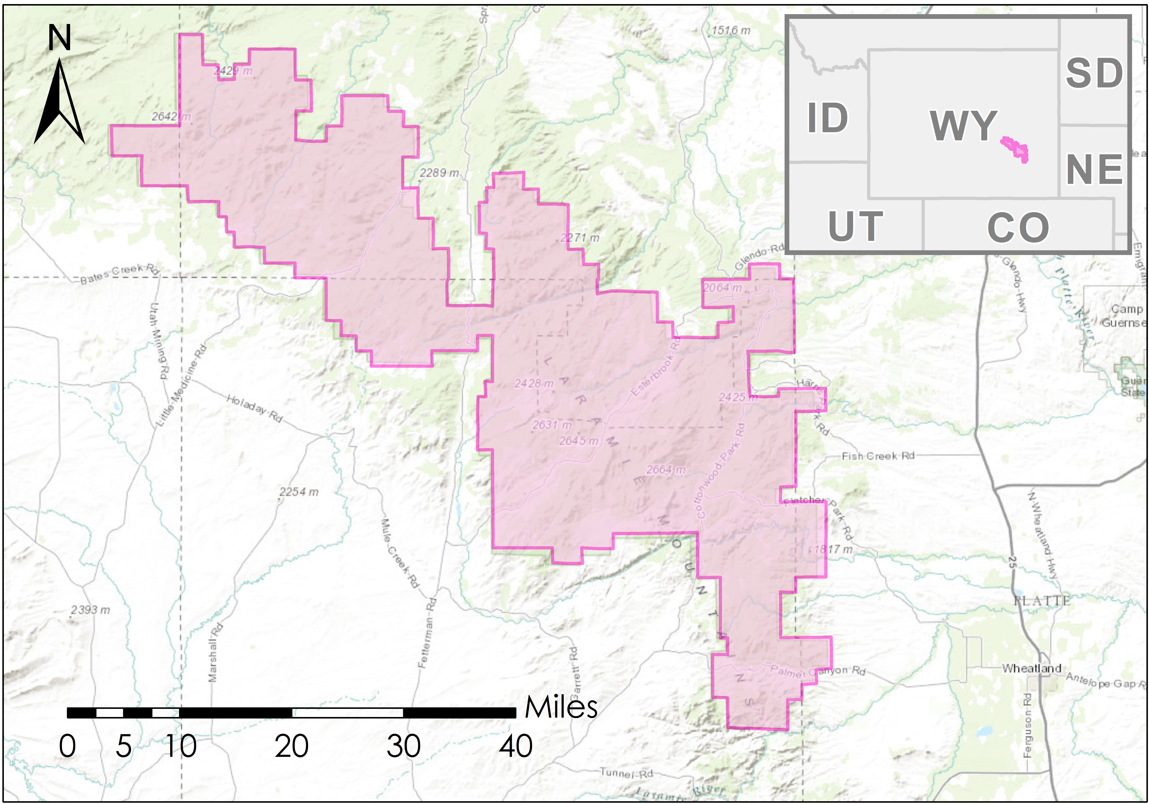

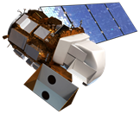
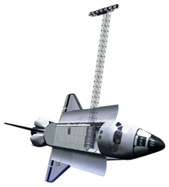
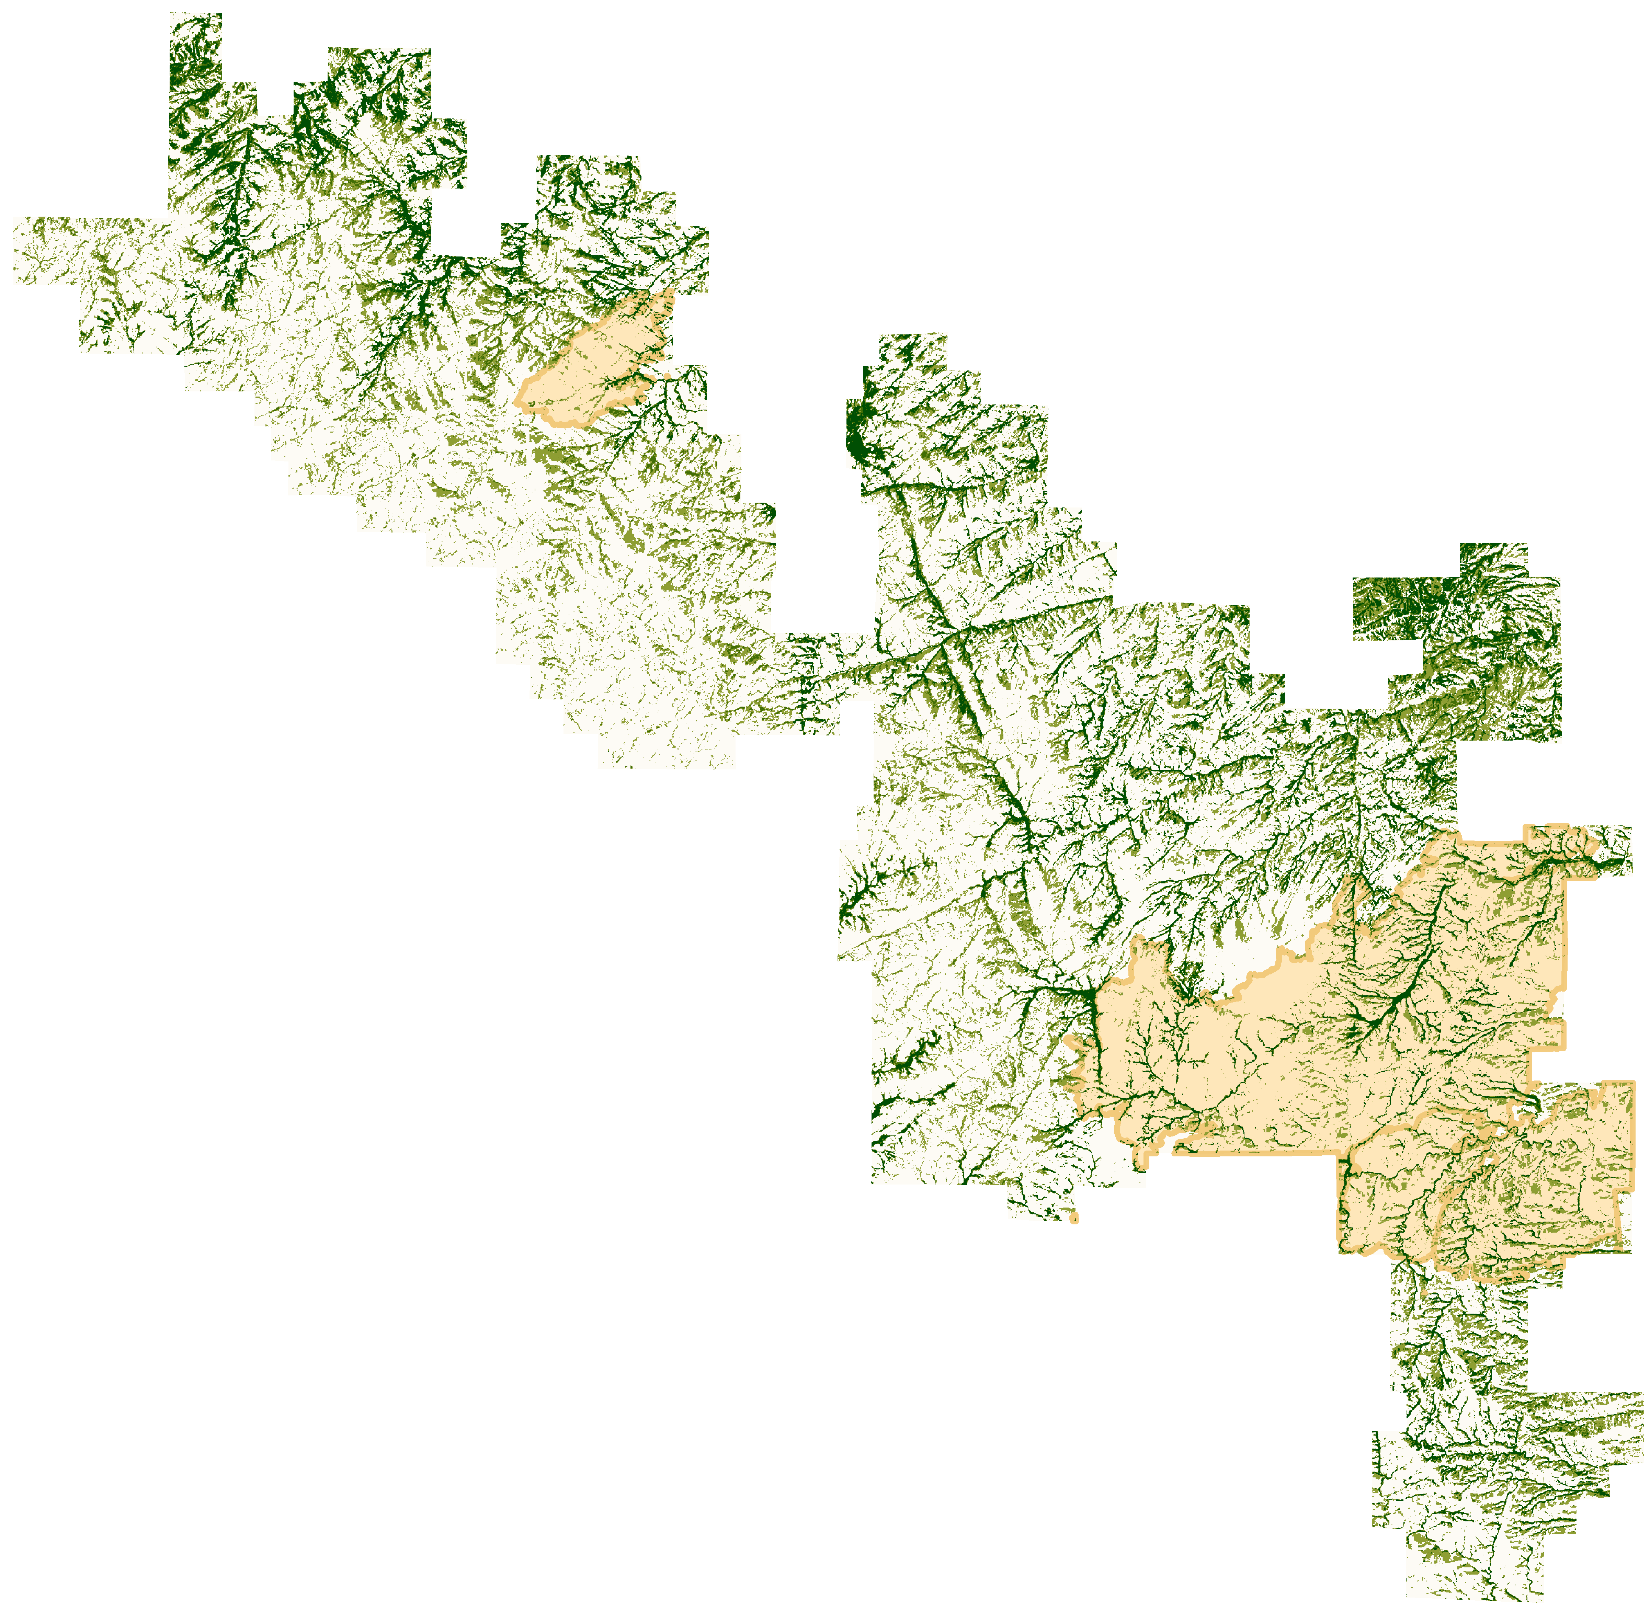
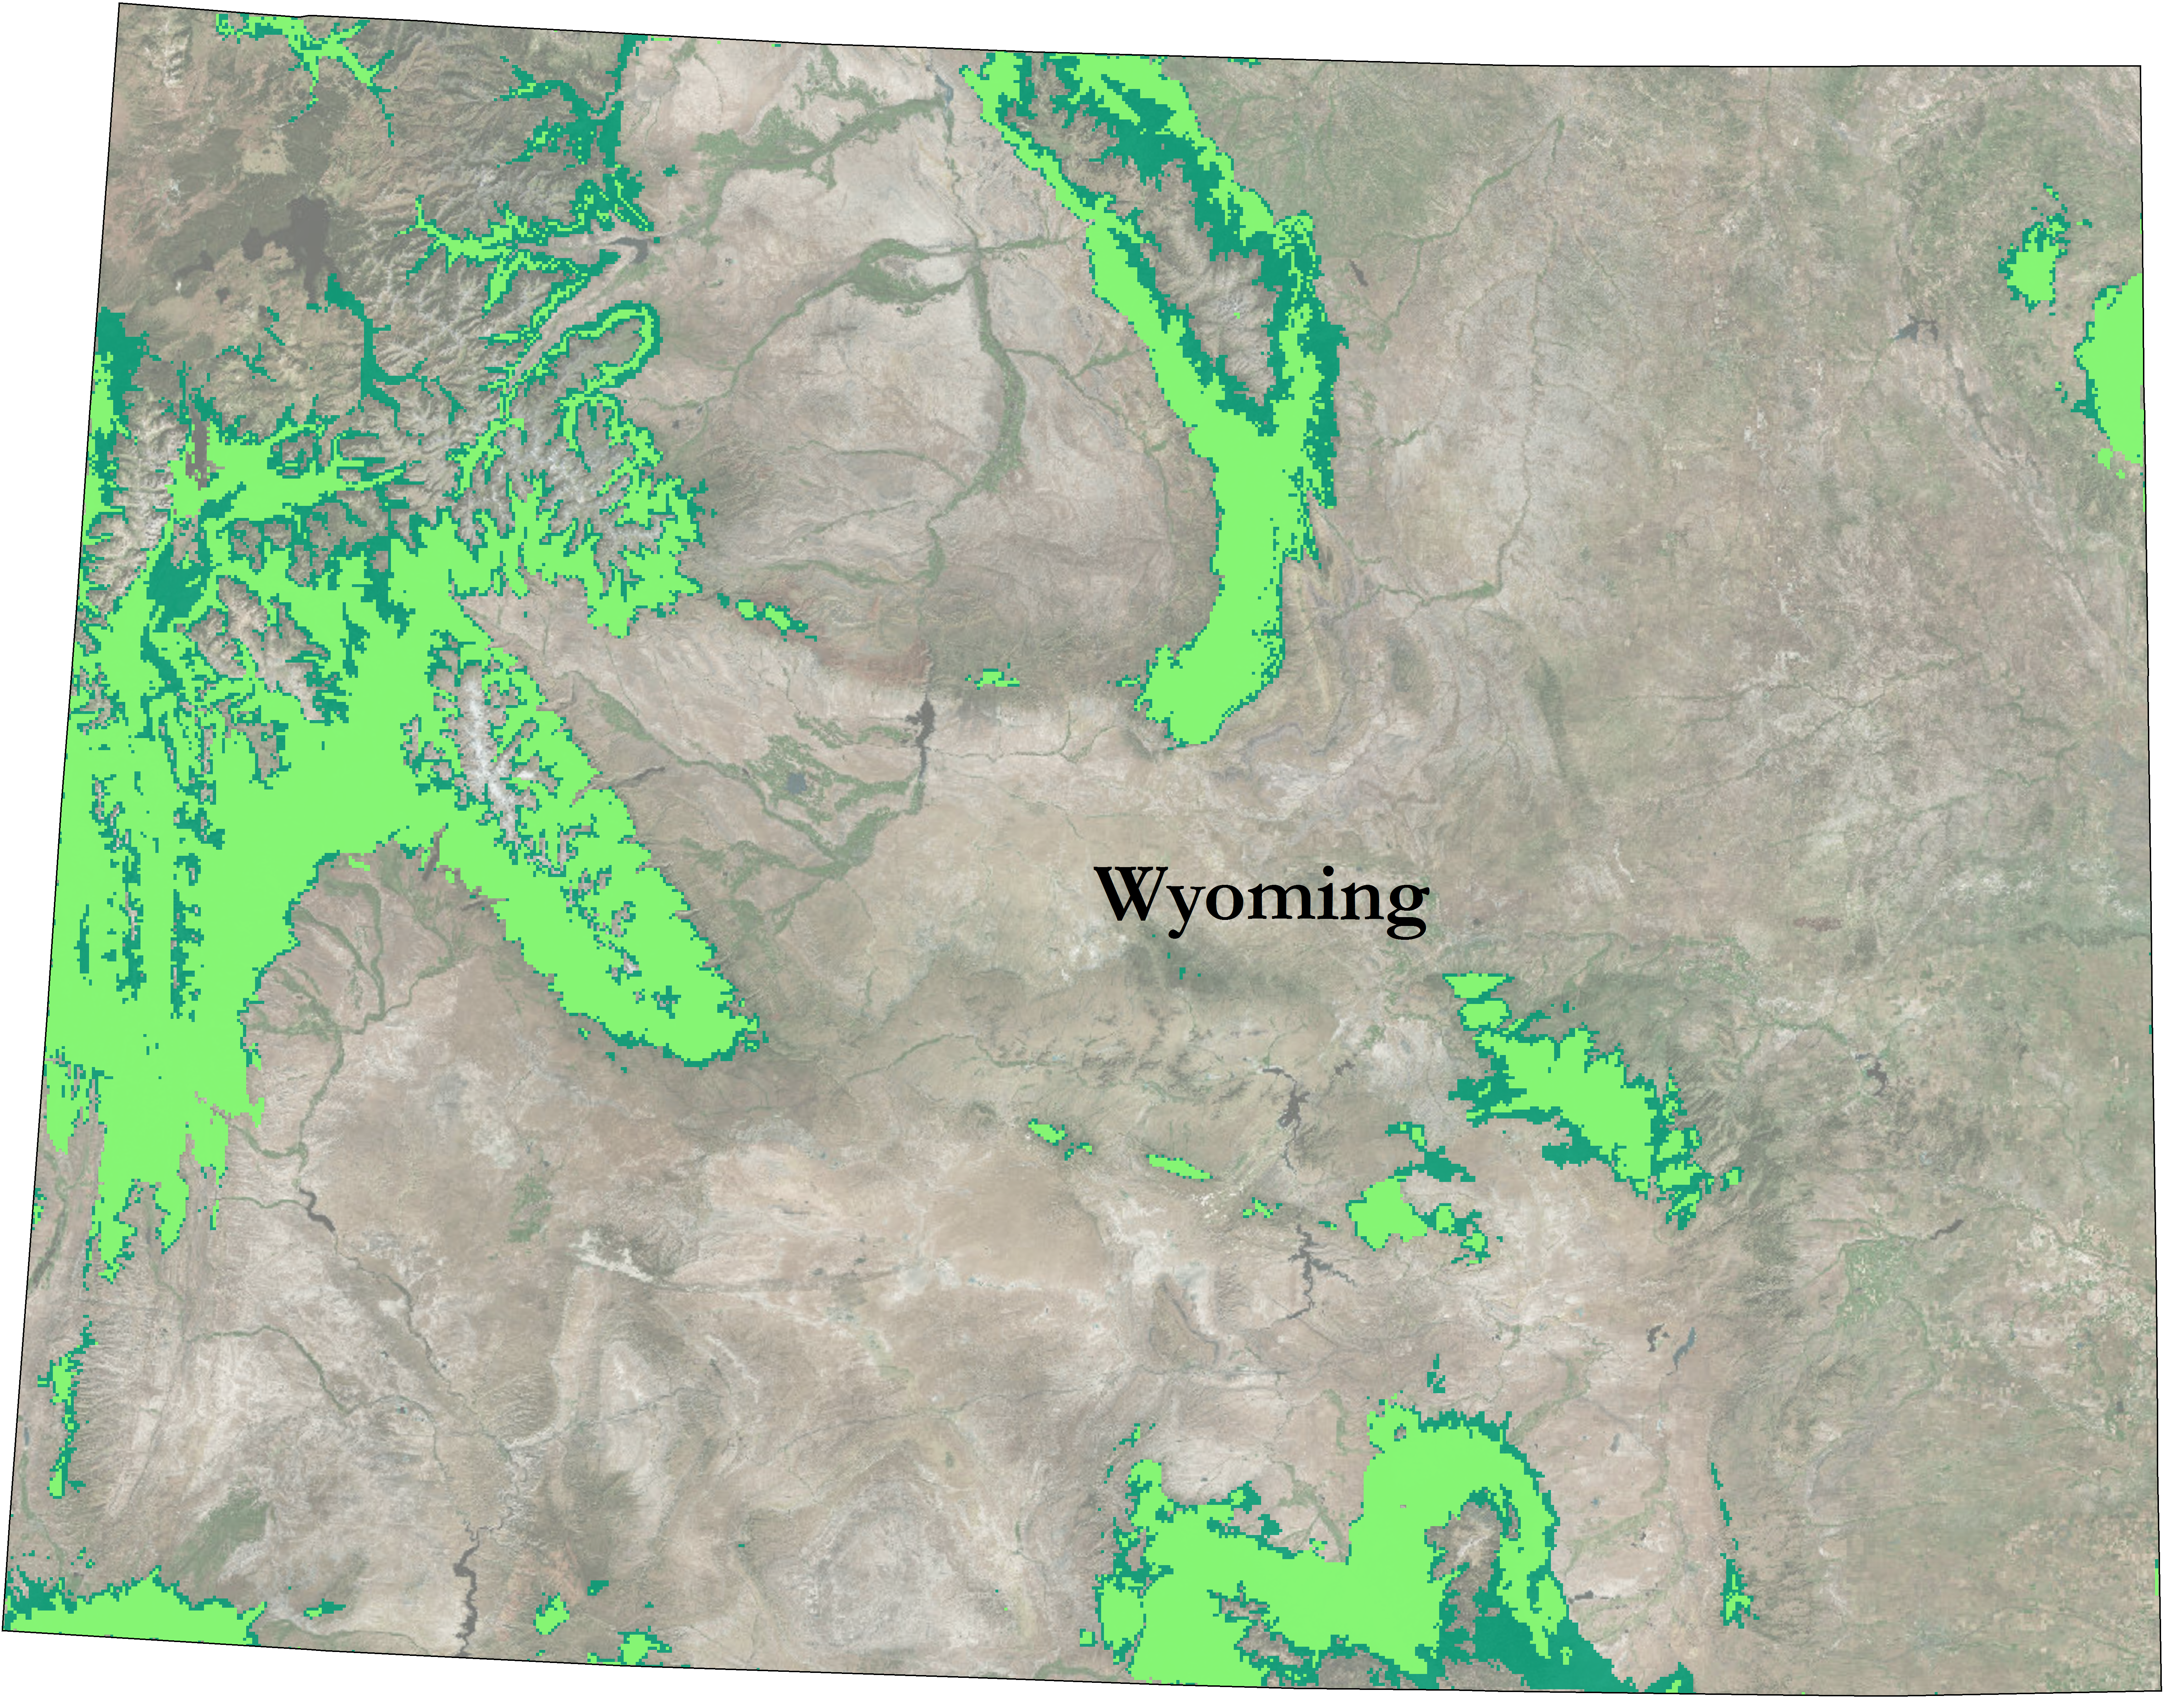

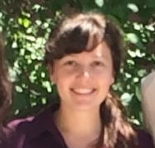
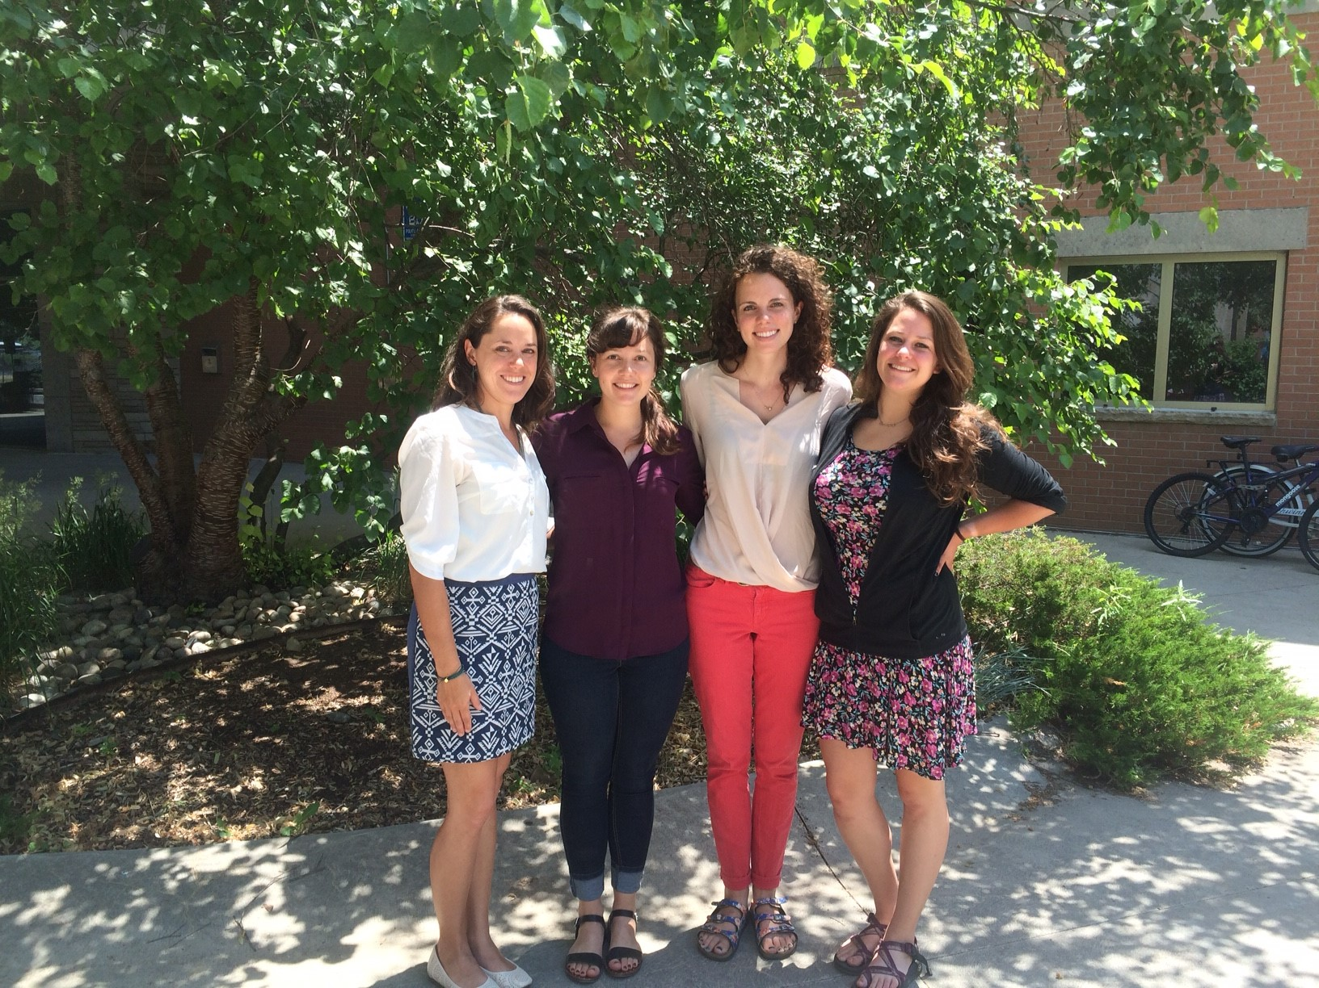
Modeling Aspen Distribution Utilizing NASA Earth Observations to Identify Critical Habitat for Mule Deer and Elk in the Laramie Range, Wyoming
Abstract
In the Laramie Mountain Range in southeastern Wyoming, quaking aspen (Populus tremuloides) stands are a source of high biomass productivity and support a diverse community of vertebrate species. Mule deer (Odocoileus hemionus) and elk (Cervus canadensis) are dependent on mature aspen communities for forage and fawning habitat, but aspen distribution data is limited and incomplete, making it difficult for wildlife managers to locate and evaluate existing critical habitat. This project utilized Landsat 8 OLI & TIRS data, SRTM V2, and aspen survey data to fit species distribution models to create a 30m resolution aspen canopy cover map for the Laramie mountain range. The resulting aspen cover data were then combined with fire history data produced in term I to disseminate the relationship between fire and aspen regeneration in the Laramie range. Additionally, topographic and climate data were utilized to model a bioclimatic niche for existing aspen, and to predict future suitable aspen habitat. Our partners at WGFD will utilize the data, results, and map products produced to estimate the carrying capacity for mule deer and elk in the region, plan effective population management strategies, and to support future aspen regeneration and management efforts.
Objectives
Assist in planning habitat improvement efforts for mule deer and elk.
Investigate the relationship between fire and aspen regeneration.
Build a distribution model to map aspen canopy cover.
Predict future habitat suitable for aspen.
Study Area
Earth Observations
Methodology
Landsat 8 Operational Land Imager & Thermal Infrared Sensor (OLI & TIRS)
Data Acquisition
Data Processing
Modeling
Results
Shuttle Radar Topography Mission V2
NASA Earth Observations
Field Sampling
Climate Data
Vegetation and Topographic Indices Derivation
SAHM
Random Forest
MaxEnt
Aspen Cover Map
Bioclimatic Habitat Map
Laramie Mountains study area
Figure 1: Map delineating our study area, the Laramie Mountain Range, within the southeast of Medicine Bow National Forest, Wyoming.
Results
Laramie Mountains Ecological Forecasting II
Presence of suitable aspen habitat
Current climate conditions
20­­­50 climate conditions
Probability of aspen cover
0 – 0.25
0.25 – 0.50
0.50 – 0.75
0.75 – 1.0
Fire occurrence in 2012
Figure 3. Probability of presence of suitable aspen bioclimatic habitat derived from a MaxEnt model under current climate conditions, and thirty-four years in the future under the same climate trajectory across the state of Wyoming.
Figure 2: Probability of significant aspen cover derived from Random Forest model implemented using Software for Assisted Habitat Modeling (SAHM). Polygons represent the extent of fires which occurred in 2012 (most recent major fire year).
Conclusions
Project Partners
Using land cover data from NASA Earth observations and field data from June of 2016, we accurately identified areas of probable significant aspen cover in the Laramie Mountain Range at a 30-meter resolution.
The results of our bioclimatic model suggest that suitable aspen habitat across Wyoming is likely to decrease by 2050 based on decreases in precipitation and increases in annual temperature ranges at a 1km² scale.
Wyoming Game and Fish Department
United States Forest Service, Laramie Ranger District
Colorado State University Natural Resource Ecology Laboratory (NREL)
Acknowledgements
We would like to thank Dr. Paul Evangelista and Dr. Amanda West, Colorado State University Natural Resource Ecology Laboratory.
We would also like to thank Ryan Amundson, Wyoming Game and Fish Department and Darron Reynolds, United States Forest Service.
Furthermore, we thank Stephanie Krail, Alexa Grafton, and Darin Schulte from the Spring 2016 Laramie Mountains Ecological Forecasting I team.
Finally, we would like to thank Brian Woodward for his continued support and mentorship throughout the Summer term.
Any opinions, findings, and conclusions or recommendations expressed in this material are those of the author(s) and do not necessarily reflect the views of the National Aeronautics and Space Administration. This material is based upon work supported by NASA through contract NNL11AA00B and cooperative agreement NNX14AB60A.
Team Members
Sarah Carroll
Project Lead
Katie Butler
Aubrey Hilte
Megan Vahsen
USGS at Colorado State University – Summer 2016
Notes:
Image Source:
Emojis: www.iemoji.com

