Slide 1
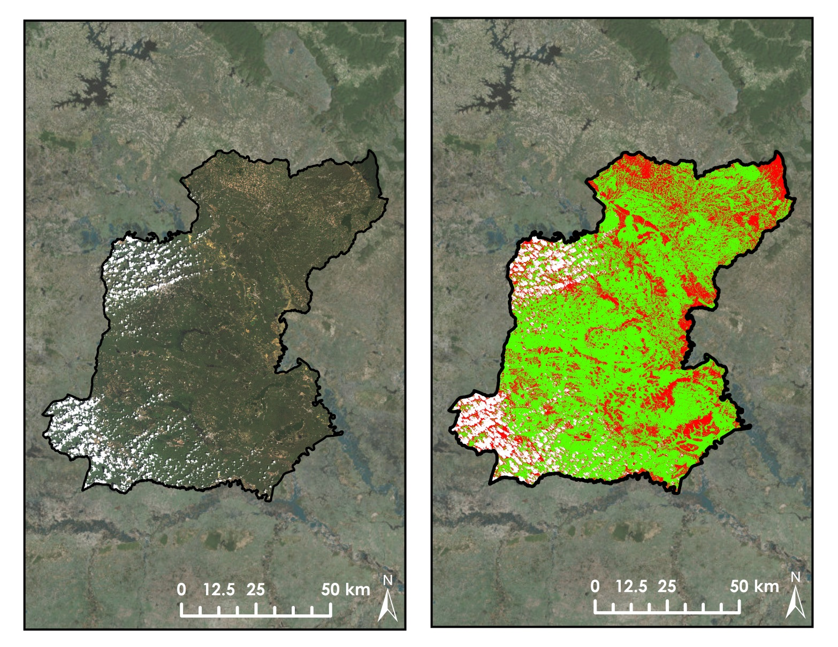
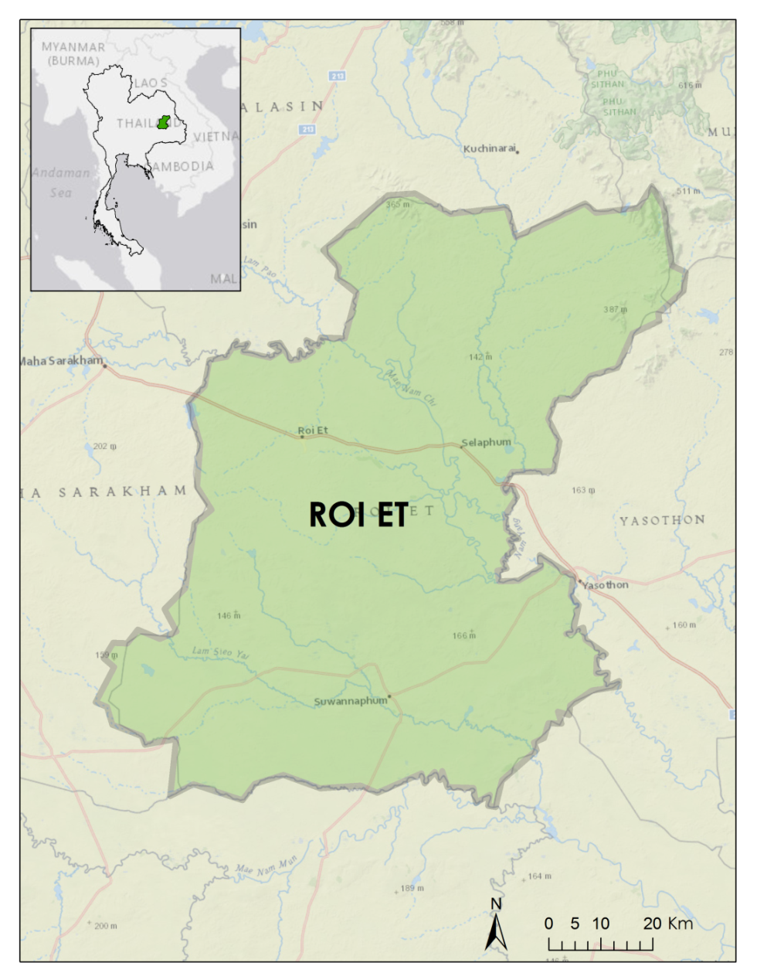



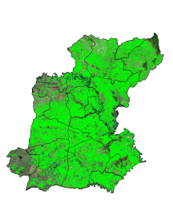
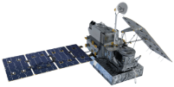
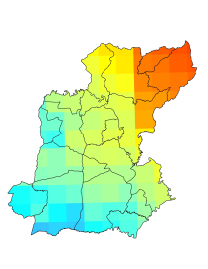
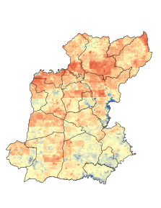
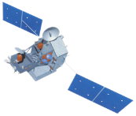
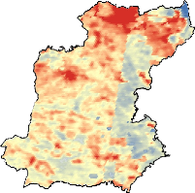
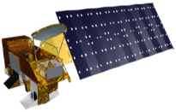
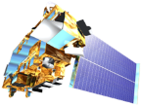
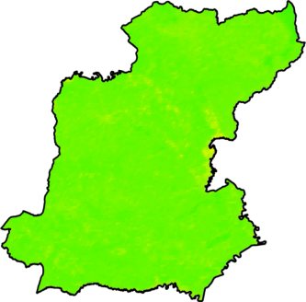
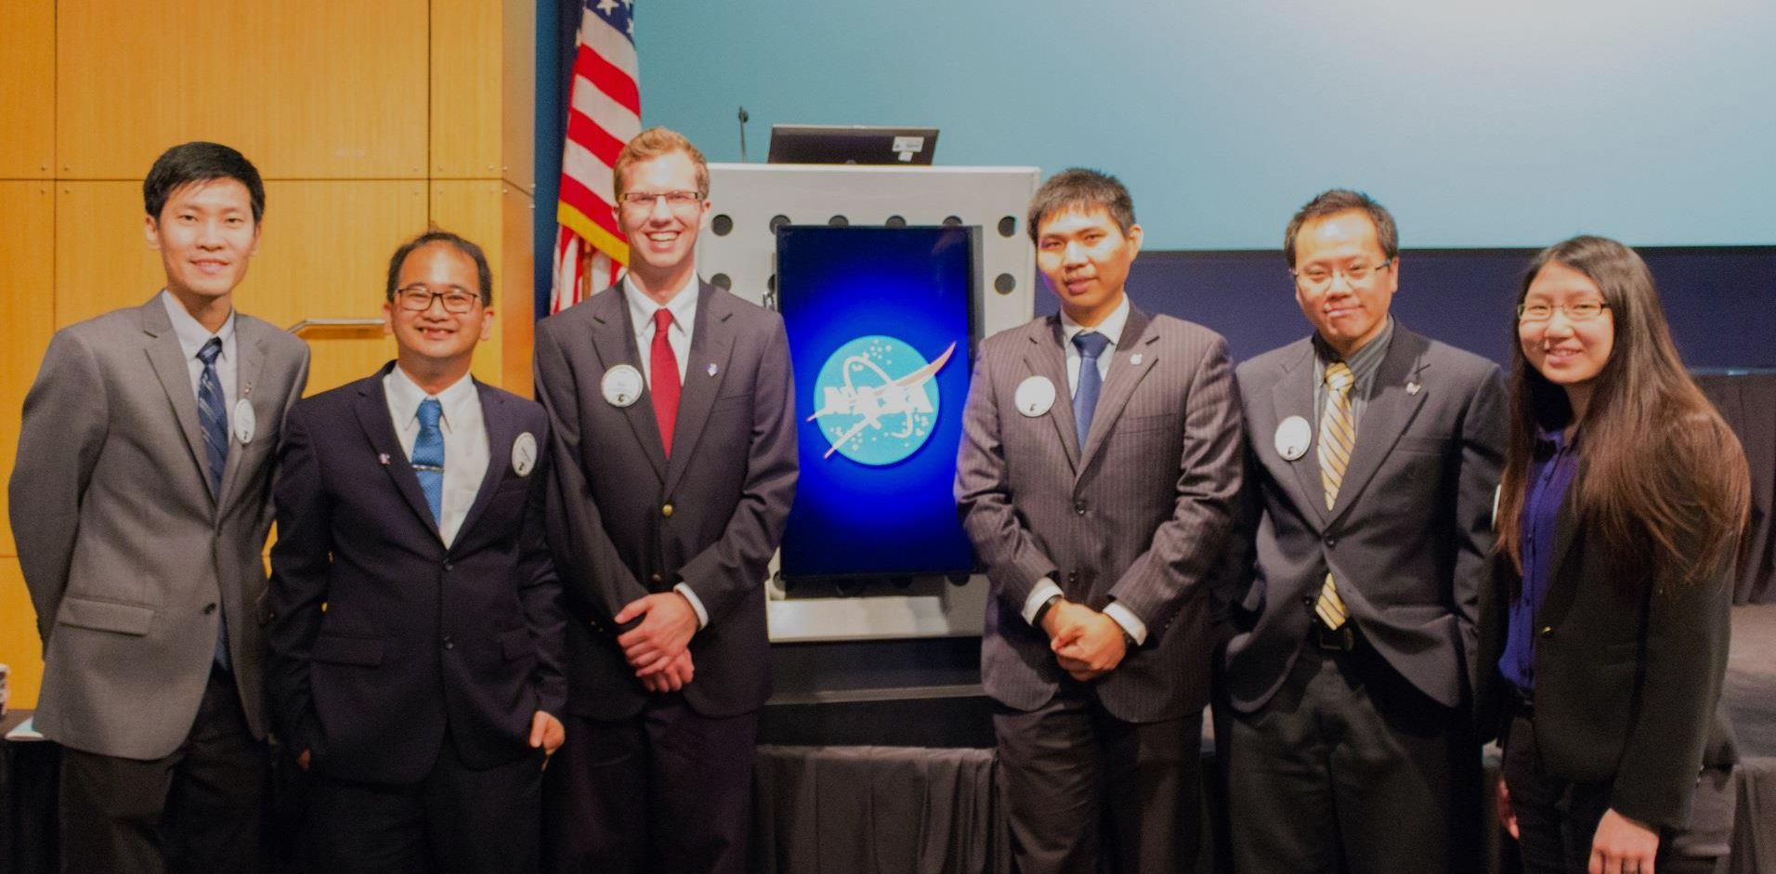

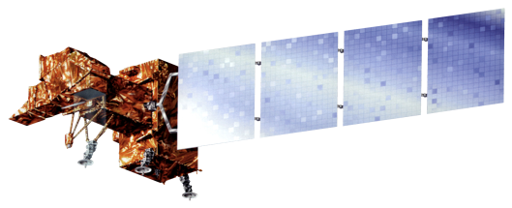

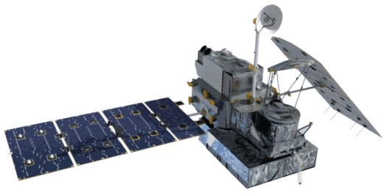
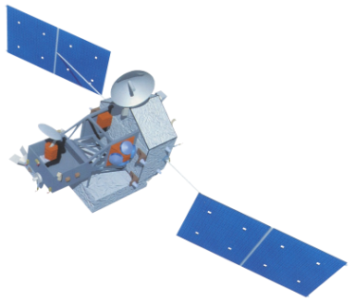


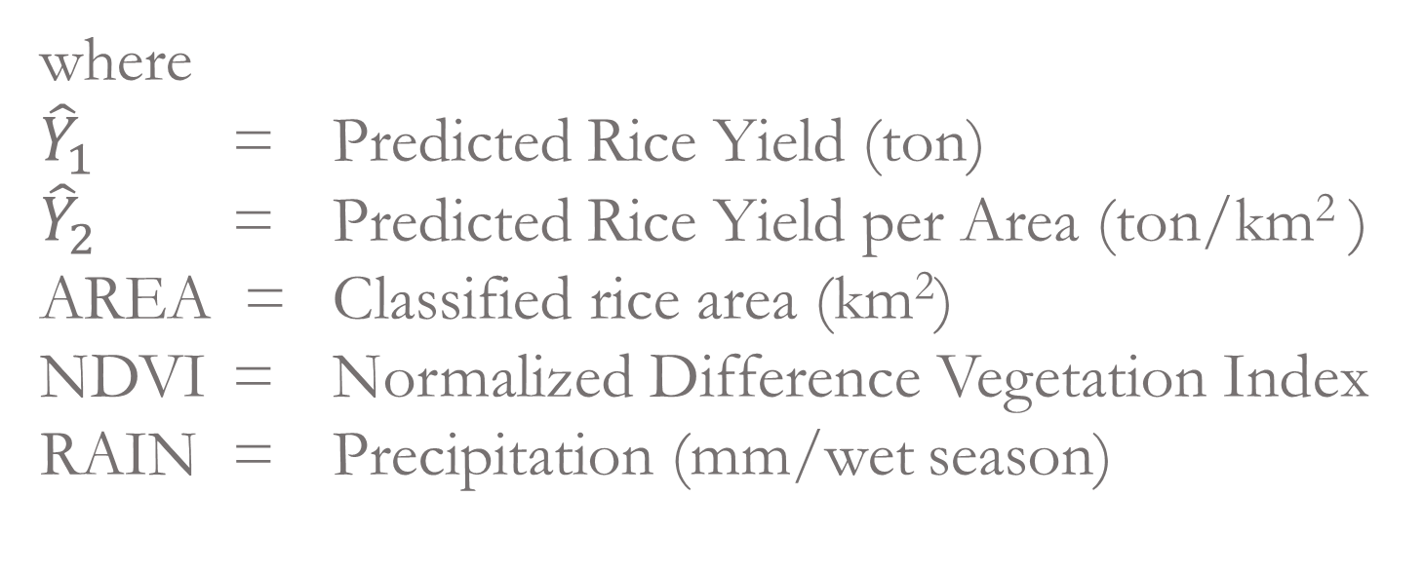
Thailand Agriculture
Monitoring food crop health and stress due to changing climate for enriched agricultural land management
Tim Klug (Project Lead), Arom Boekfah, Komsan Rattanakijsuntorn, Watanyoo Suksa-ngiam, Chayanit Choomwattana, Atipat Wattanuntachai
NASA DEVELOP National Program at Marshall Space Flight Center and Wise County Clerk of Courts Office
Abstract
Objectives
Results
Monitoring climate change is crucial for the Thailand agricultural industry. Climate change results in shifting rainfall patterns which in turn affect the management of crop production. Northeastern Thailand grows the majority of the country’s rice, but the rice yield per hectare is relatively low. One primary factor is uncertainty surrounding the ability to monitor and assess climate change. This project aims to assess changing climate patterns to improve the understanding of environmental variables, such as precipitation and temperature, to determine relationships between environmental variables and production areas of rice crop. This study used satellite imagery from Landsat 5 Thematic Mapper (TM), Landsat 7 Enhanced Thematic Mapper Plus (ETM+), and Landsat 8 Operational Land Imager (OLI) and Thermal Infrared Sensor (TIRS) and precipitation data from Tropical Rainfall Measuring Mission (TRMM) and Global Precipitation Measurement (GPM), and land surface temperature data from Moderate Resolution Imaging Spectroradiometer (MODIS). The images were analyzed by using land cover classifications, Normalized Difference Vegetation Index (NDVI), Scaled Drought Condition Index (SDCI), and precipitation data. Understanding the changing climate patterns assisted the end-users in initiating the best policies to tackle the challenges of climate change. In addition, the results of this research contributed to the scientific body of knowledge, in particular earth and agricultural sciences.
To monitor agricultural lands in Thailand under the change of environmental variables
To improve the understanding of agricultural lands under changing climate patterns
To produce models that can be used to predict rice yield from NASA Earth Observations
Landsat 8 Imagery (10/2014)
Land Cover Classification
Study Area
Paddy fields in Roi Et, a province in Northeastern Thailand.
Study period is from January 2000 to present
Pearson’s Correlation Table (N = 120)
 | Statistical Rice Yield | Yield per Area | Classified Rice Area | SDCI | NDVI | Precipitation
 | (ton) | (ton/km²) | (km²) |  |  | (mm/wet season)
Statistical Rice Yield | 1
Yield per Area | -0.0002 | 1
Classified Rice Area | 0.750*** | -0.245** | 1
SDCI | 0.095 | -0.099 | 0.252** | 1
NDVI | 0.116 | 0.304*** | -0.040 | -0.238** | 1
Precipitation | -0.114 | -0.220* | -0.013 | 0.347*** | 0.030 | 1
Two tailed significance, * p < 0.05;** p < 0.01; *** p < 0.001
Methodology
Prediction Models:
Satellites/Sensors
Intermediate Data
End Products
Analysis
$${\hat{Y}}_{1}=−116,342+187.91×AREA+213,952 ×NDVI$$
Landsat 5, 7, 8
TM, ETM+, OLI
Land Cover Classification
Time series maps
Government Rice Yield Data
${\hat{Y}}_{2}=121.05−0.07×AREA+491.03 ×NDVI−0.08×RAIN$
Monthly Precipitation (mm)
where
${\hat{Y}}_{1}$ = Predicted Rice Yield (ton)
${\hat{Y}}_{2}$ = Predicted Rice Yield per Area (ton/km² )
AREA = Classified rice area (km²)
NDVI = Normalized Difference Vegetation Index
RAIN = Precipitation (mm/wet season)
GPM
Microwave Imager
Prediction Models
Linear Regression
SDCI
Scaled Drought Condition Index
TRMM
Precipitation Radar
Land Surface Temperature
(Degrees C)
Conclusions
Prediction models of rice yield and rice yield per area were developed by using classified rice area, vegetation index (NDVI), and precipitation as predictors.
These models can be used for facilitating effective land management strategies to enhance rice production in the future.
Aqua/Terra
MODIS
NDVI
Normalized Difference Vegetation Index
Project Partners
Team Members
Earth Observations
Royal Thai Embassy
SERVIR Mekong
Acknowledgements
Landsat 5
Landsat 7
Landsat 8
We would like to thank our advisor, Dr. Jeffrey Luvall (NASA at National Space Science and Technology Center) and Dr. Robert Griffin (University of Alabama in Huntsville) for their guidance and suggestions on this project.
We also would like to thank Bunyakiat Raksaphaeng (Royal Thai Embassy), Dr. Bill Crosson and Dr. Peter Cutter (SERVIR Mekong) for their collaboration and useful information.
(Left to Right): Komsan Rattanakijsuntorn, Watanyoo Suksa-ngiam, Tim Klug, Atipat Wattanuntachai , Arom Boekfah, and Chayanit Choomwattana,
GPM
TRMM
Terra
Aqua
NASA Marshall Space Flight Center– Wise County Clerk of Courts Office

