Slide 1
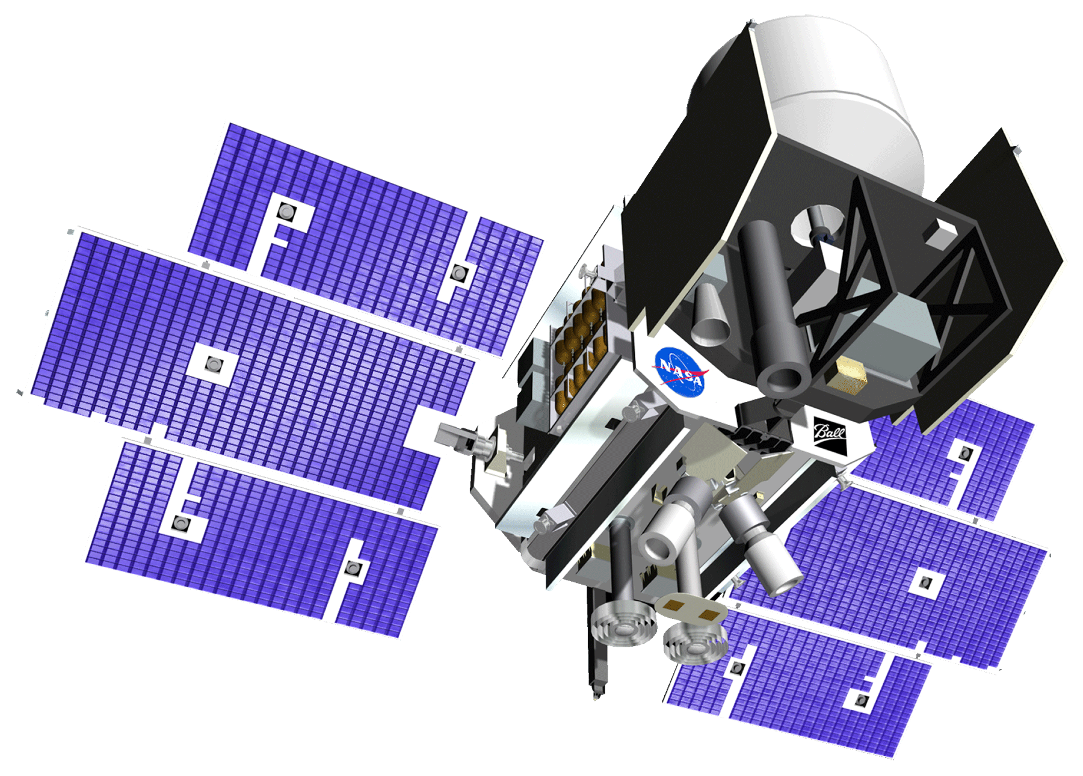
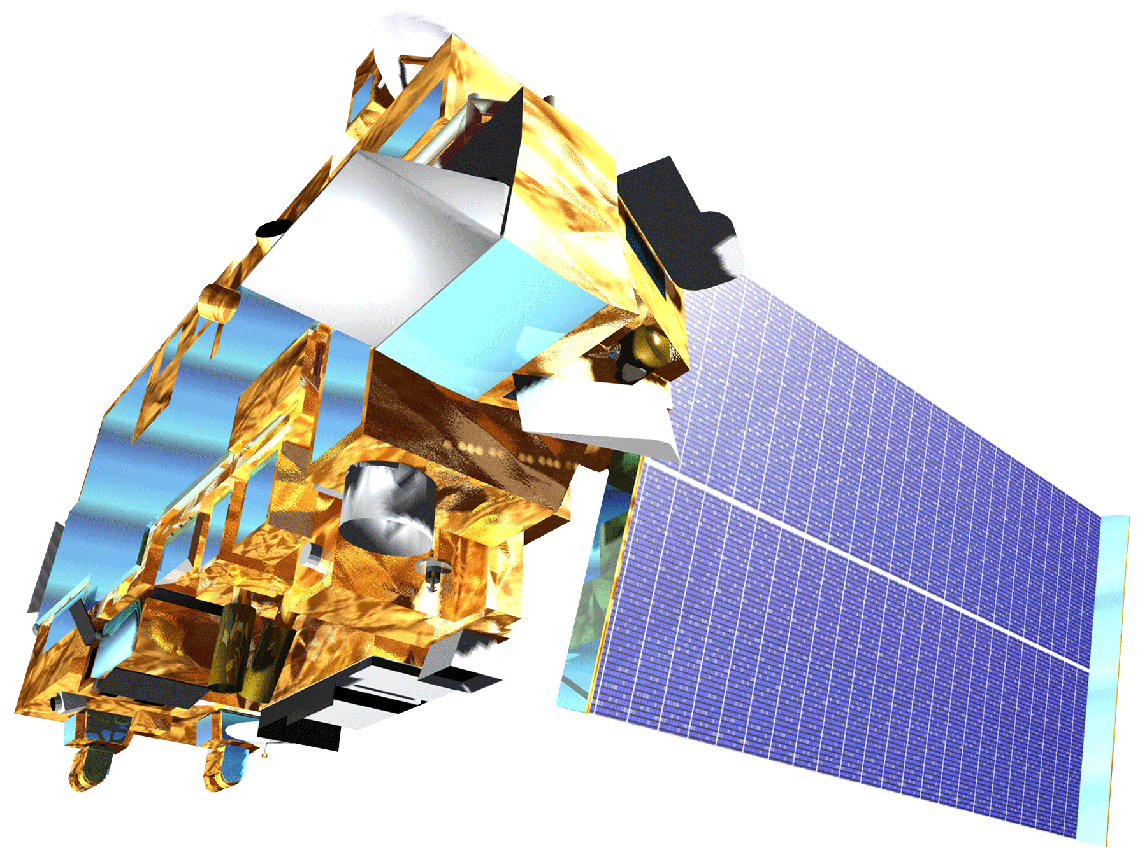
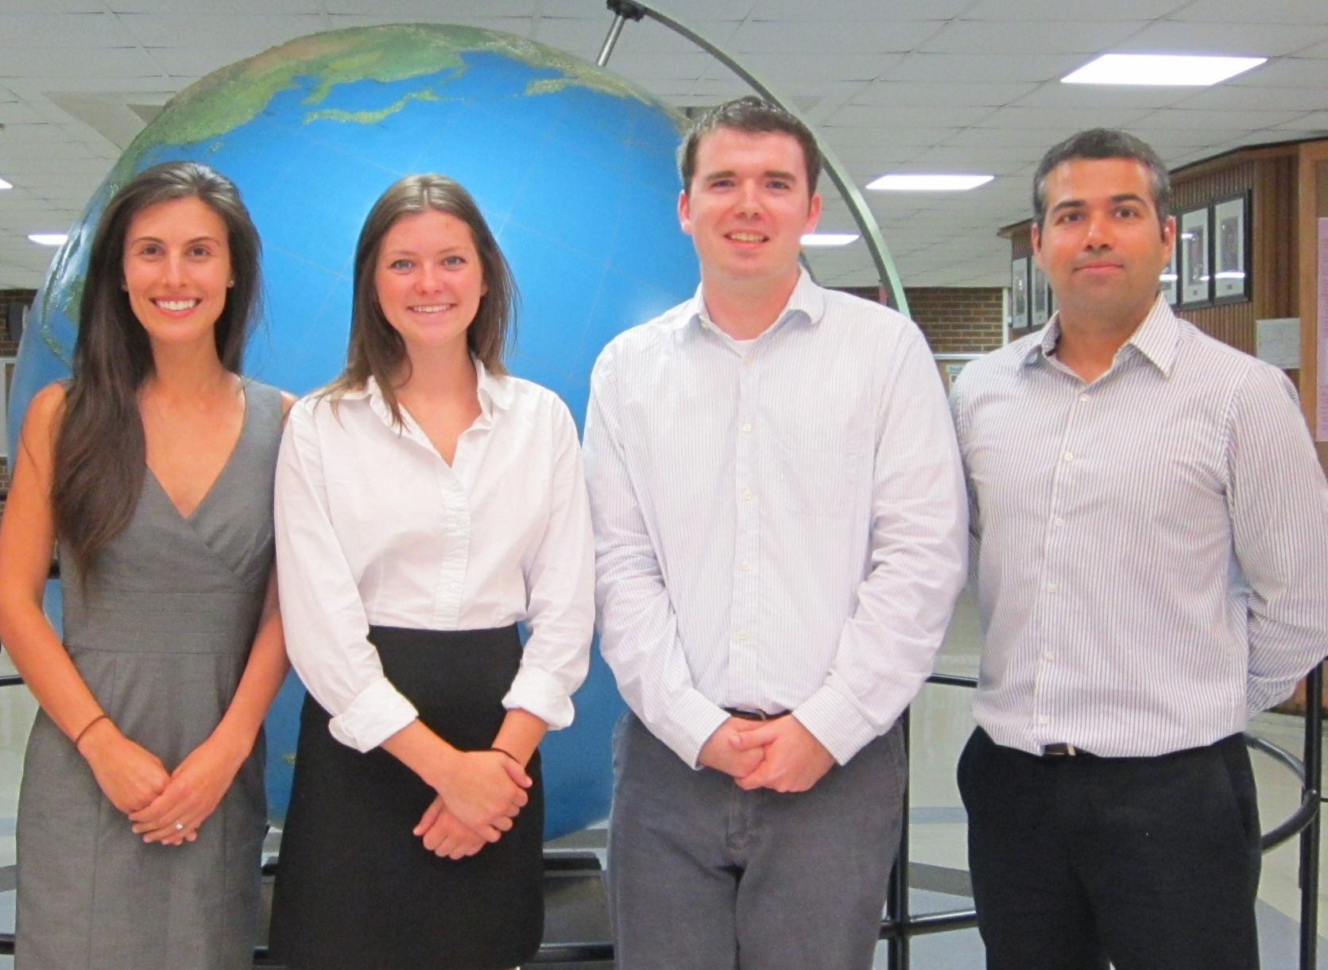
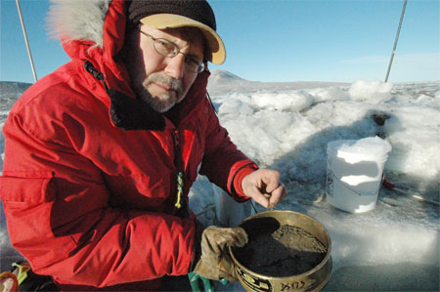
Antarctica Climate
Applying NASA Earth observations to assess the seasonal and inter-annual variability of sea ice dynamics in McMurdo Sound, Ross Sea, Antarctica
Elizabeth Benyshek (Project Lead), Christopher Cameron, Caren Remillard, Eduardo Rendon,
The University of Georgia
Abstract
Objectives
Keep this blank for now.
Body text point size should be at least 24.
Caption text point size should be at least 16.
Feel free to rename, move, and resize sections as needed.
Examine ICESat datasets from 2003 to 2008 to characterize seasonal and inter-annual variability in sea ice topography
Examine Terra datasets to characterize seasonal and inter-annual variability in sea surface temperature, ice surface temperature, and sea ice extent
Evaluate potential spatio-temporal correlations between these parameters along the coast of western McMurdo Sound, Antarctica
Methodology
Study Area
Data Acquisition
Data Processing and Analysis
End-Products
ICESat/GLAS
Cryosphere Science Research Portal
Extraction and aggregation of seasonal data
Seasonal sea ice topography maps
Terra/MODIS
National Snow and Ice Data Center and NASA’s Giovanni
Georeferencing and extraction of sea and ice surface temperature data
Seasonal temperature maps
Earth Observations
Spatio-temporal correlation visualizations
ICESat
Terra
Results
Conclusions
ICESat Seasonal Sea Ice Thickness (m) in McMurdo Sound
Use bullets.
Use complete sentences with periods.
Team Members
Project Partners
Acknowledgements
Dr. Sam Bowser (The Wadsworth Center)
Dr. Adam Milewski (University of Georgia)
Dr. Sally Walker (University of Georgia)
Linli Zhu (DEVELOP)
From left to right: Caren Remillard, Elizabeth Benyshek, Christopher Cameron, Eduardo Rendon
The Wadsworth Center
The University of Georgia
The University of Georgia

