Slide 1
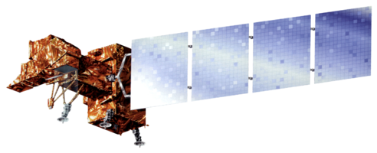
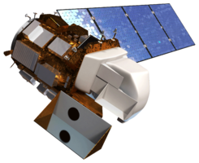
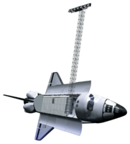
Alto Orinoco Health & Air Quality
Utilizing NASA Earth Observations to Locate Remote Yanomami Villages in the Alto Orinoco Municipality for Targeted Eradication of River Blindness Disease
Goddard Space Flight Center: Amanda Rumsey (Project Lead), Timothy Larson, Kyle Sowder
Wise County and City of Norton Clerk of Court’s Office: Rajkishan Rajappan (Project Lead), Annabel White, Zachary Tate
Marshall Space Flight Center: Sara Amirazodi
NASA DEVELOP National Program
Abstract
Objectives
Provide The Carter Center with accurate locations of targeted villages for efficient planning of missions for eradication of onchocerciasis
Develop a suitability model to assist The Carter Center in identification of Yanomami settlements
Investigate the migratory patterns of the Yanomami
Study the vegetation and soil properties of the study area
Study Area
Methodology
Locating Villages
Suitability Model
Pixel-by-Pixel Composting Technique
Data Processing All data processed with Spatial Analyst toolbox in ArcGIS.
Image coming soon
Elevation
Processing Flow
Landsat 8 Scenes
Composite Images
Cloud-free Composite Image
Slope
Input Data
Cloud Pixel Classification
Cloud Pixel Replacement
Classification and Analysis
NDVI
K-means Classified Image
Locating Yanomami Villages using Worldview-3 Imagery
dNBR
Earth Observations
Layer
Stacking
Identifying Soil Classes
Distance to Streams
Results
Landsat 7 ETM+ Landsat 8 OLI/TIRS SRTM
Village Location Shapefile
&
Population Estimate
Fuzzy Membership
Regression
Analysis
Suitability Model
Results
Conclusions
To be added
To be added
Team Members
Project Partners
Acknowledgements
To be added
The Carter Center
Dr. Jim Tucker (NASA Goddard Space Flight Center)
Kel Markert, Mentor & Science Advisor
Dr. Kenton Ross (NASA DEVELOP)
Dan Irwin (SERVIR Program Director)
Dr. John D. Bolten (NASA Goddard Space Flight Center)
Dr. Jeff Luvall (NASA at National Space Science and Technology Center)
Dr. Robert Griffin (University of Alabama in Huntsville)
Katie Melocik (NASA Goddard Space Flight Center)
Dr. Thomas Unnasch (University of South Florida)
Melanie Salyer, Mentor (Wise County)
Leigh Sinclair, Center Lead (DEVELOP Marshall)
Amberle Keith, Assistant Center Lead (DEVELOP Marshall)
Jordan Bates, Center Lead (DEVELOP Wise County)
Kiersten Newtoff, Center Lead (DEVELOP Goddard)
NASA Goddard Space Flight Center, NASA Marshall Space Flight Center, Wise County Clerk of Court’s Office

