Slide 1
Southeast US Ecological Forecasting II
Using NASA Earth Observations to Map the Spatio-Temporal Distribution of Hydrilla verticillata
Benjamin Page (Project Lead)
Brandon Hays
Pradeep Kumar Ragu Chanthar
Linli Zu

Slide 2
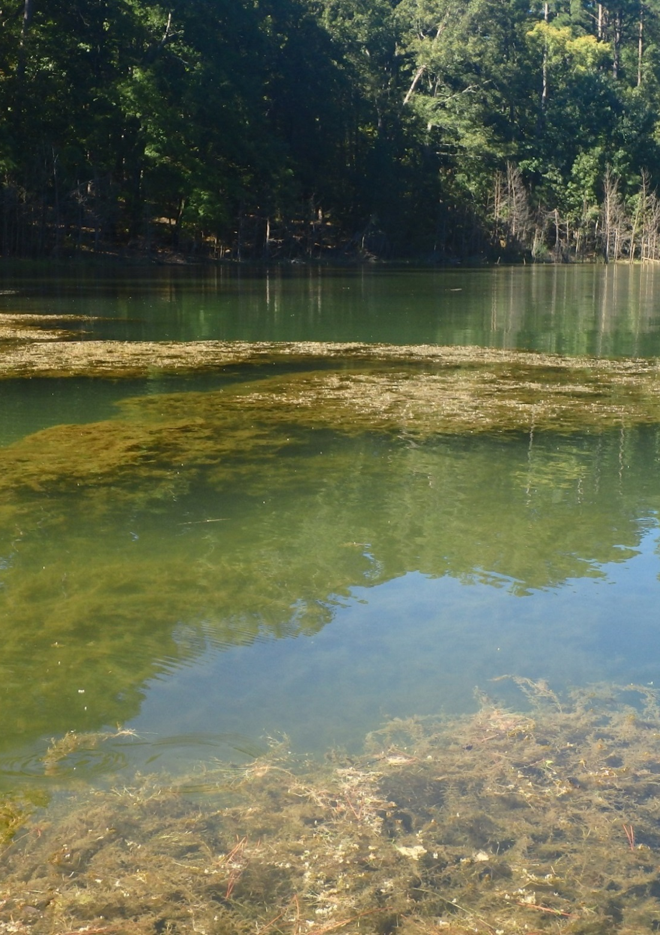
Hydrilla verticillata
Highly invasive aquatic plant
Introduced to Florida in 1950’s
Spread to 25 states across the U.S.
Costs millions of dollars in recreational and ecological damage each year
Image source: SEUS Ecological Forecasting Team II
Notes:
Hydrilla verticillata is a highly invasive aquatic plant which has spread through inland waterbodies throughout many states in the US. There are two forms of Hydrilla with differing environmental tolerances, a monoecious and a dioecious. The monoecious form is found north of North Carolina and the dioecious form is found throughout the southeast and west to Texas.
Hydrilla was originally introduced to Florida from south India; it had been ordered as an aquarium plant but was rejected upon arrival. Instead it was dumped into Tampa Bay where it started a thriving colony. This colony served as a source from which other aquarium traders attained Hydrilla and shipped it throughout the southeast.
Today Hydrilla is found in freshwater sources in 25 of the lower 48 states. It costs millions of dollars in removal efforts, decreased recreational use, and decreased fish stocks.

Slide 3
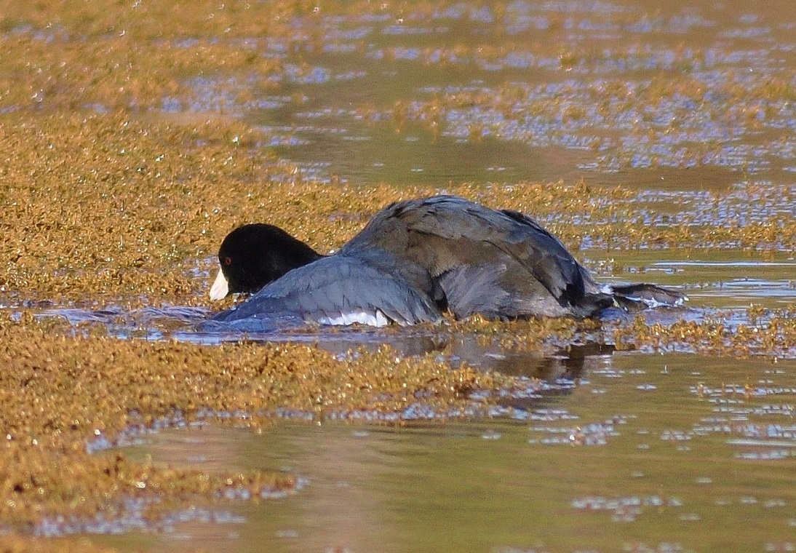
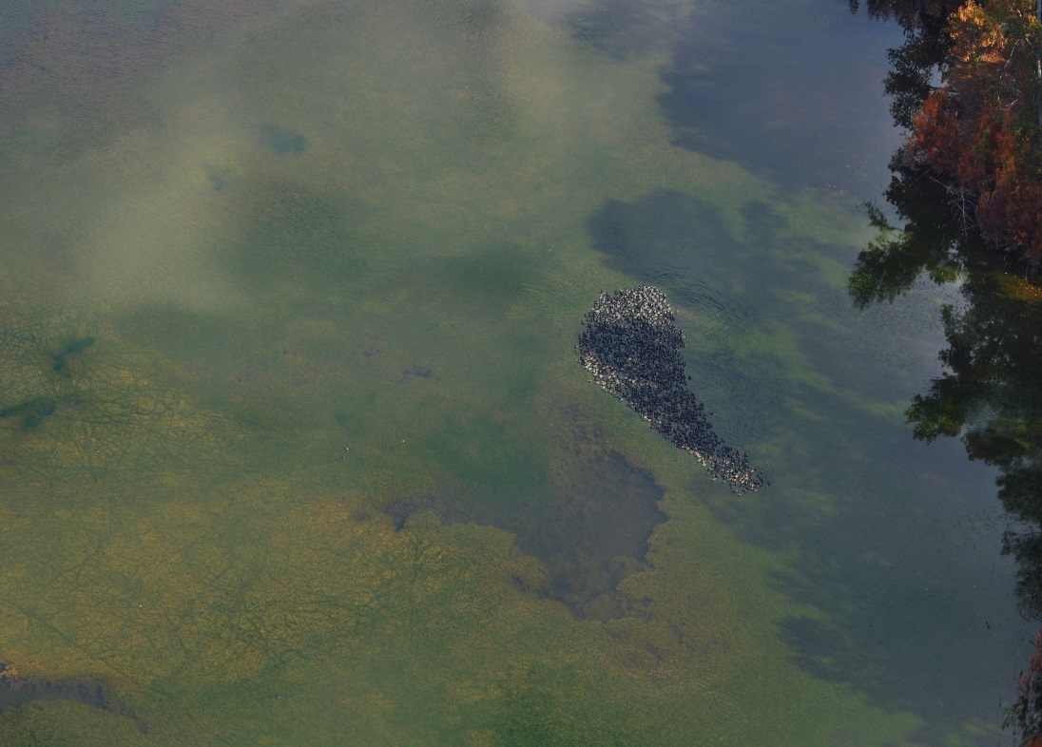
Community/End-User Concerns
Displaces native vegetation
Inhibits recreational use
Obstructs water withdrawal in reservoirs
Harbors toxic cyanobacteria (Aetokthonos hydrillicola) which endangers wildlife
Image Credit: Brigette Nelson Haram
Notes:
Hydrilla can grow from 20 feet below the surface. It quickly grows a single stem up towards the surface and then branches out prolifically to form dense mats that block sunlight from reaching anything beneath it. This has the effect of quickly shading out and killing competing native aquatic plants. The dense mats also tangle swimmers and boat motors, making effected areas unnavigable. This is particularly troublesome when it grows rampantly around boat unloading areas. The dense Hydrilla mats can also cause major problems by blocking water uptake pipes for drinking water reservoirs and clogging intake filters on hydroelectric dams. Finally, the the cyanobacteria Aetokthonos hydrillicola inhabits the leaves of Hydrilla. This cyanobacteria produces a neurotoxin which, when the Hydrilla is eaten by waterfowl such as American coots (Fulica Americana), causes Avian Vacuolar Myelinopathy and leads to the death of the unfortunate birds. These waterfowl are frequently eaten by American bald eagles (Haliaeetus leucocephalus) who contract AVM after eating the stomach contents of their effected prey.

Slide 4
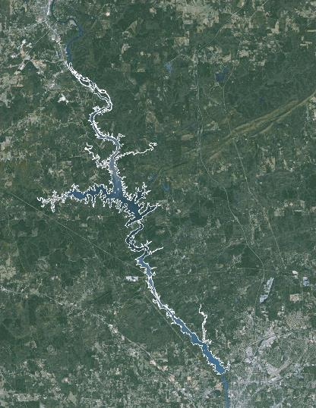
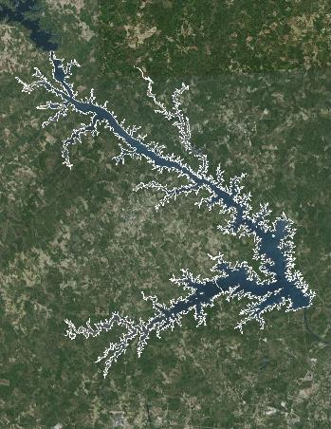
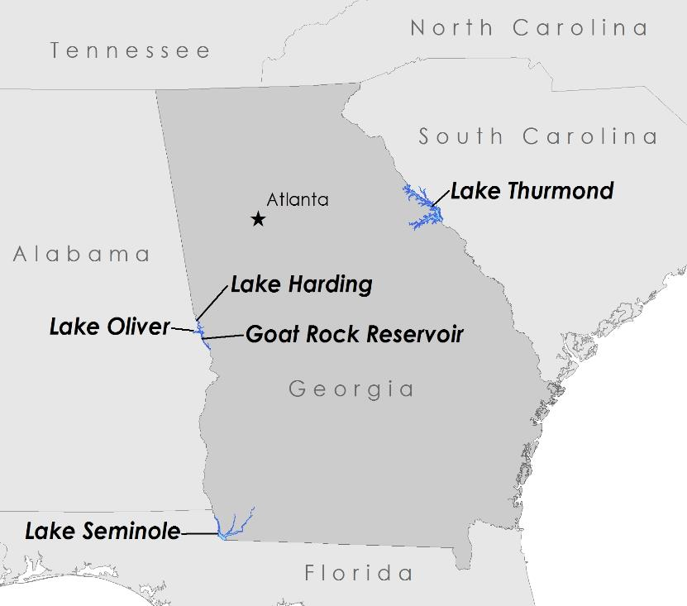
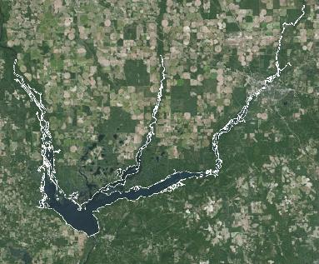
Study Areas
Lake Harding
Goat Rock
Lake Thurmond
Lake Oliver
US ACE
Georgia Power
Lake Seminole
Study Period: Oct. 2013 – Oct. 2015
Notes:
The US ACE has estimated that Hydrilla covers 7% of Lake Thurmond, which is itself 29 km2. At Lake Seminole, Hydrilla has been present almost since the impoundment of the lake more than 50 years ago. The US ACE has been attempting to exterminate it ever since with herbicides, mechanical removal, and biological controls-so far with little success.
In recent years, Georgia Power has reported the introduction in rapid spread of Hydrilla across Lakes Harding, Oliver, and Goat.
We analyzed satellite imagery from Oct. 2013 until Oct. 2015

Slide 5
Objectives
Characterize the seasonal patterns of Hydrilla distribution
Quantify total area covered by topped-out/surface floating vegetation
Synthesize these data to create a predictive model to forecast future growth of Hydrilla
Notes:
The objective of this project was to map the current distribution of Hydrilla throughout the Southeastern US and to create a forecasting model to predict future spread. In order to predict future patterns we needed to understand the past spatio-temporal patterns of Hydrilla. After mapping the seasonal changes across our study lakes we quantified the total amount of topped out topped-out/surface vegetation. Finally we integrated all of these data to create a predictive model which could be used to forecast Hydrilla growth in inland water bodies throughout the SE US.

Slide 6
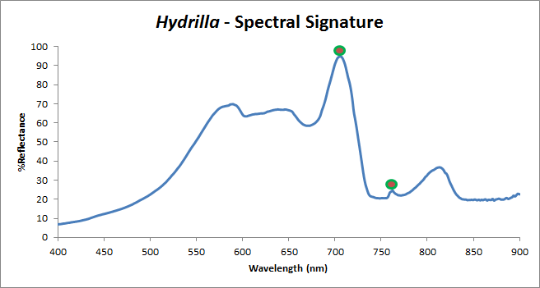

EOS Data
Landsat 8 Operational Land Imager (OLI)
9-band pushbroom multispectral sensor
Temporal resolution of 16 days
Detects light in VIS-NIR and SWIR
Species specific peaks at 710nm and 765nm can be used to identify Hydrilla
Image Credit: NASA
Notes:
We acquired Landsat 8 imagery for all dates from Oct 2013-Oct 2015 through the USGS EarthExplorer portal as level 1 TIF files. We excluded any images that had more than 10% cloud cover over our study areas.
Unfortunately Landsat 8 OLI doesn’t sense light at the wavelengths that Hydrilla reflect most strongly at. We came up with an alternative method to map Hydrilla using the existing bands.
Image url: http://www.devpedia.developexchange.com/dp/images/c/c2/03_Landsat8.png

Slide 7
Methodology
In-situ Hydrilla Depth Measurements
Maximum Likelihood Classification
Landsat 8 Data
Atmospheric Correction
VARI
Forecasting Model
NDVI Maps
Time Series
Notes:
We processed the Landsat 8 imagery with several correction algorithms. The first was a publically available program called ACOLITE; the other was a custom built model based on the work of Dash et al. 2012. After comparing the products generated by each model, we determined that our custom atmospheric correction was more accurate and provided finer resolution. From the corrected imagery we produced true color composite images which we collected into a time series. We also performed a maximum likelihood classification on the true color images for the basis of our predictive model.
We performed a Normalized Difference Vegetation Index, overlaying the results on the Landsat 8 green band to show topped out Hydrilla.
Using the field data we collected we were able to validate our other products.
Finally we compiled all of these products into one final forecasting model.

Slide 8
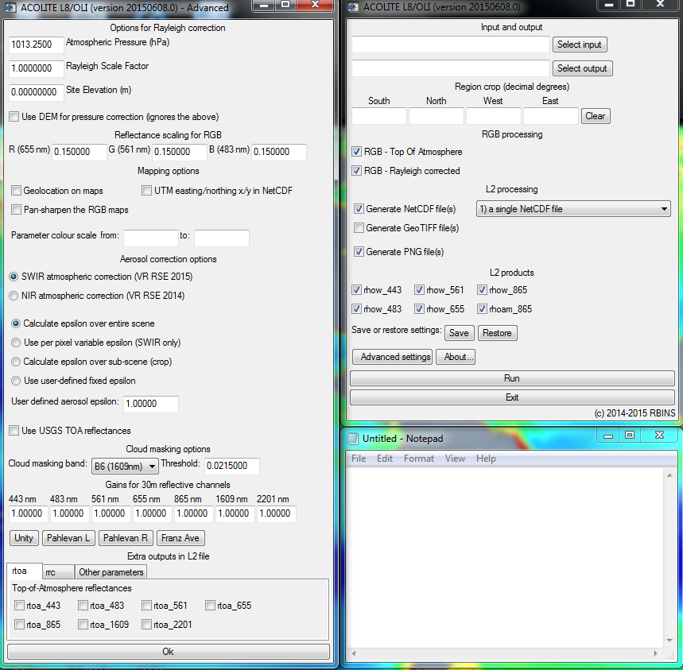
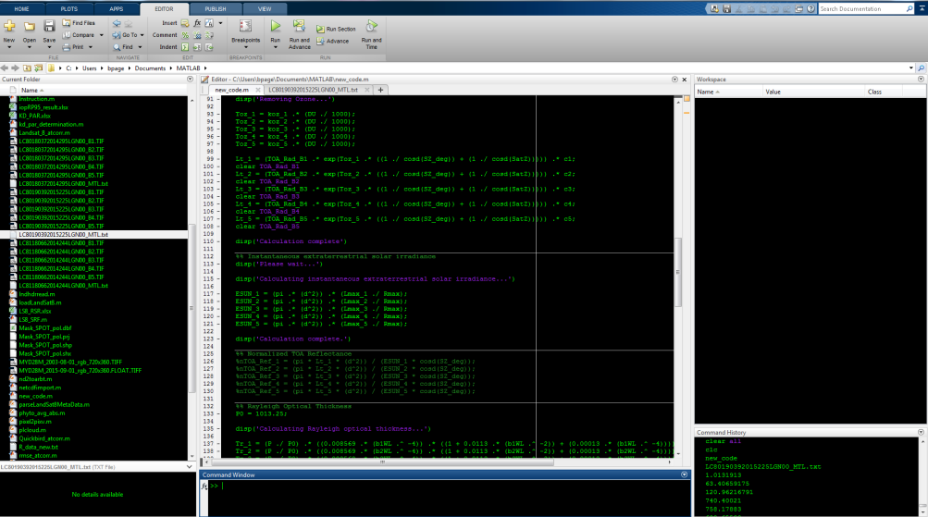
Atmospheric Correction
Several atmospheric correction procedures tested:
  ACOLITE (Ruddick, Vanhellemont, 2015)
  Vicarious Calibration (Dash/Mishra 2012) new code
Data processing and analysis done for all post-atcorr image datasets
Image Credit: SEUS Ecological Forecasting Team II
Notes:
Before any other processing could be performed, it was necessary to screen our images for the effects of atmospheric interference. To accomplish this, several atmospheric corrections were performed on the raw imagery. The publically available ACOLITE software was compared against the methods provided by Dash/Mishra et. al. 2012. ACOLITE is designed to correct for scenes of marine water leaving reflectances and takes into account factors such as extraterrestrial solar irradiance, water absorption, Rayleigh optical scattering, ozone and aerosol optical thickness (Vanhellemont & Ruddick 2014). However, ACOLITE has not been validated within highly productive, turbid waters. We corrected all imagery between August 2013 and October 2015 with each model and performed all subsequent processing techniques on both sets. The results were compared after algorithm validation to determine the most effective model.

Slide 9
VARI and VF
VARI
(RGREEN – RRED) /
(RGREEN + RRED – RBLUE)
Visible Atmospherically Resistant Index (VARI)
Vegetation indices sensitive to vegetation fraction
Can be used to quantify SAV in percentage relative to water column space
MODIS - %VF
%VF = 84.75 * VARI + 22.78
Notes:
VARI maps were created during the first term of this project in the summer of 2015. VARI has been widely used to observe submerged acquatic vegetation and is sensitive to VF. A method was created for MODIS that calculates percent vegetation fraction for wheat but is based on VARI values. One idea in this term was to apply this method to Landsat 8 OLI images, although not rigorously tested, to determine the vertical height of Hydrilla within the water column.

Slide 10
NDVI
Target topped-out/floating vegetation
Quantify total area of lake covered by floating vegetation
Trained model with local knowledge and aerial imagery to isolate Hydrilla
Can be used in time series analysis and forecasting models
NDVI
RNIR – Rred / RNIR + Rred
Notes:
We performed a normalized difference vegetation index (NDVI). This is the difference between the NIR and Red bands divided by the sum of the NIR and Red bands. The output is a number between -1 and 1, with 0.2-0.5 representing vegetation. This quantitative measure allowed us to calculate the total area over each lake covered with floating vegetation.
We applied this calculation to all of the imagery to create a time series mapping the change in the distribution of Hydrilla from 2013-2015.

Slide 11
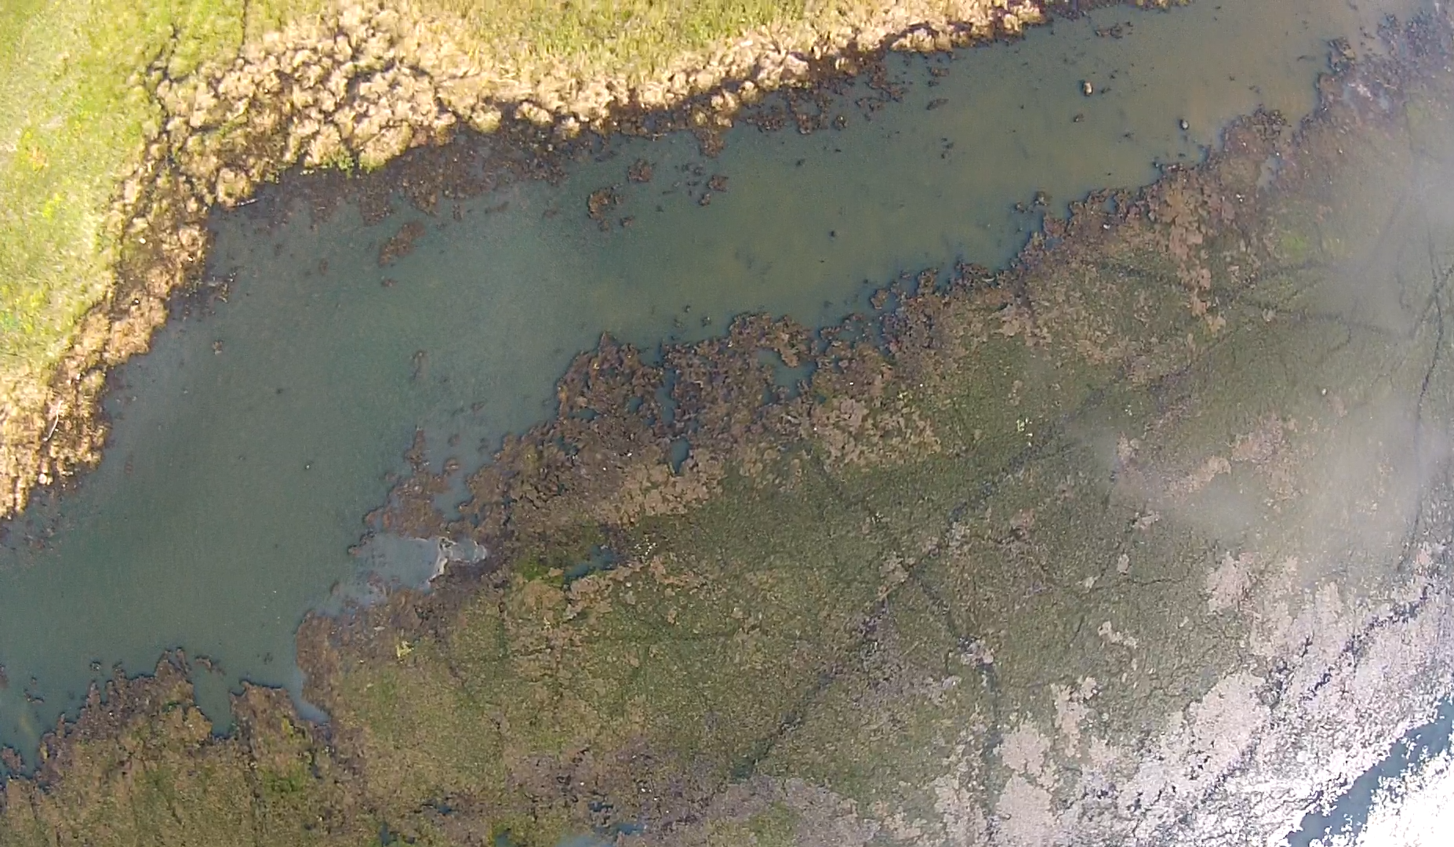
Maximum Likelihood Classification
In-situ records of Hydrilla at varying depths
Performed maximum likelihood classification
Generates vertical distribution maps of submerged Hydrilla
Image source: SEUS Ecological Forecasting Team II
Notes:
Additionally, another useful product might include performing a maximum likelihood classification on recorded in-situ Hydrilla depths measurements taken in the summer of 2015. This, in theory, will produce vertical distribution maps of Hydrilla within the water column.

Slide 12
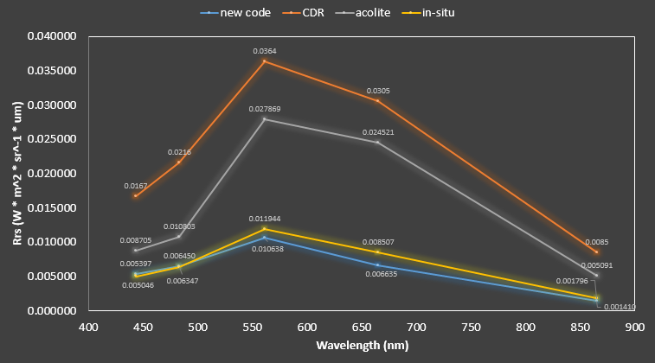
Results I – Atmospheric Correction
Vicarious calibration to compensate for the underestimated LS8 OLI reflectances due to Rayleigh scattering over turbid waters
pw Error
(W * m^2 * sr^-1 * um):
Band_1 = 0.1172
Band_2 = 0.0714
Band_3 = 0.0314
Band_4 = 0.0118
Band_5 = 0.0027
Notes:
Before any other processing could be performed, it was necessary to screen our images for the effects of atmospheric interference. To this end, we tested several atmospheric corrections and chose the method which yielded the lowest root mean square error relative to our in-situ reflectance patterns. After Rayleigh correction over turbid inland waters, negative reflectances are observed over water pixels, preventing any further analysis. This is mainly due to the underestimation of OLI TOA relfectances from Rayleigh scattering. To correct these negative values and obtain the true water leaving remote sensing reflectances of turbid waters, a vicarious calibration was performed by multiplying the RMSE values between in-situ and OLI remote sensing reflectances back to the original measured TOA reflectances for each band. Because the calibrated spectral profile usually falls under the in-situ profile, no further correction is needed, including aerosol, mai, and sun glint.

Slide 13
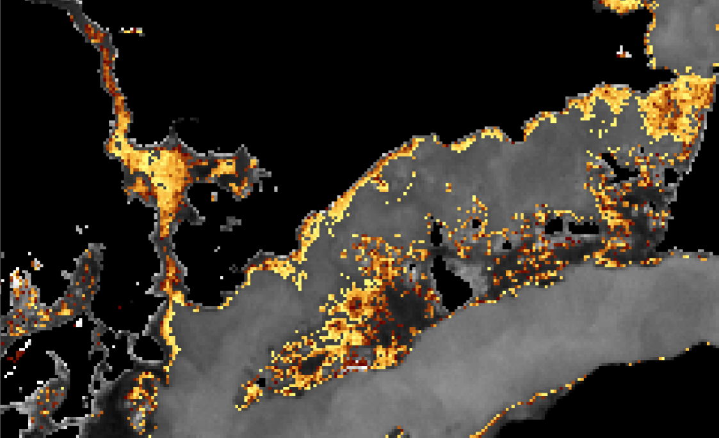
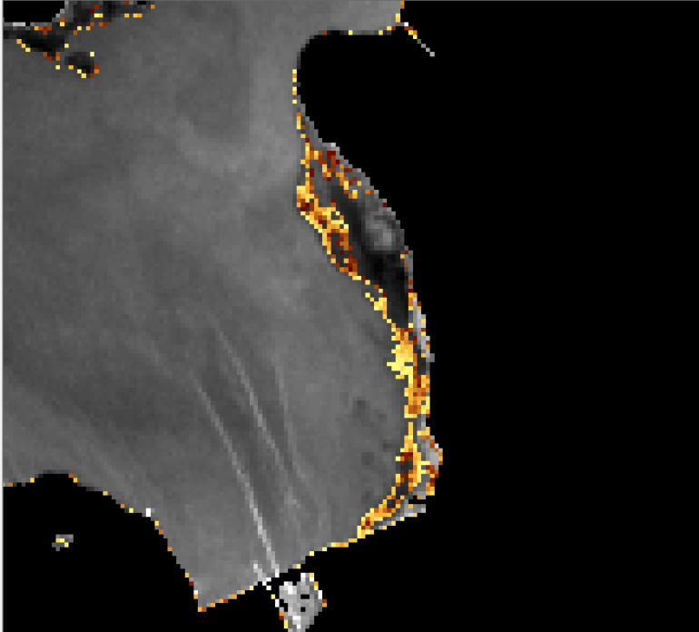
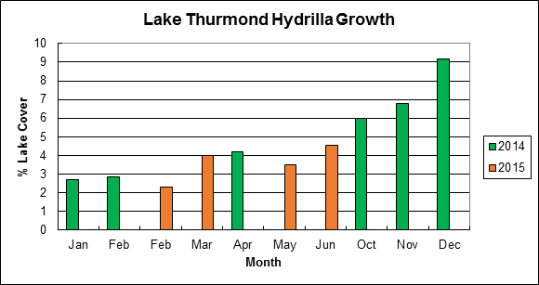
Results II - NDVI
0.2
NDVI
0.5
Highest amount of floating vegetation occurs in December
Rapidly declines by Jan. due to senescence, feeding by migratory fowl, and sinking
Topped-out Hydrilla
0.5
Topped-out Hydrilla
NDVI
0.2
Notes:
NDVI maps provide images where healthy vegetation appears red and is mainly used for forest health and land change. NDVI values range from -1 to +1 and each pixel will hold one of these values, falling in a classification determined by the calculation. Dense vegetation will fall in the range from 0.3 to 0.8, whereas non-vegetation is usually represented as negative values. Therefore, a threshold was set from 0.2 to 0.5 to capture any vegetation that may be floating on the water surface. Each NDVI positive pixel that falls within this range is then multiplied by Landsat 8’s 30x30m resolution scale (900) and then divided by the total area pixel count of the study lake, providing a total floating vegetation coverage in percent of any lake for any time.

Slide 14
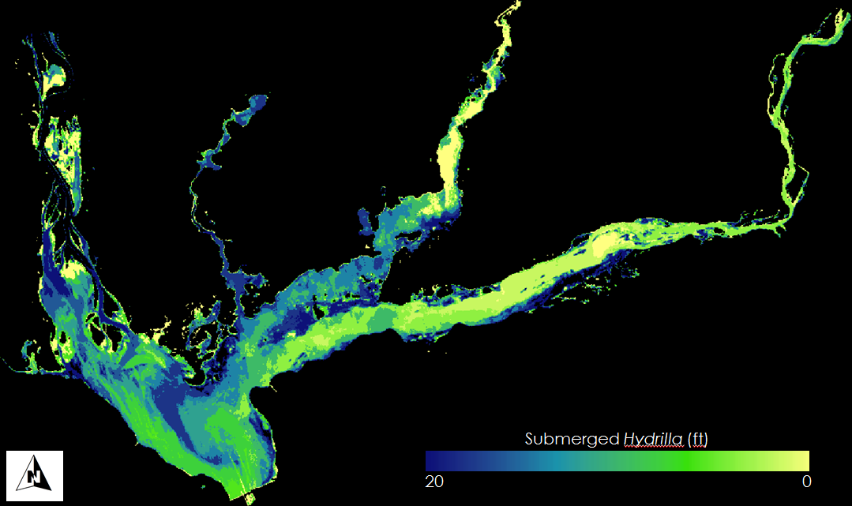
Results III – Maximum Likelihood Classification
Notes:
Finally, the maximum likelihood classification based on in situ plant depth measurements resulted in identifying Hydrilla up to to 20 feet.

Slide 15
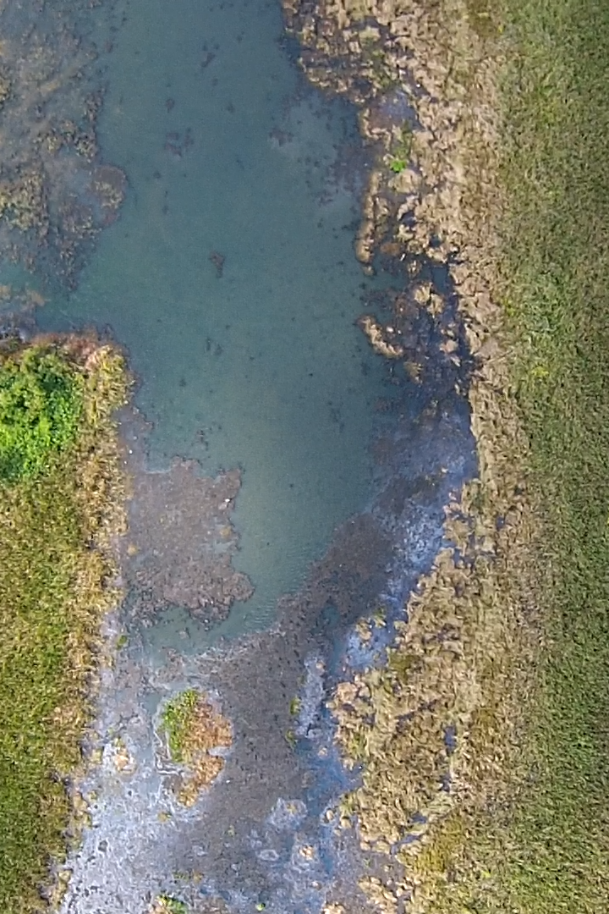
Conclusion
Mapped phenological patterns of Hydrilla in SE US water bodies
Mapped current spatio-temporal distribution of hydrilla
Identified hotspots/areas of management concern
Created tool for forecasting future growth
Image source: SEUS Ecological Forecasting Team II

Slide 16
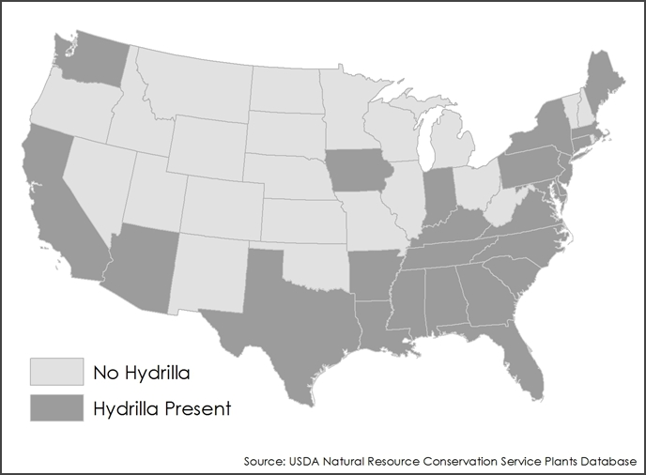
Future Work
Differentiate between floating species of aquatic vegetation by using proximal hyperspectral remote sensing reflectances
Perform 30 year time-series analysis from the time Hydrilla was introduced to the Southeastern US
Map the spread of Hydrilla through the US since the initial invasion
Notes:
Our current model cannot differentiate topped-out Hydrilla from other species of aquatic vegetation. NDVI scores cover a range of values. We can take further spectroscopy data of Hydrilla and other species to better define the spectral signature of our target plant.
Using 30 years of archived imagery from past Landsat satellites, it is possible to do a long-term time series of Lake Seminole to map the spread of Hydrilla almost since it’s initial introduction.
Similarly, we can use the same data on a larger scale to track the spread of Hydrilla throughout the Southeast and beyond in the rest of the US.

Slide 17
Advisors
Dr. Deepak Mishra, Department of Geography, University of Georgia
Dr. Susan Wilde, Warnell School of Forestry and Natural Resources, University of Georgia
Partners
Kenneth Boyd & Allen Dean, US Army Corps of Engineers
Anthony Dodd, Georgia Power
Others
Brigette Nelson Haram, Warnell School of Forestry and Natural Resources
Wuyang Cai, Elizabeth Dyer, Shuvankar Ghosh, Peter Hawman, SEUS Ecological Forecasting I Team

Slide 18
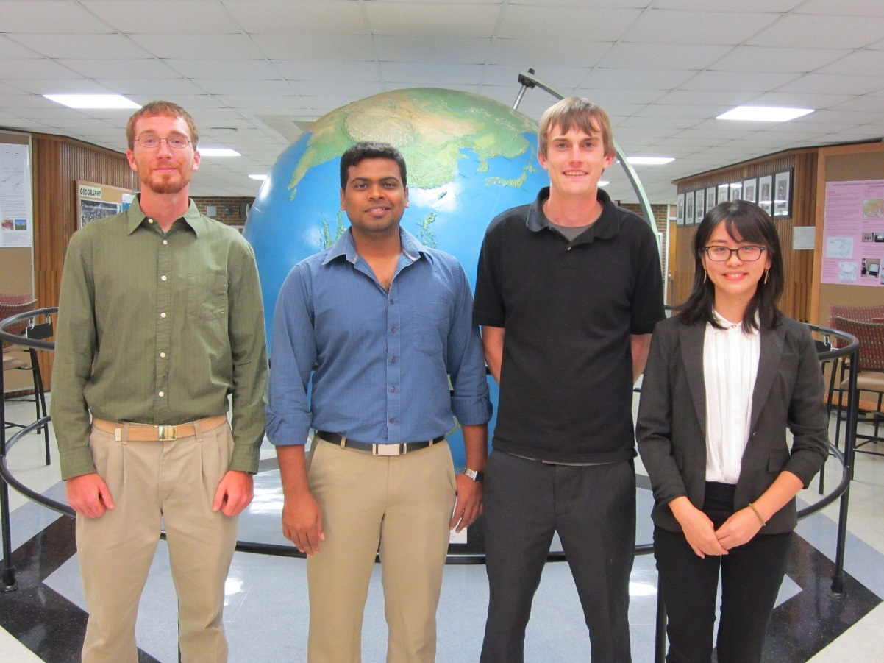
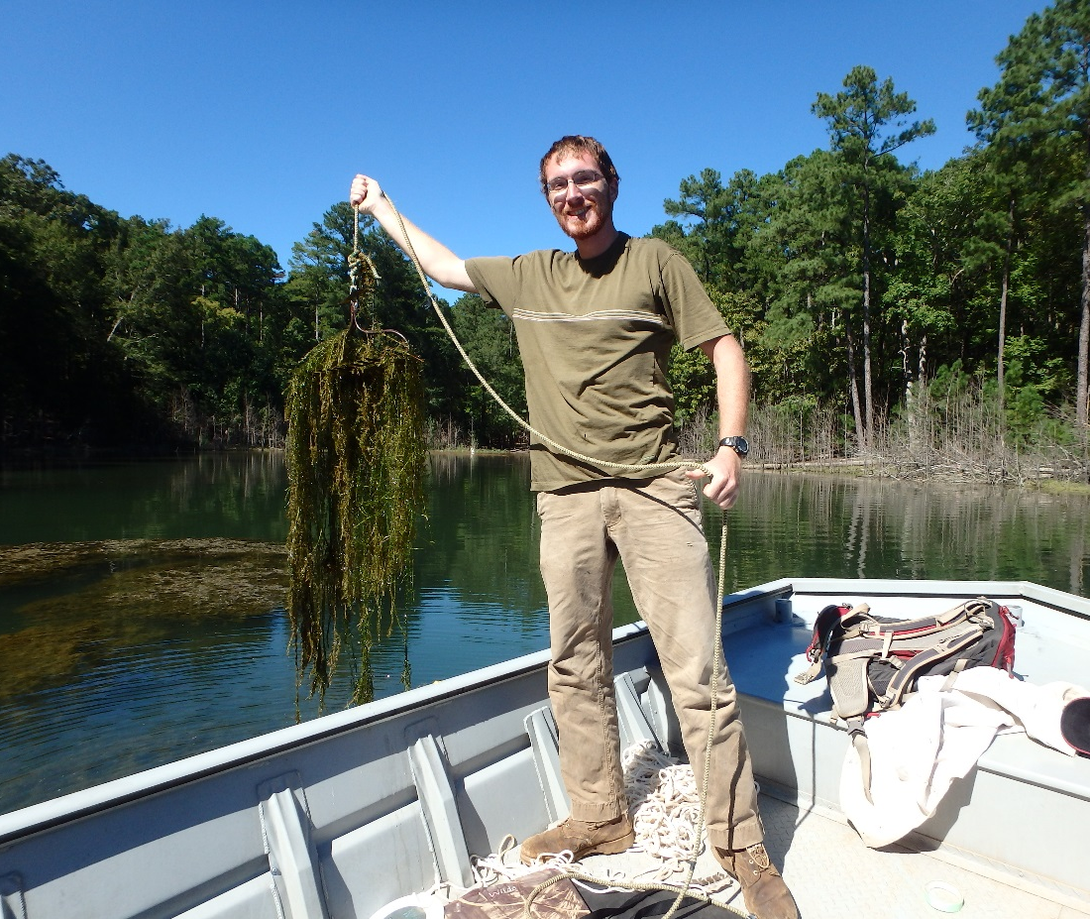
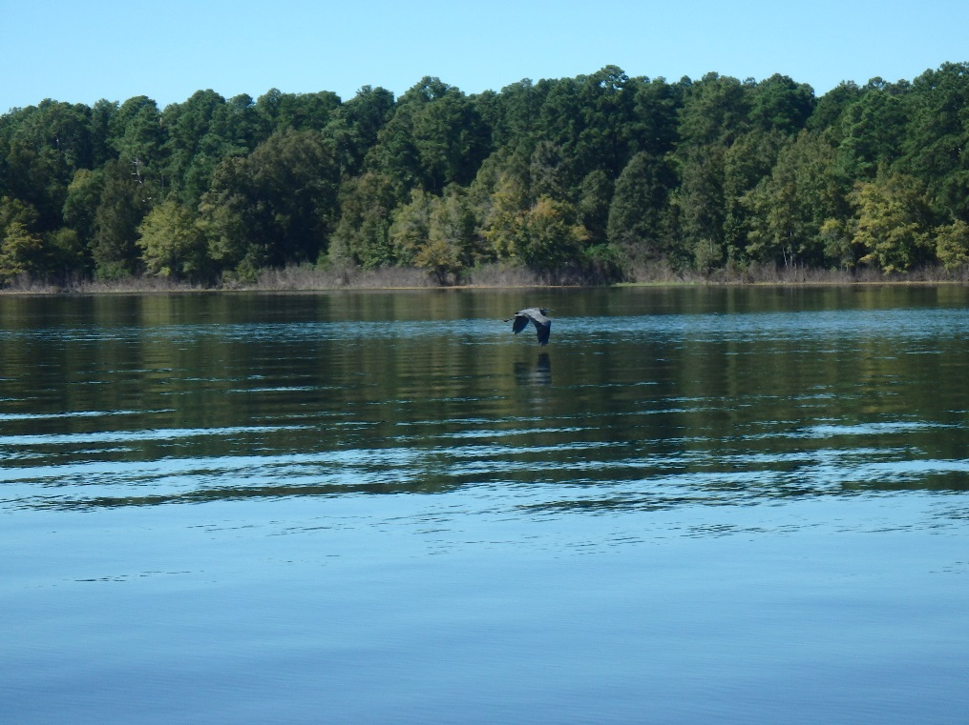
Fin
Notes:
So long and thanks for all the fish!

