Slide 1
California & Oregon
Ecological Forecasting
Detecting and Forecasting Fog Occurrence, Frequency, and Change to Support Coast Redwood (Sequoia sempervirens) Habitat Assessments
Zackary Werner, Anika Berger, Anna Winter, & Christopher Tsz Hin Choi
Colorado – Fort Collins
Notes:
Zack
- Hello welcome the DEVELOP Fall 2020 closeout. My name is Zackary Werner and I’m here with Anika Berger, Anna Winter, and Chris Choi to present to you the results from ten weeks of research on our project. The project is about Detecting and Forecasting Fog Occurrence, Frequency and Change to Support Coastal Redwood Habitat Assessments in California and Oregon. Thank you so much for tuning in, I’m going to pass things off to Anna to contextualize our project further for you.

Slide 2
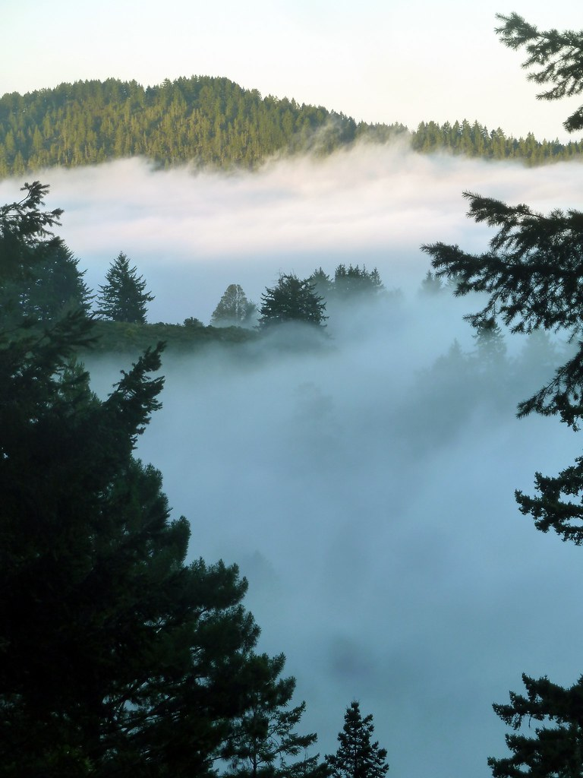
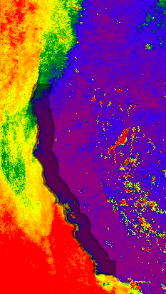
Outline
Background
Partners
Objectives
Workflow/Methodology
Results
Future Work
Image credit: CN
Notes:
Anna Winter
Thanks Zack. We want to begin with an outline of our presentation. We will start with some project background and community concerns, and move into our project partners and objectives. We will then discuss our workflow and methodology, our results, and future work.
------------------------------Image Information Below ------------------------------
Image 1 Credit: Redwoods and Morning Fog– CN (scorpio-tiger), https://ccsearch-dev.creativecommons.org/photos/9d5df2e7-d8cc-4b87-8610-370f4145e641 (licensed under CC BY-SA 2.0 )
Image 2 Credit: Study area with July 2020 potential fog and low cloud cover– Google Earth Engine, image from DEVELOP team

Slide 3
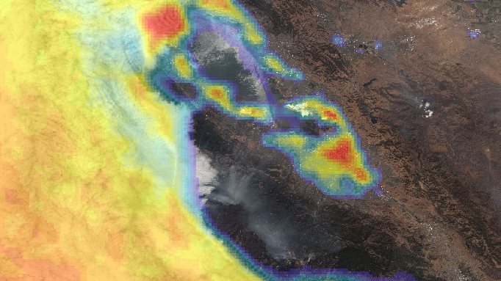
Background
Notes:
Anna Winter
We will first provide some background and contextualize our project.
------------------------------Image Information Below ------------------------------
Image Credit: Fog Frequency– ArcGIS Pro, image from DEVELOP team

Slide 4
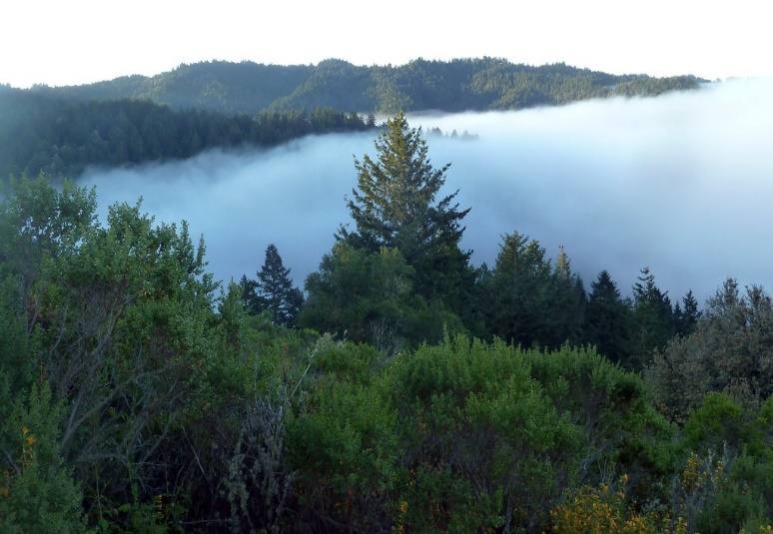
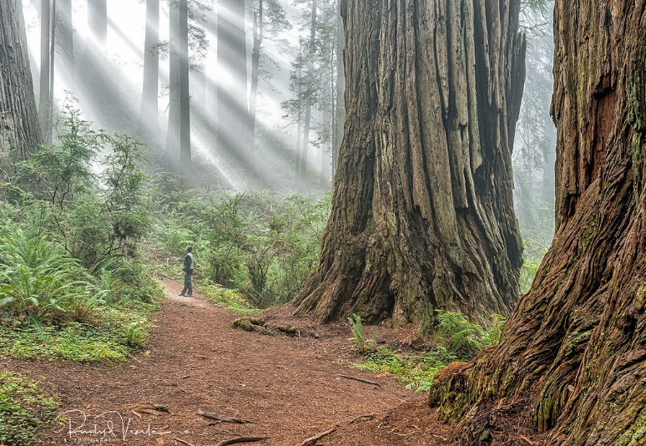
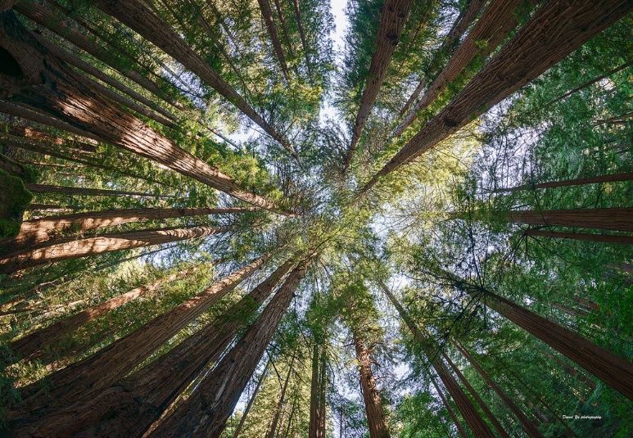
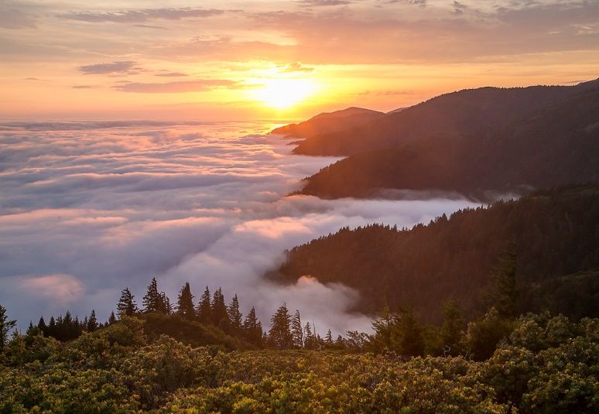
Fog and Low Stratus:
Essential for Coastal Ecosystems
Cloud base height occurring at or below 400m elevation¹
Provide water through fog drip
Reduce ambient temperatures
Image credit: CN
Raise humidity
Image credit: R. Wilms
Coast redwoods heavily associated with fog
Fog also significant for other coastal vegetation distributions
Image credit: D. Yu
1. Johnstone, et al., 2010
Image credit: BLM
Notes:
Anna Winter
##### CLICK TO ANIMATE
Fog is a type of low cloud, and is defined in previous work as a cloud whose base height occurs at or below 400-meter elevation¹.
Our detection scheme allows us to detect potential fog and low cloud cover, which we will refer to as ”fog” in this presentation.
Fog and low clouds have a significant impact on coastal ecosystems, and the water transported by fog provides a number of different ecological benefits.
##### CLICK TO ANIMATE
Liquid water from fog can be accessed via fog drip and is available for direct uptake by plants.
##### CLICK TO ANIMATE
Fog presence also reduces ambient temperatures,
##### CLICK TO ANIMATE
and raises humidity, which can be critical in surviving the dry summer conditions.
##### CLICK TO ANIMATE
The coast redwood is heavily associated with fog and relies on fog to survive the hot and dry Mediterranean summer conditions that are common in California.
##### CLICK TO ANIMATE
Fog also is an explanatory factor for a number of other coastal vegetation distribution patterns, including forest plants such as sword fern and coastal plants such as California sage brush.
------------------------------Image and Citation Information Below ------------------------------
Image 1 Credit: Purisima Redwoods– CN (scorpio-tiger), https://ccsearch-dev.creativecommons.org/photos/f8141613-7cde-457d-adb1-d63385d4d6c8 (licensed under CC BY-SA 2.0)
Image 2 Credit: Redwoods Mystical Fog– Rudy Wilms, https://ccsearch-dev.creativecommons.org/photos/4f59b5a4-bc45-48b6-8bf7-48a253410001 (licensed under CC BY-NC-ND 2.0)
Image 3 Credit: Muir Woods Redwood Forest– David Yu, https://ccsearch-dev.creativecommons.org/photos/5f8b290f-48db-4444-8164-90555ffe2a9b (licensed under CC BY-NC 2.0)
Image 4 Credit: Travel Tuesday– Bureau of Land Management, https://ccsearch-dev.creativecommons.org/photos/02935b51-9a1c-4d57-bb38-c3975e0e45a6 (licensed under CC BY 2.0)
1. Johnstone, J. A., & Dawson, T.E. (2010). Climatic context and ecological implications of summer fog decline in the coast redwood region. Proceedings of the National Academy of Sciences, 107(10), 4533-4538. doi: 10.1073/pnas.0915062107

Slide 5
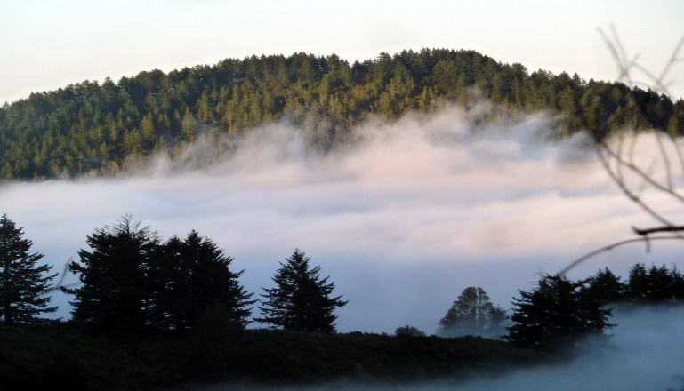
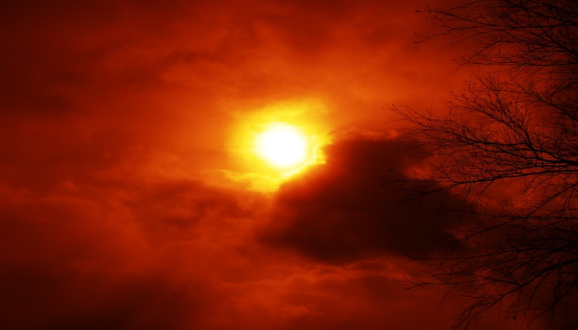
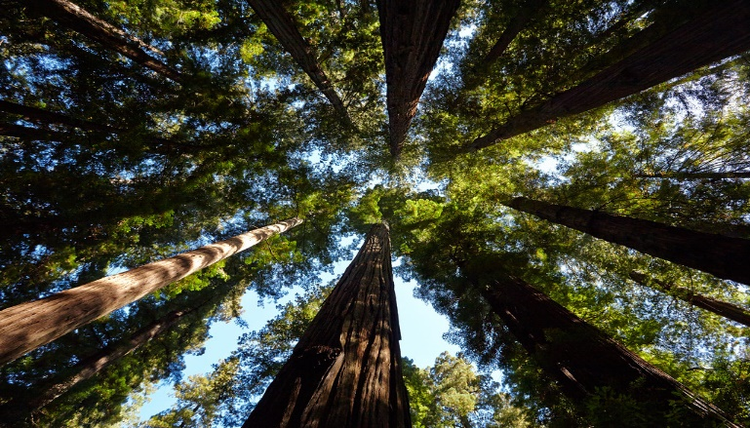
Community Concerns
Coast redwoods crucial in mitigating climate change
Carbon sequestration
Image credit: CN
Recent time series analyses point to a decline in fog
Increased fire risk and limited water availability
Image credit: J. Waltzer
Shift in suitable habitat
Satellite remote sensing of fog has become more readily available
Image credit: wolf4max
Notes:
Anna Winter
Now that you have a context of why fog is important to redwoods, we will talk about the community concerns for our project.
##### CLICK TO ANIMATE
Coast redwoods are the tallest tree in the world and are critical in mitigating climate change. Studies have shown that coast redwood trees are highly effective at capturing carbon dioxide, and protecting the trees can have a significant impact in slowing the changing climate.
##### CLICK TO ANIMATE
However, recent time series analyses have shown a decline in fog, and the future of fog longevity and presence under a warming climate is unknown.
##### CLICK TO ANIMATE
A decline in fog may lead to increased fire risk and limited water availability during the dry season.
##### CLICK TO ANIMATE
Additionally, because of the dependence on fog, a decline in fog could lead to a shift in suitable habitat for coast redwoods.
##### CLICK TO ANIMATE
Satellite remote sensing of fog has become more readily available through Google Earth Engine, and we are able to explore these fog trends and patterns at a higher spatial and temporal resolution than before.
------------------------------Image Information Below ------------------------------
Image 1 Credit: Morning Fog at Bald Knob– CN (scorpio-tiger), https://ccsearch-dev.creativecommons.org/photos/b187025d-dc46-4343-a7f5-e9c94528fede (licensed under CC BY-SA 2.0)
Image 2 Credit: Sun– Janice Waltzer, https://ccsearch-dev.creativecommons.org/photos/28e78933-81a0-4694-871d-7316c6a3de5b (licensed under CC BY 2.0)
Image 3 Credit: Redwoods Star– wolf4max, https://ccsearch-dev.creativecommons.org/photos/9ab4dc27-42b3-46ff-b3b7-4bfe0d04b962 (licensed under CC BY-NC-ND 2.0)

Slide 6
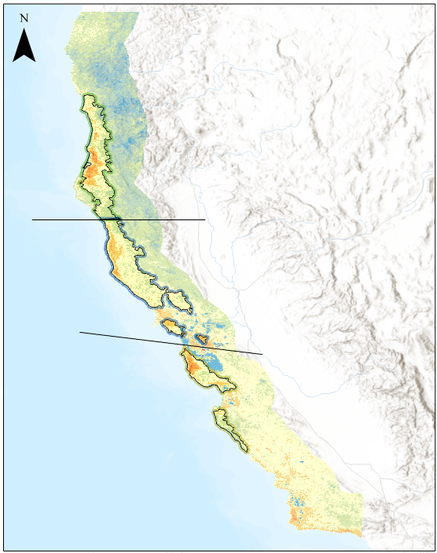
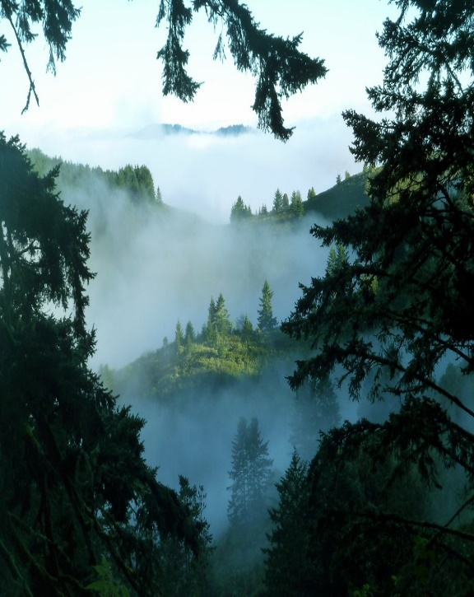
Project Partners
Save the Redwoods League
North
Responsible for conservation and restoration of coast redwoods
Central
South
Interested in fog datasets to support decision-making process
Northern range expansion
Image credit: CN
Points of contact:
Kristen Shive
Laura Lalemond
Richard Campbell
Expanding use of remote sensing products
Notes:
Anna Winter
-For our project, we partnered with Save the Redwoods League.
-Save the Redwoods League is an organization that focuses on protecting and restoring coastal redwoods by purchasing redwoods forests and restoring logged forests.
-Since redwood distribution is heavily associated with fog, Save the Redwoods League are interested in how our fog datasets could inform current and future redwoods management decisions, as well as land acquisitions.
-This was also an opportunity for Save the Redwoods League to expand their use of remote sensing in coastal redwood management.
------------------------------Image Information Below ------------------------------
Image 1 Credit: Changes in Fog Frequency over the past 20 years from MODIS data- Google Earth Engine and ArcGIS Pro, image from DEVELOP team
Image 2 Credit: Purisima Redwoods, Morning Fog– CN (scorpio-tiger), https://ccsearch-dev.creativecommons.org/photos/25a0ef39-76b4-41e2-8df8-b8be9bf1d3aa (licensed under CC BY-SA 2.0)
Icon Credits: PowerPoint ClipArt

Slide 7
Project Objectives
1. Create fog longevity dataset with GOES-17
2. Create fog presence dataset with Terra-MODIS, and analyze trends
3. Model relationship between climate variables and fog occurrence
4. Predict future fog occurrence
Image credit: fogcat5
Notes:
Anna Winter
We had four project objectives that we set out to accomplish.
##### CLICK TO ANIMATE
The first objective was to create a fog longevity dataset mapping fog hours per day for every day from June through October from 2018 to 2020 utilizing GOES-17.
##### CLICK TO ANIMATE
The second objective was to develop a historical fog presence dataset mapping the number of days with fog for each month for June through October from 2000 to 2020 utilizing Terra MODIS, and to use this dataset to analyze changes and trends in fog frequency over the past 20 years.
##### CLICK TO ANIMATE
The third goal was to model the relationship between climate and a) fog frequency and b) fog hours per day utilizing the Random Forest algorithm applied to climate variables and the team-created fog products
##### CLICK TO ANIMATE
Finally, we wanted to apply these models under future climate scenarios to predict future fog occurrence under a warmer climate.
------------------------------Image Information Below ------------------------------
Image 1 Credit: Henry Cowell Forest Redwoods and Fog– fogcat5, https://ccsearch-dev.creativecommons.org/photos/29ee33c0-0931-4ab5-82ad-957d57f9d8fe (licensed under CC BY-SA 2.0)
Icon Credits: PowerPoint ClipArt

Slide 8
Study Area: Buffered Coast Redwood Range
Dry Season
June-October
Terra- MODIS
Study Period
2000-2020
Monthly Fog Frequency
GOES-17
Study Period
2018-2020
Daily Fog Longevity
Study Area
Current Coast Redwood Range
0
100
200 Miles
1:55,000,000
Date: 10.13.2020
Created by the California & Oregon Ecological Forecasting Team at DEVELOP
Sources: NASA DEVELOP, USGS, US Census Bureau, Save the Redwoods League, Esri
Datum and Projection: WGS 1984 (EPSG 4326)
Notes:
Christopher Tsz Hin Choi
Our study area for this project is a buffered area of the current coast redwood range (which you can see in green on the map). We extended the region 100 miles north and south of the current coast redwood distribution, and 50 miles inland (outlined in grey). Our study area is mainly focused on California, while also containing a small area of southern Oregon.
##### CLICK TO ANIMATE
We focus on only the summer months (June through October), as these are the months are the “dry season” in which fog presence is critical to the ecosystem.
##### CLICK TO ANIMATE
For the GOES-17 satellite, our study period is from 2018-2020, and we focus on number of hours per day that fog was present.
##### CLICK TO ANIMATE
For the MODIS sensor onboard the Terra satellite, we study monthly fog frequency from 2000-2020.
------------------------------Image Information Below ------------------------------
Image Credit: Project Study Area– ArcGIS Pro, image from DEVELOP team

Slide 9
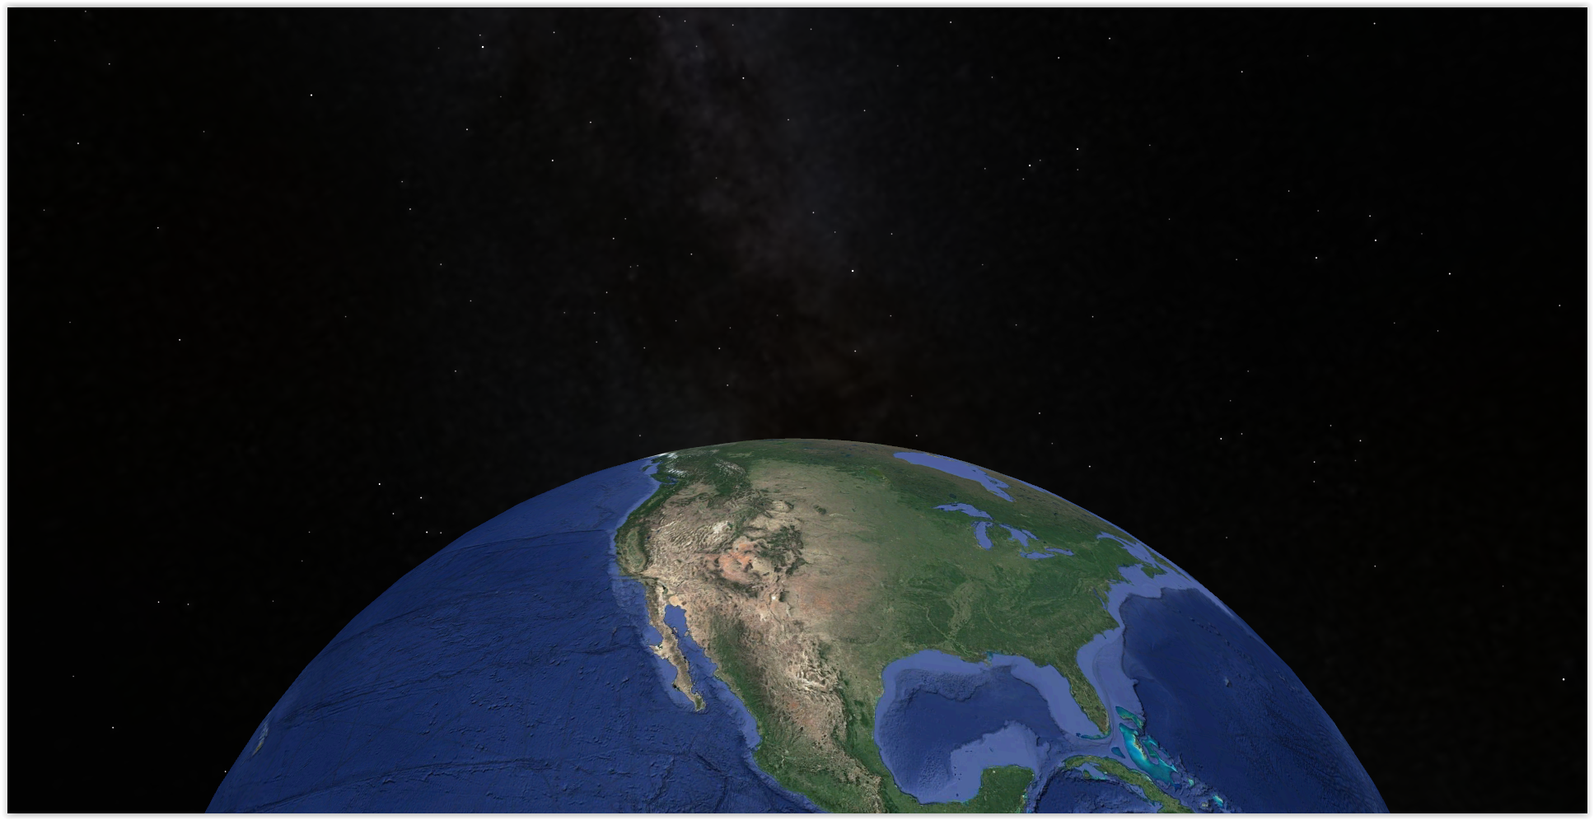
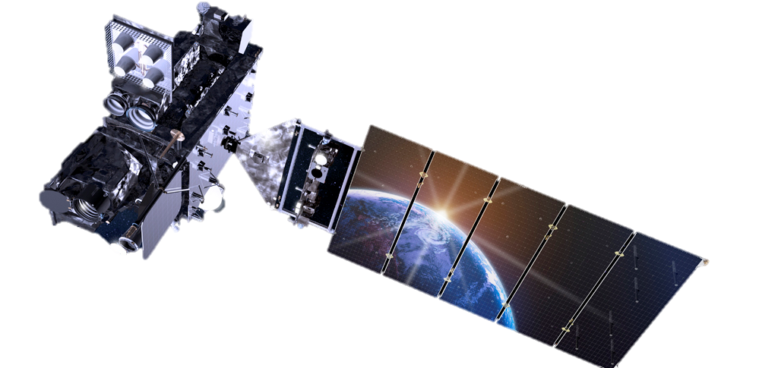
Earth Observations Utilized
GOES-17
Cloud and Moisture Imagery
(2018-2020)
Terra
Moderate Resolution Imaging Spectroradiometer
(2000-2020)
Data collected via Google Earth Engine
Image 1 (Terra) credit: NASA
Image 2 (GOES-17) credit: Lockheed Martin
Background image credit: Google Earth
Notes:
Christopher Tsz Hin Choi
-From NASA’s Earth Observation Satellites, we used Terra MODIS and GOES-17.
##### CLICK TO ANIMATE
-Terra MODIS provided us with daily imagery to create a monthly fog presence dataset spanning the last 20 years.
-The 1000-meter spatial resolution imagery provided us with detailed fog presence data at 10:30 AM every day.
##### CLICK TO ANIMATE
-GOES-17 on the other hand provided us with imagery to create a fog longevity dataset spanning the last 2 years.
-A relatively high temporal resolution of 5-minutes enabled us to track the hours fog was present each day.
-GOES-17 also has a 2000-meter spatial resolution for the bands that we used.
-All the imagery from these satellites were accessed and processed within Google Earth Engine.
------------------------------Image Information Below ------------------------------
Globe image is a high quality screenshot from Google Earth.
Image of Terra is retrieved from Developedia.
GOES-17 Image Credit: Lockheed Martin, https://spacenews.com/noaa-and-nasa-establish-board-to-investigate-goes-17-instrument-problem/

Slide 10
Terra MODIS
Methods and Results
Notes:
Christopher Tsz Hin Choi
Moving into our methodology, we will begin by discussing the Terra-MODIS data processing and results.
------------------------------Image Information Below ------------------------------
Image Credit: Fog Frequency– ArcGIS Pro, image from DEVELOP team

Slide 11
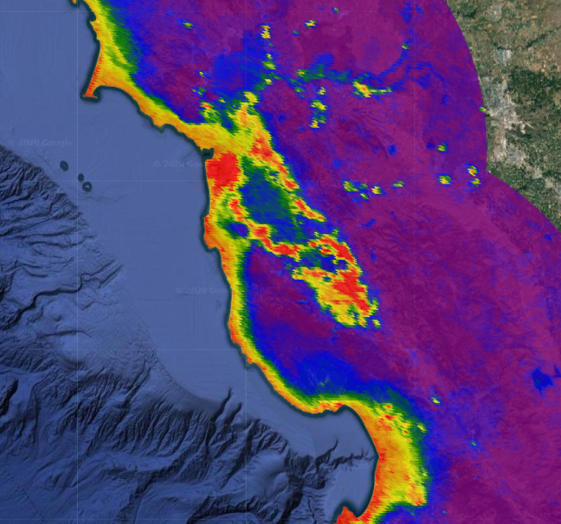
Methodology – MODIS Fog Presence
Fog / No Fog – 1 Day
MODIS Bit 10 (Cloud or No Cloud)
Extract Cloud Bitmask
Mask with Cloud
Apply Masks
One day of Fog Presence
MODIS Bit 8 - 9 (Cirrus)
Extract Cirrus Bit-mask
Mask without Cirrus
Repeat For All Days From 2000 - 2020
Count days with fog presence per pixel
Create Fog Presence Dataset
Extract 2000 Random Pixels
Random Forest model
to derive Explanatory Variables of Fog Presence
Project fog in 2050s & 2080s
Trend Analysis
Notes:
Christopher Tsz Hin Choi
##### CLICK TO ANIMATE
-To classify fog and build a fog dataset we used MODIS’s Bit 10 cloud band to identify where fog was present.
-With MODIS’s 8-9-bit bands, we identified where high altitude, colder cirrus clouds were to mask out of our fog layer.
##### CLICK TO ANIMATE
-After applying both of the cloud and the cirrus masks to our imagery, we were able to determine whether fog was present at 10:30 AM.
-This method of classifying fog and low cloud cover was repeated for all days from the year 2000 to the year 2020. “cloud only" and "neither" are the only possible outcomes that we use to estimate fog presence with a fog/no fog classification;
##### CLICK TO ANIMATE
-As a result, we compiled a dataset showing the number of days per month fog was present across our study area then
##### CLICK TO ANIMATE
conducted a trend analysis of fog presence by region over the 20 year time range.
##### CLICK TO ANIMATE
-2000 Random Pixels were then selected for a random forest modelling to determine the conditions driving current fog presence.
-Based on the weight of these variables, we projected to climate scenarios in 2050 and 2080s to understand where fog would be in the future.
------------------------------Image Information Below ------------------------------
Image Credit: MODIS Monthly Fog Presence– ArcGIS Pro, image from DEVELOP team

Slide 12
Results | Trends in MODIS Fog Presence
Slope of Change in Fog Days per Month from 2000-2020
North
Central
South
Current Redwood Distribution
≤ -0.20
-0.19 ≤ -0.15
-0.14 ≤ -0.1
-0.9 ≤ -0.05
-0.4 ≤ 0
0.01 ≤ 0.05
0.06 ≤ 0.1
0.11 ≤ 0.15
0.16 ≤ 0.2
20 Year Change in Fog Frequency
North Region
Central Region
South Region
y = -0.03x + 9.29 R² = 0.02
p-value= 0.53
y = -0.03x + 5.61 R² = 0.04
p-value= 0.40
y = -0.02x + 7.39 R² = 0.02
p-value= 0.55
0
100
Date: 11.01.2020
Projection and Datum: WGS 1984
Sources: Save The Redwoods League, Esri
200 Miles
Notes:
Christopher Tsz Hin Choi
- These are the results from our trend analysis of the MODIS fog presence dataset.
- The values of the slope image here shows the general trend in fog presence per pixel, with red areas indicating a decline in fog over the last 20 years and blue an increase.
- To create a slope image, the number of days of fog per dry season at each pixel were plotted over time, and the slope of the best fit line which indicates the general rate of change over 20 years, is used as the value on the map.
###### CLICK TO ANIMATE
- Though there is a lot of variability from year to year, the last ten years have seen a stronger decline in foggy days in the dry season.
- Looking at the map showing the change in fog frequency, we observe that change is highly variable, even across local regions.
- The graph displays the days of fog per dry season month averaged over each region in the study area, over the last 20 years.
------------------------------Image Information Below ------------------------------
Image Credit: 20 Year Change in Fog Frequency– ArcGIS Pro, image from DEVELOP team

Slide 13
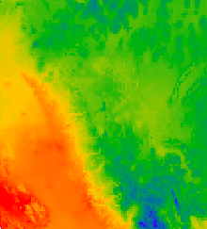
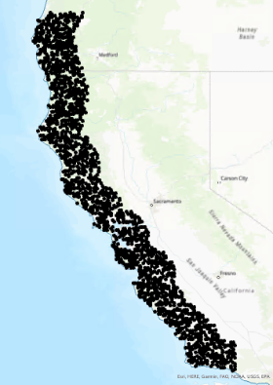
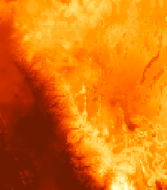
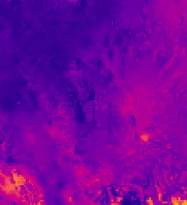
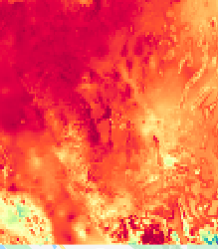
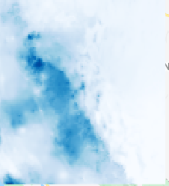
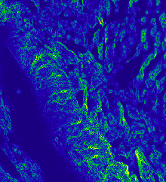
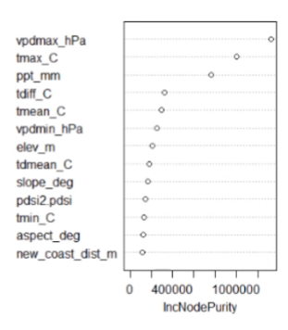
Methodology – Current Fog Conditions Model
Response
Predictors
Analysis
1.Training Sample Points
tdiff
drought
vpd
tdmean
ppt
2. Random Forest
Climatic
MODIS Monthly Fog Presence
3. Variable Importance
slope
Topographic
Notes:
Anika Berger
Thank you, Chris. I will now talk about how we used the 20 year fog presence data set to understand the climatic conditions which influence current fog presence
###### CLICK TO ANIMATE
The MODIS derived monthly fog presence dataset is our response variable, indicating the number of days with fog per month.
###### CLICK TO ANIMATE
We obtained monthly averages of climatic variables from PRISM, as well as the slope of the domain.
###### CLICK TO ANIMATE
- In our analysis, the 2000 random samples per month extracted values from both the fog response and the predictors, and this training data were used to train a machine - - learning algorithm, random forest, which derived the relationship between the climatic and topographic drivers and fog response.
- This model outputs a plot which ranks each predictor by its importance in explaining fog presence.

Slide 14
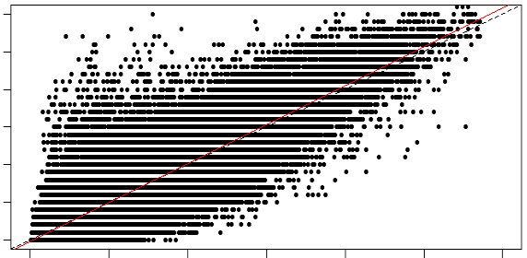
Results | Current Fog Conditions Model
Important Variables
OOB Model performance
RMSE: 2.2
R²: 0.8
Variable | Type
Temperature Difference
Precipitation
Drought Index
Mean Dew Point Temperature
Slope
Vapor Pressure Deficit
Model Performance
30
25
20
Observed
15
10
5
0
10
0
5
10
15
20
25
30
Predicted
Notes:
Anika Berger
- The results of our exploration of the current conditions driving fog presence showed the most important climatic variables influencing fog presence with the difference between the monthly maximum and minimum temperature being the most important driver.
- The out of bag performance shows an error of 2.2 and that the model is able to explain 80% of the variance of the data.
- The plot displays the observed values of the training sample points on the y axis with the number of fog days per month that the model predicts on the x axis.
- The spread of these points in relation to the best fit line indicate that the model is generally underpredicting days of fog where the observed values of fog days are higher.
- This could owe to the distribution of the randomly sampled observed values capturing more of the lower range of fog days and thus providing fewer training points of high fog frequency.

Slide 15
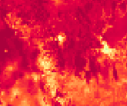
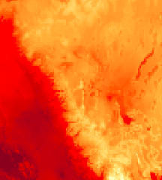
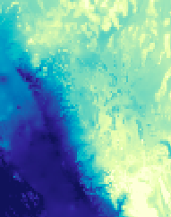
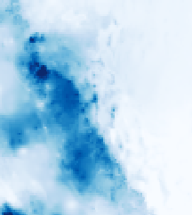
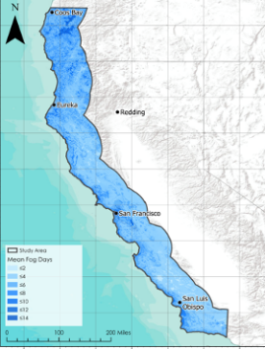
Methodology – Projected Fog Conditions Model
Response
Predictors
Analysis
1.Training Sample Points
tdiff
2. Random Forest
tmax
tmin
ppt
3. Apply model and predict
MODIS Monthly Fog Presence
ClimateNA variables
Notes:
Anika Berger
Since we are fortunate to have 20 years of fog presence data from MODIS, we related this data to the 30-year climate normals from the ClimateNA datasource.
The relationship between fog response
###### CLICK TO ANIMATE
and these variables
###### CLICK TO ANIMATE
was derived by the random forest algorithm,
###### CLICK TO ANIMATE
the most important variables were noted again, and then the model was applied spatially to rasters of an ensemble of projected future climate data under the warming scenario RCP 4.5.
------------------------------Image Information Below ------------------------------
Image 1 Credit: MODIS Monthly Fog Presence– ArcGIS Pro, image from DEVELOP team
All other images retrieved from Google Earth Engine by NASA DEVELOP

Slide 16
Results | Projected Fog Conditions Model
Coos
Bay
Study Area
Coos
Bay
Study Area
Coos
Bay
Mean Fog Days
Mean Fog Days
≤2
≤2
San Francisco
≤4
≤4
≤6
≤6
≤8
≤8
≤10
≤10
≤12
≤12
≤14
≤14
≤16
≤16
≤18
≤18
≤22
≤22
Eureka
≤20
Eureka
≤20
Eureka
Change in Fog Days
Redding
≤24
Redding
≤24
-25.81 – -20.00
≤26
≤26
≤28
≤28
0
10 Miles
≤30
≤30
San Francisco
San Francisco
Study Area
San Francisco
Change in Fog Days
≤-8.65
≤-7.18
≤-5.70
≤-4.22
≤-2.74
≤0
≤0.22
≤1.70
San Luis Obispo
San Luis Obispo
≤3.18
San Luis Obispo
≤4.66
≤6.14
≤6.65
0
100
200 Miles
0
100
200 Miles
0
100
200 Miles
Average September Fog Days 2000-2020
Predicted September Fog Days 2080
Change in Fog Days Between 2000-2020 and 2080
Notes:
Anika Berger
On the left is our average September days of fog over the 20 years, compared to a projection of number of days of fog in September in the 2080s, though they are solely based on modeled future average temperatures in September and do not include any of the climatic variables which do not currently have projections.
Though only pictured here is the projection for September, we also have monthly projections of fog presence and modeled by region.
In interpreting this projection, we noticed that fog presence during the September is projected to decline in the Northern region and in San Francisco Bay Area and some areas on the southern coast.
- We noticed that the San Francisco bay area exhibited extremely high changes in fog days that weren’t observed elsewhere. The red pixels in the zoomed in image represent locations that are projected to decline 20 to 25 days of fog from current September to September in the 2080s.
Though it is not pictured here, we also trained a model on solely the higher fog day points with the associated conditions and that showed the variables that might be important for explaining high fog days but are not projected by ClimateNA.
-And now I’ll pass it to Zack to present our methods and results from GOES-17.
------------------------------Image Information Below ------------------------------
Image 1 Credit: Average September Fog Days 2000-2020– ArcGIS Pro, image from DEVELOP team
Image 2 Credit: Predicted September Fog Days 2080– ArcGIS Pro, image from DEVELOP team
Image 2 Credit: Change in Fog Days Between 2000-2020 and 2080– ArcGIS Pro, image from DEVELOP team

Slide 17
GOES-17
Methods and Results
Notes:
Zack
Thanks Anika now I will discuss the GOES-17 data processing methodology and results.
------------------------------Image Information Below ------------------------------
Image Credit: Fog Frequency– ArcGIS Pro, image from DEVELOP team

Slide 18
Methodology – GOES Fog Longevity
Fog / No Fog – 5 Minute Interval
GOES-17 Channels 7 and 13
Calculate Difference Between S Wave and L Wave
5-min
Fog Index
Aggregate As Hourly Fog Classification Files
Not Fog
No
Is Pixel’s Fog Index Value Above 2K¹?
Fog Longevity Dataset
Is it Night or Day?
Day
Extract Fog Mask
Yes
Is Pixel’s Fog Index Value Below
-5.1K¹?
Night
Extract 2000 Random Pixels For Random Forest Modeling
Present Day Fog
Layer With Fog
No
Repeat For All 5 Minute Intervals between 2019 - 2020
Not Fog
1. Torregrossa et al., 2016
Notes:
Zack
##### CLICK TO ANIMATE
To study daily fog characteristics, GOES-17’s channel 7; a shortwave infrared band, and channel 13; a longwave infrared band were compared to derive a fog index value every 5-minutes.
##### CLICK TO ANIMATE
Pixels that exceeded 2 kelvin during the day or were below -5.1 kelvin at night in the fog index were considered potential fog or low cloud cover.
##### CLICK TO ANIMATE
GOES-17’s high temporal resolution meant that we ere able to repeat this process for imagery taken every 5-minute intervals from 2018 to 2020.
##### CLICK TO ANIMATE
Images were aggregated to produce an hourly fog longevity dataset per day.
In addition The values of 2000 random pixels were also extracted to be used in a random forest model.
However, this time the focus was on understanding what variables drove current fog longevity.
------------------------------Citation Information Below ------------------------------
1. Torregrosa, A., Combs, C., & Pters, J. (2016). GOES-derived fog and low cloud indices for coastal north and central California ecological analyses. Earth and Space Sceince, 3(2), 46-67. doi: 10.1002/2015EA000119

Slide 19
Methodology – GOES Fog Classification
GOES-17 Nighttime Imagery
Fog Classification
Notes:
Zack
-Here is also an animation displaying how fog is classified from one night of GOES-17 nighttime imagery
-On the left we have the nighttime imagery, which shows clouds making landfall.
-On the right we see how some of those cloud pixels are classified as fog.
------------------------------Citation Information Below ------------------------------
Video: GOES-17 Nighttime Imagery–Google Earth Engine, video from DEVELOP team

Slide 20
Results | GOES Fog Longevity Analysis
Average Dry Season Fog Hours Per Day
Change in Dry Season Fog Hours From 2019 – 2020
North
North
Central
Central
South
South
Study Area
Study Area
Mean Fog Hours Per Day
Change in Fog Hours
≤ 3
≤ -0.68
≤ 6
≤ -0.18
≤ 9
≤ 0.35
≤ 12
≤ 1.04
≤ 15
≤ 3.21
0
100
200 Miles
0
100
200 Miles
Date: 11.04.2020
Created By: NASA DEVELOP – California & Oregon Ecological Forecasting Team
Datum and Projection: WGS 1984
Source: GOES-17, USGS, Esri
Date: 11.04.2020
Created By: NASA DEVELOP – California & Oregon Ecological Forecasting Team
Datum and Projection: WGS 1984
Source: GOES-17, USGS, Esri
Notes:
Zack
##### CLICK TO ANIMATE
In order to connect this information to coastal redwood forests, the 2019/2020 mean GOES data was analyzed by North, Central and South redwood regions, as indicated on the map. Redwoods experience an average of 5.5 hours of fog per day in the north, and average of 4.1 hours of fog per day in the central region, and an average of 5.3 hours of fog per day in the south. How the negative trends observed in our MODIS data will alter day to day fog longevity shown here in the GOES data is yet to be seen, however, the central region may be an area of focus because redwood forests in these regions already experience less fog each day than the other regions.
##### CLICK TO ANIMATE
The 2019 and 2020 dry season fog data revealed that the coasts of California and Oregon experience a great deal of interannual variability with the positive differences between 2019 and 2020 highlighted in blue and the negative differences highlighted in red on the left.
------------------------------Image Information Below ------------------------------
Image 1 Credit: GOES-Detected Change in Dry Season Fog Hours From 2019-2020– ArcGIS Pro, image from DEVELOP team
Image 2 Credit: Average Dry Season Fog Hours Per Day– ArcGIS Pro, image from DEVELOP team

Slide 21
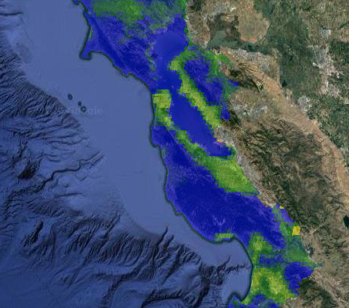
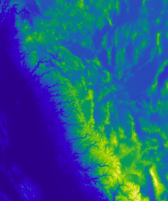
Methodology – Fog Longevity Model
Response
Predictors
Analysis
1.Training Sample Points
tdiff
tmin
vpd
tdmean
ppt
2. Random Forest
Climatic
GOES Fog Longevity
3. Variable Importance
elevation
Topographic
Notes:
Zack
Following the same methodology that Anika previously described for our random forest model for the MODIS fog dataset, we also modeled fog longevity on a day to day basis with the GOES-17 derived “hours per day” fog information as a response variable for random forest. This process allowed us to determine the most important climatic and topographic variables in driving fog longevity on a daily scale.
------------------------------Image Information Below ------------------------------
Image 1 Credit: GOES Fog Longevity– ArcGIS Pro, image from DEVELOP team
All other images retrieved from Google Earth Engine by NASA DEVELOP

Slide 22
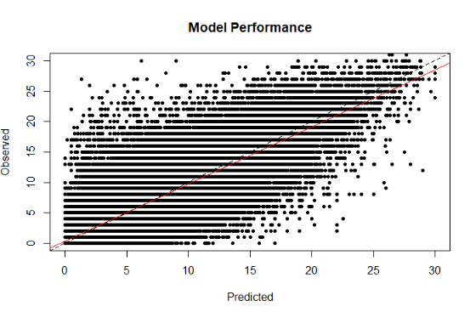
Results | Fog Longevity Model
Important Variables
OOB Model performance
RMSE: 3.99
R²: 0.35
Variable | Type
Temperature Difference
Elevation
Vapor Pressure Deficit Minimum
Mean Dew Point Temperature
Temperature Minimum
Precipitation
Model Performance
24
20
16
12
Observed
8
4
0
0
4
8
12
16
20
24
Predicted
Notes:
Zack
Here are the results of that random forest model fog hours per day. The predictor variables that were most related to day to day fog longevity were *list three variables here* and the model as a whole performed with an RMSE of 3.99 and an R2 of 0.35. Our model tells us that fog longevity is closely related to climate however, there is much work to be done to fully understand the forces driving fog longevity.

Slide 23
Future Work
Notes:
------------------------------Image Information Below ------------------------------
Image Credit: Fog Frequency– ArcGIS Pro, image from DEVELOP team

Slide 24
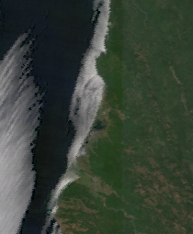
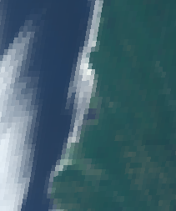
Limitations
Resolution
Spatial: GOES – 2 km resolution
Temporal: MODIS – only one image per day
MODIS (1km)
GOES (2km)
N
N
Data availability
Limited to 2 years of GOES data
Fog detection scheme for MODIS and GOES
Cannot detect fog under high clouds
Notes:
Zack
The Spatial Resolution of GOES and the temporal resolution of MODIS limit this project.
In addition, GOES-17 is a brand new state-of-the-art satellite however, it only has dry season images for two years.
Finally, based on previous research, MODIS has been shown to have an inherent 25% error in fog detection during the dry season in our domain, one major reason for this is that we cannot detect fog below clouds.
------------------------------Image Information Below ------------------------------
Image 1 Credit: MODIS potential fog and low cloud cover–Google Earth Engine, image from DEVELOP team
Image 2 Credit: GOES-17 potential fog and low cloud cover–Google Earth Engine, image from DEVELOP team

Slide 25
Future Work
Improve fog forecasting models to consider more climate variables and improve accuracy
Incorporate additional GOES satellites to extend the study period of the daily analysis
Continue work on daily landfall and dissipation time of fog
Notes:
Zack
##### CLICK TO ANIMATE
To continue work on this state-of-the-art project, we would like to investigate further daily landfall and dissipation time of fog.
##### CLICK TO ANIMATE
In addition we would like to incorporate the use of GOES15 or GOES16 to extend the study period of the daily analysis and fill some data gaps present in GOES-17.
##### CLICK TO ANIMATE
Finally we would like to continue to improve our present and future fog models to consider more climate variables and generally improve accuracy.
Icon Credits: PowerPoint ClipArt

Slide 26
Natural Resource Ecology Laboratory:
Dr. Paul Evangelista ​
Dr. Tony Vorster, M.S.
Brian Woodward, M.S.
Nick Young, M.S.
SCIENCE ADVISORS
END USERS
Kristen O’Shea, M.S.
Lead/Fellow, NASA DEVELOP Colorado Node
Justin Braaten, M.S.
Google Earth Engine Developer,
Google via Adecco
SPECIAL THANKS
Dr. Kristen Shive
Director of Science, Save the Redwoods League
Laura Lalemond, M.S.
Forest Ecologist, Save the Redwoods League
Richard Campbell, M.A.
Director of Restoration, Save the Redwoods League
Dr. Catherine Jarnevich
Research Ecologist,
U.S. Geological Survey
SCIENCE ADVISORS
Notes:
Thank Each Group

Slide 27
Thank you!
Questions?
Image credit: B. Woodward
Notes:
------------------------------Image Information Below ------------------------------
Image Credit: Coast Redwoods and Fog– Brian Woodward, provided by science advisors with permission to distribute

