Slide 1
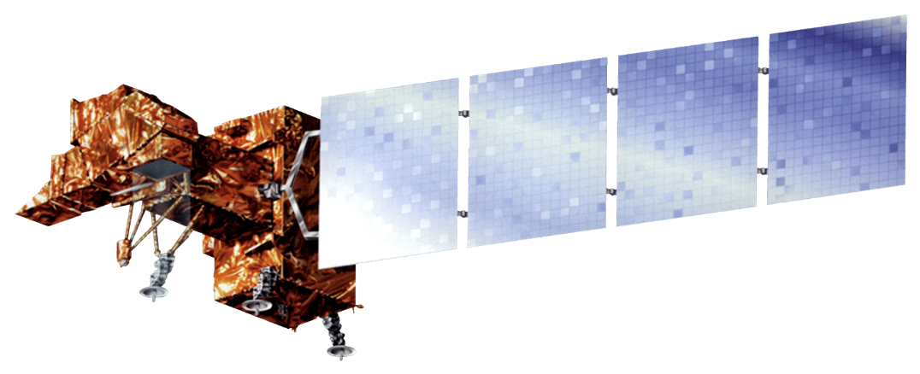
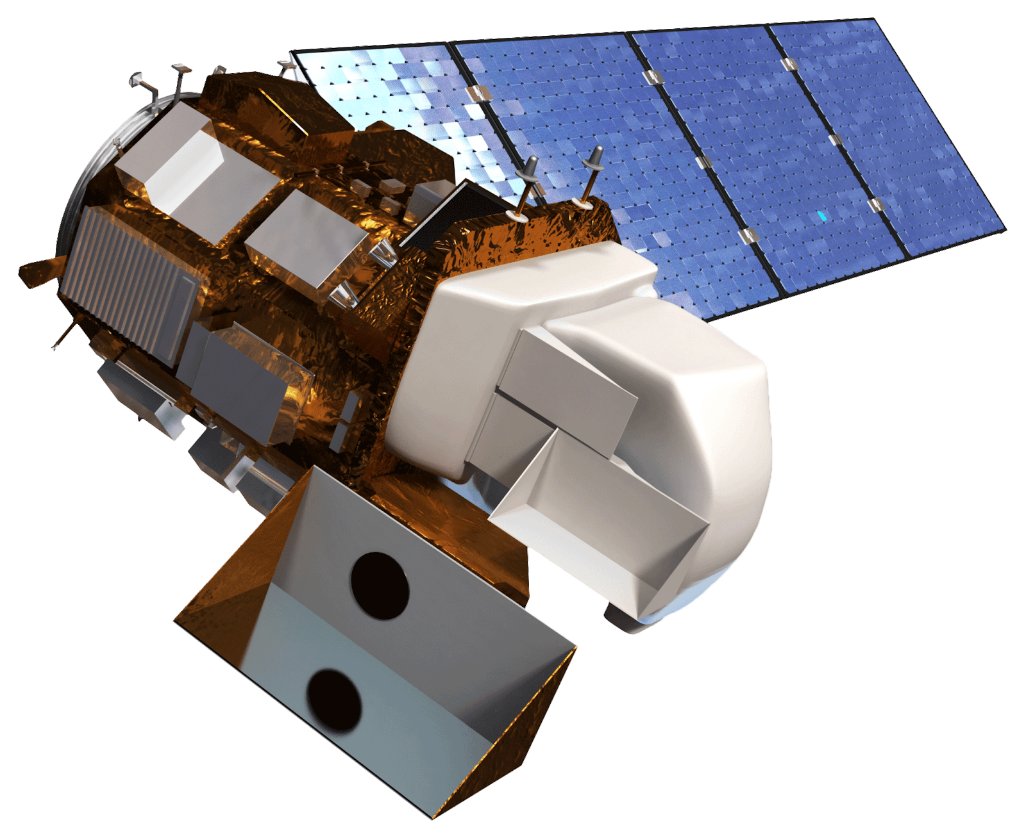
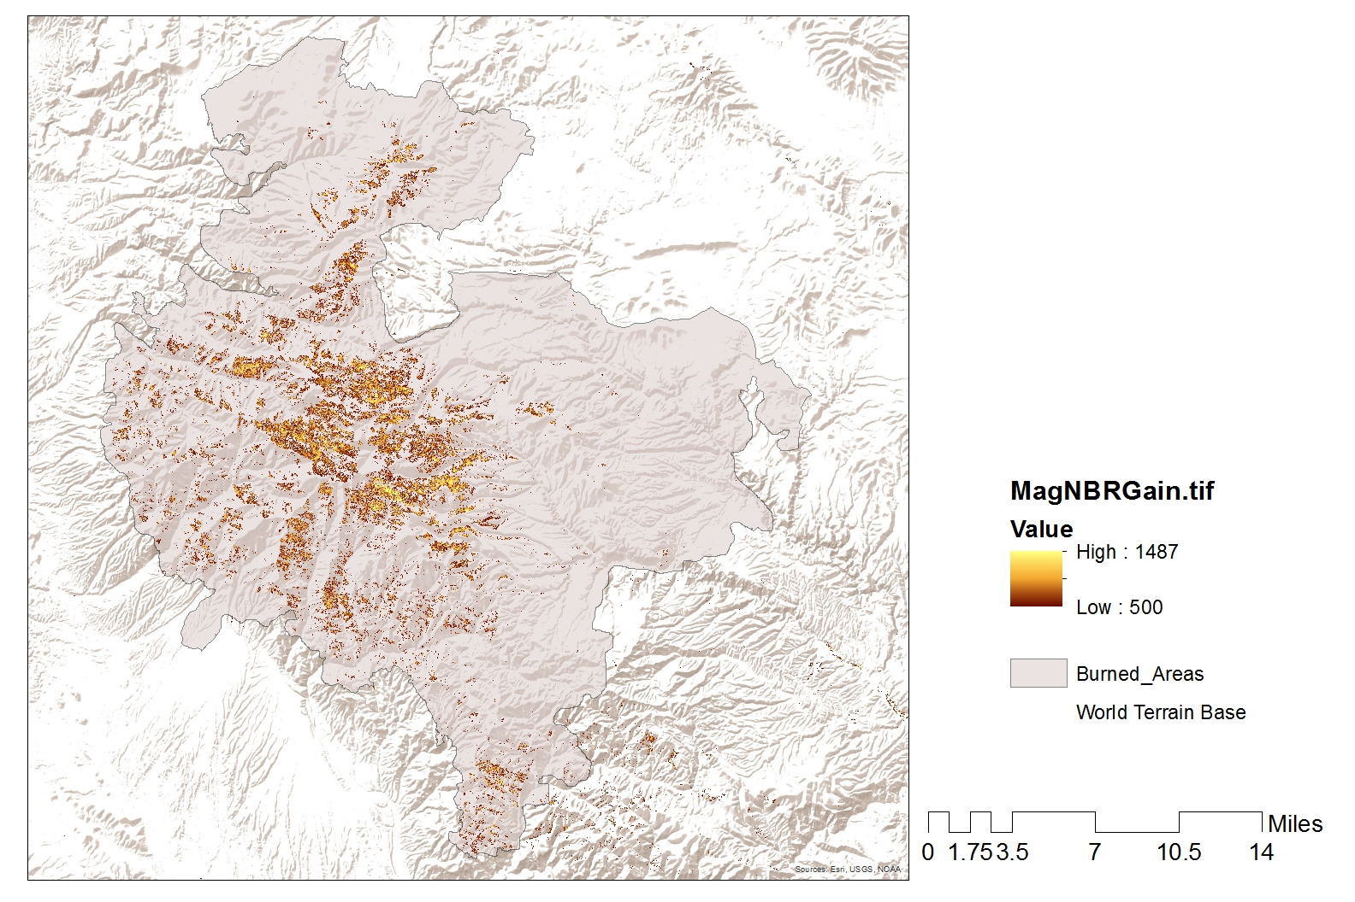
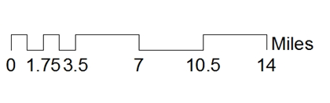
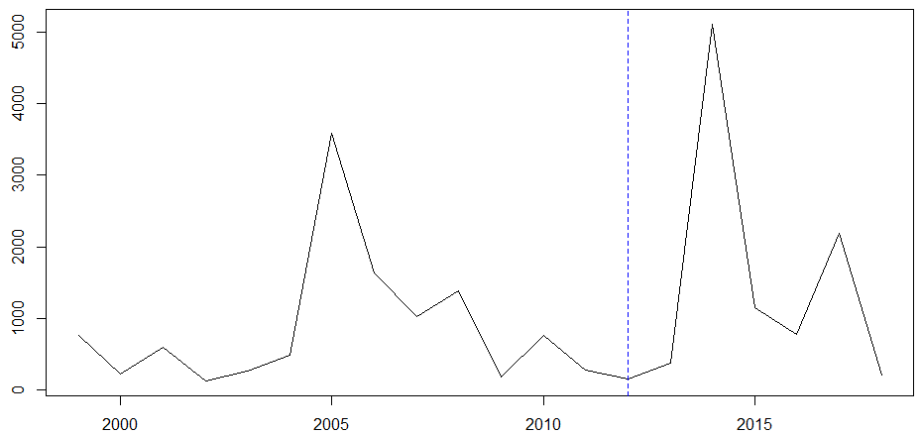
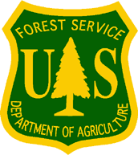

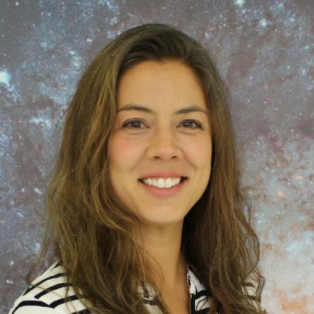
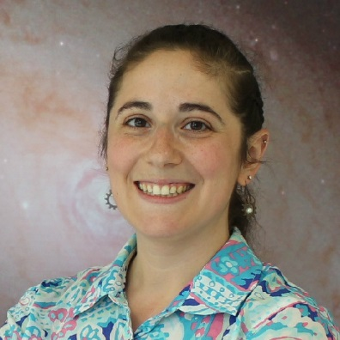
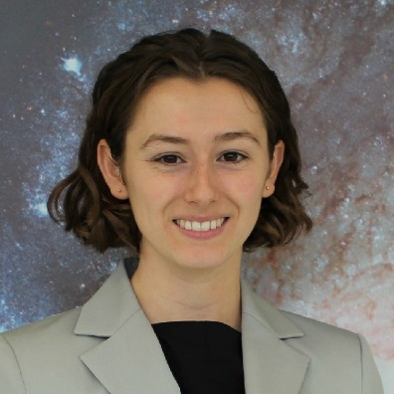
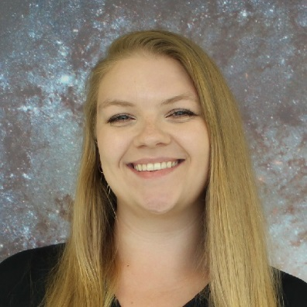
Using Earth Observations to Track Watershed Recovery After Wildfires in the Gila National Forest
Abstract
Objectives
Gila National Forest Water Resources
The largest fire in New Mexico’s recorded history, the Whitewater-Baldy Complex Fire, occurred in 2012 in the Gila National Forest (Gila NF). Then, in 2013, the Silver Fire broke historic records for destruction of private property. These disturbances have become more frequent, more severe, and are powerful forces of landscape change. Fire disturbances prompt serious concern over associated impacts, such as post-fire flooding, erosion, debris flows, and the ability of the Gila NF to provide essential goods and services, including safe drinking water and timber. Understanding the impacts of interrelated disturbances on watershed recovery dynamics is increasingly important to ensure future health and function of watershed ecosystems. This project partnered with the US Department of Agriculture (USDA) US Forest Service’s (USFS) Gila National Forest and Region 3 to explore watershed recovery trends following wildfires. The purpose of this project was to generate data-supported knowledge to inform land management decisions and planning, including the prioritization of specific regions for restoration efforts. To evaluate the watershed recovery phenomena in the Gila NF, this project used a combination of local knowledge and Earth observations, including Landsat 5 Thematic Mapper (TM), Landsat 7 Enhanced Thematic Mapper Plus (ETM+), and Landsat 8 Operational Land Imager (OLI). Normalized Burn Ratio (NBR) was the index used to evaluate recovery trends over time. Additionally, the team used USGS stream gauge data to evaluate the relationship between wildfires and flood events observed in the years following fire disturbances. Finally, potentially significant physical and environmental parameters were collected in a spatial database for use in subsequent studies.
Quantify recovery trends over time using NASA Earth observations
Evaluate the correlation between environmental factors and recovery
Explore relationships between hydrological processes and fire events
Earth Observations
Landsat 8 OLI
Landsat 7 ETM+
Results
Magnitude of Gain in NBR
High
Moderate
Low
Study Area
Burned Areas
Watershed Boundary
Gila National Forest
Project Study Area
Q7 Max of Streamflow (downstream of both fires)
Methodology
Quantify
Satellite Imagery
Normalized Burn Ratio
Explore
USGS Gauges
Streamflow Patterns
Evaluate
Vector & Raster Data
Database
Vegetation Growth
Q7 max
Spatial Relationships
MM / Day
Q7Max
Whitewater-Baldy Fire Year
Conclusions
NBR and Q7Max are viable metrics for evaluating watershed recovery.
There is an inverse relationship between percent recovery and burn severity within the Whitewater-Baldy fire perimeter; low burn severity areas display a 17% increase in recovery from high burn severity areas.
From 2013 to 2014, there was an increase of more than 10 times the Q7Max at all gauges. Conversely, the annual mean streamflow decreased between the same years, suggesting the need for additional data and metrics.
The Gila National Forest can use tabular information from the database to support land management decisions regarding post-fire restoration.
Future work should assess environmental parameters such as precipitation that impact trends observed in watershed recovery following fire disturbances.
Project Partners
USDA, US Forest Service, Gila National Forest
USDA, US Forest Service, Region 3
Acknowledgements
Team Members
Thanks to Dr. John Bolten and Dr. Ibrahim Mohammed (NASA – Goddard Space Flight Center), Dr. Sebastian Martinuzzi (University of Wisconsin), Dr. Raha Hakimdavar (USFS) and Dr. Sinan Abood (USFS) for their advising. Additional thanks to Carolyn Koury, Mike Natharius and Nessa Netharius (USFS Gila National Forest) and Jack Triepke, Bart Matthews and Anna Jaramillo (USFS Region 3). Lastly, thank you to Oregon State University.
Terra Edenhart-Pepe
Project Lead
Abigail Barenblitt
Ariege Besson
Carli Merrick
Maryland – Goddard | Fall 2019

