Slide 1
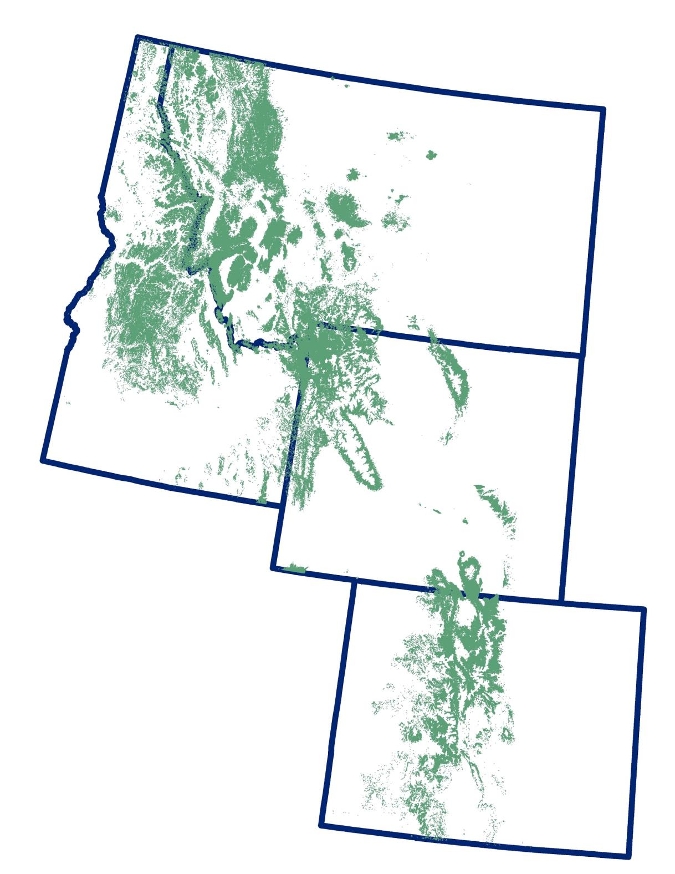
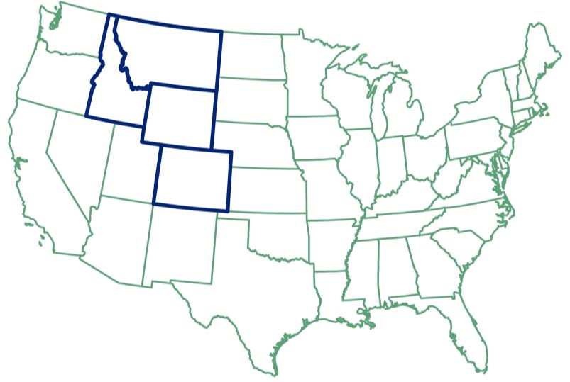
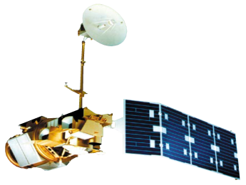
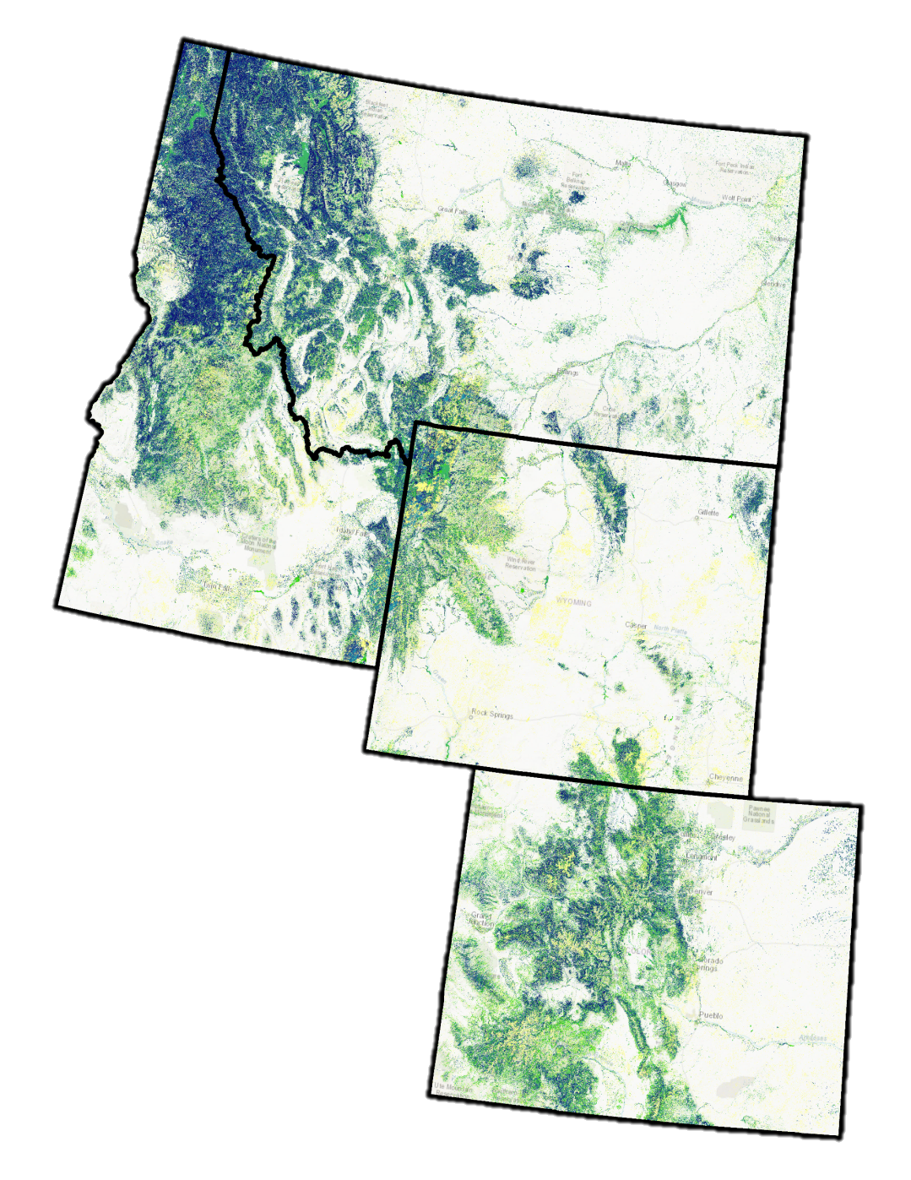
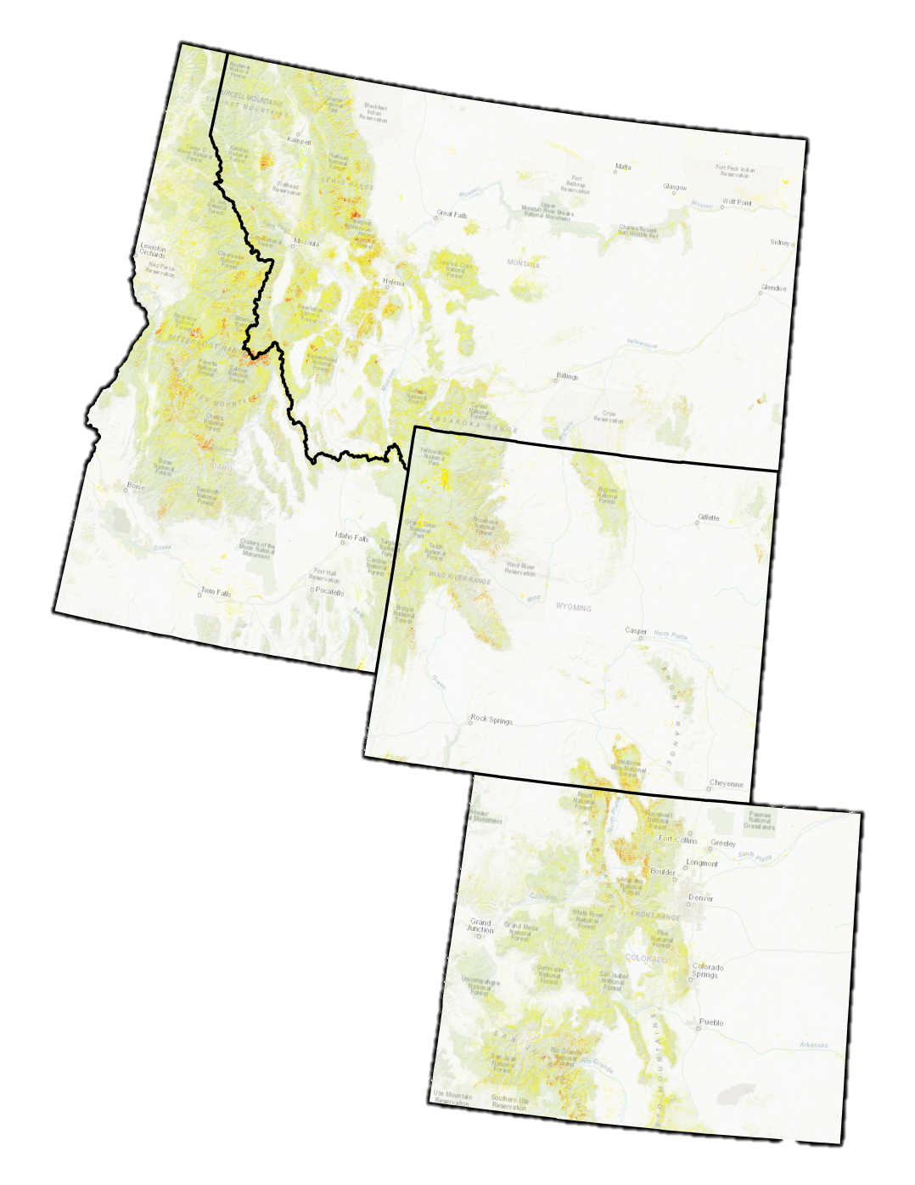
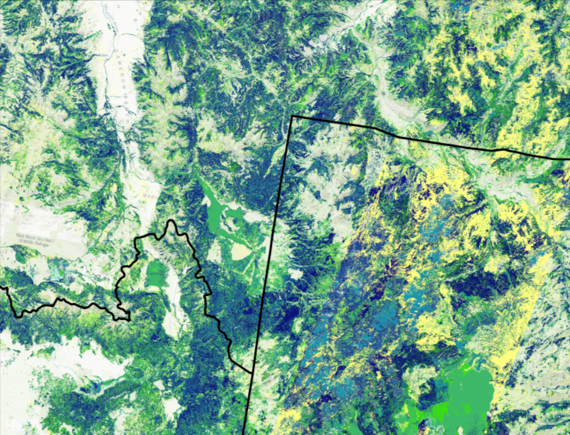
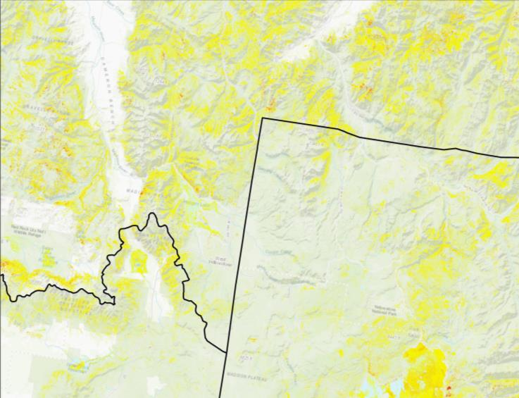
Utilizing NASA Earth Observations to Forecast Forest Vulnerability to Bark Beetle Attack in Support of a Forest Bioenergy Feasibility Assessment
Abstract
Objectives
The mountain pine beetle (Dendroctonus ponderosae) is an endemic species and a natural driver of forest ecosystems. This beetle has impacted millions of acres of coniferous forest in the western United States since the early 2000s. Forest ecosystems provide critical habitat for wildlife, filter air, improve water quality, offer erosion control, and sequester carbon. In addition to their ecological importance, pine forests provide economic services; they are sources of timber production and serve as a backdrop for recreation. Drought, coupled with warming temperatures, has increased the vulnerability of forests, specifically lodgepole pine (Pinus contorta), to bark beetle epidemics. Though recent attacks have largely subsided, major outbreaks in the future are likely due to the cyclical nature of bark beetle attacks. The forests at greatest risk to future mountain pine beetle outbreaks are those with higher proportions of live lodgepole pine host trees. This project identified these vulnerable forests by mapping existing live lodgepole pine. The team utilized Google Earth Engine to map forest structure across Colorado, Idaho, Montana, and Wyoming using topographic data from NASA’s Shuttle Radar Topography Mission (SRTM) in conjunction with spectral imagery from Landsat 5 Thematic Mapper (TM), and Landsat 8 Operational Land Imager (OLI) and Thermal Infrared Sensor (TIRS). These resulting lodgepole pine map products will inform forest monitoring efforts and assessment of the feasibility of using beetle-killed wood as a biofuel for end users at the Bioenergy Alliance Network of the Rockies (BANR).
Identify and analyze current lodgepole pine stands in Colorado, Idaho, Montana, and Wyoming
Create maps depicting current live and dead lodgepole pine
Study Area
Intermountain West states (CO, ID, MT, WY)
Lodgepole Pine
Methods Overview
Conducted NAIP imagery ocular sampling via Google Earth Engine
Utilized Google Earth Engine to generate variables from 2000-2016
Random Forest classification model
Percent live/dead lodgepole pine forest
Output of environmental predictor variables
Output predictive maps of percent live LLP cover
Source: ESRI, LANDFIRE
Project Partners
Earth Observations
Bioenergy Alliance of the Rockies, Feedstock Supply
Intermountain West Ecological Forecasting
Results
SRTM
Landsat 5 TM
Landsat 8
OLI & TIRS
Live Lodgepole Pine Cover
Dead Lodgepole Pine Cover
Percent Cover
< 20
20 - 30
30 - 40
40 - 50
50 - 60
60 - 70
> 70
Percent Cover
< 20
20 - 30
30 - 40
40 - 50
50 - 60
60 - 70
> 70
Team Members
Conclusions
Over 20,000,000 million acres of live lodgepole pine forests are potentially at risk to future outbreaks of mountain pine beetle.
The percent live maps of lodgepole pine will provide insight towards identifying the locations of possible future bark beetle outbreaks.
The maps produced will allow BANR to further explore the severity of Bark Beetle outbreak effects within the Intermountain West.
Julia Sullivan
Project Lead
Jillian LaRoe
Timothy Mayer
Jennifer Mehren
Gary Olds
Acknowledgements
Special thanks to scientists at the Natural Resource Ecology Lab, Dr. Paul Evangelista, Brian Woodward, and Anthony Vorster for their regular advice and mentorship, Robert Sturtevant for his extensive forestry expertise, Steven Filippelli, Emma Zink Hatcher, Peder Engelstad, Dr. Amanda West, and Stephen Leisz
Colorado – Fort Collins
Fall 2017

