Slide 1

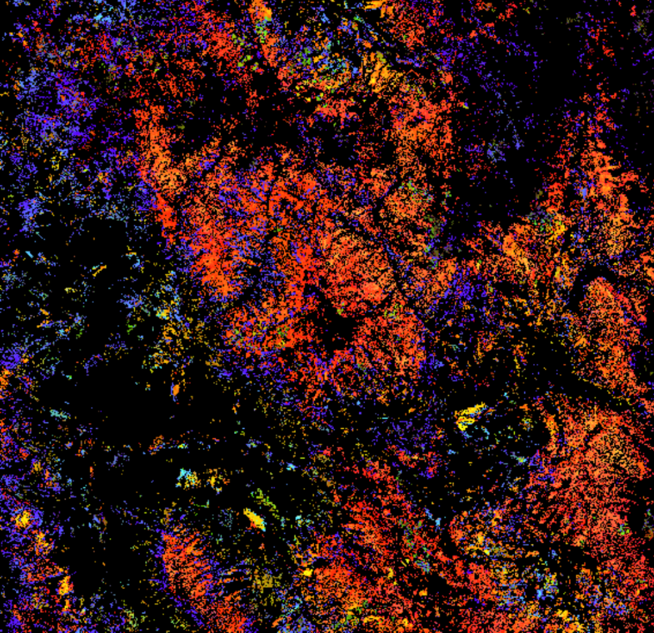
ROCKY MOUNTAIN AGRICULTURE
Peder Engelstad (Project Lead)
Utilizing NASA Earth Observations to Reconstruct and Identify Historical Forest Disturbances in the Southern Rocky Mountains for Enhanced Forest Management
Christopher Beddow
Stephanie Krail
Amandeep Vashisht
Notes:
Our title is Rocky Mountain Agriculture - Utilizing NASA Earth Observation to reconstruct and identify historical forest disturbances in the southern Rocky Mountains for enhanced forest management.

Slide 2
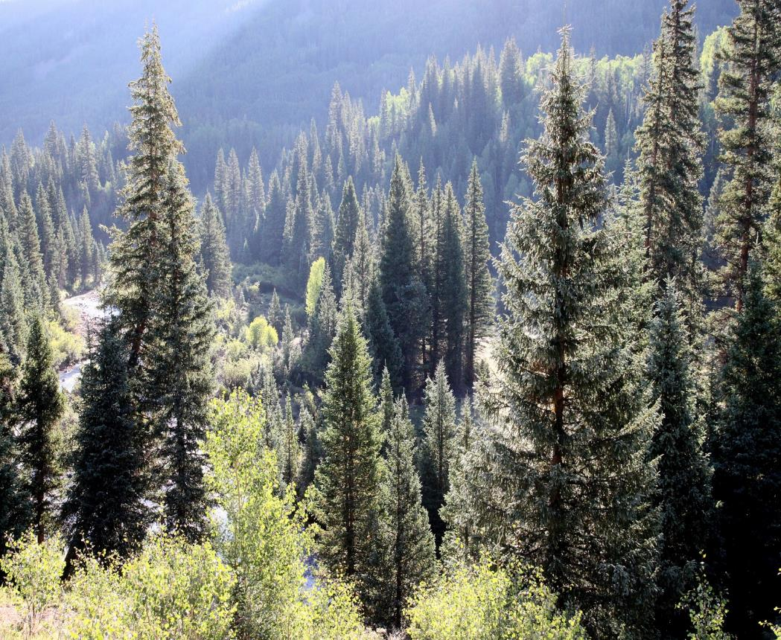
Contents
Background
Study Area
Community Concerns
Partners
Objectives
Methodology
Data Acquisition
Data Processing
Modeling
Results
Conclusions
Errors and Uncertainties
Future Work
Acknowledgements
Image Credit: Alan Schmierer
Notes:
Image source:
https://www.flickr.com/photos/sloalan/9601001030/

Slide 3
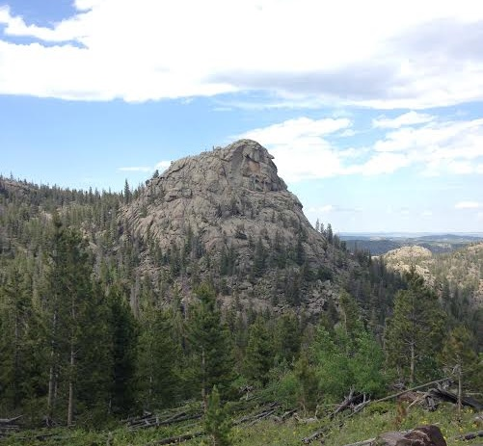
Background
Forests in Colorado cover over 98,000 km²
Changes in forest over past decades
Prominent disturbances are harvest, fires, and beetle kill
Monitoring of forest relies on field data and annual aerial surveys
Image Credit: Colorado Agriculture Team
Notes:
The area of Colorado forest cover includes State Forest, National Forest, public lands, and private lands - covering over 98,000 square kilometers.
Over the past several decades, Colorado forests have seen a net increase in growing stock and an emphasis on improved environmental policy.
Colorado forest species include lodgepole and ponderosa pine at lower elevations, and spruce and fir at higher elevations.
The most common forest disturbances types are forest harvest, wildfires, and beetle kill.
Field and aerial surveys are conducted in the area, but may not provide a complete disturbance history over large spatial extents.
Image Source:
Rocky Mountain Agriculture team

Slide 4
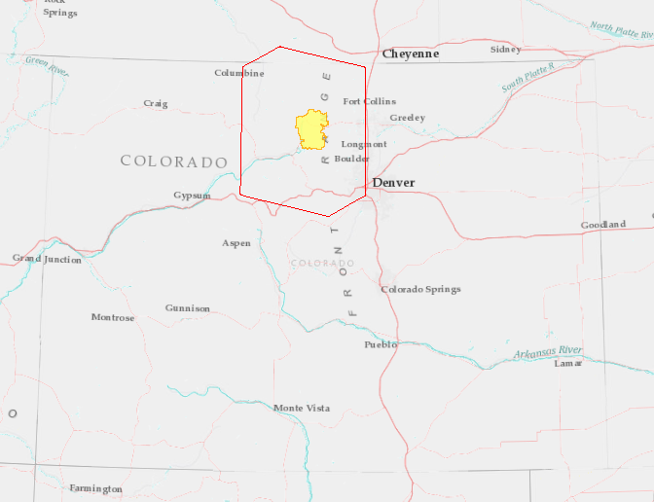
Study Area
Study Area Boundary
Rocky Mountain Agriculture
Rocky Mountain National Park
Rocky Mountain National Park
National Forest Lands
Notes:
The study area encompasses 21,927 square kilometers including northern Colorado and southern Wyoming.
The Continental Divide splits the region into the drier east and wetter west sides, while forest cover is sparse on the high mountain ridges along the divide.
The region is covered mostly by national forests and also contains National Park Service Rocky Mountain National Park.
The elevation ranges from 1478 meters in the eastern plains of Colorado to 4351 meters at the highest point in Colorado, Longs Peak.
Image Source:
Rocky Mountain Agriculture team, with data or basemaps from ESRI, DeLorme, USGS, NPS, HERE (Nokia maps)

Slide 5
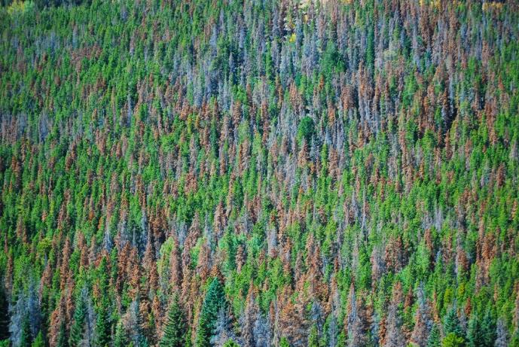
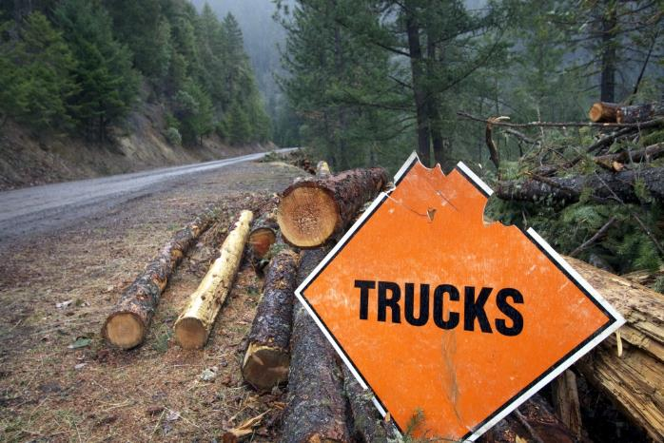
Community Concerns
High levels of forest disturbance throughout study area
Lack of historical disturbance records
Interest in improving management decisions
Image Credit: U.S. Geological Survey
Image Credit: Bureau of Land Management
Notes:
The Rocky Mountains of northern Colorado and southern Wyoming are experiencing extremely high levels of forest disturbance that threaten forest health. While dorest disturbances are natural and important components of ecosystem structure and function, anthropogenically driven changes in climate have intensified disturbance magnitude and extent to unnatural levels.
Partner organizations do not have a complete record of historical forest disturbances in the study area.
The study area has been impacted by forest harvests including clearcuts, thinning and other treatments over the years.
Insect outbreaks of Douglas-fir beetle, mountain pine beetle, and spruce beetle have resulted in millions of acres of conifer mortality.
The study area has experienced extensive wildfires, some with levels of fire severity high enough to limit conifer regeneration, potentially resulting in long-term cover type conversion.
While some disturbance records exist from several different sources, they do not provide a complete disturbance history throughout the area.
Land managers are interested in enhancing forest management decisions based on a more complete disturbance history.
Image Source:
https://www.flickr.com/photos/usgeologicalsurvey/16612752984/
https://www.flickr.com/photos/blmoregon/6780056988/

Slide 6
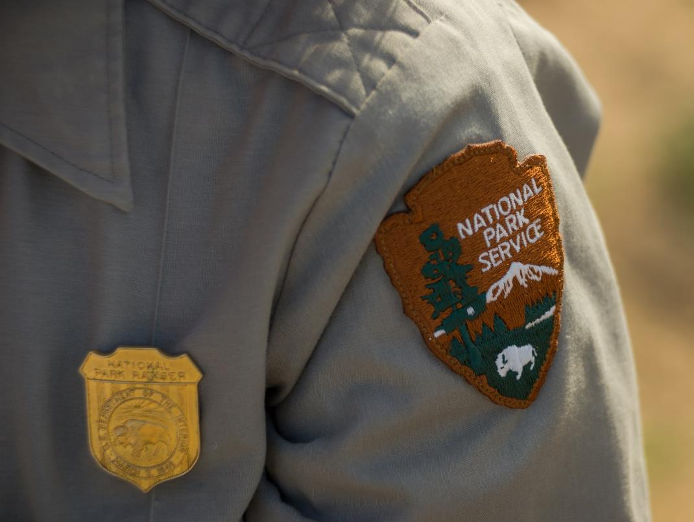
Partners
National Park Service Rocky Mountain National Park (RMNP)
Colorado Forest Restoration Institute (CFRI)
Bioenergy Alliance Network of the Rockies (BANR) Feedstock Supply Team
Image Credit: National Park Service/Kurt Moses
Notes:
The National Park Service Rocky Mountain National Park’s involvement stemmed from an interest in classifying a variety of disturbances within the park’s administrative boundaries. Historical records of these disturbances are incomplete, inconsistently collected, or non-existent.
The Colorado Forest Restoration Institute (CFRI) informs federal, state, and local entities on land management and fire reduction techniques. While their decision making process currently relies on field data and disjointed historical data, they seek to better understand land cover change and forest health at a landscape scale.
The Bioenergy Alliance Network of the Rockies (BANR) Feedstock Supply Team works to quantify forest biomass to evaluate the possibility of using this live and dead biomass as feedstock supply.
Currently, CFRI and BANR depend heavily on annual aerial survey data and reports from the Colorado State Forest Service (CSFS) to identify and monitor forest disturbance history.
Image Source:
https://www.flickr.com/photos/joshuatreenp/17303092761/

Slide 7
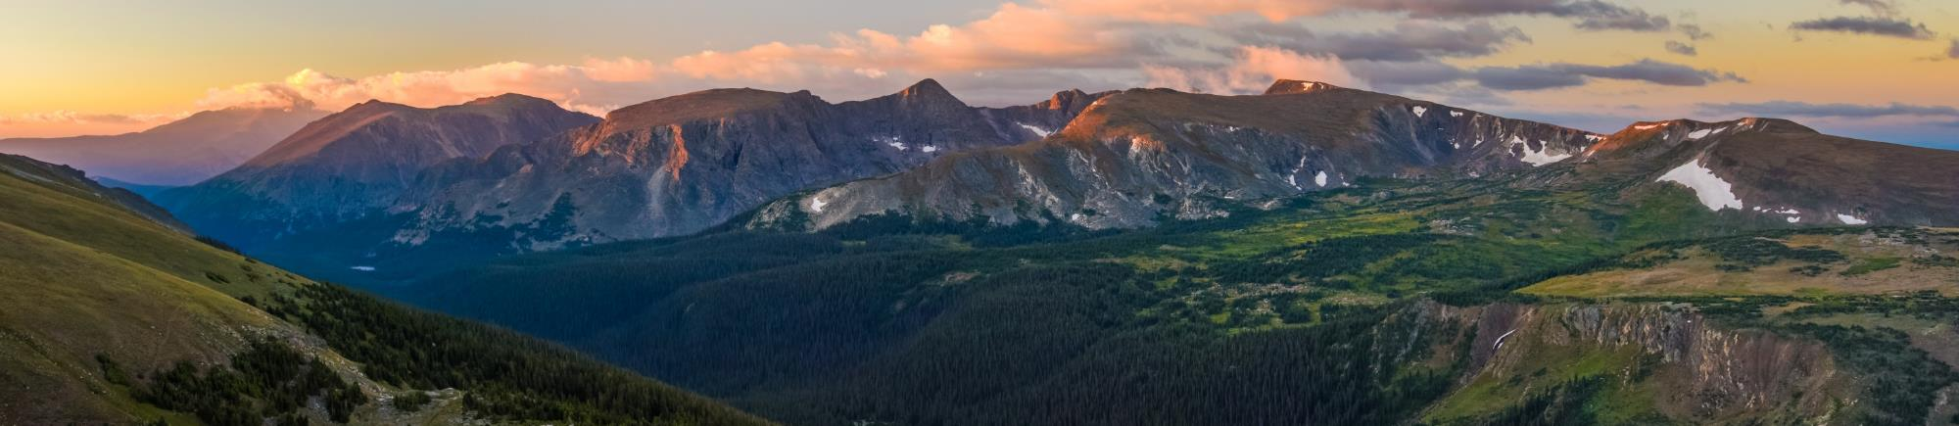
Objectives
Delineate and characterize clearcut harvests over a 30-year Landsat time-series
Identify a variety of forest disturbances within Rocky Mountain National Park
Evaluate the feasibility of identifying forest thinning treatments within the study area
Image Credit: Andrew E. Russell
Notes:
To address our partners’ needs, the Rocky Mountain Agriculture team modeled clearcut harvest disturbances at the landscape level over a 30-year time series.
The team also identified finer-scale disturbances like beetle kill, fire, landslides etc. within the National Park Service Rocky Mountain National Park.
The team also analyzed the feasibility of identifying forest thinning treatments within the study area.
Image Source:
https://www.flickr.com/photos/25949441@N02/14961414078/

Slide 8
Methodology
Data
Data
Statistical
Analysis of
Acquisition
Processing
Modeling
Results
LandsatLinkr
Landsat
Software
Disturbance
Imagery
Supervised
Classification
Maps of the
LandTrendr
Models
Study Area
Digital
Software
Elevation
Model
Topographic
Indices
Preliminary
Disturbance
Ancillary
Outputs
Maps of RMNP
Data
Finalized
Input Data
Notes:
Our workflow highlights four main stages of the Rocky Mountain Agriculture project: Data Acquisition, Data Processing, Statistical Modeling, and Analysis of Results.
The following slides explain the components of each stage in detail.
Image Source: Rocky Mountain Agriculture

Slide 9
Data Acquisition
Landsat 4 & 5 Thematic Mapper (TM)
Landsat 8 Operational Land Imager (OLI)
Shuttle Radar Topography Mission (SRTM)
Landsat 7
Enhanced Thematic Mapper Plus (ETM+)
Data Type | Source
Forest Management Data | Landscape Fire & Resource Management Planning Tools
Harvest History Records | Colorado State Forest Service
Harvest History Records | Bioenergy Alliance Network of the Rockies Feedstock Supply Team
Notes:
Landsat 4 & 5 Thematic Mapper (TM), Landsat 7 Enhanced Thematic Mapper Plus (ETM+), and Landsat 8 Operational Land Imager (OLI) Level-1 imagery from 1986-2015 was acquired for Path 34, Row 32 from United States Geological Survey (USGS) EarthExplorer portal.
After identifying imagery captured during summer through early fall months to minimize snow and cloud cover, Surface Reflectance (SR) and Cloud Mask products as well as Normalized Difference Vegetation Index (NDVI) and Normalized Burn Ratio (NBR) indices were downloaded from the USGS Earth Resources Observation and Science (EROS) Center Science Processing Architecture (ESPA) interface using Bulk Ordering.
Digital Elevation Model (DEM) data from the Shuttle Radar Topography Mission (SRTM) were acquired through the USGS Earthexplorer portal and the USGS National Elevation Dataset (NED) archive as well as the USDA UV-B Monitoring and Research Program’s ColoradoView website.
The SRTM data were 1-arc second, 30 m void-filled DEM whereas NED DEM data were 10 m resolution that were resampled to 30 meters to be consistent with Landsat imagery resolution.
Ancillary data were collected from several different sources. Forest management data were downloaded from Landscape Fire and Resource Management Planning Tools (LANDFIRE), an aggregate database from federal, state, and private environmental data. Other land disturbance records were acquired from the Colorado State Forest Service (CSFS) and Bioenergy Alliance Network of the Rockies (BANR) Feedstock Supply Team.
Image Source:
http://www.devpedia.developexchange.com/dp/index.php?title=List_of_Satellite_Pictures

Slide 10

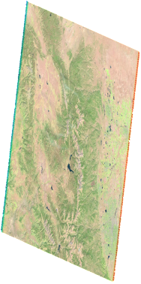
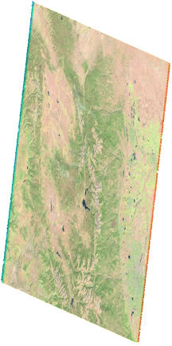
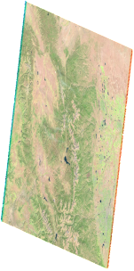
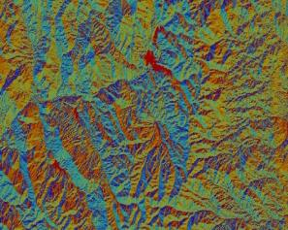
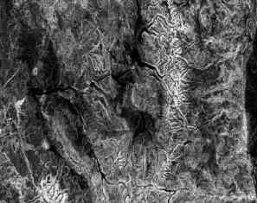
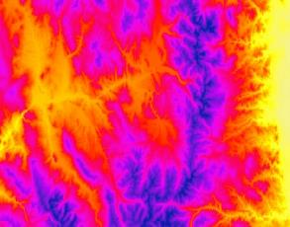
Data Processing
LandsatLinkr
Vegetation
Condition (Index)
Duration
LandTrendr
Elevation Indices
Magnitude
Time (Years)
Notes:
LandsatLinkr was used on the downloaded imagery to create cloud masks, calibrate imagery from different sensors, and stack imagery.
LandTrendr was used to analyze spectral changes in pixels across years and to classify the instances of greatest disturbances according to year, magnitude, and duration of disturbance.
Digital Elevation Model was used to create topographic indices like Slope, Aspect, and Compound Topographic Index (CTI).
Ancillary data containing forest management records were compiled and organized according to disturbance type. Forest management data were visually inspected, and quality assurance was conducted using Google Earth Pro imagery by overlaying forest disturbance history polygons. Accurately classified clear cut harvest polygons were extracted.
Image Sources:
Rocky Mountain Agriculture team

Slide 11
Inputs
Modeling
Functions
Notes:
Software for Assisted Habitat Modeling (SAHM) module package in VisTrails was utilized.
A raster file of our study area (with specified projection, spatial extent, and resolution) was input as the template layer.
Our model covariate inputs were magnitude of disturbance based on Tasseled Cap (Tcap) wetness index, duration of disturbance, pre-event vertex values, elevation, slope, aspect, and CTI.
Image Source:
Rocky Mountain Agriculture team

Slide 12
Outputs
Models
Modeling
Notes:
The five models simultaneously run in SAHM were Boosted Regression Tree (BRT), Generalized Linear Model (GLM), Multivariate Adaptive Regression Spline (MARS), Random Forest (RF) and Maximum Entropy (MaxEnt).
Outputs from all the models were analyzed and compared by their performance. Evaluation statistics included Area Under Curve (AUC), Cohen’s Kappa, True Skill Statistic (TSS), Sensitivity, Specificity, and Percent correctly classified.
Image Source:
Rocky Mountain Agriculture team

Slide 13
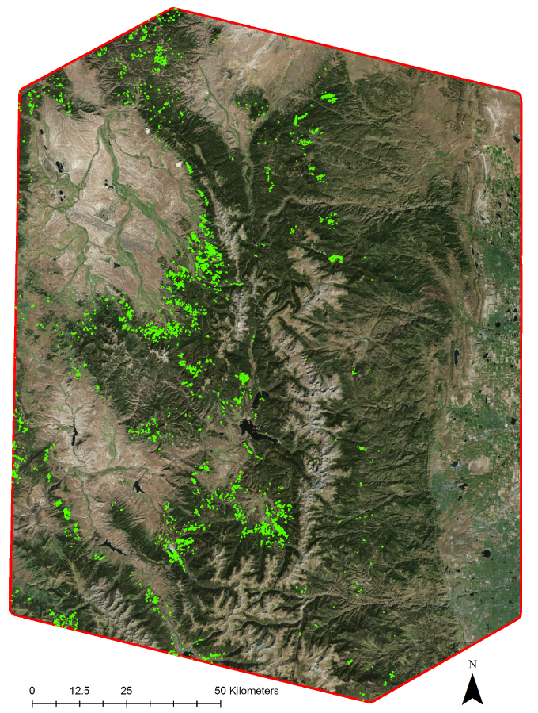
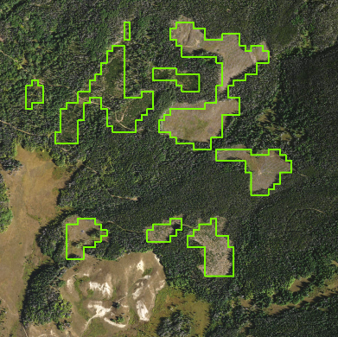
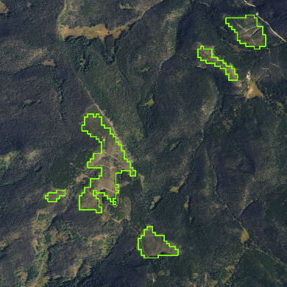
Clearcut Results
Clearcut Harvest Polygons
Study Area Boundary
Notes:
Of all the classification model outputs from SAHM, the Boosted Regression Trees (BRT) model resulted in the best performance with highest evaluation metrics for both training and cross-validation datasets.
This map shows the BRT model output for historical clearcut harvests over the entire study area. The close-up view shows the ability of the BRT model to identify clearcut patches through 30 year time-series
Image Source:
Rocky Mountain Agriculture team

Slide 14
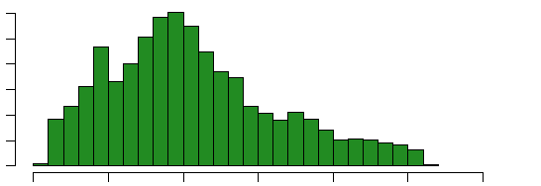
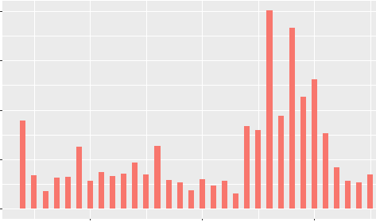
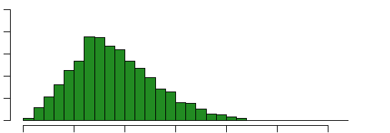
Clearcut Results
Histogram of Elevation of Clearcut Harvests
Clearcut Harvest Area By Year
300
10.0
200
Count
100
7.5
0
2600
2700
2800
2900
3000
3100
3200
Area (km²)
Average Elevation (m)
5.0
Histogram of Slope of Clearcut Harvests
2.5
400
Count
200
0.0
1990
2000
2010
0
Year
0
5
10
15
20
25
30
Average Slope (degrees)
Notes:
The graph on the left shows the area of clearcut harvests in the study area by year.
The upper graph on the right shows the count of clearcut disturbances with respect to elevation in meters. As is seen, highest frequency of clearcuts happened from an elevation of approximately 2750-2850 meters, with a decreasing frequency with elevation after this.
The lower graph on the right shows the count of clearcut disturbance with respect to slope. As seen from the graph, highest number of clearcuts happened at low-to-moderate slopes of 6 to 10 degrees.
Image Sources:
Rocky Mountain Agriculture team

Slide 15
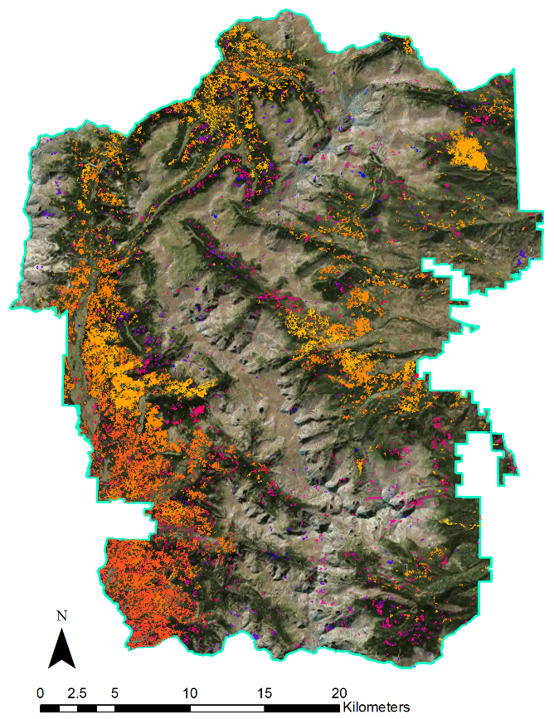
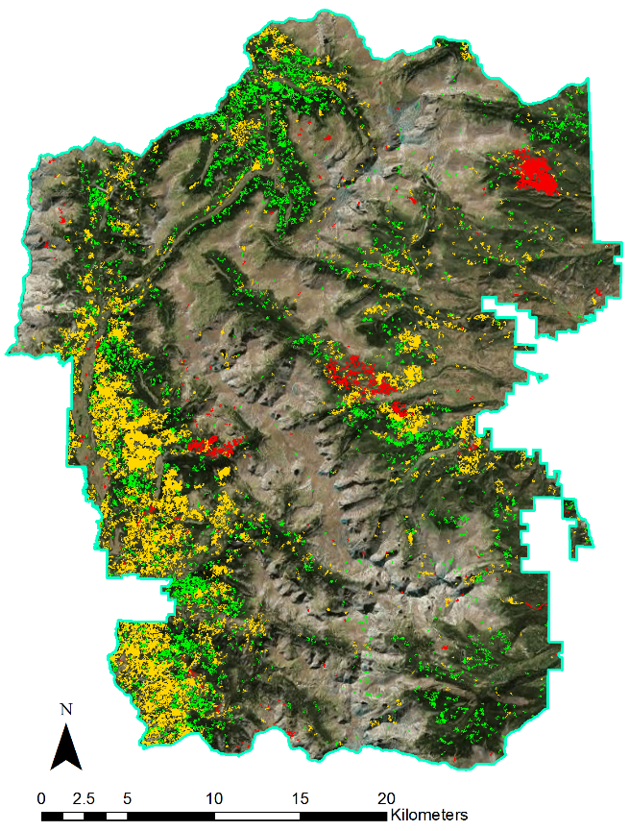
Case Study Results
RMNP
RMNP
1985
Low Magnitude
Medium Magnitude
2015
High Magnitude
Notes:
The figure on the left shows a 30-year disturbance map for Rocky Mountain National Park (RMNP). As seen, the disturbances in the recent past (over last one decade roughly) are more frequent than disturbance two to three decades ago.
The figure on the right shows magnitude of disturbance map for Rocky Mountain National Park (RMNP). Most of the disturbances in the Park were classified as medium level disturbances (like beetle kill) that are spread out over several years.
Image Sources:
Rocky Mountain Agriculture team

Slide 16
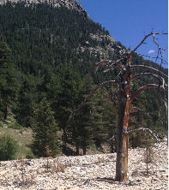
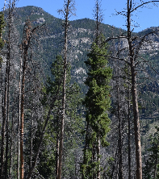
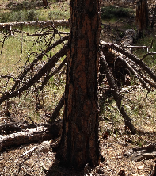
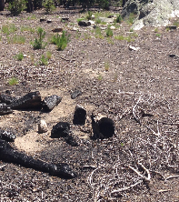
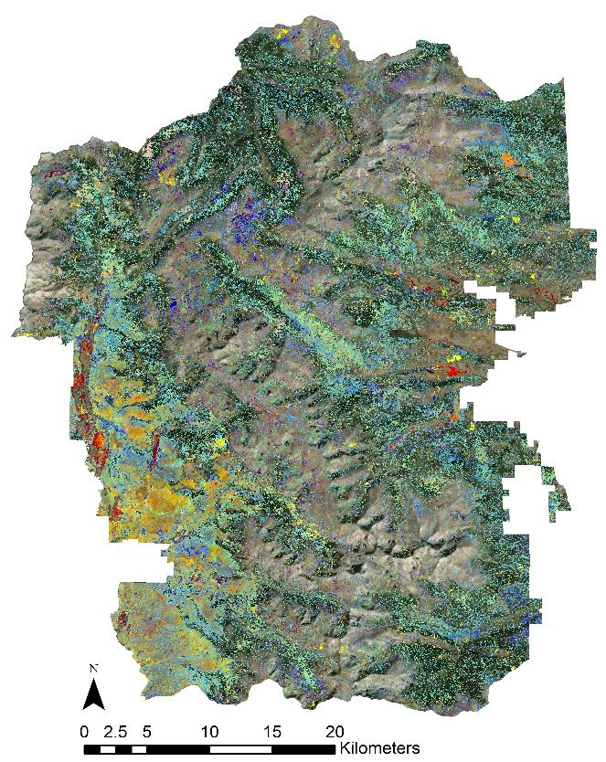
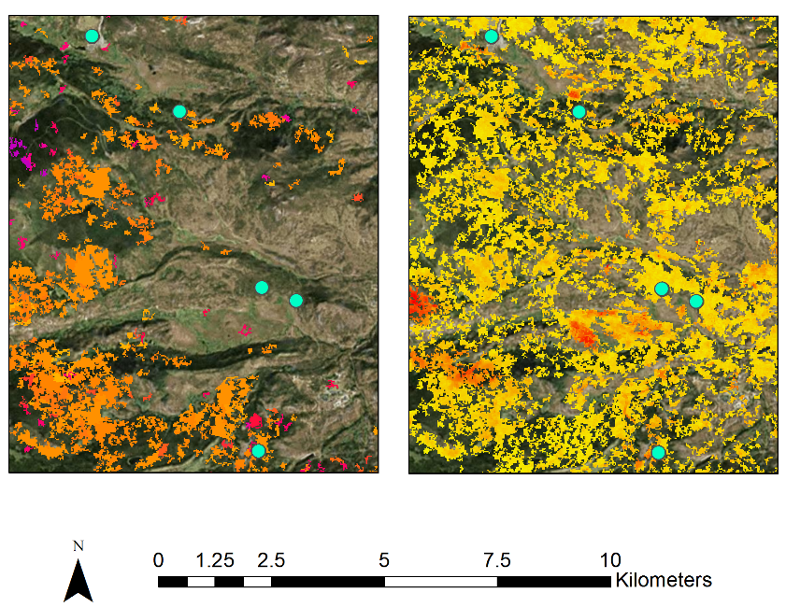
Case Study Results
Fire
Fire
Campground
Construction
Beetle-Kill Trees
Flood
1985
2015
Low
High
Notes:
The figure on the left shows classified disturbance map for RMNP. Several disturbances like forest fires, beetle damage, campground construction-related harvest events and floods were identified.
On the right, are close-up views of disturbances in RMNP. Pictures from left to right show examples of flood, beetle kill, fire, and harvest events.
Image Sources:
Rocky Mountain Agriculture team

Slide 17
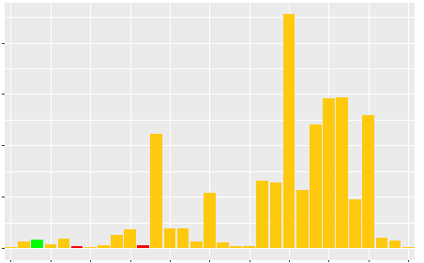
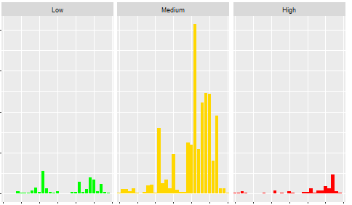
Case Study Results
RMNP Disturbance Area By Year
RMNP Disturbance Area By Magnitude and Year
1985
1988
1991
1994
1997
2000
2003
2006
2009
2012
2015
400
400
300
300
Area (km²)
Area (km²)
200
200
100
100
1985
1990
1995
2000
2005
2010
2015
1985
1990
1995
2000
2005
2010
2015
1985
1990
1995
2000
2005
2010
2015
0
0
Low Magnitude
Medium Magnitude
High Magnitude
Low Magnitude
Medium Magnitude
High Magnitude
Notes:
The graph on the left demonstrates disturbance area by year in RMNP. The high magnitude events are shown in red, medium in yellow and low in green. As is seen, most of the disturbances in RMNP were of medium magnitude with an increase in overall disturbed area occurring between 2004 and 2012.
The graph on the right is another representation of disturbed area in RMNP. It highlights low, medium, and high magnitude disturbances in green, yellow, and red, respectively, as well as the total area that was affected.
Image Sources:
Rocky Mountain Agriculture team

Slide 18
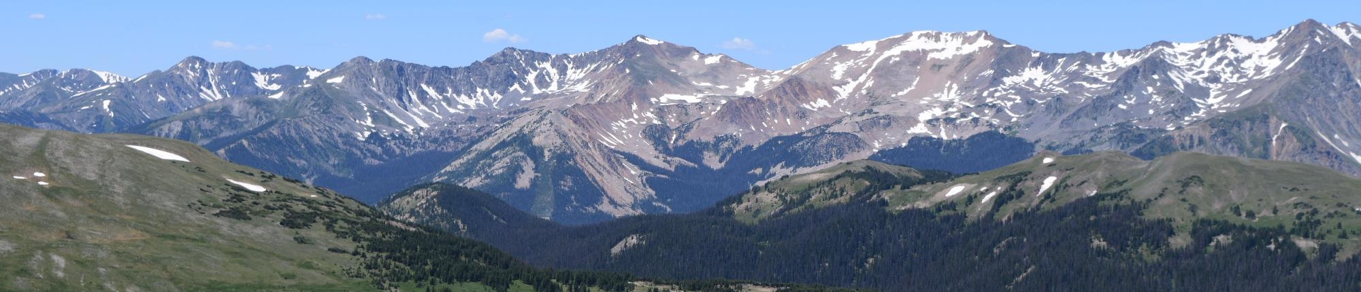
Conclusions
Delineated clearcut harvests at landscape-scale
Analyzed the feasibility of delineating thinning harvests
Identified fine-scale disturbances within Rocky Mountain National Park
Provided maps to inform management decisions & improve forest resiliency
Image Credit: Colorado Agriculture Team
Notes:
Supervised classification model outputs successfully facilitated the delineation of clearcut harvest events at the landscape-scale throughout the study area.
The feasibility of delineating thinning harvests was also explored. However, with a lack of authoritative data, we were unable to apply the same methodology as we did to identify clearcut harvests.
Fine-scale disturbances were accurately identified within Rocky Mountain National Park through further analysis of the landscape-scale products.
Final maps and other end products will better inform project partners and land managers about how their management decisions can improve forest resiliency.
Image Source:
Rocky Mountain Agriculture team

Slide 19

Errors and Uncertainties
Number of cloud-free images
Quantity and quality of training data points including true-absence points
Authoritative ancillary datasets
Image Credit: Rainer Shutz
Notes:
The first limitation is cloud-free imagery over similar phenological time periods. Using imagery from different, but related phenological time period causes land cover changes to become muted through mosaicking the images together, which ultimately results in noise in the outputs.
Possible error may stem from our training points not fully representing all of the spectral signatures within our study area.
Model may perform better if true-absence points are inputted, which was not the case for our study due to limitation of true-absence ground data.
Having additional authoritative geospatial datasets on subtle disturbance types (i.e. thinning) may enable further refinement of our data.
Image Source:
https://www.flickr.com/photos/rschuetz/6249688381/

Slide 20
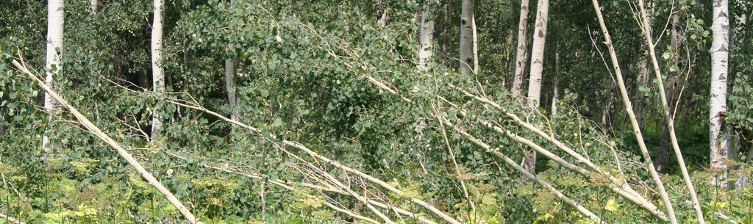
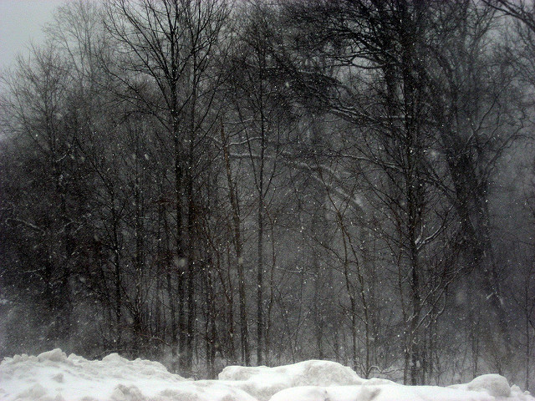
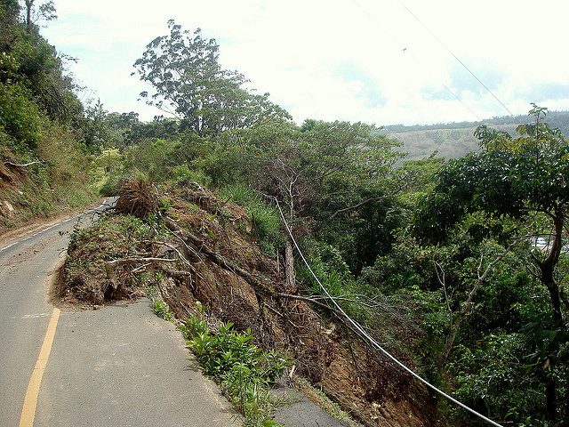
Future Work
Images Credits: Micah Coleman, Patty, and Angelysty
Expand study area to encompass a larger spatial extent
Refine methodology to improve fine-scale disturbance delineation
Validate results with extensive field data
Notes:
Our study area could also be expanded to encompass a larger percentage of Rocky Mountain forests.
Future work could entail attempts to detect other disturbances like windfalls, landslides, and storm events.
The expansion of training data, exploration of new data sources, and additional testing of model parameters will continue to refine our methodology.
We also highly recommend future ground validations of model outputs. Additional data from field surveys could improve the confidence in disturbance classification types and overall model accuracy.
Image Sources:
https://www.flickr.com/photos/micahcoleman/2781978702/
https://www.flickr.com/photos/angelysty/4347038928/
https://www.flickr.com/photos/ant_march/4438665074/

Slide 21
Advisors
Dr. Paul Evangelista (Colorado State University Natural Resource Ecology Laboratory)
Tony Vorster (Colorado State University Natural Resource Ecology Laboratory)
Partners
Hanem Abouelezz (National Park Service Rocky Mountain National Park)
Dr. Tony Cheng (Colorado Forest Restoration Institute)
Ryan Anderson (Bioenergy Alliance Network of the Rockies Feedstock Supply Team)
Others
Brian Woodward (Colorado State University Natural Resource Ecology Laboratory)
Catherine Jarnevich (United States Geological Survey)
Michael Caggiano (Colorado Forest Restoration Institute)
Justin Braaten (Oregon State University, Lab for Applications of Remote Sensing in Ecology)
Geoffrey Clark (National Park Service Rocky Mountain National Park)
Dave Frey (National Park Service Rocky Mountain National Park)

