Slide 1
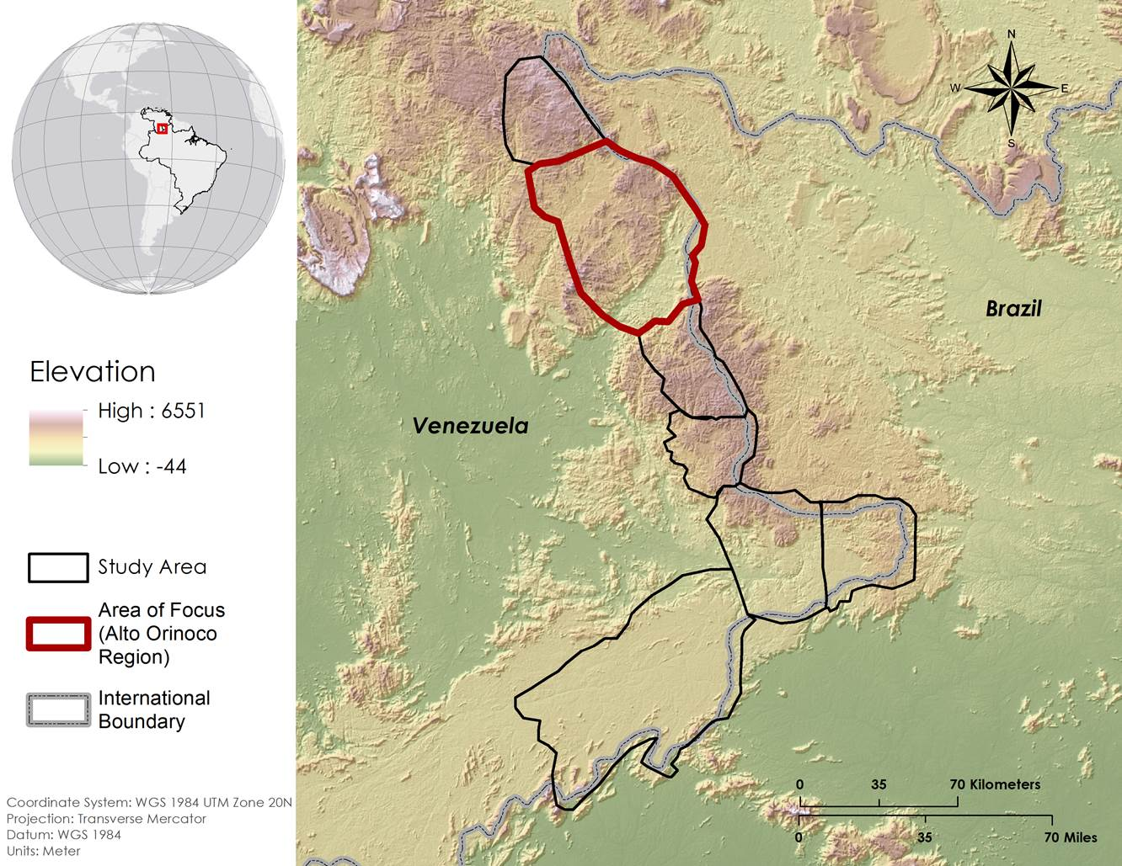
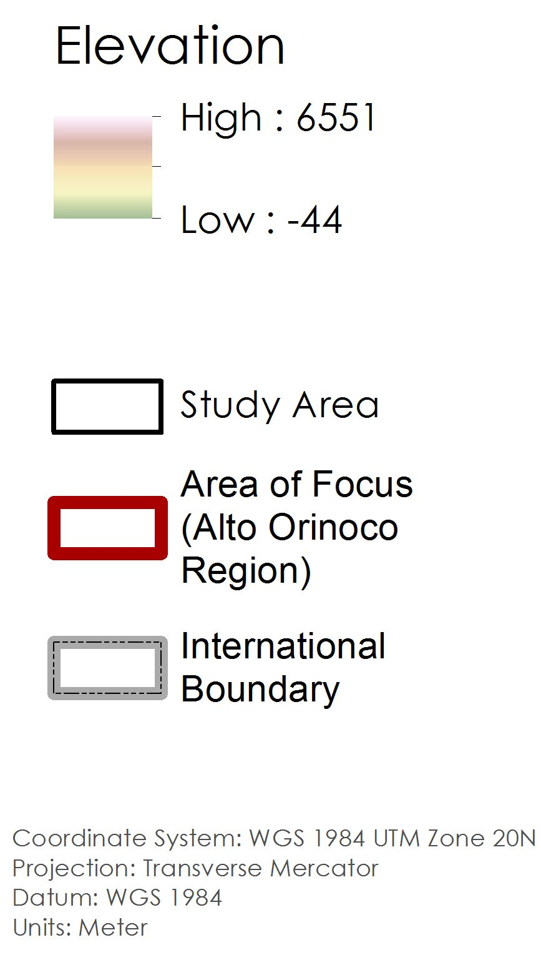
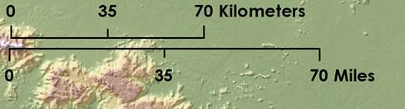
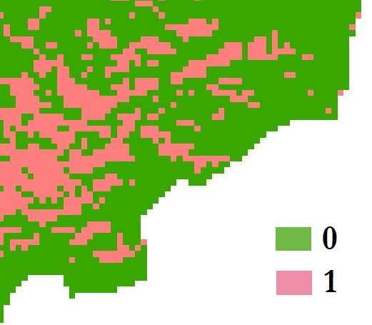
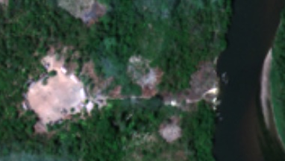
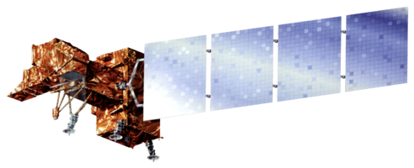
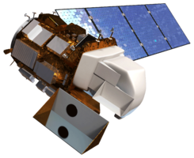
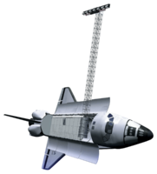
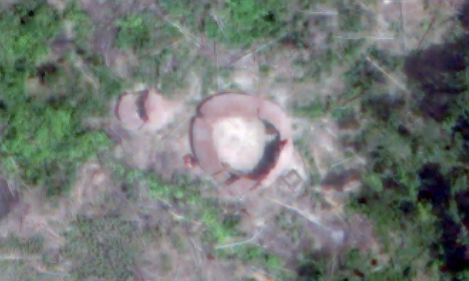
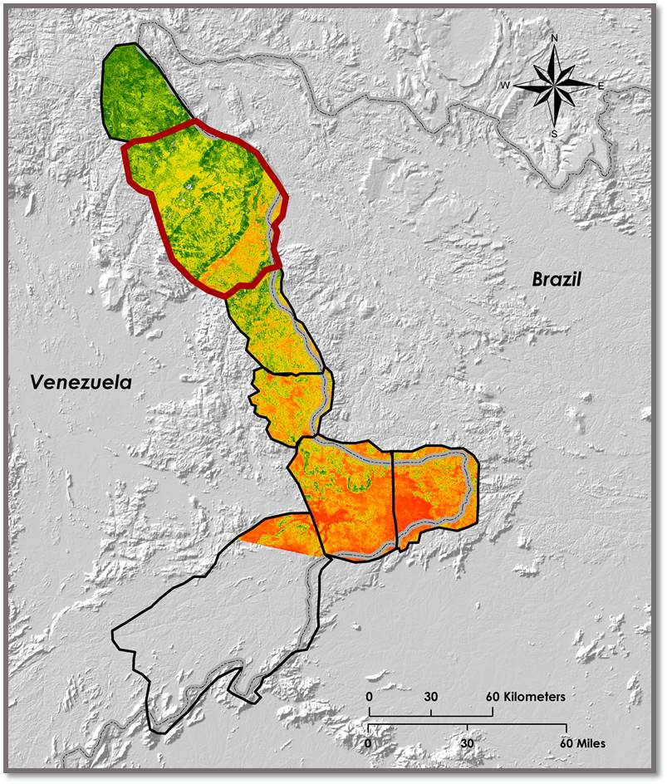
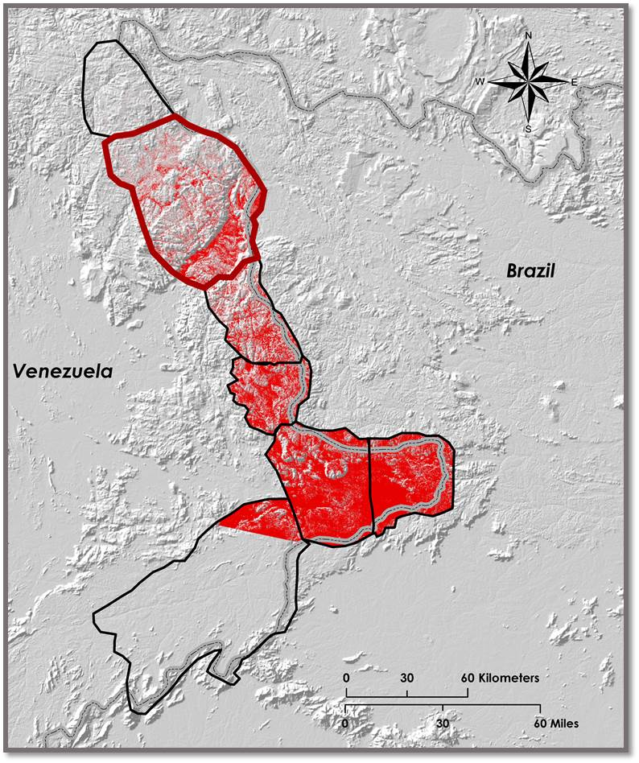
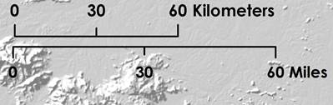
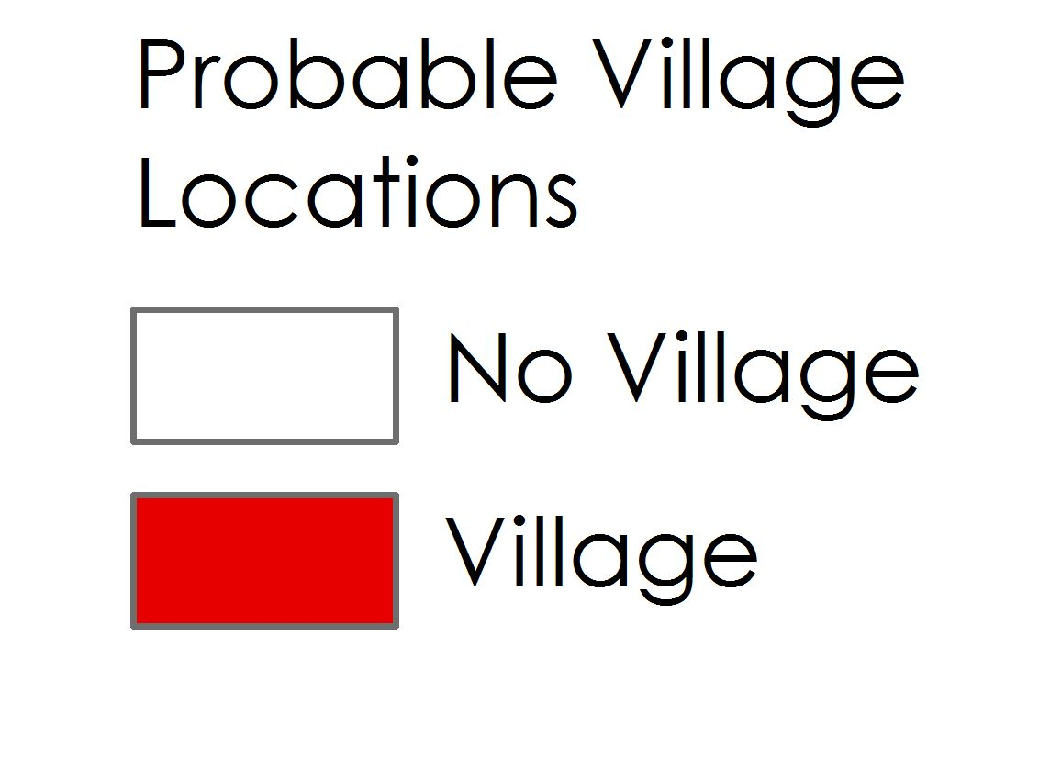
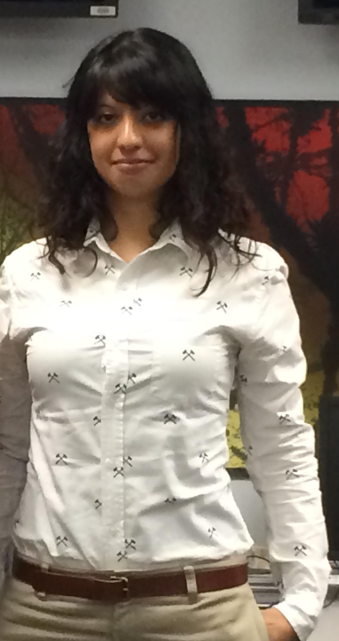
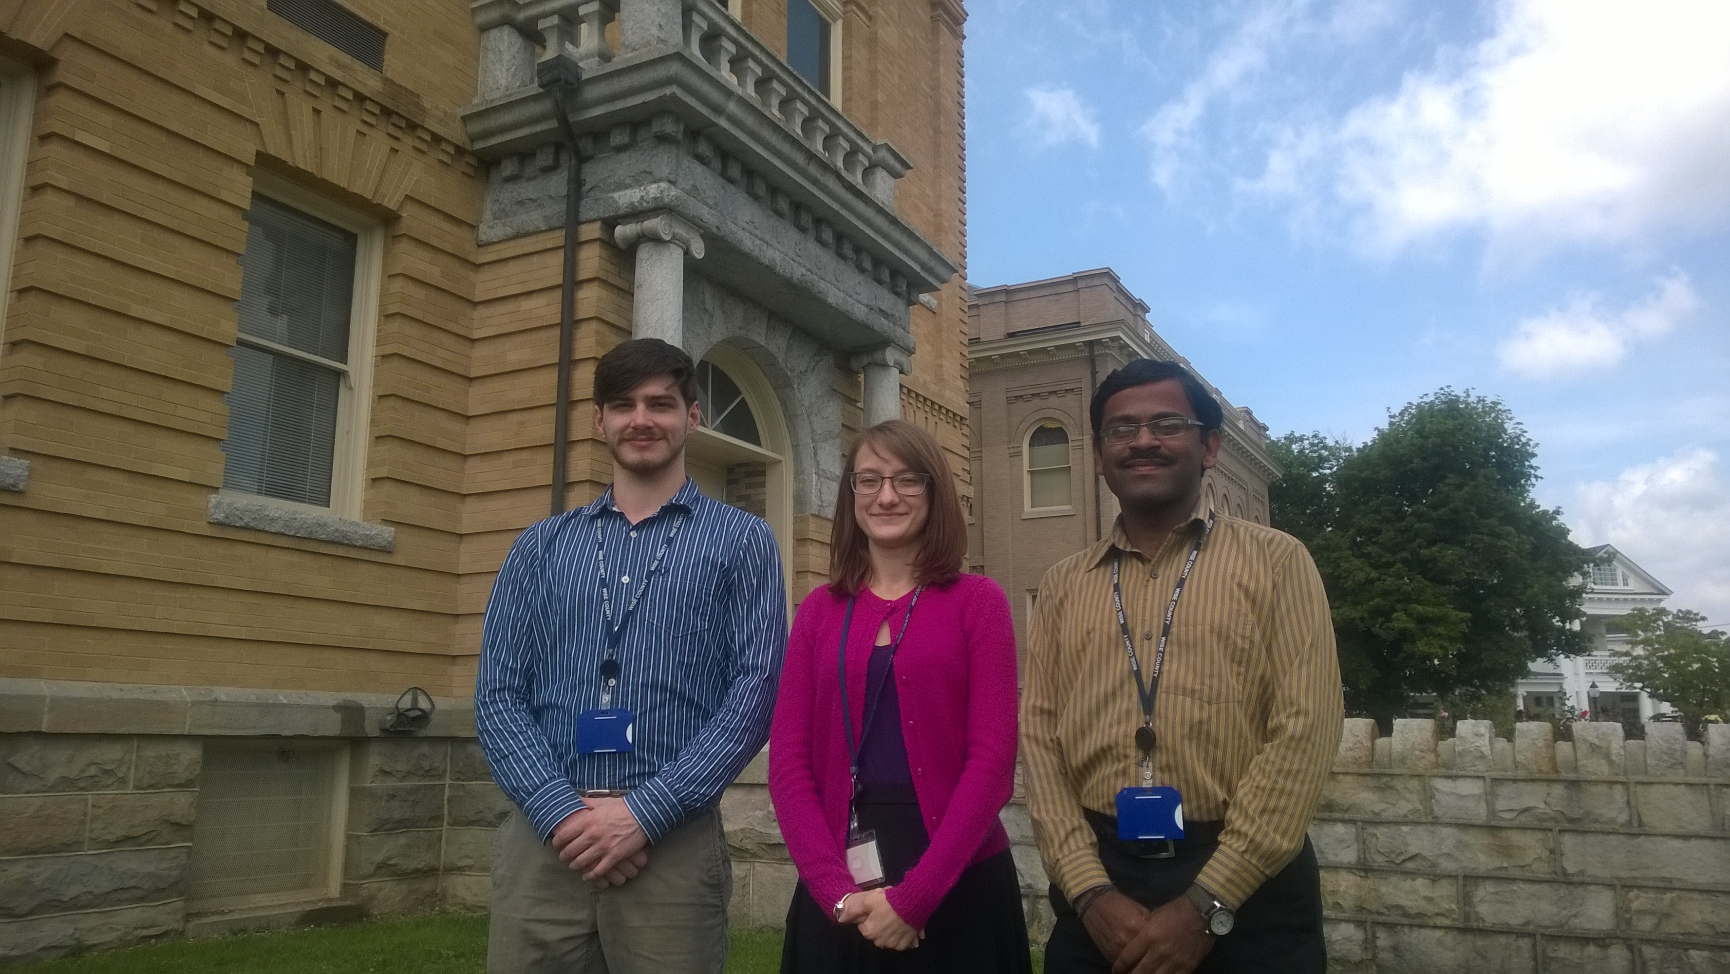
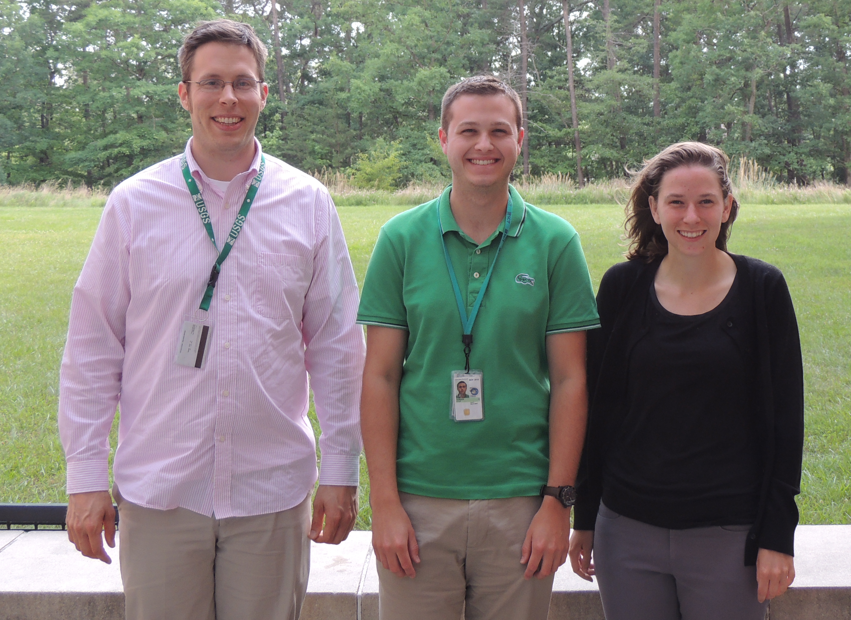
Alto Orinoco Health & Air Quality
Utilizing NASA Earth observations to locate remote Yanomami villages in the Alto Orinoco Municipality for targeted eradication of River Blindness disease
Goddard Space Flight Center: Amanda Rumsey (Project Lead), Timothy Larson, Kyle Sowder
Wise County and City of Norton Clerk of Court’s Office: Rajkishan Rajappan (Project Lead), Annabel White, Zachary Tate
Marshall Space Flight Center: Sara Amirazodi (Project Lead)
NASA DEVELOP National Program
Abstract
Objectives
Onchocerciasis, or River Blindness, is a treatable disease caused by the vector-borne parasite, Onchocerca volvulus. The parasite is transmitted through bites of infected black flies from the genus Simulium. Once inside the human host, O. volvulus migrate to the skin, various organs, and eyes, causing debilitating itching and rashes, disfigurement, visual impairment, and complete blindness. The Alto Orinoco Municipality of Venezuela is the last remaining area for active transmission of onchocerciasis in the Americas. Yanomami tribes occupy the Alto Orinoco Municipality in secluded rainforest villages and migrate frequently due to shifting cultivation, flooding, and food shortages. The remote locations of the Yanomami villages present a unique set of challenges to health workers when distributing regular treatments, collecting data, and locating groups of nomadic people whose survival depends on relocating regularly and living in isolation. The NASA DEVELOP team analyzed data from NASA’s Landsat 8 Operational Land Imager (OLI) and Thermal Infrared Sensor (TIRS) and Terra Advanced Spaceborne Thermal Emission and Reflection Radiometer (ASTER) to map suspected locations of the Yanomami villages from 2005 to 2015. Spectral analysis, cloud masking, and classification techniques along with DigitalGlobe high-resolution data were utilized to locate villages. A suitability model was also created using Landsat 8 OLI/TIRS and Shuttle Radar Topography Mission (SRTM) data. Ultimately, this project assisted The Carter Center River Blindness Elimination Program in targeting its efforts to eliminate onchocerciasis in the Americas by the end of 2015.
Provide The Carter Center with accurate locations of Yanomami villages for efficient planning of missions aiming to eradicate onchocerciasis
Develop a suitability model to assist The Carter Center in identification of Yanomami settlements and migration patterns
Study the vegetation and soil properties of the study area
Study Area
Methodology
Locating Villages
Suitability Model
Pixel-by-Pixel Composition
Cloud Pixel Replacement
Data Processing
Statistical Analysis
Results
Input Data
Cloud Mask Creation
15 Landsat 8 Scenes
15 Cloud Masks
Cloud-free Composite Image
Classification/Analysis
Classification
Identifying Villages
Earth Observations
K-means Unsupervised Classified Image
Located Villages using DigitalGlobe Imagery and Classification
Results
Landsat 7 ETM+
Landsat 8 OLI/TIRS
SRTM
Village Location Shapefile
Village ID
Village Diameter
Number of Huts
Temporal Information
DigitalGlobe Sensor
Population Estimate
Results
Conclusions
Yanomami Village Statistics
Suitability Model Results: Probable Village Locations
163 Yanomami villages were identified in the Alto-Orinoco region
Suitability maps that depict the probability of finding a village and probable village locations were created
The probable location map has not only a high accuracy of locating villages but also has a high commission rate
The Carter Center can use the probable location map to find the majority of Yanomami village locations in the study region
The Carter Center will use this information to deliver treatment and eradicate onchocerciasis
Yanomami Villages Identified: 163 | Population Estimate: 3125
Acknowledgements
Team Members
True Positive: 77% | False Negative: 23%
False Positive: 49% | True Negative: 51%
Dr. Jim Tucker (NASA Goddard Space Flight Center)
Kel Markert (University of Alabama in Huntsville)
Dr. Kenton Ross (NASA DEVELOP)
Dan Irwin (SERVIR Program Director)
Dr. John D. Bolten (NASA Goddard Space Flight Center)
Dr. Jeff Luvall (NASA at National Space Science and Technology Center)
Dr. Robert Griffin (University of Alabama in Huntsville)
Katie Melocik (NASA Goddard Space Flight Center)
Dr. Thomas Unnasch (University of South Florida)
Melanie Salyer, Mentor (Wise County)
Project Partners
The Carter Center
Left to Right: Sara Amirazodi, Zachary Tate, Annabel White, Rajkishan Rajappan , Timothy Larson, Kyle Sowder, Amanda Rumsey
NASA Goddard Space Flight Center, NASA Marshall Space Flight Center, Wise County Clerk of Court’s Office

