Slide 1
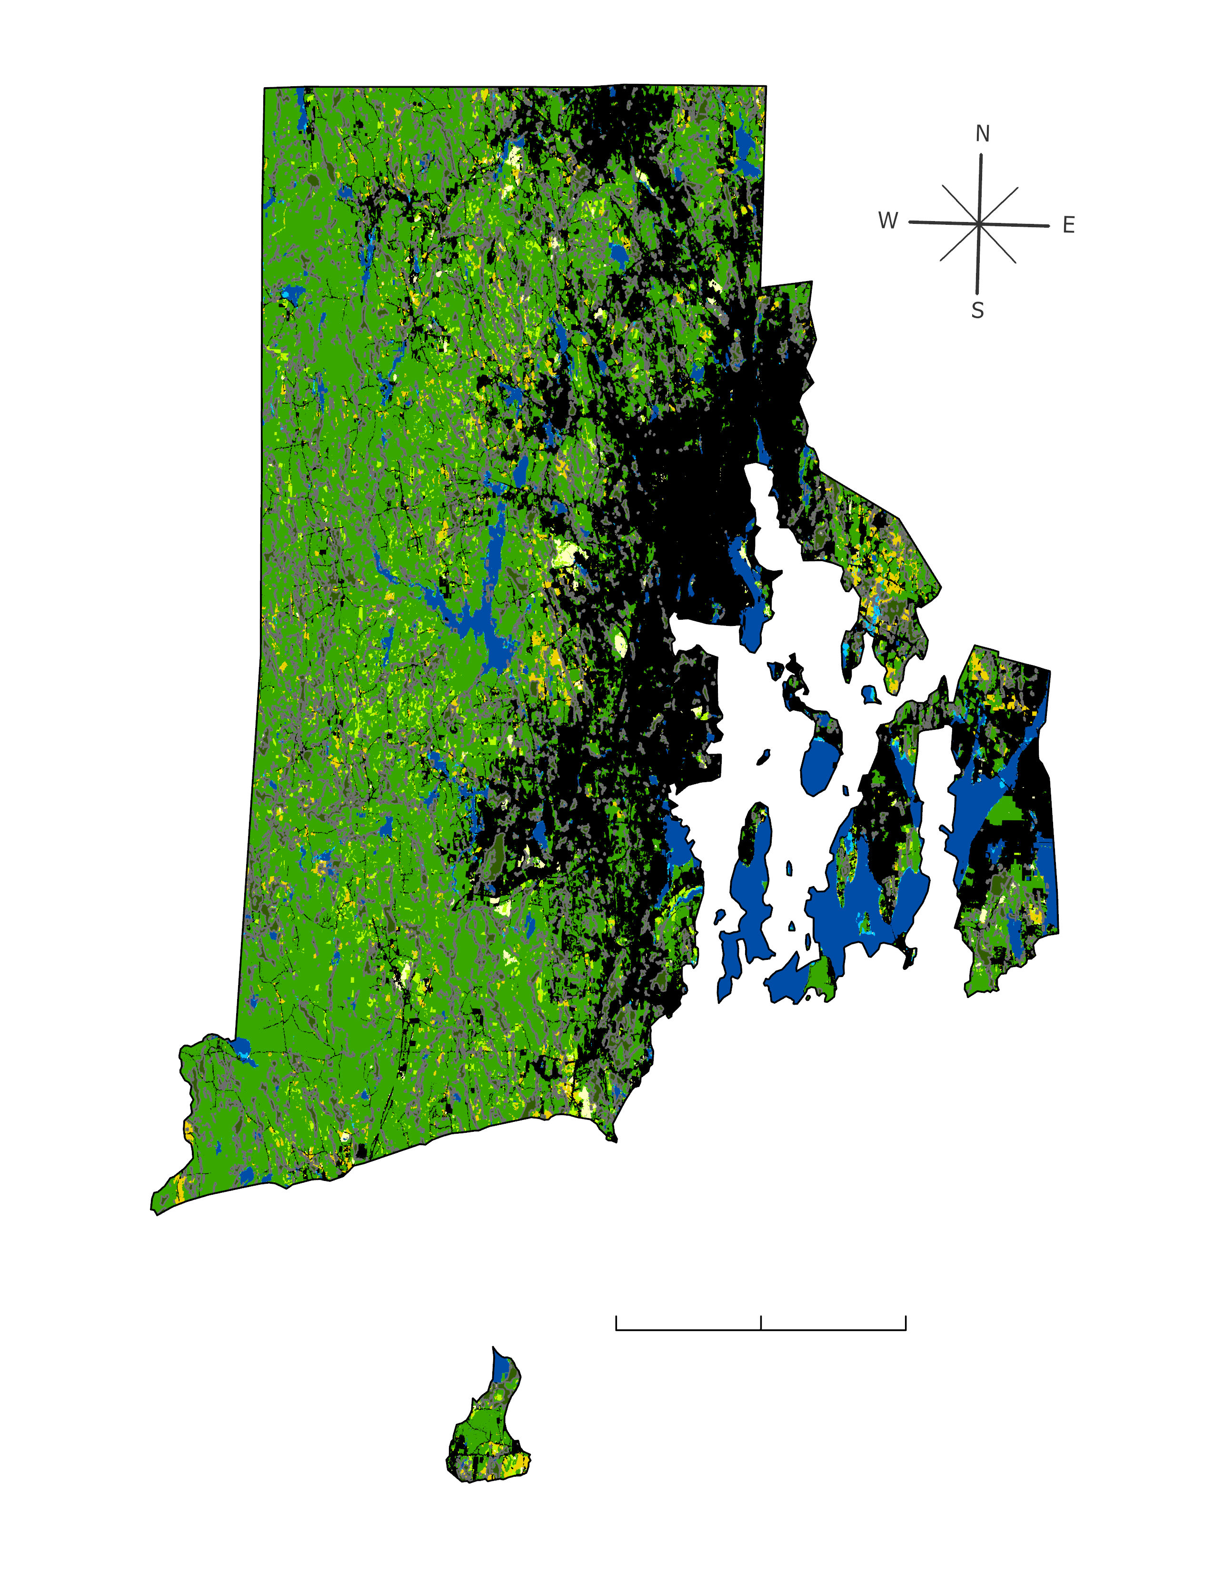
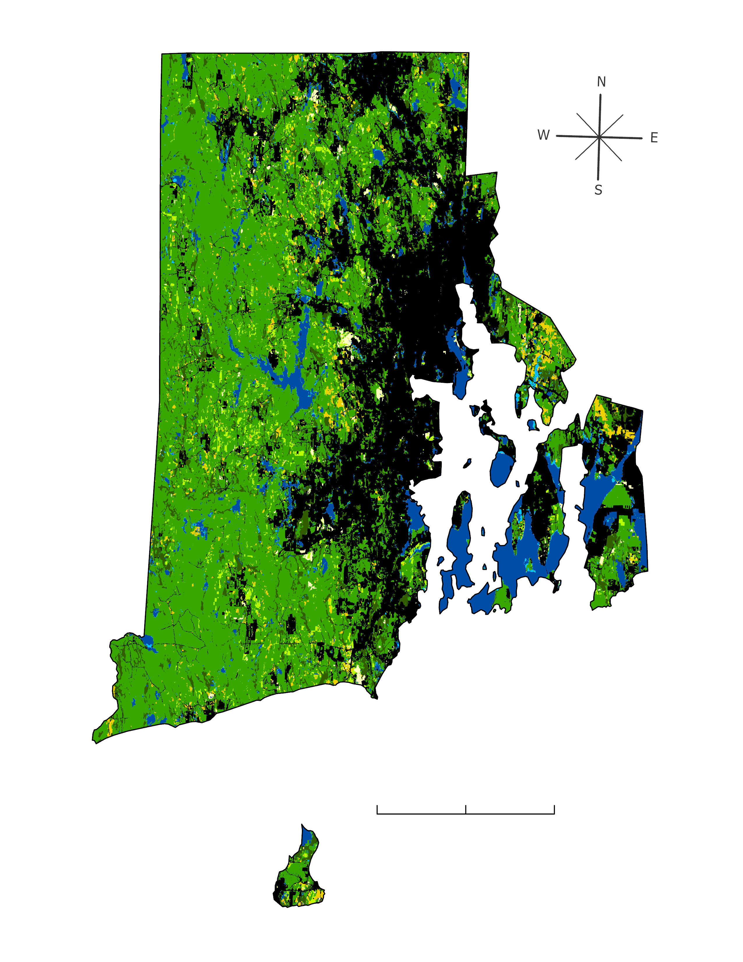
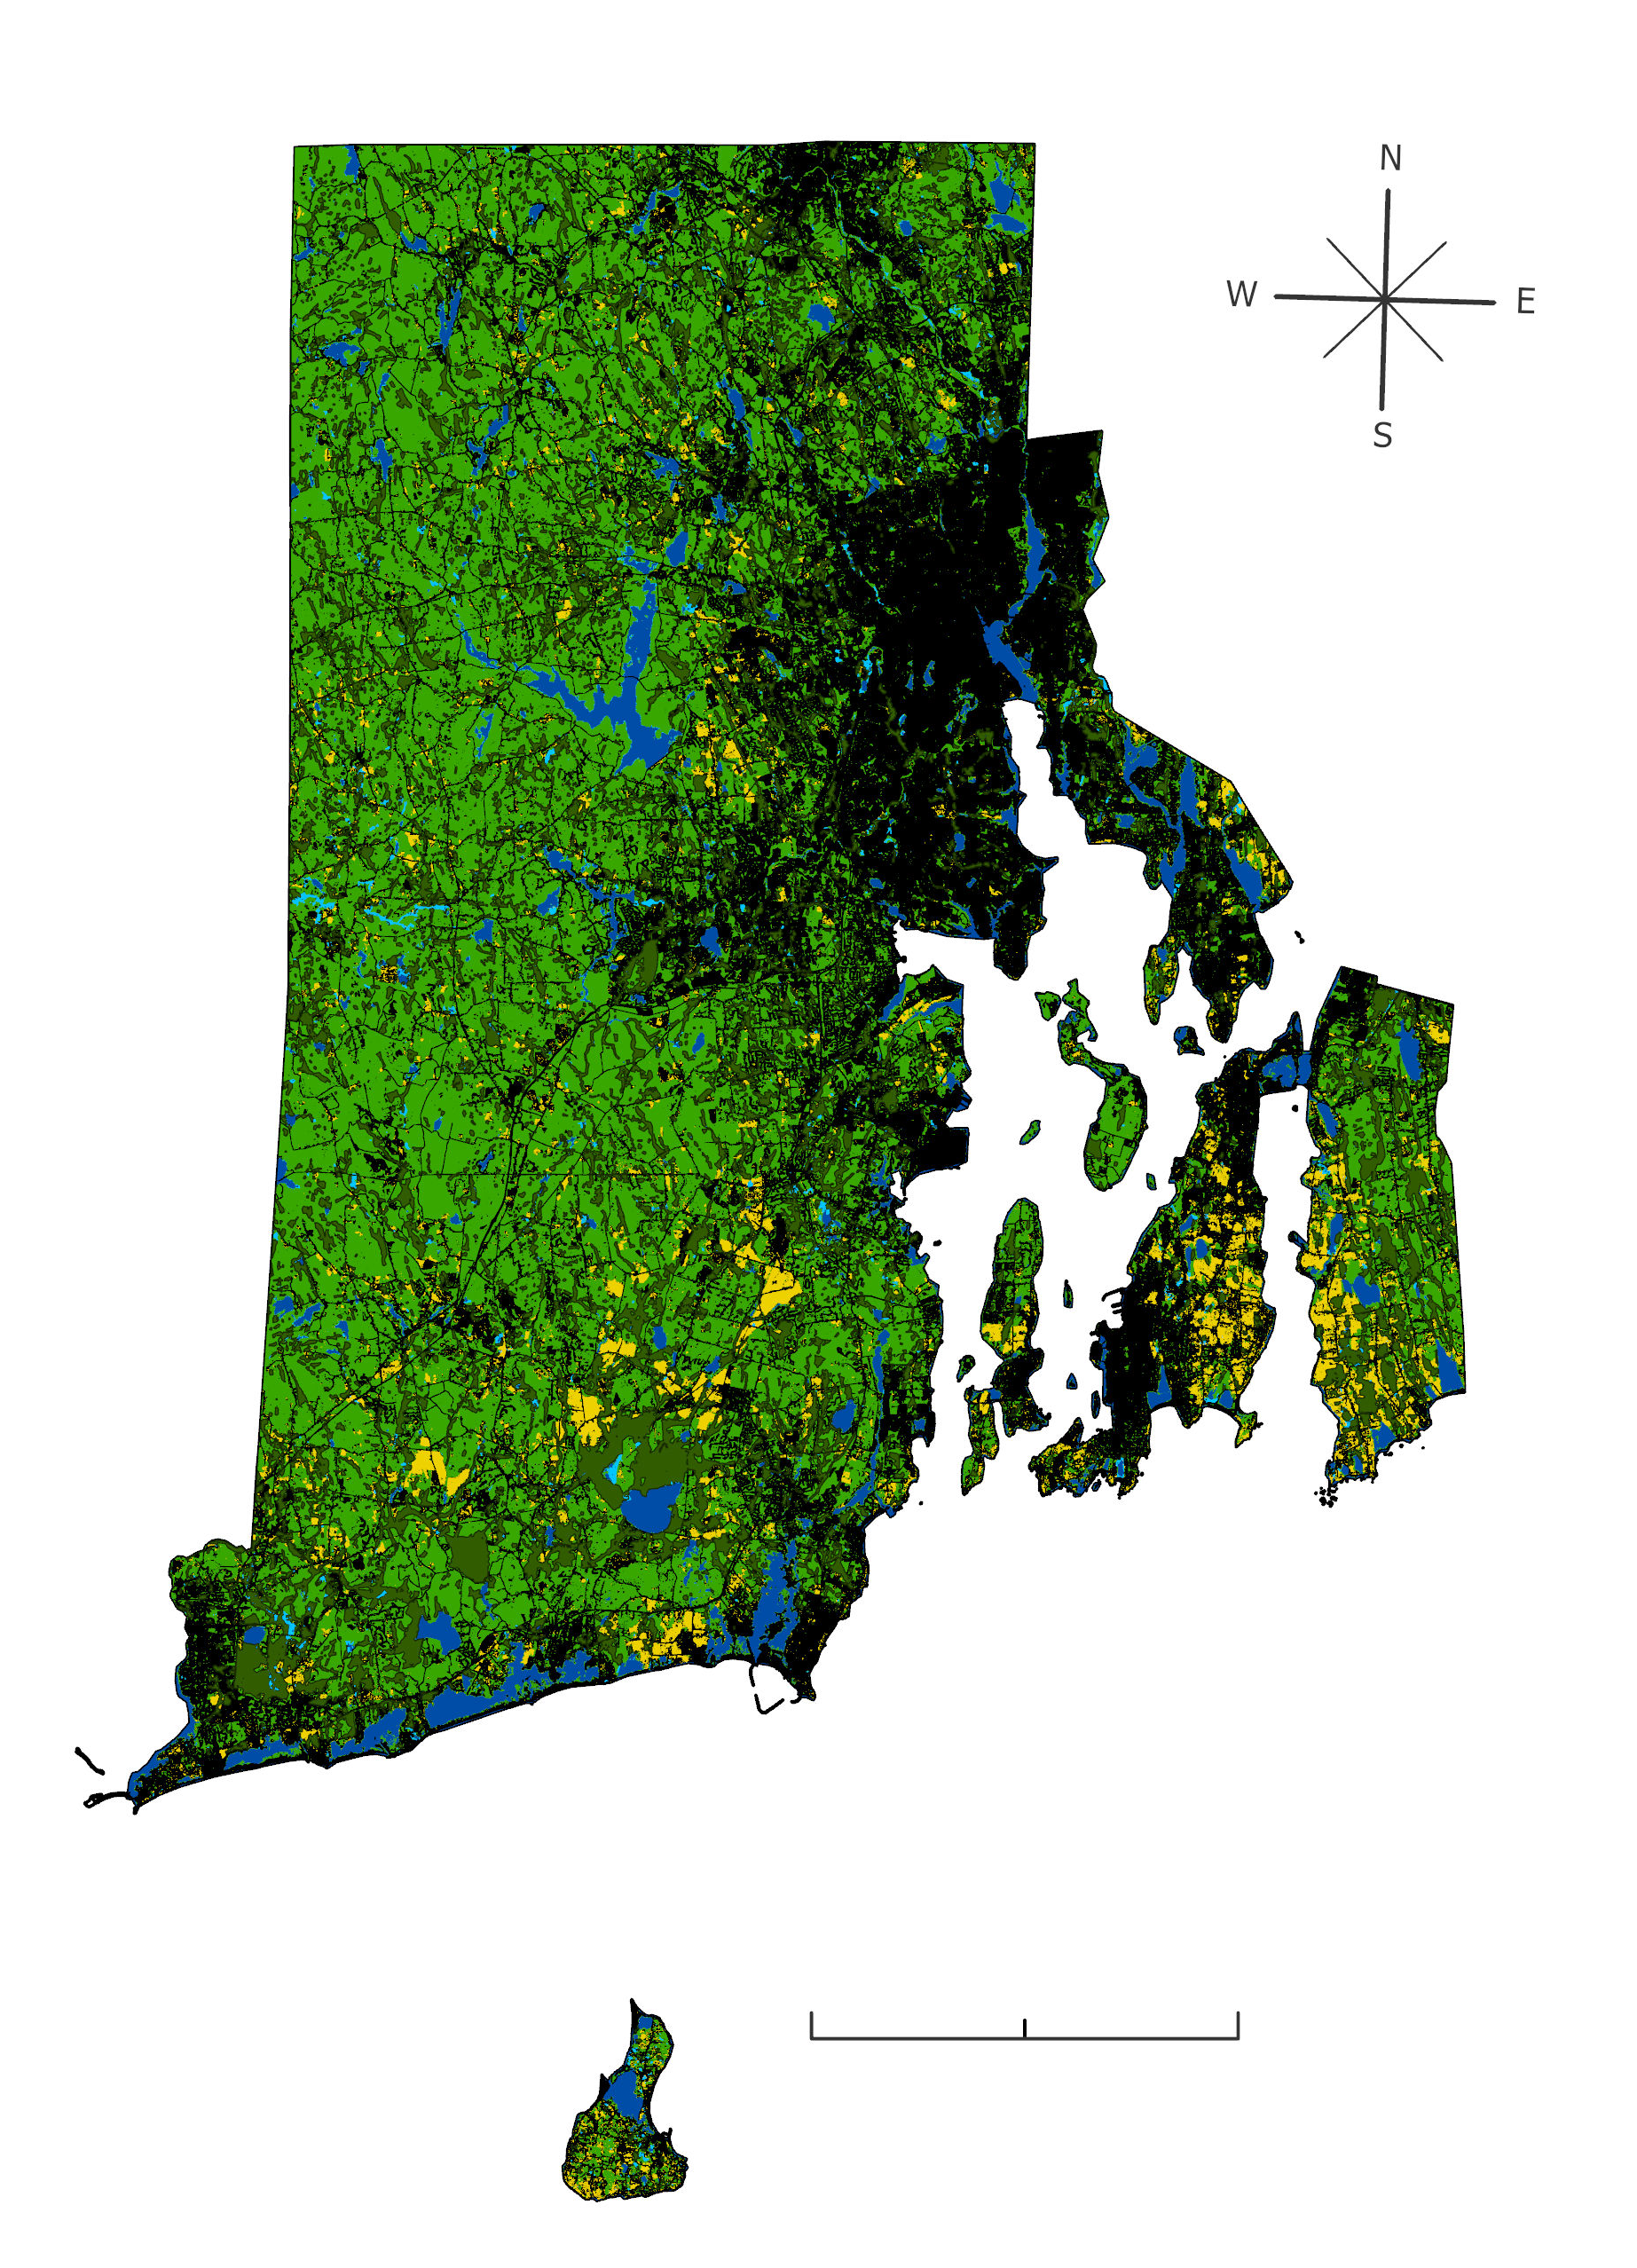
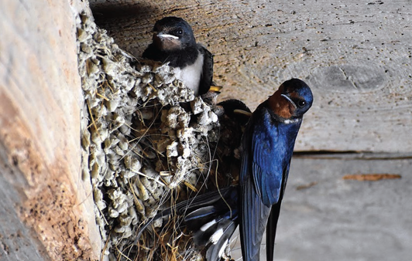
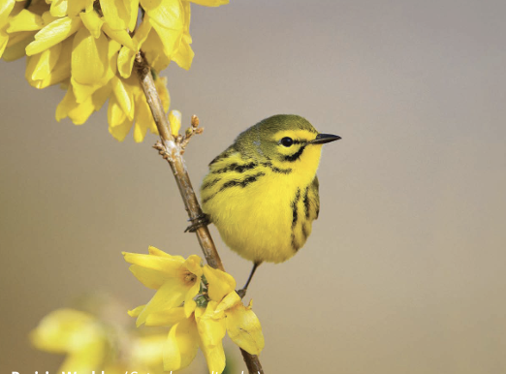
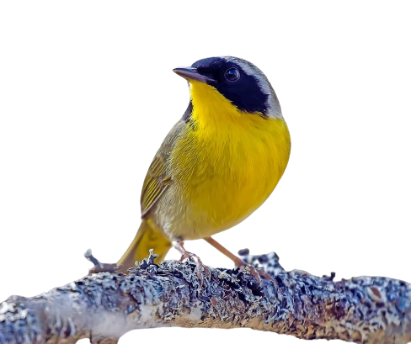
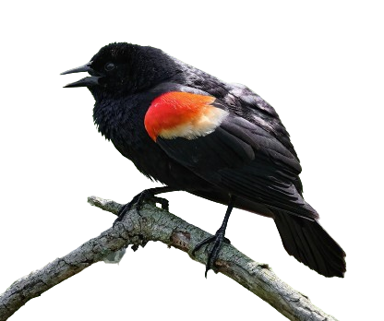
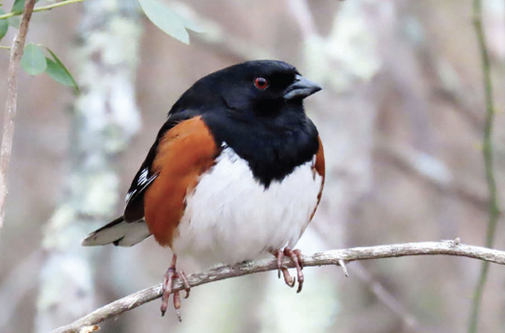
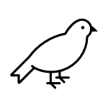
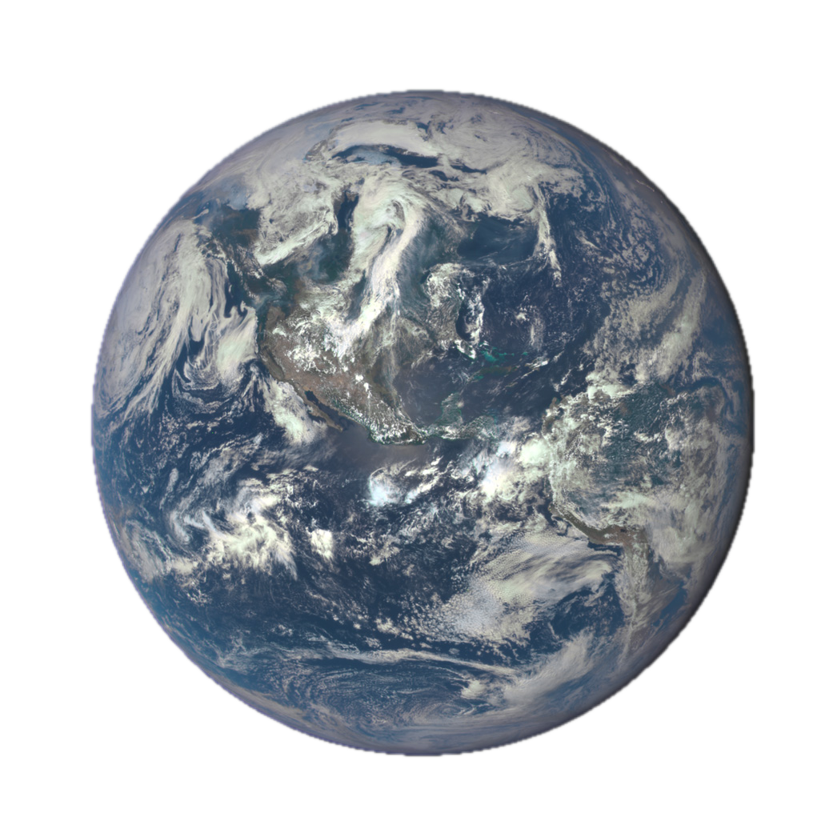
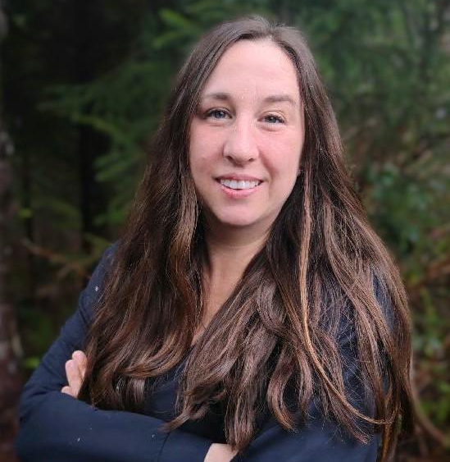
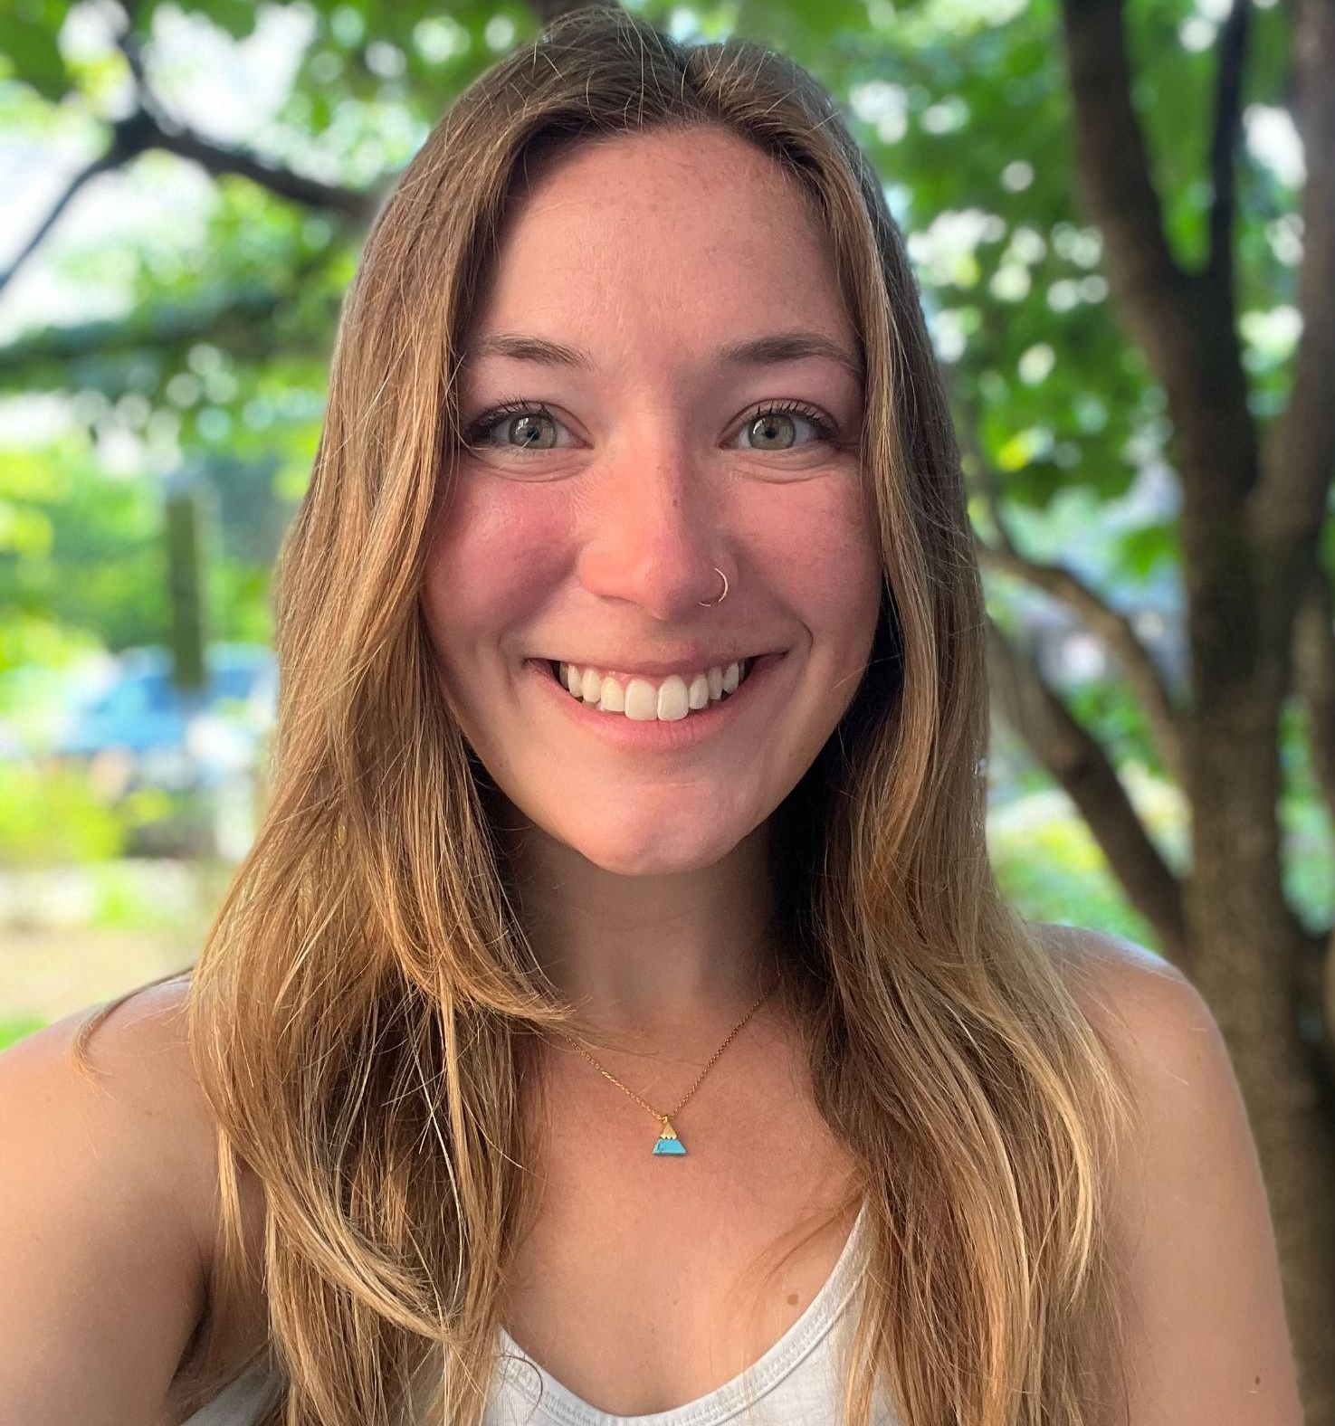
Methods for Monitoring Rhode Island Habitats:
Contributing to a Framework for Targeted Conservation and Management
Projected Land Usage in Rhode Island 2026–2043
2026
2032
2037
2043
0
10
20
km
0
10
20
km
0
10
20
km
0
10
20
km
Developed
Forest/Shrub Scrub
Grassland/Herbaceous
Woody Wetlands
Non-Woody Wetlands
Agricultural
Barren
Open Water
Based on ecological forecast models conducted using National Land Cover Database (NLCD) data, Rhode Island could see an increase in development and a decrease in wetland habitat over the next 20 years. Many bird species, such as the red-winged blackbird (Agelaius phoeniceus) and common yellow-throat (Geothlypis trichas) (both pictured below) may be negatively impacted by these changes due to habitat loss. Existing wetlands and other habitat areas could be prioritized for conservation where development expansion is shown in these forecasting maps.
Current Land Cover in Rhode Island
LULC Mapping is ‘For the Birds’
2023 Land Use Land Cover (LULC)
Upland Forest, Shrub, & Grasslands
40.7 % (286,051 acres)
Developed, Open Space, & Barren
38.7 % (272,091 acres)
Over 140 avian species call Rhode Island home throughout the year!
common yellow-throat (Geothlypis trichas)
red-winged blackbird
(Agelaius phoeniceus)
Woody Wetlands
11.7 % (82,063 acres)
Rhode Island bird populations have drastically declined in recent years, primarily due to habitat loss.
Open Water
4.5 % (31,616 acres)
The Audubon Society of Rhode Island is the second largest landowner in Rhode Island, with approximately 10,000 acres of land under their stewardship.
Agricultural
3.8 % (26,435 acres)
Audubon works to acquire habitat areas for conservation. Updated land cover classifications of avian habitats along with projected land cover change in Rhode Island can support land acquisition decisions.
Non-Woody Wetlands
0.6 % (4,360 acres)
0
10
20
km
This project utilized imagery from Landsat 9 OLI-2
May 2023
Satellites can give us a ‘bird’s eye view’ of land cover patterns and changes over time.
Rhode Island Ecological Conservation
Team Members
Lead
Project Partner
Advisors
Kathryn Caruso
DEVELOP/NOAA NCEI
Dr. Charles Clarkson,
Rhode Island Audubon Society
Joseph Spruce
Analytical Mechanics
Associates, Inc.
Natasha Crater
Project Lead
Kristen Mecke
Participant
Nancy Nthiga
Participant
Joseph Barnes
Participant
Many thanks to our contributors!
Sylvia Reeves
NOAA NIDIS
North Carolina – NCEI | Spring 2024
Notes:
Color scheme: Colorbrewer color blind color approved.
Photos (top to bottom):
[1] Common yellow-throat (Geothlypis trichas): Audubon Society of Rhode Island (emailed to use for use)
[2] Red-winged blackbird (Agelaius phoeniceus): Audubon Society of Rhode Island (emailed to us for use)
[3] NASA landsat 9: https://landsat.gsfc.nasa.gov/satellites/landsat-9/landsat-9-overview/
[4] NASA Earth image: https://earthobservatory.nasa.gov/images/151541/on-this-day-in-2015-an-epic-new-view-of-earth
[5] Eastern Towhee (Pipilo erythrophthalmus) https://asri.org/stateofourbirds/2023.html (permission given to use from Audubon Society of Rhode Island)
[6] Barn Swallow (Hirundo rustica) https://asri.org/stateofourbirds/2023.html (permission given to use from Audubon Society of Rhode Island)
[7] Prairie Warbler (Setophaga discolor) https://asri.org/stateofourbirds/2023.html (permission given to use from Audubon Society of Rhode Island)
Icons: Powerpoint native

