Slide 1
2019 Fall
NATIONAL
ORIENTATION
MODULE 8. Resources
Notes:
Your project Website Image should be placed behind the hexagon grid. An example image has been placed in this position for your reference. Delete the example image, insert your image, right click your image and select the “Send to Back” option. Position and adjust the size of your image so that it lines up with the provided margin rulers.

Slide 2
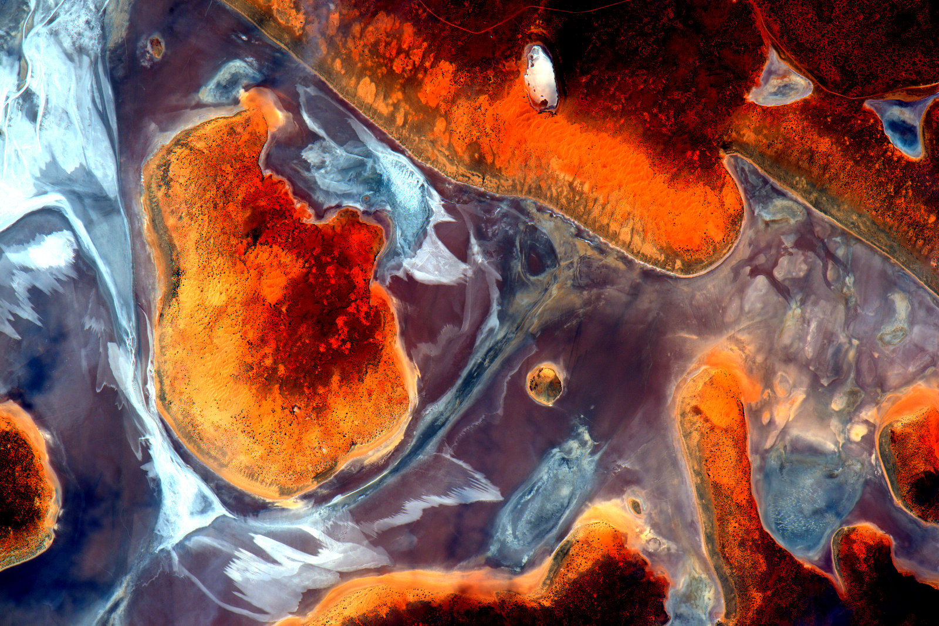
DEVELOPedia
POCs:
Danny Mangosing & Amanda Clayton
DEVELOPedia is an internal wiki intended to serve three purposes:
Enhance project workflow
Capture lessons learned and make them available to future project teams
Record data required for operational metrics
DEVELOPedia is a collaborative effort whose utility is directly related to the efforts of previous DEVELOP participants.
DEVELOPedia is a living document, constantly adapting to meet the needs of the NASA DEVELOP National Program and the people that make the program great (That’s you!).
Training Resources Homepage: http://www.devpedia.developexchange.com/dp/index.php?title=Training_Resources_Homepage
Geospatial Programs and Methods
Remote Sensing
Code and Programming Tutorials
Technical Skill Development
Professional Development: EdX Classes, Coursera Classes, Alison Classes
http://www.devpedia.developexchange.com

Slide 3
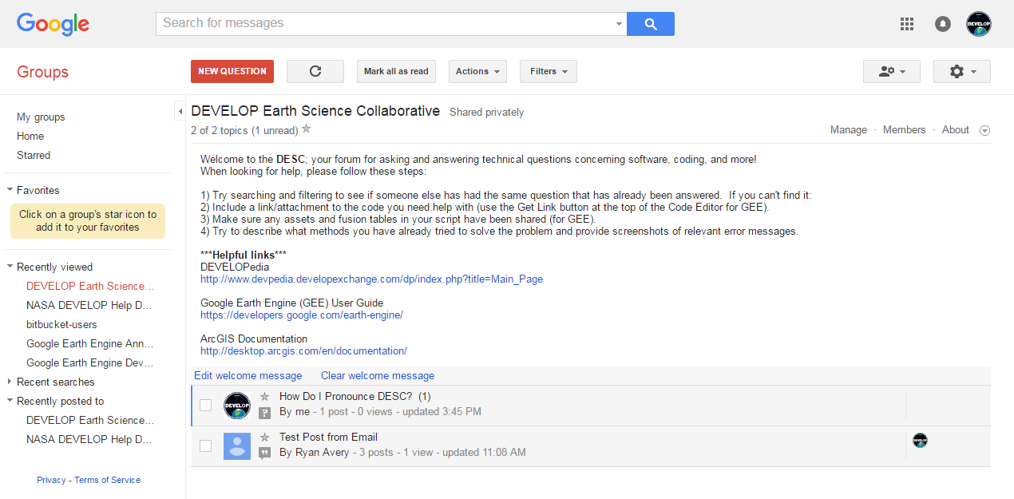
DEVELOP Earth Science Collaborative
A forum for software, geospatial, and coding questions
Can email forum directly like a regular email address
Copy link, go join, and bookmark the DESC on your favorite browser!
https://groups.google.com/d/forum/developesc

Slide 4
Nodes
Alabama – Marshall (MSFC) | DEVELOP.AlabamaMarshall@gmail.com
California – JPL (JPL) | DEVELOP.CaliforniaJPL@gmail.com
Arizona – Tempe (AZ) | DEVELOP.ArizonaTempe@gmail.com
Boston – Massachusetts (MA) | DEVELOP.MassachusettsBoston@gmail.com
California – Ames (ARC) | DEVELOP.CaliforniaAmes@gmail.com
Colorado – Fort Collins (CO) | DEVELOP.ColoradoFortCollins@gmail.com
Idaho – Pocatello (ID) | DEVELOP.IdahoPocatello@gmail.com
Georgia – Athens (GA) | DEVELOP.GeorgiaAthens@gmail.com
Maryland – Goddard (GSFC) | DEVELOP.MarylandGoddard@gmail.com
North Carolina – NCEI (NC) | DEVELOP.NorthCarolinaNCEI@gmail.com
Virginia – Langley (LaRC) | DEVELOP.VirginiaLangley@gmail.com

Slide 5
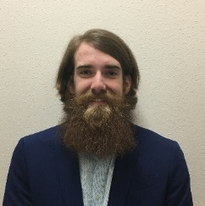
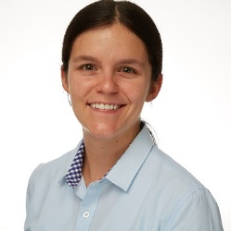
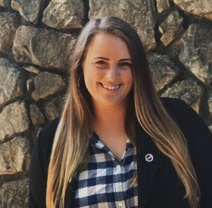
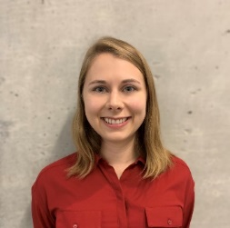
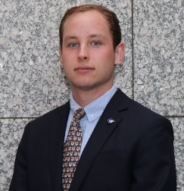
Fellows
National Support Initiatives
Geoinformatics:
Gina, Kristen, Mason, & Crystal
Project Coordination:
Zach, Sydney, & Shelby
Impact Analysis:
Andrew & Cecil
Communications:
Madison & Celeste
Gina Cova
ARC
Kristen Dennis
CO
Mason Bull
ID
Celeste Gambino
MA
Zach Bengtsson
ARC
Shelby Ingram
GA
Cecil Byles
JPL
Madison Murphy
MSFC
Crystal Wespestad
AZ
Abigail Barenblitt
GSFC
Sydney Neugebauer
LaRC
Andrew Shannon
NC

Slide 6
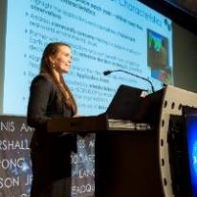
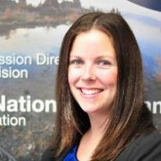
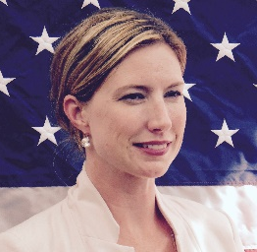
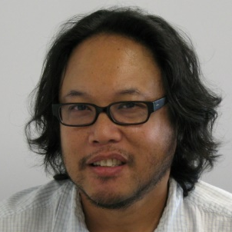
NPO & Senior Fellow
Deliverables, publications, presentations, conferences, deadlines, international work, webinars, partners, project hand-offs, proposals, Fellow positions
Amanda: 757-864-5552 Amanda.L.Clayton@nasa.gov
Timesheets, travel, schedule adjustments, paperwork, online application system, SSAI POC
Karen: 757-864-1276 Karen.N.Allsbrook@nasa.gov
Programmatic questions, budget, communications, social media approvals, media requests, NASA
Lindsay: 757-864-7283 Lindsay.M.Rogers@nasa.gov
Employment status, offer letters, SSAI application, SSAI systems, employment verifications, SSAI POC
Stephanie: 757-864-4498 Stephanie.Burke@ssiahq.com
DEVELOP Website, software release, interactive mapper, software licenses, IT, communications
Danny: 757-864-3762 daniel.c.mangosing@nasa.gov
Tracking metrics, indicators, socioeconomic impact analysis, PSI, participant surveys, alumni survey, using the national telecon line
Danielle: 757-864-5548 Danielle.L.Quick@nasa.gov

Slide 7
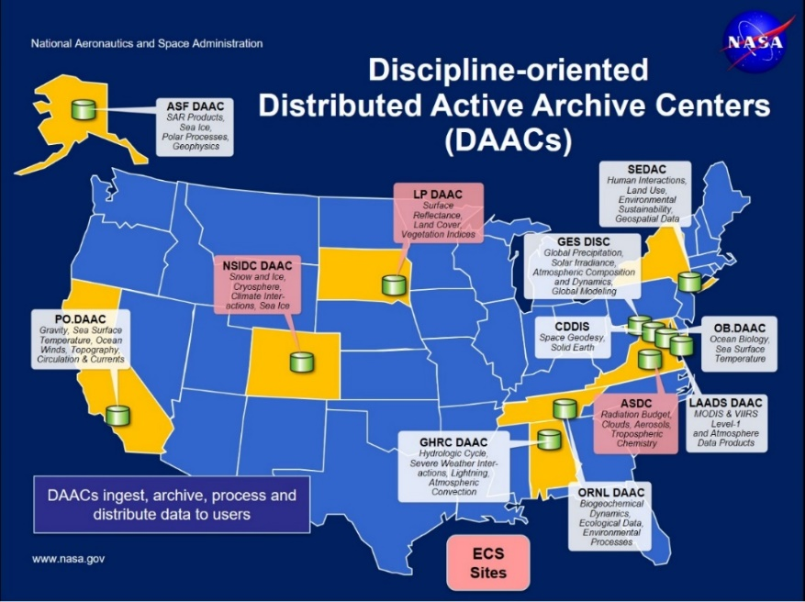
NASA Data Centers
Earth Observing System Data and Information System (EOSDIS) is designed as a distributed system, with major facilities at Distributed Active Archive Centers (DAACs) located throughout the United States.
These institutions are custodians of EOS mission data and ensure that data will be easily accessible to users.
The EOSDIS DAACs process, archive, document, and distribute data from NASA's past and current Earth-observing satellites and field measurement programs.
Acting in concert, the DAACs provide reliable, robust services to users whose needs may cross the traditional boundaries of a science discipline, while continuing to support the particular needs of users within the discipline communities. User services include:
Assistance in selecting and obtaining data
Access to data-handling and visualization tools
Notification of data-related news
Technical support and referrals
EOSDIS Distributed Active Archive Centers (DAACs)
https://earthdata.nasa.gov/about/daacs
Earth Data Search
https://search.earthdata.nasa.gov/search

Slide 8
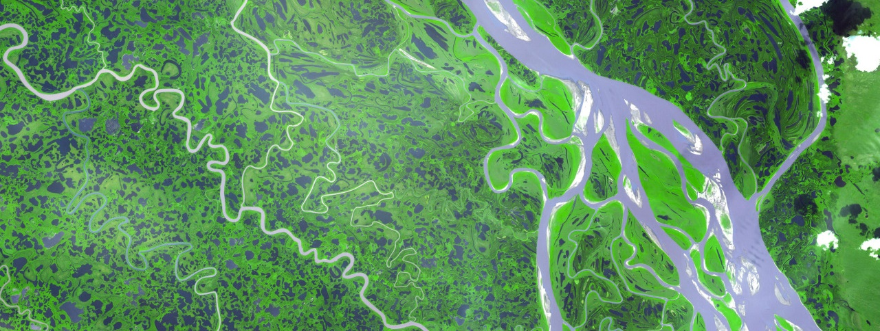
ARSET Trainings
Through ARSET trainings, you can learn how to:
Use NASA data for environmental management
Search and access NASA resources relevant to your needs
Visualize, interpret, and apply remote sensing data and imagery
Remote Sensing Fundamentals: These webinars are available for viewing at any time. They provide basic information about the fundamentals of remote sensing, and are often a prerequisite for other ARSET trainings. https://arset.gsfc.nasa.gov/webinars/fundamentals-remote-sensing
Session 1: Fundamentals of Remote Sensing
Session 2A: Satellites, Sensors, Data and Tools for Land Management and Wildfire Applications
Session 2B: Satellites, Sensors, and Earth Systems Models for Water Resources Management
Session 2C: Fundamentals of Aquatic Remote Sensing
https://arset.gsfc.nasa.gov/

Slide 9
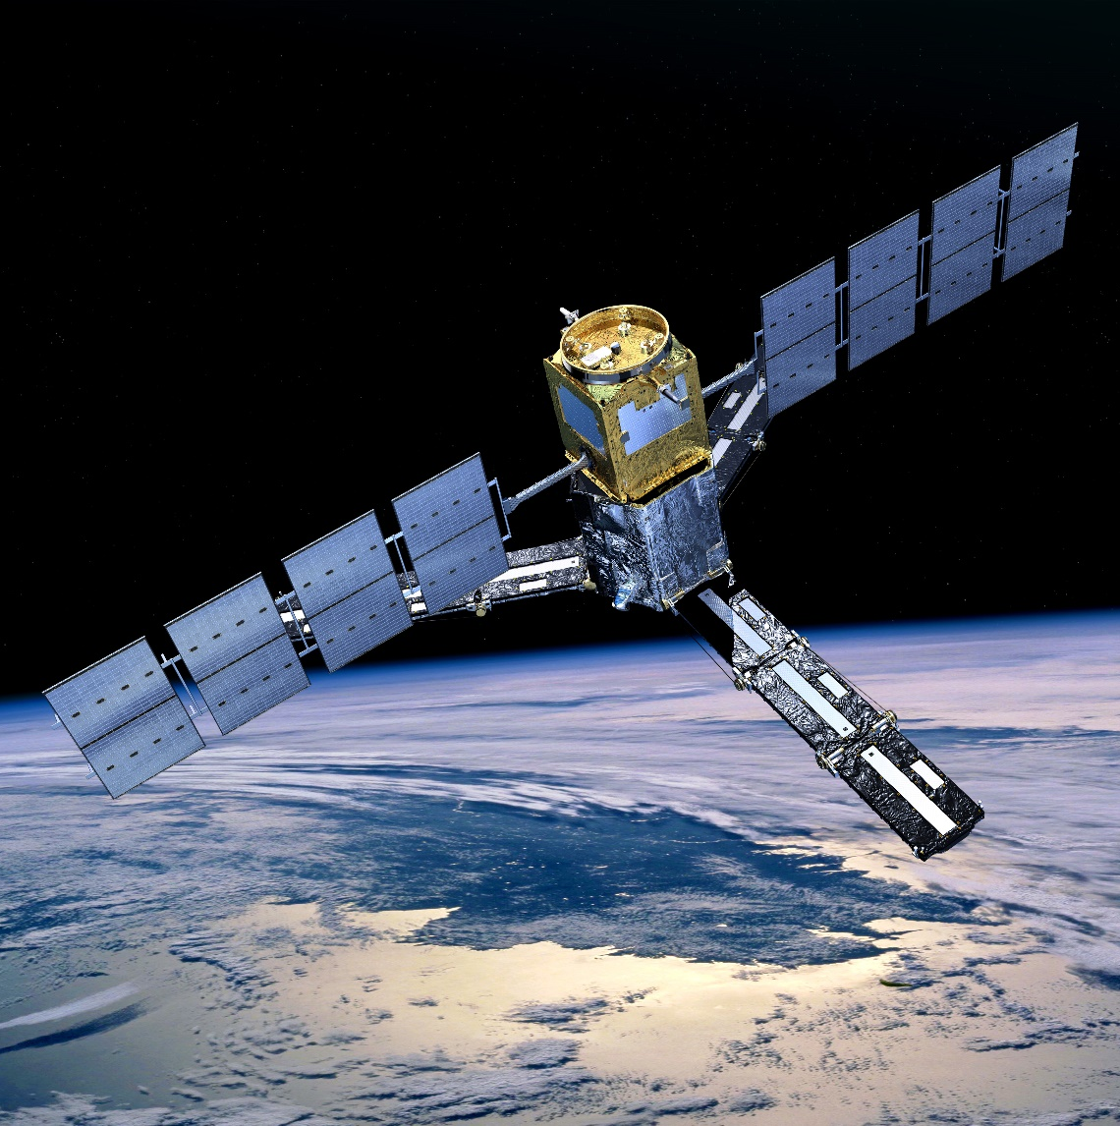
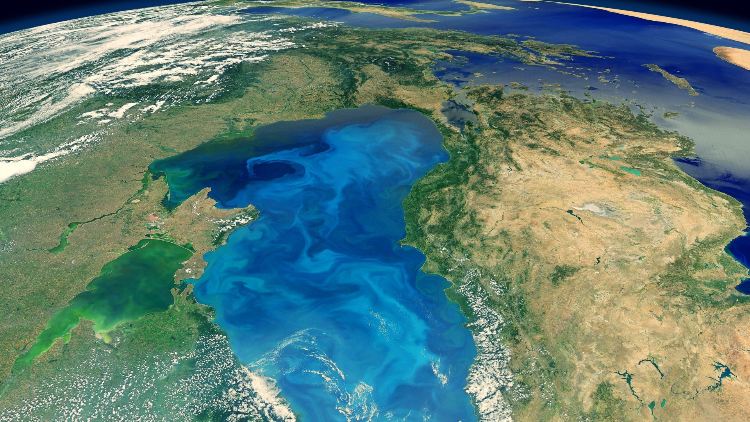
THANK YOU!
Explore all of the resources available to you! And if you find helpful resources, share them!
Notes:
Your project Website Image should be placed behind the hexagon grid. An example image has been placed in this position for your reference. Delete the example image, insert your image, right click your image and select the “Send to Back” option. Position and adjust the size of your image so that it lines up with the provided margin rulers.

