Slide 1
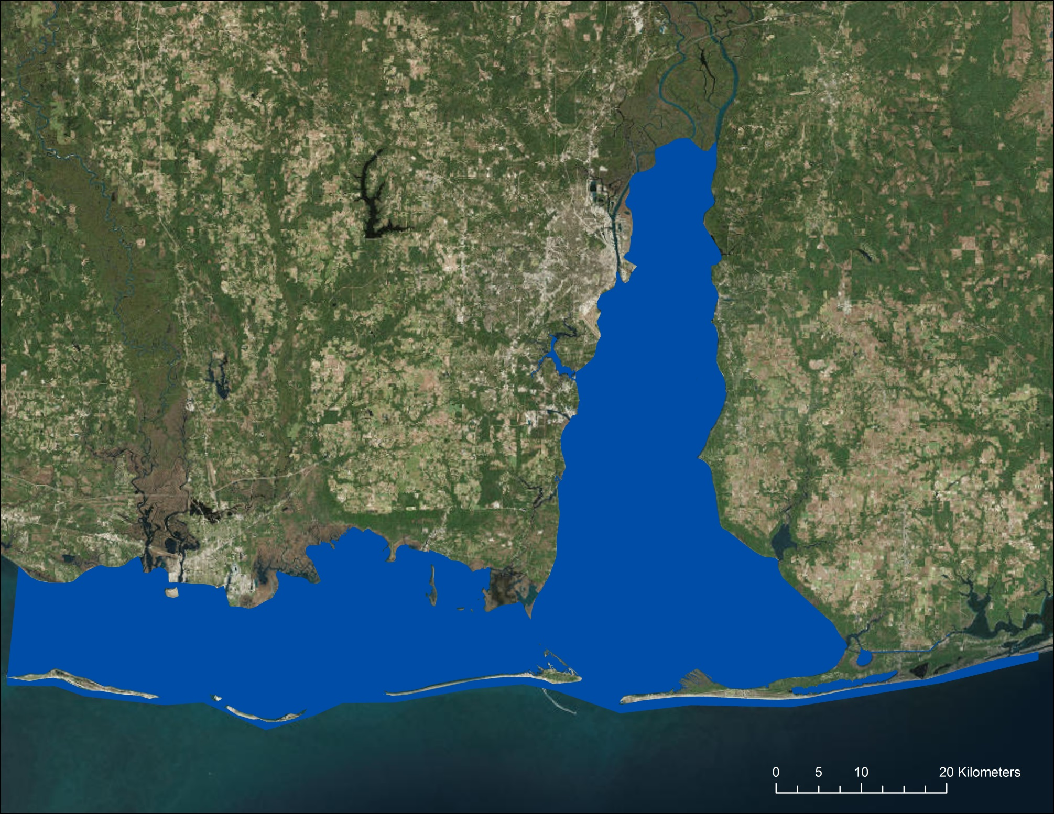
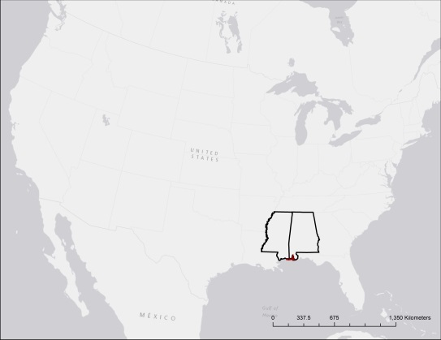
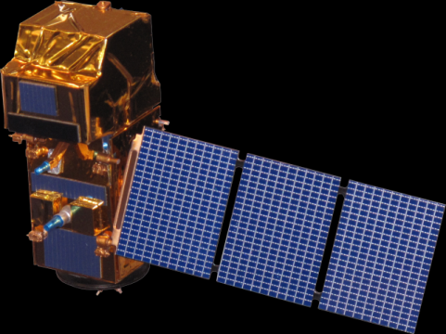

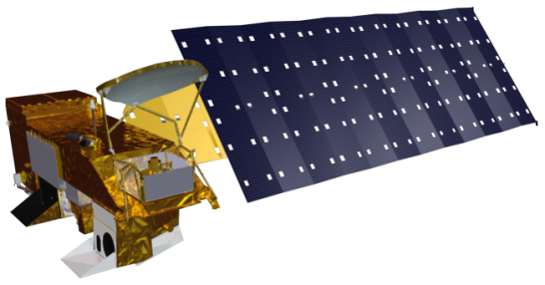

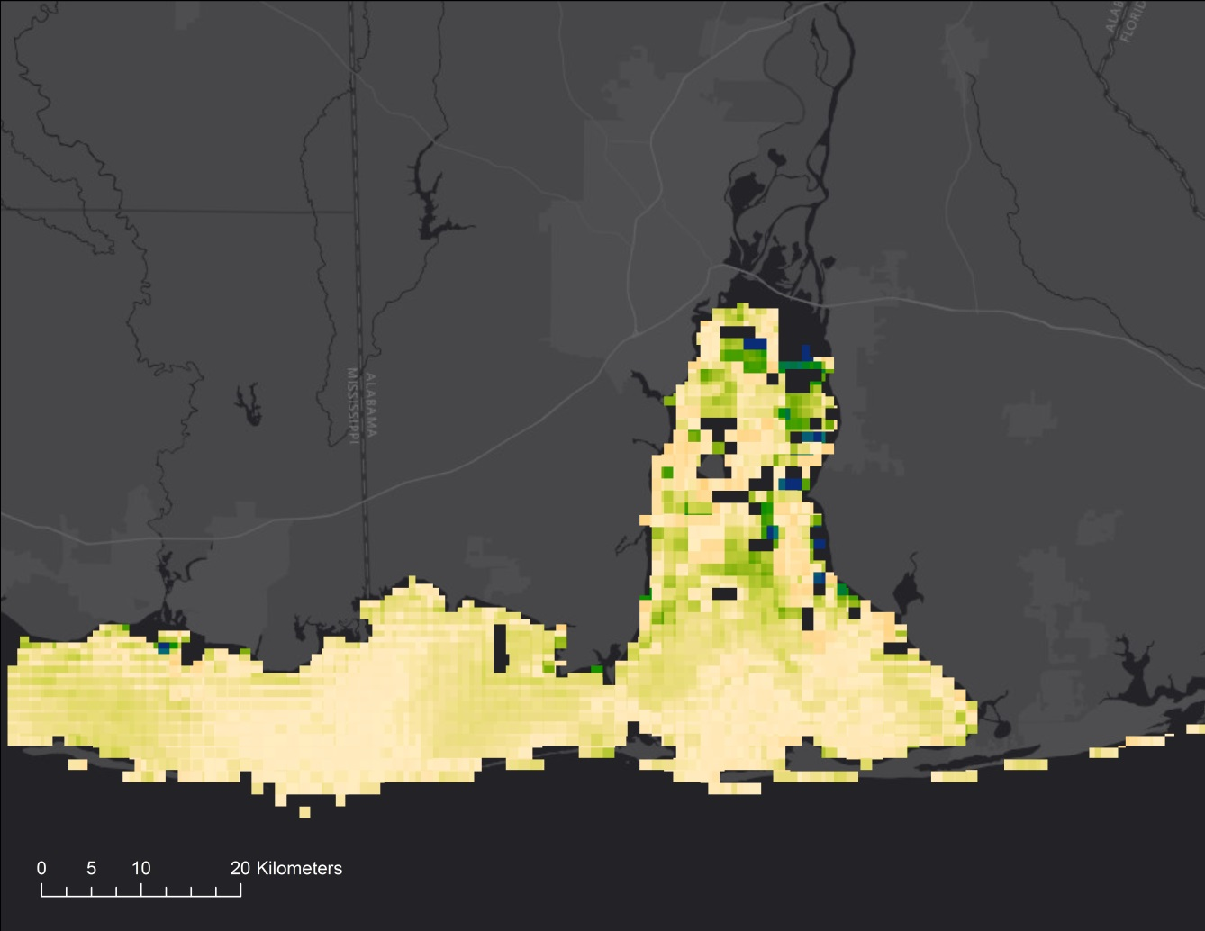
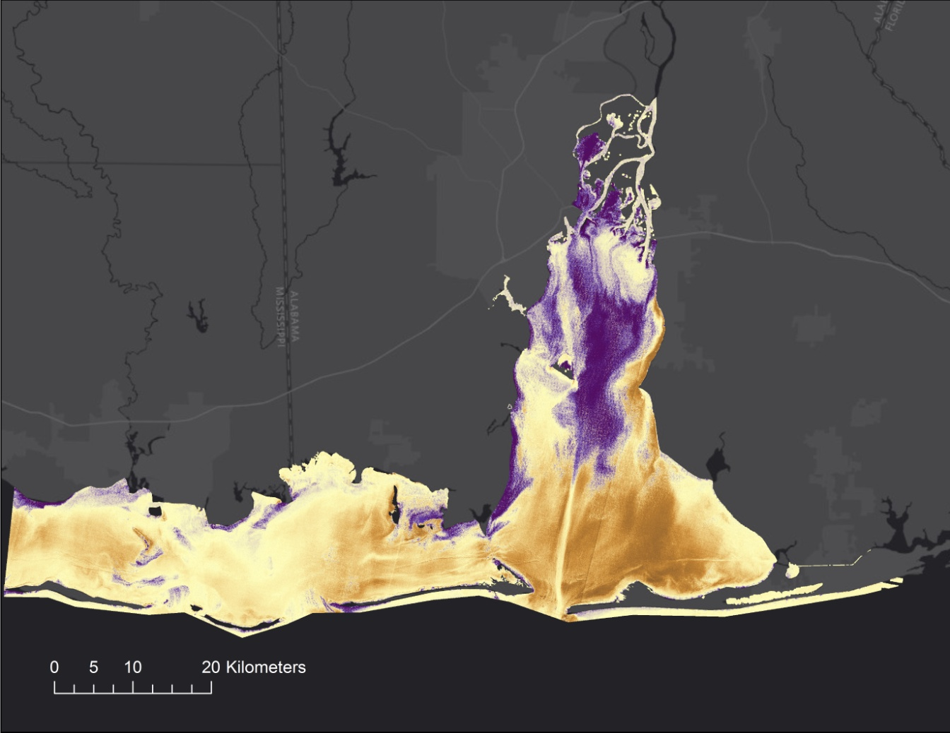
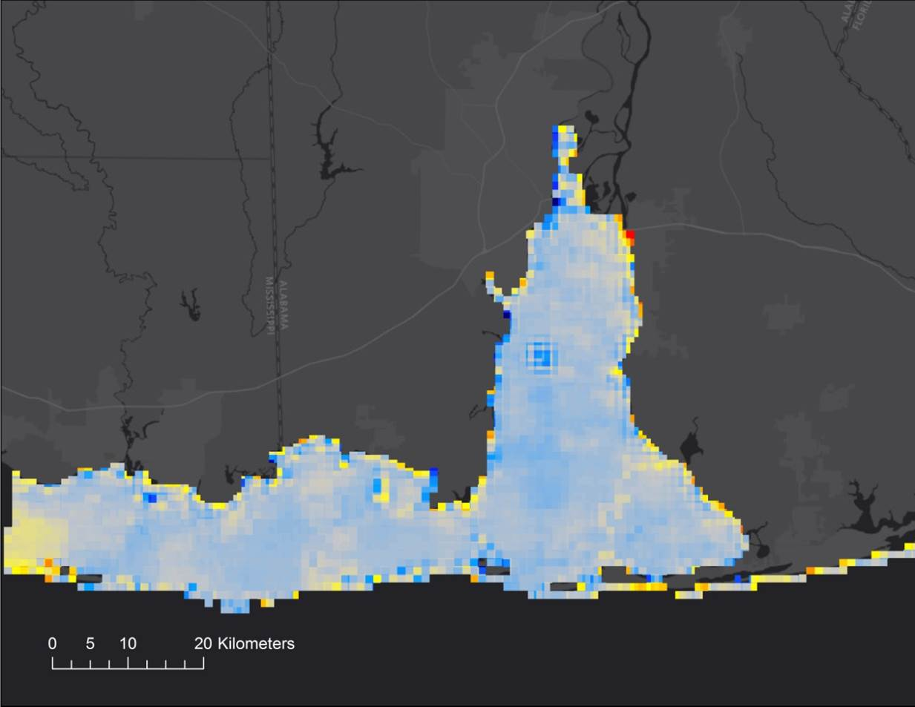
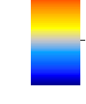
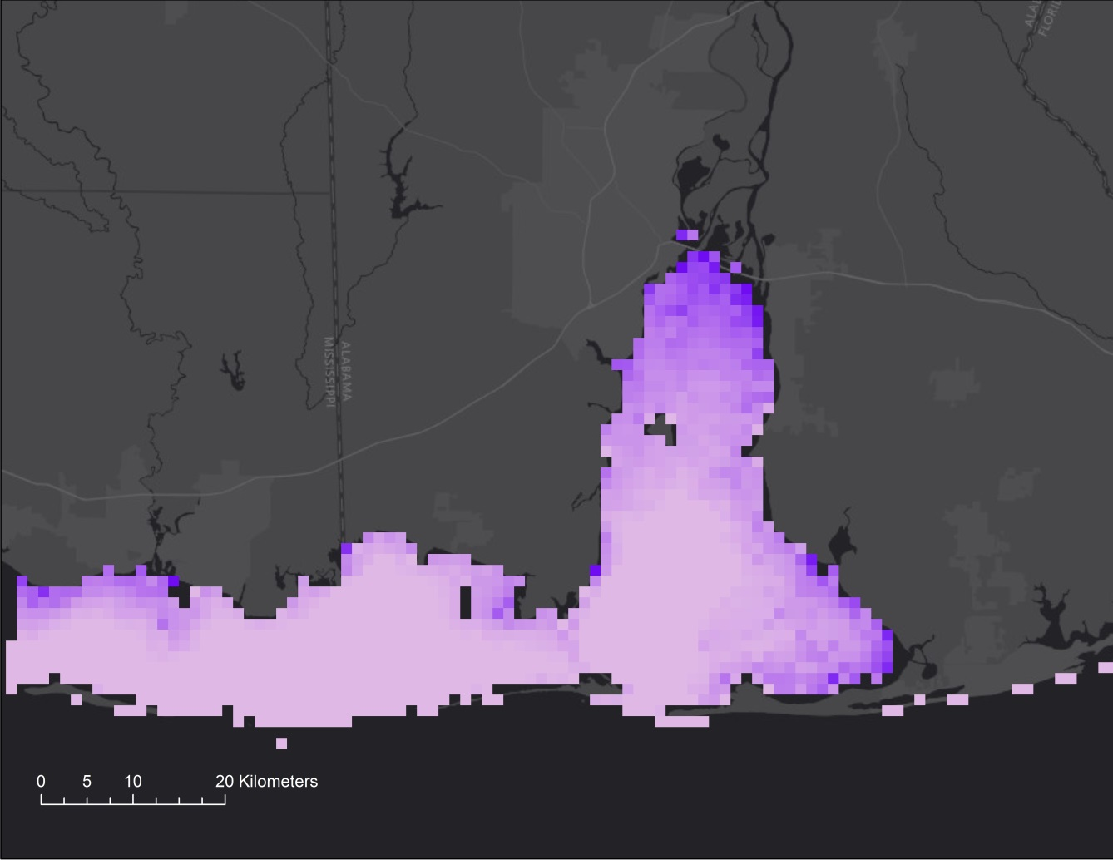
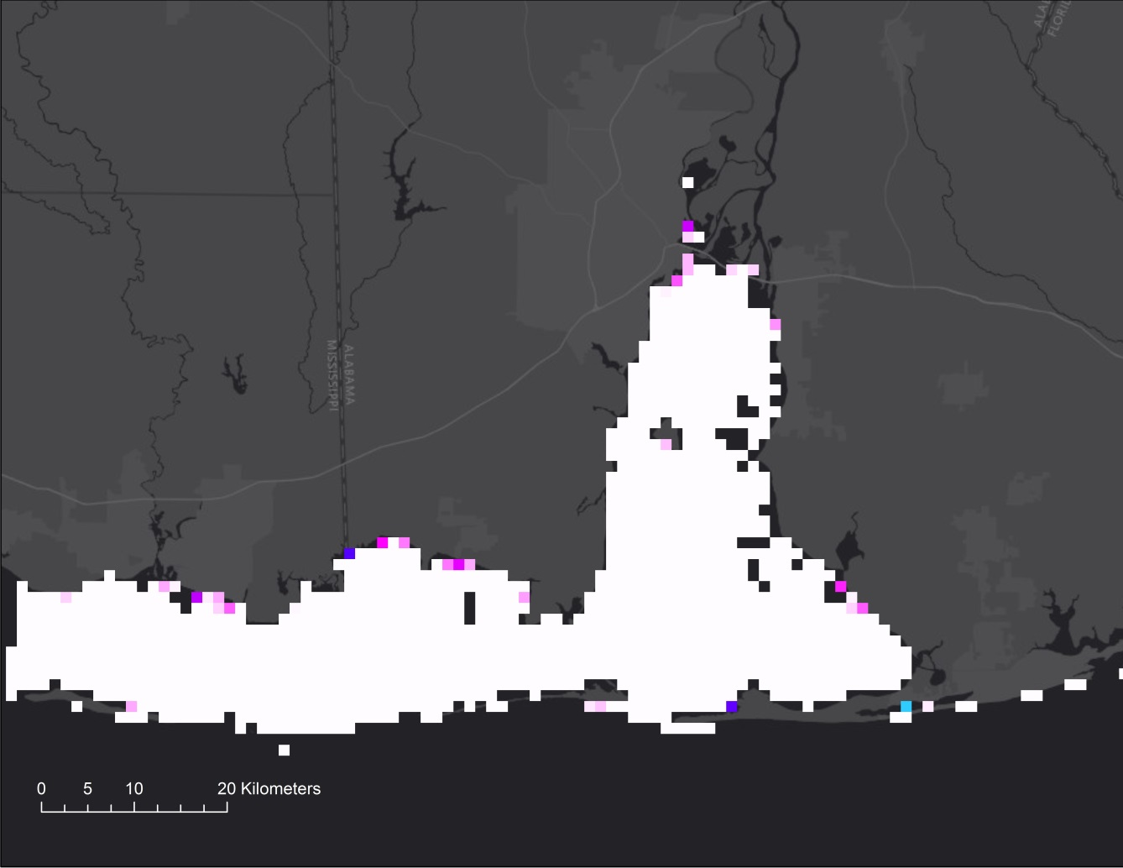
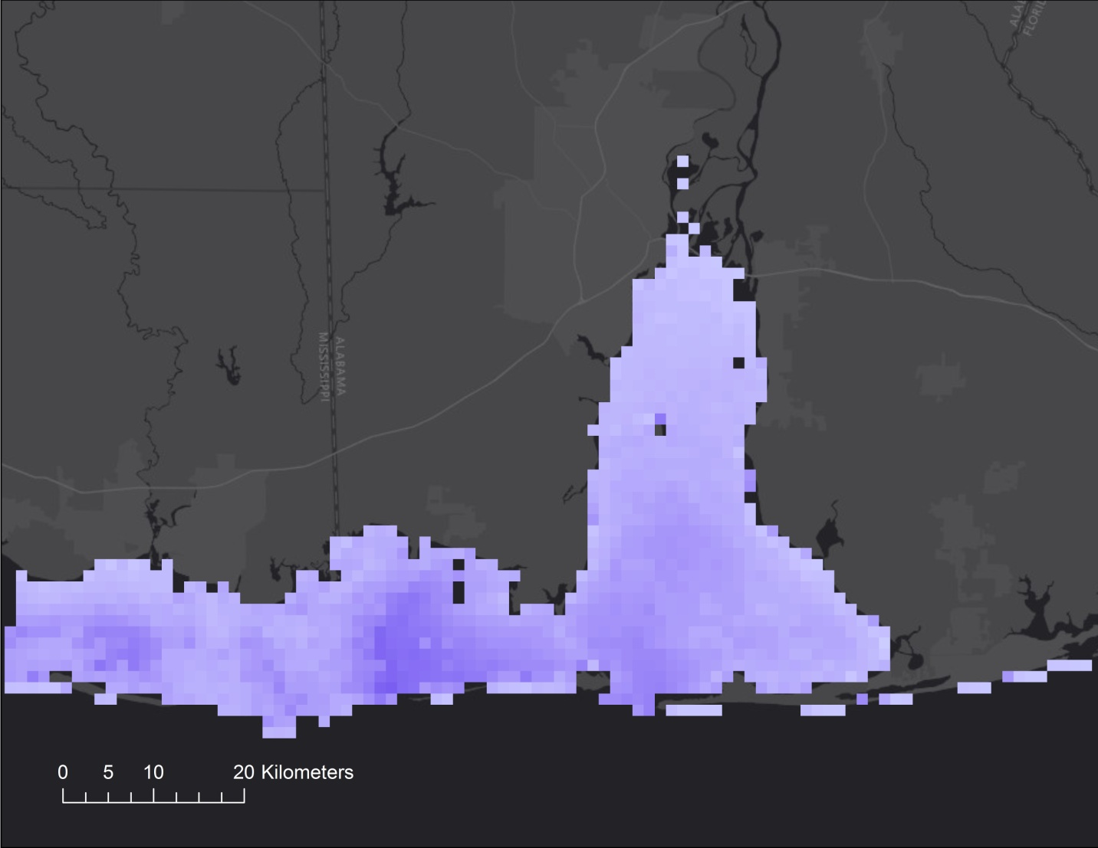

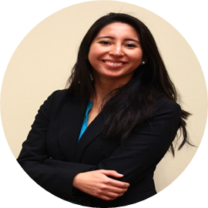
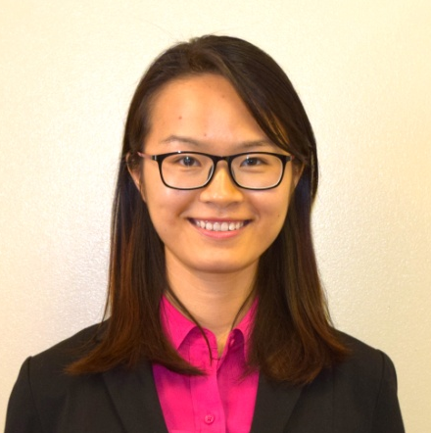
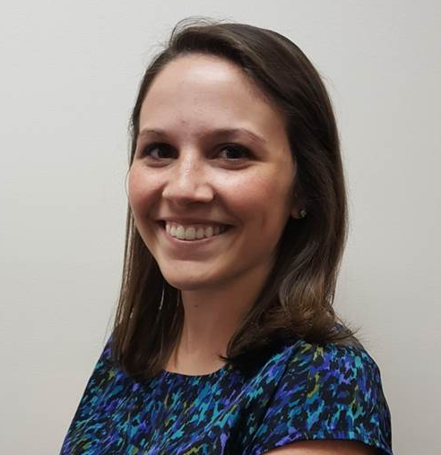
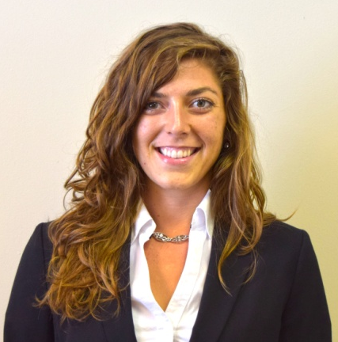
Using NASA Earth Observations to Evaluate Water Quality in Coastal Alabama to Enhance Marine Wildlife Management
Abstract
Objectives
The Mobile Bay and Mississippi Sound are the main coastal estuaries along the Alabama and Mississippi Gulf Coast. They serve as the primary drainage outlets for the Mobile Bay and Pascagoula River watersheds and provide a gradient of coastal water salinity conditions needed for a diversity of wildlife species and coastal habitat types. Coastal water “health” conditions have a direct impact on the native biota that are sensitive to water quality, including the Eastern oyster (Crassostrea virginica), a keystone species, and the West Indian manatee (Trichechus manatus), a vulnerable species. This project addressed the dynamic coastal ecosystem by creating time series analyses to monitor salinity, temperature, and turbidity changes for the Mobile Bay and Mississippi Sound from June 2007 to May 2017. The Aqua Moderate Resolution Imaging Spectroradiometer (MODIS) was used to detect salinity and sea surface temperature, while Landsat 5, Landsat 8, and Sentinel-2 Multispectral Instrument (MSI) were employed to detect turbidity levels and validate sea surface temperature. Such data products were used to compute habitat suitability maps for oysters and manatees in the Mobile Bay and Mississippi Sound to assess the optimal areas and conditions for habitat restoration initiatives. Project partners will use product results to better understand manatee movements and habitat suitability for oysters.
Conduct salinity, sea surface temperature (SST), and turbidity analyses using Aqua MODIS, Landsat 5 TM, Landsat 8 OLI & TIRS, and Sentinel-2 MSI satellite imagery in conjunction with in situ data
Produce time series analyses that assess salinity, temperature, and turbidity changes occurring from 2007 to 2017
Compute West Indian manatee and Eastern Oyster habitat suitability maps
Study Area
Methodology
Mobile Bay
Data
Acquisition
Earth Observations
Buoy Water Quality Data
Optimal Oyster & Manatee Water Quality Thresholds
DISL Manatee Sighting data
Mobile Bay
Mississippi Sound
Data
Processing
Salinity, SST., & Turbidity Algorithms
Statistical Comparison to Satellite Data
ArcMap Fuzzy Logic Tool
Mississippi Sound
Study Area
Study Area
End
Products
Water Quality Time Series Analyses
Manatee Habitat Suitability Map
Oyster Habitat Suitability Map
Earth Observations
Sentinel-2 MSI
Landsat 5 TM
Coastal Alabama Oceans
Aqua MODIS
Landsat 8 OLI & TIRS
Results
Water Quality Change from 2007 to 2017
Conclusions
Salinity Change
Turbidity Change
SST Change
NASA EO data was successfully used to analyze coastal water salinity, SST, turbidity change in the study area from 2007 to 2017.
56% of the study area increased or decreased in salinity by 1 PPT over the 10 year period.
There was an overall decrease in SST between 2007 and 2017, with 94% of the decrease being within 2°C.
From 2007 to 2017, turbidity increased on the eastern shore and southern half of Mobile Bay and decreased in the north delta and the center of Mobile Bay.
Computed suitable habitat areas for the West Indian Manatee aligned with public manatee sighting locations.
The project produced geospatial data products that are considered useful by end-user organizations for aiding manatee conservation and oyster restoration in the study area.
Salinity Changes (PPT)
Turbidity Changes (FNU)
Temperature Changes (°C)
29.5
-26.7
57.78
-66.10
12.52
-12.81
Habitat Suitability for Manatees and Oysters for 2016 - 2017
Annual Oyster
(June 2016 – May 2017)
High Manatee Season
(June – October 2016)
Low Manatee Season
(November 2016 – March 2017)
Habitat Suitability
Habitat Suitability
Habitat Suitability
High
Low
High
Low
High
Low
Team Members
Acknowledgements
Dr. Bernard Eichold, Mobile County Health Department (Mentor)
Dr. Jeffrey Luvall, NASA at Marshall Space Flight Center (Science Advisor)
Dr. Robert Griffin, University of Alabama in Huntsville (Science Advisor)
Dr. Maury Estes, Universities Space Research Association (Science Advisor)
Joseph Spruce, NASA Langley Research Center (Science Advisor)
Dr. Kenton Ross, NASA Langley Research Center (Science Advisor)
Mark Berte, Alabama Coastal Foundation
Dina Knight & Judy Haner, The Nature Conservancy
Dr. Ruth Carmichael & Elizabeth Hieb, Dauphin Island Sea Lab (Manatee Sighting Network)
Leigh Sinclair, University of Alabama,Information Technology & Systems Center (Mentor)
Erika Higa, NASA DEVELOP Jet Propulsion Laboratory
Maggi Klug & Dashiell Cruz, NASA DEVELOP MSFC
Tyler Lynn & Elaina Gonsoroski, NASA DEVELOP MCHD
Mercedes Bartkovich
Team Lead
Xin Hong
Team Lead
Project Partners
Alabama Coastal Foundation
Dauphin Island Sea Lab
The Nature Conservancy
Leah Parker
Amy Schwarber
Mobile County Health Department &
NASA Marshall Space Flight Center – Summer 2017

