Slide 1
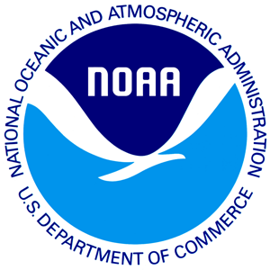
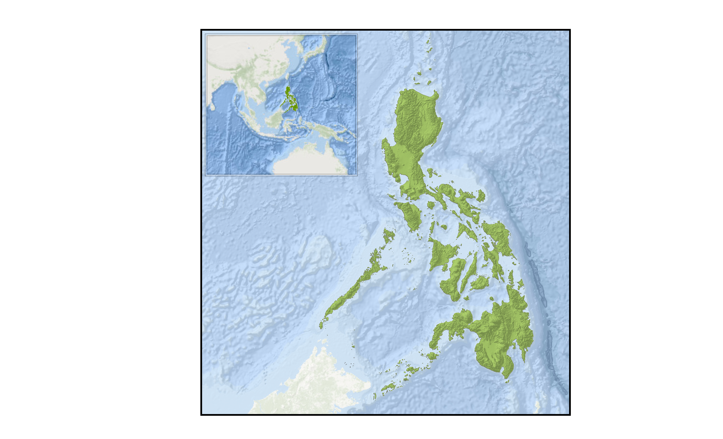
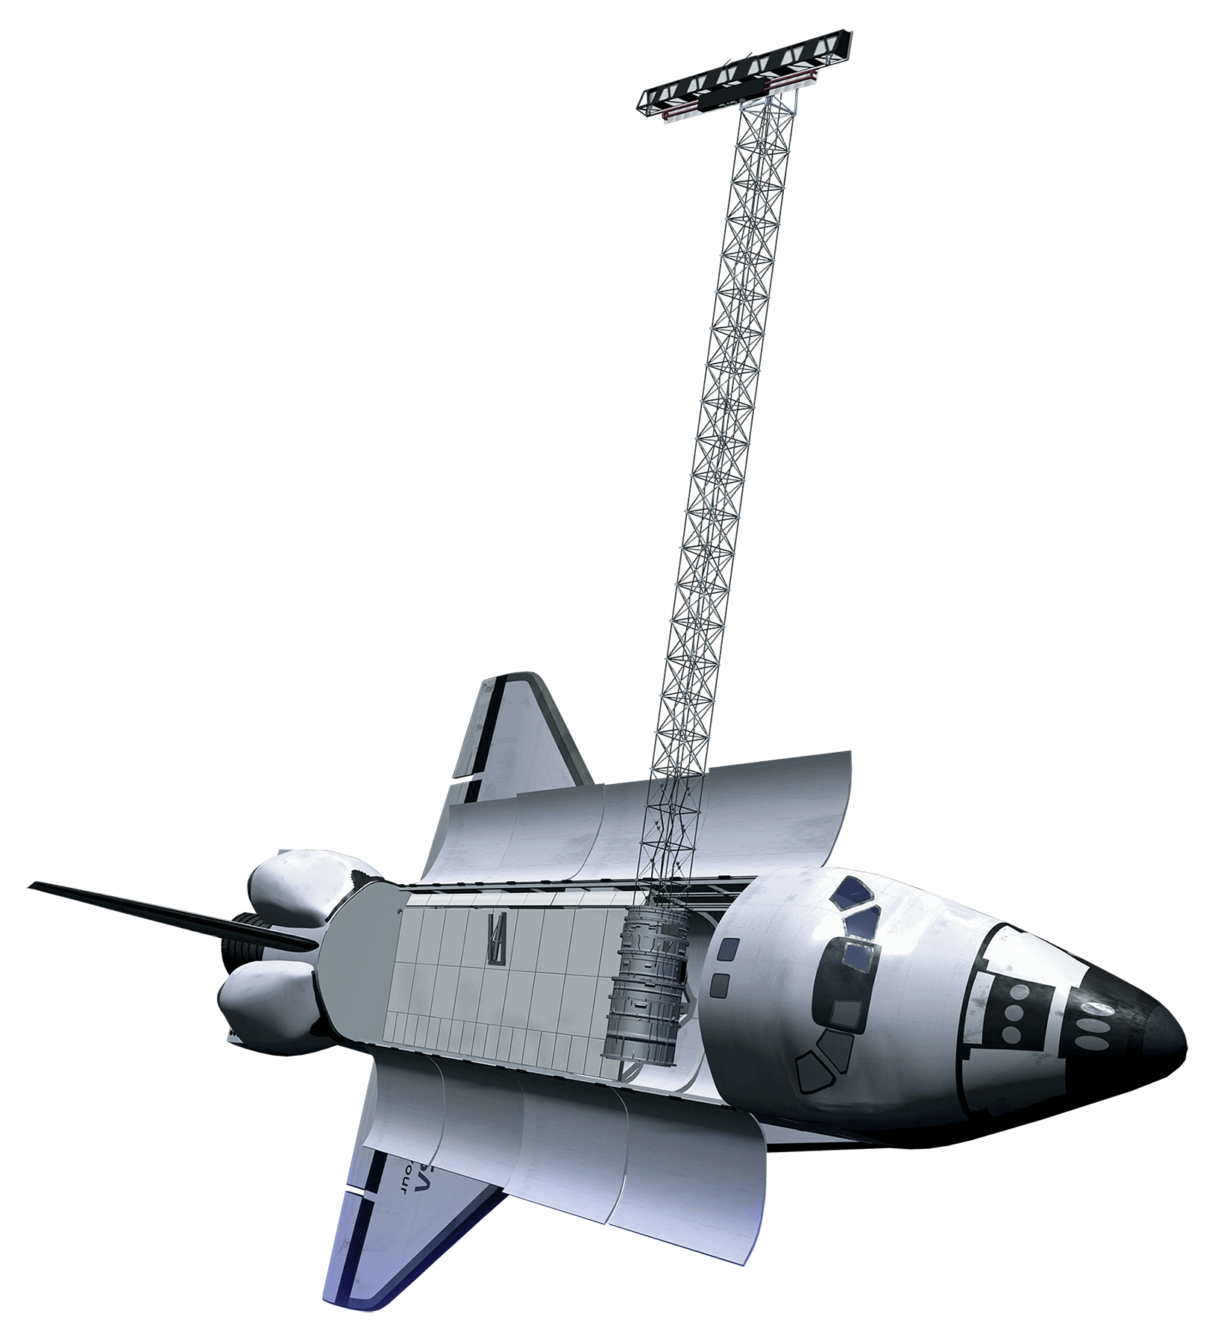
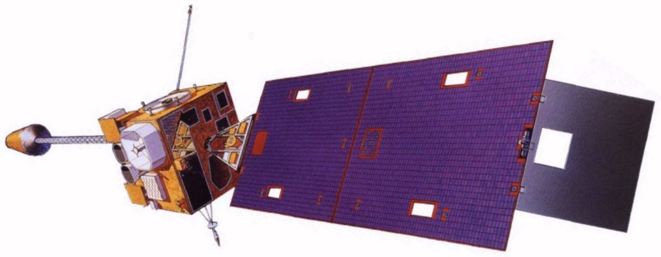

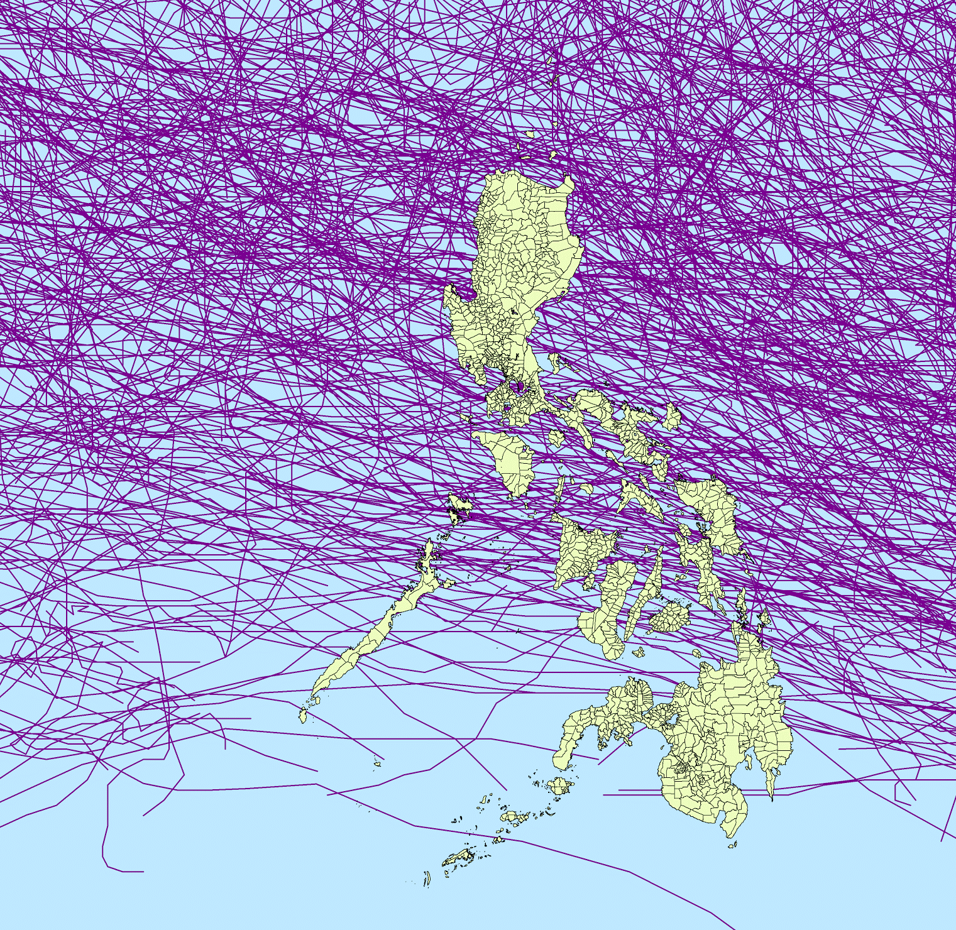
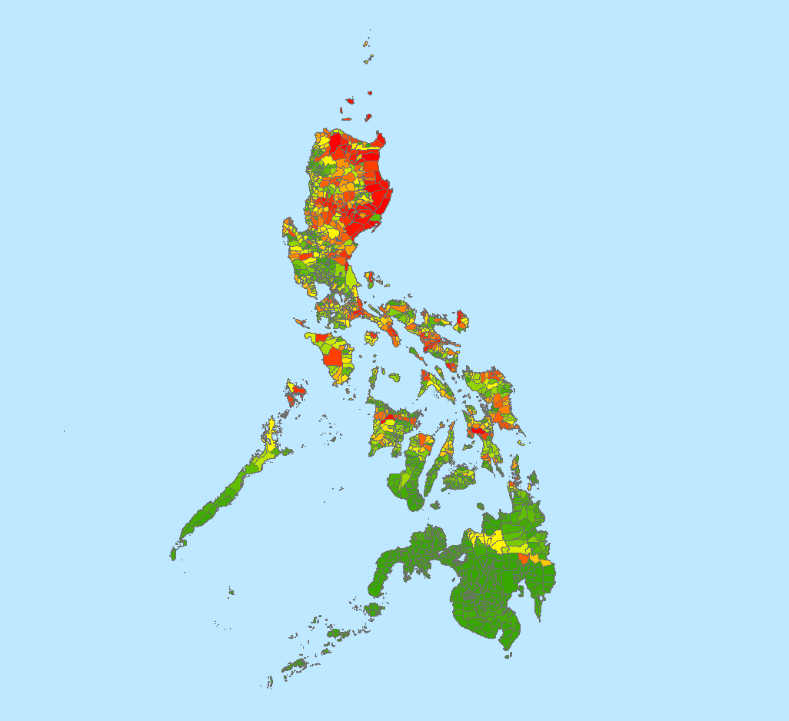
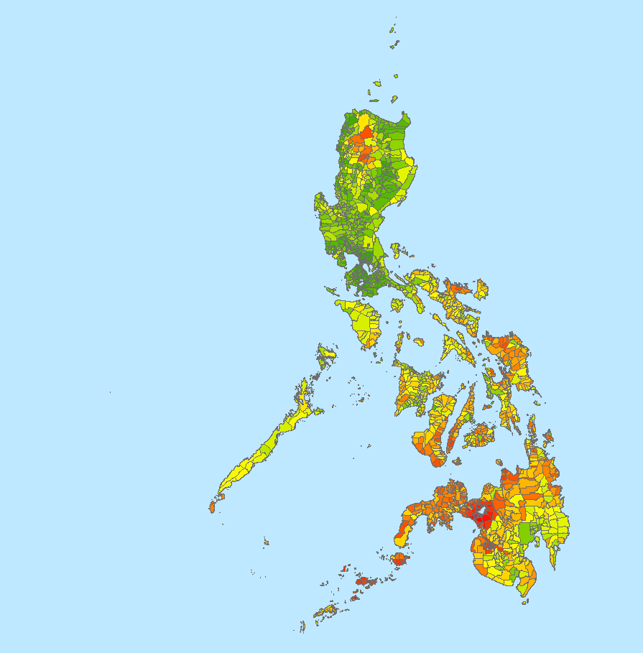
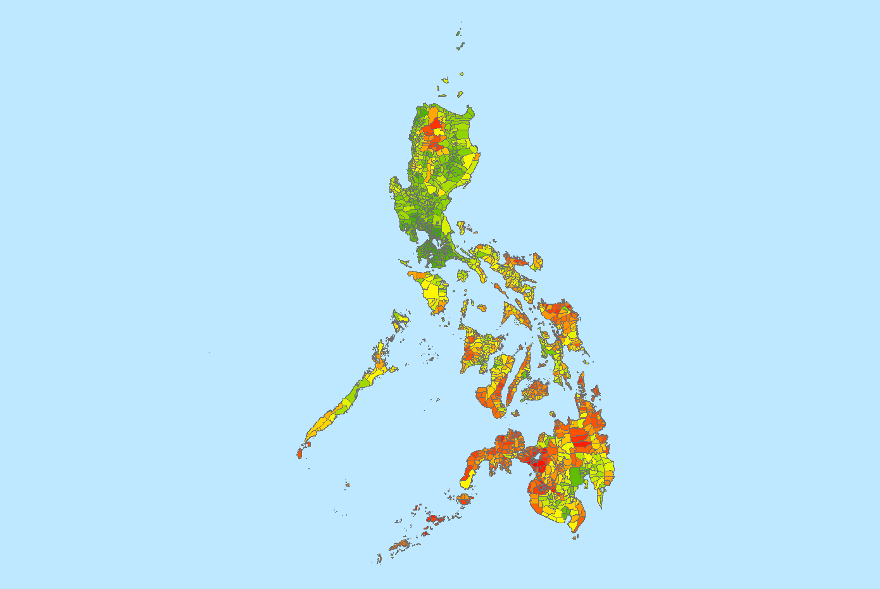
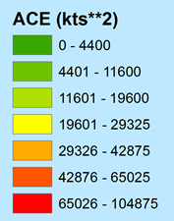
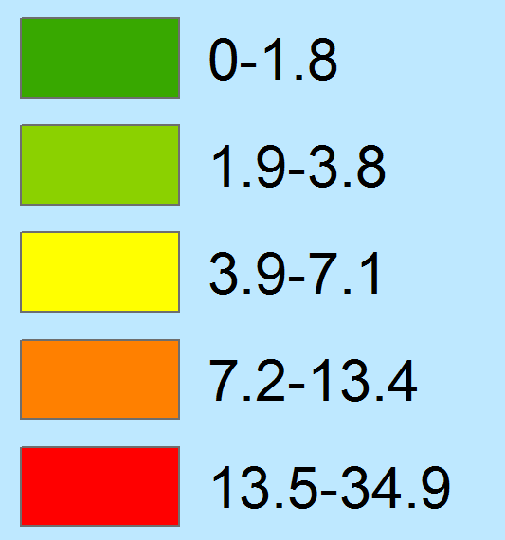
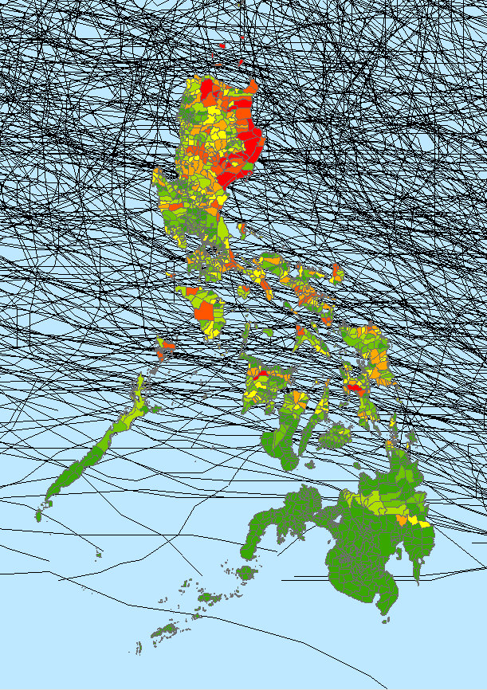
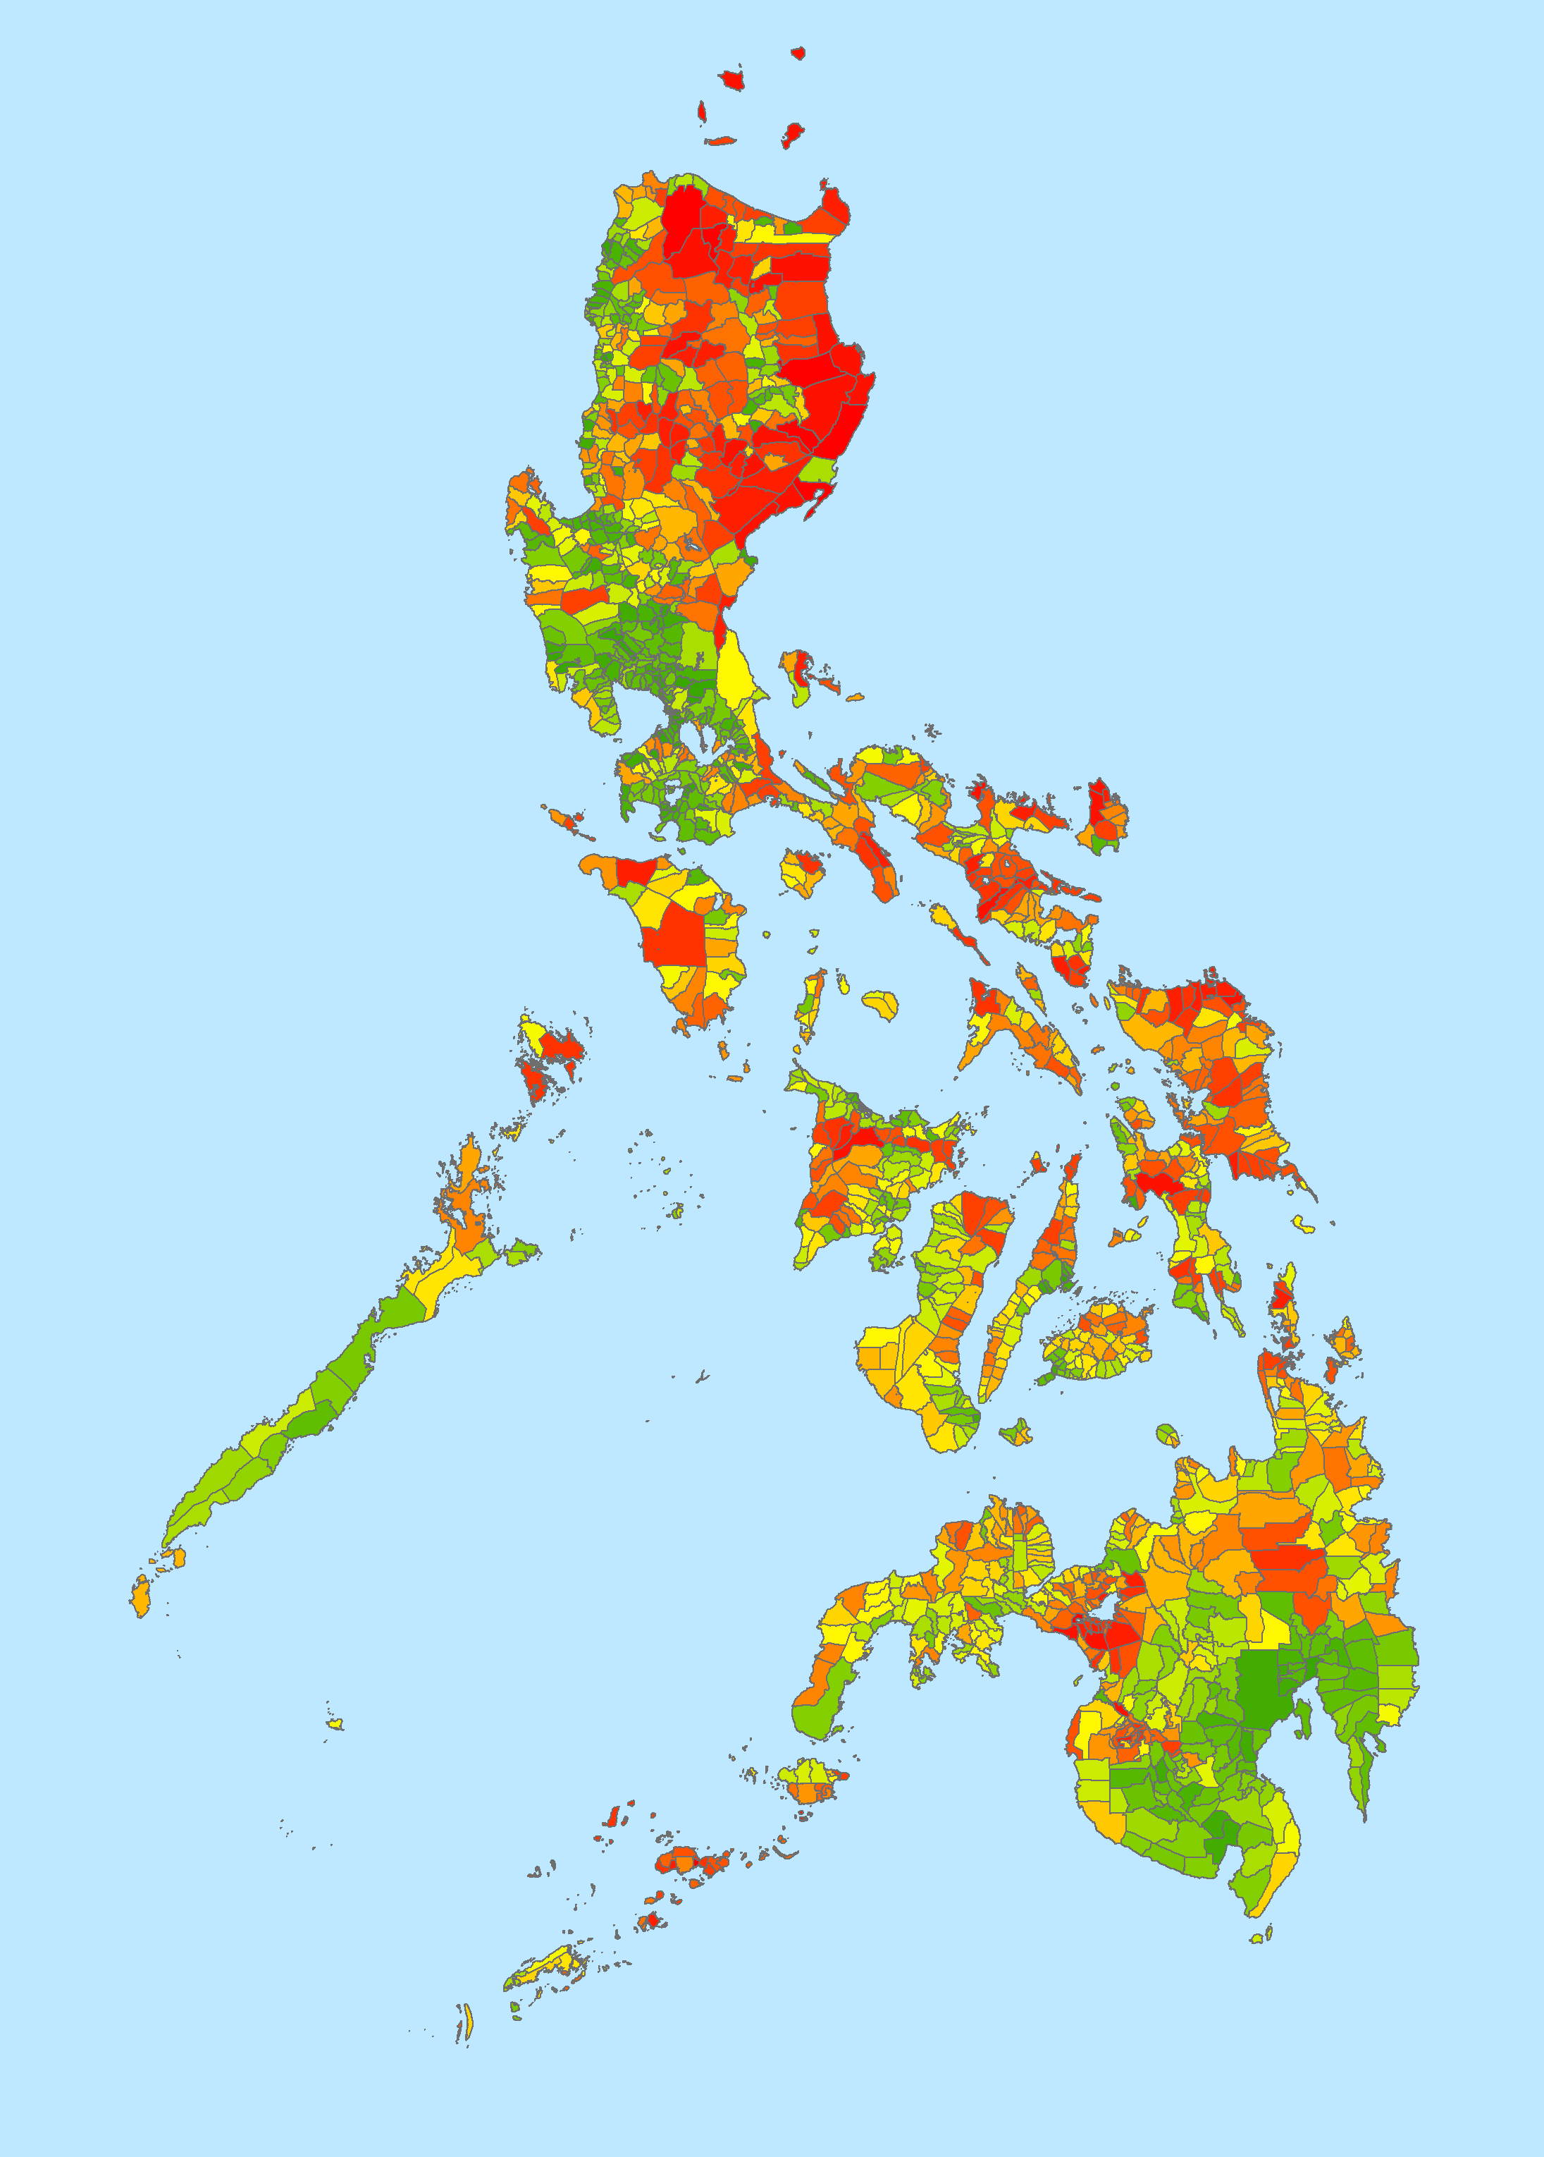
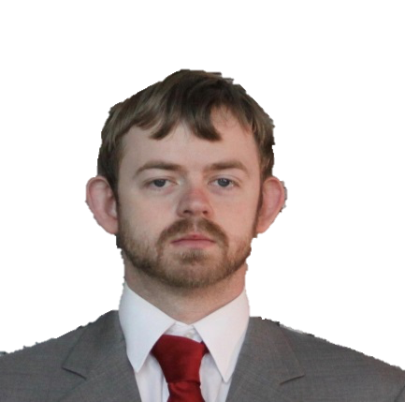





Utilizing NASA and NOAA Earth Observations to Enhance the United Nation’s Office for the Coordination of Humanitarian Affairs Storm Preparation and Disaster Relief Planning Methods in the Philippines
Abstract
Study Area
Objectives
A comprehensive understanding of where sensitive populations and demographics are threatened by natural hazards is necessary for the assessment and prevention of disasters. The island nation of the Philippines is often threatened by tropical cyclones, which have had disastrous consequences in the past (e.g., Tropical Cyclone Haiyan in 2013 claimed over 6,000 lives). This project aimed to assess areas of greatest disaster risk in the Philippines with a special focus on gender. Combining archived tropical cyclone data from the International Best Track Archive for Climate Stewardship (IBTrACS) and the Precipitation Estimation from Remotely Sensed Information using Artificial Neural Networks – Climate Data Record (PERSIANN-CDR) dataset with population demographic data from the Philippines, this project aimed to determine where intense tropical cyclones are most prone to make landfall, and what areas and populations are most sensitive to cyclone events of a given strength based on gender and socioeconomic status. These results will be used by the United Nations Office for the Coordination of Humanitarian Affairs (UN-OCHA) to target areas of greatest need for further development in disaster response and mitigation techniques.
ASIA
Republic of the Philippines
Produce hazard and vulnerability maps by combining tropical cyclone tracking and intensity climatologies with gender specific vulnerability statistics
Assess gender vulnerability based on hazard climatology to enable our partners to predict areas of greatest vulnerability in future cyclone events
PACIFIC
OCEAN
INDIAN OCEAN
AUSTRALIA
Manila
Earth Observations
Shuttle Radar Topography Mission (SRTM) hardware mounted on shuttle
Geostationary Operational Environmental Satellite Suite (i.e. GOES-8), one of many satellites contributing to the PERSIANN dataset
Methodology
DATA ACQUISITION: IBTrACS Cyclone Tracks, Philippines Municipalities & Demographics, SRTM, PERSIANN
PROCESSING & ANALYSIS: Derive natural hazards like Accumulated Cyclone Energy, combine with demographic variables
END PRODUCTS: Derive heat map, factoring all variables weighted by significance
Philippines Disasters
High
Low
Study Period Tracks (1982-2015)
Accumulated Cyclone Energy
Single Mother Household Percent
Demographic Vulnerability
Results
Conclusions
Tracks: 26,907 segments; 1,888 directly impacting Philippines (within 100 km)
315 unique storms, 188 major (winds >65kts)
Demographics: Majority of single mother households in central, southern Philippines
Natural Hazard North, Demographic Vulnerability South—Combined & widespread hazard
Our analysis suggests that while northern areas are most vulnerable to tropical cyclone impacts, southern areas are most impoverished/at risk to impacts.
Our synthesis of variables therefore showed a widespread vulnerability to cyclones.
Using these data, UN-OCHA and other government organizations can better allocate resource and alerts to minimize disaster risk
Project Partners
+
=
Rowena Dacsig, United Nations Office for the Coordination of Humanitarian Affairs (OCHA), Gender Advisor
Joseph Addawe, United Nations Office for the Coordination of Humanitarian Affairs (OCHA), Information Management Analyst
Acknowledgements
Natural Hazards
Demographics
High
The Philippines Disaster team would like to thank our science advisors for their time and support over the course of this project:
Dr. Carl Schreck, Cooperative Institute for Climate and Satellites – North Carolina
Dr. L. DeWayne Cecil, Global Science & Technology, National Centers for Environmental Information
Dr. Ken Knapp, Center for Weather and Climate, National Centers for Environmental Information
Team Members
Low
Low High
Final Cyclone Vulnerability Map
Daniel T. Martin
Team Lead
Allison Daniel
Jessica Vermillion
Kelly Meehan
NOAA National Centers for Environmental Information – Spring 2017

