Slide 1

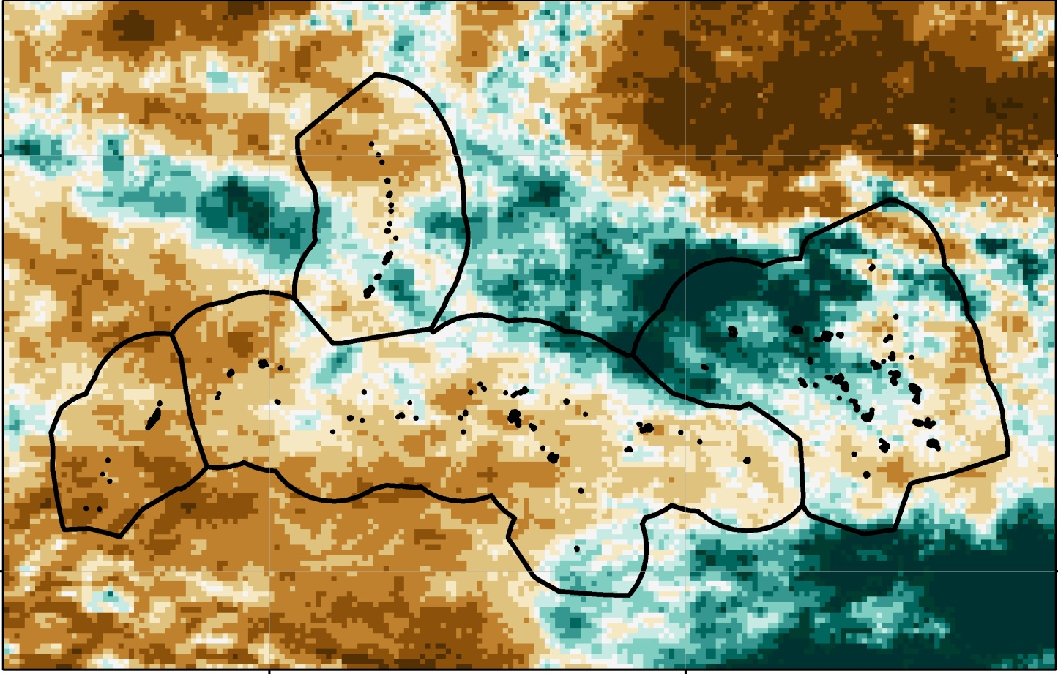

Enhancing Decision Making to Help Manage Freshwater Resources: Using NASA Earth Observations and NOAA CDR’s to Provide Near Real-Time Precipitation Estimates for Forecasters in the USAPI
Pacific Water Resources II
Nicholas Luchetti
Zach Vozzelli
Kyle Jones
Notes:
Briefly introduce the title of the project, the current team members, the advisors, and acknowledge past contributors.

Slide 2

Outline
Community Concerns
PERSIANN-CDR ENSO Atlas
Objectives
NASA satellites/sensors used
Methodology
Results
Conclusions
Acknowledgements
Image Credit: Britt Parker
Notes:
Image Credit: Britt Parker (Personal Communication)
-Briefly present the outline for the presentation.

Slide 3
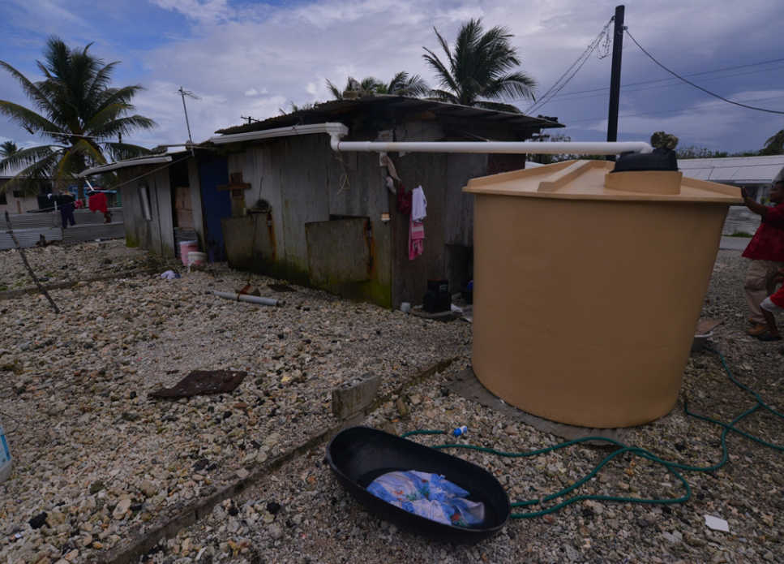
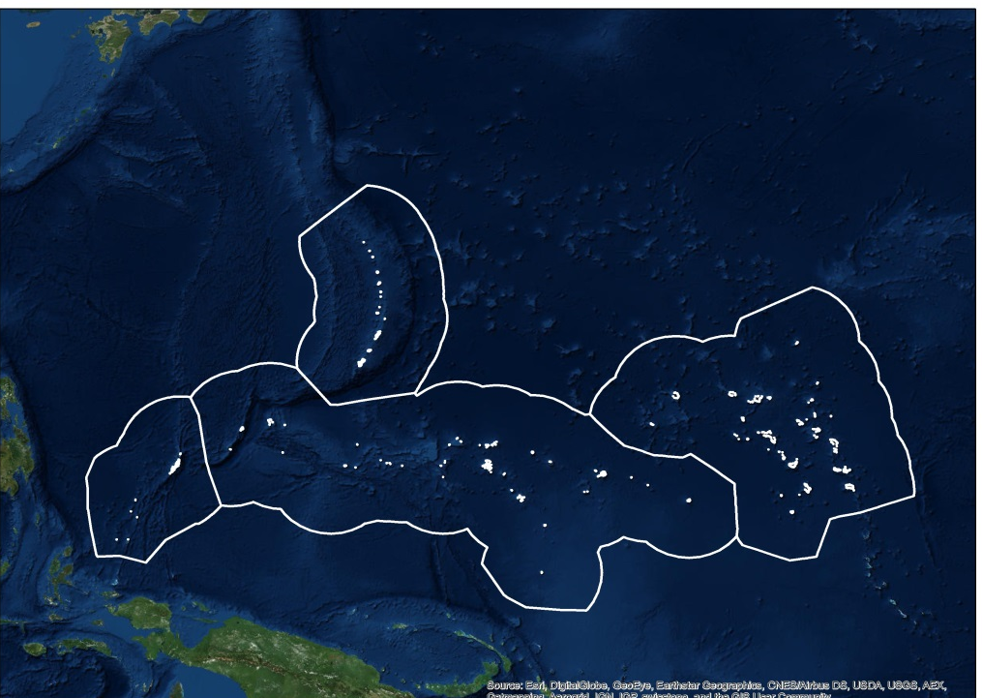
Community Concerns
Exclusive Economic Zones (EEZ)
Commonwealth of the Northern Mariana Islands
Republic of the Marshall Islands
Republic of Palau
Federated States of Micronesia
Tropical Pacific islands are particularly vulnerable to climate change
Extreme variability in precipitation distribution
Lack of freshwater resources
The region is prone to crippling periods of drought.
Few quality in-situ stations in the region.
Credit: Dennis Huang –University of Hawaii
Notes:
Image (left) source: Image was created in ArcGIS using an ESRI basemap as the background. (Source: Esri, DigitalGlobe, GeoEye, Earthstar Geographics, CNES/Airbus DS, USDA, USGS, AEX, Getmapping, Aerogrid, IGN, IGP, swisstopo, and the GIS User Community)
Image (right) source: Dennis Huang –University of Hawaii
-Introduce study area as the USAPI outlined by their EEZ.
-Highlight the islands extreme vulnerability to climate change.
-Highlight the extreme variability in precipitation distribution
-Highlight the image to the right. For many of these islands, their freshwater is almost entirely dependent on the amount of precipitation that falls in a given month/season/year. As a result, forecasters/decision makers need to understand the distribution in precipitation for drought mitigation purposes.
-VERY few quality in-situ stations in the region for forecasters and emergency mangers to gain an understanding of the recent climate shifts… Many of the stations are only on the capital islands, with the outer islands being sometimes 100km away.

Slide 4
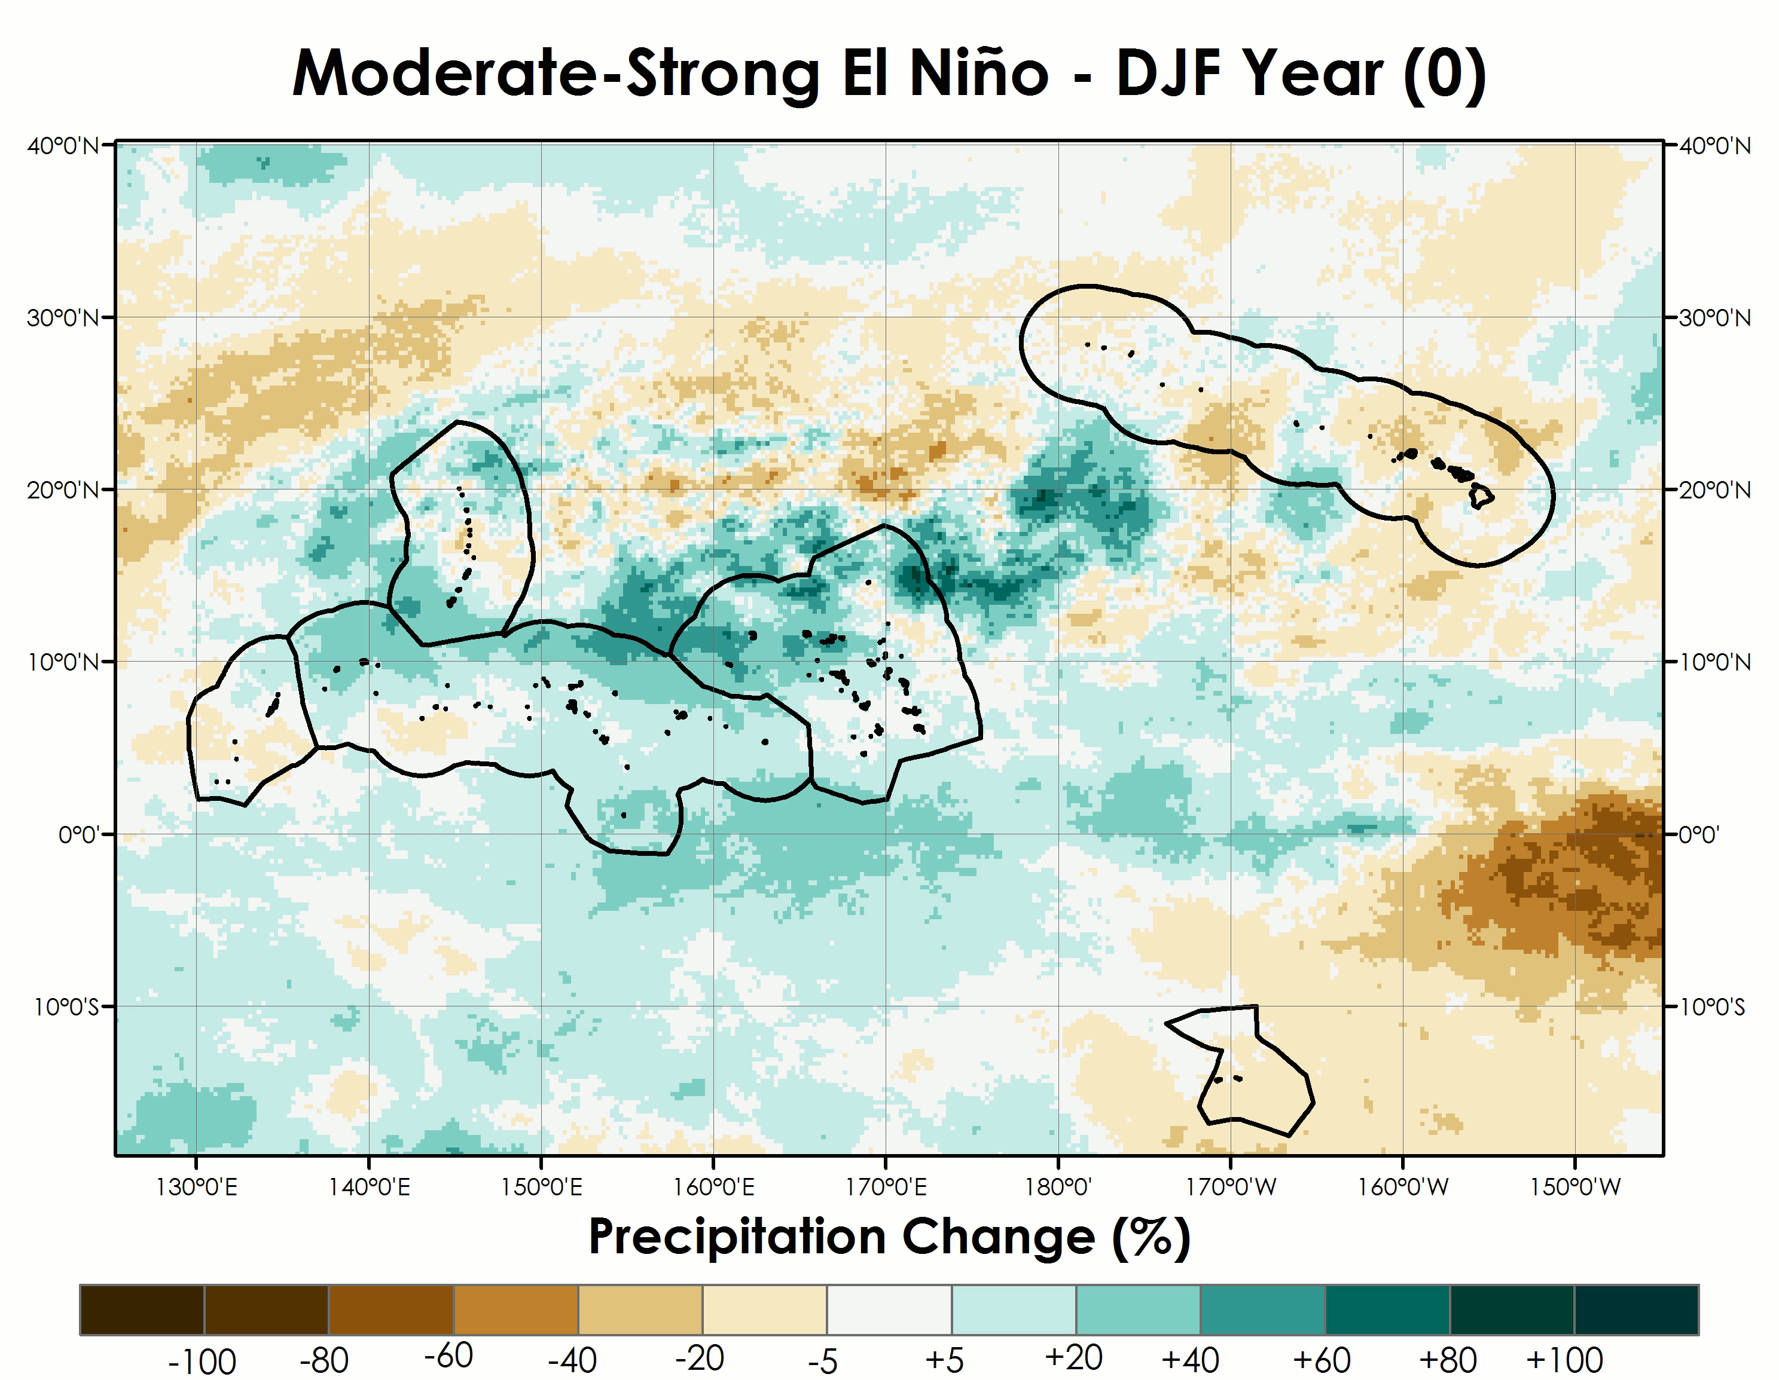
PERSIANN-CDR ENSO Atlas
Pacific Water Resources I (Summer, 2015)
Successfully delivered an updated ENSO-based Precipitation Climatology Atlas using the NOAA PERSIANN-CDR.
Limitation
  Does not provide near-real time precipitation estimates.
Pacific Water Resources II (Summer, 2016)
Provide near-real time precipitation estimates
Enhance freshwater resource management
Enhance confidence in near-term decision making
Notes:
“Image source: Created by the Pacific Water Resources I team (Jessica Sutton, Ethan Wright, Nick Luchetti)
This image is an animated GIF and therefore making it editable doesn’t seem feasible? Unless there is a way we are not aware of?
-BRIEFLY highlight the Pacific Water Resources I project and the PERSIANN-CDR ENSO CLIMATOLOGY ATLAS. Explain it’s limitation in that it does not provide real-time precipitation amounts. It is extremely useful, but could be built upon by adding near-real time tools.
-The atlas provides a CLIMATOLGY of the phases of ENSO and the associated precipitation distribution. The tools from the PWRII term will fill this gap by providing a suite of near-real time forecasting tools.
-Providing these tools to decision makers in the region will enhance confidence in short-term decision making.

Slide 5

Objectives
Create a suite of tools that provide near-real time precipitation estimates using the NASA GPM product.
Create near-real time precipitation anomalous tools using the NASA GPM product and the NOAA PERSIANN-CDR.
Perform verification analysis comparing in situ precipitation totals with remotely-sensed precipitation totals.
Credit: Britt Parker
Notes:
Image source: Britt Parker (Personal Communication)
-Briefly highlight the objectives of this project.
-Create a suite of tools that provide near-real time precipitation estimates using the NASA GPM product as the data source.
-Create near-real time precipitation anomalous tools.
-Performed a verification analysis between PERSIANN-CDR, GHCN station, TRMM, and GPM. Purpose was to make sure these remotely-sensed products were viable in the region, and also so that decision makers can be aware of any biases in the spatial plots as well as the other tools.

Slide 6
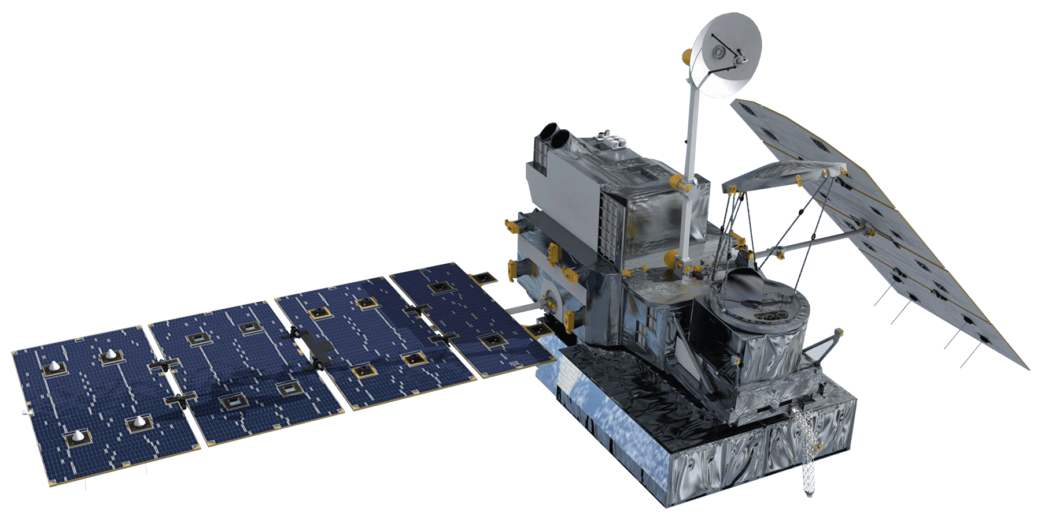
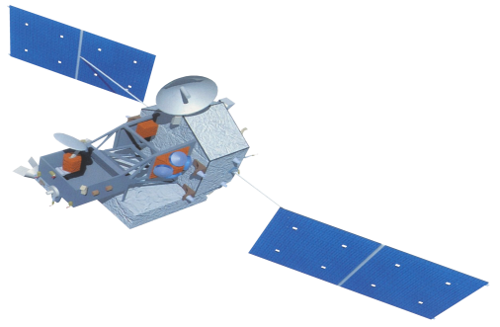
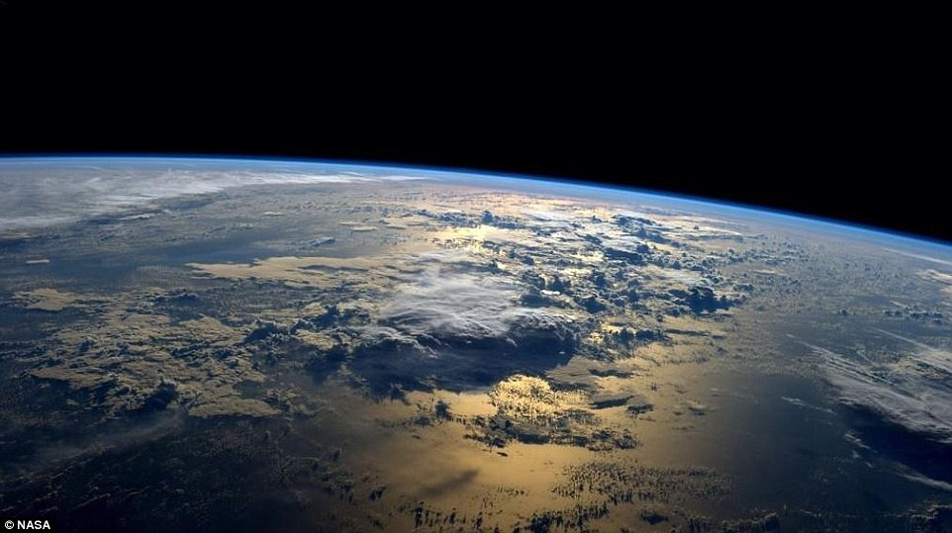
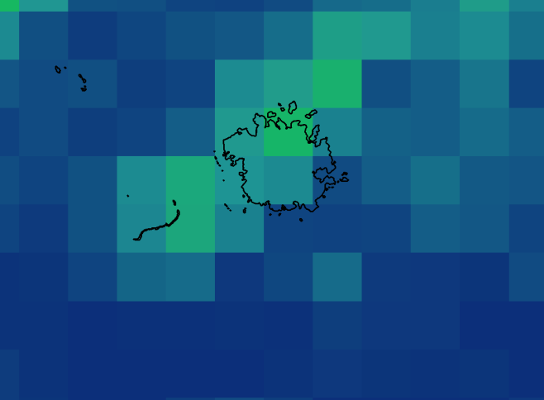

Satellite Data Sources
GPM-IMERGDE
0.10 degree resolution
Daily
PERSIANN-CDR
0.25 degree resolution
Daily
TRMM-TMPA-3B42RT
0.25 degree resolution
Daily
ALL Images Credit: NASA
Notes:
-Briefly describe each satellite product and why we chose these as primary data sources.
-Show why GPM’s resolution is better than PERSIANN
Image source:
Earth: http://www.nasa.gov/content/an-astronauts-view-from-space
GPM: http://www.devpedia.developexchange.com/dp/images/1/14/08_GPM.png
TRMM: http://www.devpedia.developexchange.com/dp/images/1/1a/04_TRMM.png
PERSIANN: http://www.nasa.gov/mission_pages/goes-n/multimedia/02_artistconcept.html

Slide 7
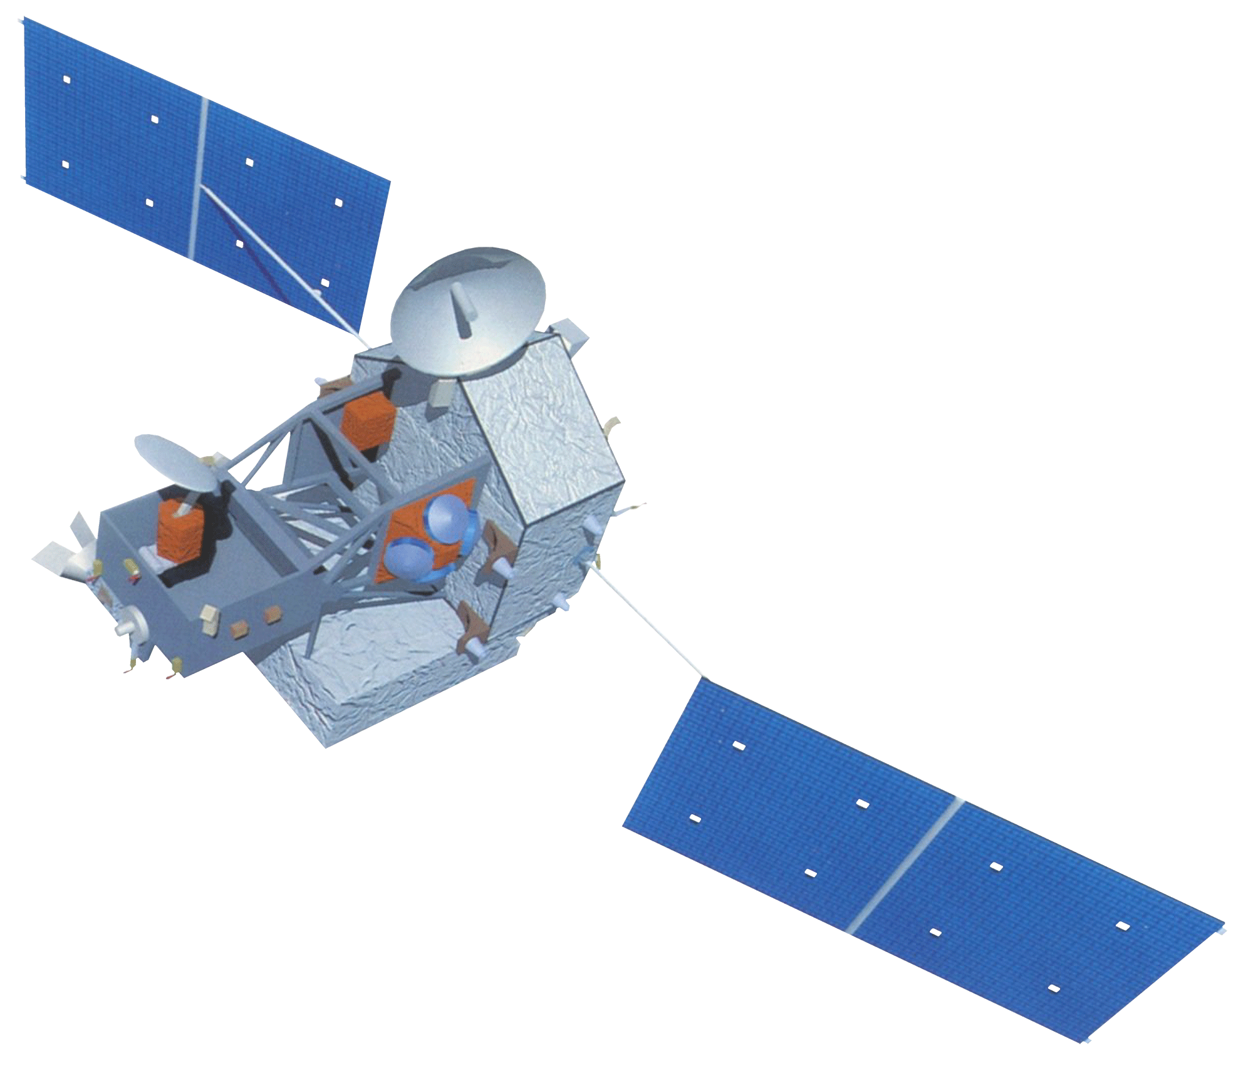
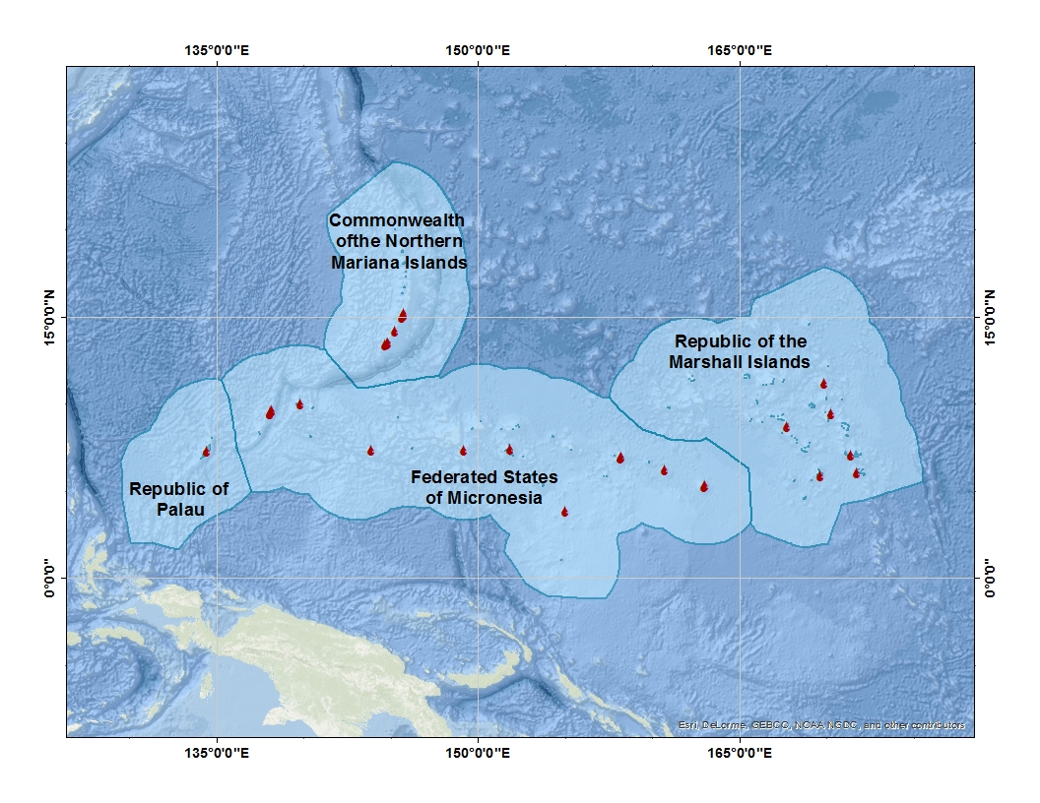
Long-Term Verification
Monthly precipitation comparison from 2000-2014
-TRMM-TMPA-3B42RT
-PERSIAN-CDR
-NOAA GHCN
Notes:
Image source:
TRMM: http://www.devpedia.developexchange.com/dp/images/1/1a/04_TRMM.png
-Go over why we chose to pick TRMM for a Long-Term validation
-Mainly hit on the PERSIANN vs GHCN mean annual R-squared plot because those two are data sources we use throughout the project

Slide 8
Short-Term Verification
Daily precipitation
comparison from April 1st,
2015 to December 31st, 2015
Notes:
Image Source:
GPM: http://www.devpedia.developexchange.com/dp/images/1/14/08_GPM.png
-Show the trend of GPM and PERSIANN vs. GHCN
-Hit on how PERSIANN and more so GPM under estimate observed rainfall from the GHCN stations.

Slide 9
Short-Term Verification
November, 2015 Daily | PERSIANN-CDR vs. GHCN | GPM-IMERGDE vs. GHCN
Bias (mm/day) | -1.32 | -2.09
Mbias | 0.77 | 0.63
Rbias (%) | -23.25 | -36.86
RMSE (mm) | 26.34 | 41.77
CC | 0.44 | 0.43
December, 2015 Daily | PERSIANN-CDR vs. GHCN | GPM-IMERGDE vs. GHCN
Bias (mm/day) | -0.76 | -1.96
Mbias | 0.87 | 0.67
Rbias (%) | -13.60 | -34.94
RMSE (mm) | 21.30 | 55.80
CC | 0.32 | 0.32
Notes:
Image Source:
GPM: http://www.devpedia.developexchange.com/dp/images/1/14/08_GPM.png
-Here we quantify the bias of how much PERSIANN and GPM under estimate for the two given months

Slide 10


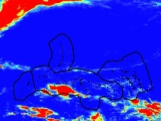
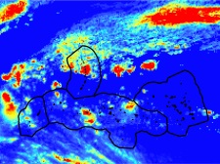
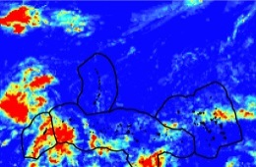
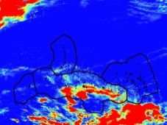
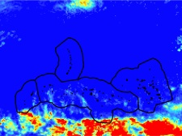
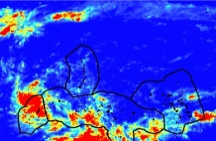
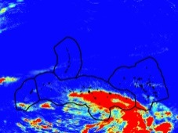
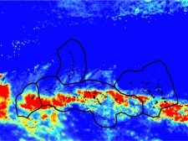
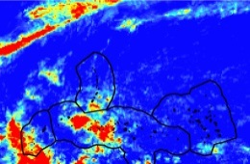
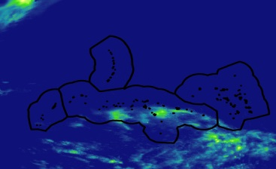
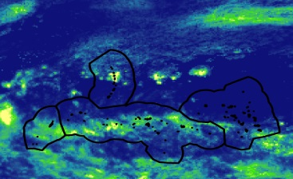
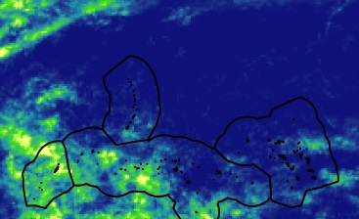
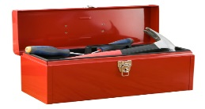
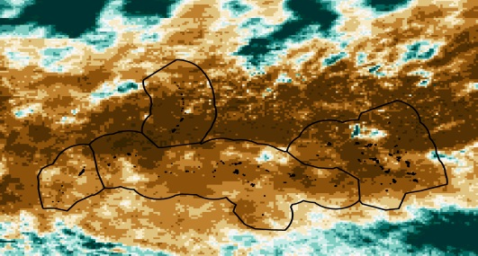
Data Processing
GPM
PERSIANN
TRMM
Download NetCDF files via FTP server
Clip and Convert to raster using R
Sum to desired time scale
Operationalize Create maps/figures or extract points
Notes:
All Images were created by our team or from clip art in Microsoft powerpoint
-Run through the process of how we obtained, manipulated, and visualized our data

Slide 11
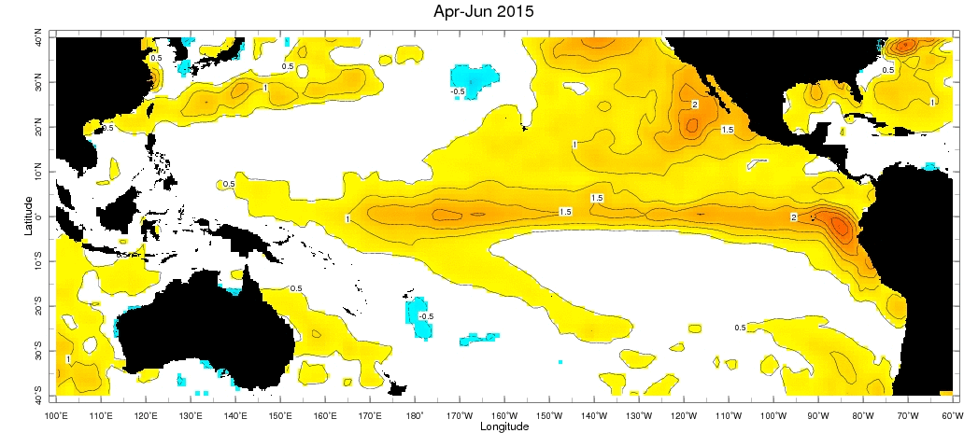
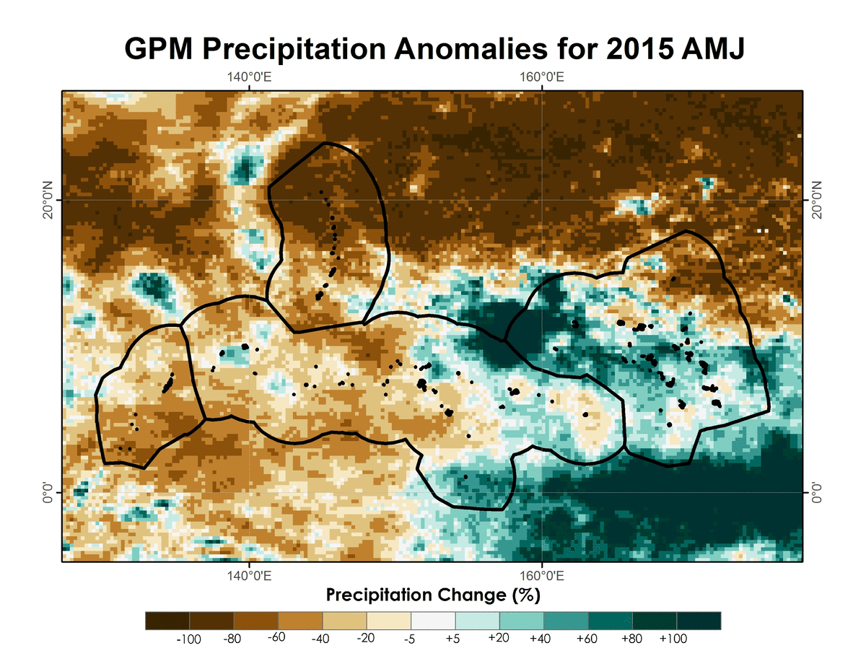
“Spatial Anomalous Precipitation Tool”
2015-2016 El Niño
Representing Precipitation
Brown = Below average
Turquoise = Above average
Equatorial Pacific SST Anomalies
Notes:
3 month Sea Surface Temperature anomalies during the 2015 -2016 El Nino Event. As the
Rainfall departure maps seen here shows how the strong 2015 – 2016 El Nino event brought wide-spread drought and dryness across much of the western pacific, as evidence of the deepening brown colors over the year. As an effect of the strong El Nino event, crippling drought was experienced in the USAPI for the winter months and into the spring.
SST images credit: International research Institute for Climate and Society – Columbia University

Slide 12
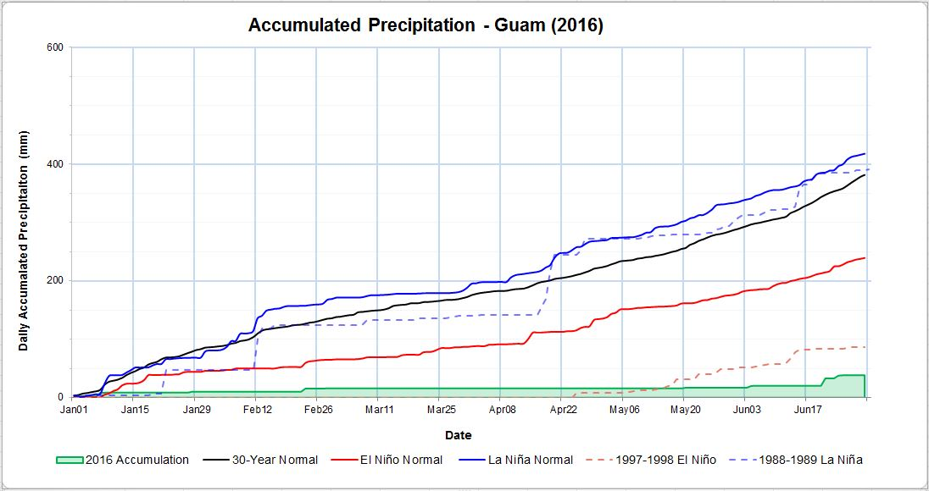
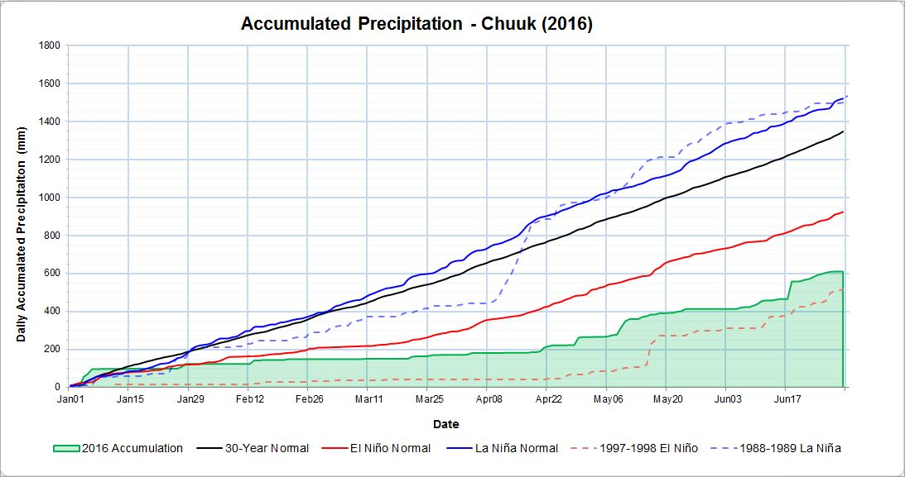
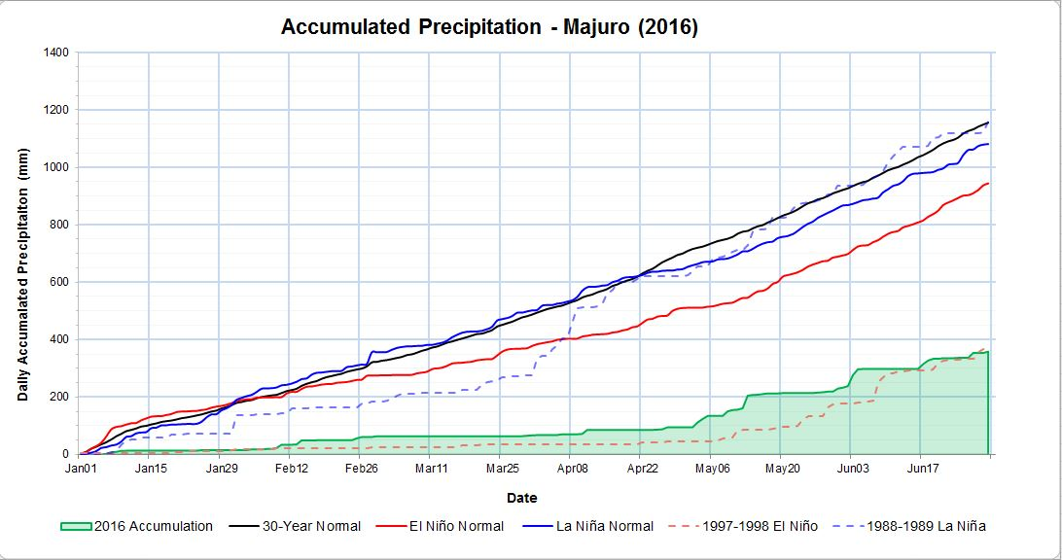
“Haywood Plot Generator”
La Niña Normal
La Niña Normal
La Niña Normal
El Niño Normal
El Niño Normal
El Niño Normal
GPM Real-Time
GPM Real-Time
GPM Real-Time
Notes:
The pattern of dryness is also evident in the line plot for the islands of Guam, Chuuk, and Majuro, which show the total accumulated precipitation to date for 2016. Similar to the precipitation departure maps, this tool quantifies the departure from normal, as well as other major ENSO events. This plot can be updated daily to capture near real-time accumulated precipitation departures.

Slide 13
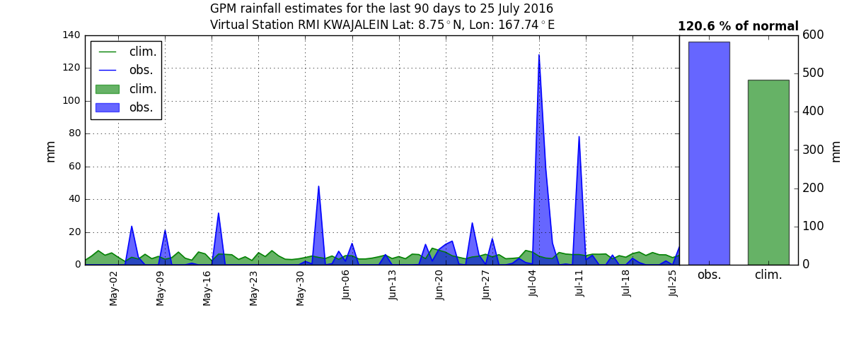
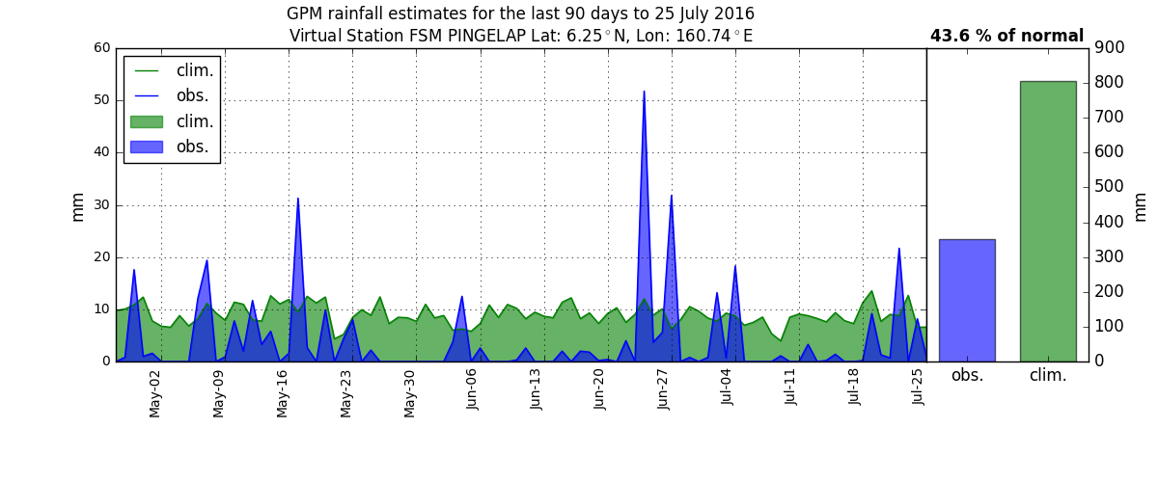
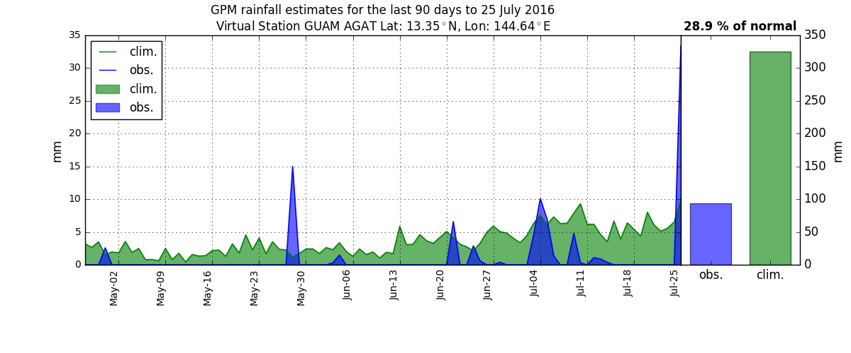
“Virtual Station Generator”
Notes:
Another way to show this data is by plotting real-time precipitation over what is expected during a given season. The utility and power of this tool is its ability to focus on a specific point during a given period in time.

Slide 14
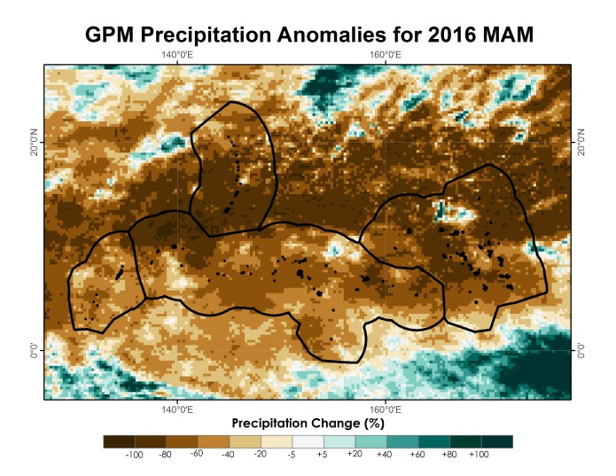
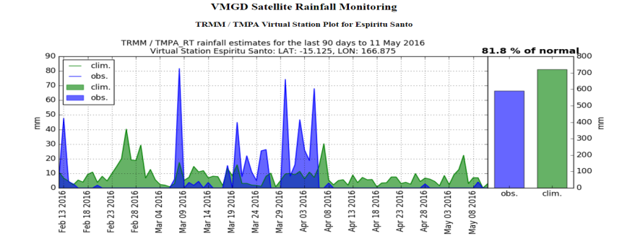
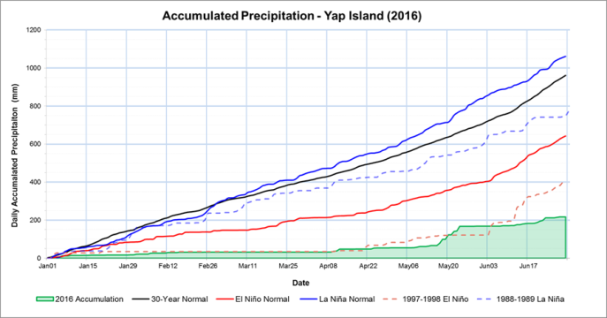

Use Case Scenarios
Adapt
Mitigate
Prepare
Notes:
Together these tools can be used by weather station officers and emergency responders and to adapt, mitigate, and prepare for future and ongoing water resources emergencies.

Slide 15
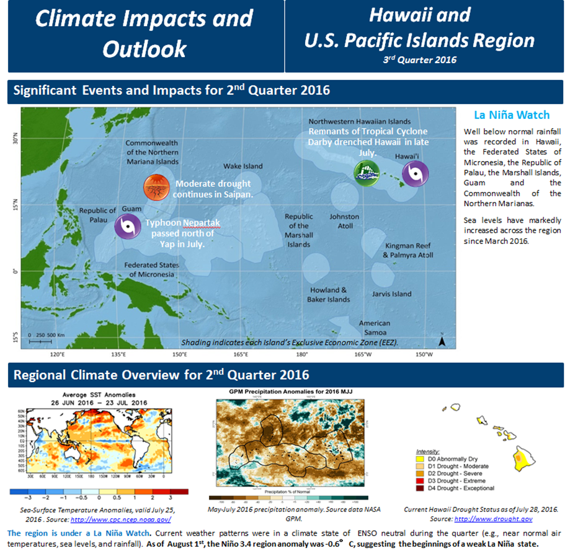
End-Users Feedback and Dissemination
“… this allows us to look at the ocean areas without “data” .... you show that there is data, but you make that data usable.”
“The product can also be used to enhance the Drought Monitor products and the Pacific ENSO Applications Climate Center products.”
Charles Guard
Warning Coordination Meteorologist National Weather Service - Guam
Image Credit: Mike Kruk
Notes:
We sent results to climate experts in the region and they the responded with positive feedback and its ability to blend with already existing tools used in the region.
Image Credit: Mike Kruk

Slide 16
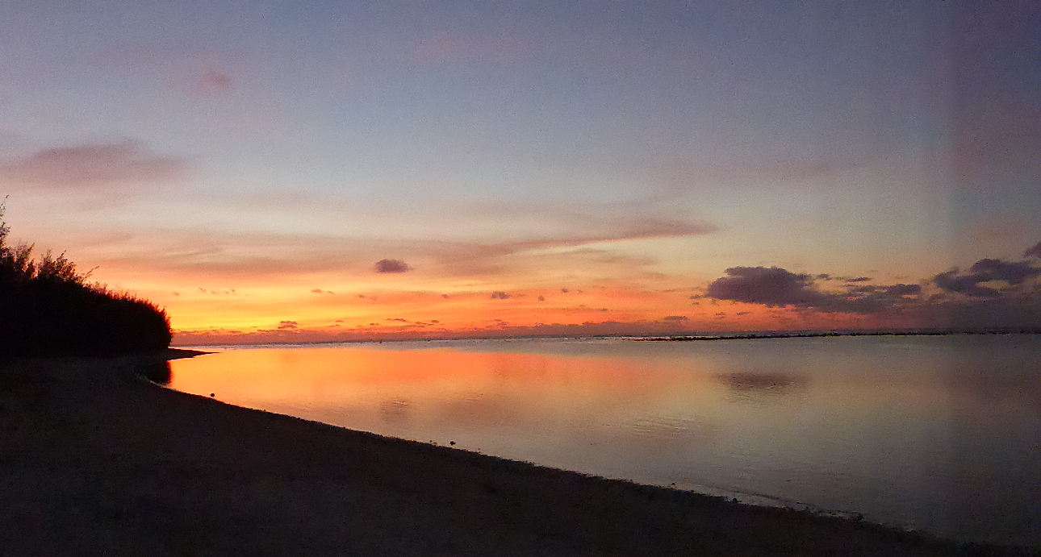
Conclusions
PERSIANN – CDR and GPM tend to underestimate raw station daily precipitation observations.
PERSIANN – CDR and GPM do follow wet and dry daily trends, and therefore can be used in a near-real time product.
Output generated by the tools confirm the crippling effects of the strong 2015 – 2016 El Niño event.
The tools are fully operational for future use by our project partners.
Image Credit: Scott Heron – NOAA Affiliate
Notes:
PERSIANN – CDR and GPM tend to underestimate raw station daily precipitation observations.
PERSIANN – CDR and GPM do follow wet and dry daily trends, and therefore can be used in a near-real time product.
Output generated by the tools confirm the crippling effects of the strong 2015 – 2016 El Niño event.
The tools are fully operational for future use by our project partners.
Dissemination to WSO’s and emergency responders is ongoing.

Slide 17
Advisors
Michael Kruk, Earth Resources Technology
John Marra, NOAA/NCEI Pacific Region Climate Services Director
Past Contributors
Jessica Sutton
Ethan Wright
Others
The authors would like to acknowledge Alec Courtright (NASA DEVELOP), Emma Baghel (NASA DEVELOP), James Potemra (IIRC), Nico Fauchereau (NIWA), Ryan Berkheimer (GST), Tom Burnet (GST), James Adams (ERT), and the NASA DEVELOP National Program Office for their support, suggestions, and edits that have fundamentally strengthened this research.
Notes:
Acknowledgements

