Slide 1
Wise County Disasters
Using NASA Earth Observations to Identify the Historic and Future Extent of Flooding Throughout Wise County, Virginia.
Kimberly Berry (Project Lead)
Zachary Tate
Abhijeet Singh Baghel
Grant Bloomer

Slide 2
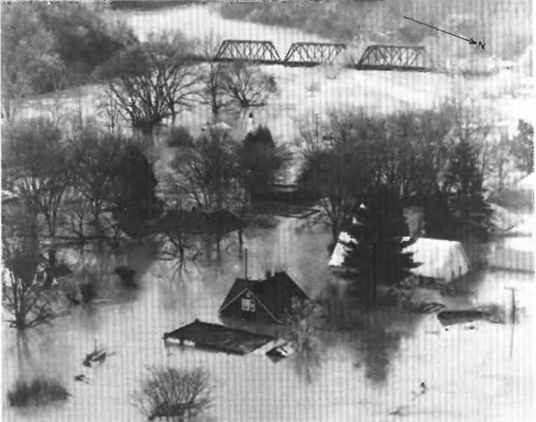
Historical Floods
April 2-5, 1977
Most devastating in resent memory
Town of Clinchport, VA “Wiped Out”
Clinchport, VA (April 15,1977) [US Department of the Interior]
Notes:
A “worst-case” scenario of what flooding can look like in the area is Clinchport VA. Clinchport is an example of towns like Big Stone Gap and Coeburn in Wise County: built next to and on the flood plain of rivers at the bottom of valleys. All this flowing water not going into the ground runs-off into the rivers and streams these towns are built next to. The flood in 1977 was potent enough to “wipe out” Clinchport. Since then it has become a ghost town, with only foundations, a few standing structures, and a road to remind people there was a town there once.

Slide 3
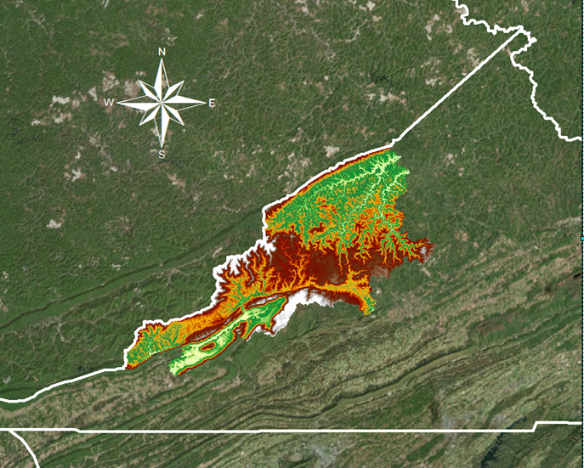
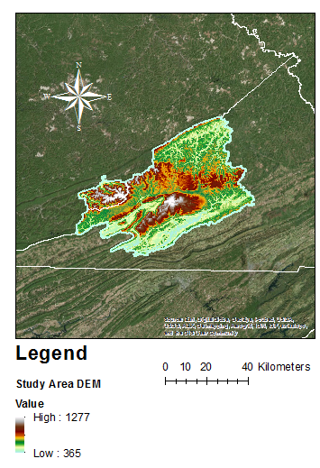
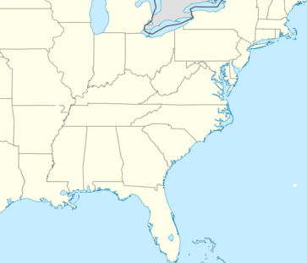


Study Area
West Virginia
Wise County, VA
  Mountainous Terrain
  Microclimate
  High precipitation events in Summer and Winter
Kentucky
Virginia
Tennessee
Notes:
Wise County lies in the heart of the Appalachian Mountains. The area is well known by its residents for its hot summers and cold winters. Historically, intense and destructive flooding has occurred from warm heavy rainfall causing rapid snowmelt and uncharacteristically wet seasons with intense rainfall. One of the factors that potentially contribute to high flooding in this area include low capacity thresholds of the many stream networks. According to the Commonwealth of Virginia Hazard Mitigation Plan in 2013, Wise County Averages between 1-4.99 flooding events annually. Storms in Wise County have contributed to millions of dollars in damages. Wise County averages an annual loss of about $400,000 due to flooding.

Slide 4

Current Management & Policies
Current Flash flood warnings come from the National Weather Service to the Wise County Emergency Management Office
Notes:
As of now, the only flood forecasting Wise County has is what the National Weather Service provides. The NWS has a network of stream gauges across the county that are part of the IFLOWS network. The gauges report stream height and where it currently lies in relation to certain flood levels. With a weather forecast, the best they can do is guess if the rivers will rise into higher flood stages and monitor current status. This project determined areas that are more susceptible to flooding using ArcGIS and CREST model.

Slide 5
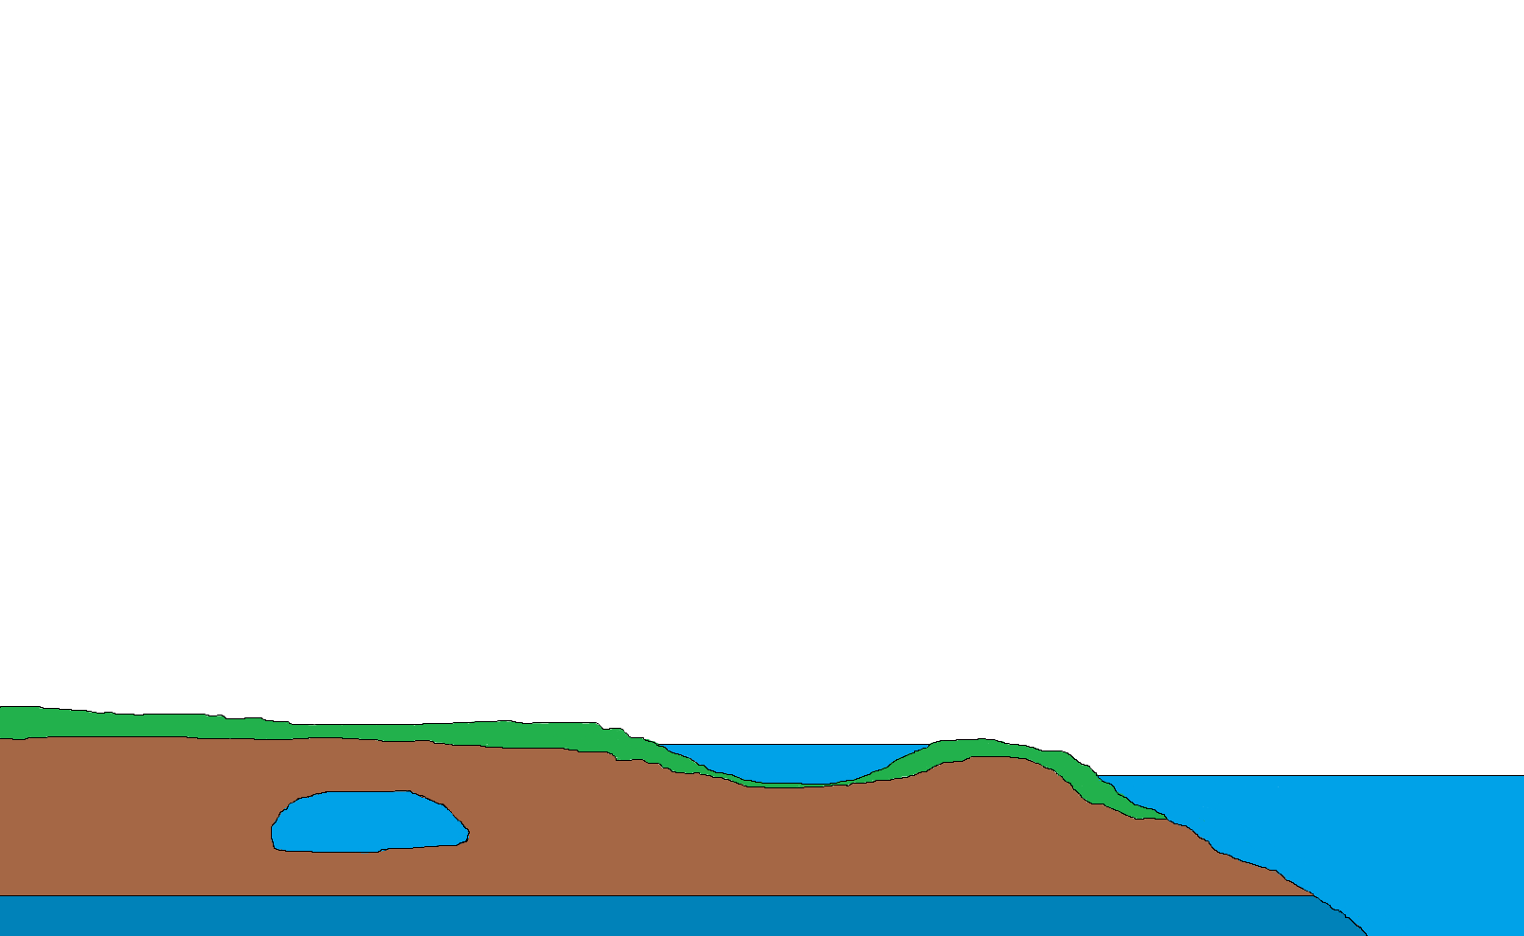





CREST
C = Coupled
R = Routing and
E = Excess
ST = Storage
Precipitation
Evapotranspiration
Evaporation
Infiltration
Excess
Storage
Routing
Notes:
The CREST stands for Coupled Routing and Excess Storage. It is a Distributed Hydrologic Model, developed by NASA SERVIR and University of Oklahoma.
Model considers 2 atmospheric forces Precipitation and Evapotranspiration.
The word Coupled means combined - which refers to the combination of surface and sub-surface runoff .
The Routing refers to the Surface and Sub surface runoff modelling.
The Excess Storage refers to surface water storage like streams, ponds etc. and underground water storage like aquifers.
The CREST model was used to calculate surface runoff by making use of cell to cell routing mechanism. Let us look at what I mean by cells in cell to cell routing.

Slide 6
CREST Model
Temporal and Spatial variation of land surface
Coupling between the runoff generation and routing mechanisms
Cell to cell routing scheme
C
A
C
A
A
B
A
A
B
B
Precipitation Data
Digital Elevation Model
Soil Data
Notes:
In the figure, Cells A, B and C represent different soil types various elevations. In CREST we input these grid cells using Digital Elevation Modelling or DEM.
ANIMATION :
CREST uses a Variable Infiltration Curve, denoted using R which determines where water goes next. The water can be infiltrated to the next soil layers or can run off on the surface to the overland reservoir.
The model has 4 running styles and we ran the model in simulation mode. Now lets look into Routing.

Slide 7
8
1
2
Cell to Cell Flow Routing
7
3
6
5
4
Based on elevation
Specified in Project file
2 types of Routing
  CLR
    Coupled Linear Routing
  JLR
    Jumped Linear Routing
8
1
2
7
2
3
6
5
4
Notes:
Routing parameter is specified in the .Project file.
Assume we have, 1-8 are grid cells of different elevations and grid cell 2 has the lowest elevation among these cells.
If starting routing position for the model is the green center cell, then the routing mechanism in CREST selects the cell with the corresponding lowest elevation (# 2 in our case).
ANIMATION :
The corresponding cell number is stored inside the green cell which determines our flow direction and the process goes on for our study area.
The image in the output results slide provides a good visualization of the routing mechanism.

Slide 8
CREST Model Inputs
Rain
PET
Soil
Crest Model
BASICS
PROJECT
FILE
DEM
FDR
FAC
Notes:
These are the various file inputs to the CREST model.
Over to Grant for more information on the CREST model inputs and source for these inputs.

Slide 9
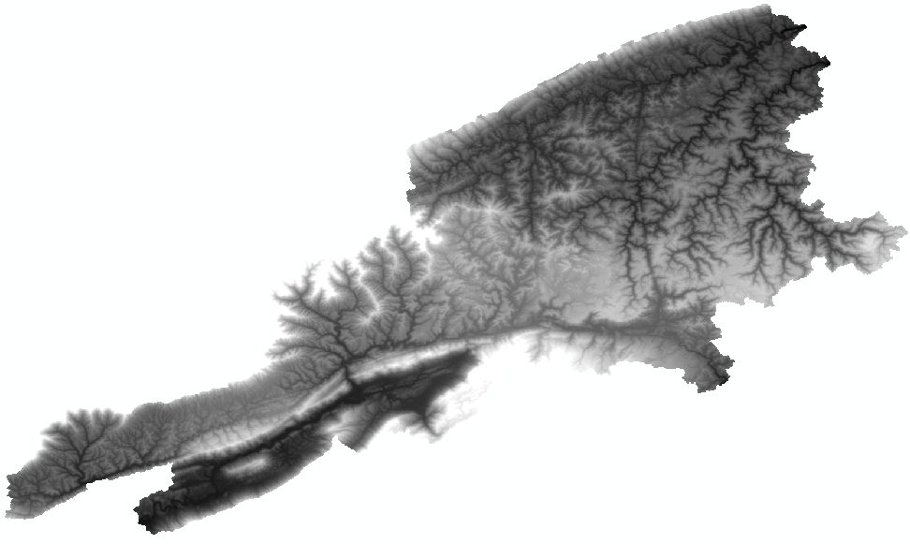
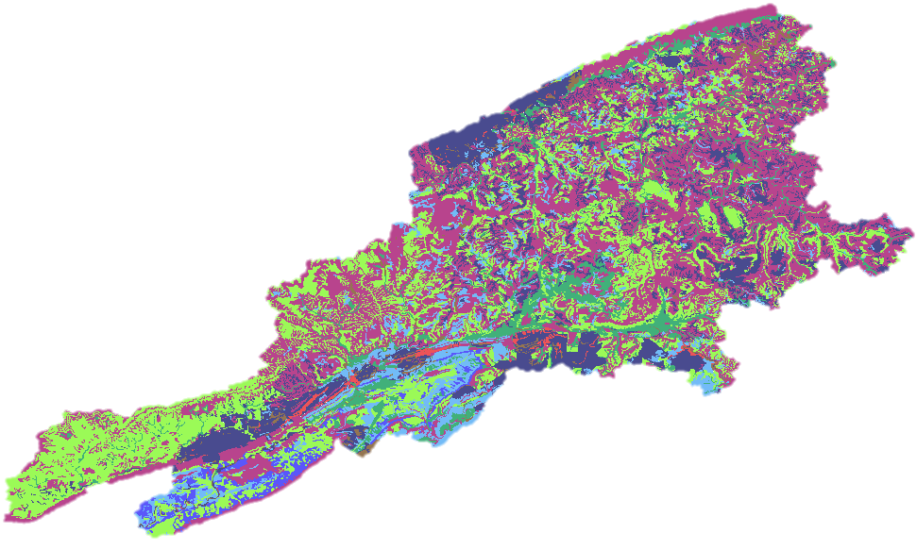
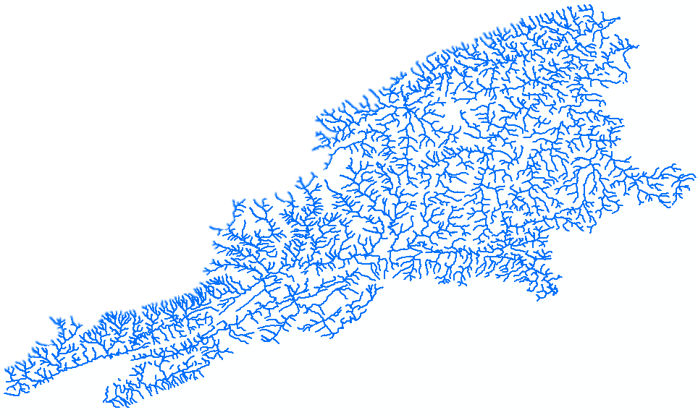
Data Inputs
Digital Elevation: SRTM
Flow direction: DEM
Flow Accumulation: DEM
Precipitation: TRMM and GPM
Soil: gSSURGO (Gridded Soil Survey Geographic database)
Stream: USGS
Observed Flow: USGS
Potential Evapotranspiration: Global Land Data Assimilation System
Notes:
To run the Crest Model, several inputs are required, such as a DEM, Flow Direction and Accumulation maps, Precipitation, Soil data, Stream maps, PET Data, and Observed flow. Without any one of these inputs the model will not run. If the inputs are in a wrong projection the model will output incorrect data or it will not run.

Slide 10
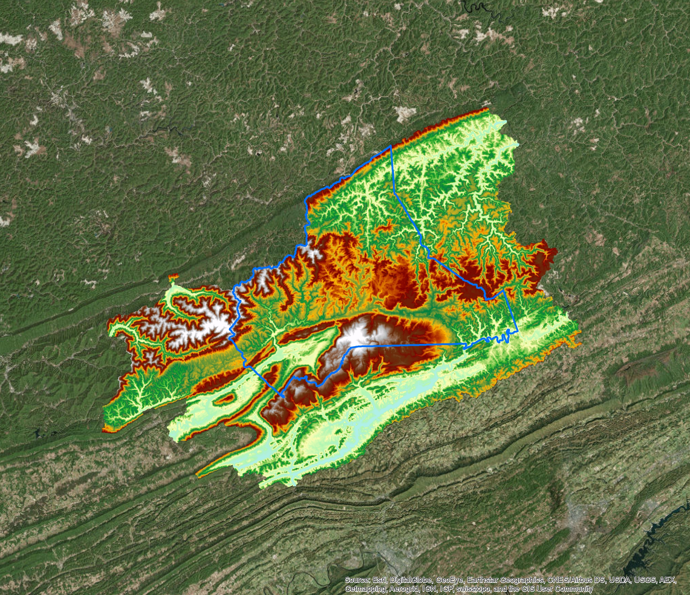
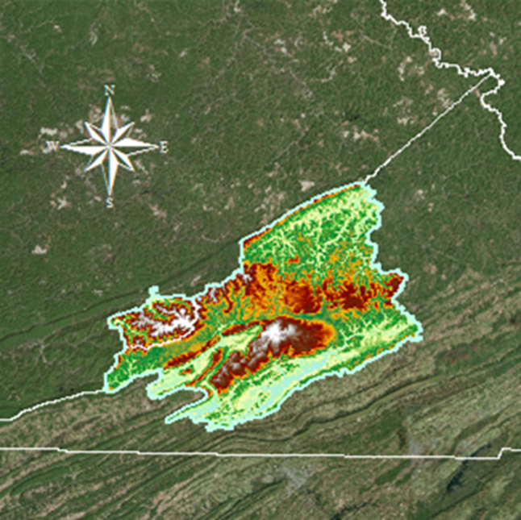

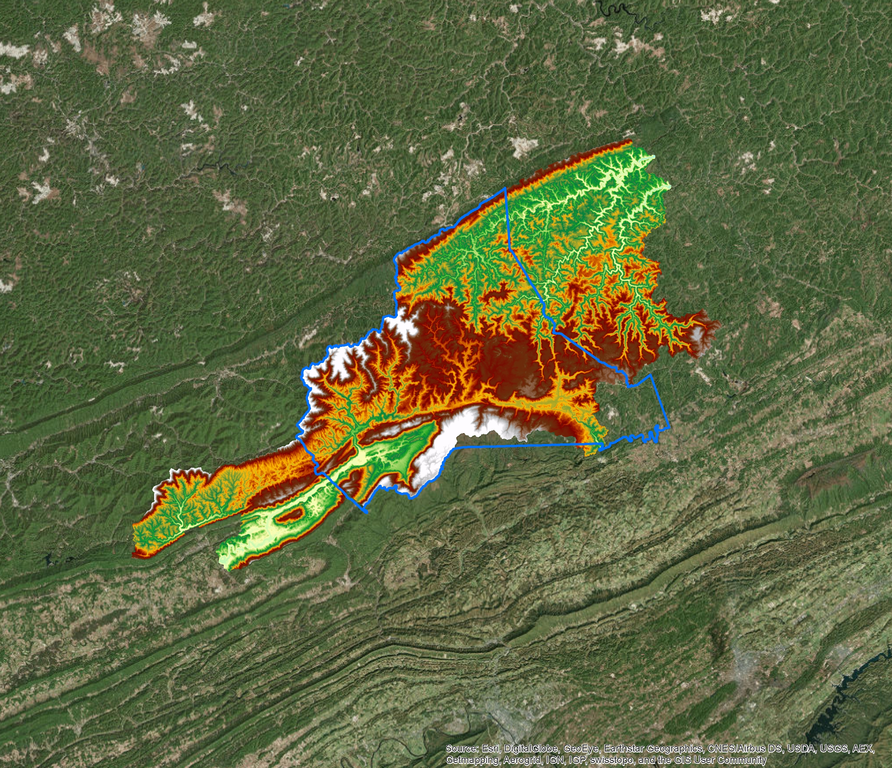
Change of Study Areas
Notes:
The study area changed part of the way through the term, due to complications with running the Crest model.

Slide 11
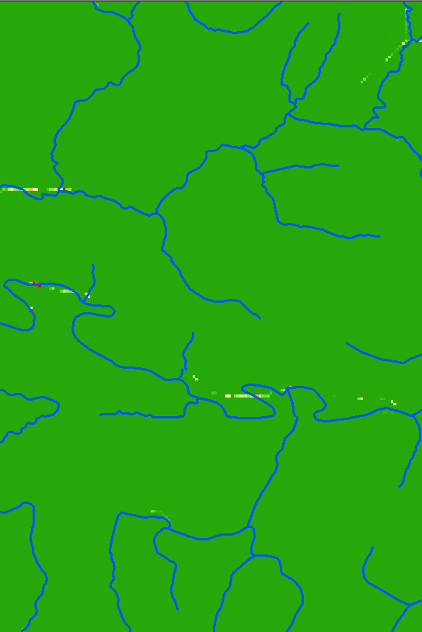
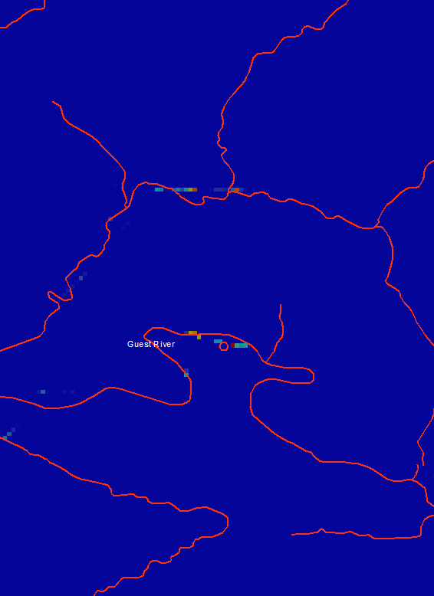
Sample outputs
The CREST model outputs were
  Stream Discharge
  Soil Moisture
  Surface Runoff
Notes:
The 3 main outputs of the CREST Model are Stream Discharge which displays how much water is exiting the stream,
Soil Moisture which shows how Saturated the ground is, and Surface Runoff shows how much water is running off into the streams.

Slide 12

Analysis
The CREST outputs were loaded into ArcGIS to visualize the areas of impact.
Areas in red are the most prone to flooding.
Notes:
In the output maps the areas in red have an increased chance of flooding compared to other areas in the county.

Slide 13
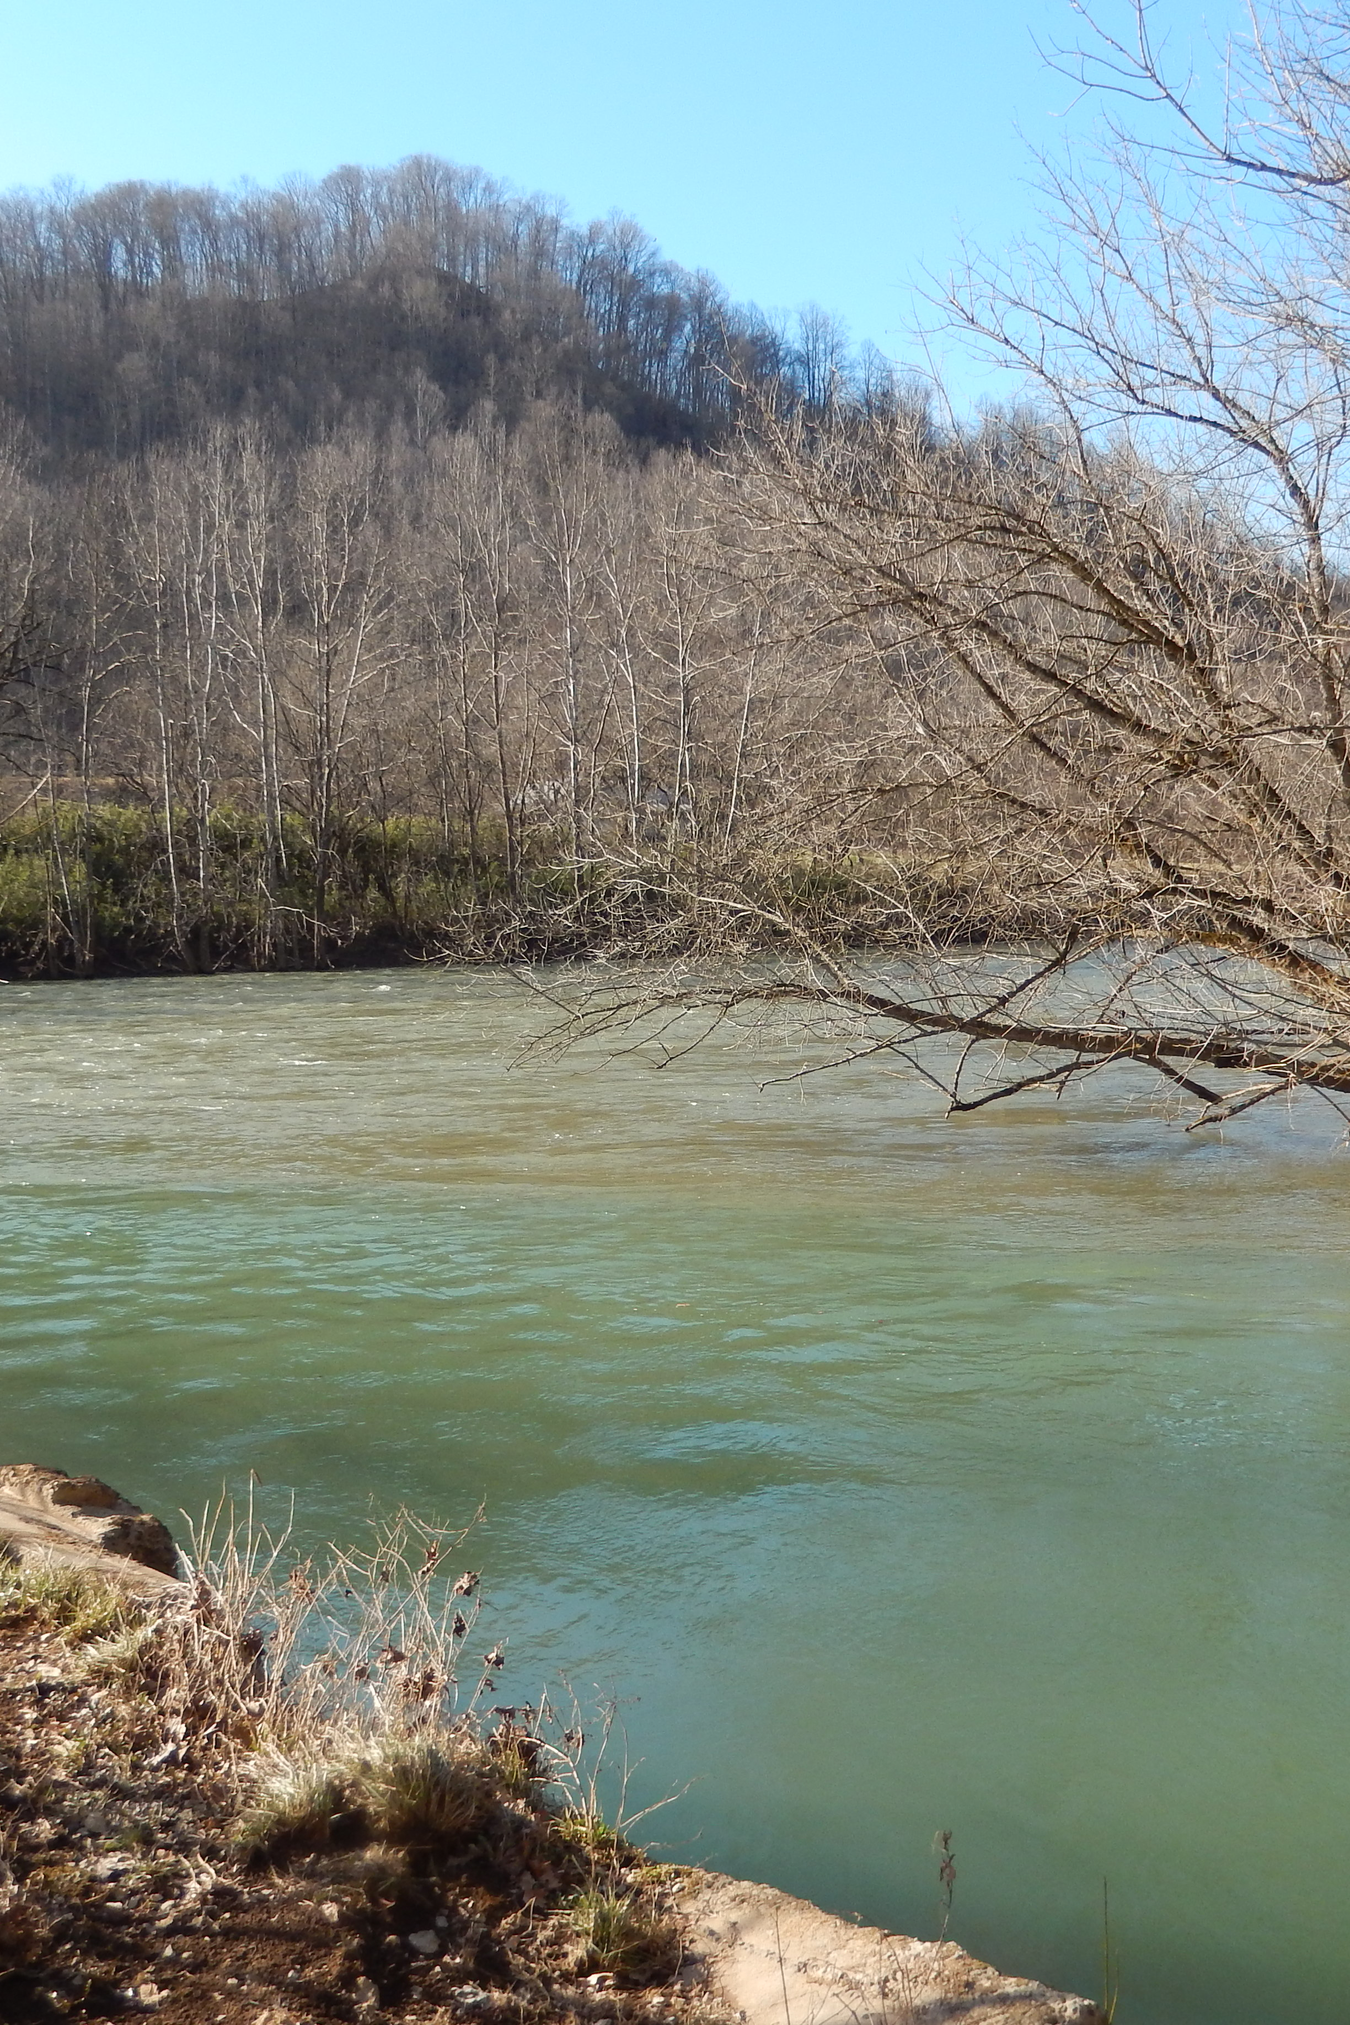
Potential Impacts
Assisting the Wise
County Board of Supervisors and Emergency Management Offices to determine flood forecasting on local streams and rivers.
Image from Kim Berry
Notes:
Like Zach had said earlier, Wise County bases its weather off of the National Weather Service so the Potential Impacts so this project are to give Wise County a more personalized Flood prediction. The National Weather service in a whole does not offer an accurate enough forecast for the area of Wise.

Slide 14
Advisors
Dr. Kenton Ross (NASA DEVELOP National Program)
Dr. DeWayne Cecil (Global Science & Technology [GST] National Centers for Environmental Information [NCEI])
Bob VanGundy (University of Virginia’s College at Wise)
Partners
Wise County Board of Supervisors (End-user),
Boundary Organization, POC: Bob Adkins ;
Boundary Organization (Director of Emergency Management)
Notes:
Thank the advisors.

Slide 15
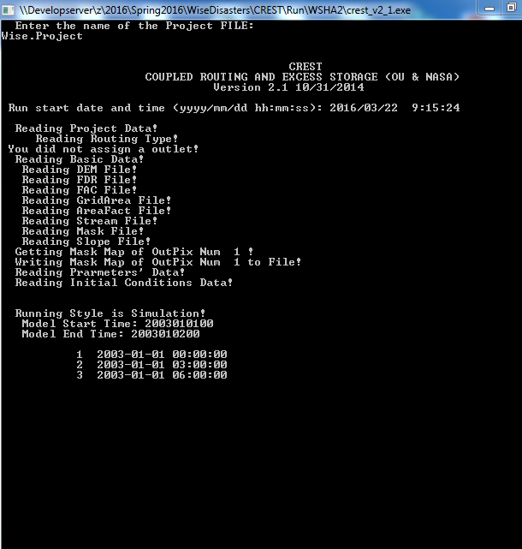
Bonus Slide
Example of CREST Running
Notes:
In this slide you can see the CREST Model run. It starts off by fetching the Basic files from the predefined folders, then it will start its Simulation, running on a 3 hour interval. After the model runs, it outputs an Excel file with the results.

Slide 16
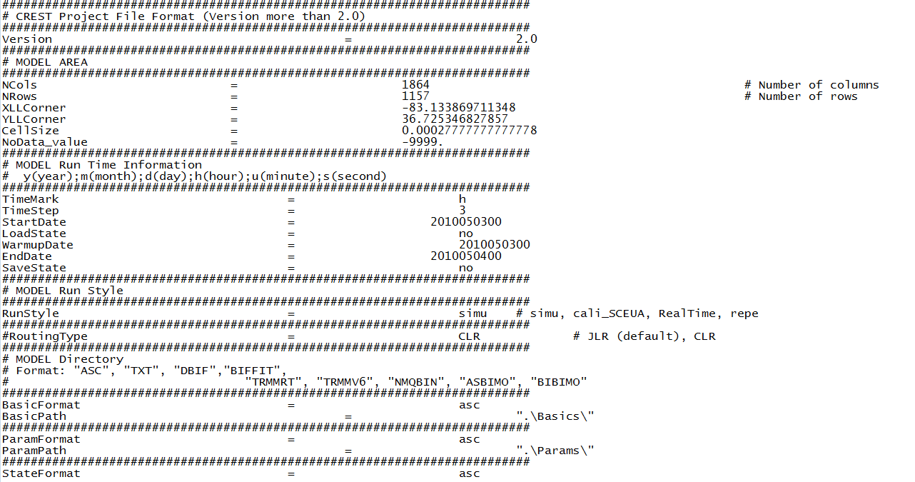
Project File

