Slide 1
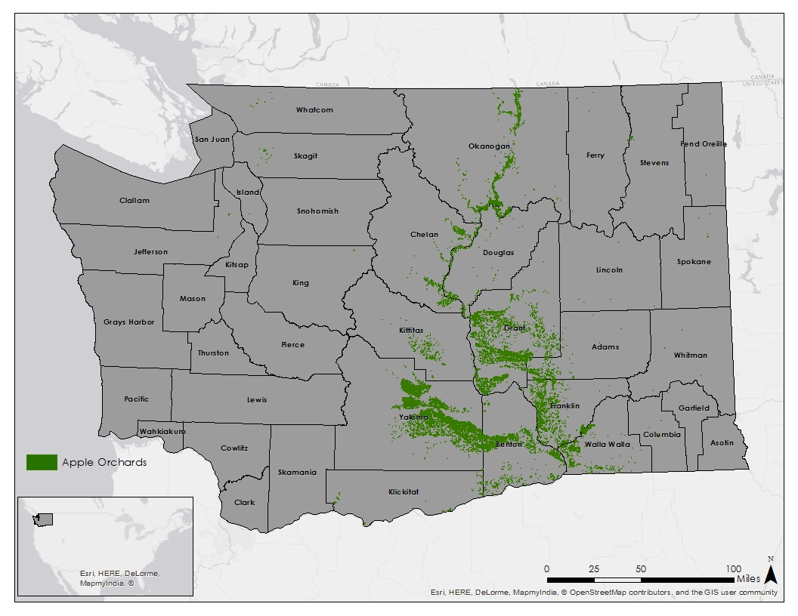
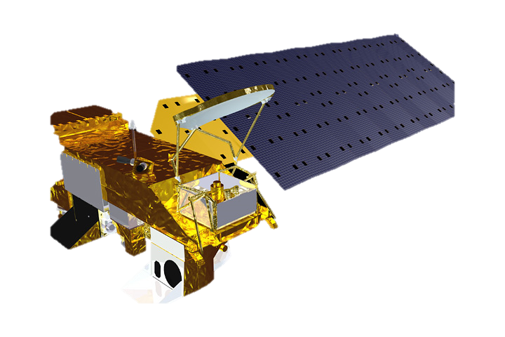
Northwest United States Agriculture III
Assessing current and future Plant Hardiness Zones for apple production in Washington State using climate models and NASA Earth Observations
Madeline Ruid (Team Lead), Teresa Fenn, Mathew Mullen, Sarah Philbrick, James Hendrickson (USAF)
Abstract
Objectives
Keep this blank for now.
Body text point size should be at least 24.
Caption text point size should be at least 16.
Feel free to rename, move, and resize sections as needed.
Create a current Plant Hardiness Zone (PHZ) map specific to Washington State
Forecast PHZs through 2100
Generate a current suitability map for apples in Washington State
Forecast the locations of suitable apple growing regions through 2100
Study Area
Methodology
Pre-
Processing
Download MODIS LST Data
Mosaic images
Estimate air temp from LST
Remove outliers
Create rolling averages
Download Climate Model Data
Mask to study area
Convert data from K to C
Project data
Data Analysis
Find minimum value per year for each pixel and average from 2002-2015
Calculate GDD
Calculate avg growing season temp
Import PHZ
Earth Observations
Classify into PHZ
Apply weights and classify into Suitability Regions
Post Analysis
Compare MODIS produced PHZ maps to current PHZ maps
Use Cropscape data to find which present day land covers will be most suitable for apple orchards in the future
Test climate model used against historical data
Aqua
Results
Conclusions
Use images.
Make sure that it has some sort of flow, that it makes sense. Show your results in a logical order.
No bullets.
Use bullets.
Use complete sentences with periods.
Team Members
Project Partners
Acknowledgements
Use a professional-looking photo.
Individual headshots are ok, if they aren’t pixelated and are all the same size.
Include a caption that states the team members’ names.
Dr. Michael Glenn
Appalachian Fruit Research Station
USDA- Agriculture Research Service
Dr. Kenton Ross
NASA DEVELOP National Program Science Advisor
Dr. Noel Baker
NASA Postdoctoral Program Fellow
Jeffry Ely
NASA DEVELOP Geoinformation Scientist
Emily Adams
NASA DEVELOP – Langley Center Lead
Dan Wozniak
NASA DEVELOP – Langley Assistant Center Lead
Northwest US Agriculture I, II
NASA DEVELOP – Fall 2014, Spring 2015
NASA Langley Research Center

