Slide 1
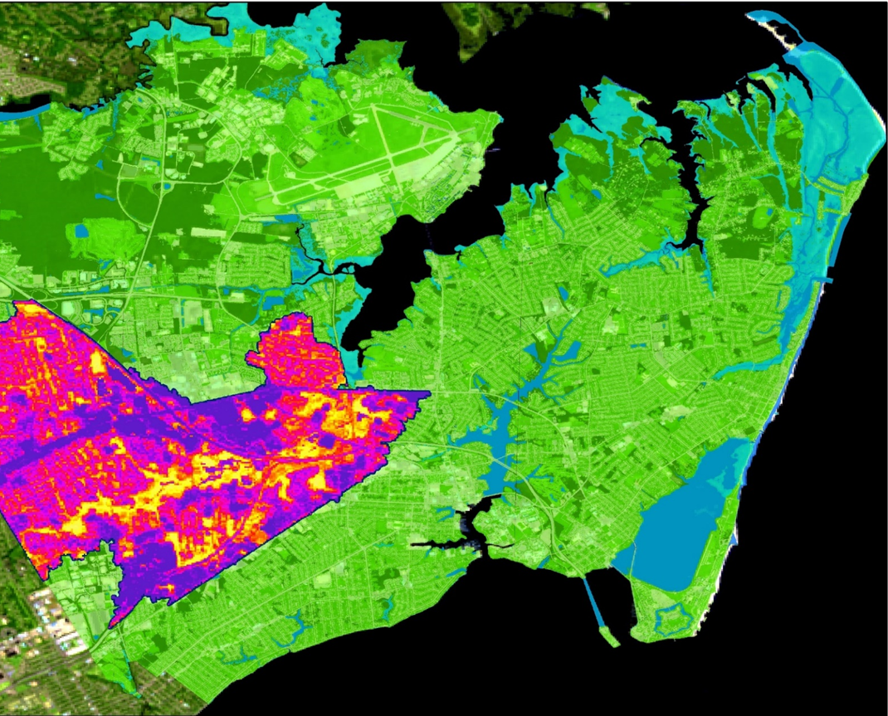
HAMPTON ROADS URBAN DEVELOPMENT II
Assessing Urban Tree Canopy and Impervious Surface Distribution to Inform Urban Planning in Hampton, Virginia
Stephanie Kealy
Sophie Barrowman
Paige Haley
Alina Schulz
Virginia – Langley | Summer 2019
Notes:
Hello! Thank you all for being here today. We are the Hampton Roads Urban Development II team, and we would like to introduce ourselves to you.
My name is ______ and I have a degree in ________.
(All 4 participants introduce themselves)

Slide 2
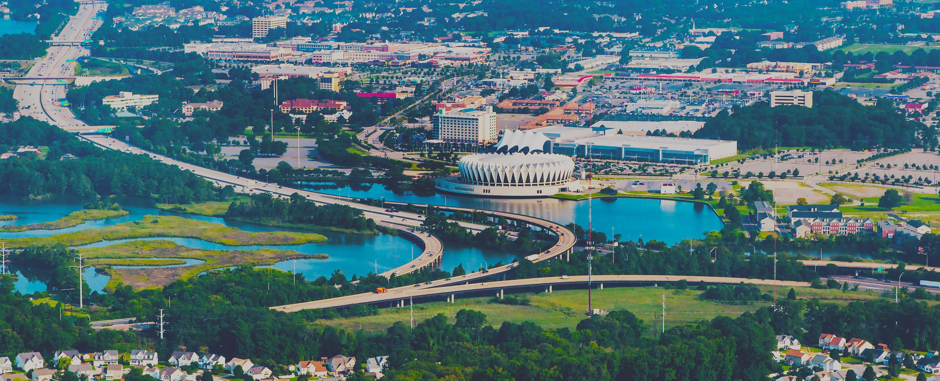
PARTNERS
City of Hampton, VA
Image Credit: City of Hampton
Notes:
Our interdisciplinary team was excited to partner with officials from right here- the City of Hampton in Virginia- to support the City’s urban management initiatives. Specifically, we communicated with Bruce Sturk, Director of Federal Facilities Support; Lucy Stoll, Senior City Planner; David Imburgia, Resiliency Officer; and Allan Lambert, GIS Manager.
------------------------------Image Information Below ------------------------------
•Image Credit: City of Hampton - permission for use granted
•Image Source: Hampton.gov

Slide 3
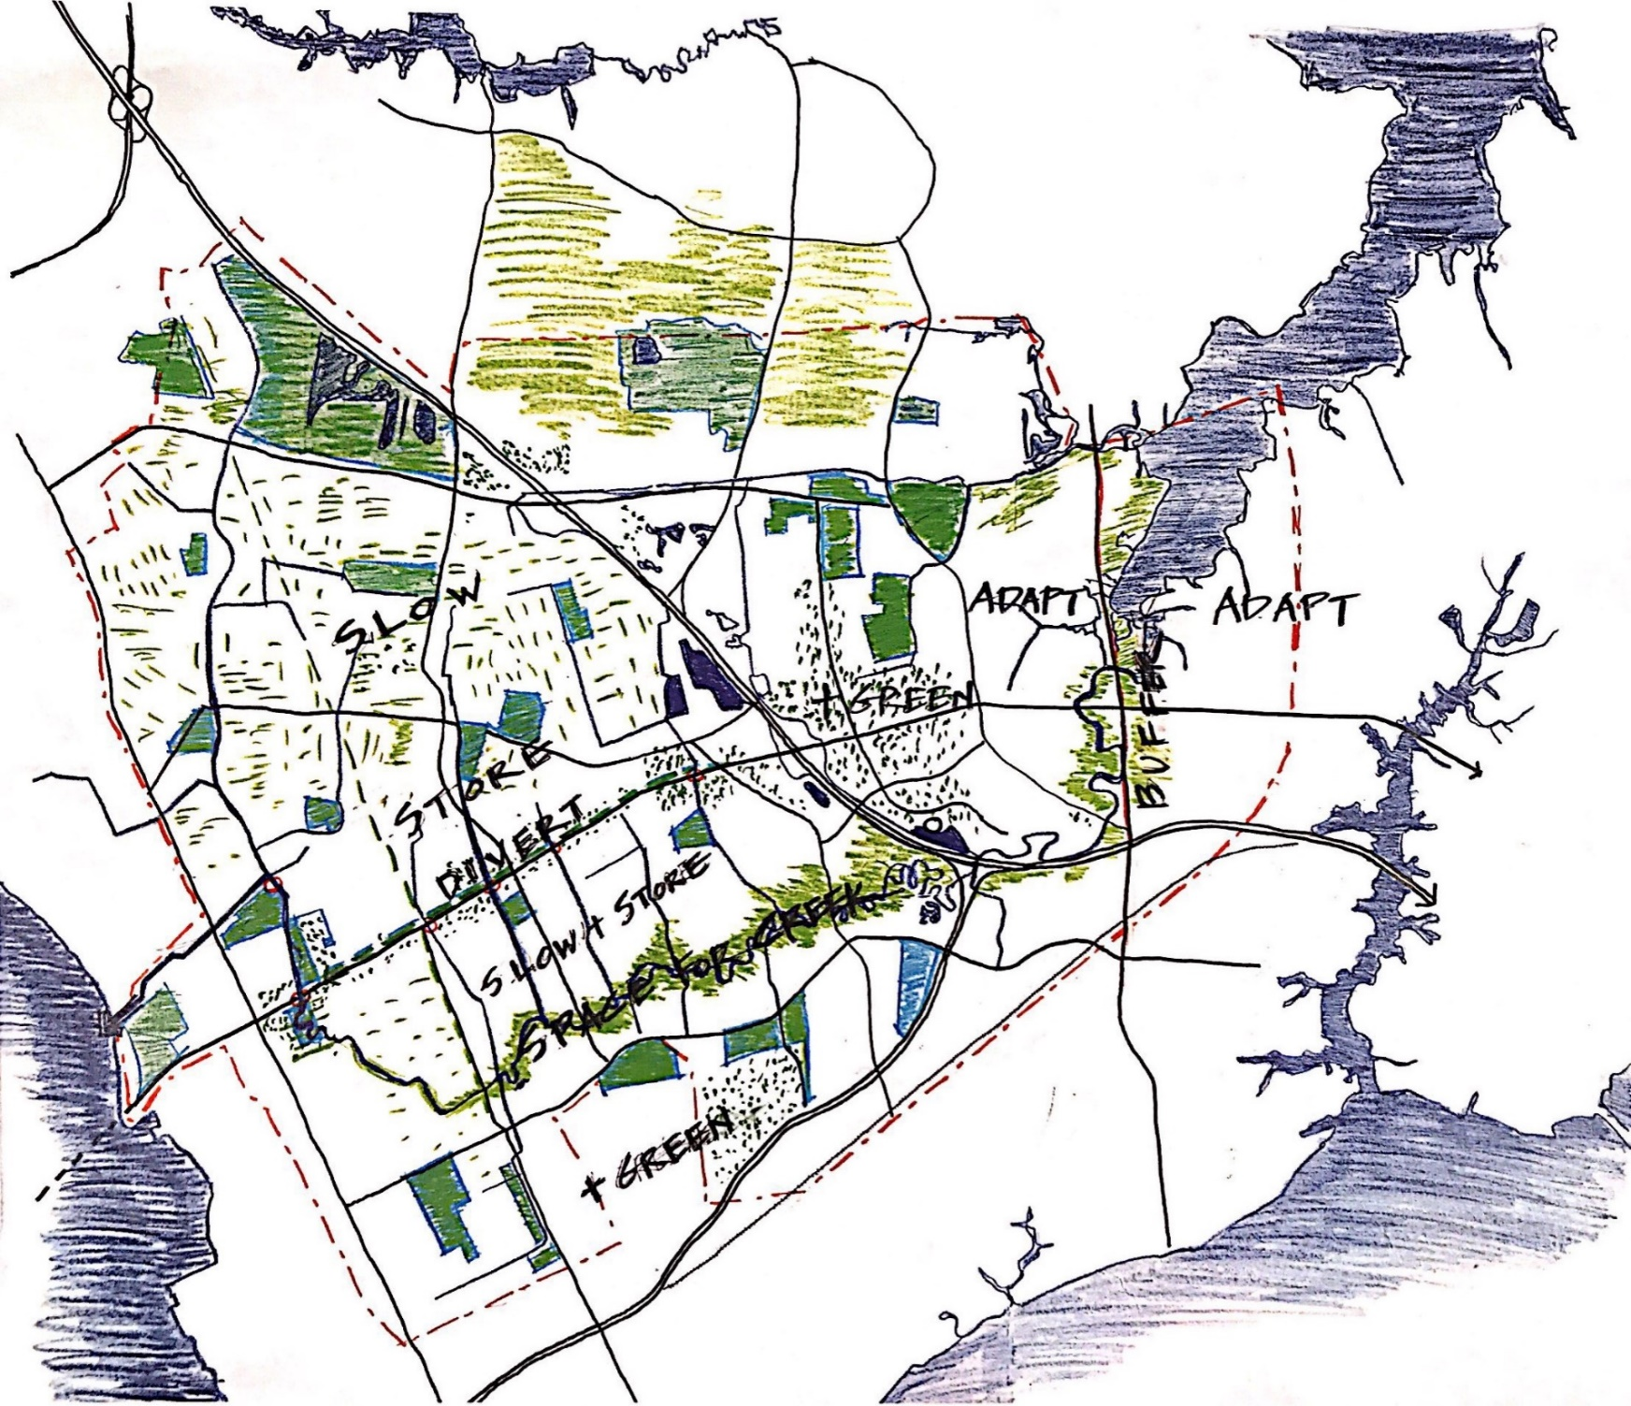
PARTNERS
Waggonner & Ball
Architects
Image Credit: Waggonner & Ball
Notes:
We also collaborated with Waggonner & Ball Architects, specifically Janice Barnes, Principal, Director of Resilience and her team.
------------------------------Image Information Below ------------------------------
•Image Credit: Waggonner & Ball - permission for use granted
•Image Source: Unpublished illustration by Waggonner & Ball

Slide 4
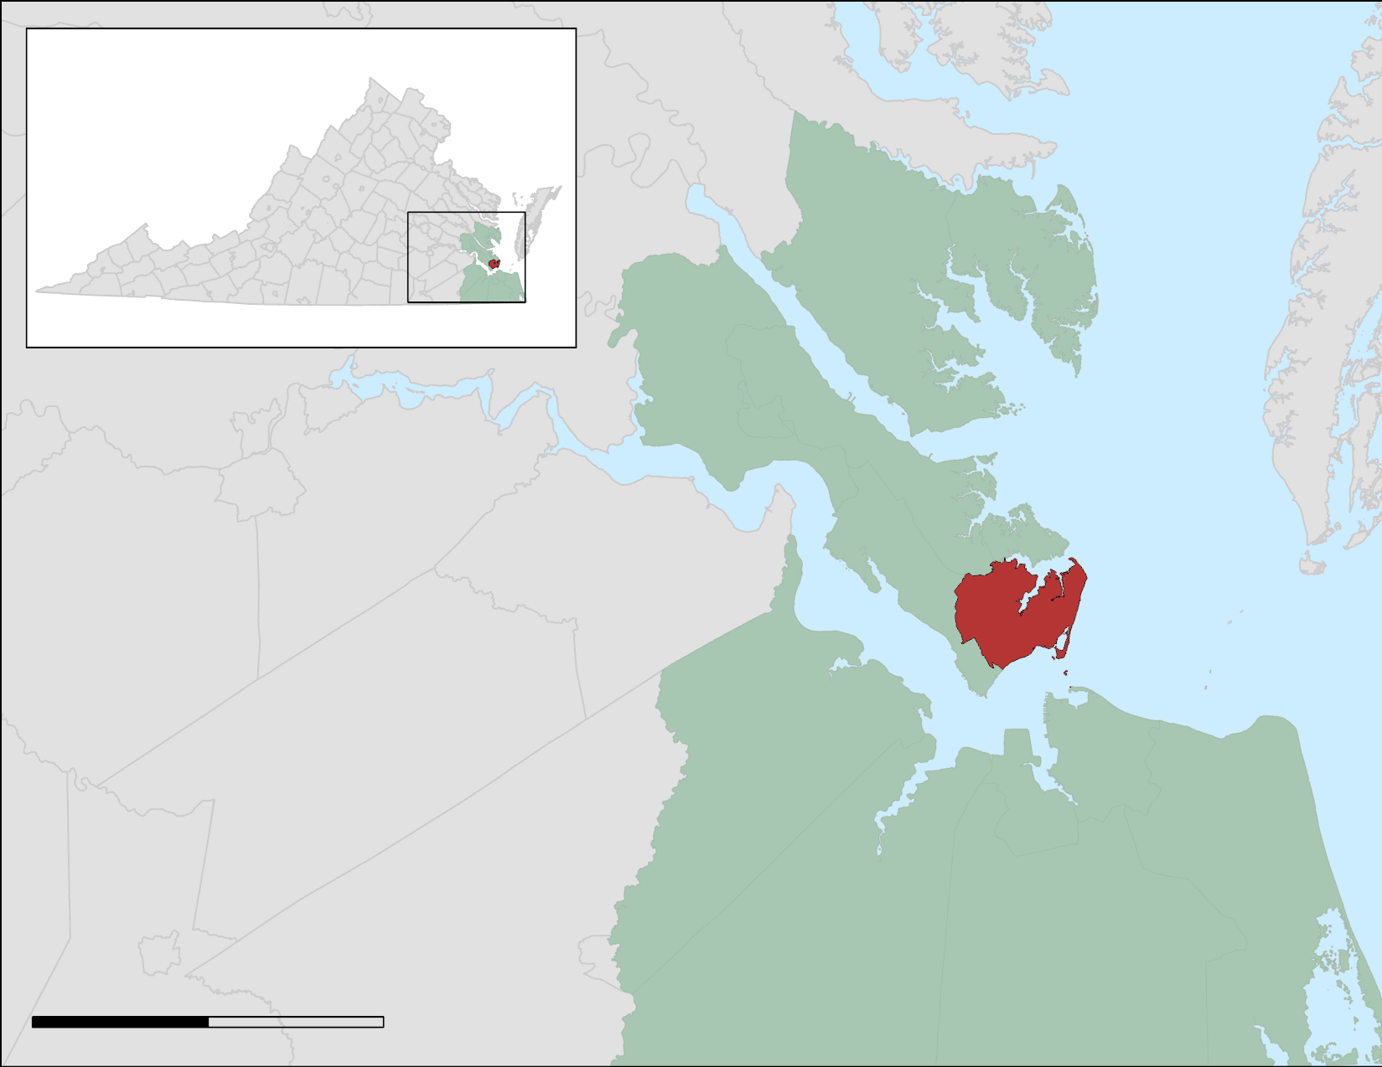
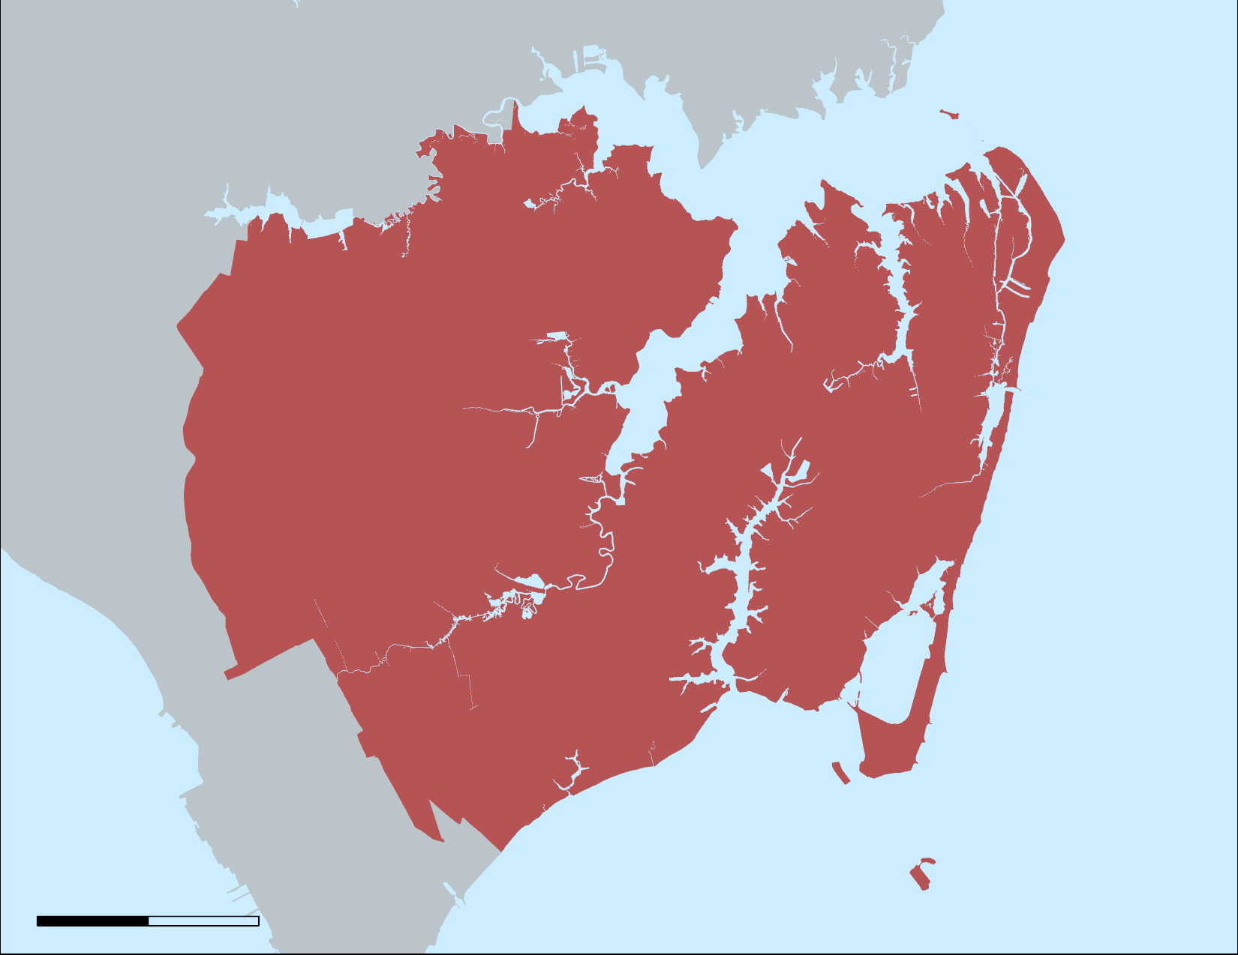

STUDY AREA
Back River
Hampton Roads
City of Hampton
Newmarket Creek
Hampton River
Chesapeake Bay
N
N
0
500
Kilometers
0
4000
Meters
Image Credit: DEVELOP Team
Notes:
Hampton, Virginia is a low-lying coastal community which is part of the greater Hampton Roads area. Hampton Roads consists of six additional city areas: Norfolk, Virginia Beach, Chesapeake, Portsmouth, Newport News, and Suffolk. The Hampton Roads area is home to over 1.6 million residents.
This project worked within the boundaries of the City of Hampton, located at the tip of the Virginia Peninsula, with waterfront areas on the Chesapeake Bay, The Hampton River, The Back River and the Newmarket Creek.
------------------------------Image Information Below ------------------------------
•Image Credit: Hampton Roads Urban Development II Team
•Image Source: ArcGIS Pro
------------------------------Image Information Below ------------------------------
•Image Credit: Hampton Roads Urban Dev II Team (Basemap)
•Image Source: (ESRI) ArcGIS Pro Living Atlas USA Counties

Slide 5
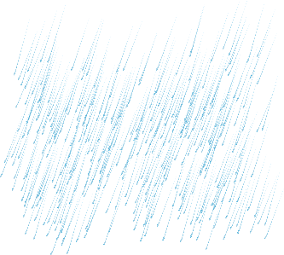

IMPERVIOUS SURFACE & TREE CANOPY
Impervious surfaces increase runoff
roads, parking lots, driveways and buildings
Trees reduce runoff
catch rainfall
slow raindrops
absorb groundwater
IMPERVIOUS SURFACE
Image Credit: PNGIMG.com, DEVELOP Team
Notes:
Impervious surfaces are surfaces that water cannot soak through, primarily roads, parking lots, and buildings. Impervious surfaces make up much of the urban landscape and can increase flooding by increasing surface runoff.
Trees can provide many important ecological services in urban environments. Tree canopies helps reduce runoff by catching rainfall in the leaves, slowing down the raindrops on their way to the ground, and absorbing groundwater through the roots.
------------------------------Image Information Below ------------------------------
Image credit: PNGIMG.com
Image source: http://pngimg.com/download/13456 (CC 4.0 BY-NC)
Image source: http://pngimg.com/download/224 (CC 4.0 BY-NC)
Diagram: original design by Hampton Roads Urban Development II Team

Slide 6
COMMUNITY CONCERNS
Hampton, VA, is at risk of floods due to increasing global temperatures and sea level rise
Increased flooding creates problems like blocked infrastructure and water damage
Decreased tree canopy cover and increased impervious surface cover exacerbate flood risk
Image Credits: Jamie Chapman, jvdgoot
Notes:
Living near bodies of water usually present typical flooding hazards like blocked infrastructure and water damage. But as Hampton urban development increases, Hampton will have less tree canopy cover and more impervious surface cover, and risk of flood hazards will increase. Moreover, a changing climate and sea level rise also increase risks of flooding hazards.
------------------------------Image Information Below ------------------------------
•Image Credit: Jamie Chapman, permission for use granted
•Image Source: Personal photo
------------------------------Image Information Below ------------------------------
•Image Credit: Creator jvdgoot
•Image Source: Creative Commons License # CC BY-NC 2.0 available at https://search.creativecommons.org/photos/085ec8ce-6384-4384-b7ba-42bd5d96458c

Slide 7
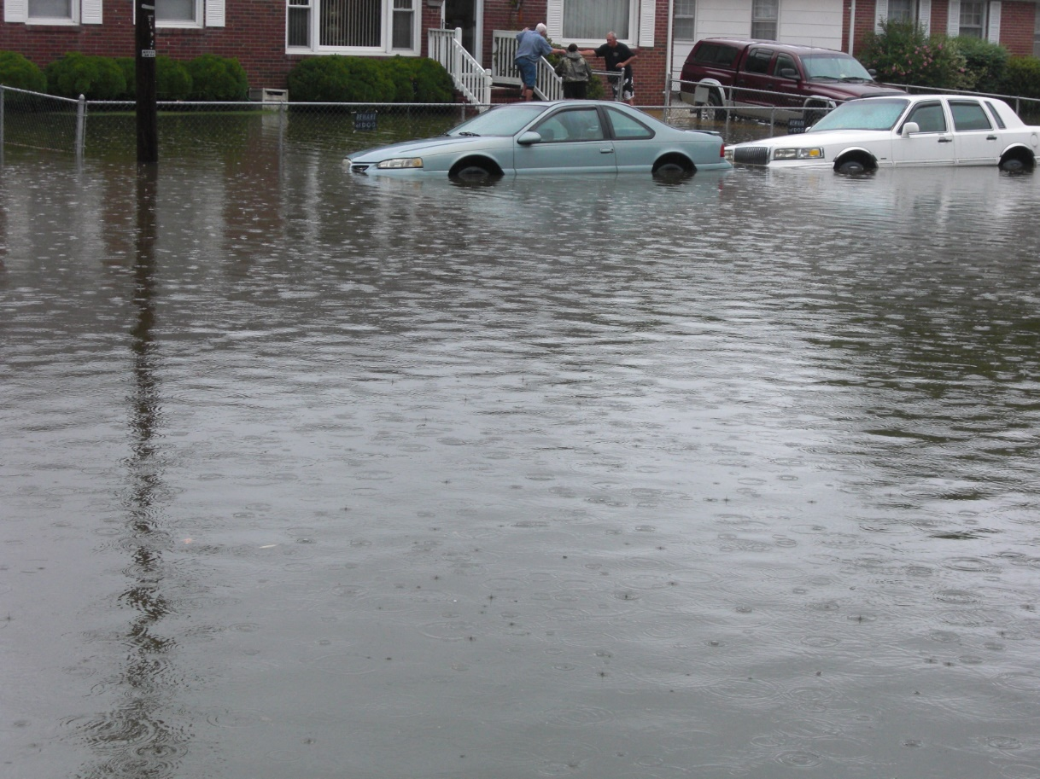

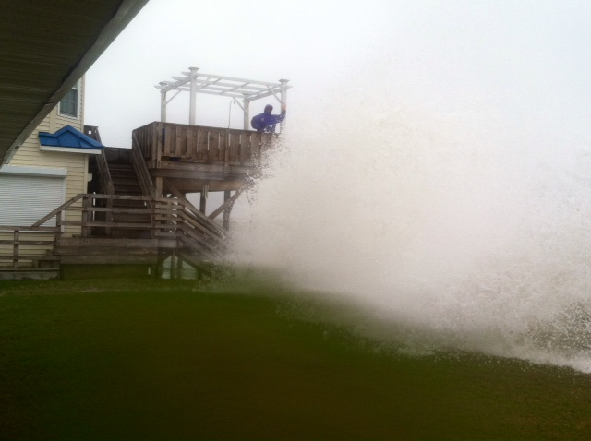
COMMUNITY MEMBERS
Sandra Campbell & Jamie Chapman
Velva Goodman
Sources: Jamie Chapman and Velva Goodman
Notes:
Because our office is located within the study area, our team was able to obtain local knowledge from community members directly. They graciously welcomed us into their homes, and shared their concerns about flooding with us. For example, resident Velva Goodman shared a story about her neighbors being brought out to safety by boat during a flood event, and Jamie Chapman and Sandra Campbell explained how storm surge brings waves that crash into their living room windows.
------------------------------Image Information Below ------------------------------
•Image Credit (Top Right): Velva Goodman, permission for use granted
•Image Source: personal photo from Velva Goodman
•Image Credit (Top Left): Hampton Roads Urban Dev II Team, permission for use granted
•Image Source: original video footage by Hampton Roads Urban Dev II Team
Image Credit (Bottom Left): Jamie Chapman, permission for use granted
•Image Source: personal photo from Jamie Chapman
Image Credit (Bottom Right): Hampton Roads Urban Dev II Team, permission for use granted
•Image Source: original video footage by Hampton Roads Urban Dev II Team

Slide 8
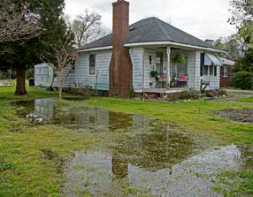
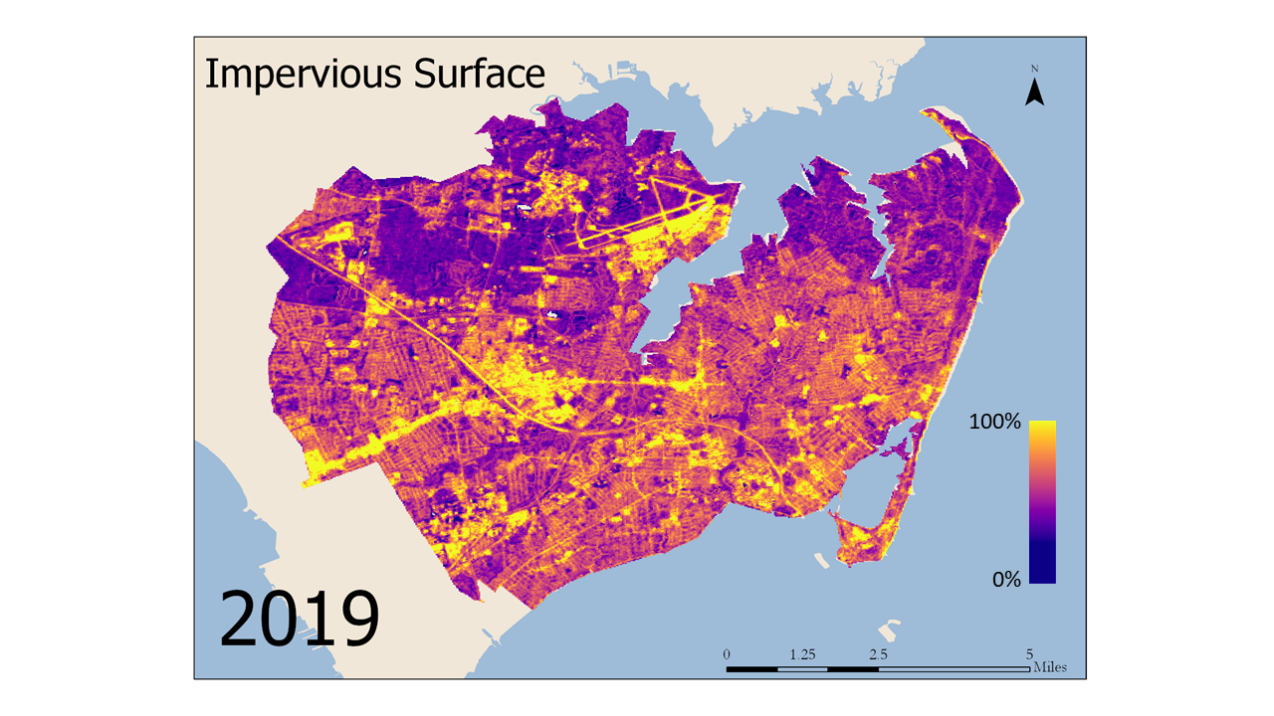
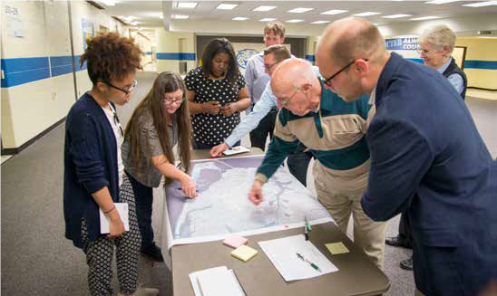
OBJECTIVES
Utilize NASA Earth observations to…
Identify zones susceptible to flooding
Empower city officials and residents to work together
Map distribution of impervious surface and tree canopy cover
Image Credits: City of Hampton, DEVELOP Team
Notes:
Our team was tasked with identifying areas of tree canopy cover and impervious surface cover. This provided information about areas with possible greater potential for flooding. This information can empower city officials and residents to work together for an holistic approach to flood risk adaptation.
------------------------------Image Information Below ------------------------------
•Image Credit (Left and Right): City of Hampton - permission granted
•Image Source (Left and Right): The City of Hampton. (2018). Resilient Hampton Initiative. City of Hampton. Retrieved from: https://hampton.gov/3459/Resilient-Hampton - permission granted
•Image Credit (Middle): DEVELOP Team

Slide 9

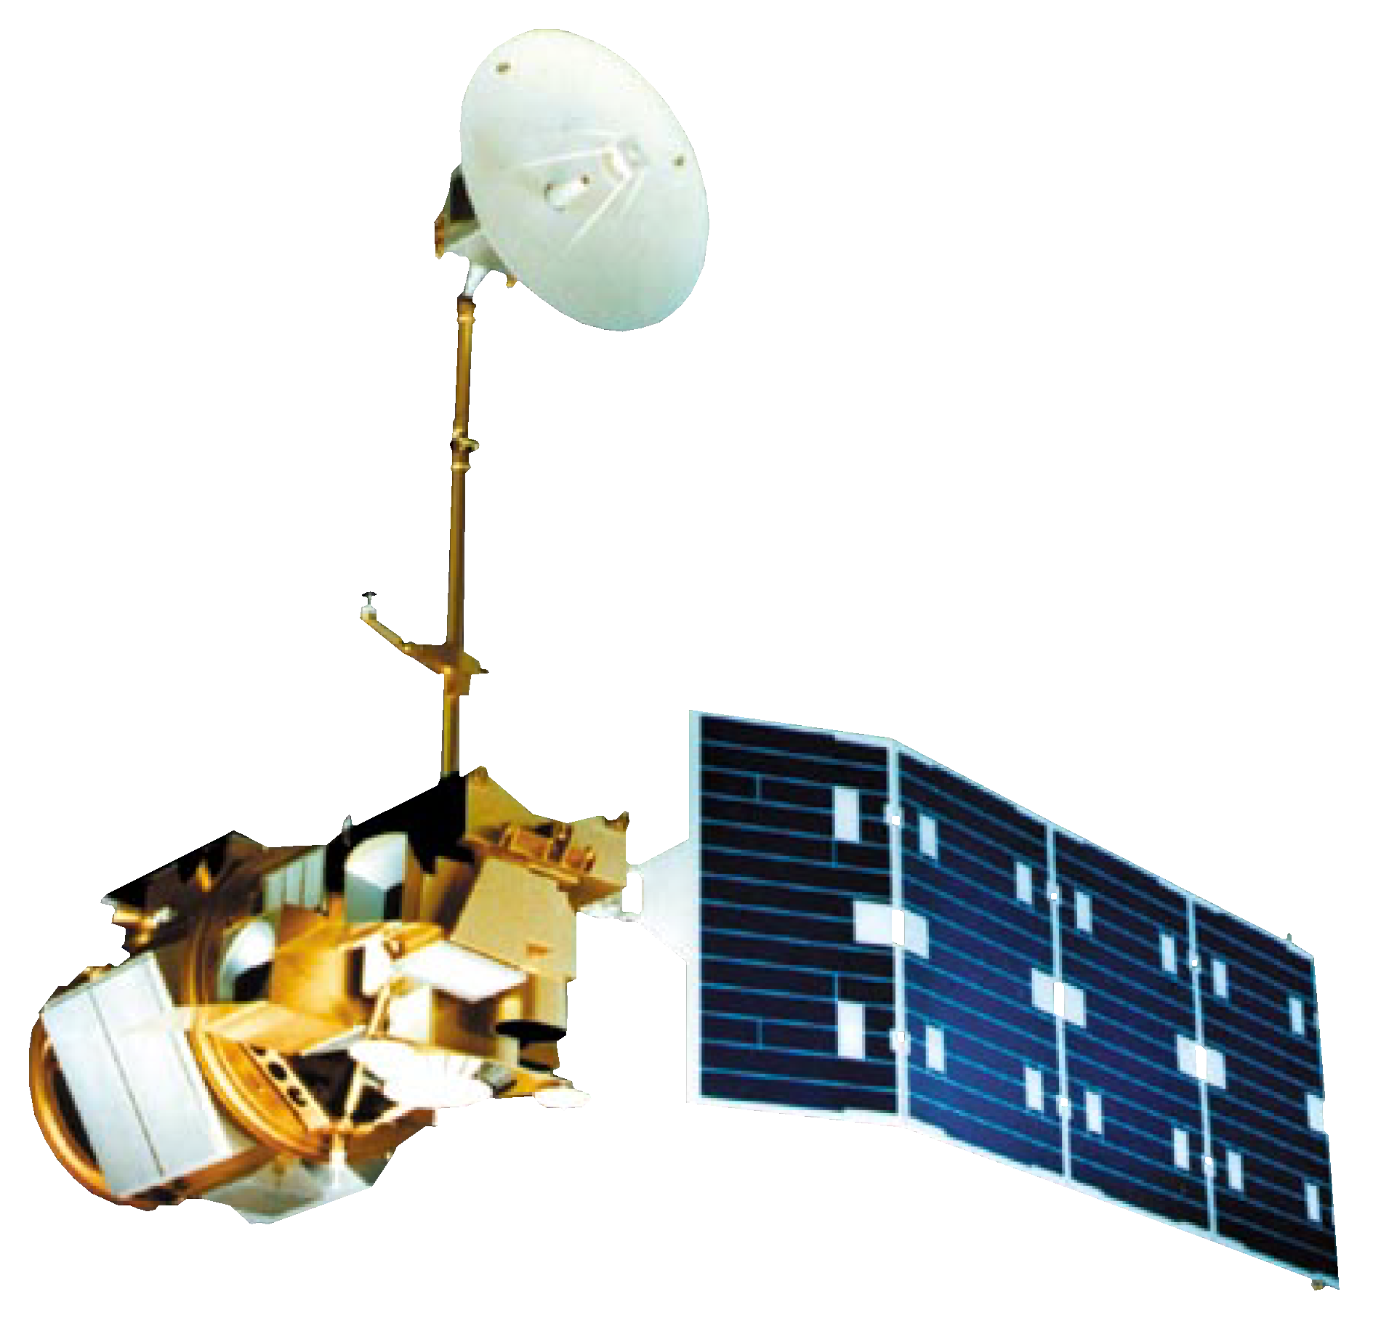

NASA EARTH OBSERVATIONS
Landsat 8 OLI
Landsat 5 TM
Image Credits: NASA
2000 to 2019
Notes:
We utilized Landsat 5 Thematic Mapper and Landsat 8 Operational Land Imager to determine percent impervious surface and tree canopy cover. We obtained imagery at approximately 5 year intervals between 2000 and 2019 for this analysis (2000, 2006, 2011, 2016 and 2019).
------------------------------Image Information Below ------------------------------
•Image Credits: DEVEOPedia (NASA)
•Image Source (Landsat 5TM): (https://earthobservatory.nasa.gov/images/81559/nasas-earth-science-satellite-fleet; NASA)
•Image Source (Landsat 8 OLI & TIRS): (http://www.devpedia.developexchange.com/dp/images/c/c2/03_Landsat8.png; DEVELOPedia)
•Image Source (Globe): https://commons.wikimedia.org/wiki/File:Earth_(blank).png

Slide 10
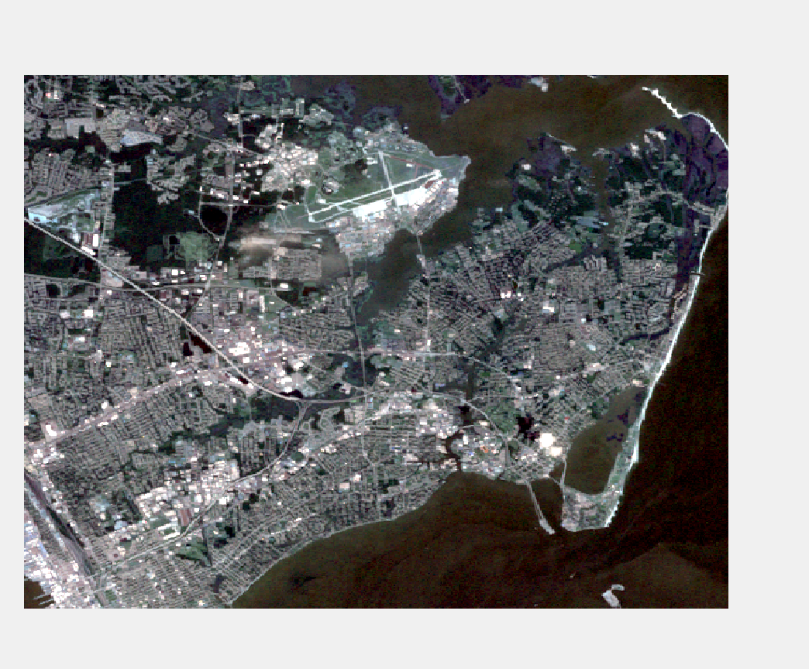
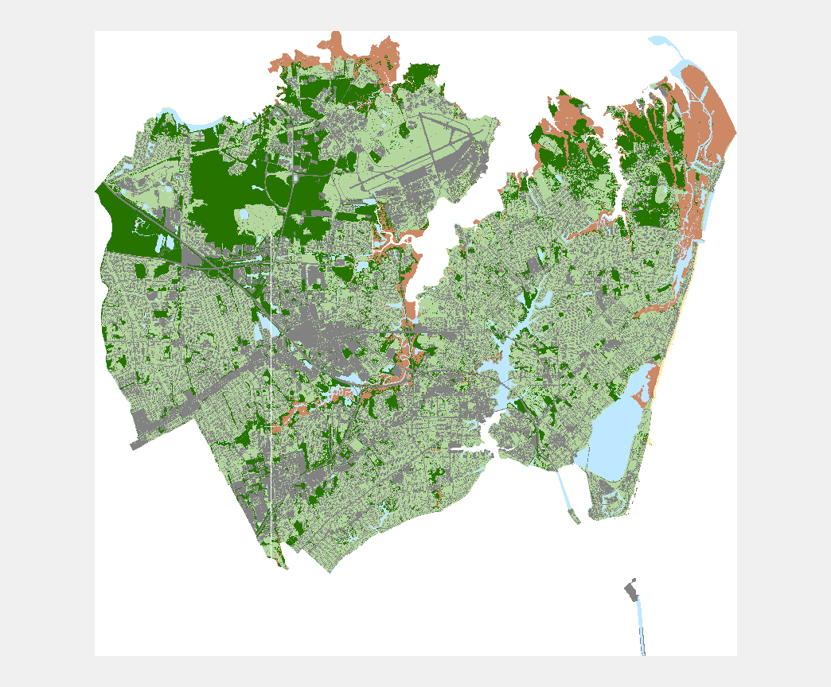
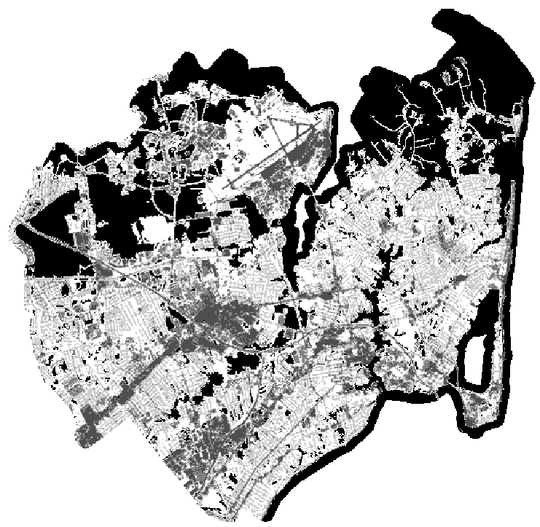
METHODOLOGY
Image Credits: DEVELOP Team, City of Hampton
Notes:
We have divided our methods into three main parts. First, we acquired all of our NASA Earth Observations imagery from Google Earth Engine. We also obtained high resolution imagery and land cover classifications from the City of Hampton, and we downloaded data from the National Land Cover Database and the Chesapeake Conservancy.
In the processing stage, we used Google Earth Engine to apply a cloud mask, filter the data by date and area of interest, and reduce the image collection to the median pixel. The files were then exported as GeoTiffs. Then, we calculated coefficients for predictor variables for regression analysis. These predictor variables are the bands and NDVI.
Finally, we ran regression in Excel using percent tree canopy and impervious surface as the dependent variables and the predictors as independent variables. The land cover percentages and predictor variable values came from 100 training sites. After running regression, we were able to use Model Builder in ArcMap to get a continuous map of percent. This process was done across all images to create maps to display change over time.
We used ISAT – Impervious Surface Analysis Tool We decided to use ISAT as a model to predict how land cover change could affect water quality.
------------------------------Image Information Below ------------------------------
•Image Credit (Left): DEVELOP Team
•Image Source (Left): Landsat 5
•Image Credit (Middle): City of Hampton, permission for use granted
•Image Source (Middle): Kimley-Horn & Associates
•Image Credit (Right): DEVELOP Team
•Image Source (Right): Landsat 5

Slide 11
METHODOLOGY
DATA
Landsat 5
Landsat 8
City of Hampton Imagery
National Land Cover Database
Conservation Innovation Center Land Cover
Image Credits: DEVELOP Team, City of Hampton
Notes:
We have divided our methods into three main parts. First, we acquired all of our NASA Earth Observations imagery from Google Earth Engine. We also obtained high resolution imagery and land cover classifications from the City of Hampton, and we downloaded data from the National Land Cover Database and the Chesapeake Conservancy.
In the processing stage, we used Google Earth Engine to apply a cloud mask, filter the data by date and area of interest, and reduce the image collection to the median pixel. The files were then exported as GeoTiffs. Then, we calculated coefficients for predictor variables for regression analysis. These predictor variables are the bands and NDVI.
Finally, we ran regression in Excel using percent tree canopy and impervious surface as the dependent variables and the predictors as independent variables. The land cover percentages and predictor variable values came from 100 training sites. After running regression, we were able to use Model Builder in ArcMap to get a continuous map of percent. This process was done across all images to create maps to display change over time.
We used ISAT – Impervious Surface Analysis Tool We decided to use ISAT as a model to predict how land cover change could affect water quality.
------------------------------Image Information Below ------------------------------
•Image Credit (Left): DEVELOP Team
•Image Source (Left): Landsat 5
•Image Credit (Middle): City of Hampton, permission for use granted
•Image Source (Middle): Kimley-Horn & Associates
•Image Credit (Right): DEVELOP Team
•Image Source (Right): Landsat 5

Slide 12
METHODOLOGY
DATA
Landsat 5
Landsat 8
City of Hampton Imagery
National Land Cover Database
Conservation Innovation Center Land Cover
PROCESSING
Google Earth Engine- filter, mask, reduce, export
Calculate predictors for analysis
Prepare metrics for ISAT
Image Credits: DEVELOP Team, City of Hampton
Notes:
We have divided our methods into three main parts. First, we acquired all of our NASA Earth Observations imagery from Google Earth Engine. We also obtained high resolution imagery and land cover classifications from the City of Hampton, and we downloaded data from the National Land Cover Database and the Chesapeake Conservancy.
In the processing stage, we used Google Earth Engine to apply a cloud mask, filter the data by date and area of interest, and reduce the image collection to the median pixel. The files were then exported as GeoTiffs. Then, we calculated coefficients for predictor variables for regression analysis. These predictor variables are the bands and NDVI.
Finally, we ran regression in Excel using percent tree canopy and impervious surface as the dependent variables and the predictors as independent variables. The land cover percentages and predictor variable values came from 100 training sites. After running regression, we were able to use Model Builder in ArcMap to get a continuous map of percent. This process was done across all images to create maps to display change over time.
We used ISAT – Impervious Surface Analysis Tool We decided to use ISAT as a model to predict how land cover change could affect water quality.
------------------------------Image Information Below ------------------------------
•Image Credit (Left): DEVELOP Team
•Image Source (Left): Landsat 5
•Image Credit (Middle): City of Hampton, permission for use granted
•Image Source (Middle): Kimley-Horn & Associates
•Image Credit (Right): DEVELOP Team
•Image Source (Right): Landsat 5

Slide 13
METHODOLOGY
DATA
Landsat 5
Landsat 8
City of Hampton Imagery
National Land Cover Database
Conservation Innovation Center Land Cover
PROCESSING
Google Earth Engine- filter, mask, reduce, export
Calculate predictors for analysis
Prepare metrics for ISAT
ANALYSIS
Run regression
Calculate percent tree and impervious cover
Display change over time
ISAT – calculate impacts of impervious surfaces on water quality
Image Credits: DEVELOP Team, City of Hampton
Notes:
We have divided our methods into three main parts. First, we acquired all of our NASA Earth Observations imagery from Google Earth Engine. We also obtained high resolution imagery and land cover classifications from the City of Hampton, and we downloaded data from the National Land Cover Database and the Chesapeake Conservancy.
In the processing stage, we used Google Earth Engine to apply a cloud mask, filter the data by date and area of interest, and reduce the image collection to the median pixel. The files were then exported as GeoTiffs. Then, we calculated coefficients for predictor variables for regression analysis. These predictor variables are the bands and NDVI.
Finally, we ran regression in Excel using percent tree canopy and impervious surface as the dependent variables and the predictors as independent variables. The land cover percentages and predictor variable values came from 100 training sites. After running regression, we were able to use Model Builder in ArcMap to get a continuous map of percent. This process was done across all images to create maps to display change over time.
We used ISAT – Impervious Surface Analysis Tool We decided to use ISAT as a model to predict how land cover change could affect water quality.
------------------------------Image Information Below ------------------------------
•Image Credit (Left): DEVELOP Team
•Image Source (Left): Landsat 5
•Image Credit (Middle): City of Hampton, permission for use granted
•Image Source (Middle): Kimley-Horn & Associates
•Image Credit (Right): DEVELOP Team
•Image Source (Right): Landsat 5

Slide 14
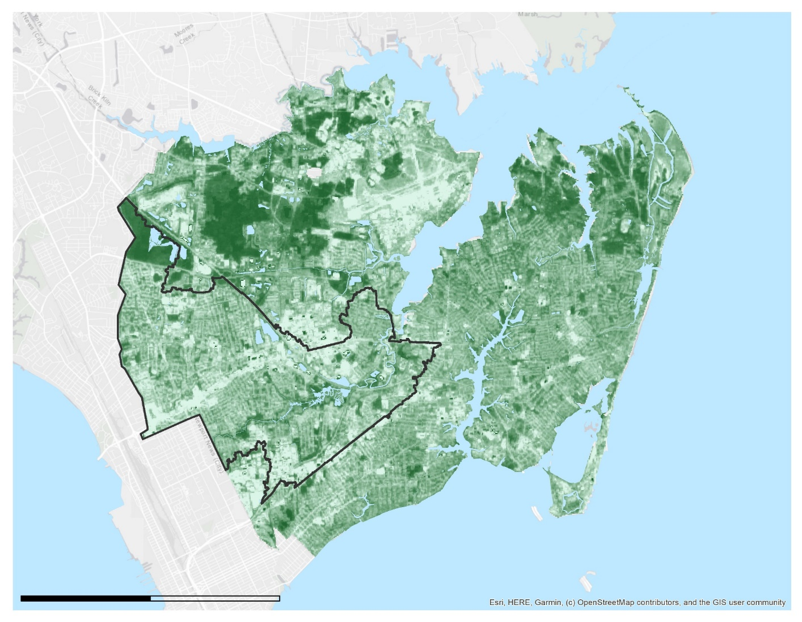
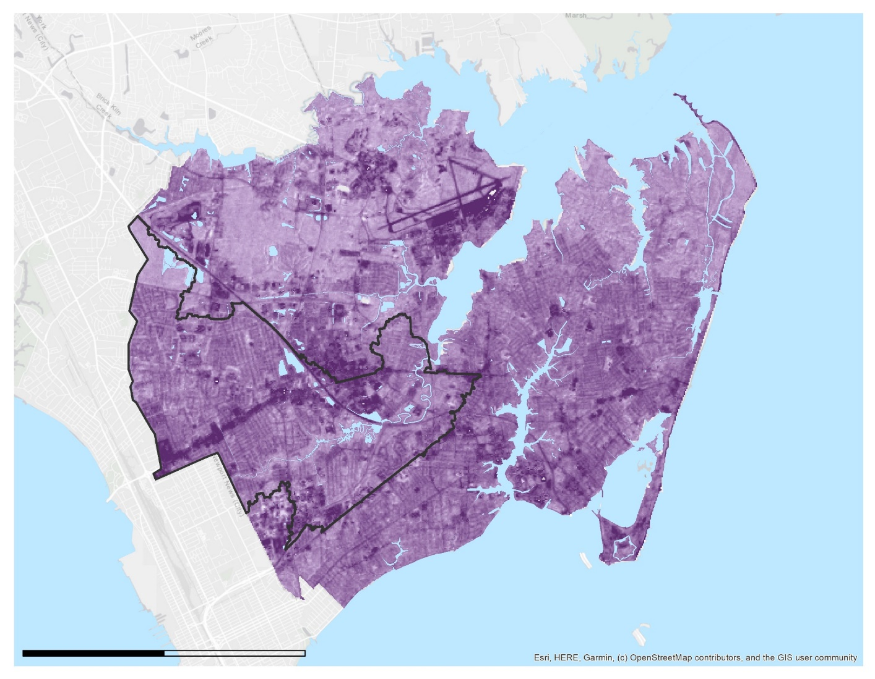



RESULTS
Tree Canopy
2019
N
Impervious Surface
2019
N
Newmarket Creek Watershed
Newmarket Creek Watershed
100%
100%
0
2,000
4,000
Meters
0%
0
2,000
4,000
Meters
0%
Image Credits: DEVELOP Team
Image Credit: DEVELOP Team
Notes:
The map on the left shows the results of the regression analysis for tree canopy cover for the entire City of Hampton, and the Newmarket Creek watershed is outlined in black. . This image shows the results generated using Landsat 8 imagery from June 2019. Values for % tree canopy cover range from 0 to 100 % canopy cover. Tree cover appears to be amalgamated in the top right and left areas of the City. The residential areas of Hampton have far lower percentages of canopy cover, and the highly developed areas like I-64 and I-664 have little to no canopy detectable by our Landsat imagery.
The map on the right shows the impervious surface cover from January 2019. This was also generated using regression analysis performed on Landsat 8 imagery. There are areas of high impervious surface cover around Langley Air Force Base, Mercury Blvd, I-64, and I-664. Unlike tree canopy cover, impervious surface sprawls across the city and is not clumped together, though the majority of the impervious surface is in the southern part of the City.
------------------------------Image Information Below ------------------------------
•Image Credit: Hampton Roads Urban Dev II Team
•Image Source: ArcGIS Pro
------------------------------Image Information Below ------------------------------
•Image Credit: ESRI Basemap Light Gray Canvas
•Image Source: ArcGIS Pro

Slide 15
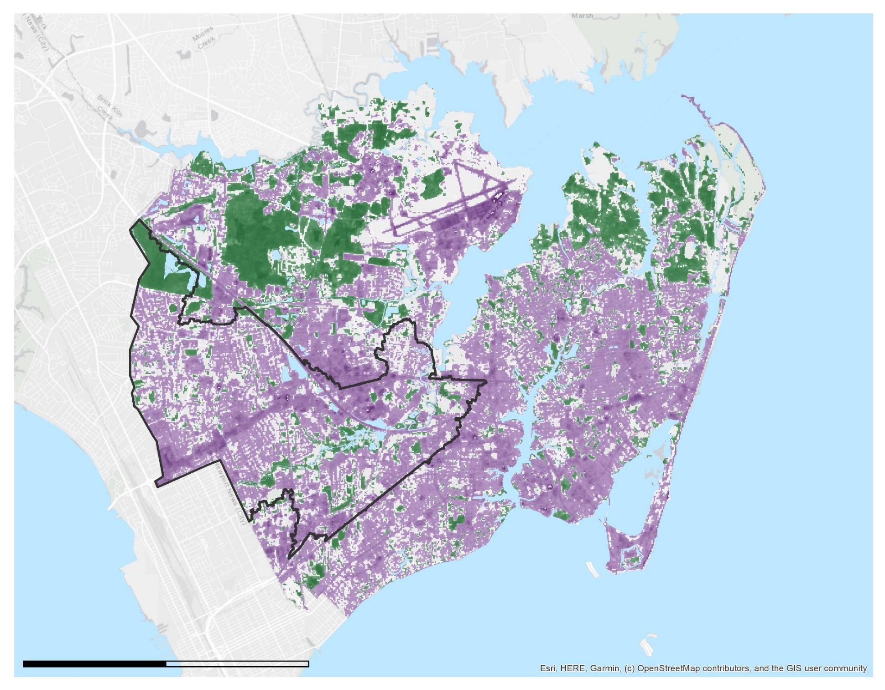



Tree Canopy and Impervious Surface
2019
N
Tree canopy
100%
50%
Impervious surface
100%
30%
0
2,000
4,000
Meters
Image Credits: DEVELOP Team
Notes:
The output for regression is a map of continuous values for impervious surface and tree canopy cover. The team then had to decide on a threshold for what percent tree or impervious cover accurately represented the ground truth. For tree canopy, pixels with values greater than 50% tree canopy were designated as true tree pixels. For impervious surface, the threshold was lower at 30% pixel values. The map displays the impervious surface and tree canopy cover with these thresholds applied. Removing the pixels below the threshold allows us to get rid of unnecessary data, like grass and marshes, as well as highlight the real areas of imperviousness and tree cover. We can better visualize the distribution of land cover with this map. The sprawling effect of imperviousness and clumping of trees is more clear now.
------------------------------Image Information Below ------------------------------
•Image Credit: Hampton Roads Urban Dev II Team
•Image Source: ArcGIS Pro
------------------------------Image Information Below ------------------------------
•Image Credit: ESRI Basemap Light Gray Canvas
•Image Source: ArcGIS Pro

Slide 16
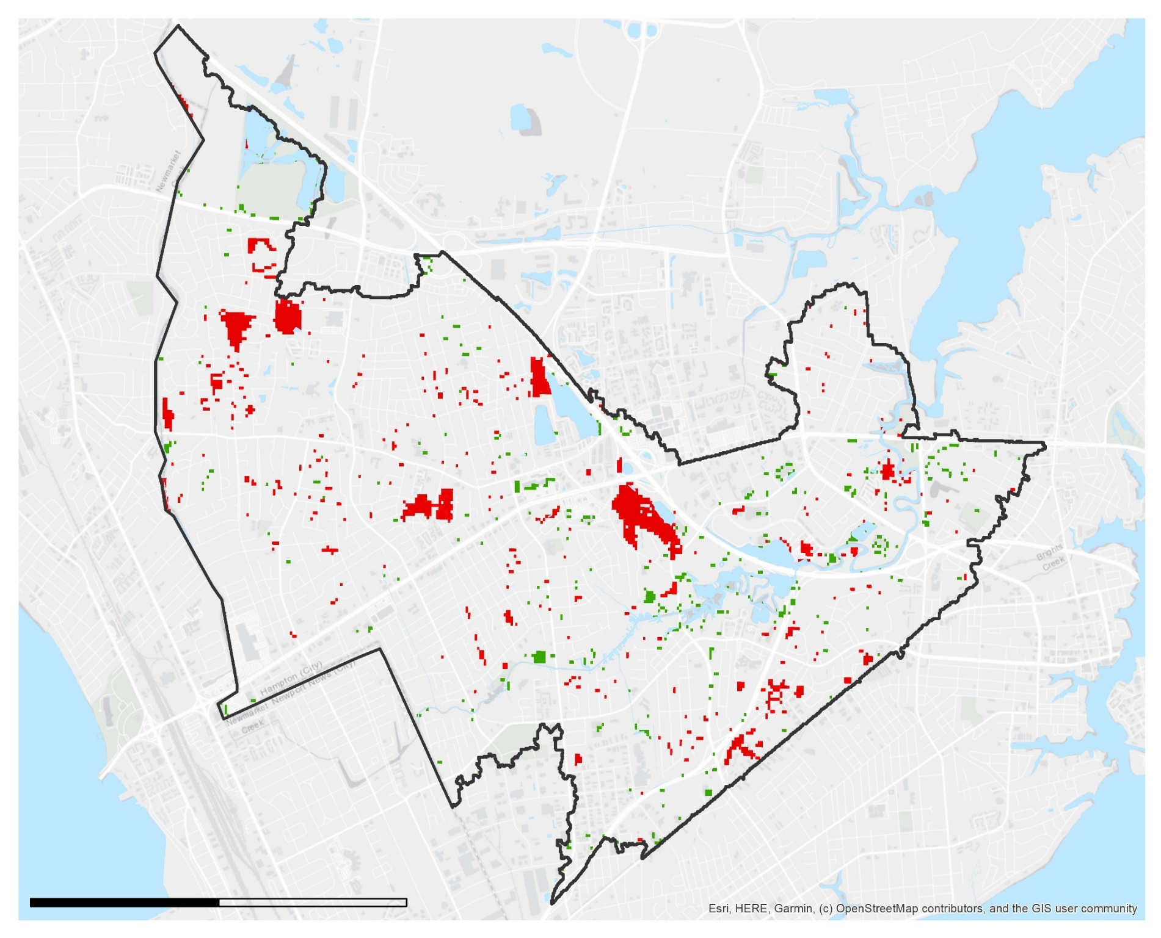

Tree Canopy Change 2000-2019
Newmarket Creek Watershed
Tree canopy increase
Tree canopy decrease
N
0
2,000
4,000
Meters
Image Credits: DEVELOP Team
Notes:
Tree canopy has increased by 8% across the whole city over the past two decades, however it has decreased by 1% in the Newmarket Creek Watershed (Hampton’s resiliency pilot area). Areas of tree loss are clustered around new developments and buildings and areas of growth are mainly near water and marshlands.
------------------------------Image Information Below ------------------------------
•Image Credit: Hampton Roads Urban Dev II Team
•Image Source: ArcGIS Pro
------------------------------Image Information Below ------------------------------
•Image Credit: ESRI Basemap Light Gray Canvas
•Image Source: ArcGIS Pro

Slide 17
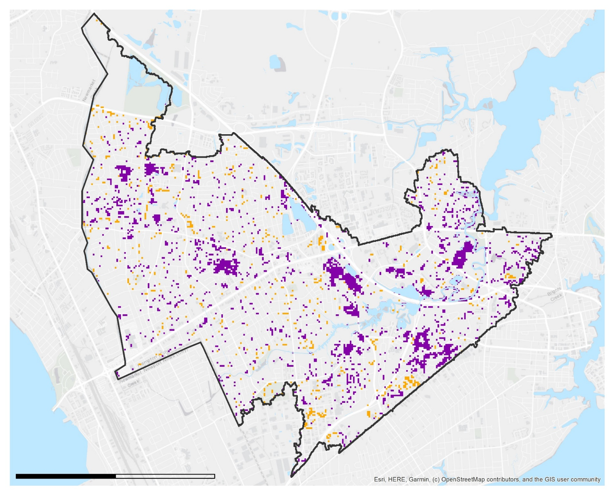

Impervious Surface Change 2000-2019
Newmarket Creek Watershed
Impervious surface increase
Impervious surface decrease
N
0
2,000
4,000
Meters
Image Credits: DEVELOP Team
Notes:
Comparatively, the impervious surface has changed much more dramatically over the past 19 years. Overall, imperviousness in the watershed has increased by about 20%. Like with tree canopy, we see large clusters of change where developments have been brought in, but the majority of the change is in the residential areas. Impervious surface increases and decreases in a salt and pepper pattern. Coupled with the lack of tree canopy increase in these same areas, the watershed may have greater issues with water slowing and storage.
------------------------------Image Information Below ------------------------------
•Image Credit: Hampton Roads Urban Dev II Team
•Image Source: ArcGIS Pro
------------------------------Image Information Below ------------------------------
•Image Credit: ESRI Basemap Light Gray Canvas
•Image Source: ArcGIS Pro

Slide 18
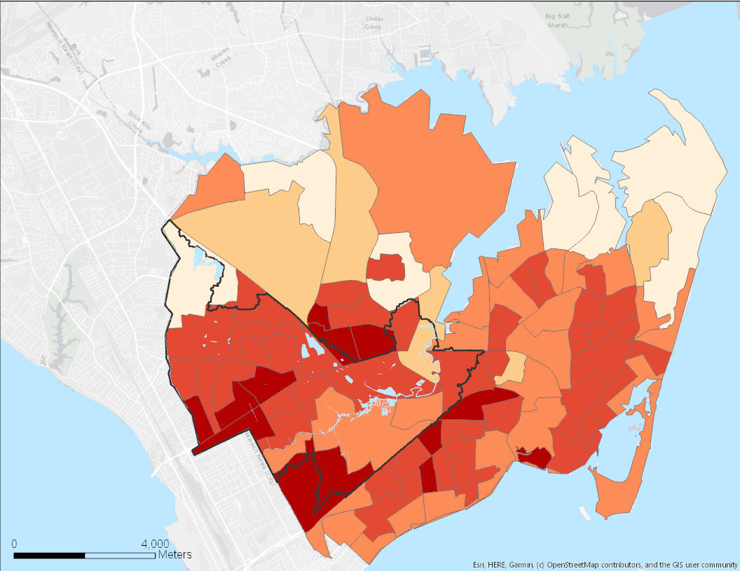

Percent Impervious Surface by Census Block
ISAT Output using High Population Density Scenario
≤ 20%
≤ 25%
≤ 30%
≤ 35%
≤ 45%
Newmarket Creek Watershed
N
Image Credits: DEVELOP Team
Notes:
Using the Impervious Surface Analysis Tool, the team calculated the percent of land covered by impervious surfaces for each census block in the City of Hampton. This map displays lower percentages of impervious surface in lighter tans and areas of increased concern in deeper orange/ red. The darker census blocks are clustered in or around the Newmarket Creek Watershed (outlined in black), indicative of this area’s reduced capacity for water storage in the ground and increased susceptibility to flooding and compromised water quality.
The power behind this form of analysis lies in its flexibility for the user. Inputs for population, land cover types, and imperviousness are user designated, areas of analysis can vary from watersheds to census blocks to neighborhoods. Finally, a visual spatial output empowers city officials and residents alike to recognize areas with reduced water storage capacity and make informed urban planning decisions as this vibrant coastal community continues to grow and change.
------------------------------Image Information Below ------------------------------
•Image Credit: Hampton Roads Urban Dev II Team
•Image Source: ArcGIS Pro
------------------------------Image Information Below ------------------------------
•Image Credit: ESRI Basemap Light Gray Canvas
•Image Source: ArcGIS Pro

Slide 19
CONCLUSIONS
All Census Blocks - degraded water storage capacity
Newmarket Creek watershed - in need of water quality & infiltration rehabilitation confirmed using NASA Earth observations
Place-based approach:
 | Change in Tree Canopy | Change in Impervious Surface
City of Hampton | + 6 % | + 8%
Newmarket Creek | - 1% | + 19%
Notes:
The results have shed light on various project objectives. First, the ISAT output indicates that all census blocks in the City of Hampton suffer from a reduced capacity for water infiltration and storage due to the pervasiveness of impervious surfaces. Second, changes in tree canopy and impervious surface in the Newmarket Creek Watershed differ from trends in the City of Hampton (see chart). Lastly, the team was able to confirm the NMC watershed as an area in need of water quality & infiltration rehabilitation using NASA Earth observations and equip the partners with a replicable methodology for future analysis of these phenomena.

Slide 20
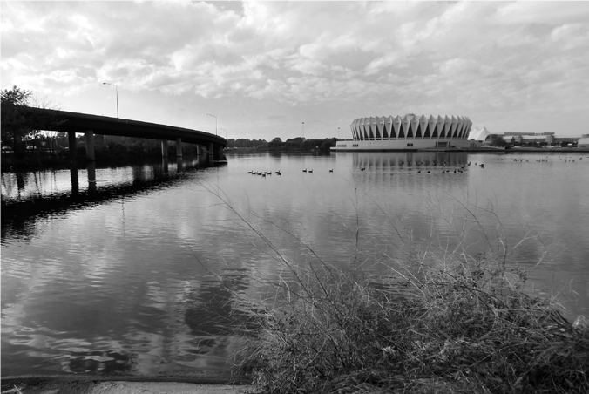
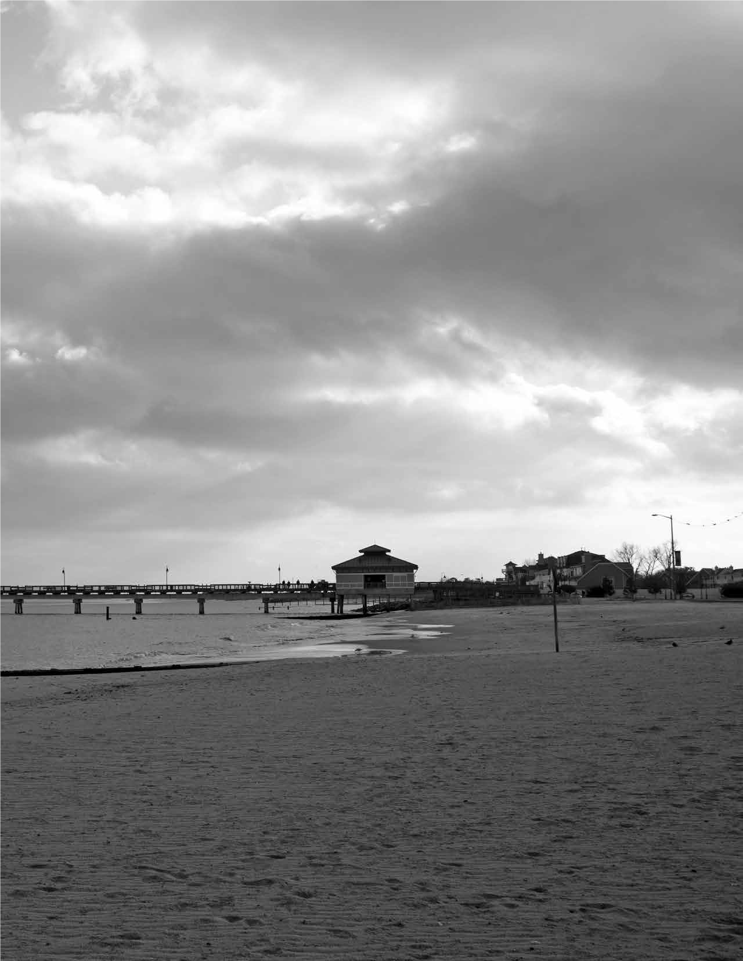
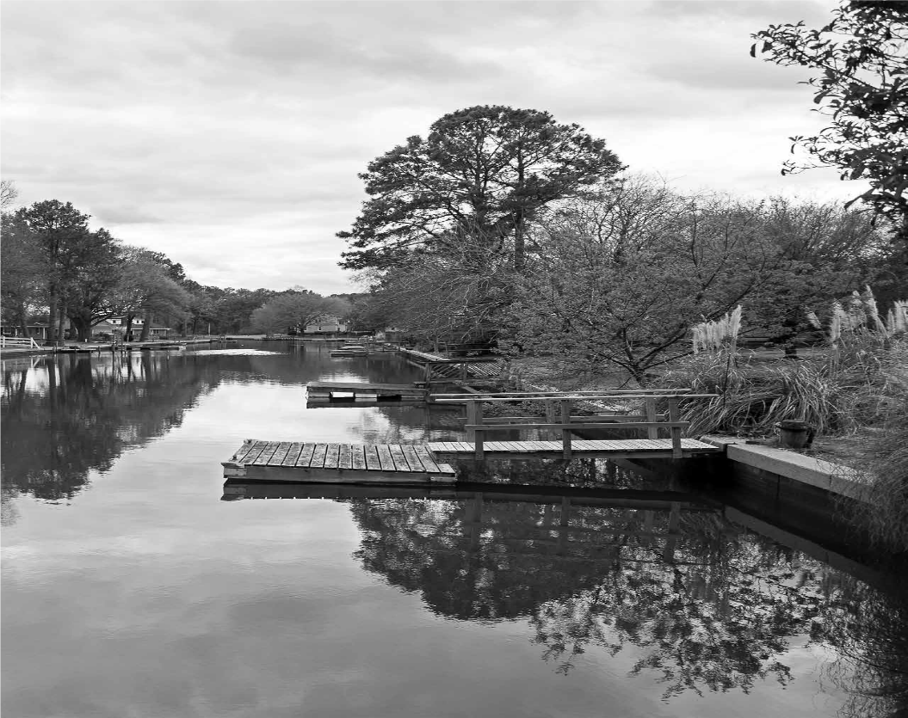
ERRORS & UNCERTAINTIES
Coarseness of Landsat sensors (30 m) increases uncertainty for detecting heterogeneous fine scale phenomena in the urban setting
Regression results have not been validated
Image Credits: City of Hampton
Notes:
Because the resolution of the Landsat imagery aggregates everything its senses in a 30 by 30 meter pixel, we can not make assumptions about land cover on a parcel level scale without considerable error. High resolution imagery is better suited for the detection of tree canopies, especially in an urban setting. The imagery used for the regression coefficients was collected over a short period of time, therefore the values do not represent average conditions but conditions at a single point in time. To best reduce the error, the imagery could be filtered by a longer time period.
------------------------------Image Information Below ------------------------------
•Image Credit: City of Hampton - permission granted
•Image Source: The City of Hampton. (2018). Resilient Hampton Initiative. City of Hampton. Retrieved from: https://hampton.gov/3459/Resilient-Hampton - permission granted

Slide 21
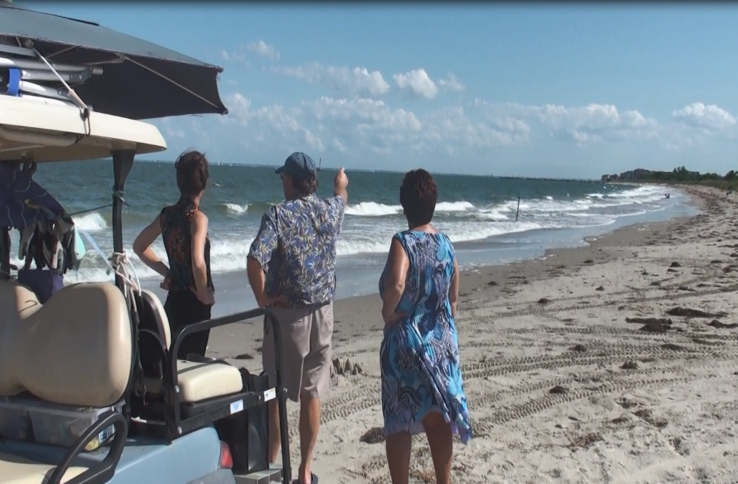
FUTURE WORK
Utilize Urban Flood Risk Mitigation Model created by the Natural Capital Project’s Integrated Valuation of Ecosystem Services and Tradeoffs (InVEST)
Expand study area to all of Hampton Roads
Image Credit: DEVELOP Team
Notes:
Our project studied two parameters: tree canopy cover and impervious surface cover. These are important parameters for Hampton officials to incorporate into hydrologic models and urban planning procedures. Specifically, Hampton officials can model runoff capacity using the Urban Risk Mitigation Model created by the Natural Capital Project’s Integrated Valuation of Ecosystem Services and Tradeoffs (InVEST) tool.
Moreover, by choosing to focus on the Newmarket Creek watershed, this place-based approach transforms the resident from a passive receiver of
environmental change into an active stakeholder in a social-environmental system. Urbanization adaptation in the face of flood risk is a complex task which requires collaboration with several disciplines. Moving forward, other communities can promote resiliency by mirroring the City of Hampton’s approach.
------------------------------Image Information Below ------------------------------
Image Credit: Hampton Roads Urban Development II Team
Image Source: original photo

Slide 22
City of Hampton: Bruce Sturk, Lucy Stoll, David Imburgia, Alan Lambert
Waggonner & Ball: Janice Barnes and team
Dr. Kenton Ross; DEVELOP Lead Science Advisor
Sydney Neugebauer; DEVELOP Virginia – Langley Center Lead
Hampton Roads Urban Development I team: Eric Deutsch, Holly Gould, Shaifali Prajapati, Danielle Ruffe
Velva Goodman, Jamie Chapman and Sandra Campbell
Notes:
The team would like to acknowledge our partners: the City of Hampton, our science advisor Dr. Kenton Ross, the Hampton Roads Urban Development I team members, and LaRC Center Lead Sydney Neugebauer. Special thanks to Velva Goodman, Jamie Chapman and Sandra Campbell.

