Slide 1
Ocmulgee
Ecological
Forecasting II
Utilizing NASA’s Earth observations for Forecasting Land Use Change and Wildlife Disturbances Along the Ocmulgee River Corridor
Christopher Cameron (Project Lead)
Ayn Remillard
Andrew Herring
Zhan Shi
Notes:
This is a multi-term project with the Georgia Department of Natural Resources (Wildlife Resources Division) to produce updated an land cover map and ecological forecast for threatened species in the study area.

Slide 2
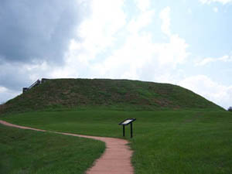
Study Area: The Ocmulgee River
Eco-recreation and preservation
Home to critical keystone species
Georgia’s largest collection of National Register of Historic Places
Ocmulgee River
Source: National Park Service
Notes:
The river flows for 180 miles starting just south of the city of Atlanta and running until it joins the Oconee River to form the Altamaha River.

Slide 3
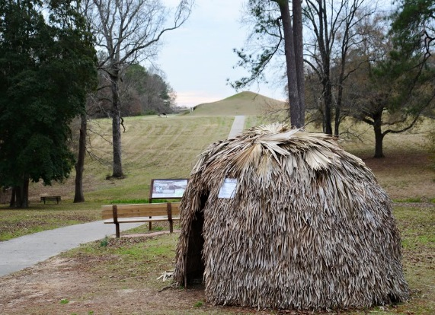
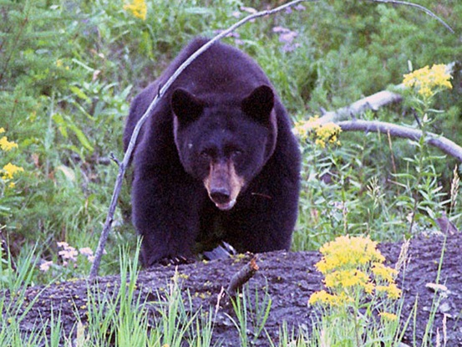
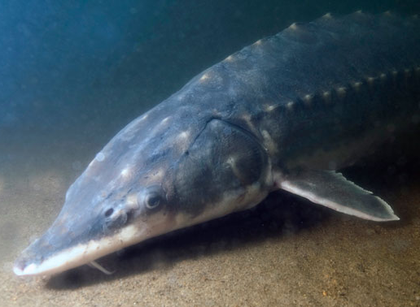
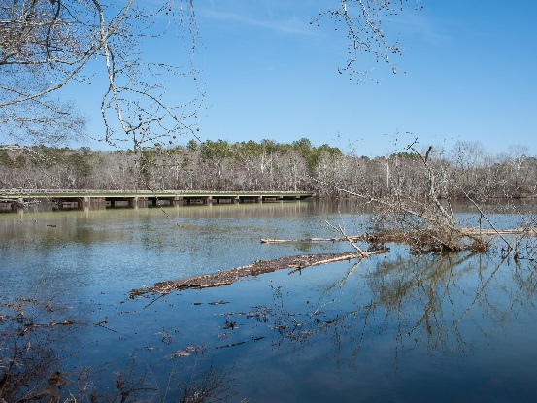
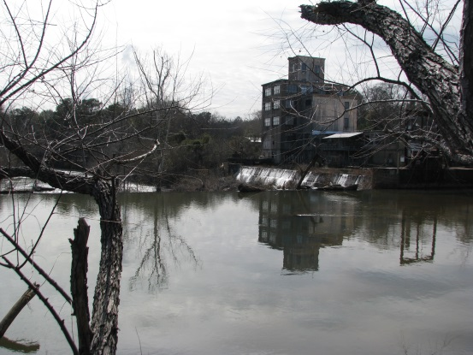
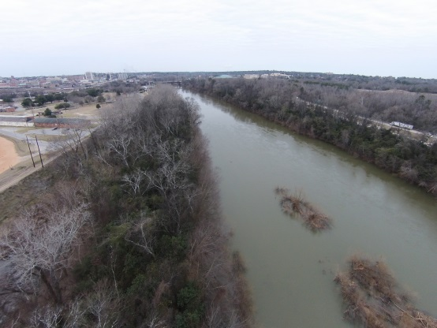
Community Concerns
High-priority landscape in Georgia’s 2005 Wildlife Action Plan
Habitat becoming fragmented due to urban sprawl
Threat to endangered species
Source: NPS website
Source: Ocmulgee Eco Team
Notes:
The Ocmulgee River corridor is inhabited by several federally protected endangered species- including the Atlantic sturgeon and Short nosed sturgeon. Other species which rely on the Ocmulgee are the black bear and many types of migratory birds. The primary concern for this study area is habitat fragmentation due to increasing urbanization.

Slide 4
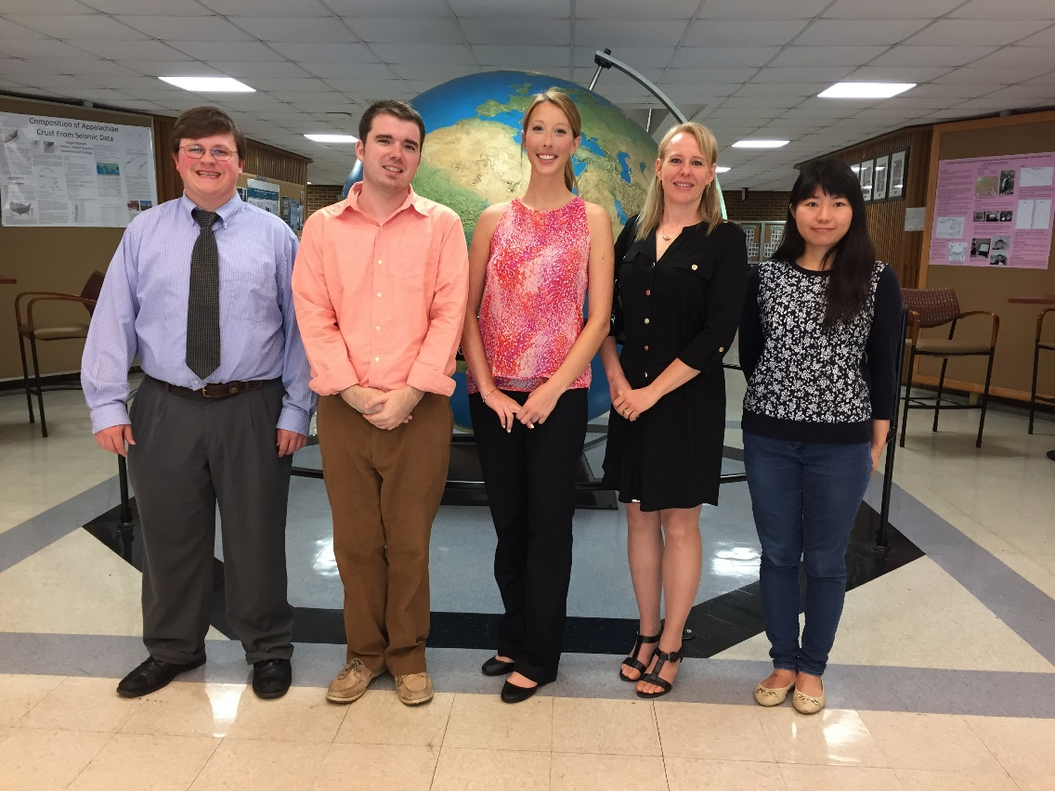
Project Partners
Andrew Herring, Christopher Cameron, Ayn Remillard, Melanie Riley (GA DNR), Zhan Shi
Notes:
Our NASA DEVELOP team worked with partners from The Georgia Department of Natural Resources to conduct a land cover change study with the goal of predicting future land use trends in the Ocmulgee River corridor.

Slide 5
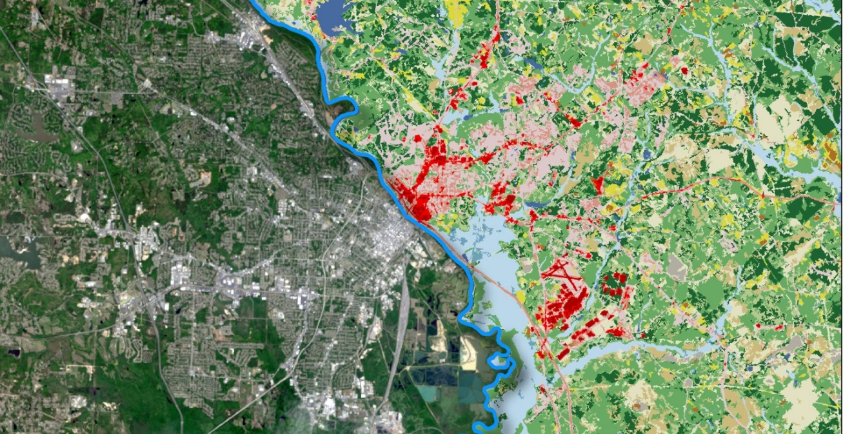
Objectives
Produce a 2014 land cover dataset using Landsat 8 imagery
Quantify land cover change in the Ocmulgee River Valley
Assess historic trends in land cover from 2001 to 2014
Predict land cover changes within the Ocmulgee Corridor
Model effects of land cover change on ecological habitats
Identify priority wildlife conservation areas for state agencies
Comparison of how the Ocmulgee River Corridor near Macon, GA looks across Landsat 8 and 2011 NLCD

Slide 6
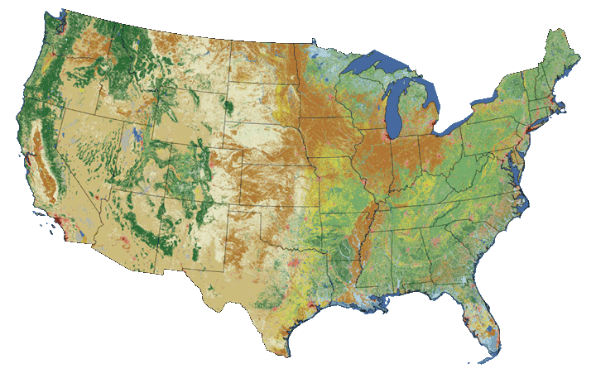
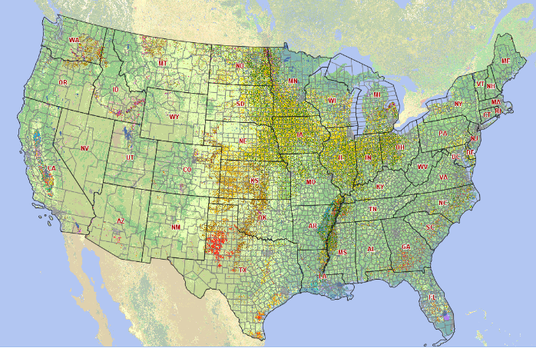
Data Sources
Landsat 8, OLI
2014 satellite imagery
United States Geologic Survey (USGS)
National Land Cover Dataset (NLCD): 2001, 2006, and 2011
United States Department of Agriculture (USDA)
CropScape Data Layer: 2008-2014
Source: NASA
Source: USGS
Source: USDA
Notes:
This project used Landsat 8 imagery to classify the study area. Landsat 8 is NASA’s eighth satellite in the Landsat series focusing on earth-observations. Landsat 8 produces approximately 400 images a day of the Earth’s surface at a resolution of 15 to 100 meters across a variety of spectral bands. This data can be used to determine land cover conditions.

Slide 7
Project Methodology
DATASETS
ANALYSIS
PRODUCTS
2014 Land Cover Dataset
Land Cover Change Predictions
Landsat 8 Imagery
Historic Land Cover
Ecological Forecasting
Land Cover Change Detection
Threat and Opportunity Assessment
Ecology and Wildlife
Notes:
The process of classification involves the comparison of multiple Landsat 8 images through the use of software like ERDAS IMAGINE, ArcGIS, and ENVI to detect changes in land cover.

Slide 8
Results: 2014 Land Cover
COMING SOON!

Slide 9
Results: Land Cover Change
COMING SOON!

Slide 10
Results: Future Changes
COMING SOON!

Slide 11
Results: Ecological Modeling
COMING SOON!

Slide 12
Results: Opportunity Assessment
COMING SOON!

Slide 13
Conclusions
COMING SOON!

Slide 14
Errors and Uncertainties
COMING SOON!

Slide 15
Future Considerations
COMING SOON!

Slide 16
Advisors
Dr. Thomas Jordan, University of Georgia- Center for Geospatial Research
Dr. Marguerite Madden, University of Georgia- Center for Geospatial Research
Partners
Thom Litts, Georgia Department of Natural Resources
Melanie Riley, Georgia Department of Natural Resources
Past Contributors
Peter Hawman, DEVELOP
Gail Miller, DEVELOP
Caren Remillard, DEVELOP
Simmone Simpson, DEVELOP
Steve Padgett-Vasquez, DEVELOP

