Slide 1
LOUISIANA
Water Resources
Using NASA Earth Observations to Monitor Historical Changes in Extent of Seagrass Meadows in the Breton National Wildlife Refuge in Louisiana
Mariam Moeen, Daniel Babin, Tasos Tentoglou,
Taryn Waite, & Kelly Young
California – Ames
Notes:
We are the Louisiana Water Resources Team, and we developed a Google Earth Engine Tool which uses NASA Earth observations to monitor historical changes in the extent of seagrass meadows in the Breton National Wildlife Refuge in the coastal Louisiana region.

Slide 2
BRETON NATIONAL WILDLIFE REFUGE
N
0
50
100
200 miles
Notes:
Pictured is a map showing the Breton National Wildlife Refuge, outlined in black, and surrounding coastal areas. Breton National Wildlife Refuge, located off Louisiana’s southeastern coast and established in 1904, is the United States’ second oldest national wildlife refuge. The refuge consists of a chain of barrier islands between the coastline and the Gulf of Mexico, including Breton Island and the Chandeleur Islands. These islands are ever-changing, shaped and reshaped by currents, storms and other dynamic ocean processes.

Slide 3
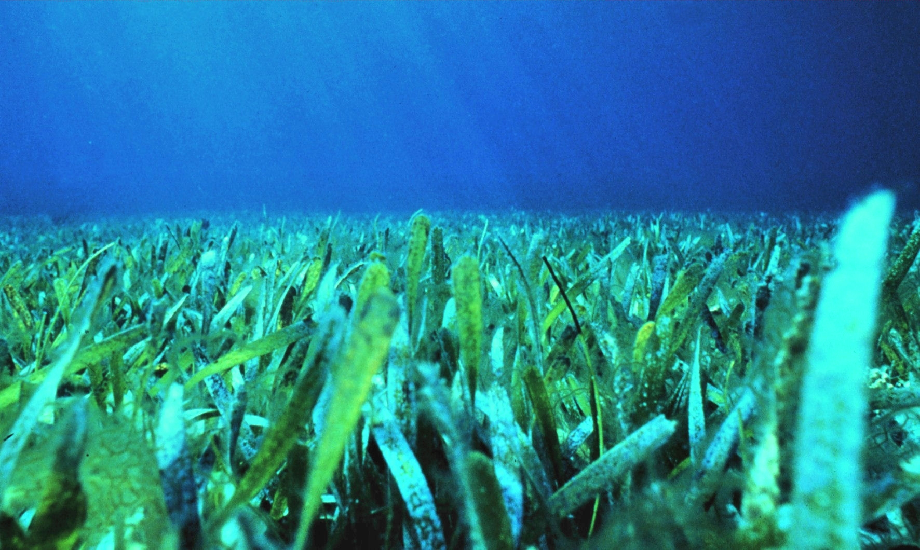
BRETON NATIONAL WILDLIFE REFUGE
Barrier Islands
Protect coastal Louisiana from storm surge
Provide habitat for important bird species
Seagrasses
Support biodiversity
Prevent harmful algal blooms
Nurture healthy fisheries
Reduce island erosion
Image Credits: USGS, NOAA
Notes:
The barrier islands protect the coastline of Louisiana, including densely populated areas such as New Orleans, from destructive storm surges. The islands are also of importance to conservation efforts as they provide crucial habitat and nesting grounds for several bird species. In the shallow waters surrounding the western shore of the islands, seagrass beds support a biodiverse marine ecosystem. Seagrasses are types of submerged aquatic vegetation and, along with supporting biodiversity, they also provide essential ecosystem services to Louisiana’s coastal community. By absorbing excess nutrients in the water, seagrasses help to prevent harmful algal blooms that can cause fish die-offs. By providing marine habitat, the seagrass beds also benefit local fisheries. Lastly, seagrasses trap suspended sediment and help to reduce erosion of the barrier islands, thereby contributing to storm surge protection.
Image Credits:
Left: Karen Morgan, USGS (https://www.usgs.gov/media/images/sediment-berm-along-northern-chandeleur-islands-Louisiana )
Right: Paige Gill, NOAA (https://photolib.noaa.gov/Collections/Sanctuaries/Florida-Keys/emodule/848/eitem/36080)

Slide 4
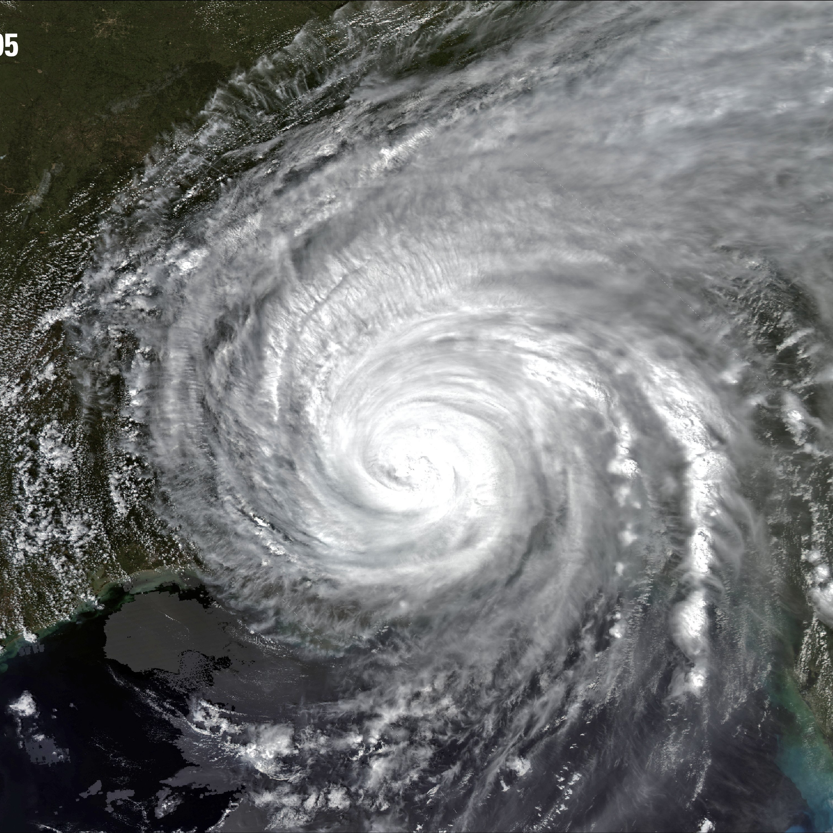
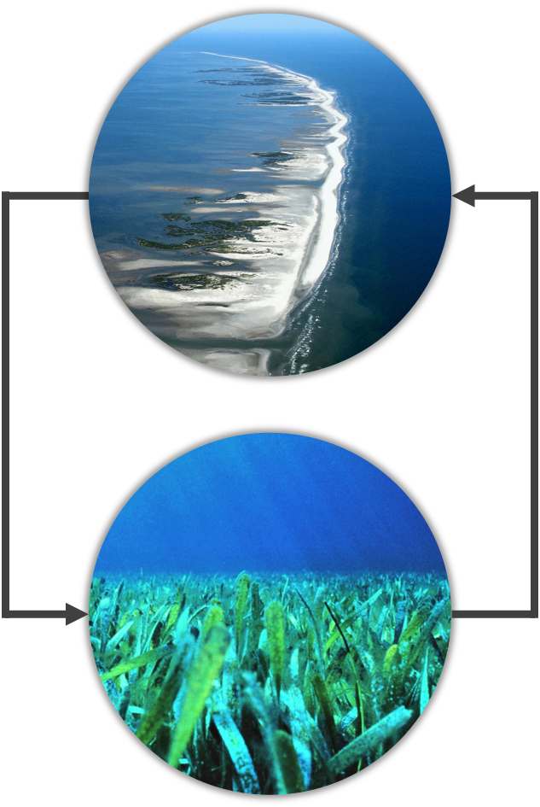
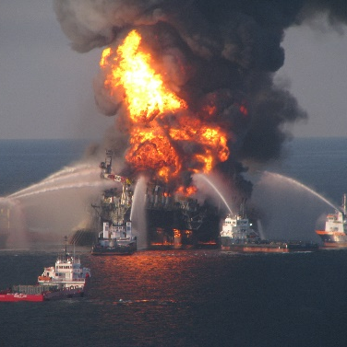
COMMUNITY CONCERNS
Shrinking islands
Hurricanes
Sea level rise
Deepwater Horizon oil spill
Dwindling seagrass
Image Credits: USGS, NOAA, USCG
Notes:
Over the past century, Breton National Wildlife Refuge’s barrier islands and seagrass beds have been shrinking, due to both devastating events and long-term stressors. A series of destructive hurricanes have subjected the islands to major erosion; most notably, Hurricane Katrina reduced the islands’ land area by 80% when it hit coastal Louisiana in 2005. As climate change increases the frequency and magnitude of major storms, each year’s hurricane season will continue to threaten the islands. Meanwhile, gradual sea level rise in the region has caused the islands to shrink further. As the land mass of the islands decreases, so does their ability to support seagrass beds; thus, the extent and health of Breton National Wildlife Refuge’s valuable seagrass beds are in decline as well. Further, the 2010 Deepwater Horizon oil spill inflicted lasting harm on the refuge’s seagrass beds. As seagrass populations decline, they provide the islands with weaker protection from erosion, exacerbating the shrinking islands problem.
Image credits:
Left panel, from top to bottom: USGS https://www.usgs.gov/media/images/hurricane-katrina-august-29-2005) , USGS (https://pubs.usgs.gov/of/2010/1146/html/imagepages/Figure10.html\), US Coast Guard (https://www.usgs.gov/media/images/battling-blaze-deepwater-horizon-oilrig)
Right panel, from top to bottom: Karen Morgan, USGS (https://www.usgs.gov/media/images/sediment-berm-along-northern-chandeleur-islands-Louisiana ); Paige Gill, NOAA (https://photolib.noaa.gov/Collections/Sanctuaries/Florida-Keys/emodule/848/eitem/36080)

Slide 5
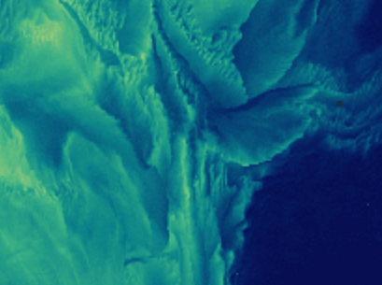
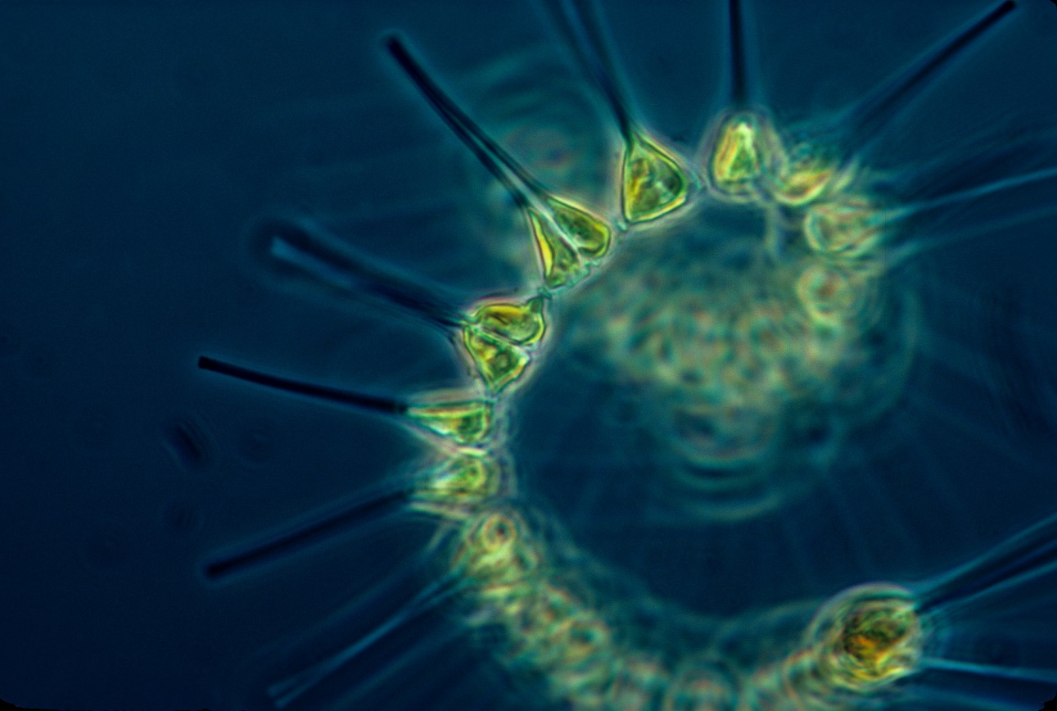
WATER QUALITY INDICATORS
Salinity
Concentration of salts
Varies with freshwater input from river
Impacts seagrass growth and mortality
Turbidity
Relative water clarity
Sediment, other suspended solids
Reduces availability of light to seagrass
Chlorophyll-a
Photosynthetic activity
Seagrass, phytoplankton
Harmful algal blooms
Nutrient-limited
Image Credits: USGS, NOAA
Notes:
Also important to the health of the Chandeleur island region and its seagrass beds is water quality. Three of the key indicators of water quality in the region are salinity, turbidity, and chlorophyll-a. Salinity is the concentration of salts in the water and, in coastal Louisiana, it can vary depending on freshwater input from the Mississippi river, shown in the image on the left. Seagrass can be sensitive to salinity, its growth and survival threatened by too high or low salt concentrations. Turbidity describes the relative clarity of the water, and it increases with higher concentrations of sediment and other suspended solids. Elevated turbidity can inhibit seagrass growth as it reduces the availability of sunlight underwater. Lastly, chlorophyll-a is an indicator of the amount of photosynthetic activity in the water. High levels of chlorophyll-a can indicate seagrass growth, but it can also suggest an abundance of phytoplankton. Too much phytoplankton can lead to harmful algal blooms, which reduce overall ecosystem health and may also limit light availability to seagrass. Primary producers’ growth tends to be limited by nutrients such as nitrogen and phosphorous, so increases in nutrients, such as those originating in agricultural runoff, tend to cause chlorophyll-a concentrations to grow.
Image credits:
Left: USGS (https://www.usgs.gov/media/images/satellite-image-new-orleans-region)
Middle: imagery created by our tool
Right: “Phytoplankton - the foundation of the oceanic food chain,” NOAA (https://photolib.noaa.gov/Collections/Fisheries/Life-In-The-Sea/Marine-Plants-Phytoplankton/emodule/1060/eitem/47219)

Slide 6
RESTORATION AND REVEGETATION
1984
2019
Image Credits: NPS, NOAA
Notes:
The images on the left show the drastic change in land area of the Chandeleur islands between 1984 and 2019. In 2020, a major restoration project began in BNWR to rebuild the islands and their habitat suitability. Millions of cubic yards of dredged sand will be added to the islands in order to increase land cover and elevation. Additionally, seagrass beds off the coast of the islands will be restored using methods such as transplantation and recolonization. However, in order to choose optimal sites for seagrass revegetation, restoration experts need to understand historical trends in seagrass bed locations and water quality conditions. They also need to be able to monitor current conditions.
Image credits
Left: imagery created by our tool
Top right: Linda York, NPS (https://www.nps.gov/articles/dredging.htm)
Bottom right: Paige Gill, NOAA (https://photolib.noaa.gov/Collections/Sanctuaries/Florida-Keys/emodule/848/eitem/36080 )

Slide 7
OBJECTIVES
Develop a Google Earth Engine tool that monitors and evaluates water quality parameters including turbidity
Analyze historical trends in water quality parameters relevant to seagrass health
Generate maps displaying current turbidity conditions and seagrass bed locations
Notes:
The main project objectives were geared to address community concerns regarding the shrinking islands and seagrass meadows in the Breton National Wildlife Refuge region. First, we developed a Google Earth Engine tool that monitors and evaluates water quality parameters in the study area. This tool enables users to analyze historical trends in water quality parameters which are relevant to seagrass health. Finally, the tool has the ability to generate maps which display current turbidity conditions, seagrass bed locations, .

Slide 8
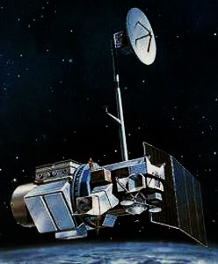
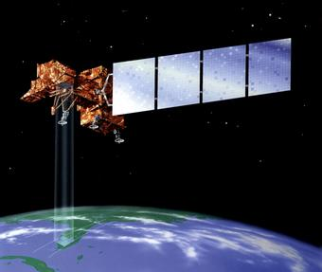
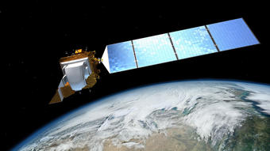
NASA EARTH OBSERVATIONS
Landsat 5 TM
1984-2012
Landsat 7 ETM+
2012-2013
Landsat 8 OLI
2013-2021
1984
2021
Image Credits: USGS
Notes:
The team used Collection 1 Tier 1 Surface Reflectance data from Landsat 5 Thematic Mapper, Landsat 7 Enhanced Thematic Mapper plus, and Landsat 8 Operational Land Imager. Though each of the satellites' date ranges overlap with one another, the datasets were pieced together in a manner that didn’t overlap the data. Landsat 7 had malfunctioned within 4 years of it's launch which resulted in major gaps (stripes of missing data) to appear in imagery. For this reason, we avoided using Landsat 7 data, and instead used Landsat 5 to cover the majority of Landsat 7's temporal range, then switched to using Landsat 8 data when it was launched. Landsat satellites take images every 16 days and have a pixel resolution of 30 meters.
The data from these satellites were obtained and processed through the cloud-computing platform, Google Earth Engine.
LANDSAT 5 Image: https://www.usgs.gov/core-science-systems/nli/landsat/landsat-5?qt-science_support_page_related_con=0#qt-science_support_page_related_con
LANDSAT 7 Image: https://www.usgs.gov/core-science-systems/nli/landsat/landsat-7?qt-science_support_page_related_con=0#qt-science_support_page_related_con
LANDSAT 8 Image: https://www.usgs.gov/core-science-systems/nli/landsat/landsat-8?qt-science_support_page_related_con=0#qt-science_support_page_related_con

Slide 9
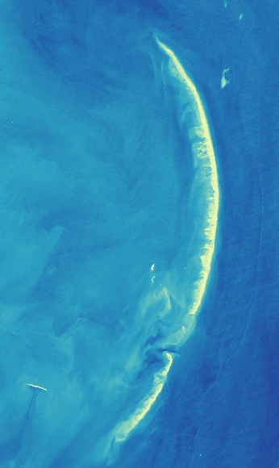
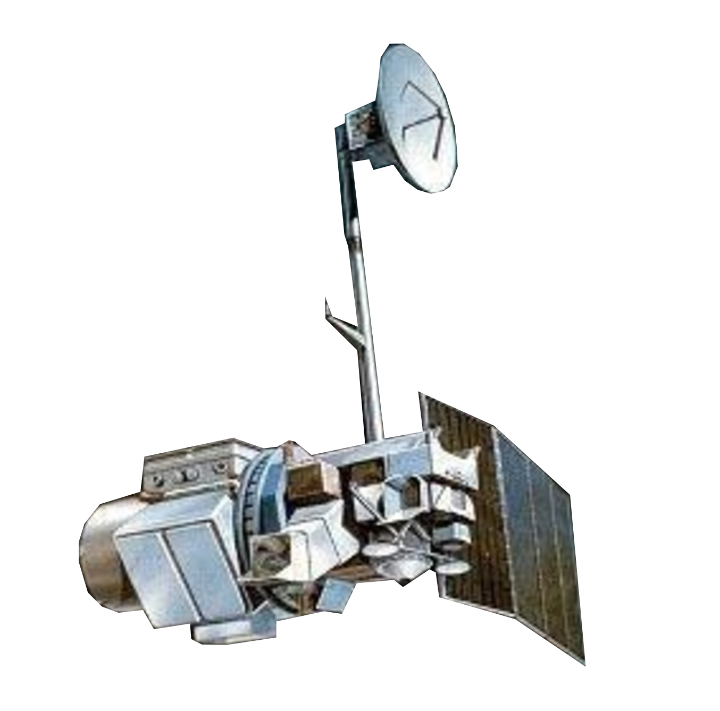
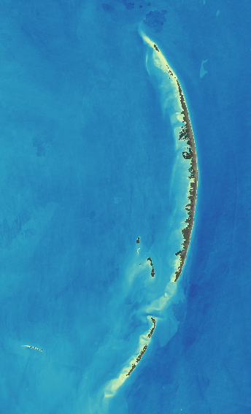
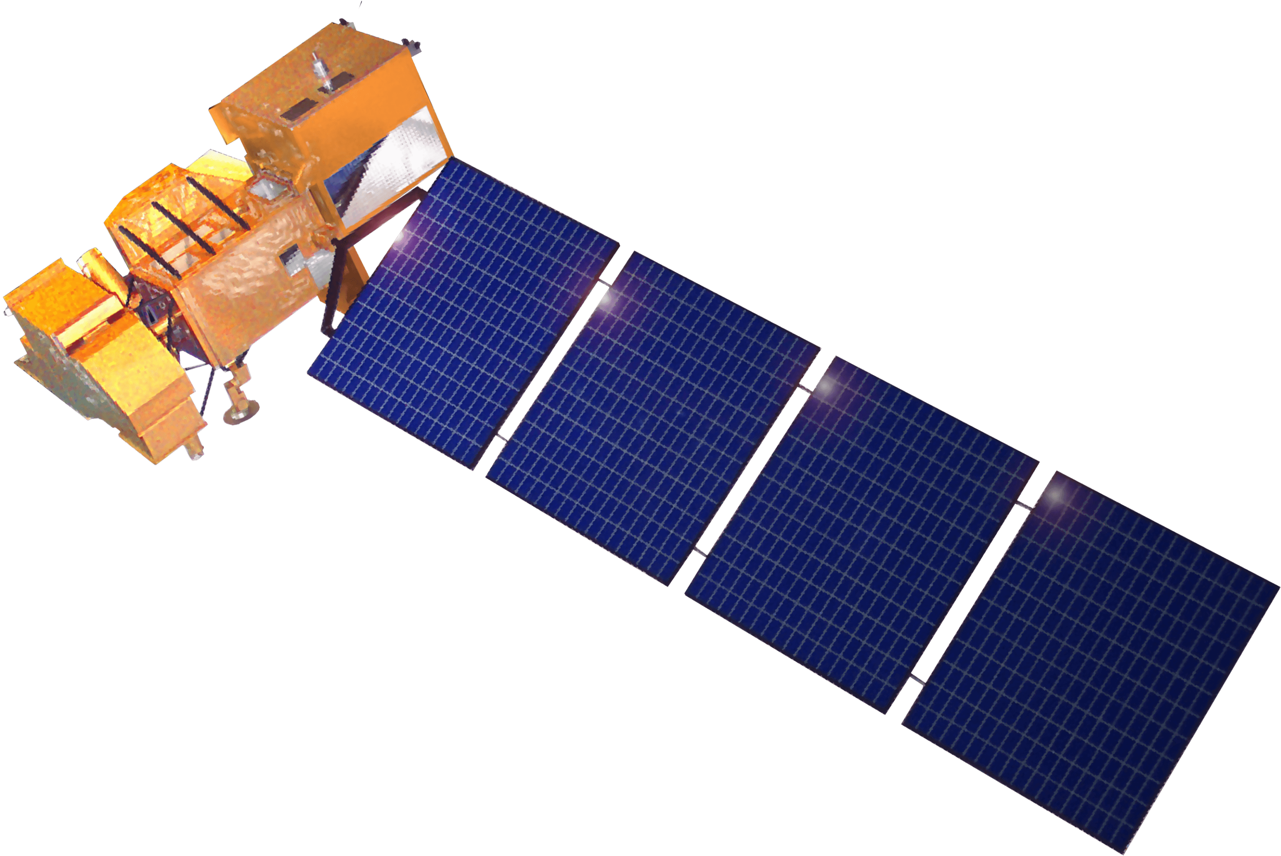
CLOUD/LAND MASKING
Landsat 5 TM
Unmasked
Landsat 8 OLI
Masked
Pixel QA
Landsat 7 ETM+
Image Credits: USGS, NASA
Notes:
For processing the data, we masked out clouds, cloud shadow, and land from the images to improve the accuracy of our data results. Images are stacked based on their level of cloudiness such that the second least cloudy image fills gaps in the least cloudy image. This was done using Landsat 5, Landsat 7, and Landsat 8’s pixel quality assessment bands, which easily identify which pixels have cloud impurities or land cover. Looking at the right-hand side, the image to left is unmasked and the image to the right has land and clouds masked.
LANDSAT 5 Image: https://www.usgs.gov/core-science-systems/nli/landsat/landsat-5?qt-science_support_page_related_con=0#qt-science_support_page_related_con
LANDSAT 7 Image: https://espd.gsfc.nasa.gov/science-land.html
LANDSAT 8 Image: https://svs.gsfc.nasa.gov/10812

Slide 10
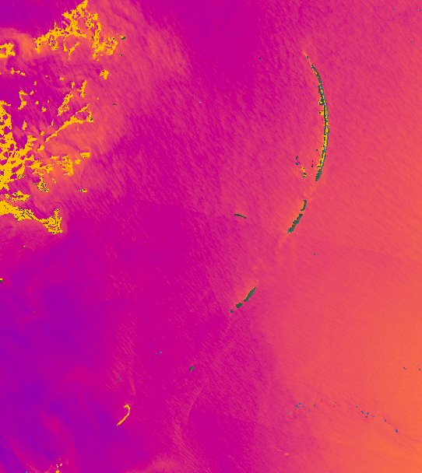
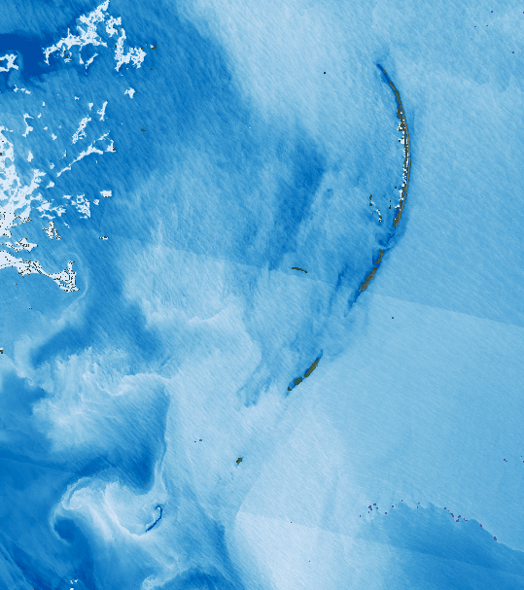
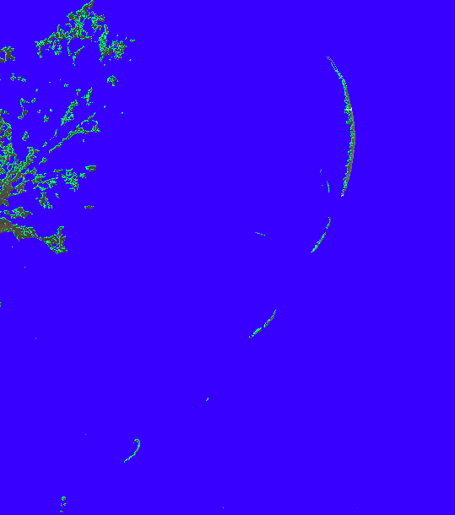
SEAGRASSES
Photosynthetic organisms reflect a large amount of near infrared light
Near Infrared Band
Blue Band
Aquatic Vegetation
&
=
NDAVI
Spring 2019 over the Chandeleur Sound
-0.5
0
Normalized Difference Aquatic Vegetation Index = (NIR– Blue) / (NIR+ Blue)
Notes:
*** Note: While this slide has very basic information, we made it for our partners, who don't have experience with remote sensing. We will add or remove it depending on our audience.
In this case, there is a unique band combination that allows seagrasses to be analyzed over time. Photosynthetic organisms reflect a large amount of near infrared light, so the NIR band and the blue band collectively allow aquatic vegetation to be assessed. The team compared the amount of near infrared light and blue light to make an index sensitive to aquatic vegetation which is known as the Normalized Difference Aquatic Vegetation Index (NDAVI).

Slide 11
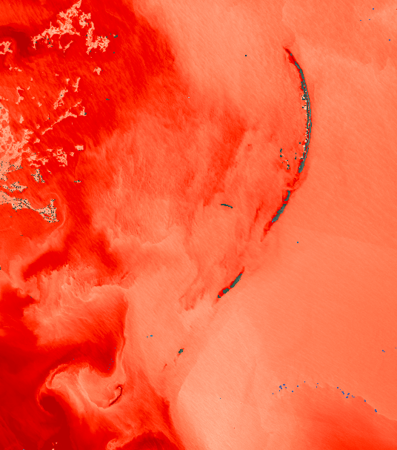
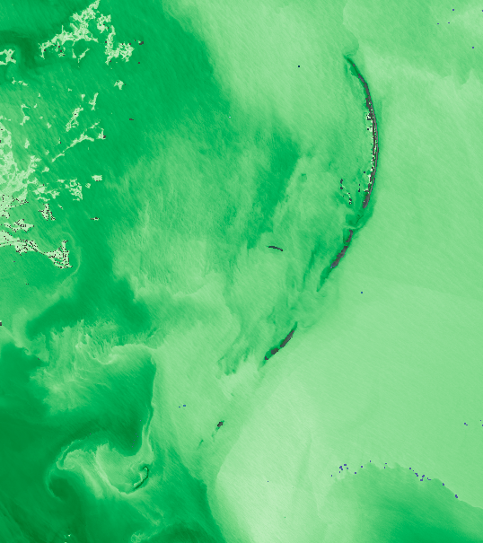
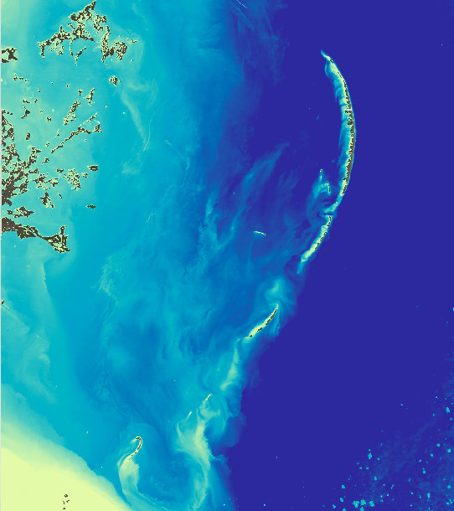
TURBIDITY
Red sediment stands out compared to greener water
Red Band
Green Band
Turbidity
&
=
Less Turbid
More Turbid
Spring 2019 over the Chandeleur Sound
-0.5
0
Normalized Difference Turbidity Index = (Red – Green) / (Red + Green)
Notes:
*** Note: While this slide has very basic information, we made it for our partners, who don't have experience with remote sensing. We will add or remove it depending on our audience.
The next parameter being assessed was turbidity which, according to the USGS, is defined as the measure of relative clarity of a liquid. It is an optical characteristic of water and is a measurement of the amount of light that is scattered by material in the water when a light is shined through the water sample. The higher the intensity of scattered light, the higher the turbidity. Material that causes water to be turbid include clay, silt, very tiny inorganic and organic matter, algae, dissolved colored organic compounds, and plankton and other microscopic organisms. Turbidity makes water cloudy or opaque, so comparing the amount of red and green light can bring out suspended sediment in water. We used a mathematical technique called a "normalized difference" which functions as a difference of the bands divided by a sum of the bands. This makes an "index" which is used to monitor the amount of suspended sediment in the region, and assess the distribution of turbidity in the study area.

Slide 12
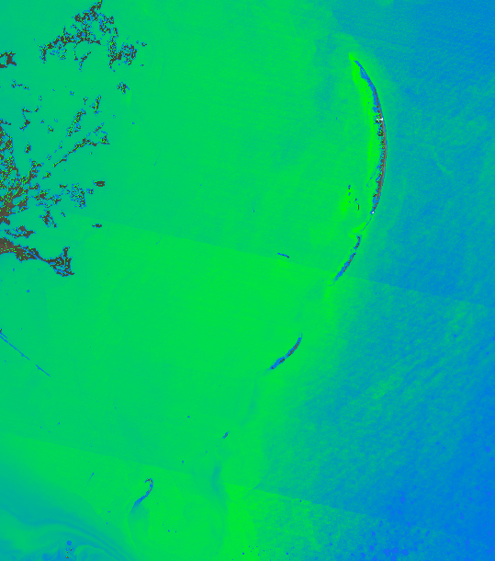
CHLOROPHYLL-A
Near-Infrared Band
Red Band
&
=
Less Chl
More Chl
Spring 2019 over the Chandeleur Sound
0
100
Notes:
*** Note: While this slide has very basic information, we made it for our partners, who don't have experience with remote sensing. We will add or remove it depending on our audience.
This slide discusses the band combinations used to assess Chlorophyll-a distribution in the Chandeleur Sound. Calculating chlorophyll-a utilized a two-fold equation adapted from Mishra and Mishra (2012). The first step involved calculating NDCI. Since we utilize Landsat 8 data we used NDVI as a proxy for NDCI. As outlined by Buma and Lee (2020), NDCI for Landsat 8 can be calculated via normalized difference between Bands 5 and 4 (NIR and Red). This equation is the same as NDVI. The results of this equation were then applied to a second equation in order to obtain chlorophyll-a values, as seen in the JPL Fall 2019 Honduras and Belize project. Constants are adopted from the JPL Fall 2019 Honduras and Belize project, as well as Mishra and Mishra (2012).

Slide 13
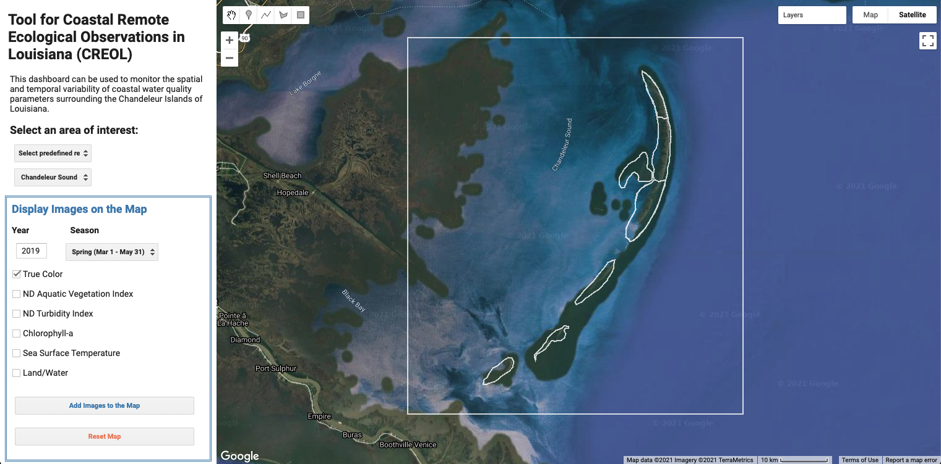
Tool CREOL
Notes:
The Tool for Coastal Remote Ecological Observations in Louisiana, or Tool CREOL, consists of an interactive user interface in Google Earth Engine. We created Tool CREOL in order to fulfill our partners’ needs both to understand historical trends in seagrass extent and water quality and to monitor current conditions. As shown here, users can choose one of several areas of interest to examine within the Chandeleur Islands region, as well as the entire sound, or the user can also select their own region of interest by "creating an asset". They can then add their choice of imagery to the map after selecting a year and season. Imagery includes true color, the spectral indices representing seagrass and turbidity, chlorophyll-a, seas surface temperature, and sea surface salinity. They can also view a land/water classification for the region of interest. Users can also generate time series charts displaying the overall variation of a parameter within the region over a chosen time period.

Slide 14
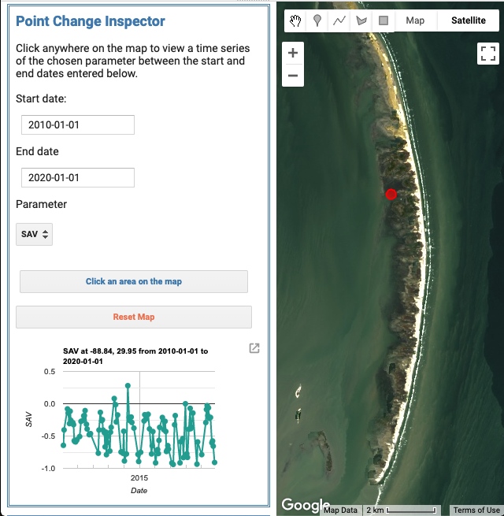
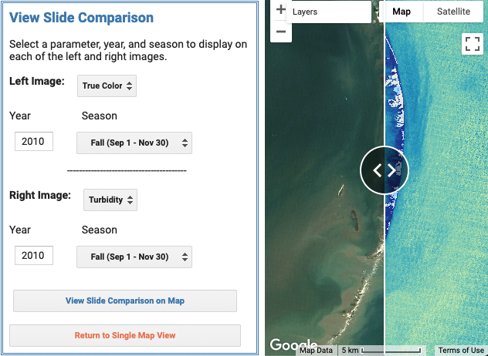
Tool CREOL
Special features
Notes:
In addition to the basic imagery and time series functions, our tool also includes some special features to help our partners further understand spatial and temporal variation of seagrass beds and water quality parameters. The slide comparison feature allows users to dynamically view two images side-by-side. This feature can be used to compare two different parameters from the same year and season, as is shown on the left with true color and turbidity from fall 2010. Users can also compare images from different times if desired. Tool CREOL also includes a point change inspector which allows users to examine temporal variation of parameters at specific points throughout the region. The example shown on the right displays a plot of the seagrass index from 2010 to 2020 at the location marked by the red circle. The point change inspector allows for a nuanced analysis of the spatial variation in historical trends.

Slide 15
RESULTS
NDAVI and land area from 1984 to 2021 at five locations along the islands.
Spring 1984
Spring 2021
Spring 2021
30.05
30.05
0.0
-0.5
Andrew
Ivan
30.00
30.00
0.0
29.95
-0.5
29.95
NDAVI
0.0
29.90
-0.5
George
Katrina
29.90
Longitude
Oil spill
Laura
Longitude
Isaac
Longitude
0.0
29.85
-0.5
29.85
Josephine
0.0
29.80
-0.5
29.80
24
Land
Area (km²)
29.75
16
29.75
5km
8
5km
0
-88.90
-88.85
1988
1992
1996
2000
2004
2008
2012
2016
2020
-88.90
-88.85
Latitude
Year
Latitude
Notes:
This figure looks the normalized Difference Aquatic Vegetation Index in the Chandeleur Islands. Five points were selected across the islands, and their NDAVI distribution was compared from 1984 through 2021. The left panel image shows the true color NDAVI imagery in Spring of 1984, and we can see how the islands covered a significantly larger area at the time. As we move through the center panel (the time series graph), it is very interesting to see how the NDAVI has shifted in relation to many different hurricanes and catastrophic events that occurred within the 36-hour time period. The panel on the right hand-side shows the true-color image of the same extent (Chandeleur Islands) in Spring of 2021.
The islands have shrunk and some portions have completely disappeared overtime due to the impacts of hurricane activity on the coastal Louisiana region in addition to other catastrophic events. The land in the southern part of the island has deteriorated drastically, and shifted coastward by a few km. Many hurricanes appear to have reduced land area in the Chandeleur Islands, but the barrier island system has been able to recover. However, Hurricanes George, Ivan and Katrina have made an impact to that the barrier island system, destroying as much as 90% of the land there. The Chandeleurs have still not completely recovered from these storms. An emergency sand berm was built in 2010 in an effort to prevent oil from the BP oil spill from reaching the island. While it failed to prevent oil from reaching the islands, it did stabilize land loss.
SAV has suffered along with the land in proximity to it. The SAV behind the northern and southern parts of the island was destroyed by the 2004-2005 hurricanes, while the SAV behind the central part of the island remains healthy and intact. The SAV seems to have benefitted from the construction of the sand berm in June 2010, stabilizing it's decline, and even causing the SAV to recover in some places.

Slide 16
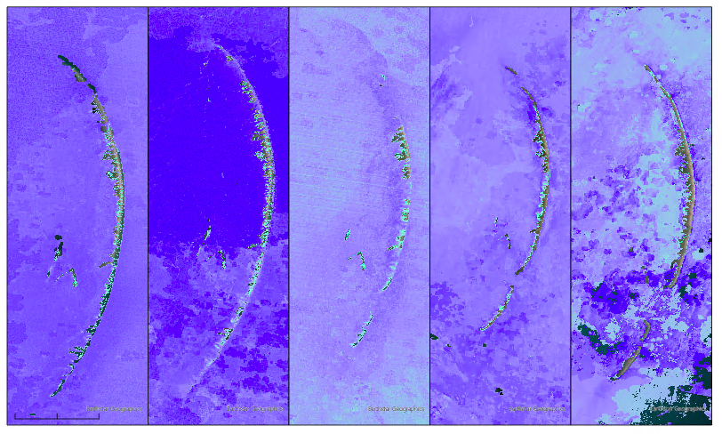
RESULTS
NDAVI around the Chandeleur Islands from Summer 2000 – Summer 2020
2000
2005
2010
2015
2020
NDAVI
1
0
2.5
5 miles
N
-1
Notes:
These images show the Normalized Difference Aquatic Vegetation Index in the summer months of 2000 to 2020. The highest values of the index, shown in green, occur very close to the islands each year. These images also exhibit the changes in land cover seen in the previous figure– the low land cover in the 2010 image, after hurricane Katrina but before the sand berm placement, is particularly striking. These images suggest that the decreasing NDAVI trends correspond with the loss of seagrasses in immediate proximity to the islands when land area disappears. Interestingly, some regions relatively far from the islands have high NDAVI values, particularly in 2020. These regions likely do not contain seagrasses, as seagrasses tend to only occur in very shallow regions.

Slide 17
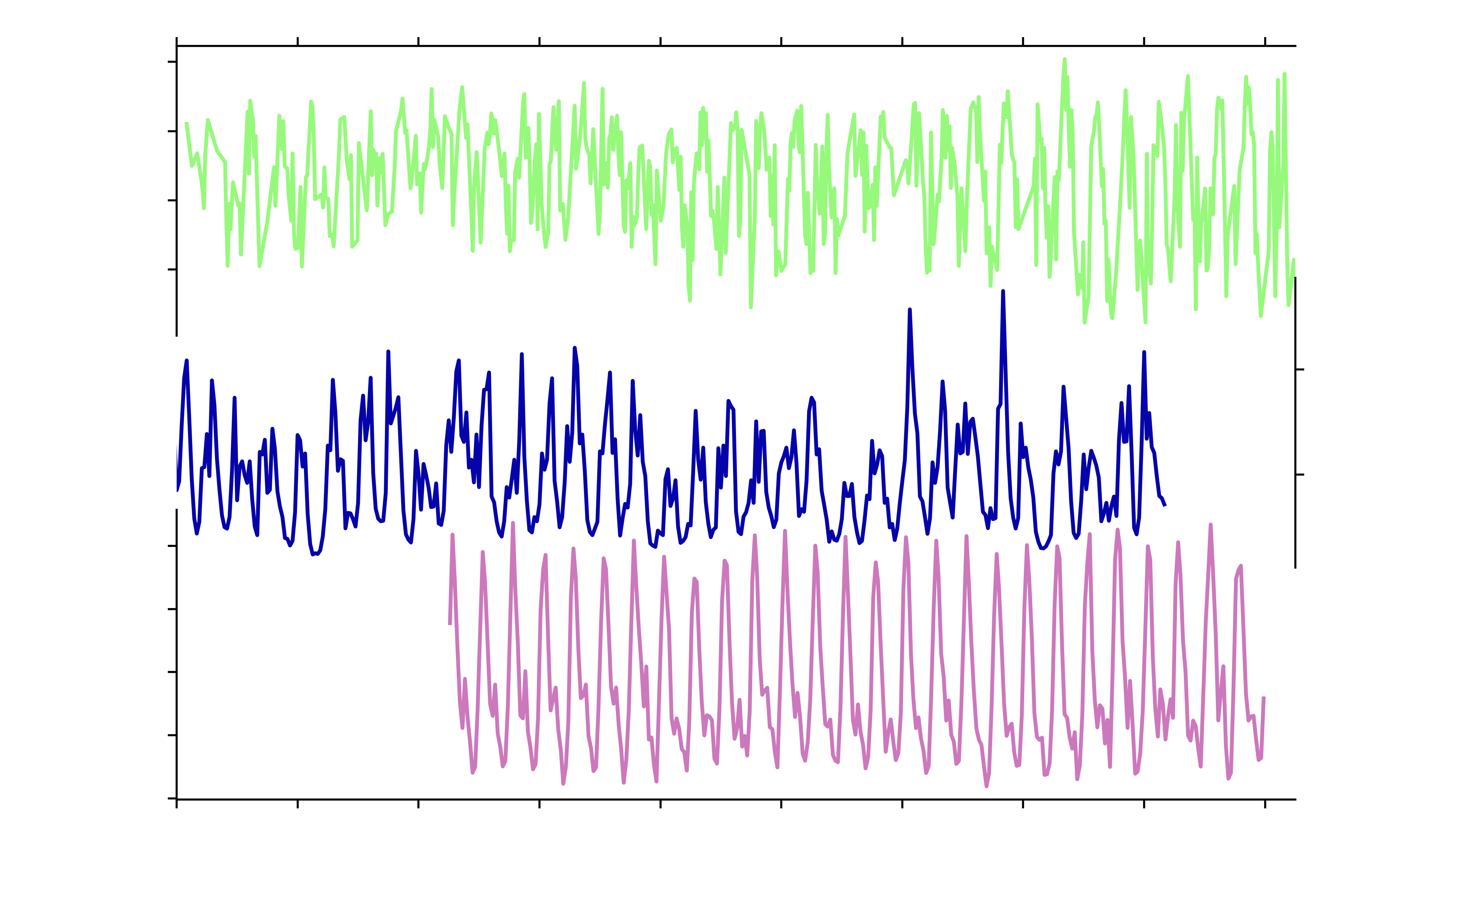
RESULTS
Seagrass and freshwater discharge
0.0
-0.25
Chandeleur Islands NDAVI
-0.5
-0.75
40000
Mississippi River Water Discharge (m3/s)
20000
22.5
25.0
Chandeleur Sound Salinity (PSU)
27.5
30.0
32.5
1984
1988
1992
1996
2000
2004
2008
2012
2016
2020
Year
Notes:
Here we compare the SAV index, acting as a proxy for SAV health, for the entire Chandeleur island system, to a major lever on the environment in the Chandeleur Sound, water discharge from the Mississippi River. River runoff and precipitation, which contributes to river run off, should be the first order control on salinity. Historically, it seems that the SAV fair better in a lower salinity, or fresher water, environment. This has major implications for ecosystem changes that will result from the installation of more river diversion projects in the lower Mississippi River in the coming decades.
Reference for Salinity Data: https://www.frontiersin.org/articles/10.3389/fmars.2018.00084/full
Reference for Mississippi River Discharge Data: https://toxics.usgs.gov/hypoxia/mississippi/flux_ests/delivery/index.html

Slide 18
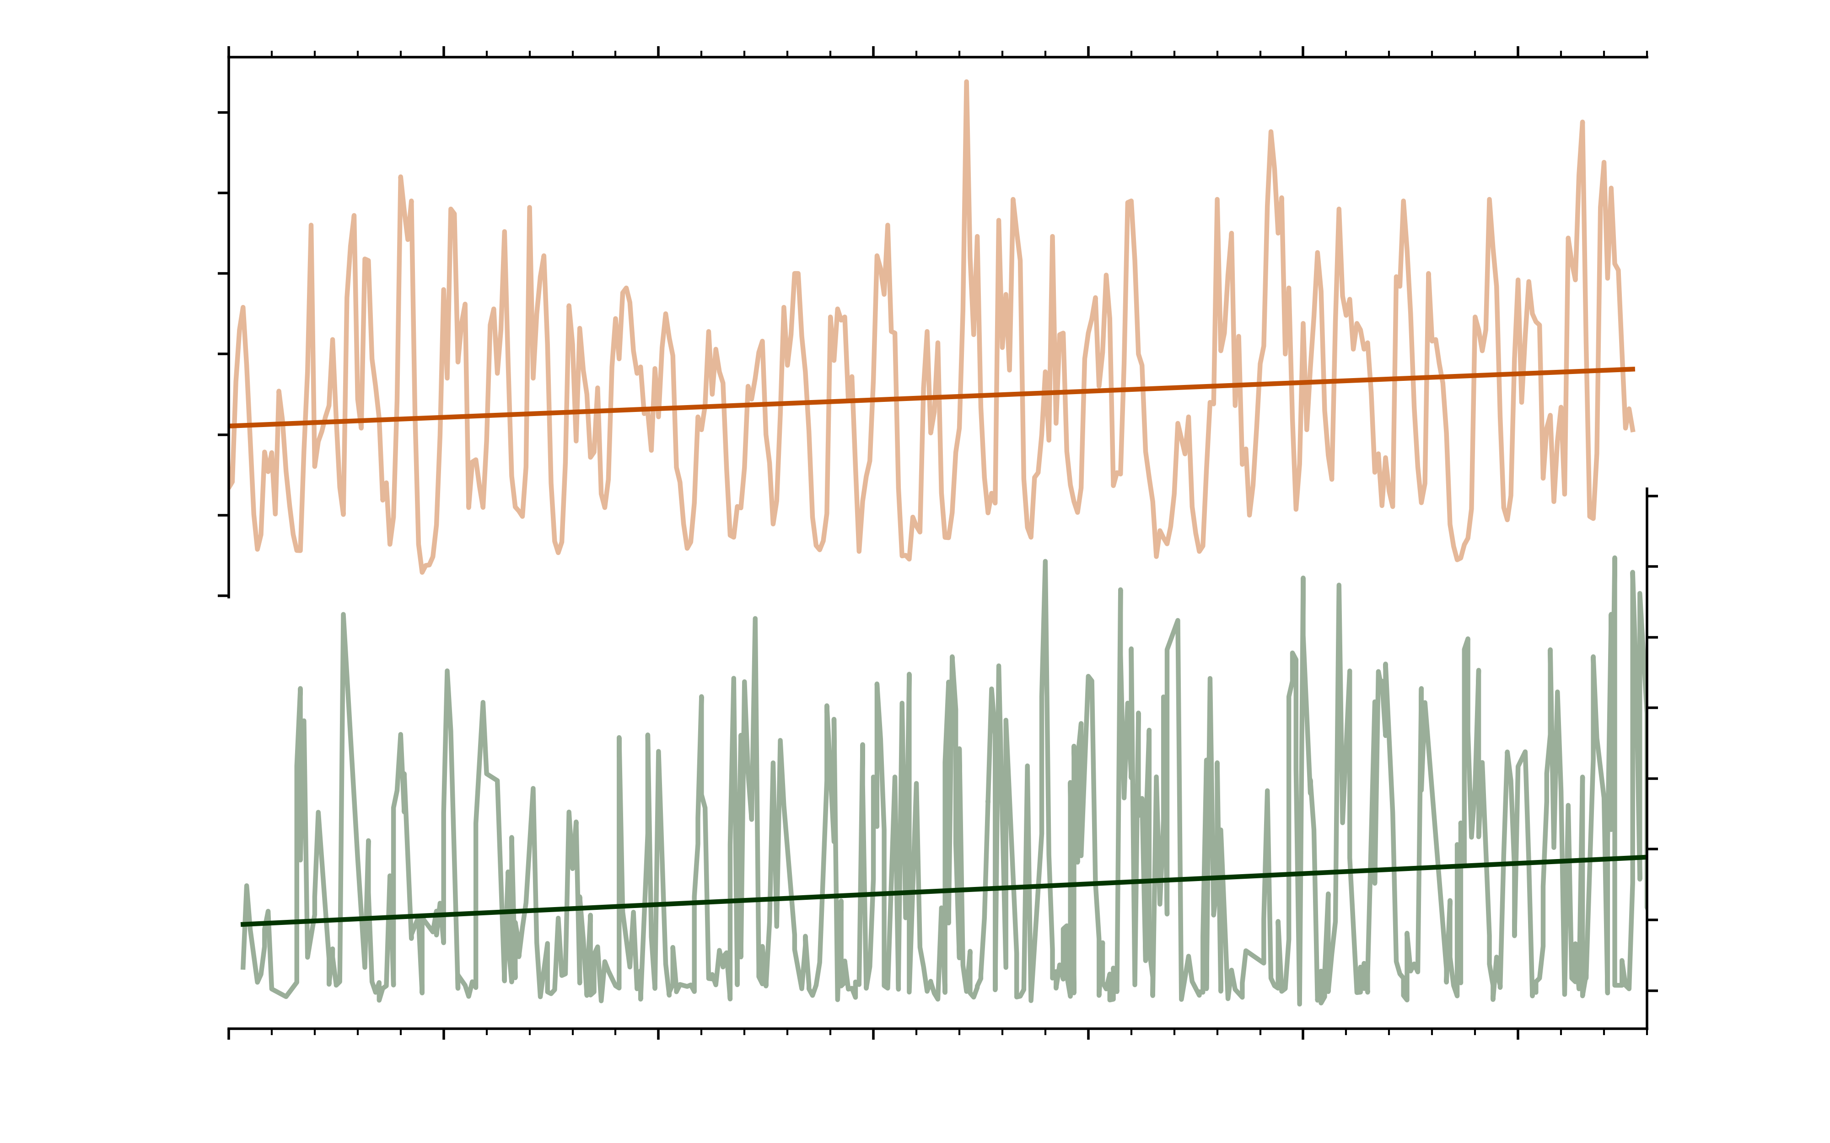
RESULTS
Nutrients and chlorophyll
30000
25000
20000
Phosphorus Discharge Mississippi River (t)
15000
10000
5000
22.5
20
0
17.5
15
Chandeleur Islands Chlorophyll-a (mg/L)
12.5
10
7.5
5
1984
1989
1994
1999
2004
2009
2014
Year
Notes:
The chlorophyll data (green) across the entirety of the Chandeleur Islands has a striking, persistent increase across our study interval. This increase is matched by an increase in the phosphorus load from the Mississippi River into the Gulf of Mexico. Macronutrients in river runoff is known to contribute to algae blooms. These algae blooms have the potential to remove too much oxygen from the water column and damage marine ecosystems.
Reference for Mississippi River Discharge Data: https://toxics.usgs.gov/hypoxia/mississippi/flux_ests/delivery/index.html

Slide 19
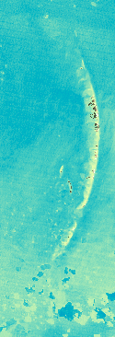
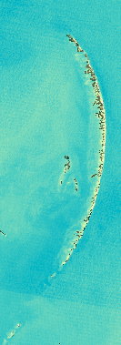
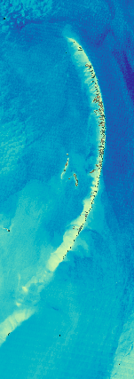
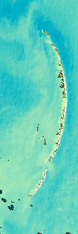
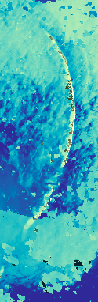
RESULTS
Turbidity Time Series (2000-2020)
2000
2005
2010
2015
2020
N
NDTI
0
0
2.5
5 miles
-0.5
Notes:
These figures show how the turbidity fluctuates in the summer months of 5 different years in the Chandeleur Islands region. In 2000, the turbidity was relatively higher in proximity to the land and moving outwards. In 2005, the turbidity was at an overall lower value in the northern portion of the islands, and got more turbid as you move south. In 2010, the turbidity increased slightly, and continued to increase in proximity to the islands as well. The 2020 summer imagery was quite cloudy which inhibited us from making comparisons to the other years.

Slide 20
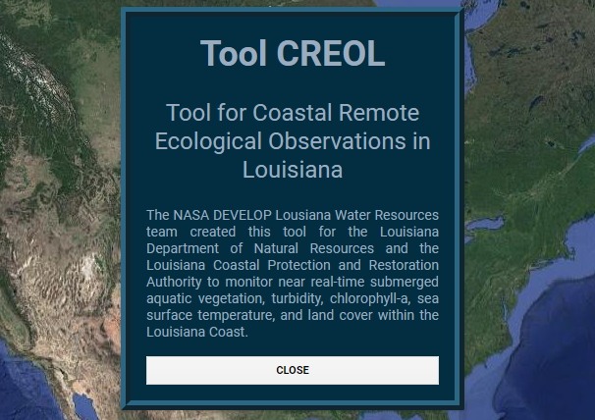
CONCLUSIONS
Benefits of Tool CREOL
Understanding historical trends in water quality and seagrasses
Real-time monitoring of conditions moving forward
Planning for restoration and revegetation
Notes:
Our partners will be able to use Tool CREOL to better understand historical trends and spatiotemporal variation in both seagrass extent and water quality around the Chandeleur Islands. As the tool automatically uses the most up to date available imagery, our partners can also continue to use the tool moving forward. These capabilities will be of great use for the restoration and revegetation project that began in 2020.

Slide 21
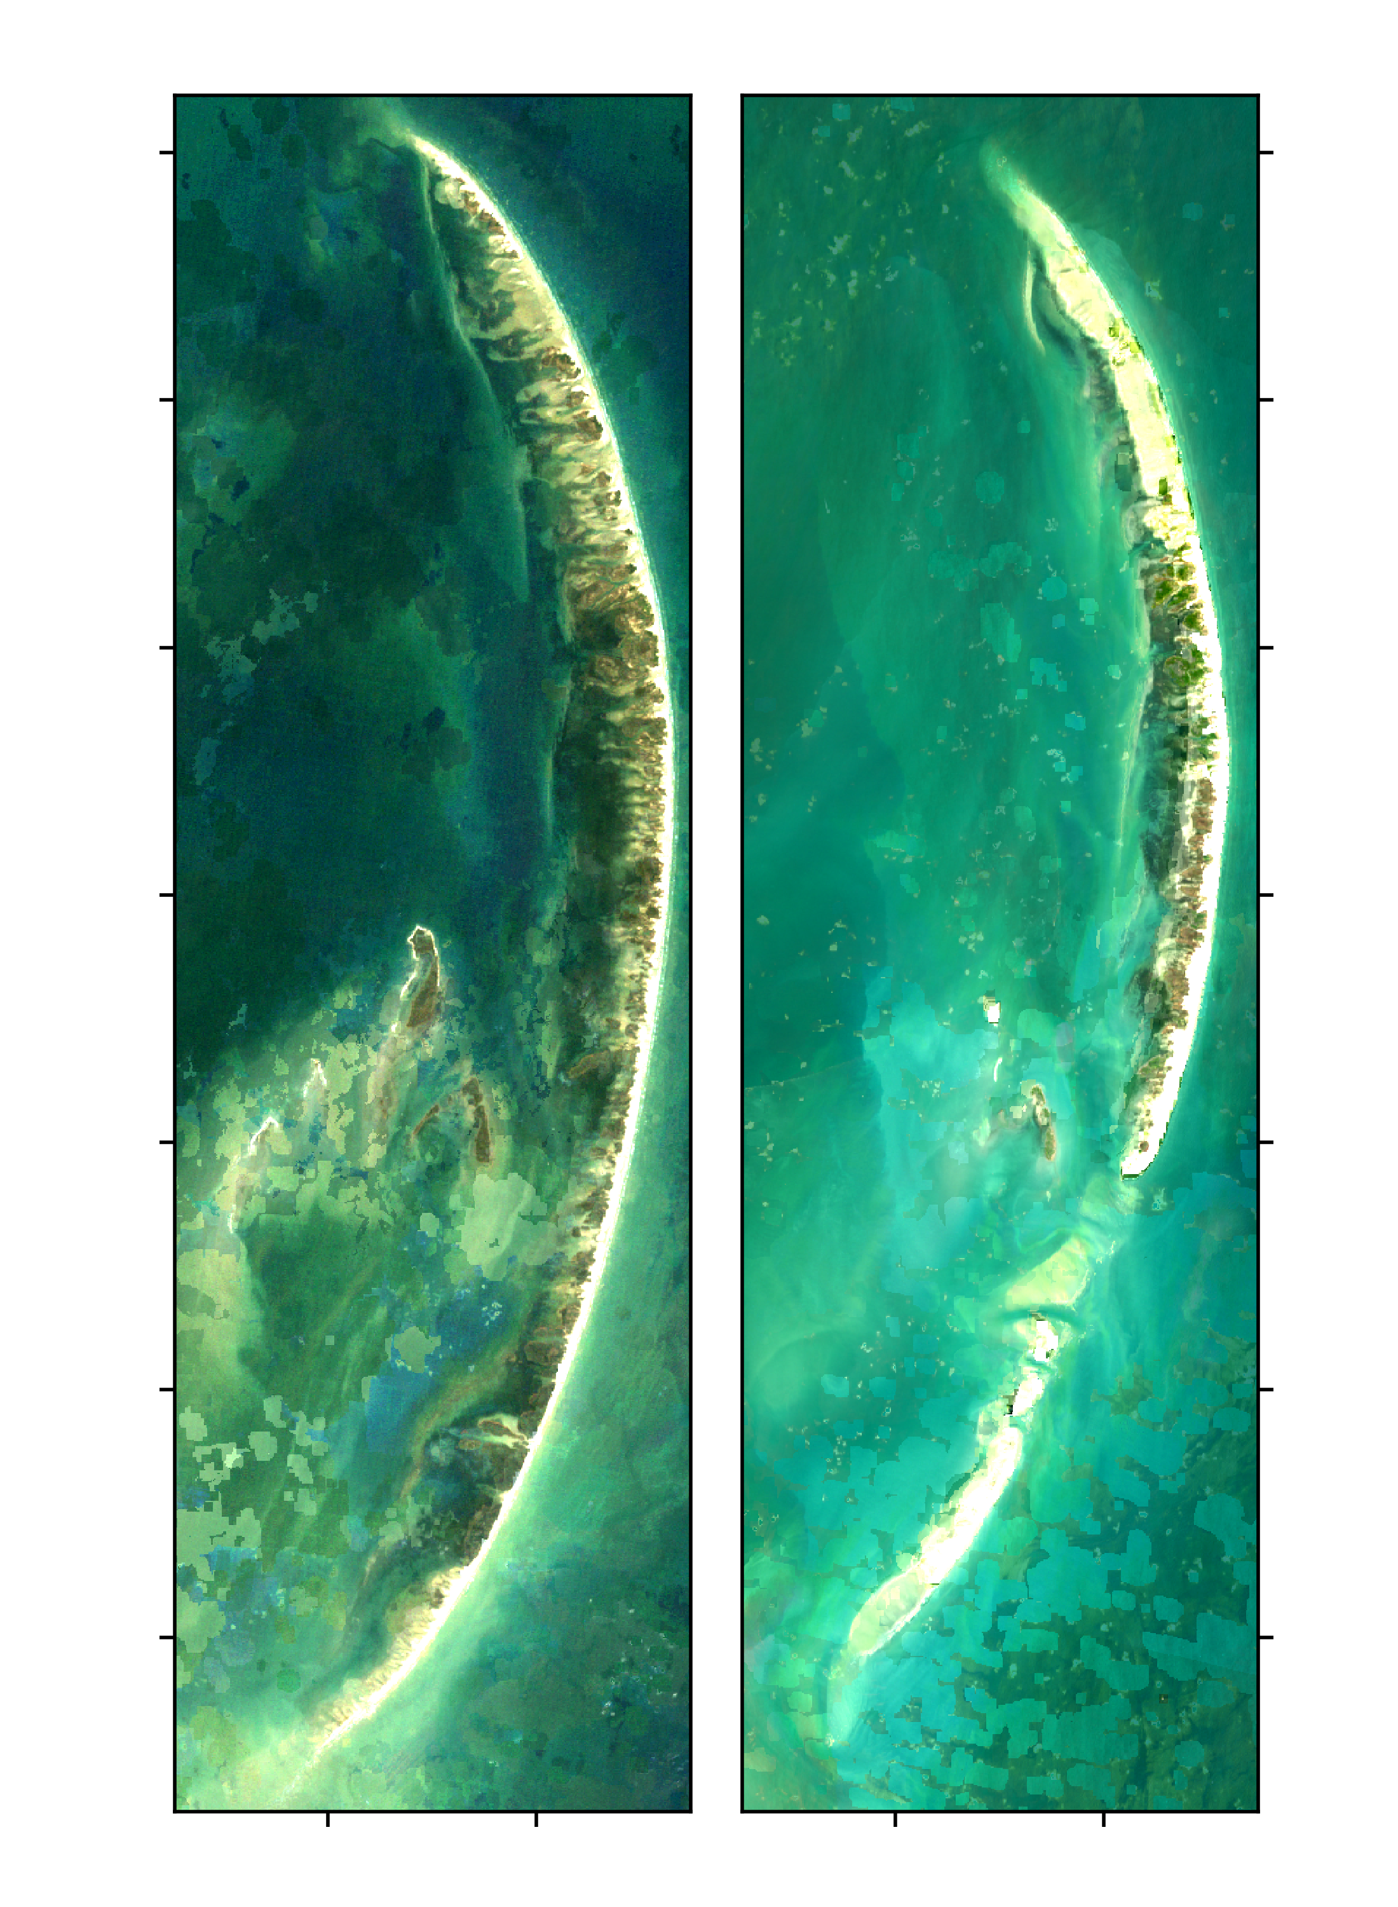
CONCLUSIONS
Spring 1984
Spring 2021
30.05
What we've learned so far:
Tremendous land loss from George, Ivan, and Katrina
Seagrass deteriorated along with the islands
2010 sand berm had a positive and lasting impact on land and seagrass
Chandeleur Island seagrasses thrive in fresher water
Chlorophyll has increased continuously since the early 1990s
30.00
29.95
29.90
Latitude
29.85
29.80
29.75
-88.90
-88.85
-88.90
-88.85
Longitude
Notes:
In conclusion, after looking at various water quality parameters through time series distributions in conjunction to the imagery, we noticed that there was tremendous land loss from Hurricanes George, Ivan, and Katrina. Overall, the seagrass ecosystem deteriorated along with the Chandeleur Islands. There were some restoration efforts that were implemented in the coastal Louisiana region to restore damage from destructive events such as the Oil Spill. A sand berm constructed in 2010 had a positive, and lasting impact on land and seagrass health. The Chandeleur Island segrasses thrive in less saline conditions. Additionally, algal blooms have increased continuously since they early 1990s.

Slide 22
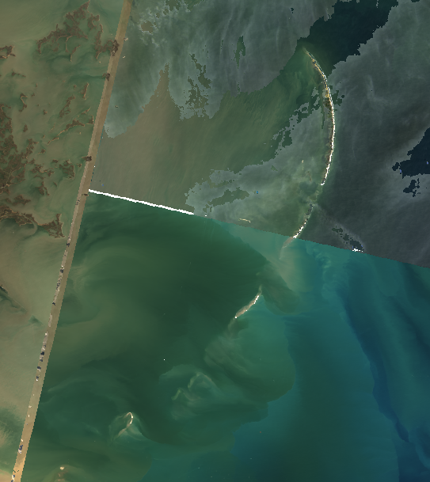
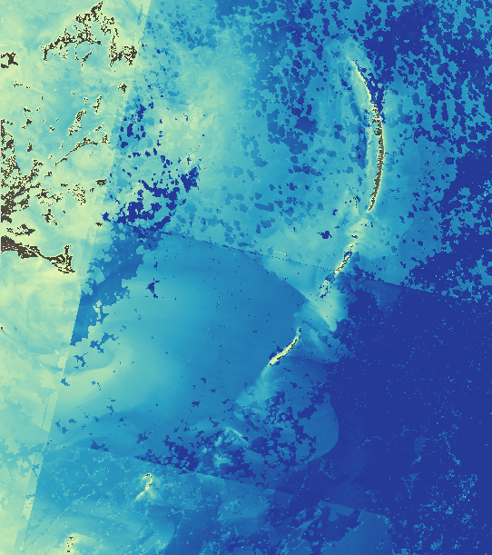
ERRORS/UNCERTAINTIES
Cloud masking reducing data accuracy
Intensity of parameters in relation to seasonality
Inconsistency between sensors
Insufficient in situ data for validation
NDVI as a proxy for NDVI
Notes:
Several factors limited our ability to obtain consistently accurate results from our analysis. First, the high frequency of heavy cloud cover, particularly during the hurricane season, meant that we had to mask significant portions of many images used in our analysis. This led to patchy imagery for some years and seasons, as shown in the images on the right. Additionally, the differences in parameter intensity between seasons introduced challenges in our choice of visualization parameters for Tool CREOL. A source of uncertainty in our time series analysis was the inconsistencies between sensors, particularly the differences in the wavelength ranges measured by Landsat 5’s near infrared band compared to Landsat 7 and 8. Finally, we did not have access to sufficient in situ data to validate our results. Lastly, to measure chlorophyll we initially use NDVI as a proxy for NDCI for Landsat 8. Our equations are adopted from Mishra and Mishra (2012) as well as the Fall 2019 JPL Honduras and Belize project. Using a proxy can reduce accuracy and increase uncertainty in our data.

Slide 23
FUTURE WORK
Incorporate Landsat Collection 2 data
Utilize in situ data for validation
Improve seagrass indices
Create a GIF generator
Image Credit: USGS
Notes:
Future work includes incorporating Landsat Collection 2 Data into the tool, utilizing in situ data to provide validation for our imagery and adding a GIF generator panel into the tool. Incorporating Landsat Collection 2 would provide the most up to date and accurate imagery in our tool. We previously attempted to incorporate this dataset, but ran into multiple processing errors that made the data difficult to use. Additionally, very little in situ data was available for our study area parameters. Obtaining data for chlorophyll, turbidity and SAV would improve Tool CREOL's accuracy and provide validation for the results. Lastly, we hope to add a GIF generator to our tool. The addition of a GIF generator would provide additional usability for the user and allow for the creation of gifs to model changes in our parameters over time.
Image credit: Karen Morgan, USGS (https://www.usgs.gov/media/images/sediment-berm-along-northern-chandeleur-islands-Louisiana )

Slide 24
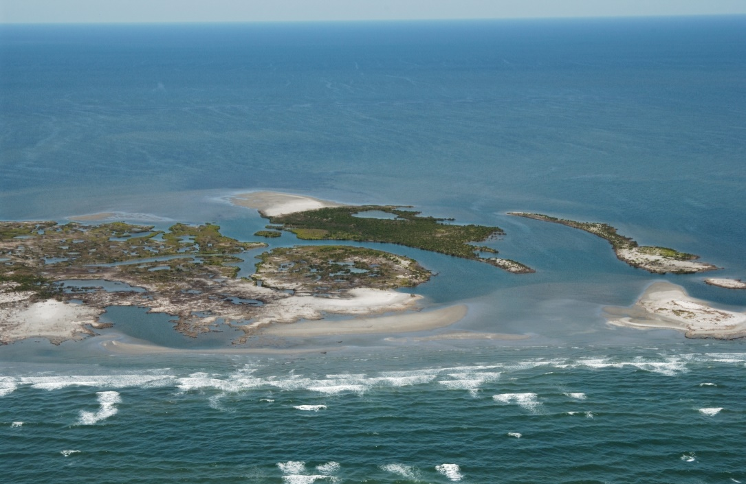
ACKNOWLEDGEMENTS
Partners:
Louisiana Coastal Protection and Restoration Authority (CPRA)
Gregory Grandy – Deputy Executive Director
Todd Baker – Coastal Resources Project Manager
Kenneth Bahlinger – Project Manager Administrator
Louisiana Department of Natural Resources (LDNR)
Mark Hogan - Coastal Resource Scientist Supervisor
Sara Krupa – Coastal Resource Scientist Manager
Science Advisor:
Dr. Juan Torres-Pérez (NASA Ames Research Center)
Mentor:
Britnay Beaudry (Science Systems and Applications, Inc., NASA Ames Research Center)
Image Credit: USGS
Notes:
We would like to thank our partners for collaborating with us on this research project. A huge thank you also to our Science Advisor Dr. Juan Torres-Perez and our mentor Britnay Beaudry for all their help, guidance and support throughout this summer term.
Image credit: Karen Morgan, USGS (https://coastal.er.usgs.gov/data-release/doi-P9DQZQCX/)

Slide 25
REFERENCES
Aulenbach, B. T., Buxton, H. T., Battaglin, W. A., & Coupe, R. H. (2007). Streamflow and nutrient fluxes of the Mississippi-Atchafalaya River Basin and subbasins for the period of record through 2005. In Streamflow and nutrient fluxes of the Mississippi-Atchafalaya River Basin and subbasins for the period of record through 2005 (USGS Numbered Series No. 2007-1080; Open-File Report, Vols. 2007–1080). U.S. Geological Survey. https://doi.org/10.3133/ofr20071080
Bradberry, J., Harris, Thomas, Wilson, S., Montoucet, J., Brown, C., Pierson, D., Strain, M., Dardenne, J., Milling, K., Waskorn, J., Donelon, J., Mackie, C., Cantrelle, J., Wilson, S. C., Curole, W., Hidalgo, W., Cormier, L., Charbert, N., & Magee, T. (2017). Louisiana’s Comprehensive Master Plan for a Sustainable Coast. Coastal Protection and Restoration Authority, State of Louisiana, 93.
DeMarco, K., Couvillion, B., Brown, S. & La Peyre, M. (2018). Submerged aquatic vegetation mapping in coastal Louisiana through development of a spatial likelihood occurrence (SLOO) model. Aquatic Botany, 151, 87-97. https://doi.org/10.1016/j.aquabot.2018.08.007
Droghei, R., Buongiorno Nardelli, B., & Santoleri, R. (2018). A New Global Sea Surface Salinity and Density Dataset From Multivariate Observations (1993–2016). Frontiers in Marine Science, 0. https://doi.org/10.3389/fmars.2018.00084
Suir, G.M., Sasser, C.E. & Harris, J.M. (2020). Use of remote sensing and field data to quantify the performance and resilience of restored Louisiana wetlands. Wetlands, 40, 2643–2658. https://doi.org/10.1007/s13157-020-01344-y
Xu, S., Xu, S., Zhou, Y., Yue, S., Zhang, X., Gu, R., … Liu, M. (2021). Long-term changes in the unique and largest seagrass meadows in the Bohai Sea (China) using satellite (1974–2019) and sonar data: implication for conservation and restoration. Remote Sensing, 13(5), 856. http://dx.doi.org/10.3390/rs13050856
Notes:
These are our references! Thank you for listening, and we will take any questions.

