Slide 1
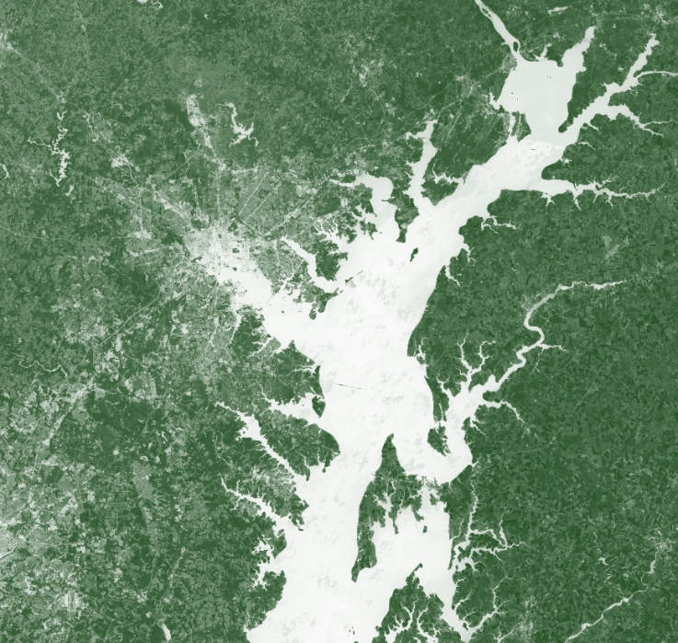
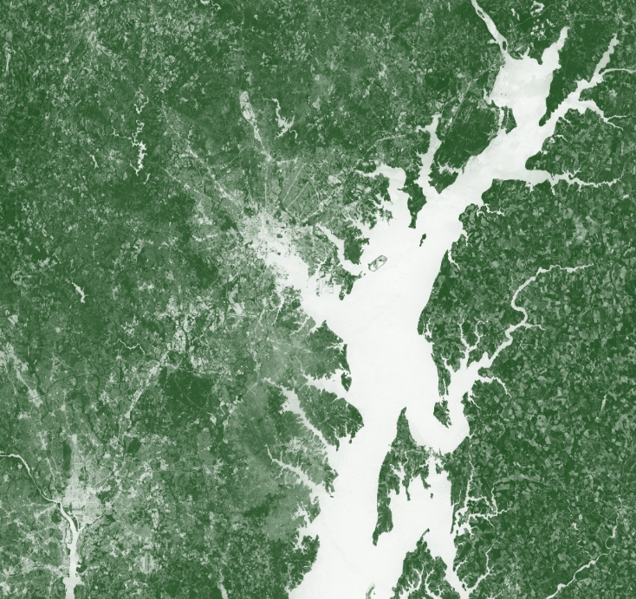
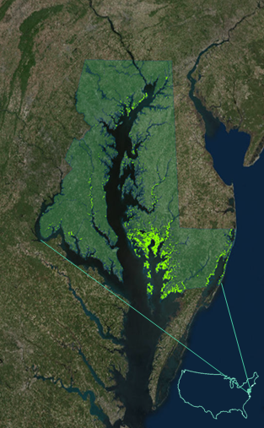
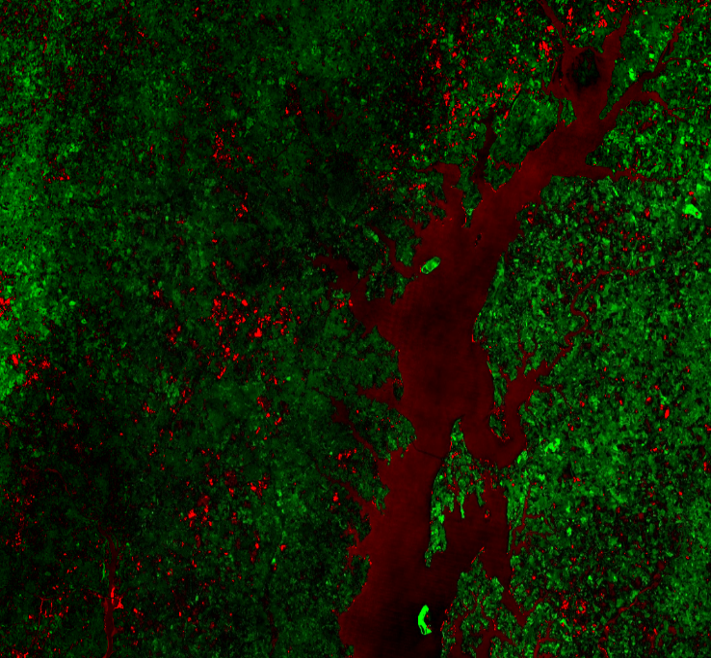
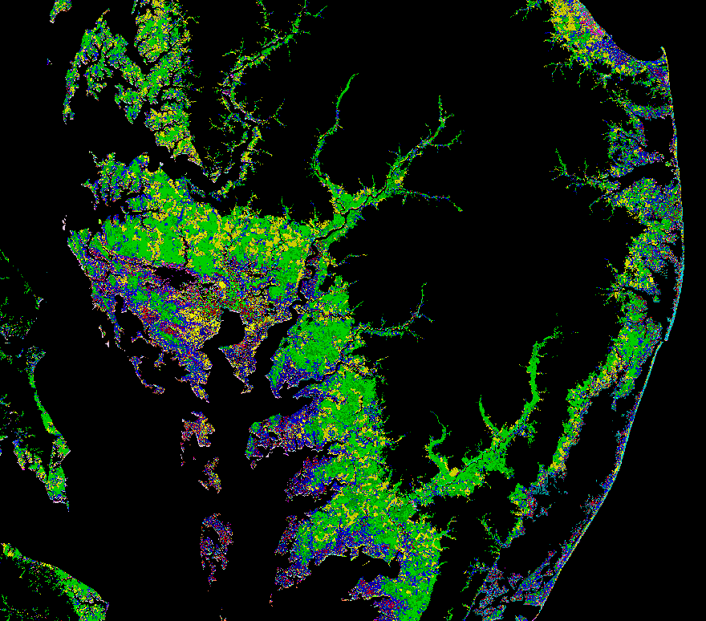
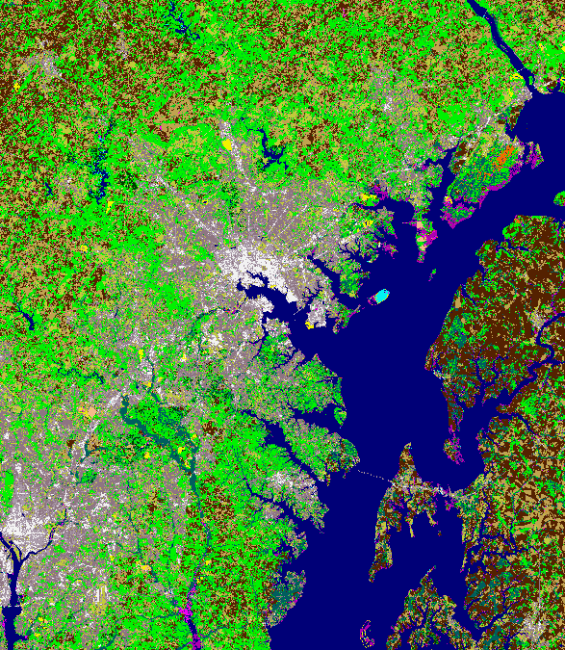
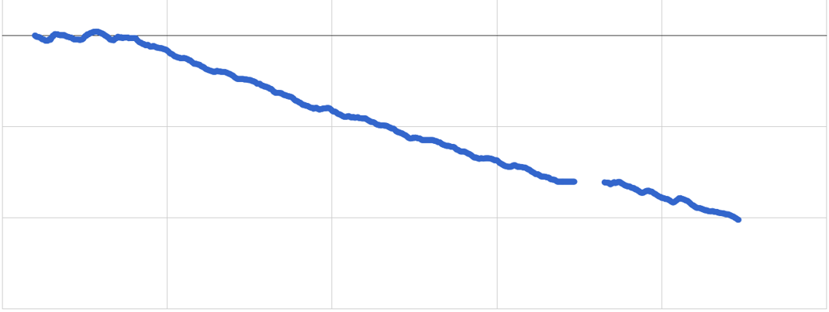
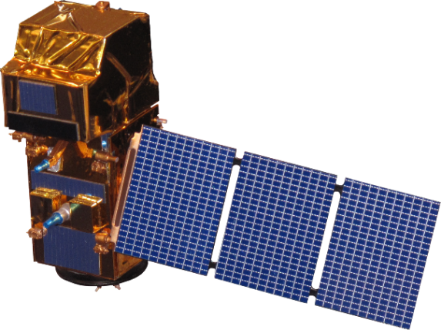
Utilizing NASA Earth Observations to Monitor Marsh Health in the Chesapeake Bay to Support the Maryland Department of Natural Resources Coastal Resiliency Assessment
Abstract
Methodology
Tidal wetlands, such as marshes, are among the Chesapeake Bay’s most protective natural features. Not only do they provide vital ecological services such as breeding grounds and water purification, but wetlands also deliver direct benefits to coastal communities through water absorption, wave attenuation, and sediment stabilization. Thus, marshes can buffer vulnerable communities from erosion, flooding, and storm damage. The Maryland Department of Natural Resources partnered with The Nature Conservancy (TNC) to conduct a Coastal Resiliency Assessment to identify coastal habitats that provide protective benefits to vulnerable coastal communities. While healthy marshes were determined to have high risk-reduction potential, the quality of coastal habitats on the Maryland shoreline is difficult to assess without historical context. The goal of this study was to utilize NASA Earth observations to analyze trends in marsh health on the Maryland coast of the Chesapeake Bay from 1984 to 2017 and to forecast changes in marsh health from 2017 to 2030. Vegetation, soil, and water indices calculated from Landsat and Sentinel-2 imagery were used to detect changes in marsh health over the past 33 years. A change detection algorithm was used to detect changes in marsh elevation and location of high marsh and low marsh over the study period. The Maryland Department of Natural Resources and The Nature Conservancy will use these results to supplement their Coastal Resiliency Assessment and develop more informed decision-making plans regarding restoration and conservation in the Chesapeake Bay.
NDVI
1984
NDVI
NDSI
Objectives
NDWI
Measure past and present marsh health in the Chesapeake Bay using Earth observations for the period of 1984 to 2017
Evaluate and map marsh health using spectral vegetation indices derived from multispectral imagery
Forecast marsh health within the study region to the year 2030
Provide end users with marsh health trend analysis maps and scripts, marsh health forecast maps, and project methodologies
NDVI
2017
All
Results
Study Area
Chesapeake Bay Ecological Forecasting
Earth Observations
Marsh
Chesapeake Bay
Landsat 5 TM
Past
Present
Future
Landsat 8 OLI
0
NDVI Values in Different Regions Over Time
Relative NDVI Value
-20
N
-40
Sentinel-2 MSI
-60
2000
2005
2010
1995
Year
2015
2020
Project Partners
Conclusions
Maryland Department of Natural Resources
The Nature Conservancy (TNC)
Preliminary historical analysis showed hotspots of both positive and negative NDVI change throughout Maryland’s Chesapeake Bay. Blackwater National Wildlife Refuge, one of the largest contiguous blocks of salt marsh along the Northeast Atlantic Coast, has experienced dramatic loss in vegetation over the study period.
Sentinel-2 imagery was successfully used to create 10-meter resolution maps of Maryland marsh health.
Maryland’s marshes are trending towards degradation and, if all contributing factors persist, will continue to degrade over time.
Team Members
John Fitz
Sean McCartney
Acknowledgements
David Lagomasino, PhD, NASA GSFC/UMD
Jenny Allen, MD DNR
Nicole Carlozo, MD DNR
Michelle Canick, TNC
John Bolten, PhD, NASA GSFC
Rachel Marks, MD DNR
Victor Lenske
(Project Lead)
Sara Lubkin, PhD
Helen Plattner
NASA Goddard Space Flight Center – Summer 2017

