Slide 1
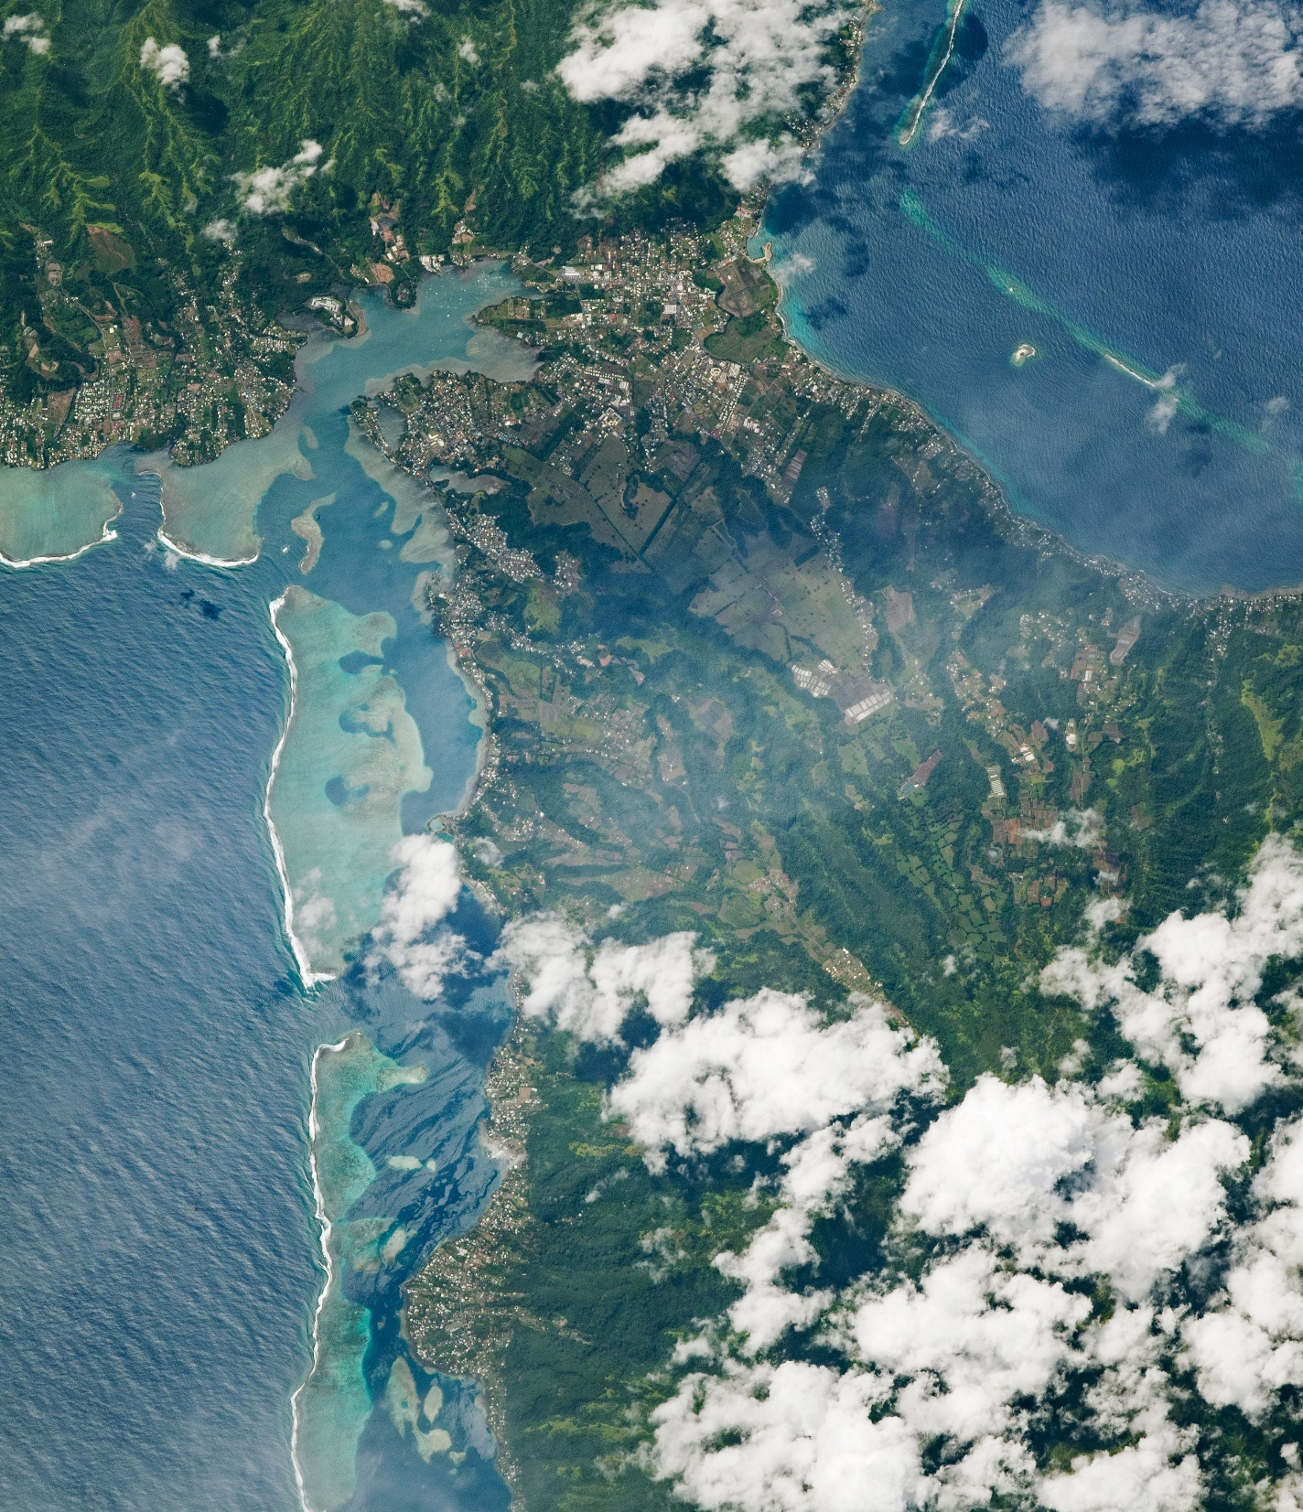
DEVELOP Orientation
Module 3. Participant & Team Responsibilities

Slide 2
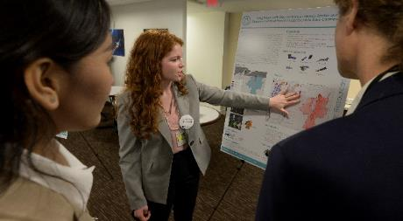
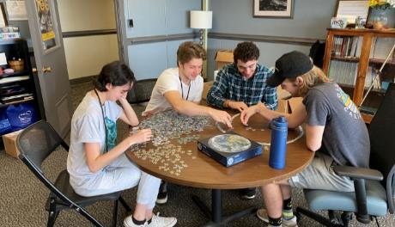
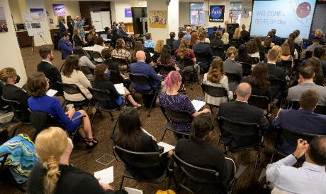
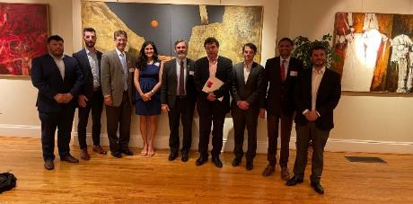
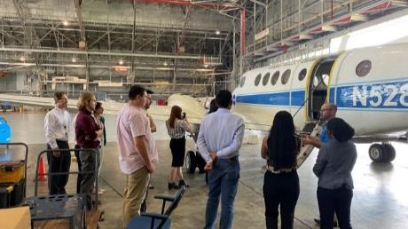
PARTICIPANT & TEAM RESPONSIBILITIES
Project Team Responsibilities
Set goals and work towards them as a team.
Ensure that mandatory deliverables are completed, then pursue optional deliverables as time allows.
Be organized and document all research and contacts along the way so the project and/or communication with end users may be continued after the 10 weeks.
Take initiative! Look at what else needs to be done when you have completed your assigned tasks.
Network with other teams. Help other teams. Get help from other teams.
Have an open mind & learn from each other! Be nice to your fellow DEVELOPers and have fun getting to know each other and building your network!
DEVELOP is what you make of it. Make the most out of these 10 weeks!

Slide 3
PARTICIPANT & TEAM RESPONSIBILITIES
Federal definition of research misconduct:
Researcher Responsibilities
“fabrication, falsification, or plagiarism in proposing, performing, or reviewing research, or in reporting research results”
Researchers (all personnel involved in conceiving, designing, conducting and supervising research) have the responsibility to:
Uphold and embody the professional standards of the research community.
Exercise personal and professional honesty in proposing, designing, performing, and reporting research.
Maintain mutual respect with all members of the research team and accurately represent the contributions of each member’s work.
Not allow outside influence or pressure (e.g., political consideration, ideology, financial conflicts of interest, peer pressure, or individual opinion) to affect the results of research, input to or from advisory committees, or the dissemination of research and analysis.
Uphold all of NASA’s core values of ethical conduct and integrity.
DO NOT:
Fabricate: Making up data or results and recording or reporting them.
Plagiarize: The appropriation of another person’s ideas, processes, results, or words without giving appropriate credit.
Falsify: Manipulating research materials, equipment, or processes, or changing or omitting data or results such that the research is not accurately represented in the research report.

Slide 4
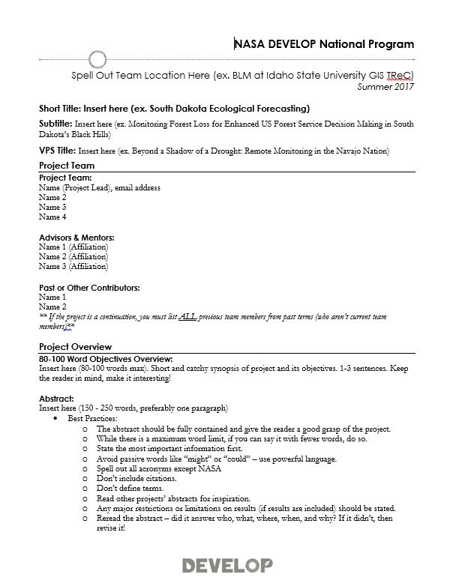


PARTICIPANT & TEAM RESPONSIBILITIES
Project Deliverables
You’ll learn more about deliverables from the Project Coordination team’s Deliverables Tips & Tricks Webinars throughout the term, but it’s never too early to start thinking about deliverables!
Things to start thinking about now:
Communication Deliverable: If your team and partners are interested in creative ways to inform the public about your project, familiarize yourself with the optional Creative Communication deliverable. You can choose between a videos, one-page flyer, trifold brochure, or social media series! Consider what fits best for your project, consult with your partners, and submit your Creative Communication selection form in Week 4.
Code or Tutorial: You will work with the Geoinformatics team if you are developing any internal code or are creating a tutorial for your partners. Note, not all projects do this!

Slide 5
PARTICIPANT & TEAM RESPONSIBILITIES
Deliverable Submission
The Fellows supporting project coordination will work with you throughout the deliverable creation and submission process.
Each team has a designated Fellow to correspond with, as well as a set team of editors, throughout the whole term for continuity.
Any deliverable questions can be asked using the @Project Coordination tag in Teams or sent to your Project Coordination point of contact
To submit: All non-code deliverables will be uploaded to the respective folder in the DEVELOP Summer 2023 Teams channel.
YearTerm_Node_Team_Deliverable_Draft
Ex. 2023Sum_ARC_MarinCountyWildlandFiresII_Poster_FD
File Nomenclature
Node Acronyms:
ARC, CO, GA, GSFC, ID, JPL, LaRC, MA, MSFC, NC, VEJ, PUP
App Area Shorthand:
Ag, Disasters, Eco, Energy, HAQ, TI, Urban, Water, WildlandFires

Slide 6
PARTICIPANT & TEAM RESPONSIBILITIES
By The Way
Teams submit deliverables to the Fellow for a first review prior to submission to NPO! Take note of internal deadlines.
Deliverable Deadlines to NPO
Check out DEVELOPedia’s Deliverable Calendar
Week 1 – 6/8: Personality Assessment, Media Release Form, DEVELOPedia Participant Page, Entrance Personal Growth Assessment
Week 2 – 6/15: Study Area Shapefile
Week 3 – 6/22: Technical Paper and Presentation Checkpoint #1
Week 4 – 6/29: Creative Communications Selection Form
Week 5 – 7/02: Project Video Check in; 7/06: Technical Paper Checkpoint #2
Week 6 – 7/13: Tech paper checkpoint #3, Presentation Checkpoint #2, Tutorial Checkpoint, HQ Highlight and Flashtalk Presentation RD (if applicable)
Week 7 – 7/20: Website Image, Presentation Checkpoint #3 (optional), Gitlab Checkpoint
Week 8 – 7/25: Presentation FD, Poster FD, Tech Paper Checkpoint #4, HQ Highlight & Flashtalk Presentation FD (if applicable)
Week 9 – 8/03: Creative Communication FD; Project Summary FD, DEVELOPedia Project Page
Week 10 – 8/7: Exit Personal Growth Assessment, Tutorial FD, GitLab Code Submission, Anonymous Program feedback; 8/10: Tech Paper FD, Project Feedback Form
See the detailed deliverable calendar on DEVELOPedia.

Slide 7
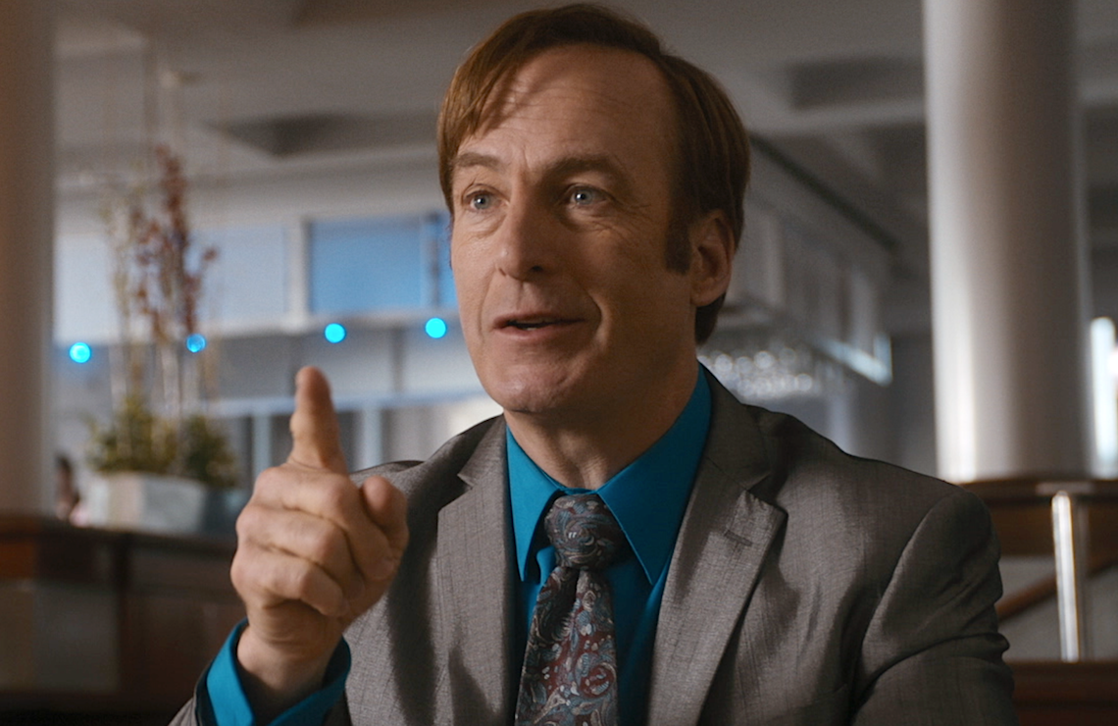

PARTICIPANT & TEAM RESPONSIBILITIES
These statements are on all premade deliverable templates, but you’ll have to add it to your optional deliverables and custom templates!
Required Legal Statements
Take it from me – I’m a lawyer!
ALL deliverables and products created
by teams need to include this short
paragraph of legal statements:
“This material is based upon work supported by NASA through contract NNL16AA05C. Any mention of a commercial product, service, or activity in this material does not constitute NASA endorsement. Any opinions, findings, and conclusions or recommendations expressed in this material are those of the author(s) and do not necessarily reflect the views of the National Aeronautics and Space Administration and partner organizations.”

Slide 8
PARTICIPANT & TEAM RESPONSIBILITIES
Commercial Smallsat Data Acquisition (CSDA)
NASA’s Commercial Smallsat Data Acquisition (CSDA) program was established by NASA ESD to identify, evaluate, and acquire commercial small-satellite (smallsat) data that support NASA's Earth science research and application goals. There are multiple vendors providing data, the two most commonly used by DEVELOP are:
Planet: optical to near-infrared data acquired by the Planet small satellite constellations: PlanetScope, RapidEye, and SkySat, with a resolution of 3 m/pixel.
NOTE: Planet data is approved for research, experiments, evaluation, and development—including basic and applied research—that may lead to journal publications, licensed user-derived data products, white papers and maps for use by the broader scientific community, or to support logistical planning of future scientific research experiments such as field campaigns. Planet data may NOT be used operationally for non-scientific logistical planning, response efforts outside U.S. Government agency applied science missions, management of human resources, remote monitoring (i.e., construction, facility monitoring, etc.), enforcing compliance of regulations, and law enforcement and investigations.
Required Citations for Planet Data Use (with each image include):
For data products: “© Planet Labs PBC {Year}. All rights reserved.”
For derivatives: “Includes copyrighted material of Planet Labs PBC. All rights reserved.”
In acknowledgements section include, “This work utilized data made available through the NASA Commercial Smallsat Data Acquisition (CSDA) Program.”
Maxar: data acquired by the Maxar constellation, including: WorldView-1, WorldView-2, WorldView-3, WorldView-4, GeoEye-1, QuickBird, and IKONOS, with very-high-resolution data products with resolutions as low as 31 cm per pixel, from the WorldView-3 Panchromatic band.
NOTE: Maxar data users must obtain approval for release of Maxar data to the public (publications, presentations, etc.) from the National Geospatial-Intelligence Agency (NGA). This process takes time and means you cannot include data products in deliverables, only derivatives.
Required Citations for Maxar Data Use (with each image include):
Data derivatives for Maxar imagery must contain copyright markings as specified below (YYYY is the year of the image acquisition).
For all sensors except WorldView-4 and IKONOS: “©YYYY, Maxar, USG Plus”
For IKONOS: “©YYYY, Maxar, NextView”
For Worldview-4: “Includes copyrighted material of { Maxar Intelligence, Inc}. All rights reserved.”
In acknowledgements section include, “This work utilized data made available through the NASA Commercial Smallsat Data Acquisition (CSDA) Program.”

Slide 9



PARTICIPANT & TEAM RESPONSIBILITIES
Use of Government Equipment*
U.S. Government computers are for authorized users only.
It is NASA's policy to permit limited personal use of Government office equipment, including information technology (IT).
The limited personal use of Government office equipment by NASA employees and contractors shall not interfere with official business, violate existing laws, and should involve only minimal additional expense to the Government.
Unauthorized use of the computer accounts and computer resources to which you are granted access is a violation of Federal Law; constitutes theft; and is punishable by law.
Misuse of assigned accounts and accessing others' accounts without authorization is strictly forbidden.
Failure to abide by these provisions may constitute grounds for termination of access privileges, administrative action, as well as civil or criminal prosecution.
*All information for government policy and equipment is also true for SSAI and Space Systems
NASA 2540.1G & NPR 2810.1A: http://insidenasa.nasa.gov/ocio/policy/policy_direct/index.html

Slide 10
PARTICIPANT & TEAM RESPONSIBILITIES
By The Way
If you log into a personal Gmail while on a government computer, they can see your entire browsing history! Do you want them to see it? Think twice before you log in to personal accounts!
Privacy
Expect NO privacy when using a government/SSAI computer, when emailing a government/SSAI email address, or when using Microsoft Teams. This also applies to the SSAI instance of Microsoft Teams and Office365.
Strict computer use policy in effect – every keystroke is stored, every NASA email is public domain.
NASA Policy:
NASA employees and contractors do not have a right to expect privacy while using Government office equipment at any time, including accessing the internet and using email.
The Government maintains call details and network access records to monitor telephone activity and internet access.
The Government also employs monitoring tools to track system performance and improper usage.
This applies to those emailing a NASA email as well.
NASA 2540.1G & NPR 2810.1A: http://insidenasa.nasa.gov/ocio/policy/policy_direct/index.html

Slide 11
PARTICIPANT & TEAM RESPONSIBILITIES
Generative AI Guidance
NASA’s Use of Generative Artificial Intelligence (AI) Technologies and Large Language Models such as OpenAI, ChatGPT, Google Bard, Facebook Llama, or Similar
NASA’s Office of the Chief Information Officer (OCIO) recognizes NASA has a creative, curious, and scientific workforce and many are interested in popular AI technologies. OCIO has conducted an initial level of due diligence through collaboration within NASA and external organizations to identify the maturity of and risks associated with these evolving tools. In view of the potential benefits and risks associated with Generative AI, can/should NASA employees use these technologies today? Further guidance will be forthcoming, presently we may NOT use GenAI outputs in summer projects.
Currently, NASA has not authorized the operation of generative AI technologies (e.g., OpenAI, ChatGPT, Google Bard, Facebook Llama, or similar) for widespread use on sensitive NASA data. NASA follows existing federal requirements and processes to ensure NASA data is appropriately protected. At this time, these evaluations have not been conducted at NASA and/or across the federal government for Generative AI systems.
This means that today, individuals at NASA are not authorized to share, upload, or otherwise expose sensitive Agency data to ChatGPT or any other generative AI capability. Until the Agency formally approves their use, individuals at NASA are not authorized to use them in any way that may implicate NASA data, devices, and/or networks.
You may not use NASA emails to register for personal GenAI access.
You may not download any client-based Generative AI tools, until those tools are authorized.

Slide 12
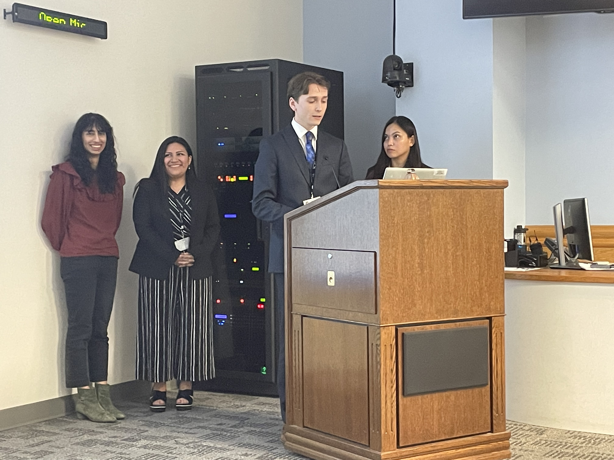
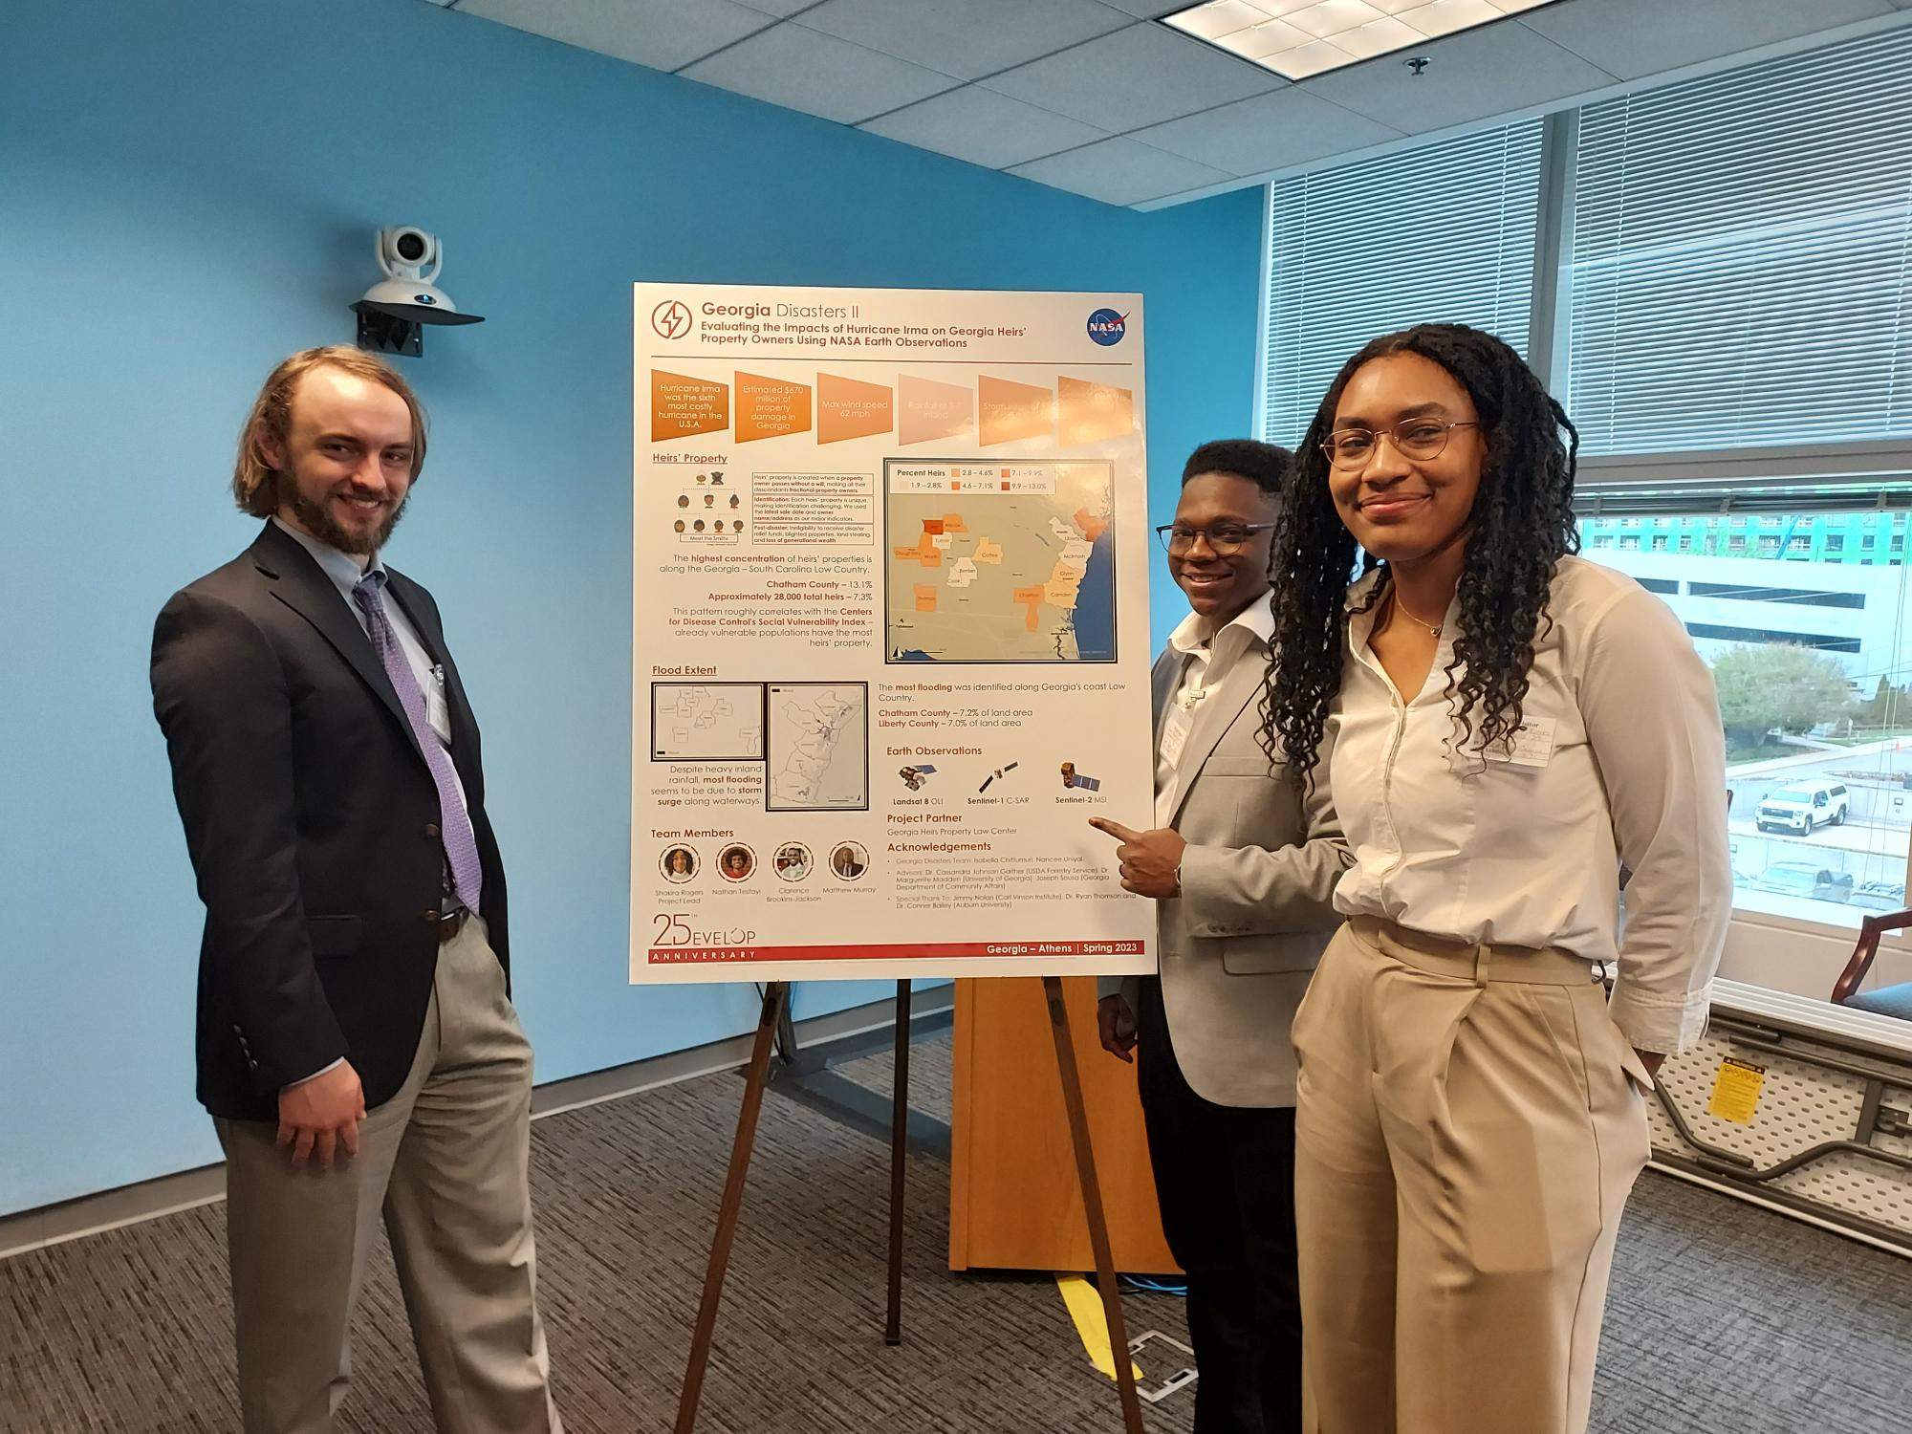
PARTICIPANT & TEAM RESPONSIBILITIES
External Communications
A single DEVELOPer per team (usually the Project Lead) typically serves as the main point of contact to NPO, science advisors, and partners through email communication, leading project-related telecons, and coordination of team meetings.
Emails relating to your DEVELOP projects and being sent to international recipients should be reviewed by your Lead/Fellow & NPO, if necessary, before they are sent outside of DEVELOP.
CC your Fellow when sending ALL project-related emails – this ensures continuity of communication and knowledge after the project ends.
All participants should check their Space Systems-provided email each workday.

Slide 13
PARTICIPANT & TEAM RESPONSIBILITIES
Participant Reporting
Personal Growth Assessments: Two online assessments that collect information relating to participant skill levels and expectations, provide valuable feedback to nodes and the program.
  Entrance Assessment – week 1
  Exit Assessment – week 10
Program Feedback: An online survey which serves as DEVELOP’s performance review and allows for a national perspective on the program, leadership, and advisors. It helps DEVELOP evolve and improve, and we value your input greatly!
  Link emailed – week 10
Performance Reviews: DEVELOP’s main objective is to assist participants in developing both professionally and personally. Part of this process is giving feedback in performance reviews at the middle and end of the term. Please consider this process constructive and take any feedback as goals for improvement.
  Midterm Review – typically week 5 or 6
  End of Term Review – typically week 9 or 10
Alumni Survey: Periodically, DEVELOP reaches out to alumni to see where they are working and assess the impact DEVELOP had on their career and career fields that participants progress into. We look forward to surveying you in the near future! Before you leave this term, please make sure that DEVELOP has the best email address to reach you.
Time Sheets: Each day you must complete your time sheet. At the end of each pay period, you will sign your timesheet electronically and email your Fellow a copy of your time sheet.

Slide 14
PARTICIPANT & TEAM RESPONSIBILITIES
Professionalism
Professionalism is “the conduct, aims, or qualities that characterize or mark a profession or a professional person.”
DEVELOP is an opportunity for all participants to improve in their professionalism.
Characteristics of professionalism:
Reliable
Competent
Ethical
Poised
Organized
Mindful
Polite
Orderly Appearance
Calm Demeanor
Good Written & Oral Correspondence
Accountable
By The Way
Why? DEVELOP’s signature is that of professionalism and respect. We respect ourselves, our partners, and NASA. We go above and beyond. We stand out from our peers. We strive for excellence in all things we do.

Slide 15
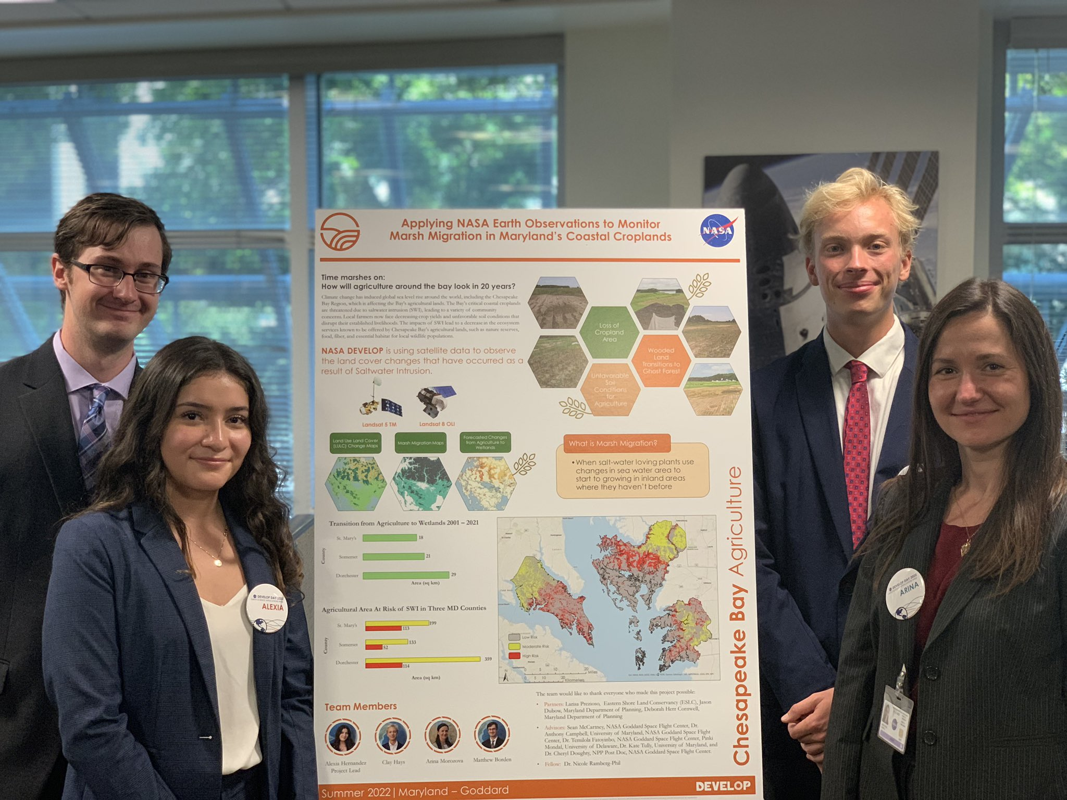
PARTICIPANT & TEAM RESPONSIBILITIES
Dress Code
Whether you’re working from home or in-person at a node, it’s important to represent the program well!
Pay special attention to dress when your team has in-person or video call meetings with partners, science advisors, and NPO! Make sure you are presenting yourself professionally.
Dress for success when working from home or in the office!!
Daily Dress Code = Business Casual
Shirts: Collared shirts, polo shirts, blouses, sweaters
Professional Presentations = Business Professional
Wear blazers or jackets for hand-off and closeout presentations
Follow the instructions and advice given by your DEVELOP Fellow when in doubt.

Slide 16
PARTICIPANT & TEAM RESPONSIBILITIES
Pay & Taxes
Pay Scales
All participants are part-time, temporary employees of Space Systems
Participants are paid on a step scale based on applicant classification and education level.
Your classification and education level was self-identified in your application to the program.
  Classification = student, recent graduate, early/transitioning career professional
  Education level = degree held for non-students or current grade level for students
Some remote work locations have locality adjustments – these are set by the federal government based on cost of living in specific geographic areas.
To qualify for the next step pay rate, the participant must be currently taking classes or graduated at that grade level. Ex. a participant who finishes their sophomore year in May is only eligible to move to the next pay step in the fall once they begin taking junior level classes.
Taxes & Insurance
All necessary taxes will be withheld from your paycheck based on your tax enrollment forms
Foreign nationals who are from countries that do not have a tax treaty with the United States will see an automatic 30% of their payment withheld by their funding organization and sent to the IRS. To see which countries have tax treaties with the IRS website.
It is your responsibility to have the appropriate health and medical coverage. Space Systems does not provide insurance coverage for temporary employees during the 10-week term.

Slide 17
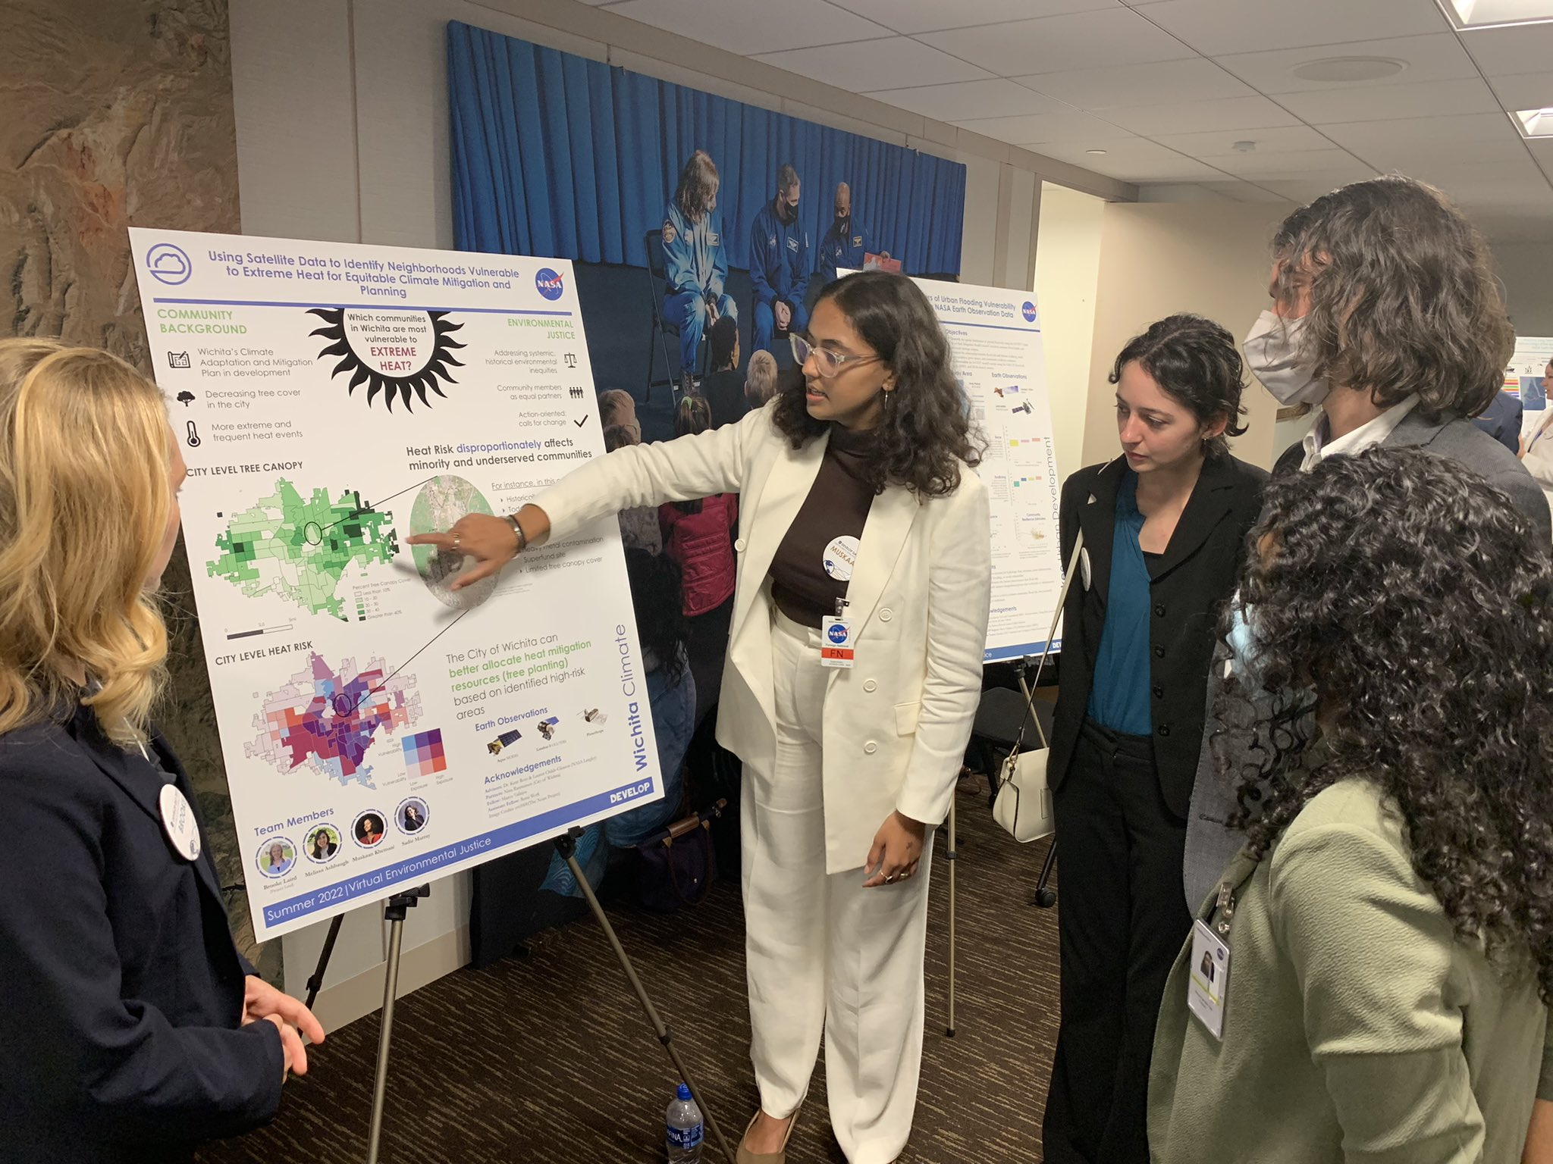
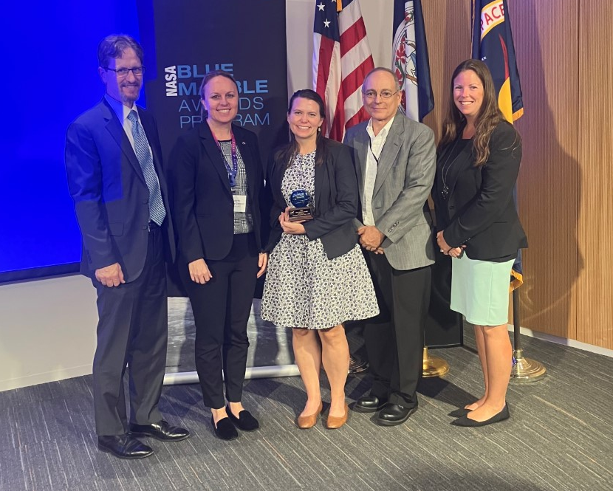
LEADERSHIP STYLES
As a DEVELOPer, you are a leader!
All DEVELOPers help lead the program to success by taking on leadership of specific tasks and serving in different leadership roles as needed
Lead with a style that fits you, fits the situation, and fits the group
Consider what leadership role you will fill in each situation:
There are 4 leadership roles:
                Designated Leadership
                Self Leadership
                Active Followership
                Peer Leadership
At any time in DEVELOP, you can be a leader, but only sometimes will you be a “designated leader.”
Notes:
As you learn how to work with your team members and execute your project, it’s imperative to not lose sight of what it means to be a leader within DEVELOP.
There are many leadership opportunities across DEVELOP – from leading a specific analysis or task of the project to leading a node
Lead with a style that fits you, fits the situation, and fits the group
There are four leadership roles to understand: designated leadership, self leadership, active followership, and peer leadership.
The designated leader is the head architect in a group and guardian of the group process. They can delegate tasks and decisions, but can’t abdicate responsibility or accountability. This is not your project lead...It can be, but in the day-to-day of DEVELOP, there is no hierarchy on the team….
Self leadership is leadership through character and judgment. All members lead by virtue of who they are and how they influence others, not just the positions they hold, and this has a huge influence on group dynamics. This includes taking responsibility for yourself, being kind and inclusive of others, and helping the group….
Active followership is when group members show good leadership by following the leadership of others, participating in the group process, modeling good team behavior, and supporting the leader by engaging and respecting others.
Peer leadership is when each person sees what needs to be done and takes the initiative to do it, without a hierarchy. This also works best when members communicate general expectations and clarify who is responsible for what. If something needs to be done, do it, and if others aren’t pitching it, talk about it.

Slide 18
LEADERSHIP STYLES
Project Leads: Common Misconceptions
Project Leads do not…
Do more work or work more hours than other team member
  Project Leads are also participants and have the same participant role, just different tasks within the role
Tell team members what to do each day
  Project Leads are in charge of project organization. This means occasional delegation, but it does not mean daily oversight. If they need to delegate, they should check in with the team about who wants to do what, then helping keep the team accountable as they work.
Pick up slack if other team members are struggling
  DEVELOP isn’t always easy! Your team should be communicating together about workloads and supporting each other when things get stressful.
By the way:
Project Leads are not the "designated" leader.
Notes:
Many teams within DEVELOP have a Project Lead. It’s important that everyone—team members, Fellows, and project leads themselves—are aware of what this means and doesn’t mean. Above all else, it’s important to remember that PLs are still participants and it’s not an elevated role within the team. In other words, PLs are not the designated leader of the team.

Slide 19
LEADERSHIP STYLES
The Responsibilities of a Project Lead
Project Leads do…
                Serve as the primary point of contact, team liaison
                Write and send emails on behalf of their team (varies by node)
                Provide project/team updates to Fellows
                Ensure the team completes and submits all deliverables on time
                Foster a productive team dynamic and work environment
                Empower and support team members
Important!
Project Leads responsibilities can vary by node. Check with your Fellow to make sure everyone is on the same page.

Slide 20
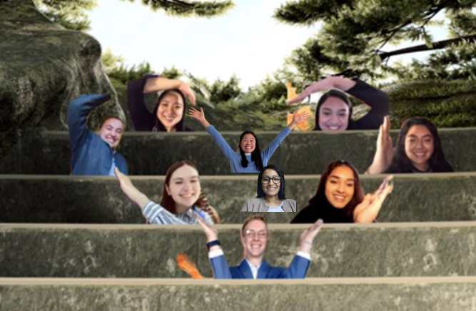
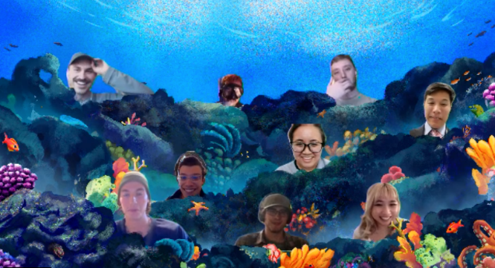
PERSONALITIES
Virtual Teams
Make sure to keep communication lines open during work hours and be responsive to virtual communications: Teams, email, texts, etc.
Ensure that all virtual interactions are positive, thoughtful, and respectful
Use your camera during video calls to help with non-verbal communication
Technical difficulties will happen! Just troubleshoot as best you can
Remember you are representing NASA, CBP, DEVELOP, your team, and yourself in all interactions
In addition to scheduled partner calls, advising calls and node calls, how do you want to work together as a team?
  Does our team want to stay on a call all day?
  Do we meet up throughout the day as need arises?
  Or do we meet only during scheduled times?
Camera best practices position your camera at/around eye level, minimize background distractions, make sure what’s behind you is professional (not unmade beds or dirty laundry piles), assess lighting – being front-lit is best

Slide 21

PARTICIPANT & TEAM RESPONSIBILITIES
What’s your Hogwarts House?
Getting to Know Y’all
Personality Assessments & Miscellanea
DEVELOP teams must form – storm – norm – perform in only 10 weeks! Part of working together is understanding each other and ourselves.
Personality assessments provides an opportunity for:​
Introspection: to understand your tendencies and motivations, strengths and weaknesses, and innate preferences​
Interpersonal skill development: recognize these traits in others​
Common language: provides terminology for identifying inherent nature​
Freedom: identifies inherent needs, and helps alleviate pressure, all so you can be accepted for just being you

Slide 22
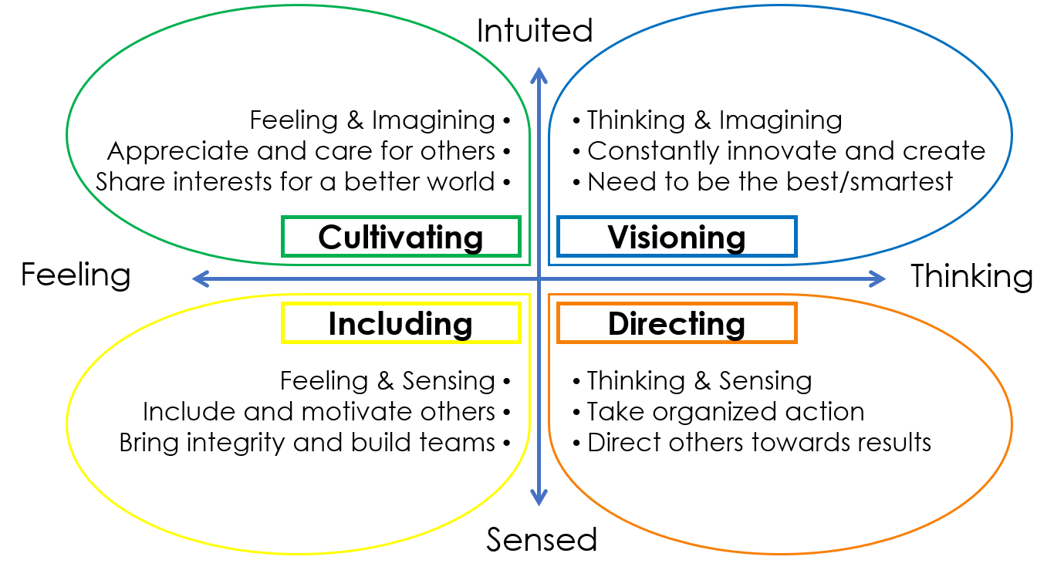
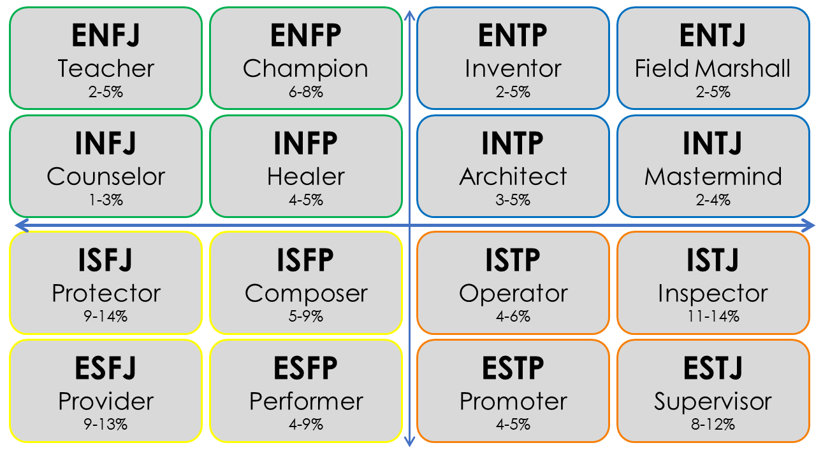
PERSONALITIES
Two Assessments
NASA 4D
Created to help science/engineering teams (like those at NASA) boost performance and avoid mistakes​
MYERS – BRIGGS TYPE INDICATOR
Created to put psychological theory to practical use - assisting women entering the WWII workforce with job selection

Slide 23
PERSONALITIES
Myers-Briggs Type Indicator (MBTI)
16 personalities based on four dimensions of personality
Four dichotomies
Attitude
Where do we get our energy?
Extroversion
(E)
Introversion
(I)
Information Gathering
How do we take in our information?
Intuiting
(N)
Sensing
(S)
Decision-Making
How do we make our decisions?
Thinking
(T)
Feeling
(F)
Lifestyle
How do we organize our world?
Judging
(J)
Perceiving
(P)

Slide 24
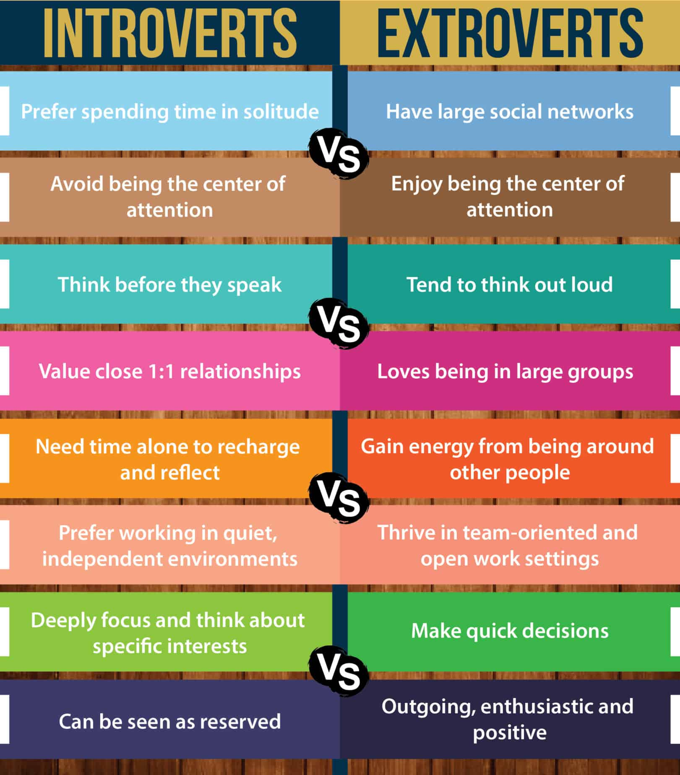
PERSONALITIES
Extroversion (E) & Introversion (I)
Where do you get your energy?
Extroverts recharge and get energy from spending time with people
Introverts recharge and get energy from time spent alone
Ambiverts- in the middle

Slide 25


PERSONALITIES
Sensing (S) & Intuition (N)
How do you take in information?
Sensing trusts information that is concrete, tangible, present (info collected by your senses)
  Experiences
  Details and facts
Intuition trusts information that is abstract and theoretical
  Concepts
  Future possibilities & big picture

Slide 26

PERSONALITIES
Thinking (T) & Feeling (F)
How do you make your decisions?
Thinking people make their decisions more objectively, measuring what is reasonable, logical, and matching a given set of rules
  Value truth, fairness and honesty
  Motivated by achievement
Feeling people make their decisions more based on measuring from the inside and associating or empathizing
  Value harmony, peace, and compassion
  Motivated by appreciation

Slide 27
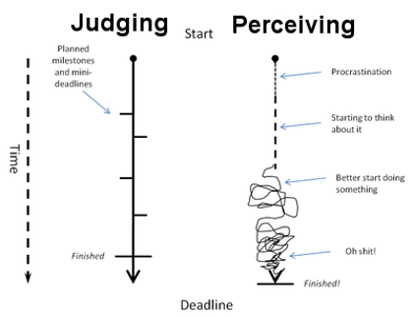
PERSONALITIES
Perceiving (P) & Judging (J)
Judging people like to have things settled, pay close attention to time, and find comfort in schedules and organization
  Work in a task-oriented, steady pace
  Typically plan work to avoid rushing before a deadline
Perceiving people tend to be more spontaneous, less aware of time, and find comfortability in flexibility and freedom
Work in bursts of energy
Motivated by approaching deadlines

Slide 28

PERSONALITIES
NASA 4D Personality Types
Developed by Charles Pellerin
Uses a foundation of MBTI but refines personalities into four types
Applicable to individuals and organizations
Created to help science/engineering teams at NASA boost performance and avoid mistakes
Green
"Cultivating" People Builders
Yellow
"Including" Team Builders
"Directing" System Builders
Blue
"Visioning" Idea Builders
Orange

Slide 29
PERSONALITIES
NASA 4D
Intuited
Created to help scientific teams to collaborate and work together more effectively
Four quadrants / types named by color
Feeling & Imagining
Appreciate and care for others
Share interests for a better world
Thinking & Imagining
Constantly innovate and create
Need to be the best/smartest
Cultivating
Visioning
Feeling
Thinking
Including
Directing
Feeling & Sensing
Include and motivate others
Bring integrity and build teams
Thinking & Sensing
Take organized action
Direct others towards results
Sensed

Slide 30
PERSONALITIES
NASA 4D & Myers-Briggs
ENFJ
Teacher
2-5%
ENFP
Champion
6-8%
ENTP
Inventor
2-5%
ENTJ
Field Marshall
2-5%
INFJ
Counselor
1-3%
INFP
Healer
4-5%
INTP
Architect
3-5%
INTJ
Mastermind
2-4%
ISFJ
Protector
9-14%
ISFP
Composer
5-9%
ISTP
Operator
4-6%
ISTJ
Inspector
11-14%
ESFJ
Provider
9-13%
ESFP
Performer
4-9%
ESTP
Promoter
4-5%
ESTJ
Supervisor
8-12%

Slide 31
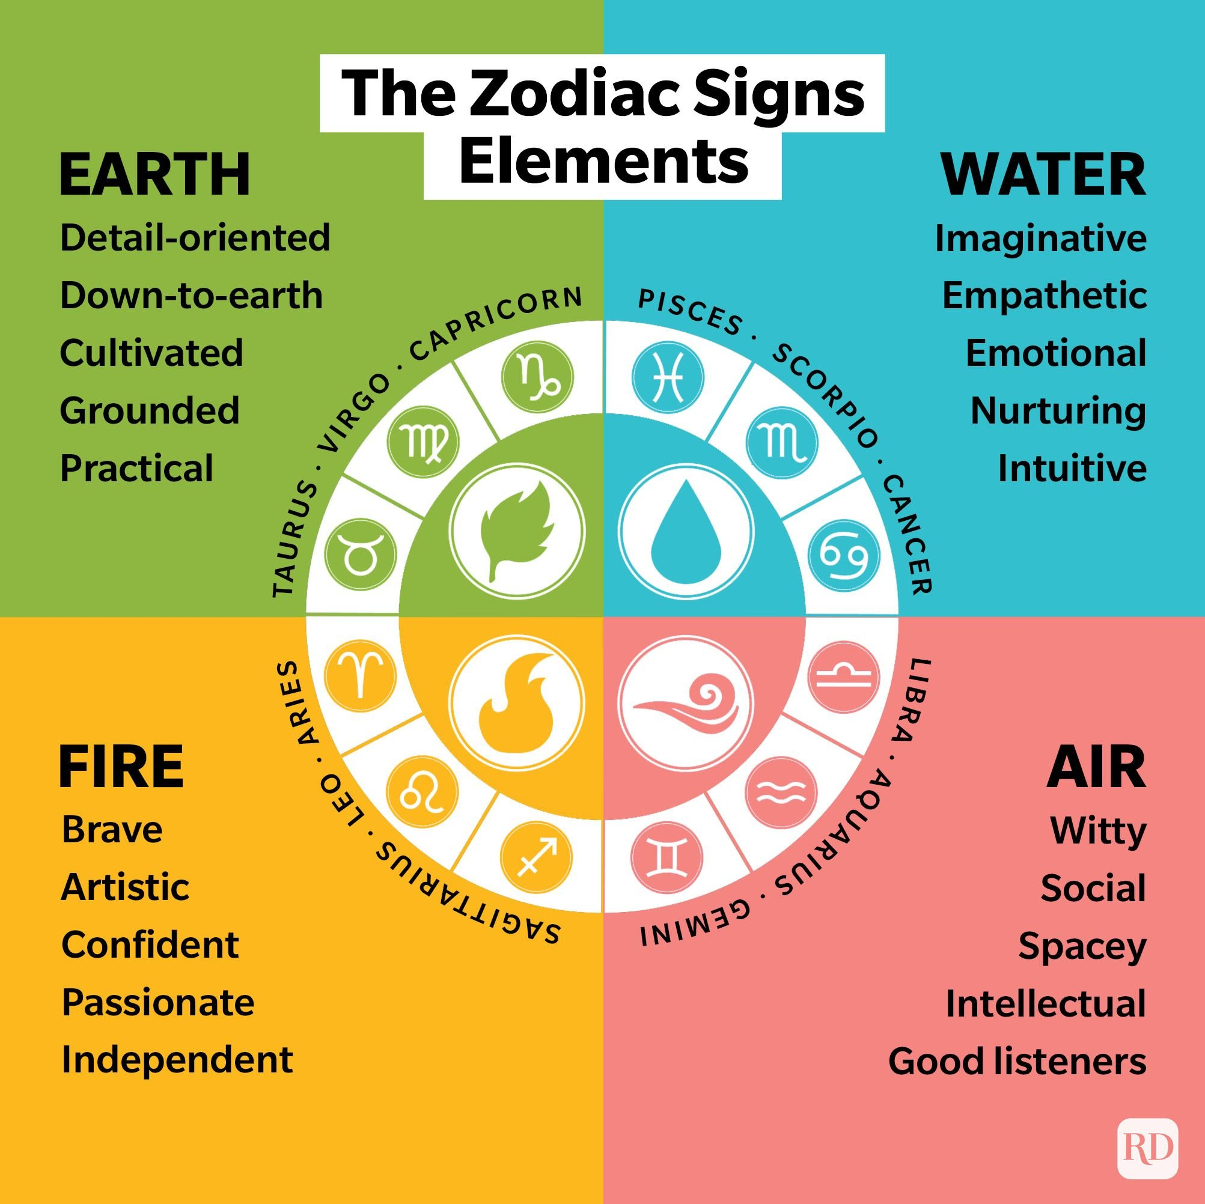
PERSONALITIES
What’s your sign?
Astrology
Are you an Earth, Water, Fire, or Air sign?
Aries | March 21 - April 20
Taurus | April 21 - May 21
Gemini | May 22 - June 21
Cancer | June 22 - July 22
Leo | July 23 -August 23
Virgo | August 22 - September 22
Libra | September 24 - October 23
Scorpio | October 24 - November 22
Sagittarius | November 23 - December 21
Capricorn | December 22 - January 20
Aquarius | January 21 - February 19
Pisces | February 20- March 20

Slide 32

PERSONALITIES
Practical Applications of Getting to Know Each Other
What else could be true?
Compassion – Perspectives and work styles naturally differ, there is no “correct” type for a DEVELOP participant
Flexibility – These assessments are guides that help facilitate discussion. Many people do not identify with their given “types” and that is ok
If you notice your teammates...
Don’t ask questions verbally on calls
Ask all the questions and lead the conversation
Ask for constant updates on progress
Don’t share progress until a task is done
…consider approaching this from a compassionate and flexible perspective.

Slide 33

PERSONALITIES
Things Happen! Issues Will Arise!
Amanda/Stephanie
Make all efforts to maintain a positive work environment.
Be kind to each other and have empathy!
Participants can feel comfortable coming to their Fellow or reaching out to Amanda Clayton or Stephanie Burke.
If you would like counseling for how to respond to a specific situation, reach out to Stephanie Burke.
#1 – Do not send emails about the situation – remember that NASA/SSAI emails are NOT private. Should a personnel issue arise, immediately and verbally communicate the situation up the chain.
Microsoft Teams chats are also NOT private (even if it’s only your team on it)
Fellow
Participant

Slide 34
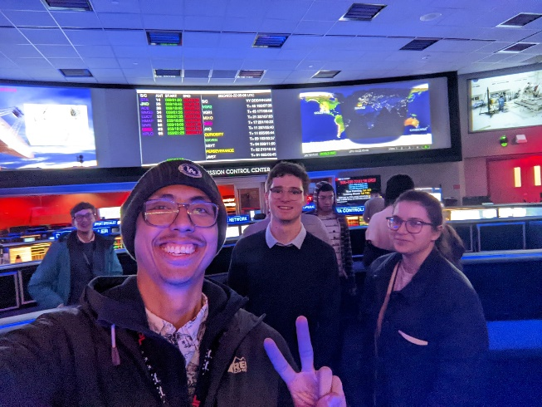
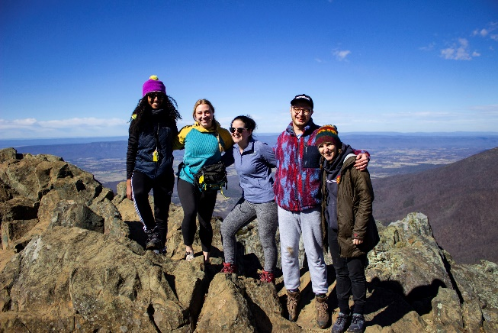
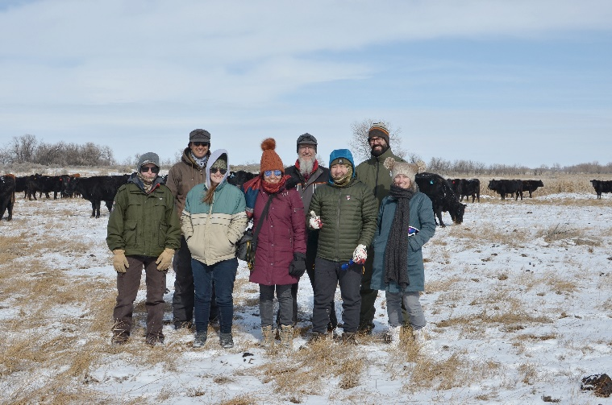
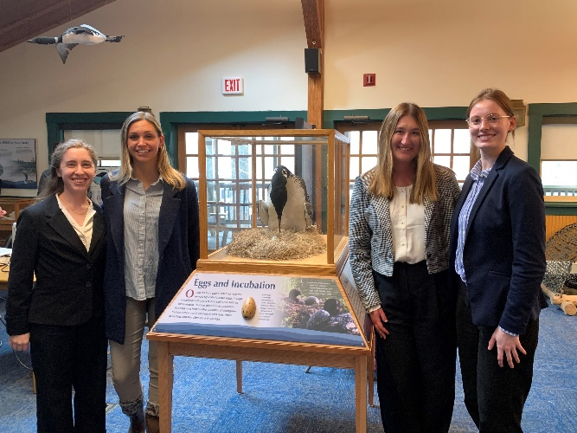
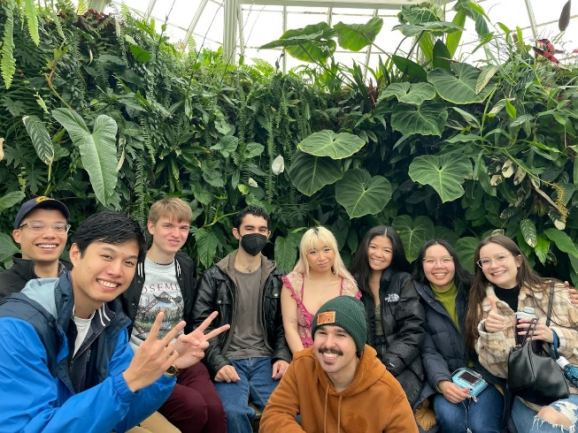
PERSONALITIES
Keep in Mind
Our personalities and life experiences influence our approach to work and how we work with others
It’s important to identify our personality styles and recognize potential personality trait conflicts and find balance
Remember, your team members are your coworkers, and are your future network, treat them as such!

Slide 35
PARTICIPANT & TEAM RESPONSIBILITIES
Tips for Success
Professional Development
Build your résumé
Teamwork is key
Keep track of deadlines
Explore opportunities
Be flexible and on time
Follow the rules
Stay organized
Demonstrate integrity
Network! Network! Network!
Technical Development
Have an open mind
Be innovative
File management is key
Nomenclature matters
Never plagiarize
Be ready to present any moment
Accept that things change
Expect the unexpected
Personal Development
Learn from those around you
Maintain a positive attitude
Promote harmony
Try new things
Go above and beyond
Help and encourage others
Be mindful and respectful
Have fun

Slide 36
PARTICIPANT & TEAM RESPONSIBILITIES
Quiz Time
Is it ok to use your teammate’s account log-in when you can’t get access?
How often should you complete your time sheet?
What should DEVELOPers wear if giving a formal presentation?
Can you expect privacy when using a government computer OR when emailing a government email address?
What are the 4D types?

Slide 37

Thank You.
Teamwork is dream work!
“Be excellent to each other!”
--- William Preston & Theodore Logan ---

