Slide 1
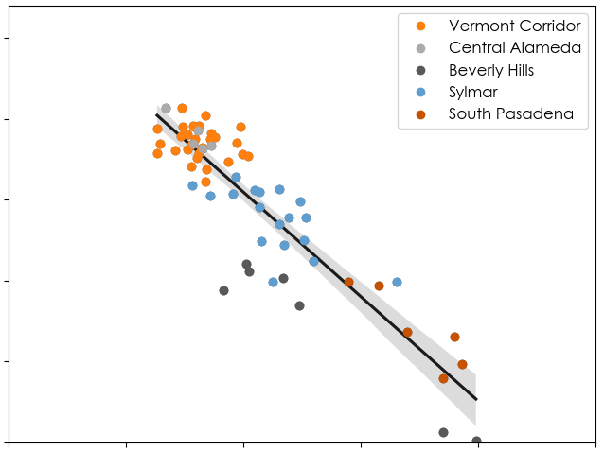
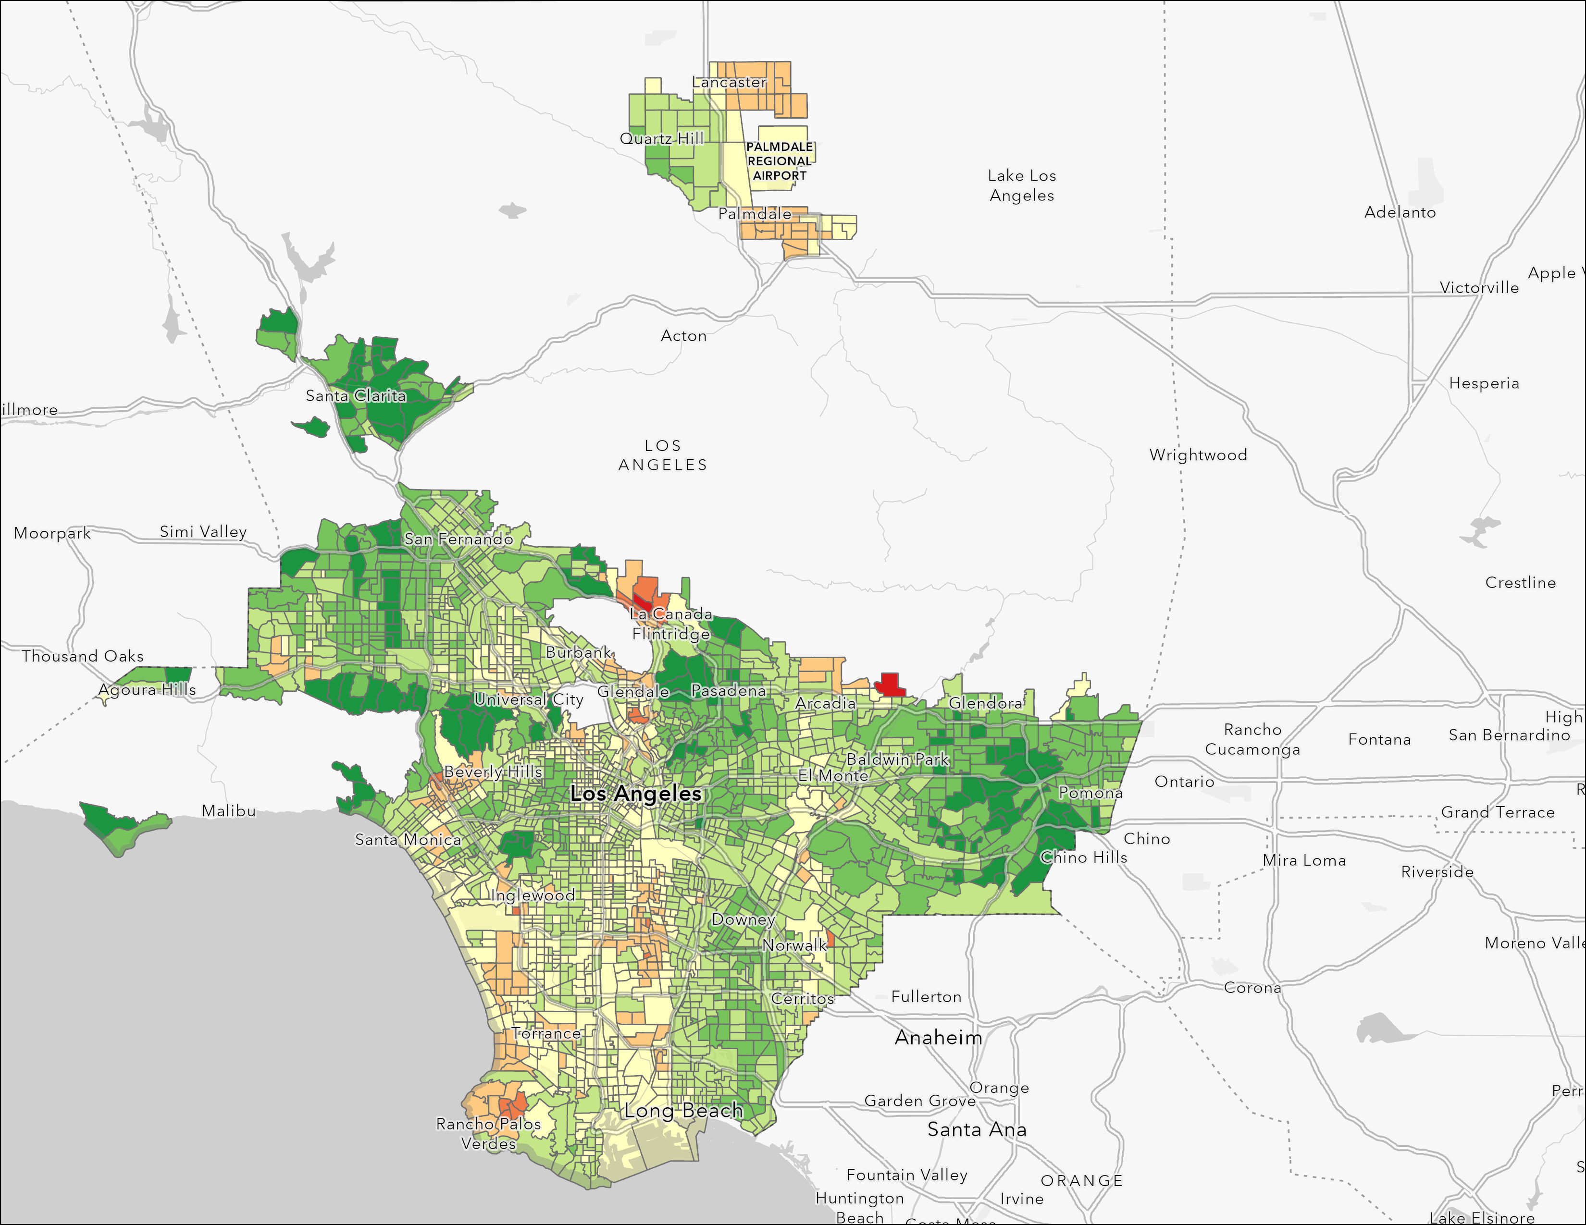
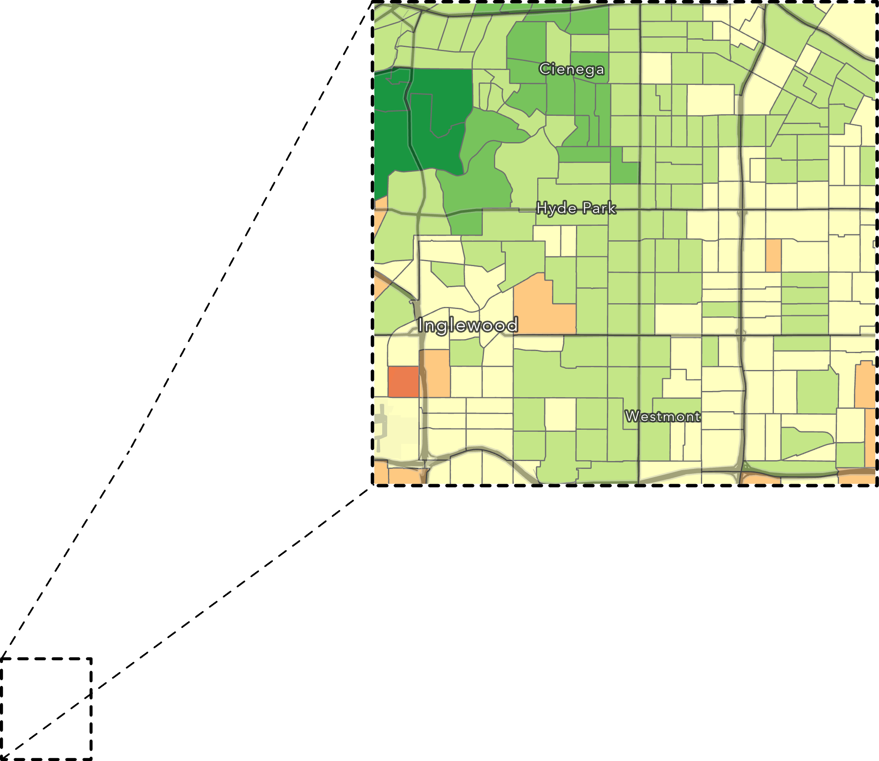
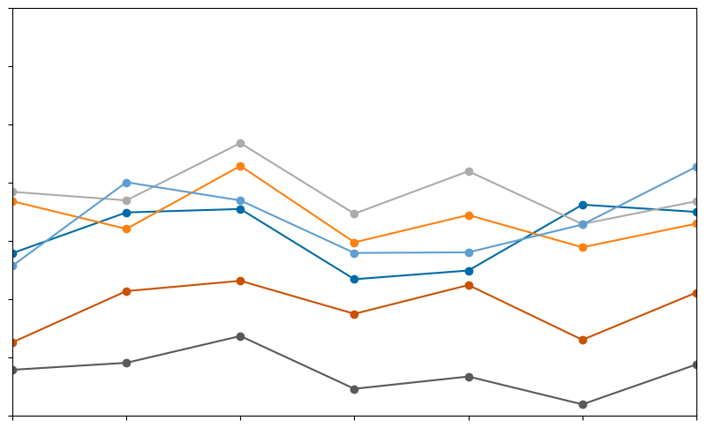
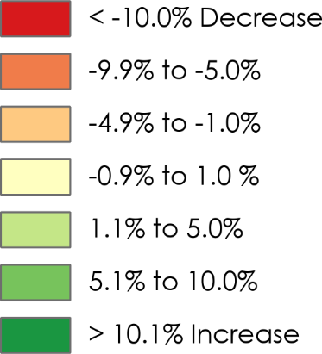
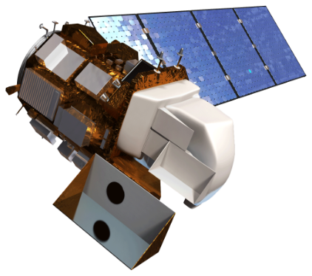
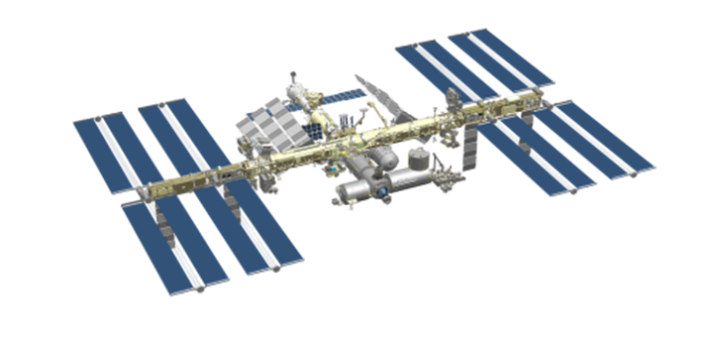
Los Angeles Urban Development
Utilizing NASA Earth Observations to Evaluate the Impact of Tree Coverage on Urban Heat Mitigation
In recent decades, Los Angeles, California has experienced an increase in summer temperatures that has intensified the urban heat island effect. The expansion of developed areas has contributed significantly to this phenomenon by trapping and reradiating heat, posing dangerous health risks to residents. To mitigate this problem, organizations including City Plants and the L.A.’s Office of City Forest Management have implemented initiatives to promote urban greening and tree planting, which help cool down vulnerable communities. In collaboration with these partners, NASA DEVELOP has undertaken a study to investigate the role of trees in urban environments and their effectiveness in reducing local urban heat islands.
COMMUNITY CONCERNS
Increasing
Temperatures
Urban Greening
Social & Health Vulnerability
Future Interventions
The Vermont Corridor Project planted over 600 trees along Vermont Ave and increased tree canopy cover by up to 5% in the community
The study of five distinct regions in L.A. indicates a strong correlation between temperature and the presence of vegetation cover
125
Vermont Corridor
Central Alameda
Beverly Hills
Sylmar
South Pasadena
120
Tree Canopy Cover Change by Census Tract 2016-2022
115
Average Summer 2016
Land Surface Temperature (◦F)
110
105
100
0.2
0.3
0.4
0.5
0.0
0.1
0 0.5 1 2 Miles
Vegetation Cover Summer 2016
(Normalized Difference Vegetation Index)
135
LA County
Vermont Corridor
Central Alameda
Beverly Hills
Sylmar
South Pasadena
Greener areas (such as South Pasadena and Beverly Hills) show consistently cooler summer temperatures
130
125
120
Average Summer Land Surface Temperature (◦F)
115
110
105
100
2017
2018
2019
2020
2021
2022
2016
Year
Looking Ahead
NASA Earth Observations
Explore the impacts of additional tree planting programs in Los Angeles, as well as extending these efforts to other cities worldwide
L.A.’s Green New Deal includes planting 90,000 trees by 2028 in low-income areas with the least shade
Investigate additional benefits that tree planting programs provide to communities beyond heat mitigation
Landsat 8 (OLI & TIRS)
ISS (ECOSTRESS)
Team Members
Acknowledgements
Advisors: Dr. Anamika Shreevastava, Dr. Glynn Hulley, Benjamin Holt (NASA Jet Propulsion Laboratory, California Institute of Technology)
Fellow: Michael Pazmino
Leyla Namazie
Project Lead
Julie Gevorgian
Theo Ross
Stephanie Hernandez
Project Partners
City Plants
City of Los Angeles, Department of Public Works, Office of City Forest Management
California – JPL

