Slide 1
SOUTHERN CALIFORNIA
Health & Air Quality
Using Remote Sensing to Detect the Frequency and Drivers of Red Tide Blooms in California to Assist in the Management of Human and Marine Exposure to Algal Toxins
Michael Enz, Petra Nichols, Maya Zimmerman, Melanie Leung, Jonathan Van Dermark
California – Ames
Notes:
(SPEAKER NAME) SCRIPT: Michael
Hello everyone and thank you for joining us today. We are the Fall 2021 Southern California Health & Air Quality team. My name is Michael and I am joined by my incredible team: Petra Nichols, Maya Zimmerman, Melanie Leung, and Jonathan Van Dermark. We are excited to share a little bit about our project this term, including our methods and our notable results and findings regarding the use of Remote Sensing to Detect the Frequency and Drivers of Red Tide Blooms in Southern California.

Slide 2
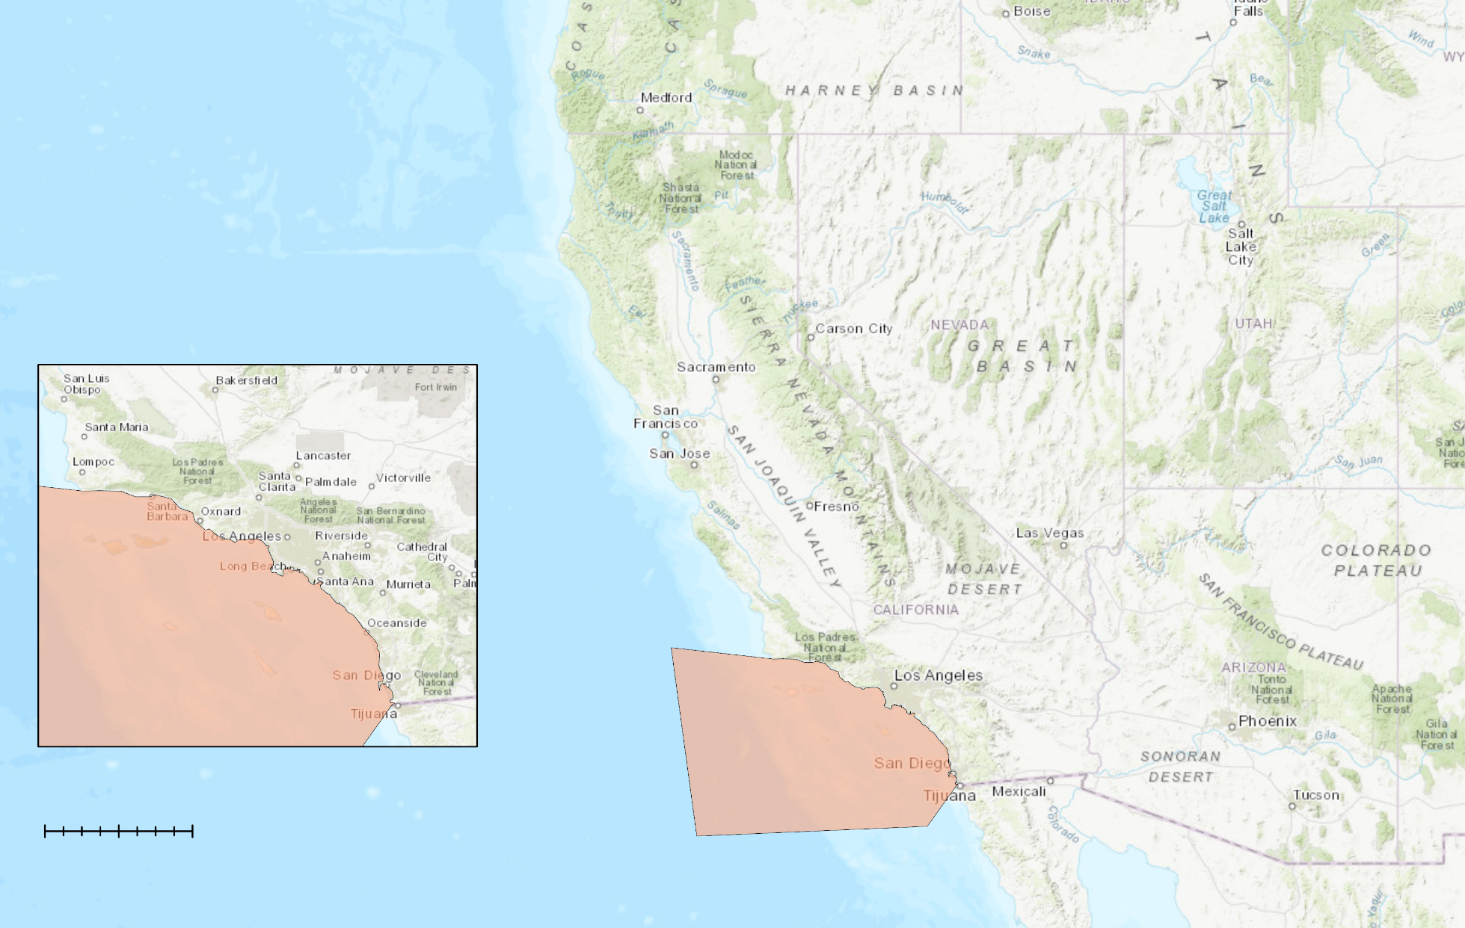
STUDY AREA & PERIOD
N
Study Period:
January 2010 - November 2021
Focus:
April 16th - May 20th 2020
Kilometers
0
300
Southern California Coastal Zone
Study Area
Notes:
(SPEAKER NAME) SCRIPT: Michael
For this project, we focused on the Southern California coastal zone, which spans from Santa Barbara, CA down to the California border with Mexico. Annually, millions of beachgoers partake in activities along this coast, both recreational and economic, which can directly expose them to the impacts of harmful algal blooms, and more particularly red tide events. (California Department of Public Health, 2020).
Recently, there has been an observed increase in the frequency of algal bloom events along this coast. Because of this, it has become crucial for government agencies to gain an understanding of harmful algal bloom dynamics in order to protect the health and wellness of the coastal communities, including both the people and the wildlife.
The main tools that we created for this project focus on and analyze historic trends of harmful algal blooms in the study area from 2010 to 2021. More specifically, we performed a sub-analysis across various satellite imagery data from April to May of 2020, which was a period of known bloom presence.
------------------------------Image Information Below ---------------------------------
Study area map created by team
Basemap: ESRI “World Topographic Map”, ArcGIS Pro

Slide 3
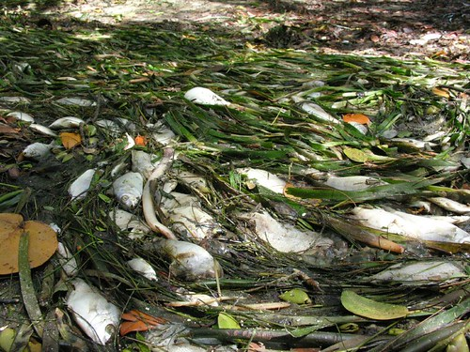
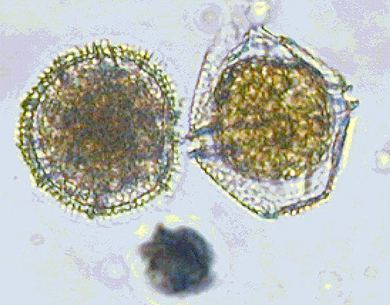
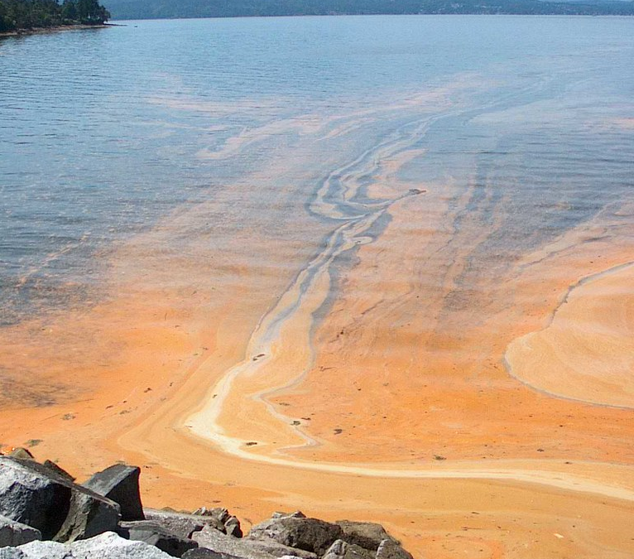
INTRODUCTION: Lingulodinium polyedra
Highest-ever concentration of Lingulodinium polyedra
measured at Scripps Pier, CA in 2020
Lingulodinium polyedra contains
high levels of dangerous
Yessotoxins
Image Credit: Thesix, Heal the Bay, Chris Wiley
Notes:
Michael:
Red tide blooms are a naturally occurring oceanic process, in which pigmented algae exhibits overwhelming and uncontrolled growth. In some cases, these thick blooms of algae like those seen on the right hand image have the ability to create murky, oxygen-sparse hypoxic marine conditions that can choke the life out of the creatures living within it. The image on the left, shows the destruction that these kinds of red tide blooms can bring with them.
While harmful algal blooms can be caused by both dinoflagellate, like those seen in the middle image, and diatom algae species, for this project we will be focusing on a specific dinoflagellate species, Lingulodinium polyedra, or L. polyedra.
L. polyedra is of particular interest because of it's production of yessotoxin, a dangerous neurotoxin.
In the spring of 2020, the Scripps monitoring pier in La Jolla, California, measured 9 million cells of L. polyedra per liter in water samples, the highest ever recorded. These unprecedented and record high levels make it essential to study this specific dinoflagellate and its impacts.
One way this is being done is through Satellite Remote Sensing, and the unique UV wavelength absorption characteristic that L. polyedra showcases, as we will discuss throughout this presentation.
For now, I will pass it over to Petra to talk about some of the negative implications these blooms are having on Coastal Communities.
------------------------------Image Information Below ------------------------------
Image Credit: Chris Willey
Image Source: https://search.creativecommons.org/photos/72fc34ab-d9f8-4e72-be77-3806a4d48e00. Licensed under CC BY-NC-ND 2.0
Image Credit: Thesix
Image Source: https://search.creativecommons.org/photos/4f266a63-aafa-4c60-8ad1-1dd034b2364f. Licensed under CC BY-NC-SA 2.0.
Image Credit: Heal the Bay
Image Source: https://search.creativecommons.org/photos/78503775-44cd-4708-8d2f-20399ee719f6. Licensed under CC BY-NC-SA 2.0

Slide 4
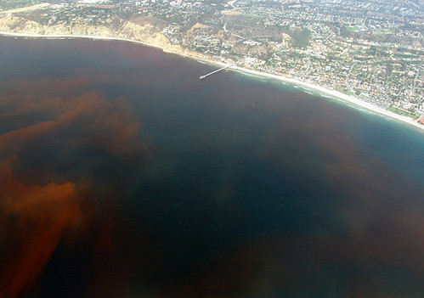
COMMUNITY CONCERNS
Human Health
Respiratory problems
Muscle paralysis
Ecosystem and Fish Health
Marine mammal mortality
Economy and Industry
Fishery closures
Beach closures
Skin irritation
Food-borne illness
Fish mortality events
Image Credit: eutrophication&hypoxia
Notes:
Petra SCRIPT:
Thanks Michael
High levels of harmful algae has the potential to cause marine life mortality, food-borne illness and aerosolized toxic algae which has been hypothesized to contribute to respiratory-related health risks in humans. The shift in ecosystem dynamics from harmful algal bloom like this can have wide reaching impacts and can lead to major changes in marine ecosystem dynamics that may be hard to recover from or even worse, may even be irreversible.
Beyond this, when a harmful algal bloom event (HAB) occurs, local fishing and tourism industries, and coastal recreational activities are impacted economically due to widespread fishery and beach closures.
------------------------------Image Information Below ------------------------------
Image Credit: Eutrophication and hypoxia
Image Source: https://search.creativecommons.org/photos/557a0a01-83f4-4428-8d59-acf256d6b6ed. Licensed under CC BY 2.0

Slide 5
PROJECT OBJECTIVES
Detect and monitor harmful algal blooms (HABs) using satellite imagery
Cross-validate remotely sensed bloom parameter data with in situ and GCOM-C data to assess validity of using satellite imagery for HAB detection
Generate interactive tools on Google Earth Engine and ESRI’s ArcGIS Dashboard
km
Notes:
Petra SCRIPT:
To contribute to the monitoring of red tide blooms and provide an educational and informative final product, our team:
Wanted to detect and monitor red tide bloom extents and movement over the last 20 years using NASA Earth observations.
Cross-validated remotely sensed NASA chlorophyll-a data with both in-situ and remotely-sensed harmful algal bloom data from the Japanese Aerospace Exploration Agency’s GCOM-C satellite.
And Generated two interactive tools, within Google Earth Engine and Esri's ArcGIS Dashboard.
------------------------------Image Information Below ------------------------------
Icon Source: Microsoft Suite/powerpoint

Slide 6
PARTNERS
Collaborators
University of California San Diego – Scripps Institution of Oceanography (SIO)
End-Users
National Oceanic & Atmospheric Administration (NOAA) – Southwest Fisheries Science Center (SWFSC)
California Department of Public Health (CDPH)
Office of Environmental Health Hazard Assessment (OEHHA)
Image Credit: NOAA
Notes:
Petra SCRIPT:
For this terms project we had 3 end users and 1 collaborator. We collaborated with the Scripps Institution of Oceanography to develop the research methods of this project. Additionally, we partnered NOAA’s Southwest Fisheries Science Center, the California Department of Public Health, and the Office of Environmental Health Hazard Assessment.
Now Melanie will talk about our data sources.
------------------------------Image Information Below ------------------------------
Image Source: NOAA Fisheries
Image Credits: https://commons.wikimedia.org/wiki/File:NOAA_Fisheries_logo_vertical.png. Public domain image.

Slide 7
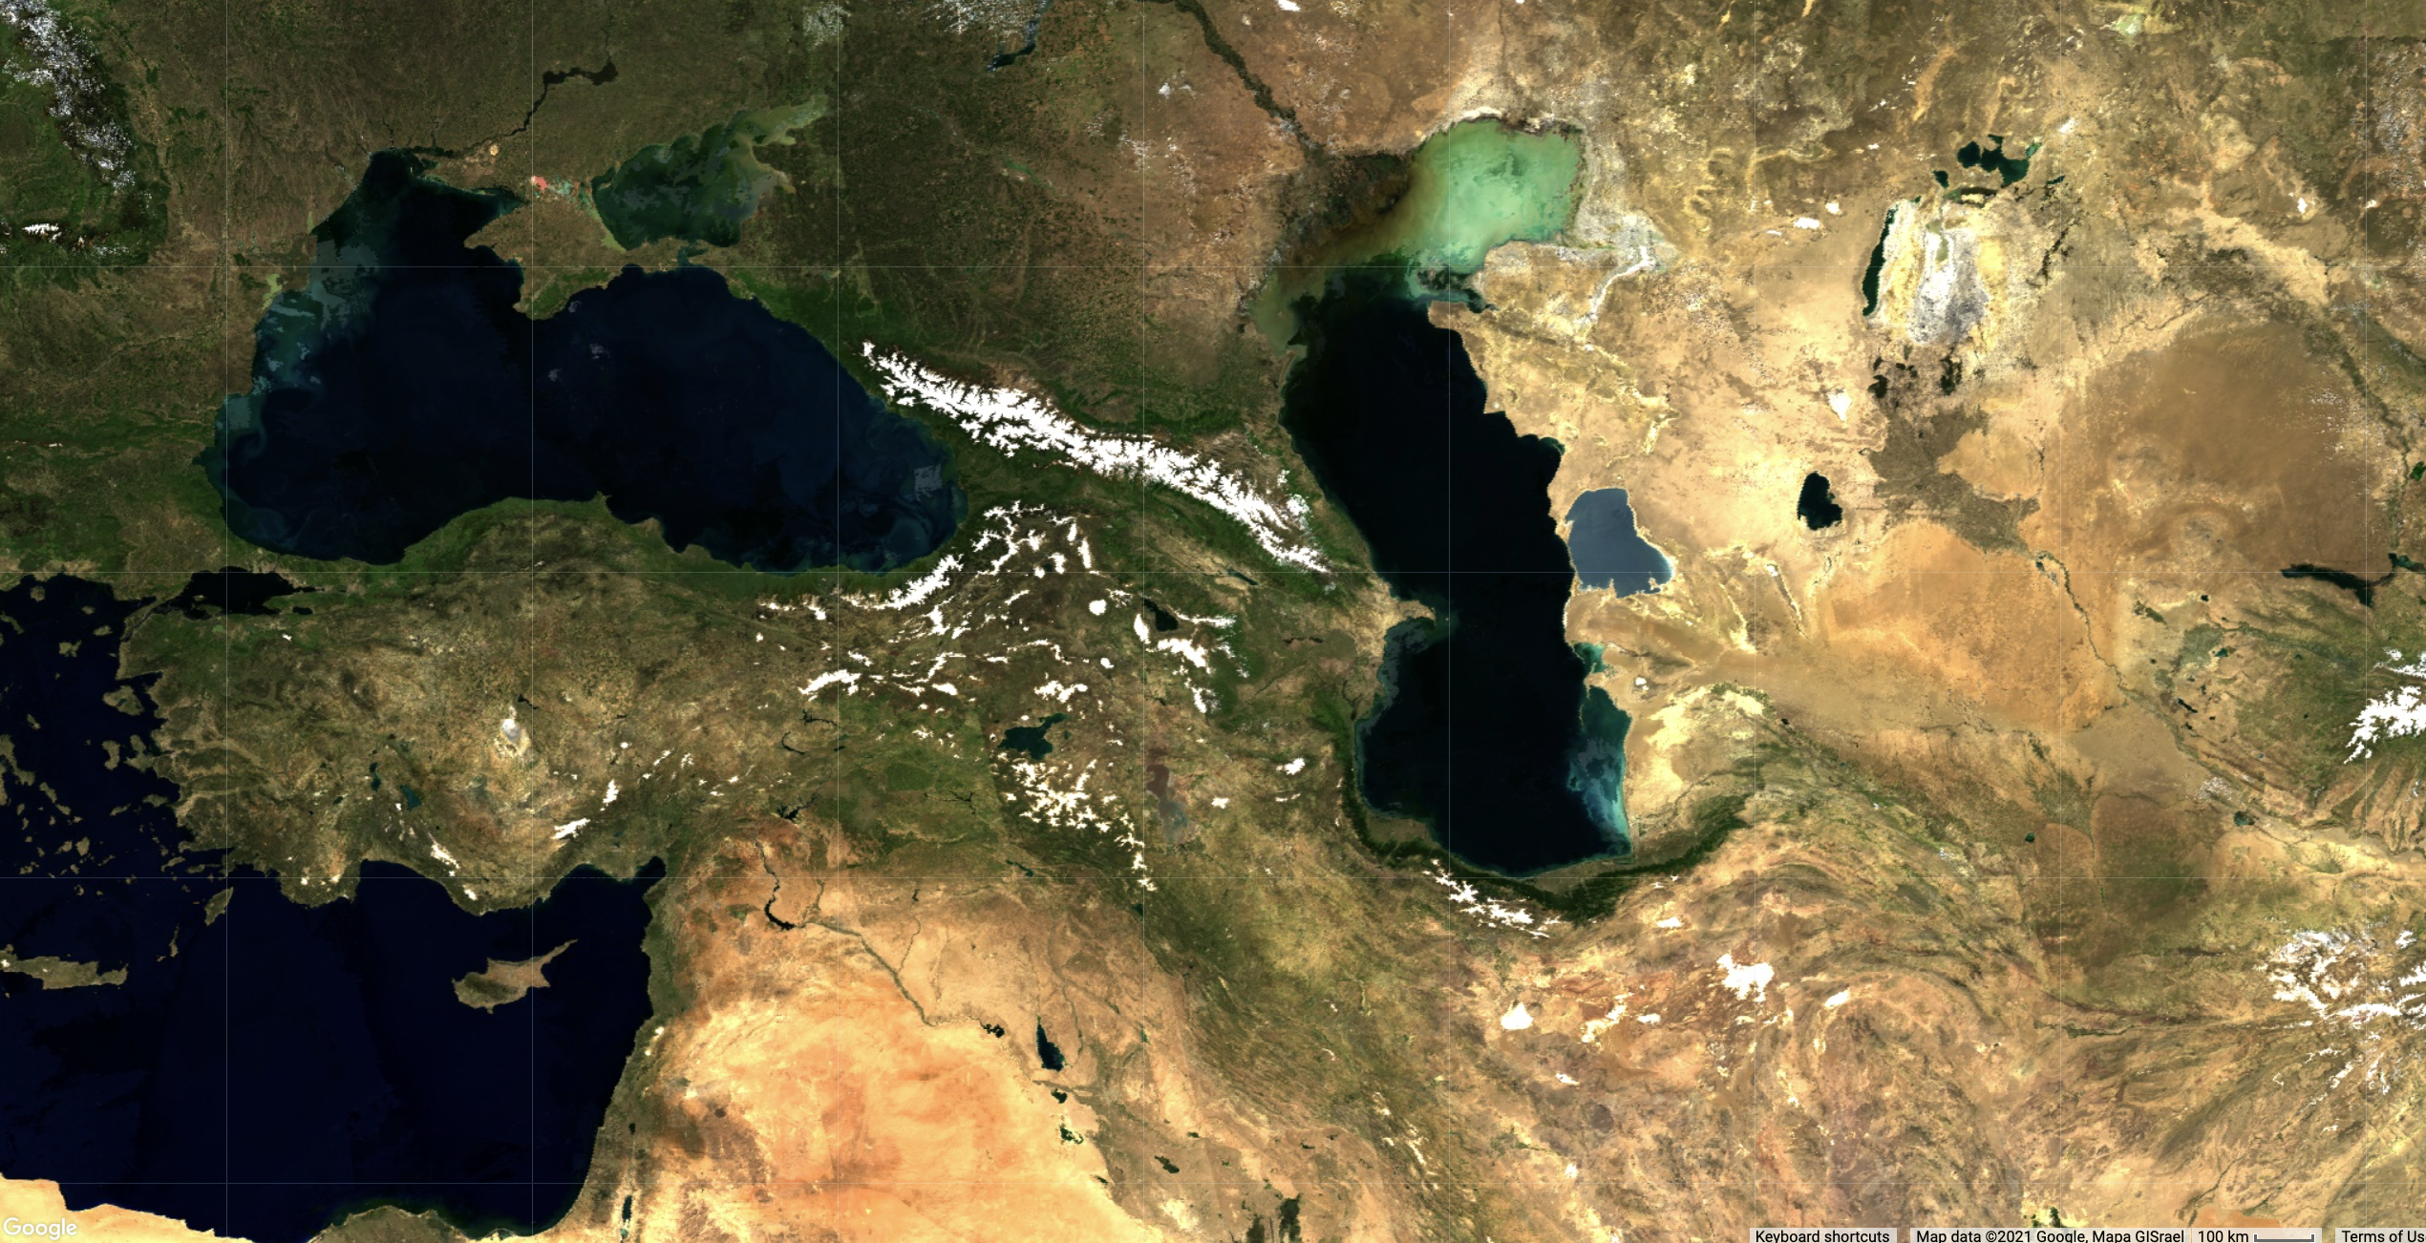
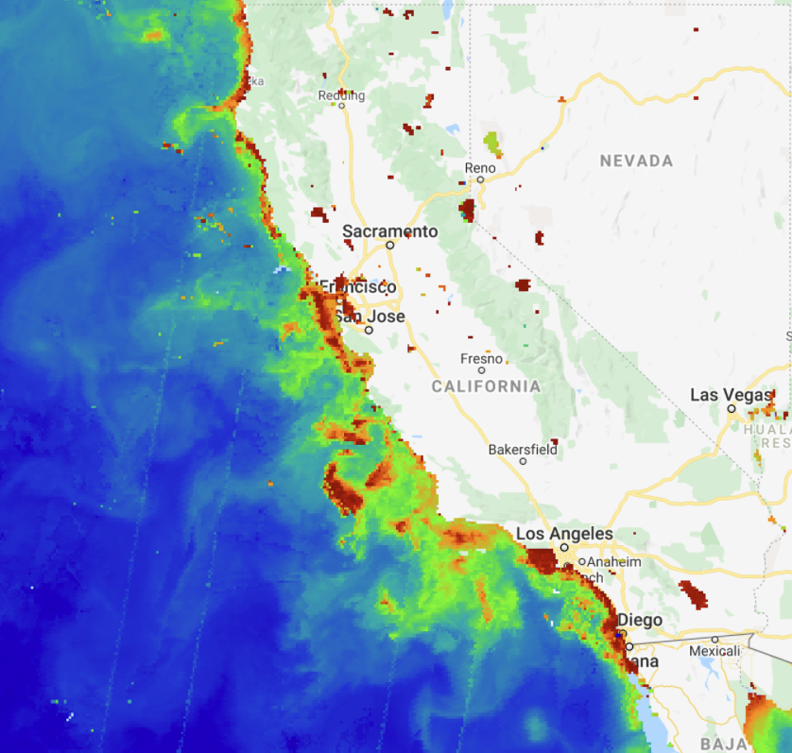
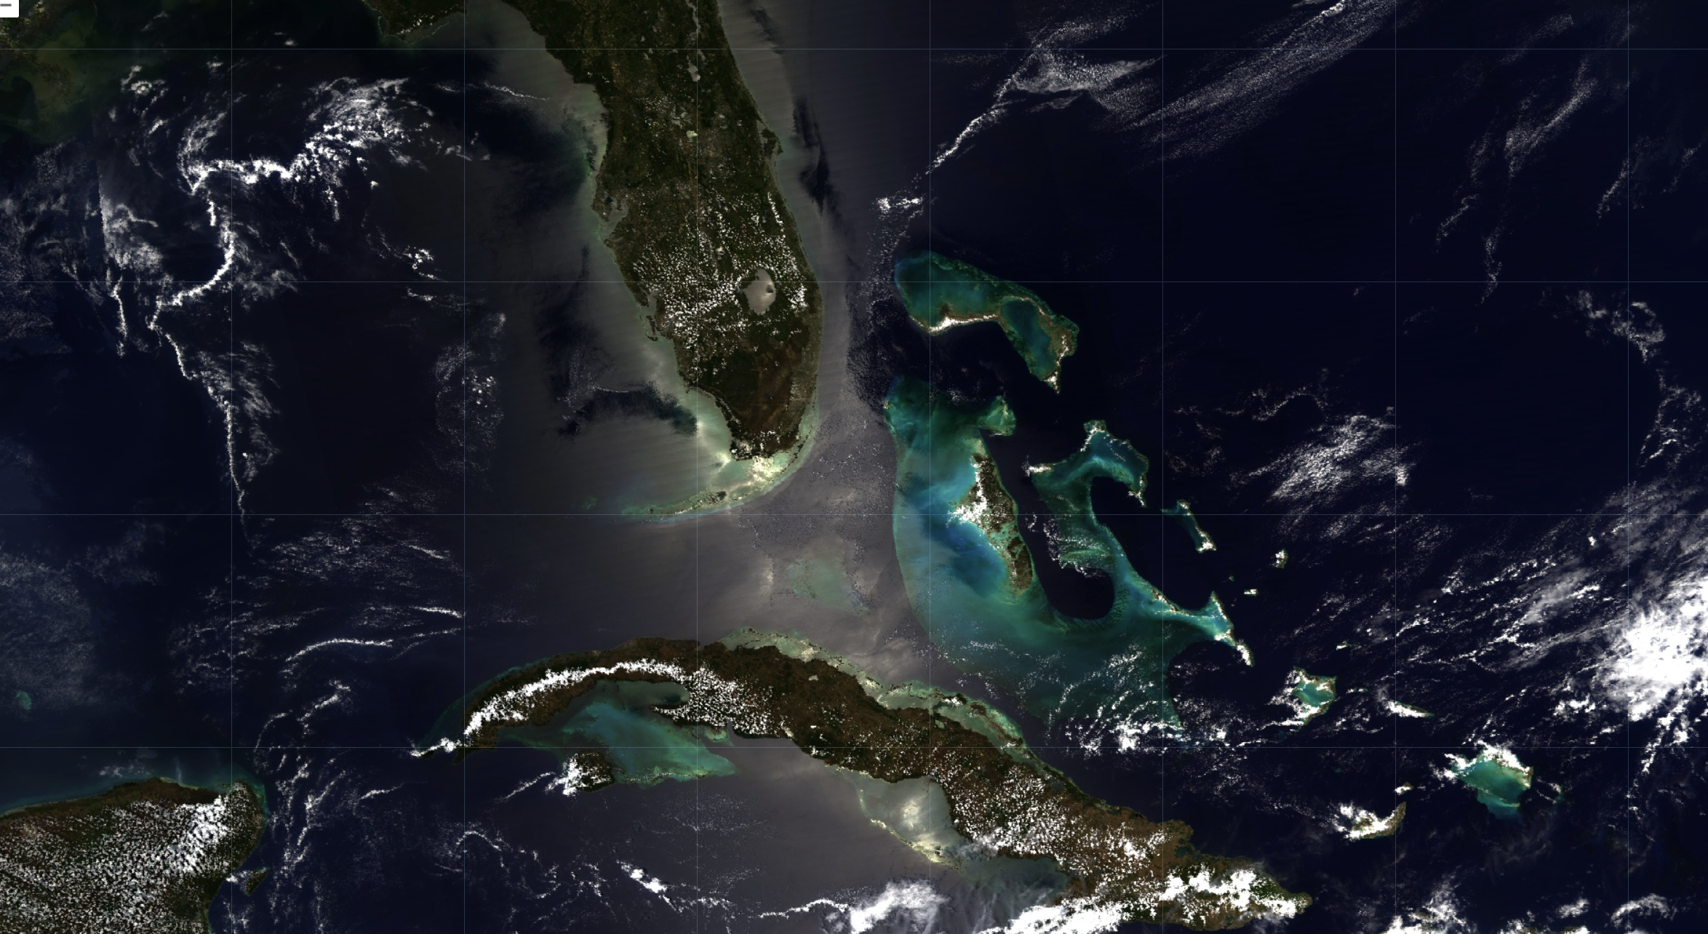
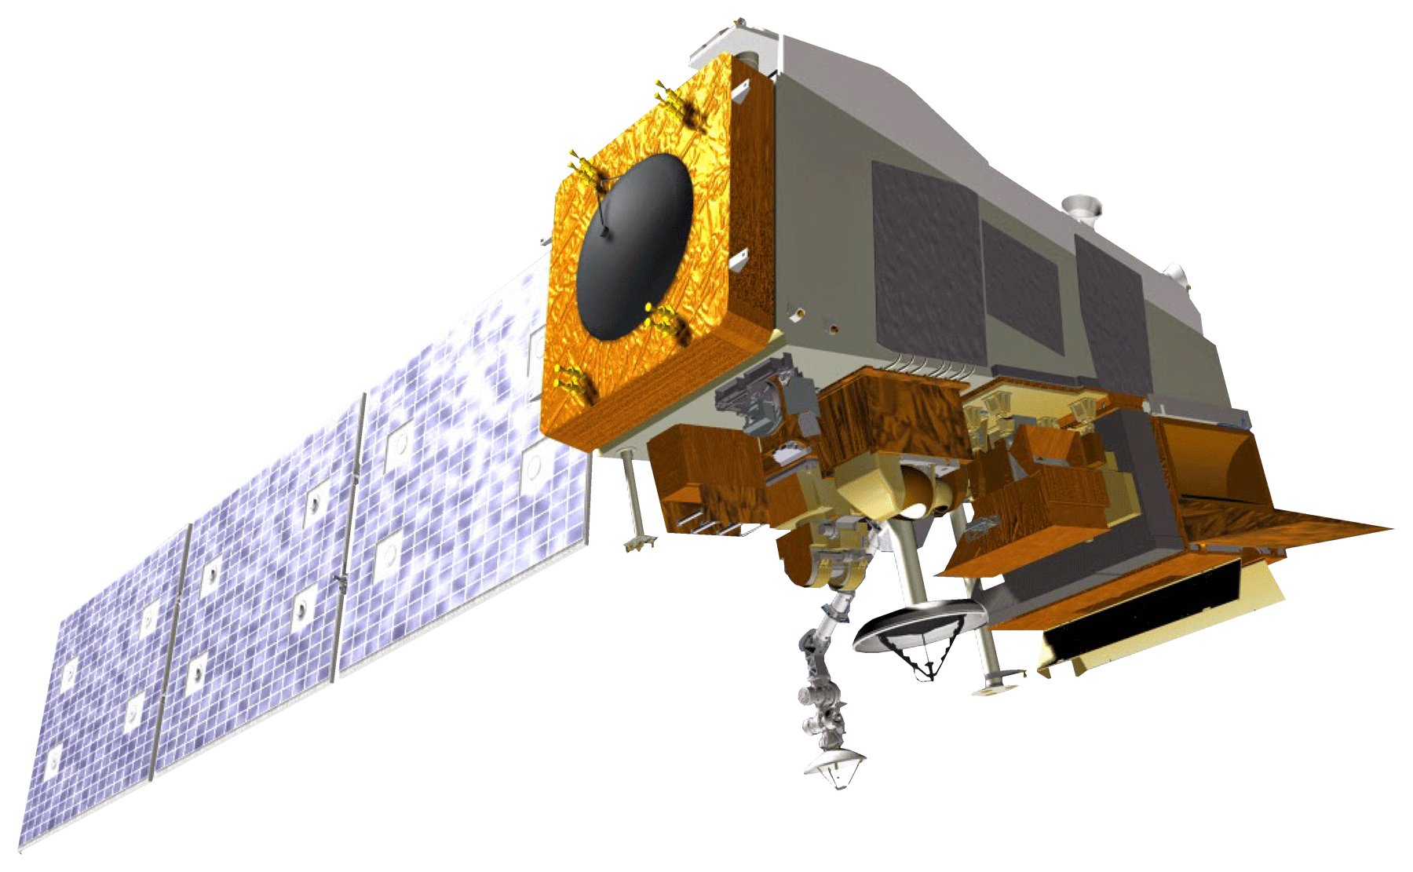
SATELLITES
Aqua Moderate Resolution Imaging Spectroradiometer (MODIS)
NASA
Global Change Observation Mission (GCOM-C) Second Generation Global Imager (SGLI)
JAXA
Suomi NPP Visible Infrared Imaging Radiometer Suite (VIIRS)
NASA/NOAA
Image Credit: NASA and JAXA
Notes:
Melanie:
We chose to use three different satellites and sensors:
NASA Earth observations were sourced from Aqua MODIS and Suomi NPP’s VIIRS.
Japanese Aerospace Exploration Agency Earth observations were sourced from GCOM-C.
Next slide please.
------------------------------Image Information Below ------------------------------
Image Credit: DEVELOPedia
Image Source: https://www.devpedia.developexchange.com/dp/index.php?title=List_of_Satellite_Pictures
Image Credit: LANDSAT Image Gallery (NASA)
Image Source: https://landsat.visibleearth.nasa.gov/view.php?id=146412
Image Credit: JAXA
Image Source: https://www.ioccg.org/sensors/sgli.html
Image Credit: Michael Enz
Image Source: This material contains modified Suomi VIIRS data (2021), processed by Mike Enz in Google Earth Engine
License: Public Domain (https://www.nasa.gov/multimedia/guidelines/index.html)

Slide 8
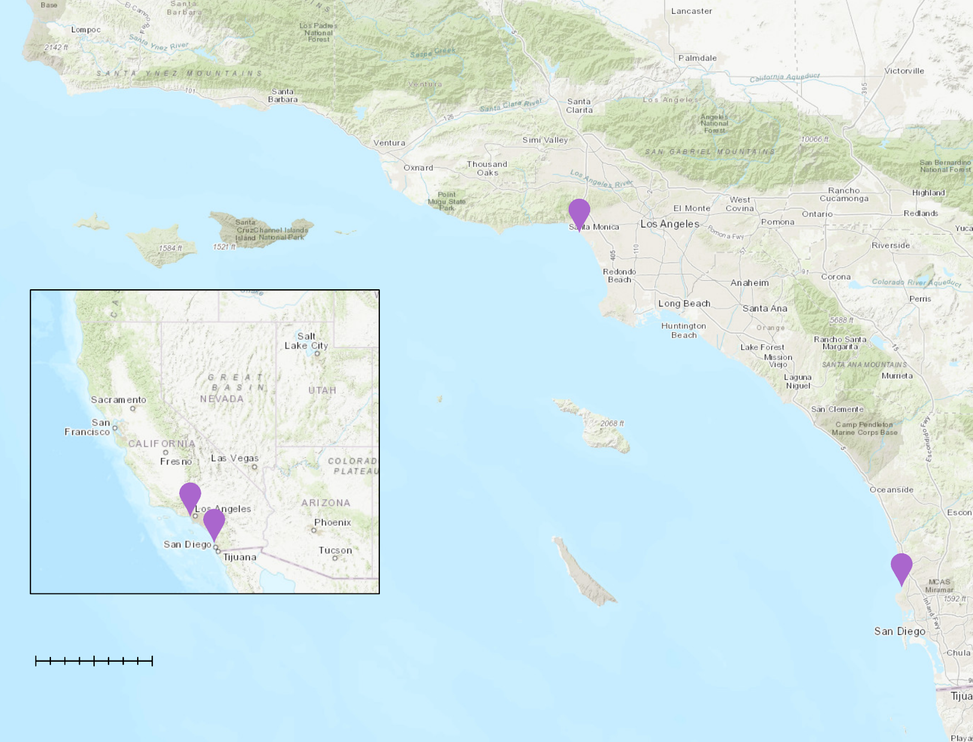
IN SITU DATA
N
Southern California Coastal Ocean Observing System (SCCOOS)
Lingulodinium polyedra (Cells/L)
Chlorophyll-a concentrations (mg m^3)
Santa Monica Pier
Newport Beach Pier
Scripps Pier
Kilometers
0
300
In situ collection site
Notes:
Melanie:
With the help of our collaborators, we had access to in situ data collected from the sites seen in the map here. This data ranges from March through June of 2020 and includes average chlorophyll-a concentrations, which we used to validate the use of remote sensing data in future algal bloom detection.
Now Maya will begin to talk about our workflow and methodology.
------------------------------Image Information Below ------------------------------
Map Created by team
Basemap: ESRI “World Topographic Map”, ArcGIS Pro

Slide 9
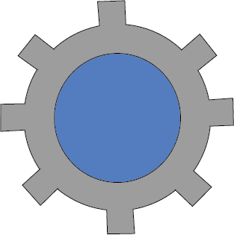
METHODOLOGY
Data Acquisition
Google Earth Engine
JAXA G-Portal
Data Processing
Google
Earth Engine
Data Analysis
Aqua
MODIS
Suomi NPP VIIRS
GCOM-C SGLI
Notes:
MAYA :
Thanks Melanie.
For the sake of clarity, we split our methods up into three distinct parts. Data acquisition, data processing, and data analysis.
To begin, we acquired the necessary data from public access online sources. For 2 out of our 3 satellites of interest we were able to directly pull data into Google Earth Engine from the built-in libraries.
Our final satellite of interest, GCOM-C, was not available In Google Earth Engine in the format that we needed to complete our project, so we downloaded this data from the JAXA G-portal, processed it in ArcGIS Pro and then uploaded it to Google Earth Engine.
Next slide please.
------------------------------Image Information Below ------------------------------
Icon Source: Microsoft Suite/powerpoint

Slide 10
METHODOLOGY
Data Acquisition
GCOM-C
Rrs ( λ) = $\frac{\text{nLW}}{\text{Fo} }$
Data Processing
Rrs (380nm) = $\frac{\text{nLW}}{\text{117.1379 }}$
Rrs (443nm) = $\frac{\text{nLW}}{\text{195.4065} }$
Data Analysis
$$\text{D} =\frac{\text{Rrs} \text{(}\text{380}\text{nm}\text{) }}{\text{Rrs}\text{ (}\text{443}\text{nm}\text{) }}$$
Kahru et al. 2021
Image Credit: JAXA
Notes:
MAYA :
The next step was to process our data. For processing GCOM-C data, we found that a UV Ratio identified in an experimental study by Kahru et al in 2021, detects a correspondence between the ratio of 380 and 443 nanometer bands and the presence of L. polyedra.
It is because of these preliminary findings that we used this ratio in our study. In order to find this ratio, first, we calculated the remote sensing reflectance values for each wavelength, denoted as Rrs. This was completed by dividing the normalized water leaving radiance by the solar irradiance, or F knot, for values at both 380 and 443nnm.
Next, we divided the 380nm band by the 443nm band. This calculation would help us to differentiate blooms dominated by dinoflagellates vs diatoms. After completing this final piece of the algorithm, these values would serve as comparison points to the other satellites, sensors, and algorithms we already had available in Google Earth Engine.
----------------------------Image Information Below------------------------
Image Credit: DEVELOPedia
Image Source: https://www.devpedia.developexchange.com/dp/index.php?title=List_of_Satellite_Pictures
Icon Source: Microsoft Suite/ powerpoint

Slide 11
METHODOLOGY
Data Acquisition
VIIRS
MODIS
Data Processing
Chlorophyll-a Algorithms
Data Analysis
OCx
GROC4
CI
RGCI
Image Credit: NASA
Notes:
MAYA :​
​
In processing data for MODIS and VIIRS, we identified 4 chlorophyll-a algorithms that could be used, each chosen because they identify different aspects of phytoplankton dynamics.
In general, chlorophyll-a algorithms are a measurement of total biomass in an area and are not very specific. In this case, we were looking to find an algorithm that might be better at specifically identifying dinoflagellates or L. polyedra. Each algorithm looked at here has a specific strength. For example, the algorithms using green-red bands are optimized for murky shallow water and those using green blue bands are more optimal for clearer, open water detection. That said, we would expect that each algorithm shown here might have with differing results.
The 4 algorithms chosen for analysis were: OCx, Color index (CI), Red- green color index (RGCI), and green red ocean color 4.
​
Now I will pass it over to Jonathan to talk about our data analysis.
​
----------------------------Image Information Below------------------------​
Image Credit: DEVELOPedia​
Image Source: https://www.devpedia.developexchange.com/dp/index.php?title=List_of_Satellite_Pictures ​
​
Icon Source: Microsoft Suite​/powerpoint
​
​

Slide 12
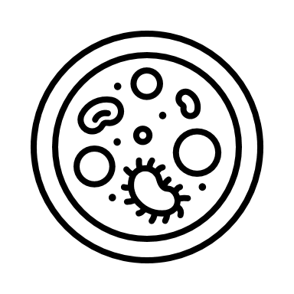
METHODOLOGY
Bloom presence
Bloom absence
Data Acquisition
Data Processing
NASA Earth Observations:
MODIS & VIIRS
Python
GEE
Data Analysis
In situ data:
Scripps Pier & Santa Monica Pier
JAXA Earth Observations:
GCOM-C SGLI
Notes:
(SPEAKER NAME) SCRIPT: Jonathan
Thanks, Maya.
After acquiring mean chlorophyll-a concentrations from our satellite data, the team identified periods of “known bloom presence” and “known bloom absence”.
We first compared the output visualizations for each of these sensors for the bloom presence and absence time periods.
In addition, we used a python script to compare our MODIS and VIIRS chlorophyll-a measurements against in situ data for the known bloom presence period.
Melanie will now talk about our google earth engine tool.
----------------------------Image Information Below------------------------
Icons: Microsoft Suite/powerpoint

Slide 13
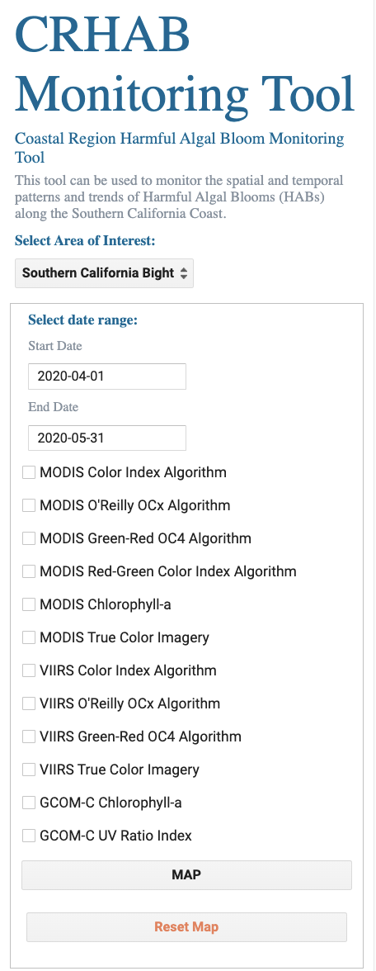
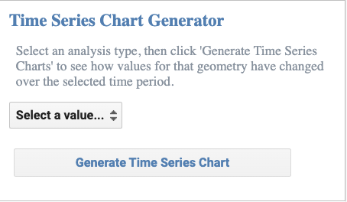
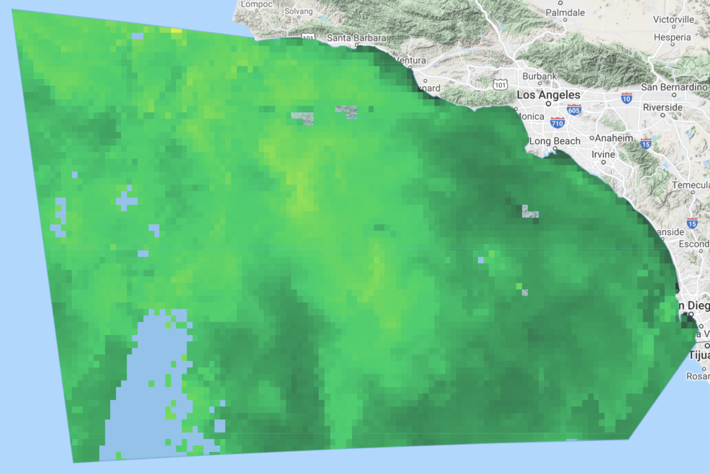
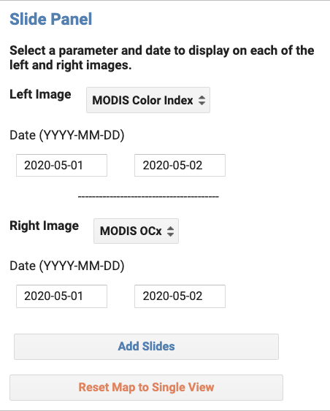
RESULTS
The Coastal Region Harmful Algal Bloom (CRHAB) Monitoring Tool
N
0.5
1.5
1
Dinoflagellate dominated
Diatom dominated
Notes:
Melanie:
The primary end product of our project was the Coastal Region Harmful Algal Bloom Monitoring Tool, otherwise known as the CRHAB monitoring tool. This is a graphic user interface developed in Google Earth Engine that utilizes both NASA and JAXA Earth observations to display and allow users to analyze chlorophyll-a and harmful algal blooms over time. It has several features, such as a time series chart generator, an image sliding feature, and the ability to export images from the map into different formats. Using the tool, we explored each of the sensors’ ability to detect harmful algal blooms.
Next slide please.
----------------------------Image Information Below------------------------
Map created by team
Images/Basemaps: INEGI Imagery 2021; NASA, Terrametrics Google, INEGI 2020

Slide 14
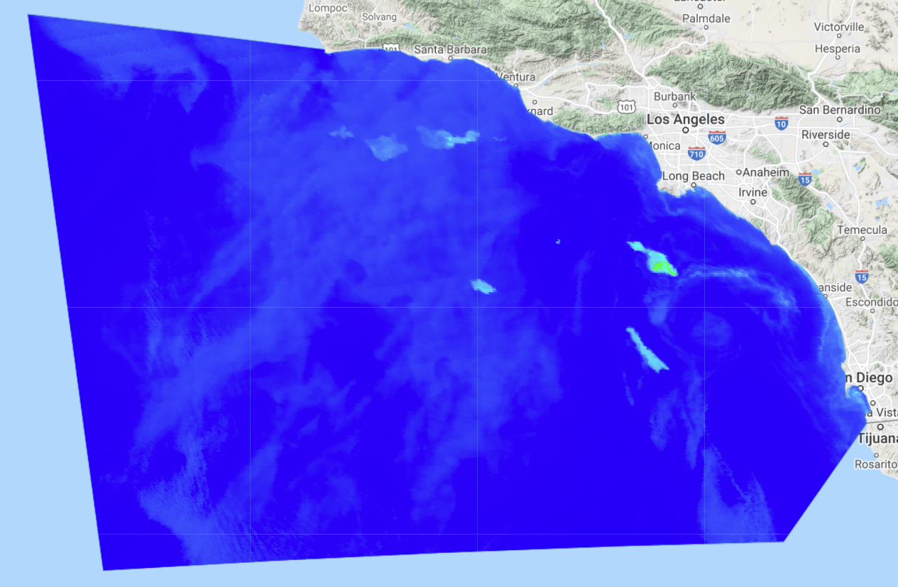
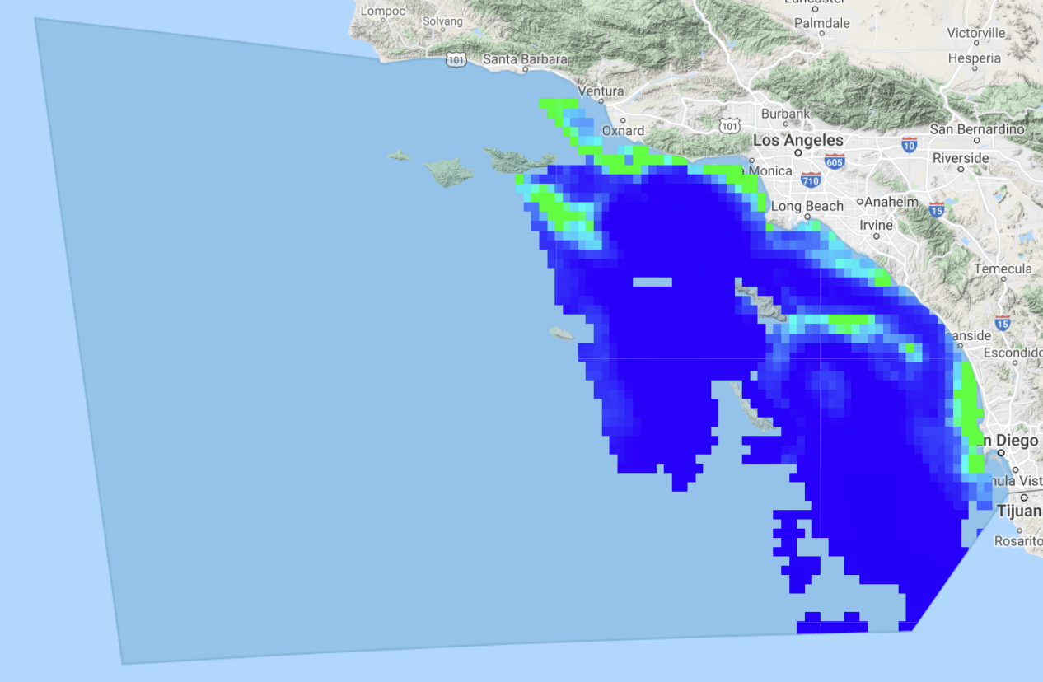
RESULTS
OCx Algorithm
VIIRS
MODIS
May 15th, 2020
May 15th, 2020
N
N
N
Chlorophyll-a Concentration (mg/m³)
Chlorophyll-a Concentration (mg/m³)
0
10
0
2.5
Notes:
Melanie:
Using the CRHAB tool, we compared the visual outputs of each algorithm for MODIS and VIIRS. The discrepancy in values between each sensor is because MODIS measures remote sensing reflectance while VIIRS measures surface reflectance.
Here we have the results for the Ocx algorithm. These images show the median Chlorophyll-a values during a known Red Tide Event. Darker blue indicates less chlorophyll while brighter green depicts more chlorophyll in the area. Both sensors show increased chlorophyll levels right off the coast of southern California.
Next slide please.
----------------------------Image Information Below------------------------
Images/Basemaps:
INEGI Imagery 2021; NASA, Terrametrics
Icon Source: Microsoft Suite

Slide 15
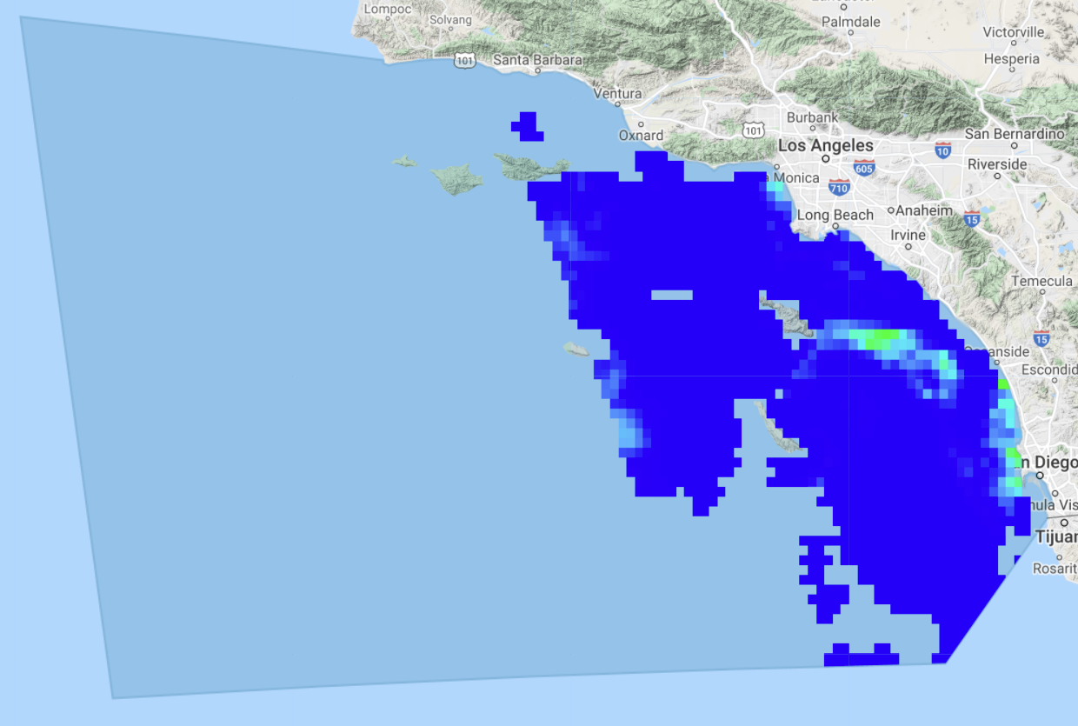
RESULTS
Red-Green Color Index Algorithm &
Green-Red OC4 Algorithm
MODIS RGCI
May 15th, 2020
MODIS GROC4
May 15th, 2020
N
N
Chlorophyll-a Concentration (mg/m³)
Chlorophyll-a Concentration (mg/m³)
0
40
0
55
Notes:
Melanie:
Next, we looked at the red-green color index and Green-Red OC4 algorithms for MODIS. This algorithm utilized a Red and Green band ratio, unlike the previous algorithms which use Green and Blue wavelengths for calculation.
The red-green color index algorithm shows different trends than the other algorithms, with higher chlorophyll levels dispersed across the study area and not limited to areas near the coastline.
Jonathan will talk about additional outputs.
----------------------------Image Information Below------------------------
Images/Basemaps:
INEGI Imagery 2021; NASA, Terrametrics
Icon Source: Microsoft Suite

Slide 16
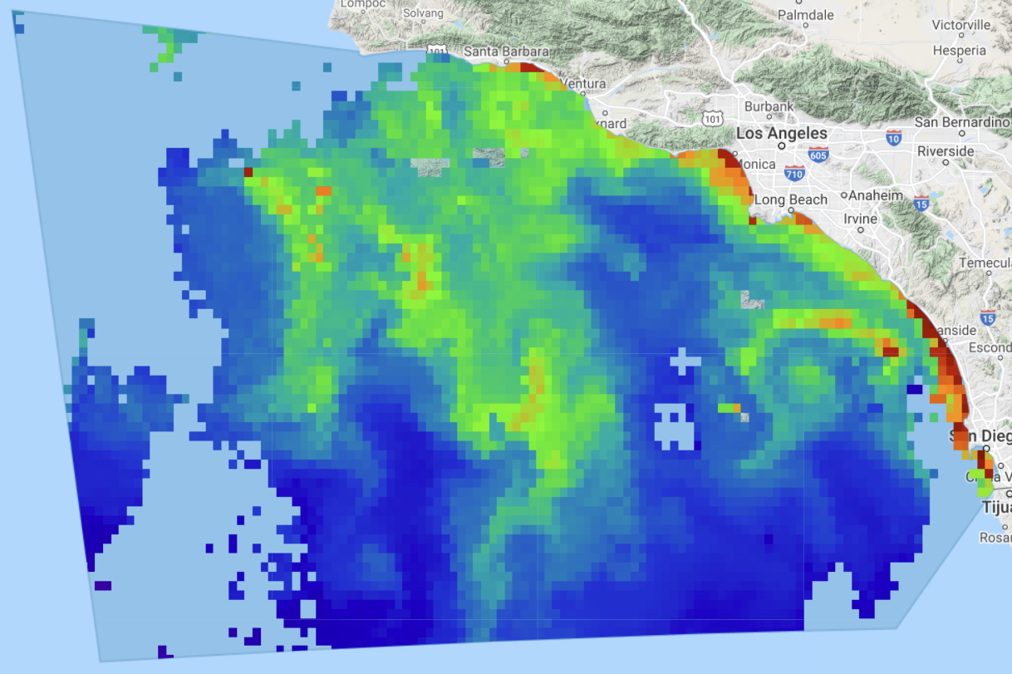
RESULTS
Chlorophyll-a Data
MODIS Provided
GCOM-C Provided
May 15th, 2020
May 15th, 2020
N
N
Chlorophyll-a Concentration (mg/m³)
Chlorophyll-a
0
10
-2
2
Notes:
Jonathan:
Thanks, Melanie,
Here we show the default Chlorophyll-a layers that are provided by NASA and JAXA with the Level 3 processing for MODIS and GCOM-C data. Although the colors and values differ between the two sensors, we can see the same areas along the Southern California coastline show high levels of chlorophyll-a concentration in both MODIS and GCOM-C Provided imagery. The MODIS data on the left is shown as Chlorophyll-a concentration whereas the right image is an index of Chlorophyll-a presence/absence. Areas in red indicate high chlorophyll presence.
Now Petra will talk about the quantitative output results for GCOM-C data.
----------------------------Image Information Below------------------------
Images/Basemaps:
INEGI Imagery 2021; NASA, Terrametrics
Icon Source: Microsoft Suite

Slide 17
Image Credit: Microsoft suite
RESULTS
GCOM-C Dinoflagellate Index
May 15th, 2020
D= Rrs(380nm)/Rrs(443nm)
Green: D <1
Dinoflagellate Bloom
Yellow: D >1
Diatom Bloom
N
Ratio of 380nm/443nm
0.5
1.5
1
Dinoflagellate dominated
Diatom dominated
Notes:
Petra SCRIPT:
Thanks Jonathan
Here we have our processed results for the dinoflagellate index for our study region. A dark green color represents a value of less than 1 which implies a dinoflagellate dominated bloom, while a more yellow color indicates a measurement over 1 which means the bloom is not predominately dinoflagellates and may show the presence of another species such as diatoms.
Next, I will discuss some of the UV ratio imagery from a red tide event occurring during September of 2021. This period was optimal to showcase the change in UV ratio values as the bloom transitions from one species domination to the next.
------------------------------Image Information Below ------------------------------
Map created by team
Images/Basemaps: INEGI Imagery 2021; NASA, Terrametrics Google, INEGI 2020
Icon Source: Microsoft Suite/powerpoint

Slide 18
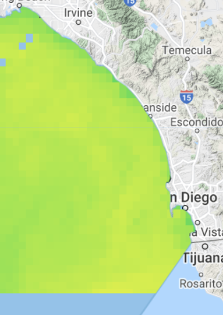
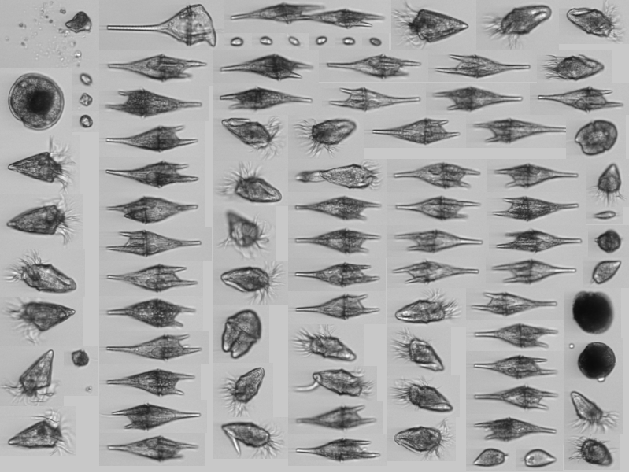
Sept 4th, 2021
RESULTS
N
Tripos spp. Dominated Bloom
Newport Beach Pier
Images collected by Imaging FlowCytoBots: September 3rd, 2021
Image Credit: SCCOOS
Ratio of 380nm/443nm
0.5
1.5
1
Dinoflagellate dominated
Diatom dominated
Notes:
Petra SCRIPT:
The left side image shows an image of phytoplankton species present on September 3rd, 2021, collected from an Imaging FlowCytoBot monitored by the Southern California Coastal Ocean Observing System. These in situ samples collected at the Newport Beach Monitoring Pier showcase the prevalence of a species of dinoflagellate, Tripos, pictured above as a long clear organisms. At about the same time, the GCOM–C sensor flew overhead, collecting imagery that depicted a ratio over 1, indicating a lack of L. polyedra.
------------------------------Image Information Below ------------------------------
Map created by team
Images/Basemaps: INEGI Imagery 2021; NASA, Terrametrics
SCCOOS-Dashboard, 2021, https://sccoos-ifcbdb.srv.axds.co/dashboard

Slide 19
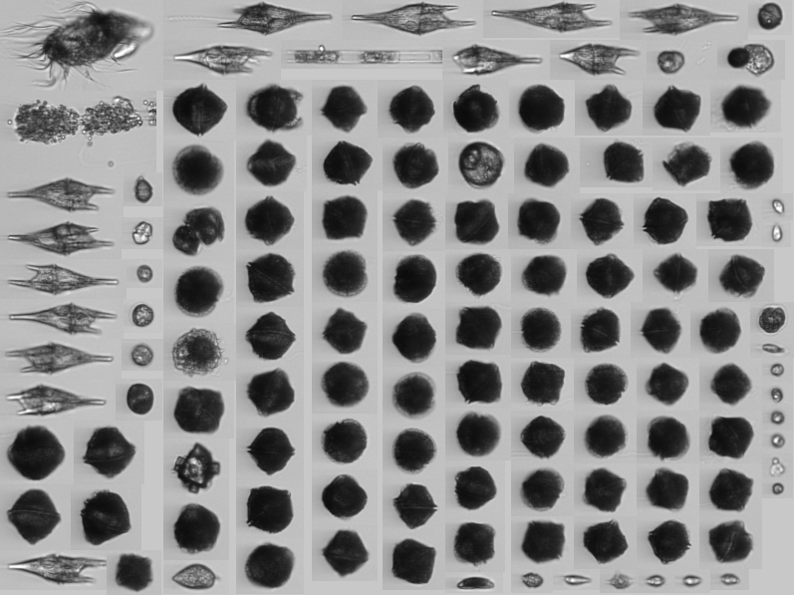
Sept 8th, 2021
RESULTS
N
L. polyedra Dominated Bloom
Newport Beach Pier
Images collected by Imaging FlowCytoBots: September 9th, 2021
Image Credit: SCCOOS
Ratio of 380nm/443nm
0.5
1.5
Dinoflagellate dominated
1
Diatom dominated
Notes:
Petra SCRIPT:
A few days later, around September 9th, 2021, the same FlowCytoBots collected and measured a much higher number of L. Polyedra compared to other species. These L. polyedra, can be seen on the left-hand image as the dark spheres. A day earlier (September 8th, 2021) GCOM–C flew overhead and collected imagery that showed a UV ratio below 1, implying a higher concentration of L. polyedra due to the UV-absorbing Mycosporine-like Amino Acids contained within them. This time series gave us confidence that our UV ratio index was able to identify changes in algae bloom species make-up.
I will now turn over to Maya. She will be talking about differences and similarities between the calculated algorithms and GCOM-C data.
------------------------------Image Information Below ------------------------------
Map created by team
Images/Basemaps: INEGI Imagery 2021; NASA, Terrametrics
SCCOOS-Dashboard, 2021, https://sccoos-ifcbdb.srv.axds.co/dashboard

Slide 20
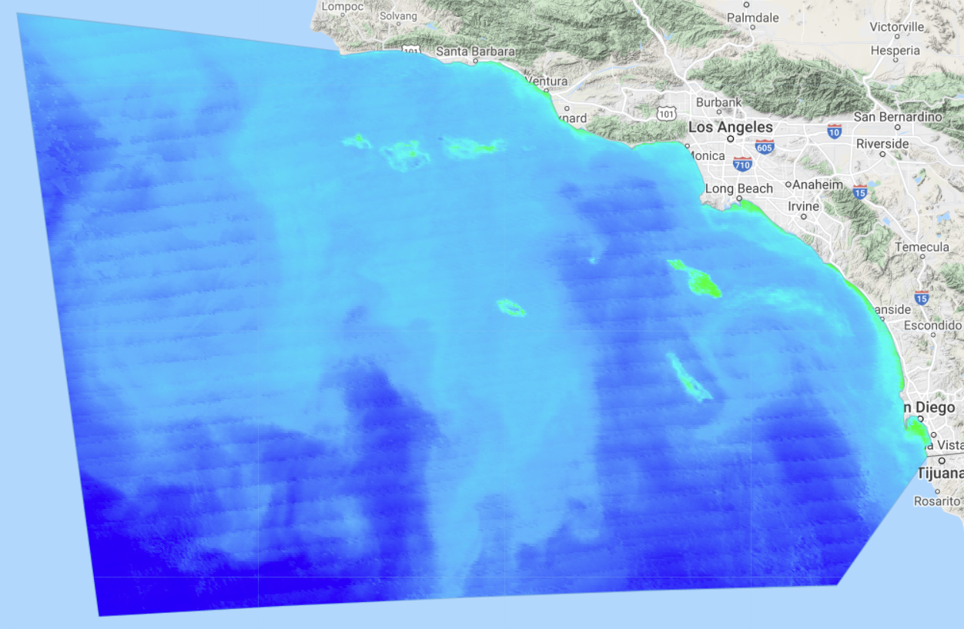
RESULTS
VIIRS
vs.
GCOM-C
VIIRS Color Index
May 15th, 2020
GCOM-C UV Ratio
May 15th, 2020
N
N
Chlorophyll-a (mg/m³)
Ratio of 380nm/443nm
0.5
1.5
0
200
1
Dinoflagellate dominated
Diatom dominated
Notes:
MAYA :​
​
Next, we compared VIIRS color index algorithm outputs to our GCOM-C UV Ratio imagery. It is in these side-by-side images that we can see that higher concentrations of Chlorophyll-a detected by VIIRS in light green on the left seem to directly correlate with lower UV Ratio values as indicated by dark green on the right. ​
​
​
​
​
​
------------------------------Image Information Below ------------------------------​
​
Images/Basemaps:​
INEGI Imagery 2021; NASA, Terrametrics​
Icon Source: Microsoft Suite​
​

Slide 21
RESULTS
VIIRS
vs.
GCOM-C
VIIRS Color Index
May 15th, 2020
GCOM-C UV Ratio
May 15th, 2020
N
N
Chlorophyll-a (mg/m³)
Ratio of 380nm/443nm
0.5
1.5
0
200
1
Dinoflagellate dominated
Diatom dominated
Notes:
MAYA:​
​
This is particularly apparent in areas along the coastline, such as the area highlighted by the red circle, exhibiting the highest measured Chlorophyll-a values, and lower UV ratios of less than 1. As discussed earlier, lower values in the UV ratio imply the presence of UV absorbing dinoflagellates, particularly L. polyedra, while lighter green and yellow colors imply a dominance of diatoms in the water. This implies that with the establishment of a concentration threshold, the VIIRS Color Index algorithm could potentially be used to identify L. polyedra ​
​
May 15th , 2020​
​
​
​
------------------------------Image Information Below ------------------------------​
​
Images/Basemaps:​
INEGI Imagery 2021; NASA, Terrametrics​
Icon Source: Microsoft Suite​
​

Slide 22
RESULTS
MODIS
vs.
GCOM-C
MODIS-provided Chlorophyll-a
May 15th, 2020
GCOM-C UV Ratio
May 15th, 2020
N
N
Chlorophyll-a (mg/m³)
Ratio of 380nm/443nm
0.5
1.5
0
10
Dinoflagellate dominated
1
Diatom dominated
Notes:
MAYA:​
Next, we compared the MODIS provided chlorophyll- a band outputs to our GCOM-C UV Ratio imagery. The areas highlighted here show the same results as previously described for VIIRS.
Now I will pass it over to Michael to discuss the conclusions of our project. ​
​
​
------------------------------Image Information Below ------------------------------​
​
Icon Source: Microsoft Suite​
Basemap: INEGI Imagery 2021; NASA, Terrametrics​
​

Slide 23
CONCLUSIONS
Question 1
Can we use NASA Earth observations for future algal bloom detection?
Question 2
How accurate were each of the sensors? Algorithms?
Question 3
When were the findings valid? Time frame? Location?
Question 4
What does this mean for the future detection of HABs and safety of impacted communities?
Notes:
(SPEAKER NAME) SCRIPT: Michael
Thanks Maya. As we wrapped up our results, we took a step back to understand what questions we wanted to answer based on our work this term. I will now walk through each of the following questions. First: Can we use NASA earth observations for future algal bloom detection?

Slide 24
CONCLUSIONS
Question 1
Question 3
When were the findings valid? Time frame? Location?
Question 4
What does this mean for the future detection of HABs and the safety of impacted communities?
Question 2
How accurate were each of the sensors? Algorithms?
NASA Earth observations show promise as a first spatial approximation for dinoflagellate growth, but require validation
Notes:
(SPEAKER NAME) SCRIPT: Michael
We were able to determine that NASA Earth observations show promise as first approximations for identifying spatial characteristics of dinoflagellate dominated algae blooms. However, these observations need to be used in conjunction with in situ data or GCOM-C UV ratio data to confidently identify algal bloom events.
On their own, these Earth observations do not have the necessary wavelength bands to correctly identify red tide events, but after the correct identification,, these observations could be used to better understand the spatial and temporal characteristics of red tide events.

Slide 25
CONCLUSIONS
Question 1
Question 2
Question 4
What does this mean for the future detection of HABs and the safety of impacted communities?
VIIRS CI showed greatest correlation when compared to GCOM-C
Question 3
When were the findings valid? Time frame? Location?
NASA Earth observations show promise as a first spatial approximation for dinoflagellate growth, but require validation
Notes:
(SPEAKER NAME) SCRIPT: Michael
Our second question was: How accurate were each of the sensors and algorithms we picked out for this project?
We were interested in finding out which sensors and algorithms provided the most accurate results. Our qualitative results show that VIIRS Color Index algorithm and sensor combination had promise in identifying Lingulodinium polyedra. However, each sensor and algorithm identified unique spatial characteristics and patterns of the blooms that others missed, indicating that no single sensor or algorithm was 'better' than the other.

Slide 26
CONCLUSIONS
Question 1
Question 2
Question 3
Question 4
What does this mean for the future detection of HABs and the safety of impacted communities?
Able to detect high levels of bloom presence
Coastal water vs. open ocean
NASA Earth observations show promise as a first spatial approximation for dinoflagellate growth, but require validation
VIIRS CI showed greatest correlation when compared to GCOM-C
Notes:
(SPEAKER NAME) SCRIPT: Michael
Next we wanted to know when were these findings valid? Was it time dependent? Location dependent?
We found that, again, the VIIRS sensor using the Color Index algorithm proved to be most spatially accurate for this study area. It is however important to note that there is a discrepancy between coastal water algorithms and open water algorithms, and no one algorithm or sensor was able to accurately detect blooms in both locations.

Slide 27
CONCLUSIONS
Question 1
Question 2
Question 3
Question 4
Keep both locals and tourists safe
The ability for industry to adapt quickly
NASA Earth observations show promise as a first spatial approximation for dinoflagellate growth, but require validation
Able to detect high levels of bloom presence
Coastal water vs. open ocean
VIIRS CI showed greatest correlation when compared to GCOM-C
Notes:
(SPEAKER NAME) SCRIPT: Michael
Finally, we were interested in knowing what the implications of our work would be for future bloom detection and management.
We hope that the results from our project can help ensure that there is a more consistent and wide-reaching detection of harmful algae in the southern California region. The overall goal of this heightened detection is to keep humans, wildlife and ecosystems in the area safe in addition to looking out for industry and economy in the area.
Next, Jonathan will talk about some of the errors and uncertainties within our project.

Slide 28
ERRORS & UNCERTAINTIES
VIIRS
Data availability
Fo values found in documentation
Chlorophyll algorithms
In situ Data
Data availability
Date syncing with satellite data
Cloud masking
GCOM-C data
Units of Measurement
Land Influence
Notes:
(SPEAKER NAME) SCRIPT: Jonathan
Thanks, Michael,
Given the use of several data sources, there were inherent errors and uncertainties that came along with our study.
First, our VIIRS data had some trouble with the cloud masking methods.
For GCOM-C data, we encountered image availability issues for bands of interest for our given study area and time period. Additionally, we had to adjust the wavelength using the Thuillier solar spectrum wavelength (NASA) to gather the Remote Sensing Reflectance out of Normalized Water Leaving Radiance.
Beyond this, Each chlorophyll algorithm used produced results that depended on additional factors such as the type of reflectance collected by each sensor. Working with different chlorophyll algorithms contributed to more uncertainty in our project do to the fact that to this point there is no objective algorithm to be applied towards the southern California coastal zone.
Finally, limited in situ data introduced uncertainty in our cross-validation analysis. The missing values within the data sets needed to be interpolated and therefore cast additional uncertainty in our final results.
With these limitations in mind, Michael will talk about the future work we have in mind for this project.

Slide 29
FUTURE WORK
Expansion of time series analysis
Global detection of HABs
Water quality and air quality parameters
Image Credit: Microsoft suite
Notes:
(SPEAKER NAME) SCRIPT: Michael
If we had more time to work on this project, there are a number of ways in which we could expand the work done this term.
First, we could expand the comparison of GCOM-C data vs. MODIS and VIIRS data to a larger date range. While we only focused on one bloom period and one control period for this project, gathering and comparing data from a larger time period would help us to understand a little bit more about the ability of NASA Earth observations to identify dinoflagellate blooms.
Second, while our work focused on the Southern California coast, because satellites often provide global coverage, the work that we completed for this project could be expanded and applied to the entire California coast, and perhaps even most of the coast lines around the globe. If something like that is possible, it would help in providing critical information for water body management agencies around the world.
The final thing that could be added to our work is the addition of both water and air quality parameters. This type of work would help us to understand something about the potential DRIVERS of these blooms and the AEROSOLIZATION of toxic algae that could directly impact human health.
And Finally – click
-----------------------------Image Information Below ------------------------------
Image Credit: ‘Earth image’
Image Source: PowerPoint
Icon Source: Microsoft Suite

Slide 30
Special thanks to:
Science advisor Dr. Juan Torres-Pérez of NASA Ames Research Center
Science Advisor Ben Holt, NASA Jet Propulsion Laboratory
Science Advisor: Dr. Christine Lee, NASA JPL
NASA DEVELOP Fellow Britnay Beaudry
NASA DEVELOP Senior Fellow Hayley Pippin
We would like to thank our collaborators from:
Scripps Institution of Oceanography
Dr. Clarissa Anderson
Dr. Andrew Barton
Dr. Melissa Carter
As well as our project partners at:
The Office of Environmental Health Hazard Assessment
The California Department of Public Health
NOAA Southwest Fisheries Science Center
Notes:
(SPEAKER NAME) SCRIPT: Michael
We would like to express our thanks to our collaborators at Scripps Institution of Oceanography, Clarissa Anderson, Andrew Barton, and Melissa Carter. We would also like to thank our project partners at the Office of Environmental Health Hazard Assessment, the California Department of Public Health, and NOAA Southwest Fisheries Science Center
We would also like to give a special thanks to our Science advisors Dr. Juan Torres-Pérez, Ben Holt, and Dr. Christine Lee, as well as our Fellow Britnay Beaudry, and Senior Fellow Hayley Pippin

