Slide 1
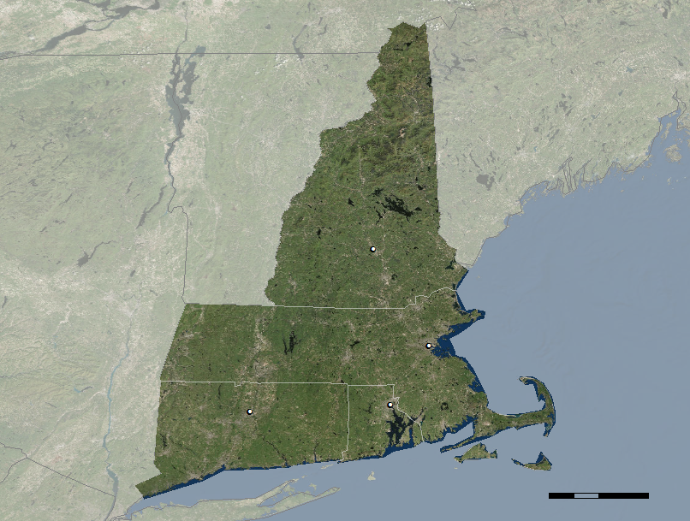
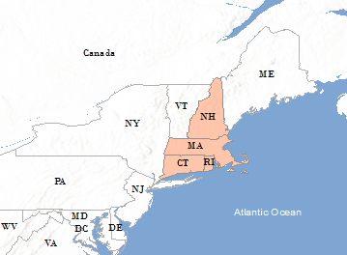
Incorporating NASA Earth Observations into an Assessment Tool to Identify Correlations Between Factors Associated with Bee Health
Abstract
Methodology
Honey bees (Apis mellifera) are a vital component to global agriculture, however, over recent decades their populations have been declining. Honey bees provide pollination services to more than 90% of the leading 107 global crop types, and without them it is estimated that 5-8% of global production would be lost. Anthropogenic drivers such as land use change, habitat fragmentation, existence of vegetative land cover (native or agricultural), climate, and the use of fertilizers and pesticides, contribute to honey bee health complications and annual population losses. Also, the presence of invasive pests (Varroa mite [Varroa destructor], tracheal mites, and small hive beetles) and pathogens (e.g. Nosema) further compound these issues. Leveraging citizen science, NASA Earth observations, and nationally reported statistics, a comprehensive methodology was developed to illuminate environmental variables that are linked to honey bee prosperity in the New England region of the United States from 2015 to 2018. The team created a tool harnessing Google Earth Engine to incorporate in situ data collected from local hives and apiaries and biophysical variables, such as vegetation indices, and soil moisture collected from satellite data. The tool will aid in the development of historical trends in honey bee welfare and will provide insight for better understanding of bee habitat suitability conditions.
Land Classification
Elevation
Precipitation
Soil Moisture
EVI
NDVI
Objectives
~ 250 hives
Visualize honey bee hive environmental factors from satellite data between 2016 and 2018
Produce a graphical user interface that allows collaborators to look at historical environmental trends that correlate with in-hive measurements
Enhance honey bee research methodologies
Utilize the computational power of Google Earth Engine to summarize remotely sensed attributes
January 2016 – May 2018
Hive Locations
Results
User View
Study Area
ME
NH
Concord
NY
MA
Boston
Conclusions
Hartford
RI
Providence
An interactive map of environmental and geophysical attributes pertinent to hive localities was generated with functionality to export temporally correlated remotely sensed data.
Hive health is likely correlated with environmental parameters however the effects associated with these parameters are dynamic and confounding, masking the individual effect of any one single variable.
The tool will allow users to visualize and explore ideal hive locations and connect environmental variables with honey bee health.
Future work should focus on exploring high spatial and temporal resolution data, as well as air quality data, to precisely quantify regional phenomena on hive health.
PA
NJ
CT
km
Earth Observations
0 25 50 100
Landsat 8 OLI
Sentinel-2 MSI
GPM
ALOS
Team Members
Landsat 7 ETM+
SRTM
SMAP
Project Partners
Urban Beekeeping Laboratory and Bee Sanctuary, Inc.
The Bee Informed Partnership
University of Maryland, vanEngelsdorp Honey Bee Research Lab
BeekeepingIO
Jeremy Rapp
Project Lead
Victor Lenske
Eyob Solomon
Ryan Young
Acknowledgements
Sean McCartney, Science Systems & Applications, Inc
Dr. John Bolten, NASA Goddard Space Flight Center
New England Agriculture & Food Security
Maryland - Goddard | Summer 2018

