Slide 1
COASTAL ALABAMA WATER RESOURCES II
Using NASA Earth Observations to Obtain Water Quality Trends in the Mobile Bay and Mississippi Sound to Assess Future Oyster Habitat Suitability and Aid Fisheries Management
Dionne Blanks
(Team Lead)
Gregory Leenig
Chad Austin
Madeline Statkewicz
Alabama-Mobile
Fall 2017

Slide 2
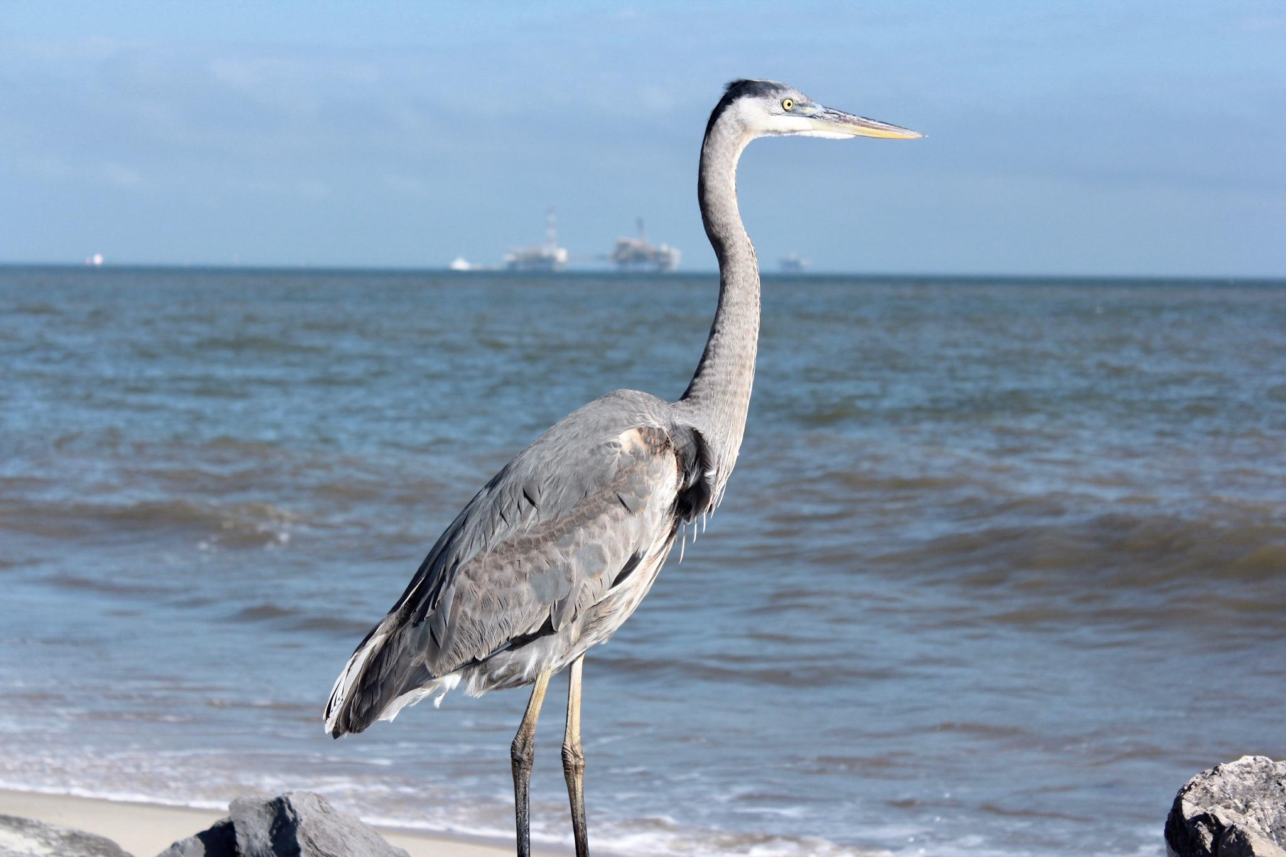
Components
Study Area and Study Period
Objectives
Partners
Community Concerns
NASA Satellites and Sensors Used
Methodology
Results
Conclusions
Errors and Uncertainties
Acknowledgements
Image Credit: Madeline Statkewicz, NASA DEVELOP
Image Credit: Le.Loup.Gris
Notes:
This presentation will cover the listed topics as followed: study area and study period, objectives, partners, community concerns, NASA sensors used, methodology, results, conclusions, errors and uncertainties, and acknowledgements.

Slide 3
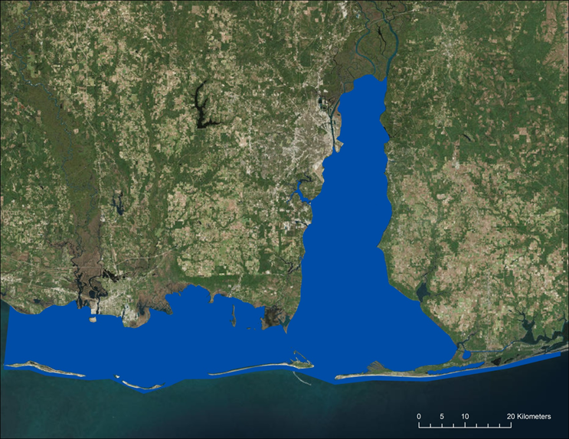
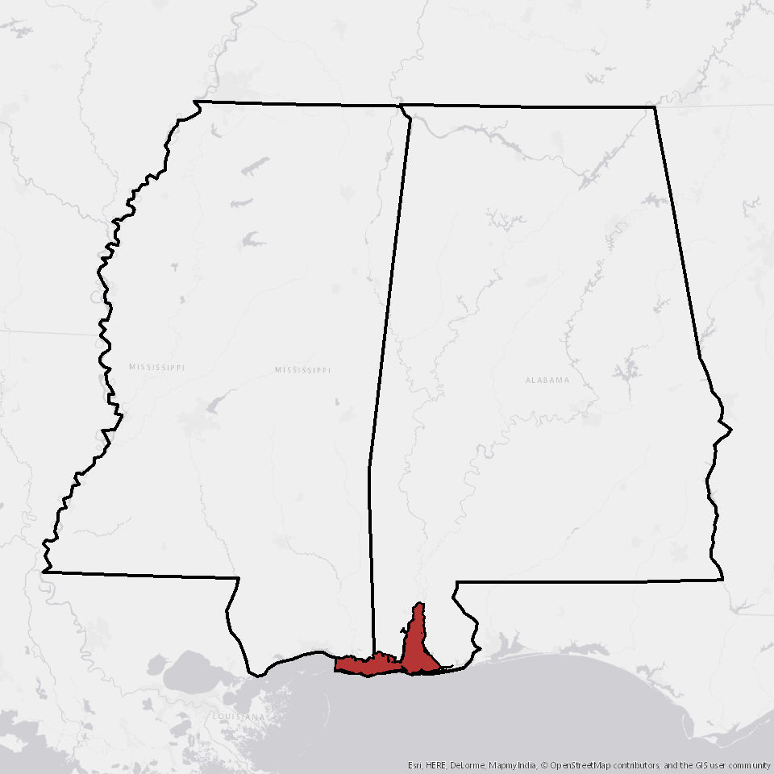
Study Area & Study Period
MS
AL
Mobile Bay, AL and Mississippi Sound, MS
Consists of 170 miles of shoreline and an area of 525 square miles
September 2003 - May 2007
Mobile Bay
Mississippi Sound
Study Area
Image Credit: Le.Loup.Gris
Notes:
Speaker: The study area for this project includes the Mobile Bay and Mississippi Sound. This area contains around 525 square miles of coastal marine habitat. It extends from coastal Jackson County, Mississippi to eastern Baldwin County, Alabama, consisting of nearly 170 miles of shoreline. The study period was from June 2003 to June 2007.
Note: Map layer and graphics are from Term 1 of the project.
Service Layer Credits: Source: Esri, DigitalGlobe, GeoEye, Earthstar Geographics, CNES/Airbus DS, USDA, USGS, AeroGRID, IGN, and the GIS User Community
Service Layer Credits: Source: Esri, USGS, NOAA

Slide 4
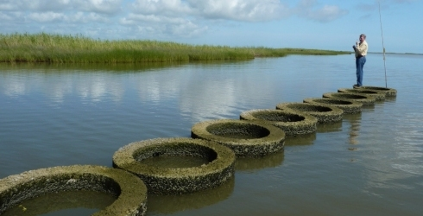
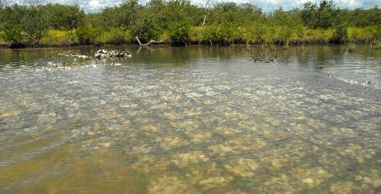
Objectives
Derive and assess additional coastal salinity products, comparing with local buoy data (2003-2007)
Compute additional SST time series data (2003-2007)
Create turbidity & salinity time series analysis to further establish baseline conditions needed to develop habitat suitability maps (2004-2007)
Image Credit: Amy Smith-Kyle, TNC
Image Credit: TNC
Image Credit: Le.Loup.Gris
Notes:
Speaker: The main objective of the fall 2017 project is to calculate water quality parameters from June 2003 to June 2007 and combine both datasets to obtain a time-series analysis and show overall water quality trends in the study area. The project further aims to develop a tool that partners can use in deciding where to focus future oyster bed restoration and other management efforts. The results will assist project partners to make better-informed decisions for their organizations.
Image on left: https://www.nature.org/ourinitiatives/regions/northamerica/unitedstates/louisiana/oyster-reef-building-at-vermilion-bay.xml
Image on right: https://www.nature.org/ourinitiatives/regions/northamerica/unitedstates/florida/volunteer/oyster-reef-restoration-project.xml

Slide 5
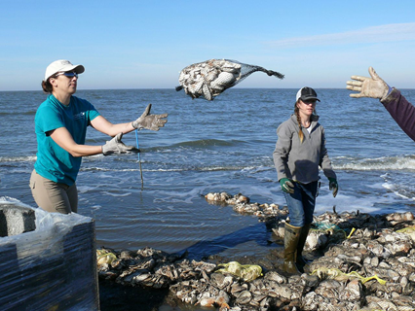
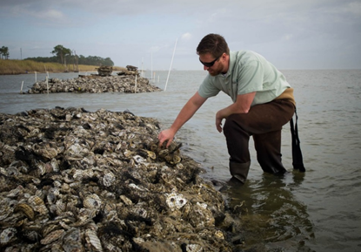
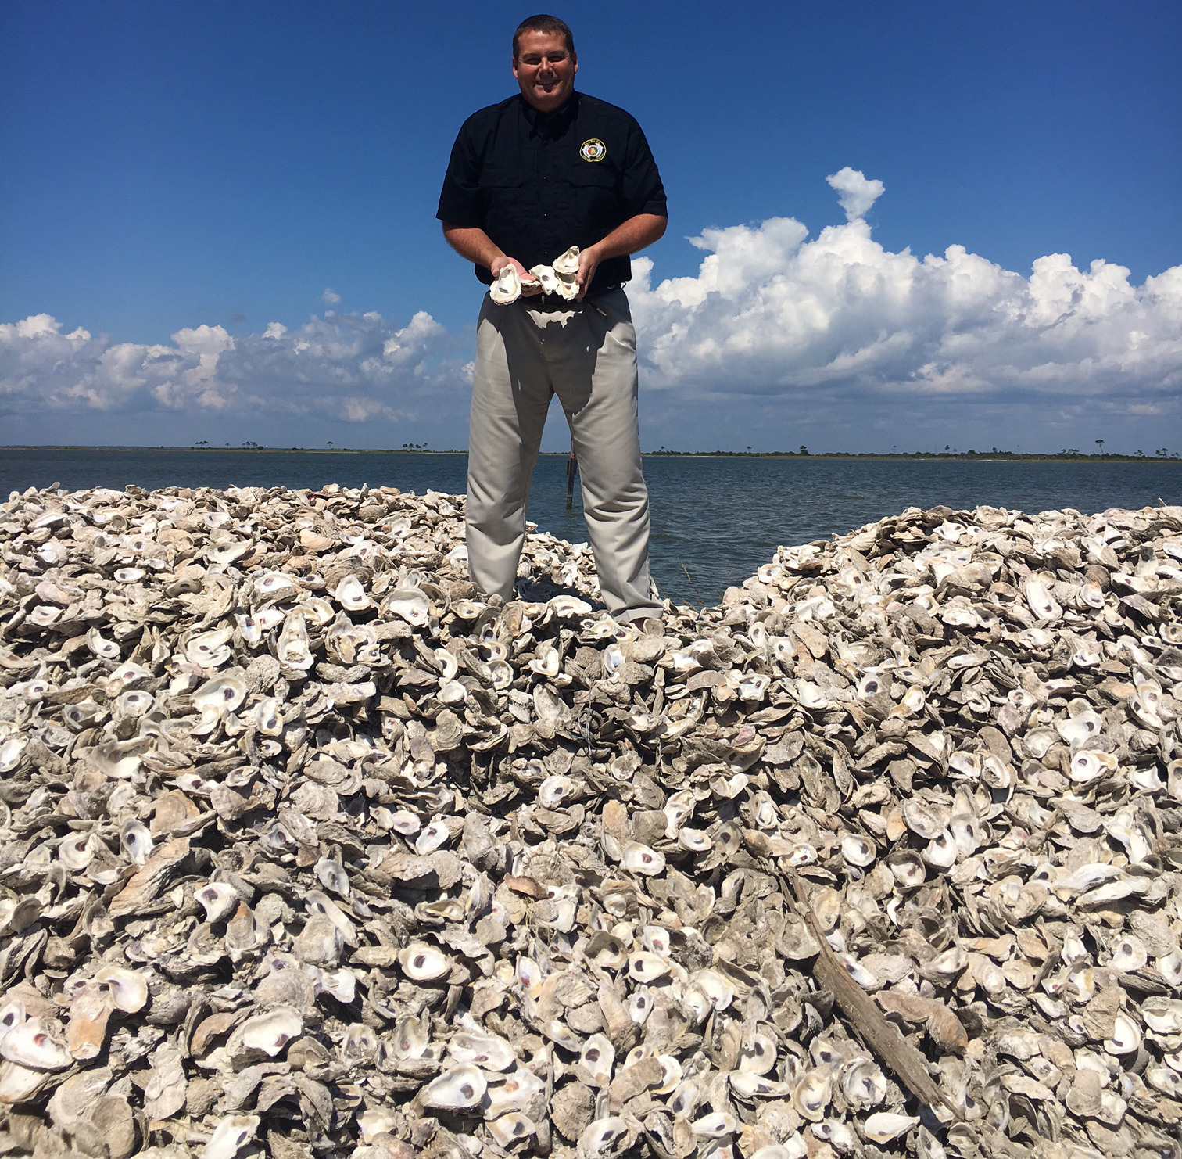
Project Partners
The Alabama Coastal Foundation (AFC)
Dauphin Island Sea Lab (DISL): Manatee Sighting Network
The Mississippi-Alabama Sea Grant Consortium (MASGC)
The Nature Conservancy (TNC): Alabama Chapter
Image Credit: USFWS
Image Credit: TNC
Image Credit: ACF
Image Credit: Le.Loup.Gris
Notes:
Speaker: Our partners include the Alabama Coastal Foundation, Dauphin Island Sea Lab’s Manatee Sighting Network, The Mississippi-Alabama Sea Grant Consortium, and the Alabama Chapter of the Nature Conservancy.
Image on top: https://www.flickr.com/photos/usfwsnortheast/16494656212
Image bottom right: http://coastalresilience.org/project/gulf-of-mexico/
Image bottom left: https://www.originaloysterhouse.com/news.php?pid=252

Slide 6
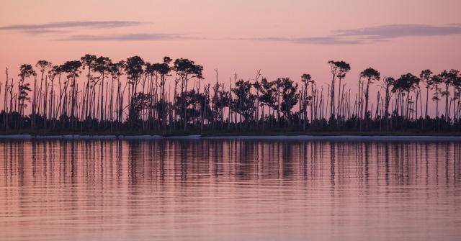
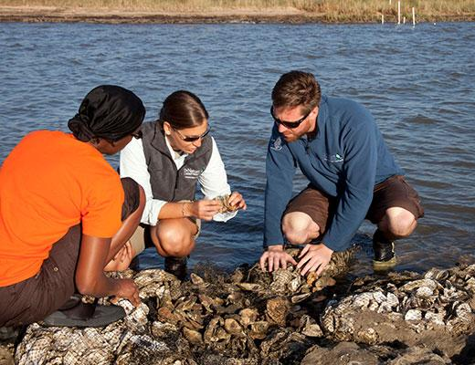
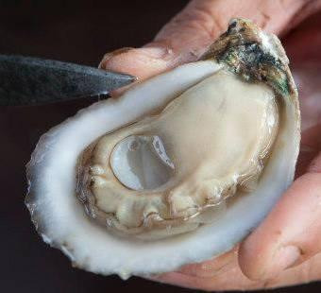
Community Concerns
Image Credit: DISL
Oysters are important part of the local seafood economy
Oyster reefs filter pollutants from water and enhance biodiversity
Water quality data are needed for aiding fisheries and environmental management
Information on water quality parameters are needed to aid oyster habitat restoration
Image Credit: ACF
Image Credit: Monet
Image Credit: Audra Melton, TNC
Image Credit: Hunter Nichols, TNC
Image Credit: MASCG
Image Credit: Le.Loup.Gris
Notes:
Speaker: Water quality parameters such as turbidity, sea surface temperature (SST) and salinity influence marine life in the northern Gulf of Mexico. Many researchers, community leaders, and commercial fishers in the region need geospatial data to enhance water quality assessments and future fisheries management. Suitable water quality in the region is important for maintaining a healthy environment for the fishing industry. Researching these water quality parameters will help identify areas of coastal zones suitable for creating living shorelines and conducting habitat restoration.
Sources for the images:
http://masgc.org/oyster-farming/off-bottom-oyster-farming
https://www.nature.org/ourinitiatives/regions/northamerica/unitedstates/alabama/explore/index.htm
Image source: https://www.nature.org/ourinitiatives/regions/northamerica/unitedstates/mississippi/recovering-the-coast.xml

Slide 7
NASA Satellites and Sensors Utilized
Image Credit: Monet
Landsat 5 TM
Thematic Mapper (TM)
Aqua MODIS
Moderate Resolution Imaging Spectroradiometer (MODIS)
Image Credit: NASA
Notes:
Speaker: This project obtained NASA Earth Observation data from Landsat 5 Thematic Mapper and Aqua MODIS.
Satellite images retrieved from:
http://www.devpedia.developexchange.com/dp/index.php?title=List_of_Satellite_Pictures
http://www.devpedia.developexchange.com/dp/images/6/69/01_Landsat5.png
http://www.devpedia.developexchange.com/dp/images/b/bf/06_Aqua.png

Slide 8
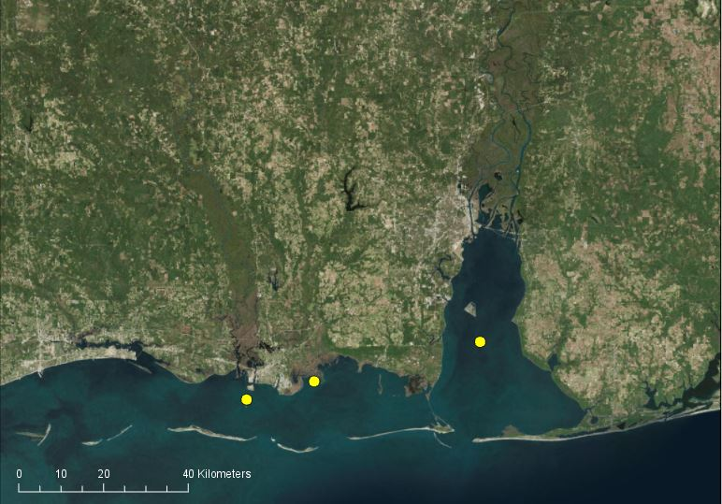
Ancillary Datasets
Salinity & SST Buoy Data
Mobile Bay National Estuary Program (Middle Bay Lighthouse, Mobile Bay, AL)
Mississippi Department of Marine Resources (Round Island, MS)
National Estuarine Research Reserve System (Point Aux Chenes Bay, MS)
Ocean Color
Goddard Space Flight Center
Buoy for 2003-2007
Notes:
Additional data were obtained from the Mobile Bay National Estuary Program (Middle Bay Lighthouse), Mississippi Department of Marine Resources, National Estuarine Research Reserve System, and Goddard Space Flight Center DAAC.
Service Layer Credits: Source: Esri, DigitalGlobe, GeoEye, Earthstar Geographics, CNES/Airbus DS, USDA, USGS, AeroGRID, IGN, and the GIS User Community

Slide 9
Methodology
Landsat 5 TM
Aqua MODIS (SST and OC)
Buoy Water Parameter Values
Data Acquisition
Turbidity, Salinity, & Sea Surface Temperature
Comparison of In Situ to Satellite Data
Data Processing
Turbidity, Salinity, & Sea Surface Temperature Time Series
End Products
Notes:
The team used landsat 5 tm to calculate turbidity and create a time series for september 2003-june 2007. Aqua MODIS ocean color data, was used to calculate salinity and SST, while also creating a time series for june 2003-june 2007. SST and salinity were validated in comparison to buoy data.

Slide 10
Results - Turbidity
Changes
September 2003 vs May 2007
Changes
June 2007 vs June 2017
Turbidity (FNU)
Turbidity (FNU)
100
100
0
0
Notes:
Landsat products were averaged for 2003-2017 for turbidity. Products were computed with Acolite software. The dark red indicates higher turbidity, and the blue represents lower turbidity.
Image on left: Turbidity in the northern delta and Eastern Mobile Bay increased. West Mississippi sound and West Central Mobile Bay showed decreasing turbidity.
Image on right (Summer 2017 Coastal Alabama Oceans project): Decreasing turbidity is shown in the delta region and the central Mobile Bay. On the other hand, southern Mobile Bay presented notable increases in turbidity.
Software: Arc GIS Pro
Service Layer Credits: Esri, HERE, DeLorme, MapmyIndia, OpenStreetMap contributors, and the GIS user community

Slide 11
Results – Salinity
Changes
June 2003 vs May 2007
Changes
June 2007 vs June 2017
Salinity Reflectance Ratio
Salinity (PPT)
34.60
1034
16.72
-190.5
Notes:
Image on left: Ocean Color products acquired from Aqua MODIS reflectance ratio were used to detect average salinity changes from 2003 to 2007:
Salinity has slightly decreased in the south-central Mobile Bay and scattered throughout Mississippi Sound.
Salinity has slightly increased along west coasts of Mobile Bay.
Image on right (Summer 2017 Coastal Alabama Oceans project): Ocean Color products originated from Aqua MODIS were converted to salinity measured in parts per thousand (PPT) from 2007 to 2017 to evaluate salinity changes:
- The most evident increases occurred within north Mobile Bay. 56 % of the total salinity changes, including increase and decrease, were within one parts per thousand.
And only 2% of the study area increased or decreased more than 10 parts per thousand.
Software: Arc GIS Pro
Service Layer Credits: Esri, HERE, DeLorme, MapmyIndia, OpenStreetMap contributors, and the GIS user community

Slide 12
Results - SST
Changes
June 2003 vs May 2007
Changes
June 2007 vs June 2017
Temperature
C°
Temperature
C°
12.52
12.52
-12.81
-12.81
Notes:
Data Source: Aqua MODIS Sea Surface Temperature products were averaged for 2003-2017.
Image on left: Aqua MODIS Ocean Color Sea Surface Temperature products were used to display average SST changes 2003 to 2007:
- Increased in north Mobile Bay.
- Slightly decreased in north-central Mobile Bay and south-central Mississippi Sound.
Image on right (Summer 2017 Coastal Alabama Oceans project): Aqua MODIS Ocean Color Sea Surface Temperature products were used to display average SST changes from 2007 to 2017:
- The majority of the study area underwent a slight decrease in temperature, however, in the Western Mississippi Sound there was a slight increase.
Software: Arc GIS Pro
Service Layer Credits: Esri, HERE, DeLorme, MapmyIndia, OpenStreetMap contributors, and the GIS user community

Slide 13
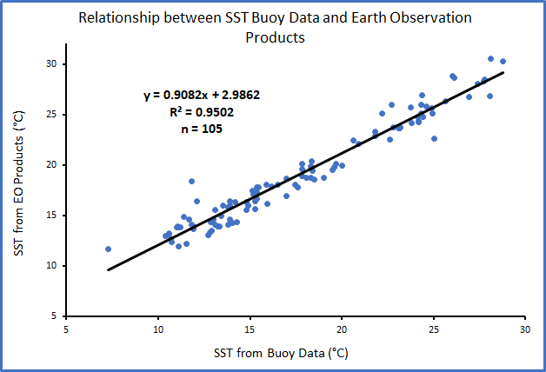
SST Validation
Eighty-eight dates from 2003 to
2007
Three buoy locations:
Round Island, MS
Point Aux Chenes Bay, MS
Middle Bay Lighthouse, Mobile Bay, AL
R² indicates high correlation
Notes:
A linear regression was also used to validate the earth observation SST data using data collected from three buoy locations in the study area. The buoy stations used to validate SST were the same used to validate salinity. The buoy data used for the validation contains eighty-eight dates from 2003 to 2007. The coefficient of determination (R-squared), indicates a high correlation between the earth observation SST product and the in situ buoy temperature data.

Slide 14
Oyster Habitat Suitability Map
September 2003 – June 2007
June 2007 – July 2017
Habitat Suitability
Habitat Suitability
0.96
0.52
0.0005
0.0003
Maps based on Salinity, Turbidity, and SST inputs
Notes:
We combined salinity, SST, and turbidity and used a Fuzzy Logic Model to generate a habitat suitability map for oysters based on the data between 2003-2007. The darker purple indicates higher habitat suitability, and the lighter purple indicated lower habitat suitability.
Image on left: Western Mississippi Sound and central Mobile Bay are more suitable for oyster restoration. Southeastern, and north Mobile Bay have low suitability for oysters, as well as eastern Mississippi Sound
Image on right (Summer 2017 Coastal Alabama Oceans project): Oyster restoration would most likely to be successful in the Eastern and the central Mississippi Sound.
It was important to include an oyster habitat suitability map for 2003-2007 because this helps bring awareness to our end users which areas has changed over time and which areas would be best suitable for oyster restorations.
Software: Arc GIS Pro
Service Layer Credits: Esri, HERE, DeLorme, MapmyIndia, OpenStreetMap contributors, and the GIS user community

Slide 15
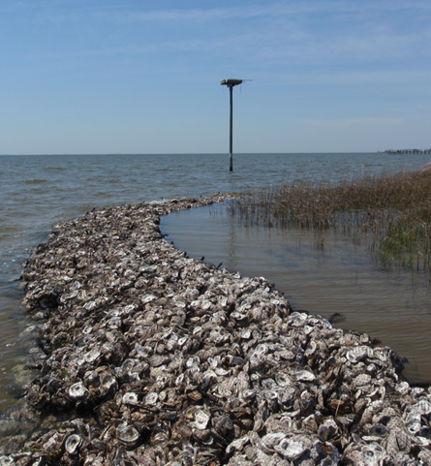
Conclusions
NASA Earth observations were used to estimate turbidity and sea surface temperature
The EO were not successful for validating turbidity and salinity
Geospatial data products were produced to assist oyster fisheries management and habitat restoration
Image Credit: SARP
Image Credit: Le.Loup.Gris
Notes:
NASA Earth observation can be used to evaluate water quality in the region and to enhance future wildlife management. Throughout the study area both increased and decreased varied for salinity, turbidity, and sea surface temperature.
Image source: http://southeastaquatics.net/resources/webinars/livingshoreline.png/view

Slide 16
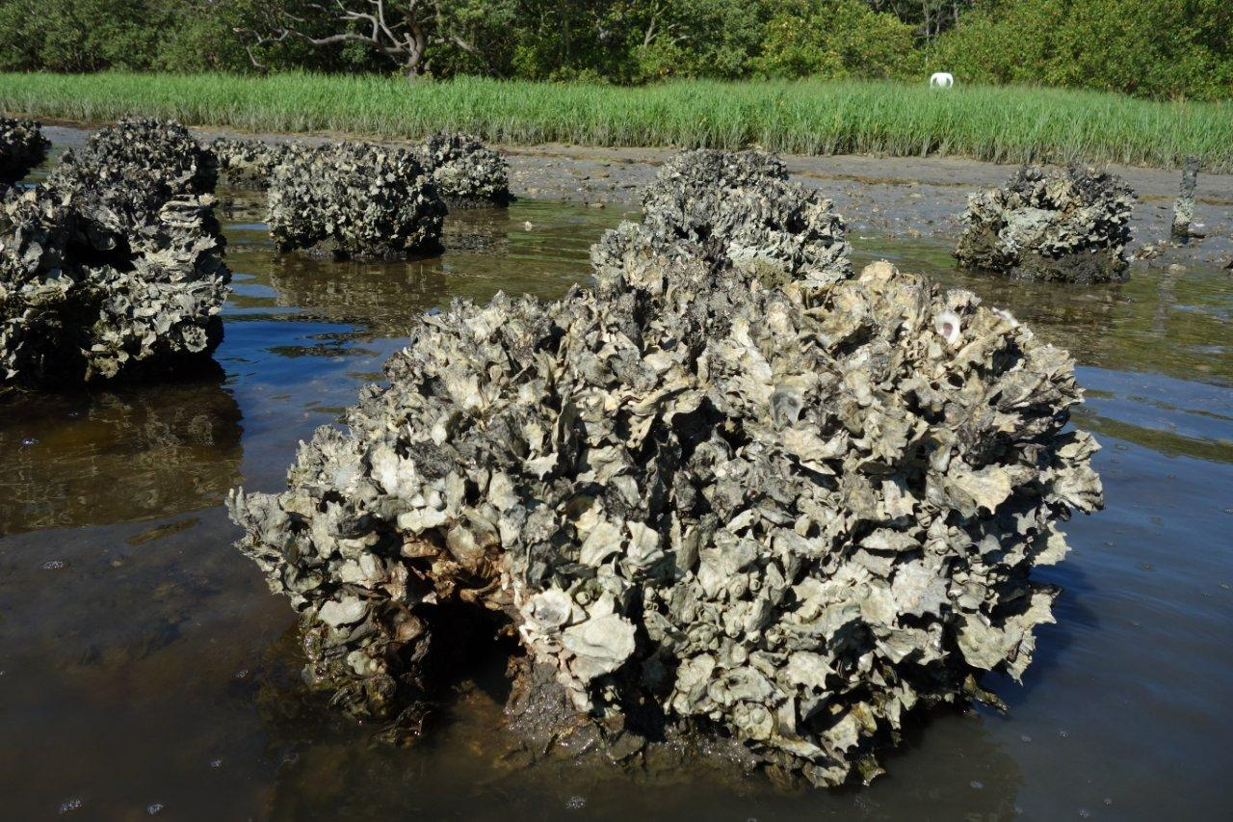
Errors & Uncertainties
Low spatial resolution
Cloud cover frequency
More work is needed to forecast water quality
Image Credit: Reef Innovations
Image Credit: Le.Loup.Gris
Notes:
Some uncertainties that we encountered during this project include working with the low spatial resolution of Aqua MODIS data and avoiding cloud cover. Salinity and turbidity are primarily influenced by precipitation, which fluctuates based on the wet and dry season. To track this using satellites had to obtain clear images during both of these seasons, which is difficult because of the increase in clouds during the wet season. In addition, we were limited to using only certain buoys for the validation process due to their proximity to land which affected our algorithm. And lastly, we only analyzed the changes between 2007 and 2017 rather than examine the differences between individual years within that period, which can leave out important fluctuations
Image up top: http://reefinnovations.com/services/ecosystem-restoration/living-shoreline-reef-balls-are-being-used-across-the-coast

Slide 17
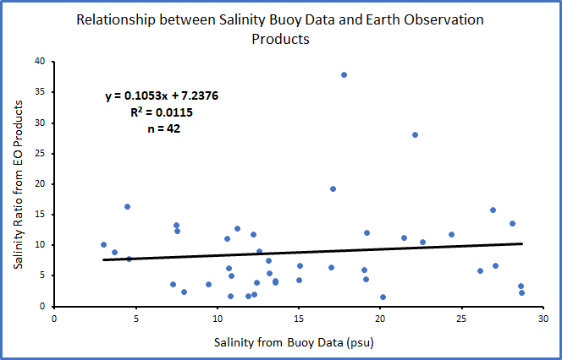
Additional Uncertainties
The salinity EO product could not be validated using buoy data as indicated by the low R²
The EO sensor reflectance measurement is quite shallow while depth of each buoy sensor is unknown
The turbidity EO product could not be validated because of a limited number of samples
Image Credit: Le.Loup.Gris
Notes:
A linear regression was used to validate the earth observation salinity product using in situ data collected from three buoy locations. The satellite salinity products were derived from the reflectance ratio of the 677 nm wavelength to the 488 nm. The buoys were located at Sound Island in the eastern portion of the Mississippi Sound, Point Aux Chenes Bay, MS, and Middle Bay Lighthouse, which is situated in the Mobile Bay. The buoy data used for the analysis encompasses thirty-seven dates from 2003 to 2007. The coefficient of determination (R-squared), indicates that the earth observation salinity ratio cannot be validated by the buoy data in the present project.

Slide 18
Acknowledgements
Dr. Bernard Eichold, Mobile County Health Department (Mentor)
Joseph Spruce, Science Systems & Applications, Inc. (Science Advisor)
Dr. Kenton Ross, NASA Langley Research Center (Science Advisor)
Mark Berte, Alabama Coastal Foundation
Dina Knight, The Nature Conservancy
Judy Haner, The Nature Conservancy
Dr. Ruth Carmichael, Dauphin Island Sea Lab (Manatee Sighting Network)
Elizabeth Hieb, Dauphin Island Sea Lab (Manatee Sighting Network)
Russell Grice, The Mississippi - Alabama Sea Grant Consortium
Dr. Jeffrey Luvall, NASA at NSSTC (Science Advisor)
Dr. Robert Griffin, University of Alabama in Huntsville (Science Advisor)
Dr. Maury Estes, University of Alabama in Huntsville (Science Advisor)
Leigh Sinclair, University of Alabama/Information Technology & Systems Center (Mentor)
Mimi Tzeng, Dauphin Island Sea Lab
Renee Collini, Dauphin Island Sea Lab
Dr. Just Cebrian, Dauphin Island Sea Lab
Josh Goff, Dauphin Island Sea Lab
Dr. Brian Dzwonkowski, Dauphin Island Sea Lab
Erika Higa, NASA DEVELOP Jet Propulsion Laboratory
Maggi Klug, NASA DEVELOP MSFC (Center Lead)
Dashiell Cruz, NASA DEVELOP MSFC (Former Impact Analysis Fellow)
Tyler Lynn, NASA DEVELOP AL-Mobile (Former Center Lead)
Elaina Gonsoroski, NASA DEVELOP AL-Mobile (Former Impact Analysis Fellow)
Farnaz Bayat, NASA DEVELOP AL-Mobile (Center Lead)
Danielle Quick, NASA DEVELOP AL-Mobile (Impact Analysis Fellow)
Mercedes Bartkovich, NASA DEVELOP MSFC (Former Co-Team Lead)
Xin Hong, NASA DEVELOP AL-Mobile (Former Co-Team Lead)
Leah Parker, NASA DEVELOP MSFC (Former Team Member
Amy Schwarber, NASA DEVELOP AL-Mobile (Former Team Member)
Notes:
We would like to acknowledge all the advisors, mentors and contributors to this project.

