Slide 1
VPS: Best Tips & Practices
The Communications Team

Slide 2
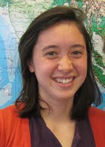
Your Communications Team
Fellows
Christie Stevens
Christine.L.Stevens@nasa.gov
Caitlin Toner
Caitlin.K.Toner@nasa.gov
Jenna Williams
Jenna.L.Williams@nasa.gov
Senior Fellow
Carrie Kelley
Carrie.L.Kelley@nasa.gov
Notes:
Hello, everyone!
We are your Communications Team! This is Christie here, accompanied by my fellow Fellows, Caitlin & Jenna, as well as our Senior Fellow, Carrie Kelley.
Today we’re going to introduce the Virtual Poster Session and some best tips & practices to make your team’s VPS informative, clean, and stellar. This is your chance to fully utilize your creativity in communicating science!

Slide 3
The Overall Flowchart
The Message
Who? Why? Where? less How?
The Pre-Plan
What style?
What pieces?
Order the pieces
Prep the questions/ write the script
‘A way to communicate science creativly and use more of the right side of our brains.’
Gather Materials
Conduct Interviews
Get the shots, make the animations
Record the audio
Keep track of downloads!
Put it Together
Put the pieces in the order you planned
Find the music
CITE it ALL
Finalize the script
Name (time) – Words spoken
Review with Comm/PC
Export and Submit
Notes:
Most of the other deliverables in DEVELOP are very structured and have a template already but the VPS is one place where participants have a lot of autonomy. The VPS is the most outward facing deliverable and often the only on seen by a large audience like your friends and parents. It can be daunting but it can also be really fun too. This is a general overview of the process to help your team make a good video and have fun while you’re at it.
Like anything you do if you put in the time planning, the result will be easier in the end. We will go into these stages more in-depth but in general if you follow this flowchart you shouldn’t become too overwhelmed. There are a lot of resources on DEVELOPedia and we are also here to help.

Slide 4
What is your Message?
What are the community concerns and perceptions based on project outcomes?
Why is this project important and how will this video add value to society?
What tools are you using and how did your team use EO?
How much should be technical (percentage?) and what type of technical information should be used?
VPS is a story, not a tech paper. Make it compelling!!
Who is your
Audience?
Notes:
Take the time to step back and remember who your audience is. Why does this project matter? What value are you adding to their lives? Their children’s lives? Society, in general?
Think about what types of videos engage you? What approach do the producers take to gain and keep your interest? Don’t think of this project as a tech paper. Share the information in a way that is compelling, inspirational, yet informative. The maximum time allowed for a VPS 4 minutes and 15 seconds. Do you really need this much time to explain your project? Some times less is more.
In the past, teams focus so much on their project results and methodology that they forget who they are talking to. Yes, there will be educated viewers in the audience, but remember the average education level of the national and international population. Communicate to the masses, to the taxpayers who deserve to know about your projects.

Slide 5
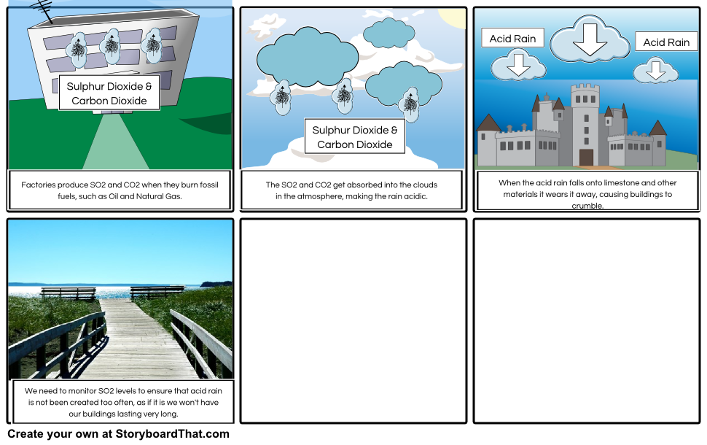
Storyboard
Pre-plan Your Production
Why is it useful?
Give structure and organization
Plan A-Roll and B-roll shots
Examples & Inspiration
Previous VPS videos
Example storyboard template
Find your creative genius!
Narrator/Script:
Timing/Duration:
Captions:
Media Source:
Graphics/Movement:
Royalty-Free Music:
Rough sketches
Screen Grabs
Text Descriptions
Source: storyboardthat.com
Notes:
Preparation pays off. Video producers use storyboards to lay out their vision for each production they work on.
Why is it useful?
This is a tool to collect your thoughts and visualize your story on paper. This will allow everyone on your team to see the vision to give input. You will be able to see what type of shots you will need to collect prior to production. Secondary storyboards can also be helpful to use during interviews and planned filming events. So, if you are going to record an interview, you will have a single reference to for the event to plan camera angles and B-roll opportunities.
Take the time to look at previous teams’ videos. We have included a link to DEVELOP’s YouTube page where all previous VPS videos are storied.
If you team would like to see an example of a previous team’s VPS storyboard, a link has been provided. Please don’t copy this layout, but use your own creativity to tell your project’s story.
Many times participants think that they “are not creative” and often concerned about the timing of the deliverable. Start to plan your production now. Brainstorm with your team on locations and events to film, interviews to schedule, angles to tell your project story, and resources you will need. Google and YouTube external videos for inspiration. The best ideas often come at inconvenient times. My best ideas come when I’m driving in my car, falling asleep at night, or listening to music. Don’t let the “lack of creativity” stress you out and keep a notebook or your phone close for when the ideas come to you.

Slide 6
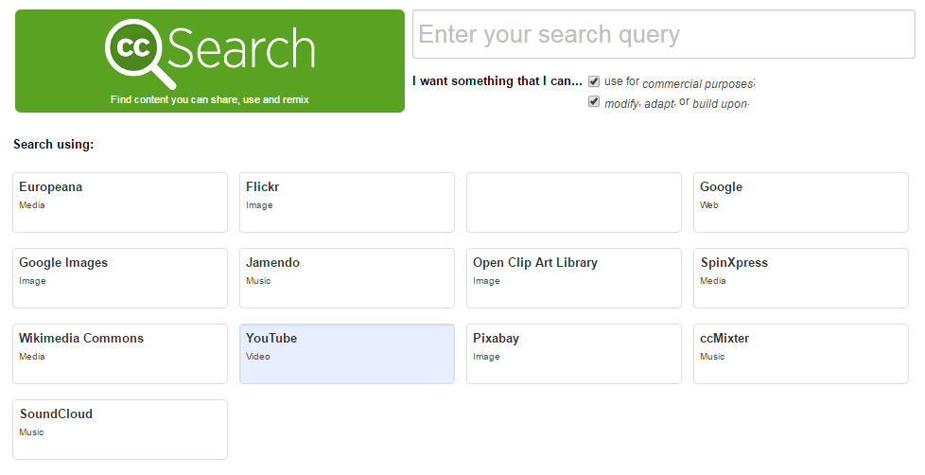
Gathering Creative Commons
Know what you can use…Use and Citation Guildlines on DEVELOPedia
Use creativecommons.org to look on multiple sites at once
Keep track of EVERYTHING you download and use
Cite Twice - 1st in video 2nd in credits
ALWAYS GIVE CREDIT
WHERE CREDIT IS DUE!
Tip: To download from YouTube type ‘ss’ in from of the ‘y’
Eg: https://www.ssyoutube.com/watch?v=AxqZWCK1Gds
Notes:
Understanding what you can and cannot use in your video is very important. It would be awful if you put together a video and found out during the review that you are unable to use some of the footage because you didn’t look closely at the licensing rights. There is a lot of information about what you can and cannot use on DEVELOPedia, YouTube (https://support.google.com/youtube/answer/2797468?hl=en)
Describes creative commons and when in doubt ask us.
A lot of teams use YouTube to find footage so be sure to check the licensing type before you download your videos. A good website I found that can steer you in a good direction is creativecommons.org. This site lets you search for creative commons stuff on multiple locations from flicker to YouTube, to sound cloud. STILL CHECK THE LICENSING.
Be sure you are keeping track of EVERYTHING you download. Where did you get it (URL), who is the main author (YouTube name), what type of media is it, (music, video, and photo). You should cite everything twice in your video. Once when it appears on the video and two when you roll credits. It is highly encouraged your team keep a live recorder of where you got your pieces so you don’t have to search it out again when you are editing the video together.
A pro tip, when you fine a creative commons video on YouTube that you want to download if you put ss in front of the y it will take you to a site where you can download the video quick and easy.

Slide 7
Interviews
Crafting Questions
Brainstorm list with team
Choose 3-5 questions
Avoid YES or NO
Start with: WHERE, WHAT, HOW, & WHY
Preparing for the Interview
4 - 5 questions prepared
10 - 20 sec clips
3 interviewees max
4 interview clips max
Test audio & lighting ahead of time
During the Interview
Bring media release form
Ask about time constraint
Make interviewee feel comfortable
Explain your message
Notes:
While not mandatory, interviews with your project partner is a great way to add value, interest, and credibility to the video.
CRAFTING QUESTIONS:
It is important to spend time crafting your questions, because good questions will lead to interesting answers with valuable content. Have your team brainstorm a long list of questions, and then narrow it down to three or five quality questions.
Avoid close-ended questions that produce one word answers such as “yes” or “no.” Instead, choose questions that start with Where, What, How, or Why.
I’m going to say a question, and you tell me if it’s a good or bad question. Question 1: Will interventions be intensified in the region? Answer: This is not a good question because the interviewer can simply say “yes” or “no” rather than provide knowledgeable information. Question 2: What are the next steps? Answer: This is a good question because the interviewer has to elaborate on the project. Question 3: How will NASA satellite information contribute to the Ethiopia project? Answer: This is a great question because One) it is open-ended and Two) It really ties in the benefits of NASA DEVELOP
PREPARING FOR THE INTERVIEW
The VPS is only 4:15 long, which means the interviews need to be short and concise. We recommend:
10-20 second clips
No more than 3 interviewees
and no more than 4 clips of the interview
If you would like to interview a partner but they are at a different location, ask them to record themselves or record them through a Skype call.
Make sure you know how to use your equipment such as the camera, microphone, tripod, etc. before the interview. This will prevent any technical difficulties during the interview.
DURING THE INTERVIEW
If you can get to your meeting early, set up the video equipment in advance. This looks professional and doesn’t waste their time. Test it with a team member as well so that the shot looks good and the audio is clear.
Make sure your partner signs the media release form, which can be found on our DEVELOPedia page. You can send them the form in advance, but make sure they sign it before you start filming.
Your partner may be busy and only have thirty minutes before their next meeting. Make sure you ask your partner about any time constraints they have.
To ensure the interviews are valuable content, tell the person being interviewed what kind of information would help the story. It’s ok to tell them the overall message you are going for so that they can rephrase their own information and adjust for accuracy. Do not tell them what to say word for word, but instead, use leading or rhetorical questions. If there is time, ask the interviewee if there is anything else they would like to add. Giving them the opportunity to talk about what they are passionate about can also provide valuable information.
Make it a comfortable conversation, don’t Interrogate, and take your time talking. The more conversational you make the interview, the more likely the interviewee we open up and share interesting pieces of information.

Slide 8
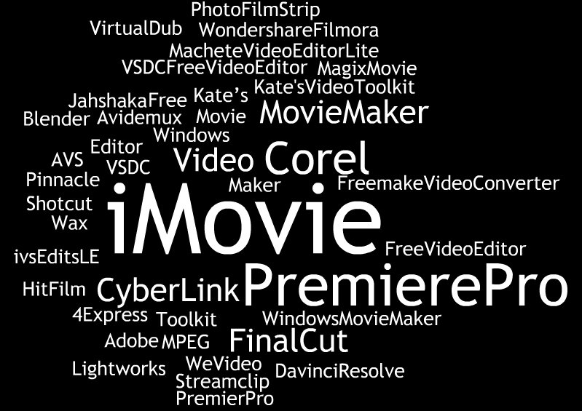
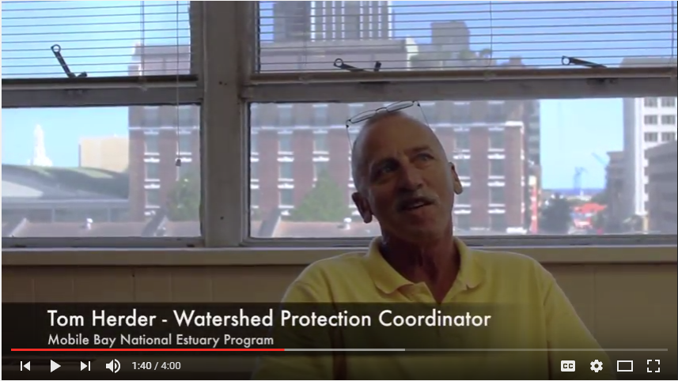
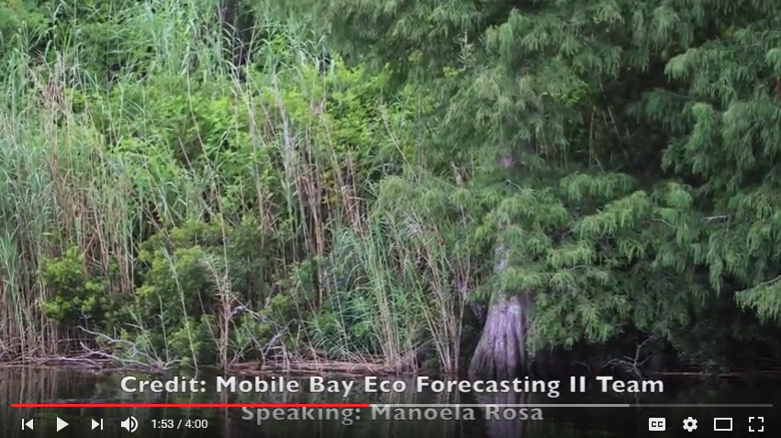
Video Production
Technical editing software and production resources
A-Roll – primary footage
B-Roll – secondary footage
Voice Overs – speak lively
Lighting – avoid shadows
A-Roll
B-Roll
Notes:
Once your team has a clear idea of your storyboard and the information you want to include, the next step is to think about the actual video-making.
Teams have used various video editing software in the past. iMovie and Microsoft Movie Maker are options depending on what computers your team members have. Some software such as Adobe Premiere has a 30 day free trial. There are also many cost-free and legal software programs.
A-Roll – primary footage, such as filmed interviews. This is footage you will create yourself, so use a high quality camera and tripod if possible. For example, here is a screenshot of a project partner being interviewed. This was produced by the Mobile Bay Eco-Forecasting team and is therefore considered A-Roll.
B-Roll – supplemental footage. A-Roll can be mundane on its own, so add some B-Roll. For example, if a project partner is talking about the study area, cut and show some footage of the study area. This will add interest and keep viewer’s attention. Effective use of B-Roll produces a quality video without needing fancy software. B Roll will commonly be images, video, and music you did not create. Jenna gave you a good overview of where to find some of these sources and if you forget, you can check out the DEVELOPedia VPS page. DO NOT FORGET TO CREDIT THESE SOURCES! If you do not credit b-roll material, the Comm Team will send it back.
Voice overs – you and your team members will be narrating the video. A few tips for voice overs is to write a script, and to practice ahead of time. Avoid sounding monotone by modulating your voice, and even smile while narrating. Talk more slowly than your regular talking voice. You want to speak at approximately 160 words per minute.
Audio – test your microphone in advance and make sure there is no echo or distracting background noises
Lighting – lighting can be hard to control, but a few tips are to choose natural lighting over artificial lighting, and incandescent lighting over fluorescent lighting. Be aware where the lighting is coming from and try to avoid shadows. For example, in the A-Roll image on the screen, there is bright natural lighting in the background, which darkens the image of the interviewee. Fortunately, there is enough lighting in front of the interviewee that the shadows are not too dark.

Slide 9
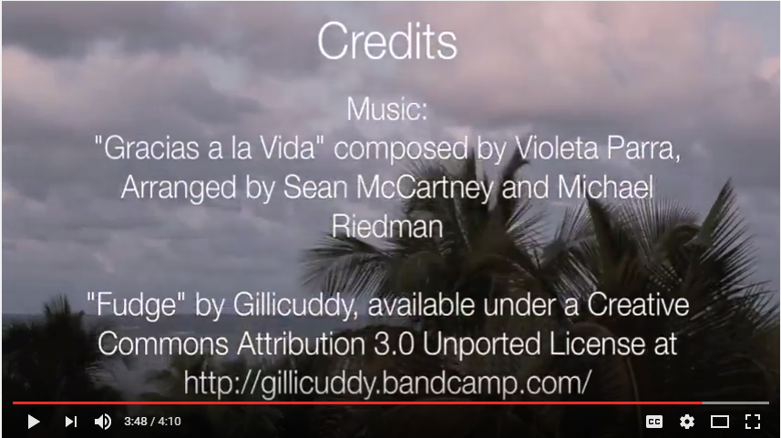
Legal Considerations
Legal Statements – DEVELOPedia > VPS page > Citing, Footage, Imagery > Use Citation Guidelines
Public Domain – DEVELOPedia > VPS page > Imagery links > US Federal Imagery
Things you need:
Media release form
Opening and Closing Clips
Legal statement
Ending credits
Notes:
The legal considerations are the most common edits teams receive. I repeat, the most common mistakes come from the legal considerations, so use citations. If you don’t want a lot of edits from the Comm team, check and double check your use and citations before submitting.
The simplest rule is if it’s copyrighted, don’t use it. Instead, use things with Creative Commons or Public Domain. Jenna showed you how to find creative commons. Public Domain is anything that Fed Agencies release to the public, so videos of NASA satellites can be used. In addition to NASA you can use footage from NOAA, USGS, FEMA, NPS, USDA, and more. We even compiled links of the federal agencies' public domain. Guess where that link is? It’s in DEVELOPedia AND this powerpoint!
Make sure everyone seen or heard in your video signed the media release form. Other than the NASA and DEVELOP logo only use logos for other federal agencies. For example, you can use the National Park Service logo, but you can’t use the The Nature Conservancy logo.
Show opening clip
Credit examples – show another slide and point to proper citations
Opening and closing clips – Mandatory to use the opening and closing clips. It’s the DEVELOP logo. There should not be music during these clips
Required text – There are three mandatory statements that need to be shown in the credits. These are legal statements the NASA needs to have in the VPS. You can find these statements under VPS page > Citing Footage and Imagery > Use Citation Guidelines
Proper citation use – Images are credited to the editor or agency. Music should be credited right when the music begins. The full citation should be displayed in the credit section at the end
HAVE DEVELOPEDIA LINK READY TO GO
XXXXXXXXXXXXXXXXXXXXXXXXXXXXXXXXXXXXXXXXXXXXXXXX
Copyright/licensing – you cannot use any images, footage, music, or other form of copyrighted or licensed material. The only exception is if you have written permission from the owner.
Creative commons – you can use materials that have a creative commons. Jenna mentioned before how to find them, and there are resources to help with that on our DEVELOPedia> Communications> VPS page. With creative commons materials, make sure you do the following: credit the creator, provide the title of the work, provide the URL where the work is hosted, and the type of license it is available under (and a link to that license).
Public Domain – has no copyright. US federal agencies, including NASA have photo and video galleries that can be used by the public.
Authorization and consent - anyone in your video needs to sign a NASA Media release. Most participants have already signed one, but anyone outside of DEVELOP needs to sign one
Logos – Other than the NASA and DEVELOP logo, no other logos can be used. This includes government orgs like NPS, non-profits like TNC, and companies like ESRI

Slide 10
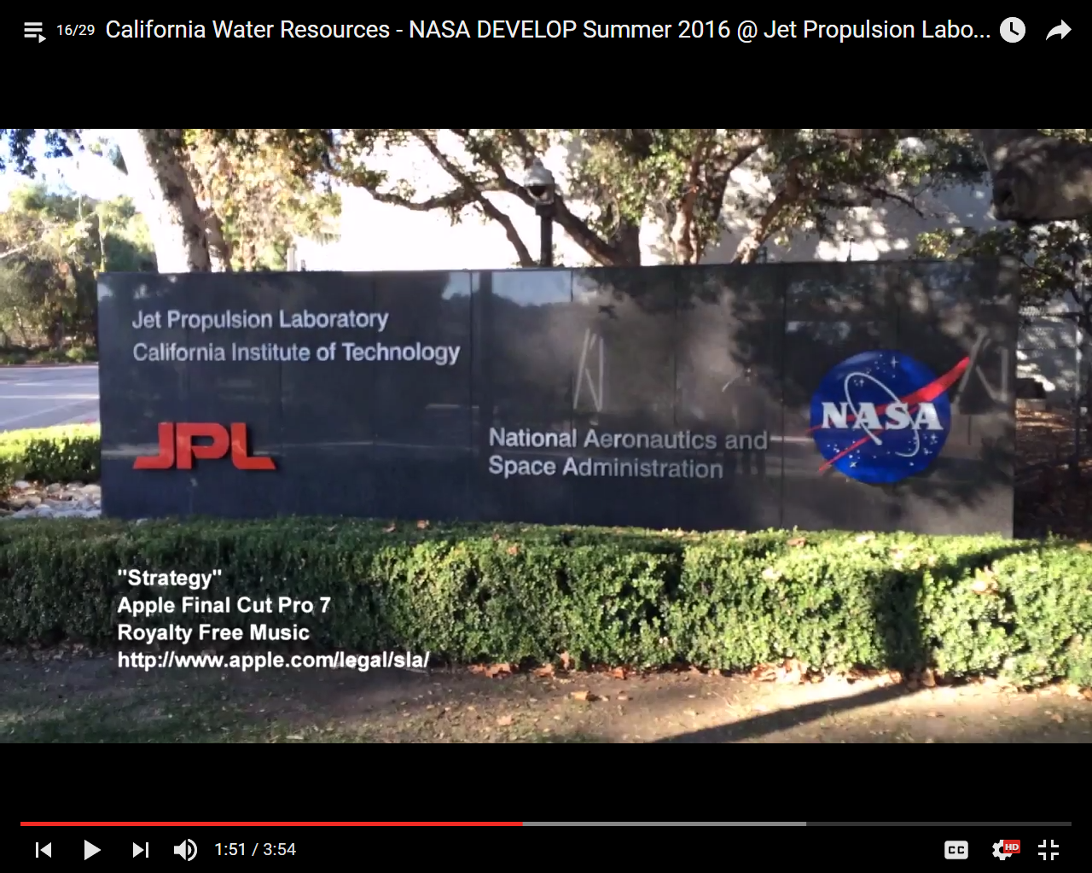
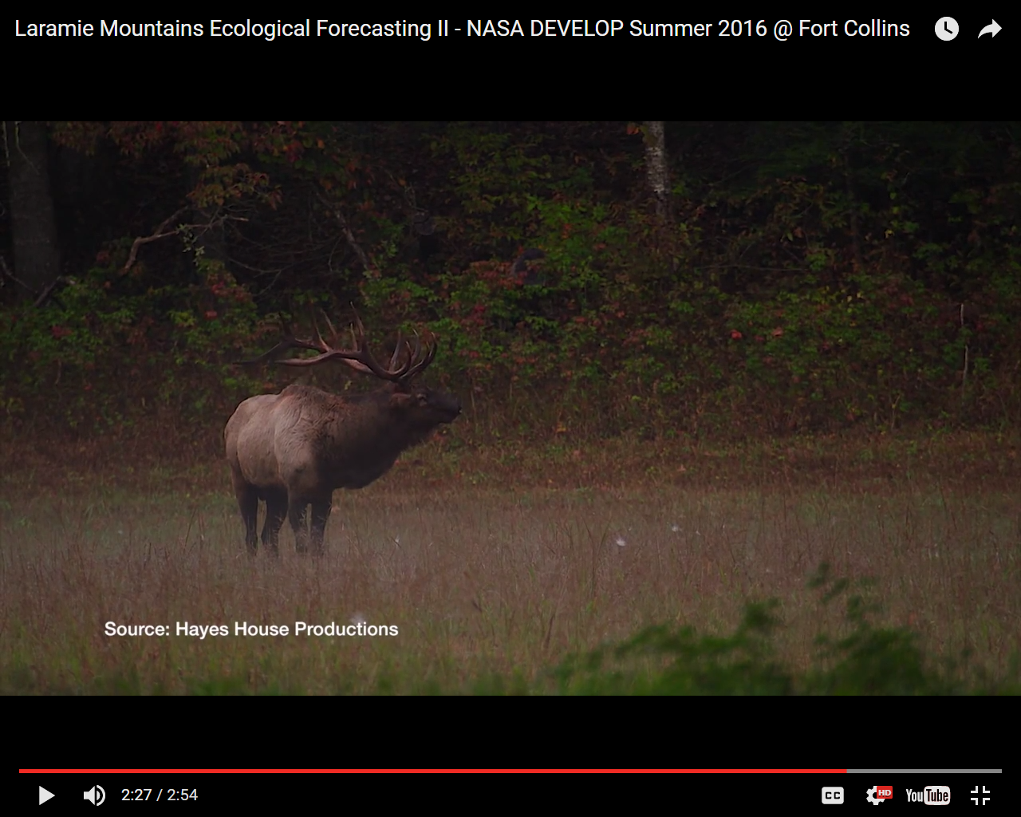
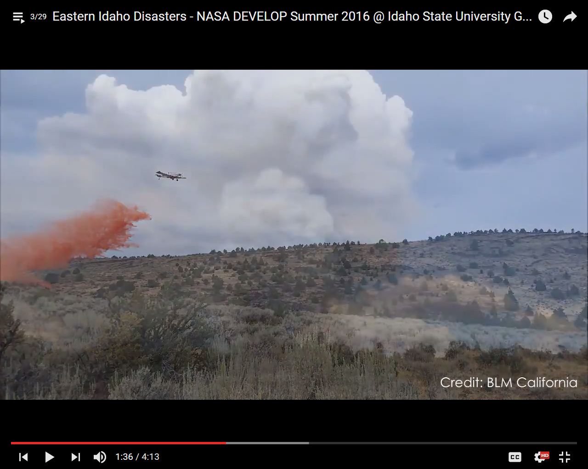
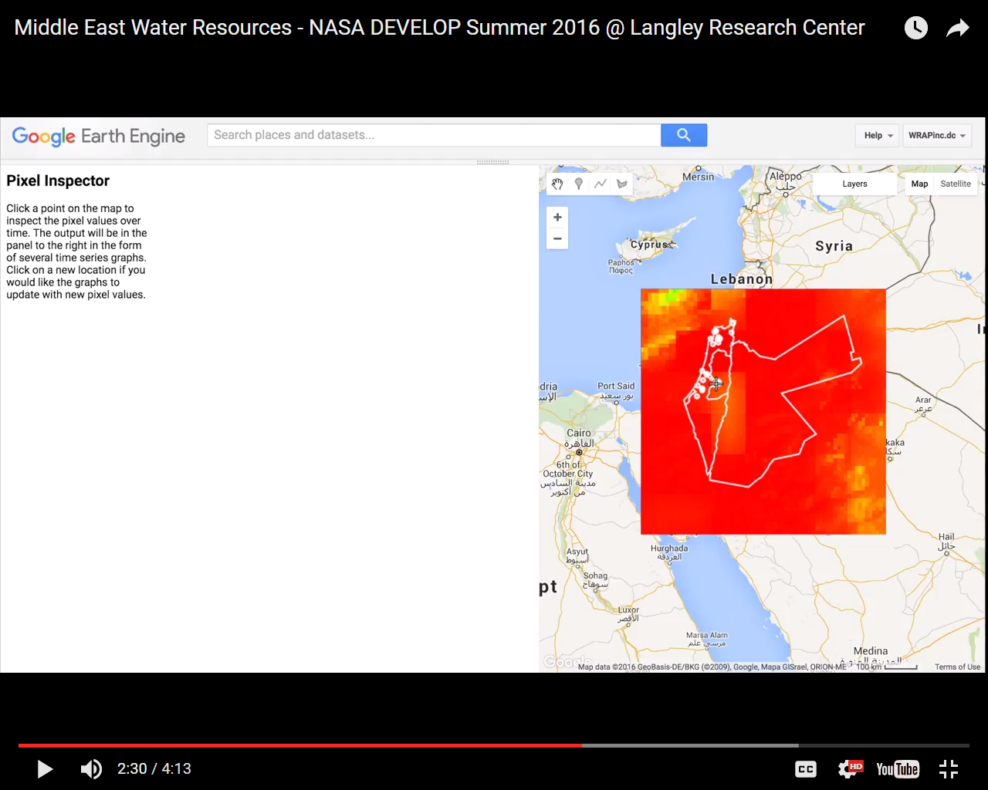
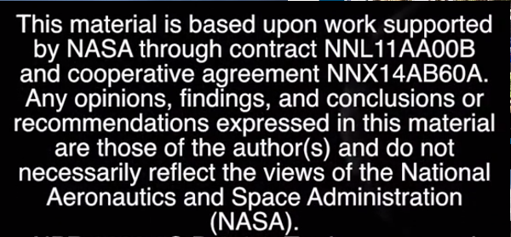
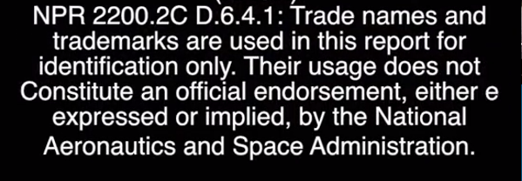
Music
Creative Commons
Public Domain
Proper Citation: title of the work, editor, URL, type of license
Legal Statement
Software
Notes:
Here are some examples of citing in the VPS. For music, display the credit right when the music starts playing. When the music changes, you need to credit the new song as well. For footage and imagery you find in with creative commons licensing, credit the editor of the work. For public domain, credit the agency rather than the editor. When displaying software such as GIS software, you can display it if your location has a license to use the software. Unless it’s Google, you CANNOT show the software logo in your VPS. If it is google such as Google Earth, Google Maps, or Google Earth Engine, you need show attribution to both Google and any data providers on screen at the time the content is shown.
Every VPS needs a credits section at the end of with full list of citations. The credits should include anyone involved in the making of this VPS. This includes project partners, interviewees, science advisors, team participants, and anyone featured in the VPS. The credits also needs a list of citations of all the video, audio, and imagery featured in the VPS. A proper citation should have the title of the work, name of the editor, URL, and type of license. Lastly, the VPS needs to have the mandatory legal statement, shown here on the left. The statement on the right is only necessary if you are using logos that are not NASA or DEVELOP, for example National Park Service logo.
Here’s a quick demo video of how the citations work.
If you understand the citations and legal considerations the first time around, you won’t have as many edits from the comm team after submission.
Citing music
Citing creative commons
Citing public domain
Citing your own work
Legal statement
Credits

Slide 11
Review Process
The PC & Comm Teams are joining forces to help with the VPS process!
VPS Check-In
Week 6: Tuesday 10/18 – Thursday 10/20
One-on-one feedback session between team & PC/ Comm Fellow
Flexible format (i.e. full video, half video, storyboard)
VPS Live Review
Week 8: Tuesday 11/1 – Thursday 11/3
Live review session between team & PC/ Comm Fellow
Mandatory final video viewing
*Sign-up sheet sent to CLs
YouTube! Rubric available on DEVELOPedia
Contact develop.communications@gmail.com for questions/ concerns!
Notes:
Lastly, we are introducing a new review process this term for the VPS. We will have two sessions in which each team will meet with a pair of Project Coordination & Communications Fellows for feedback.
The first session is the “VPS Check-In,” in which each team will have the opportunity to meet with PC/ Comm Fellows for initial feedback on their VPS progress during Week 6.
This session can have a rather flexible format, but we want to give you all the opportunity to get feedback prior to final submission, regardless of where you are in the stages of creating your video.
This will be an informal google hangout in which you can share parts of your video via screenshare (or if you’re way ahead of schedule and have a whole video to share) or even go over ideas or questions regarding your storyboard. The check-in sessions will be brief, up to 20 minute slots. Just remember that the more you share (ideas or actual footage), the more feedback you’ll receive!
Next, during Week 8, teams will participate in the “VPS Live Review” in which they will meet back up with their PC/ Comm Fellows for their final video viewing. This will occur via WebEx in time-slots that each team will sign up ahead of time for. This will streamline the review process with live feedback and comments as all parties watch the video simultaneously. Center Leads will soon be sent sign-up sheets for each review session.
The videos will be published on Earthzine and critiqued by a panel of judges based on a rubric provided by Earthzine. This rubric is available as a resource to you – definitely check it out to make sure you are on track with the various components of your VPS.
Be sure to contact the Communications Team for any additional questions/ concerns with your VPS! We’re all incredibly excited to see your creative juices flow! This powerpoint will also be available as a resource to all DEVELOPers.
Questions?

Slide 12
NASA DEVELOP National Program @NASA_DEVELOP #NASADEVELOP
Facebook - https://www.facebook.com/developnationalprogram/
LinkedIn - https://www.linkedin.com/groups/4343498
Twitter - https://twitter.com/NASA_DEVELOP - @NASA_DEVELOP
YouTube - https://www.youtube.com/user/NASADEVELOP
Encourage your node to DEVELOP our brand!
Notes:
Make sure you follow us on social media! Why should you follow us on social media? First, this is a great way to see what other nodes are doing and connect with them if you have similar projects or interests. Additionally this is a great way to connect with DEVELOP alumni and see if there are any job opportunities. And most importantly, you’re contributing to growing the DEVELOP program. If more people learn about the program, this makes you more marketable when you look for jobs in the future. Do your part by following NASA DEVELOP.
If you post an image about your project, hanging out with participants, or exploring the NASA campus, make sure to use the hashtag NASA DEVELOP. That way potential applicants can see all the activities available as a DEVLEOPer, and they can have a better understanding on what the program is like.
Thanks for doing your part!

