Slide 1
Caribbean Oceans II
Jordan Ped
Investigating Inundation Events: A Study of Remote Sensing Techniques and Novel Data Sources for Sargassum Detection and Quantification in the Caribbean Sea
Emma Accorsi
Maria Lopez-Peña
Notes:
[MARIA]
Hello everyone!
I am Maria Lopez-Peña from the Metropolitan University of Puerto Rico and I am Emma Accorsi from Emory University. We are the Caribbean Oceans DEVELOP team at the NASA Ames Research Center in Mountain View, CA, and today we will be speaking about utilizing NASA Earth Observations to detect Sargassum and to model its relationship between oceanic variables in the Caribbean Sea in response to unprecedented Sargassum inundation events.

Slide 2
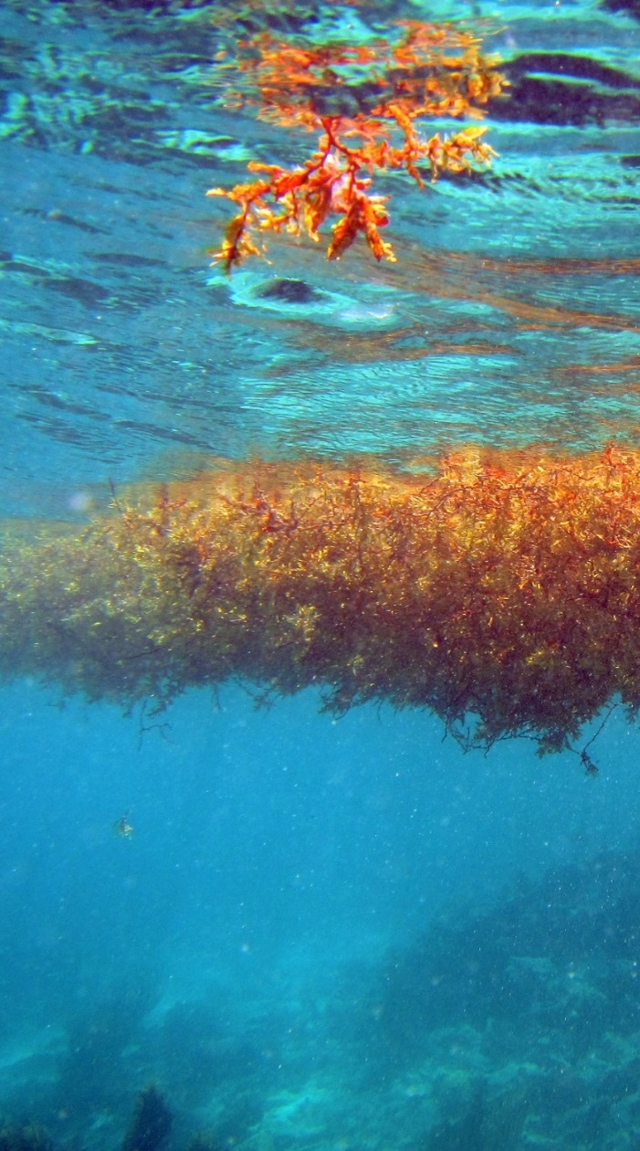
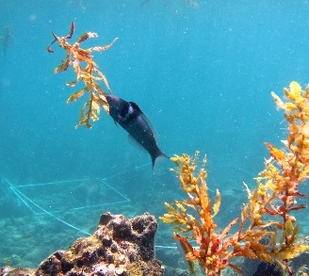
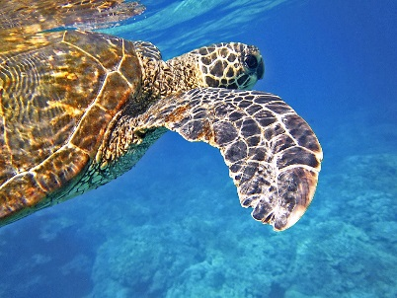
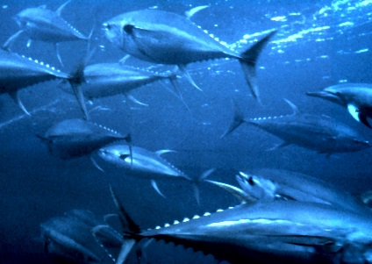
What is Sargassum?
Sargassum - genus of pelagic brown macroalgae
Holopelagic: S. fluitans and S. natans
Significant ecosystem services:
Ocean nutrient cycling
Food Source
Nursery
Habitat
Source: Dr. Juan Torres-Perez
Source: Pixabay
Source: Wikipedia
Helps Promote Biodiversity
Image Credit: Dr. Juan Torres-Perez
Notes:
So what is Sargassum?
Sargassum is a holopelagic brown seaweed that spends its entire life cycle floating in the upper-most part of the water column and plays a vital role in the marine ecosystem.
Many of the ecosystem services that these floating mats provide include: food source and habitat for endemic and migratory species such as the Sargassum Anglerfish and juvenile sea turtles, fish nursery, and nutrient cycling.
These services can promote biodiversity and sustain unique marine communities to flourish in the open ocean.
Image URL:
Turtle: https://pixabay.com/static/uploads/photo/2014/11/27/02/55/sea-turtle-547163_960_720.jpg
Tuna: https://en.wikipedia.org/wiki/Yellowfin_tuna

Slide 3
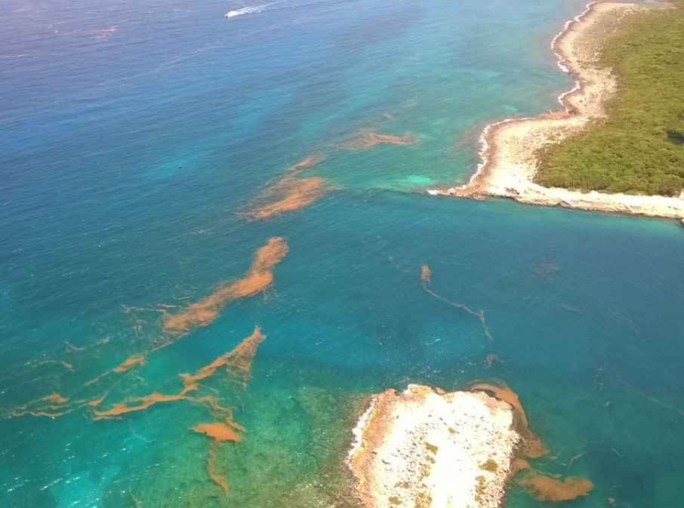
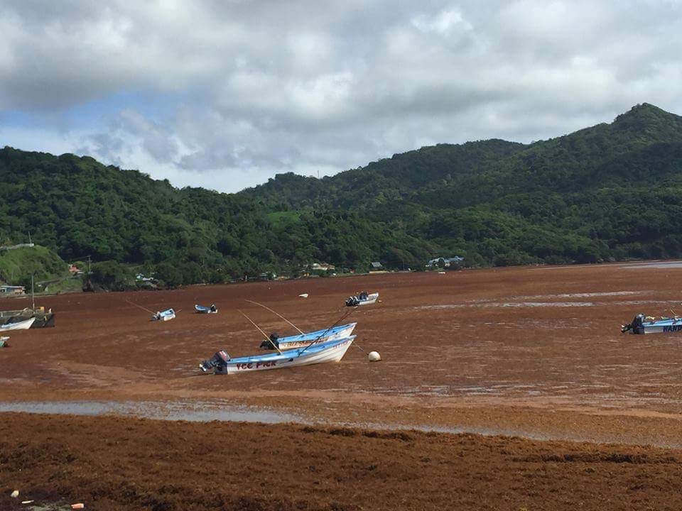
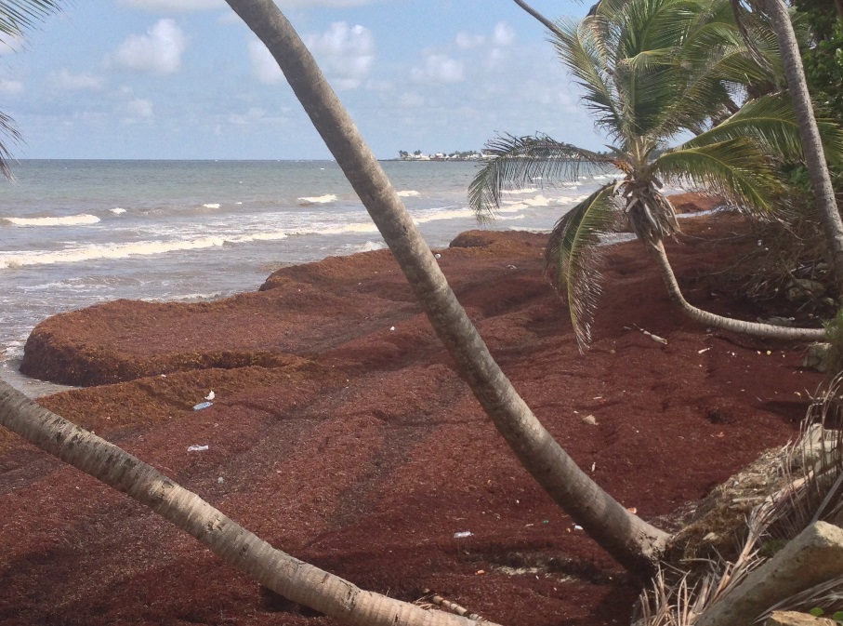
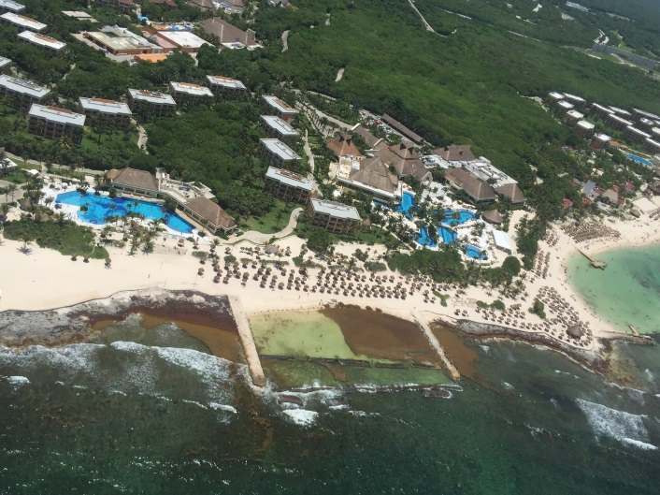
Caribbean Influx
Community Concerns
Environmental
Economic
+
Image Credit: Roy Armstrong
Image Credit: Roy Armstrong
Significant influx in Caribbean in 2011, 2014, 2015
Growing concern from Caribbean Nations
Notes:
The nations of the Caribbean face both economic and environmental concerns from Sargassum inundation events.
Including: harm to near shore-ecosystems from block sunlight to coral reefs and hypoxia for fish populations, compressed sand for sea turtle nests. Reduction in tourism from lack of beach access and putrid smell
Inundation occurred in 2011, 2014, and 2015 prompting significant investigation into the reasons for these events

Slide 4
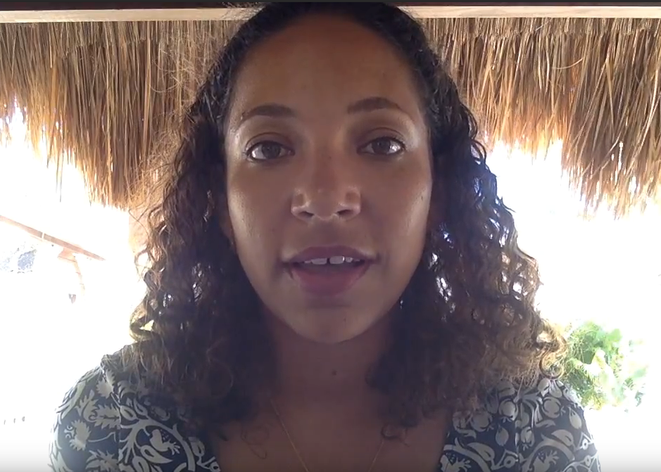
Partnerships
Dr. Porfirio Alvarez Torres, Executive Secretary at CiiMarGoMC
Dr. Sergio Cerdeira, CONABIO
Frederique Fardin,
Project Coordinator on Sargassum Issues at SPAW-RAC
A 2016 survey of 45 marine researchers showed that 80% (36/45) agreed that the amount of Sargassum in the Caribbean in 2015 was significantly higher than in previous years.
Notes:
Our project partners included:
Dr. Porfirio Alvarez from Consorcio de Instituciones de Investigación Marina del Golfo de México y del Caribe (CiiMar-GoMC) who brought our attention to the Project
Dr. Sergio Cerdeira from Comisión Nacional para el Conocimiento y Uso de la Biodiversidad (CONABIO) who helped us with technical specifications
Frederique Fardin from the UN’s Regional Activity Center for Specially Protected Areas and Wildlife (SPAW-RAC) helped us coordinate with other researchers

Slide 5
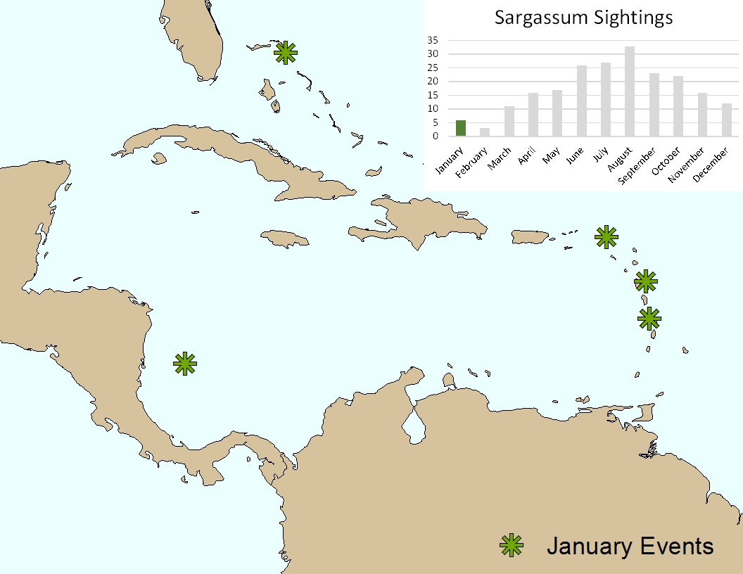
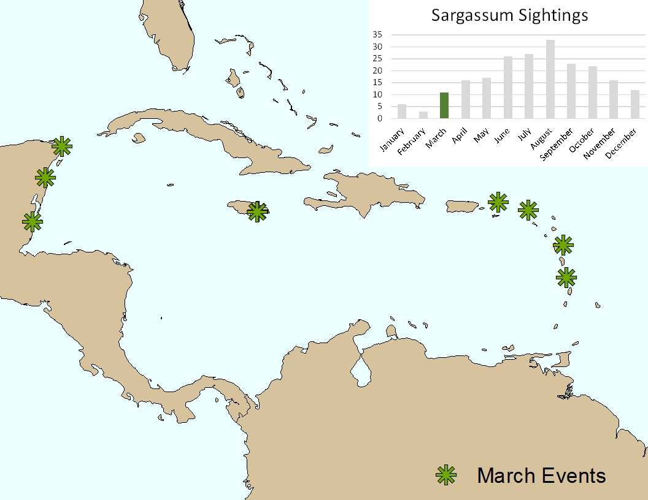
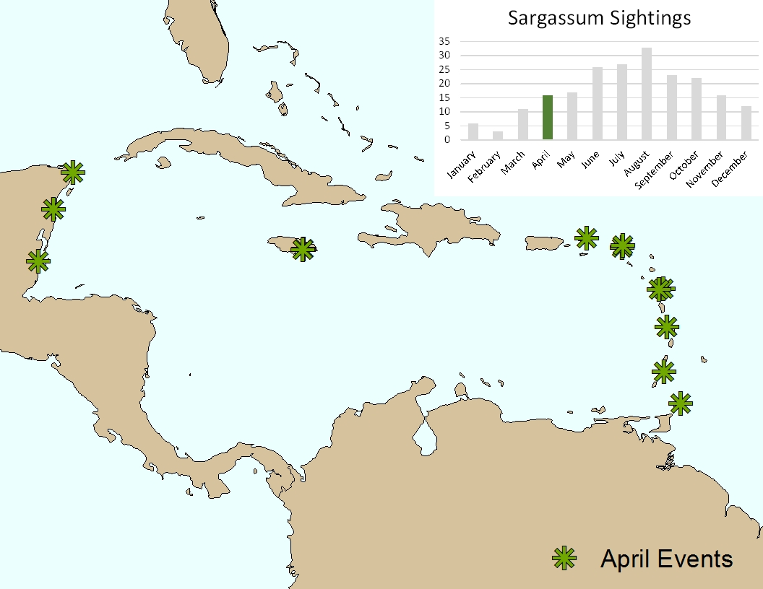
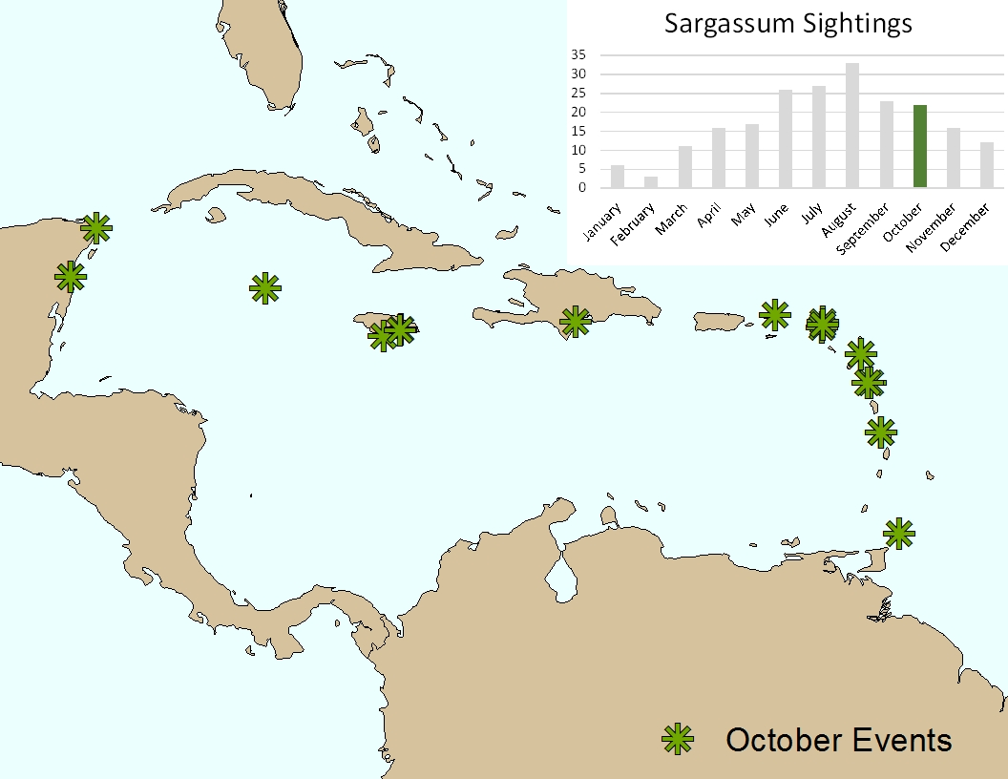
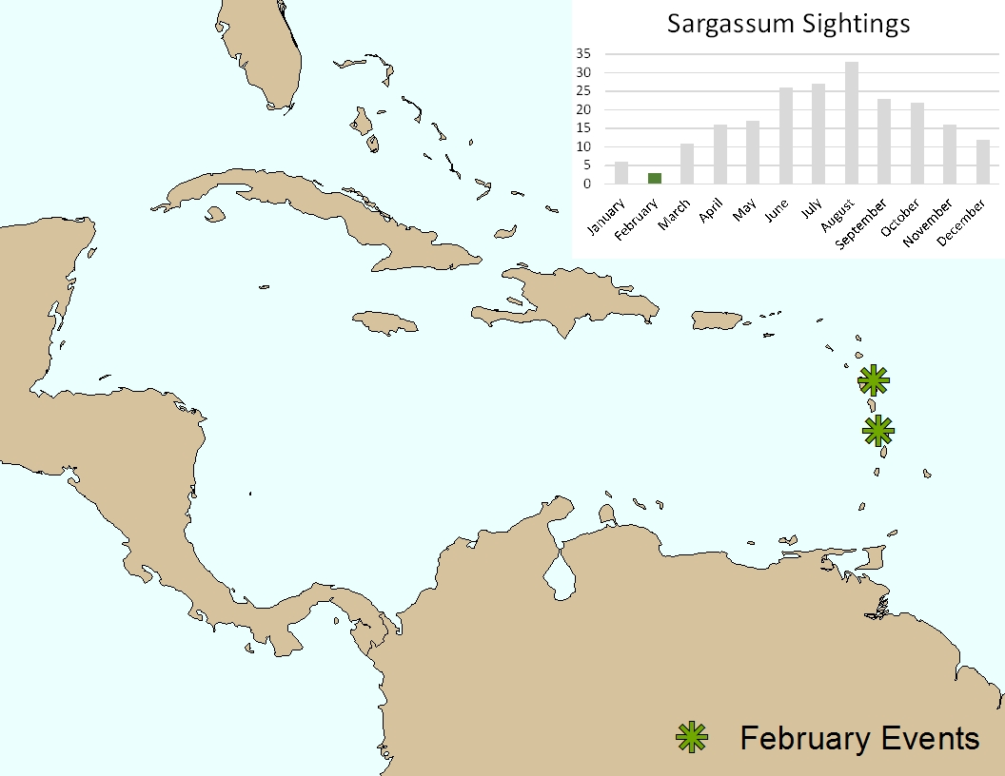
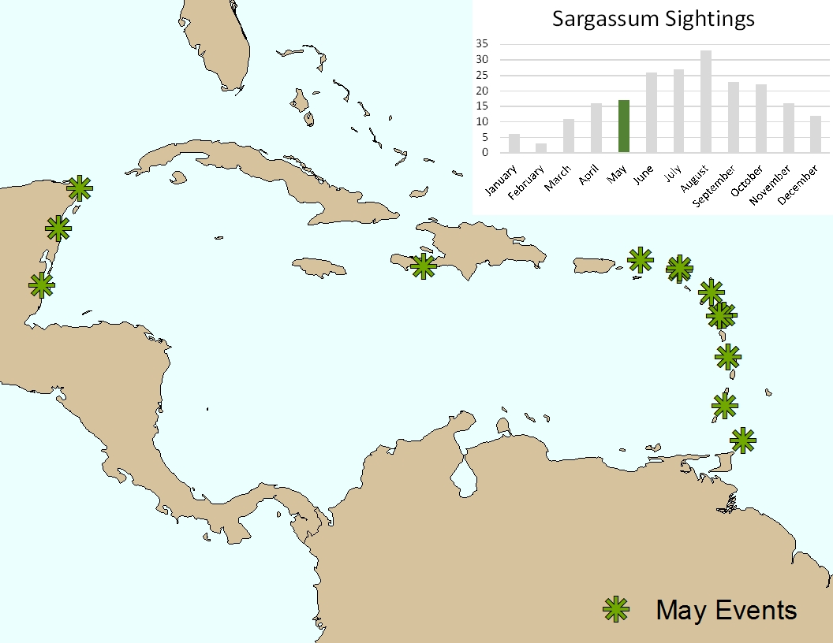
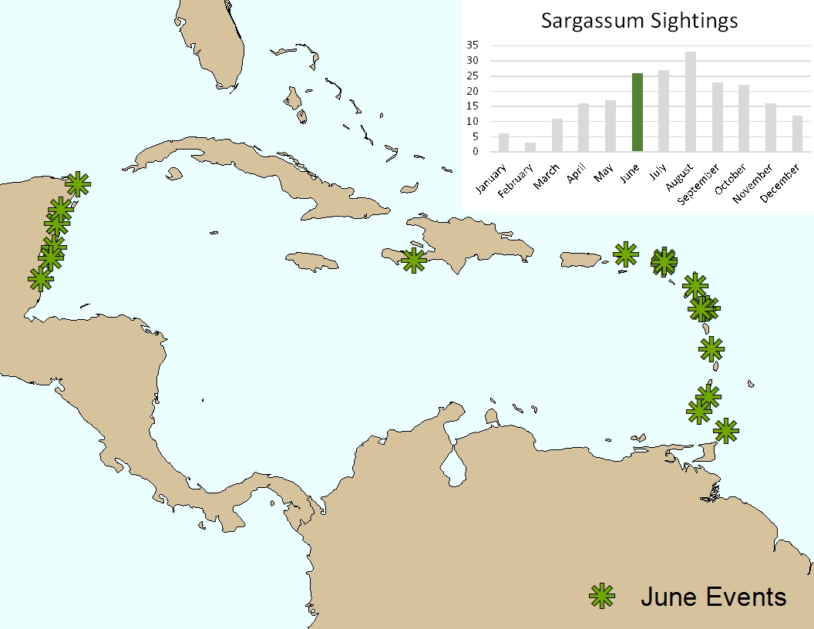
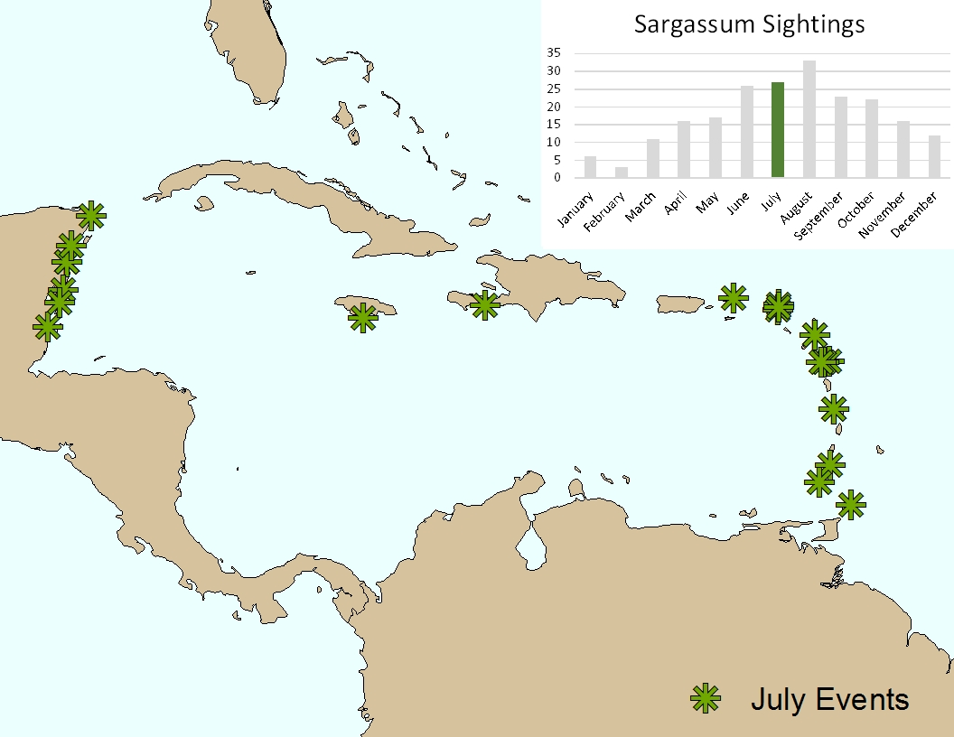
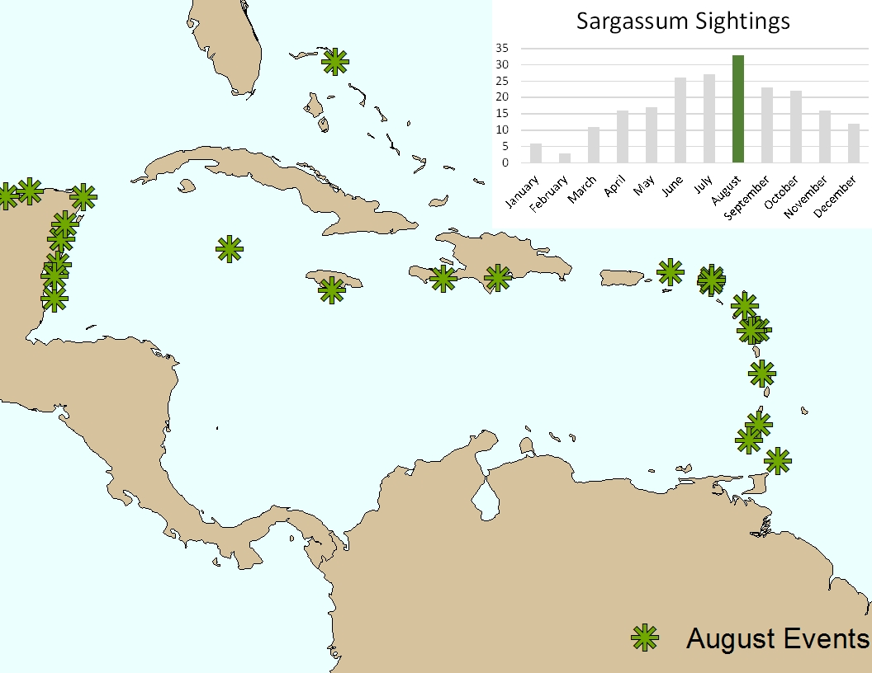
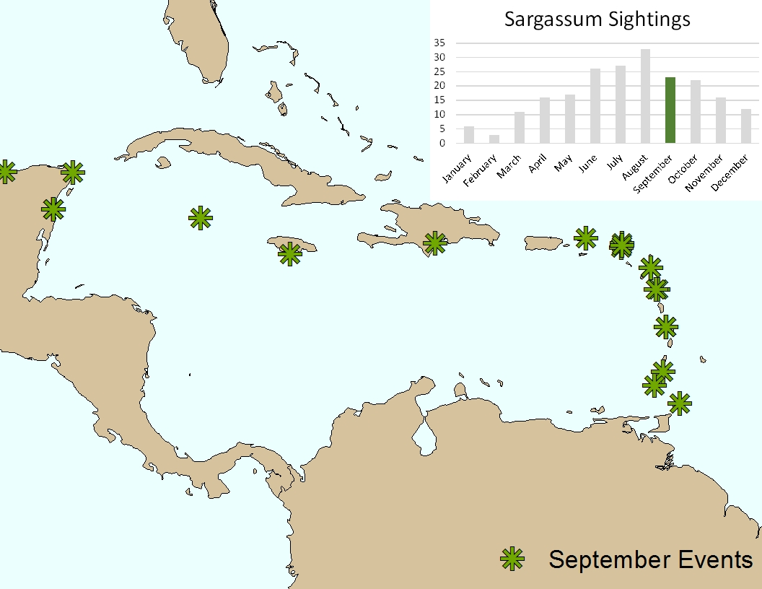
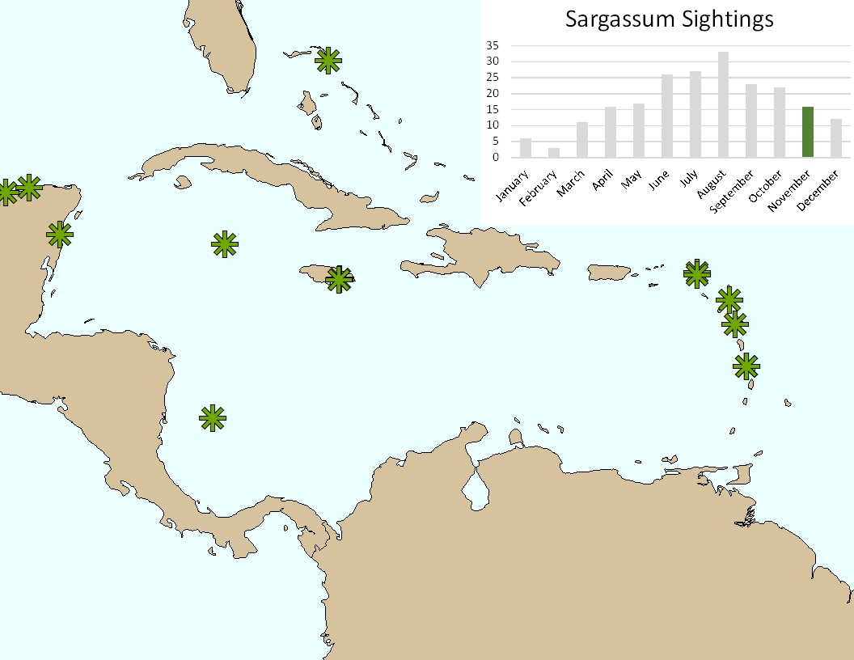
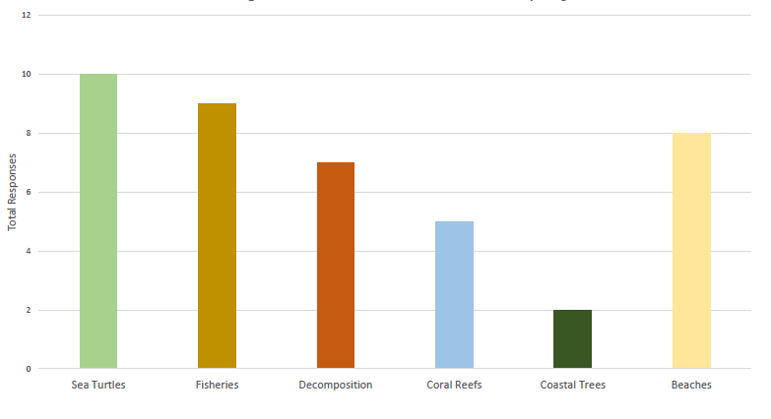
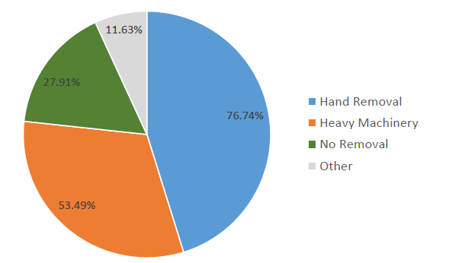
Survey Analysis
Question 7: What time of the year do you observe Sargassum?
Question 4: Main categories of environmental problems caused by Sargassum influx
Question 6: How is Sargassum most commonly removed from the shoreline?
Notes:
Next we analyzed the survey data,
Survey data showed strong seasonality
We also collected information on the context of the problem – such as the main environmental concerns and the most common removal strategies
We have a document summarizing the survey data that we can share if anyone is interested

Slide 6
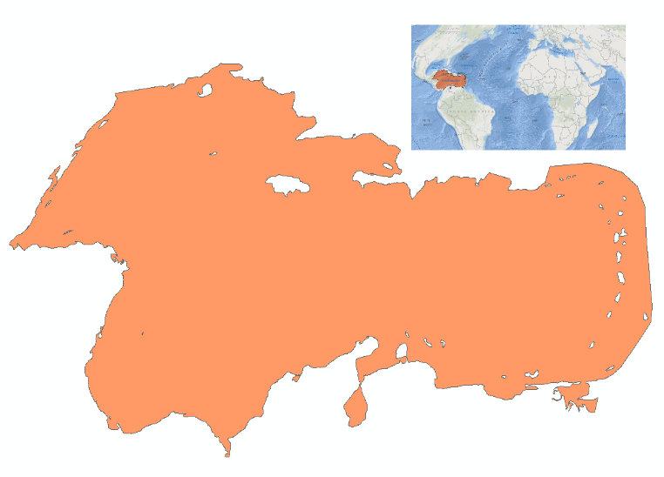
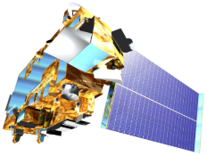
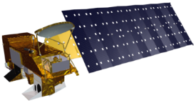
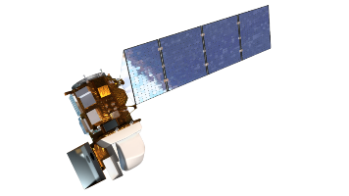
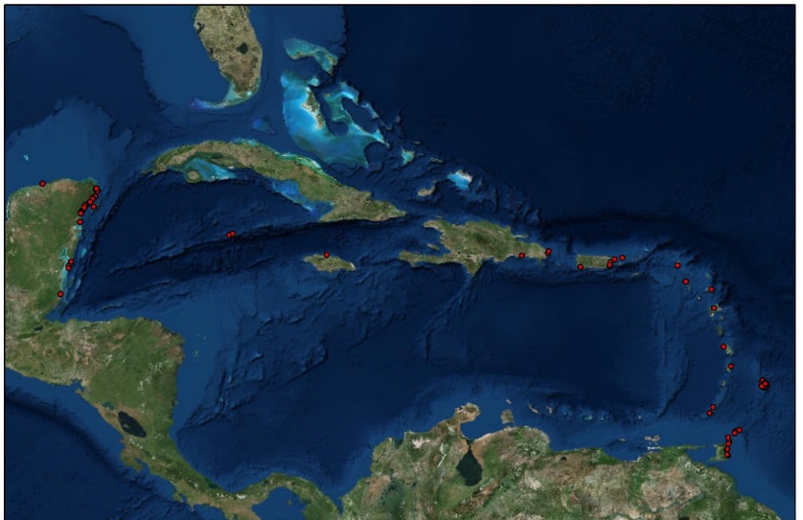
Objectives
Address the recent Sargassum inundation events in the Caribbean Sea using NASA Earth Observations
Compare indices and sensors used for Sargassum detection
Caribbean Sea
Assess accuracy of Instagram as a source of ground truth data

Slide 7
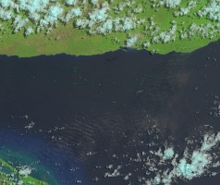
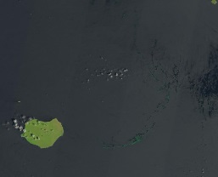
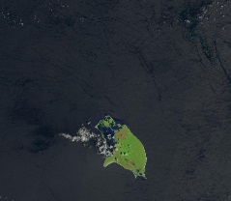
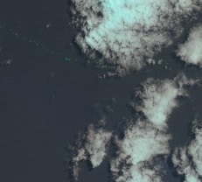
Methods Overview
I. Data Sources & Site Identification
II. Instagram Assessment
II. Imagery Analysis
A. Database Geolocation
A. Image Pre-Processing
B. Accuracy Estimate
B. Application of Indices
C. Sargassum Identification

Slide 8
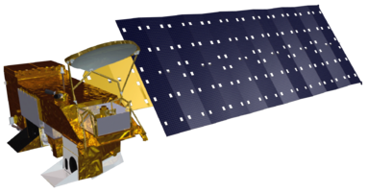
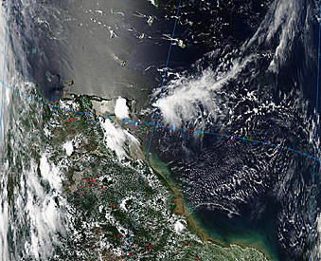
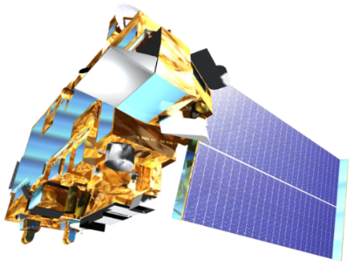
Data Sources
Aqua MODIS
Terra MODIS
Landsat 8 OLI
GLOVIS Earth Explorer Ocean Color Web
glovis.usgs.gov earthexplorer.usgs.gov oceandata.sci.gsfc.nasa.gov
Notes:
We used Aqua, Terra, and Landsat 8 downloaded from glovis, earth explorer, and ocean color web. Landsat has higher spatial resolution and MODIS has higher temporal resolution

Slide 9
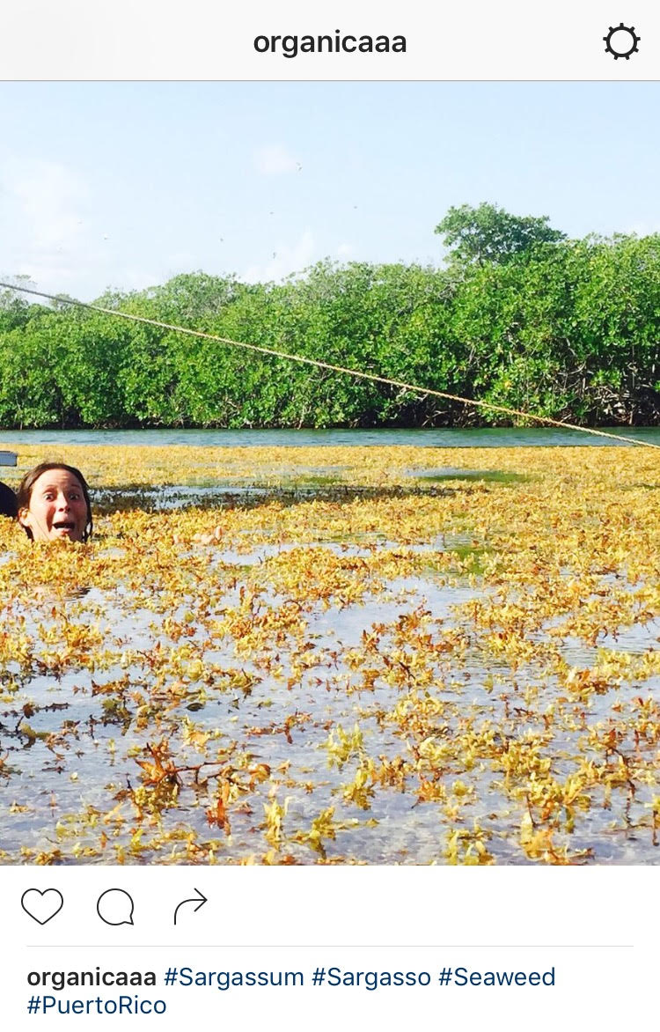
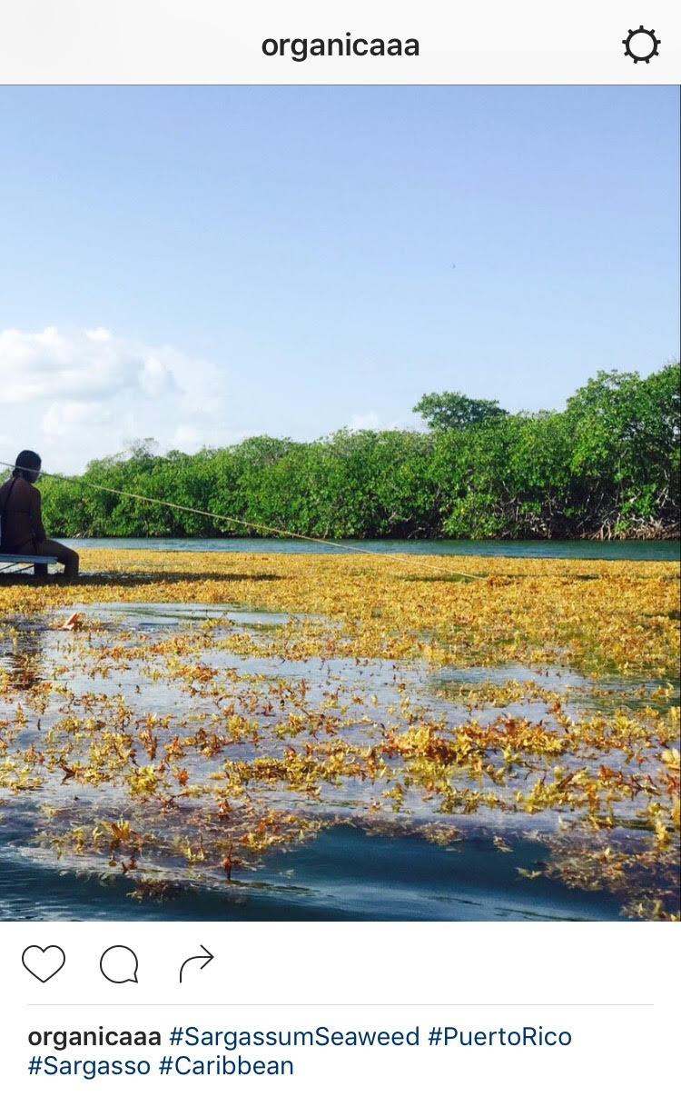
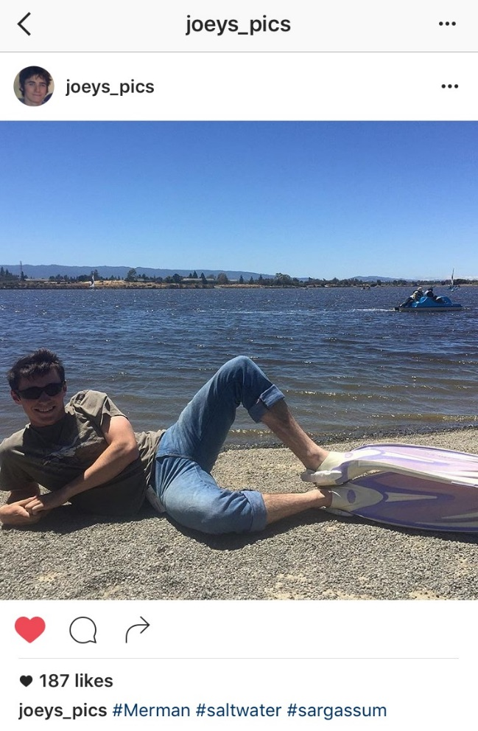
Novel data source:
#Sargassumseaweed
#Sargassum
Notes:
In 2015, users of the social media site Instagram uploaded roughly one hundred images of Sargassum sightings.
Our first goal was to assess the reliability of these reports as a source of ground truth data.

Slide 10
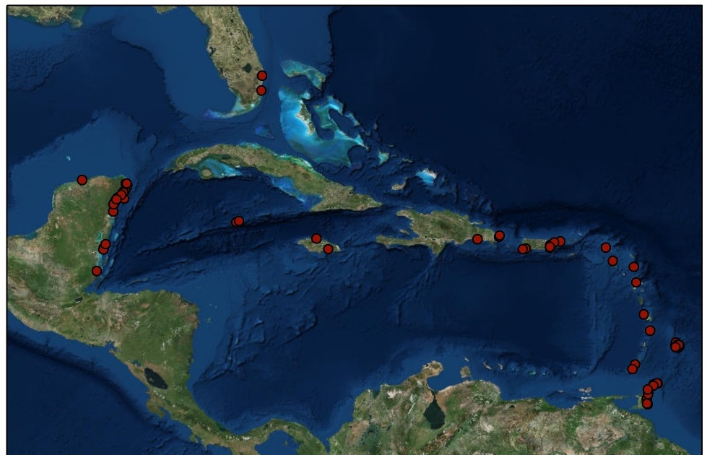
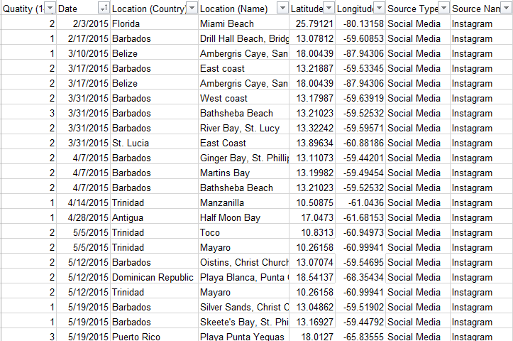
Methods #Instagram
Totals:
103 Instagram reports
128 Landsat images
Database:
Notes:
We created a database of their reports with date and location and visually assessed Sargassum presence in the corresponding Landsat 8 OLI images.

Slide 11
Results #Instagram
79% of images contained Sargassum
Notes:
The results indicate that Sargassum Instagram is a better predictor of Sargassum in landsat imgery when the flyover and posting dates are closer
Additionally as the number of sightings increase Instagram because a better indicator, with all sightings more than 6 being identifiable in a landsat scene
The x-axis in the second graph gives the difference between the Instagram date and landsat fly over in bins of several days. Negative values represent landsat flyovers proceeding Instagram posting.

Slide 12
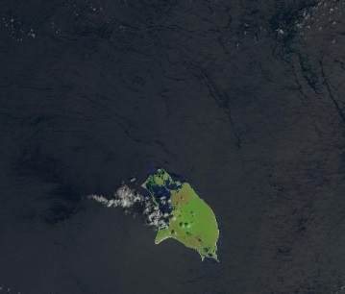
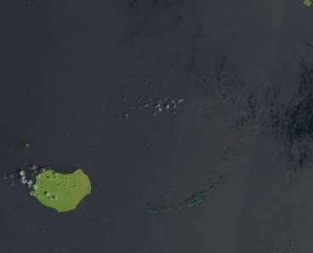
Methods: Imagery Analysis
Landsat 8 NDVI
NDVI = $\frac{RNIR −RRED}{RNIR+RRED}$
FAI = R_{NIR} – $\left[RRED+\left(RSWIR−RRED\right) × \frac{λNIR −λRED}{λSWIR −λRED}\right]$
AFAI = R_{NIR} – $\left[RRED+\left(RNIR2−RRED\right) × \frac{λNIR −λRED}{λNIR2−λRED}\right]$
MODIS NDVI
1
-1
Scene Identification
Atmospheric Correction
Indices
Classification
Notes:
Ideal Sargassum sites were identified based on typical patterns of Sargassum distribution and then corrected using seadas before the application of the ndvi fai and afai imagery. Finally the iamges were classified using arcmap to identify pixels most likely to be Sargassum
FAI and AFAI are similar indicies, but using different MODIS bands the second NIR modis band has lower resolution, but also lower noise creating an index that can be more accurate in some instances

Slide 13
Results: Sargassum Identification
MODIS FAI
MODIS NDVI
Landsat FAI
Landsat NDVI
Notes:
The results indicated that Sargassum can be best identified with landsat fai and our complete results will estimate the difference in amount of Sargassum identified. This is an example from September 19th 2015 near the coast of Isla De Mona in the Dominican republic

Slide 14
Conclusions:
NASA Earth Observations are an effective tool for addressing the recent Sargassum inundation events in the Caribbean Sea
MODIS imagery likely misidentifies large areas
Landsat imagery performs well with FAI
Stronger conclusions cannot be made without a more comprehensive ground truth survey
Instagram can be used as a novel data source for hypothesis generation
Posts with the hashtag can provide researchers initial coverage
Imagery and sightings are more highly correlated at matching flyover dates
Instagram is not a substitute for validation
Image Credit: http://www.hdwidewallpaper.com/caribbean-beach-wide-high-definition-wallpaper-download-pictures/
Image Credit: Roy Armstrong
Image Credit: Roy Armstrong
Notes:
This slide concludes the presentation

Slide 15
Advisors
Dr. Sherry Palacios, Bay Area Environmental Research Institute
Dr. Juan Torres-Pérez, Bay Area Environmental Research Institute
Partners
Dr. Porfirio Alvarez Torres, Consorcio de Instituciones de Investigación Marina del Golfo de México y del Caribe (CiiMarGoMC)
Dr. Roy A. Armstrong, Bio-optical Oceanography Laboratory University of Puerto Rico, Department of Marine Sciences
Dr. Sergio Cerdeira, Marine Monitoring Coordinator at Comisión Nacional para el Conocimiento y Uso de la Biodiversidad (CONABIO)
Dr. Amy Siuda, Dr. Deb Goodwin, Dr. Jeff Schell Sea Education Association
Frederique Fardin, SPAW-RAC
Others
Chippie Kislik (NASA Ames DEVELOP Center Lead)
Victoria Ly (NASA Ames DEVELOP Assistant Center Lead)
Erica Scaduto (DEVELOP Alumna)
Notes:
[MARIA]

Slide 16
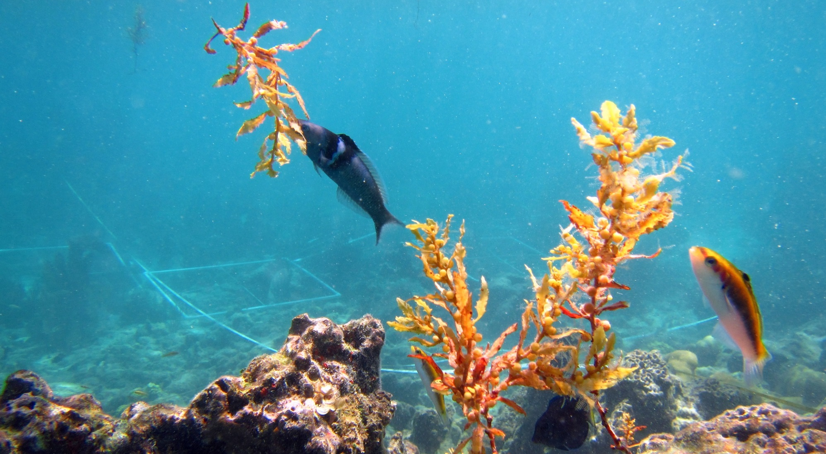
Questions?
Contact:
emma.k.accorsi@nasa.gov
maria.c.lopez-pena@nasa.gov
jordan.w.ped@nasa.gov
Source: Dr. Juan Torres-Perez

