Slide 1
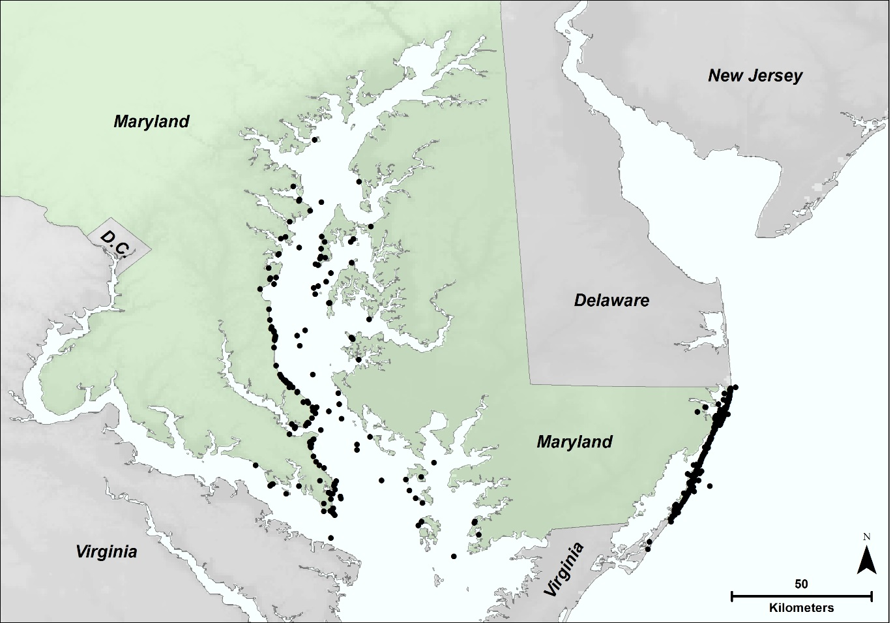
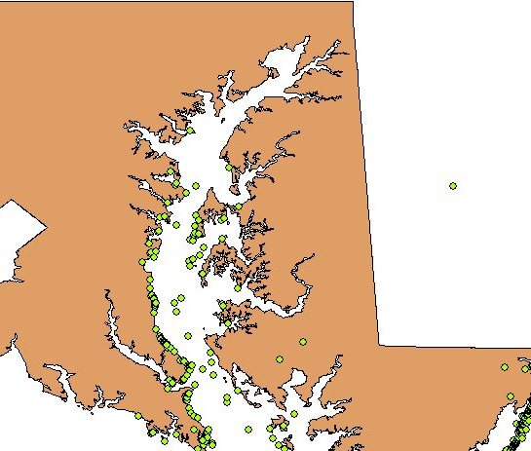
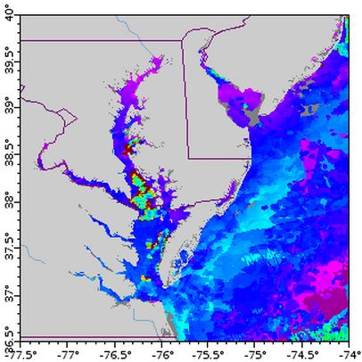
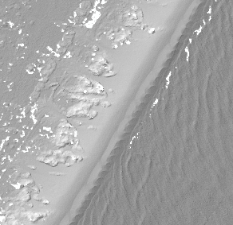
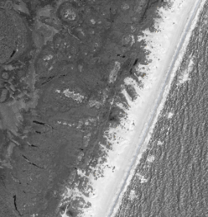
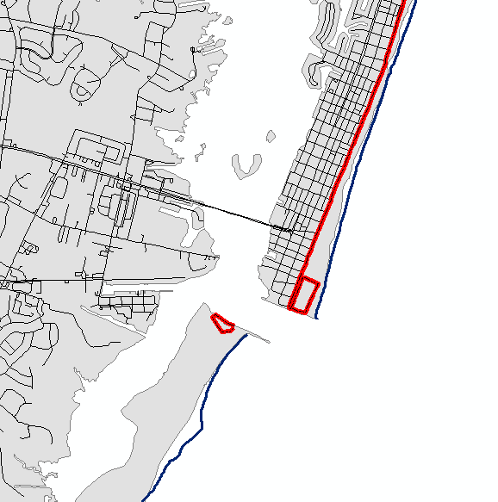
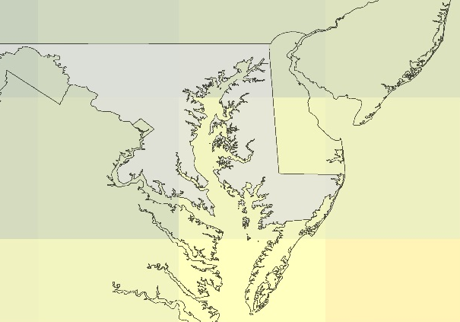

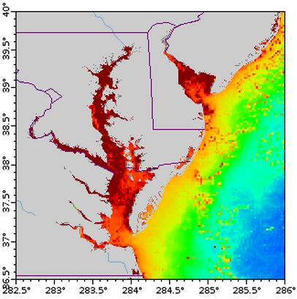
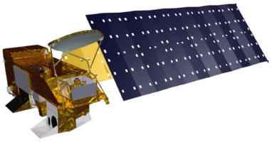
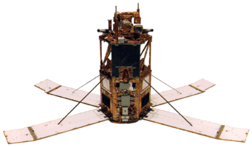
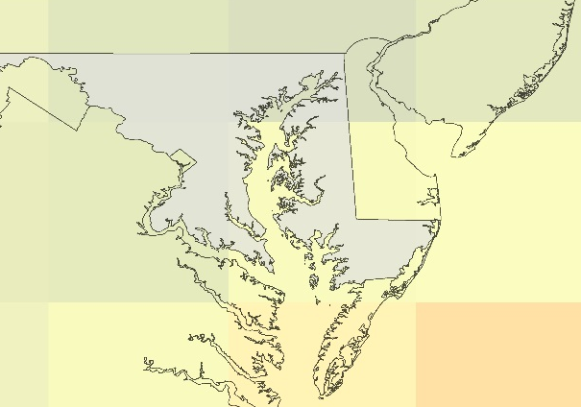
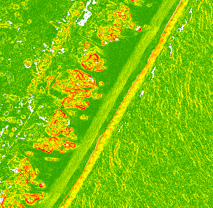
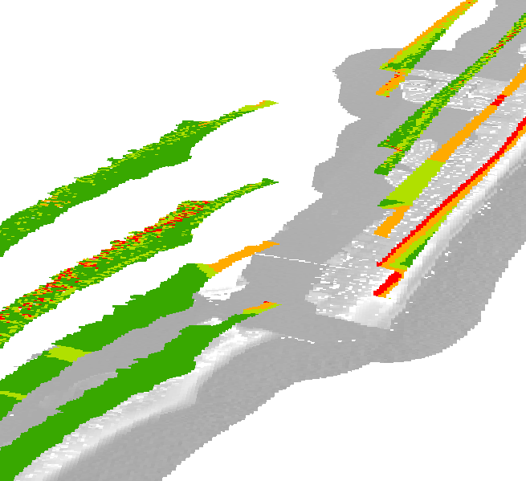
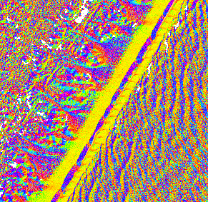
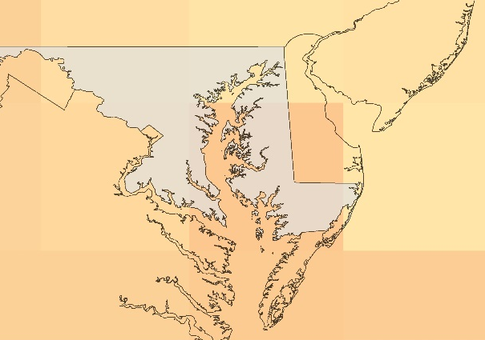
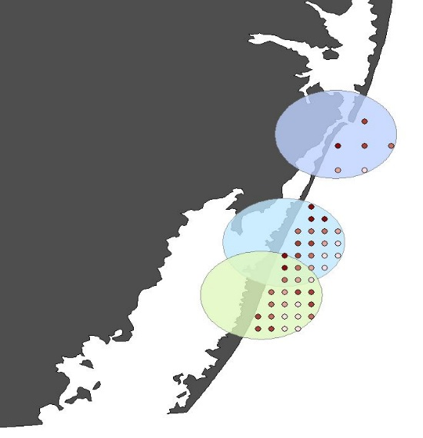
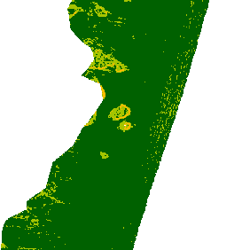
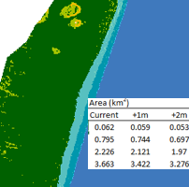
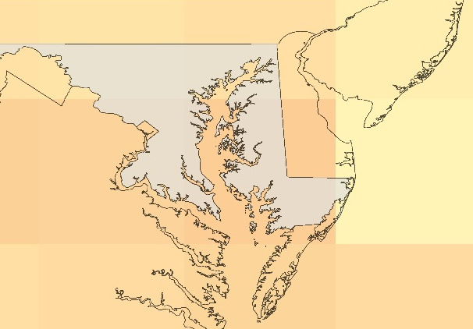
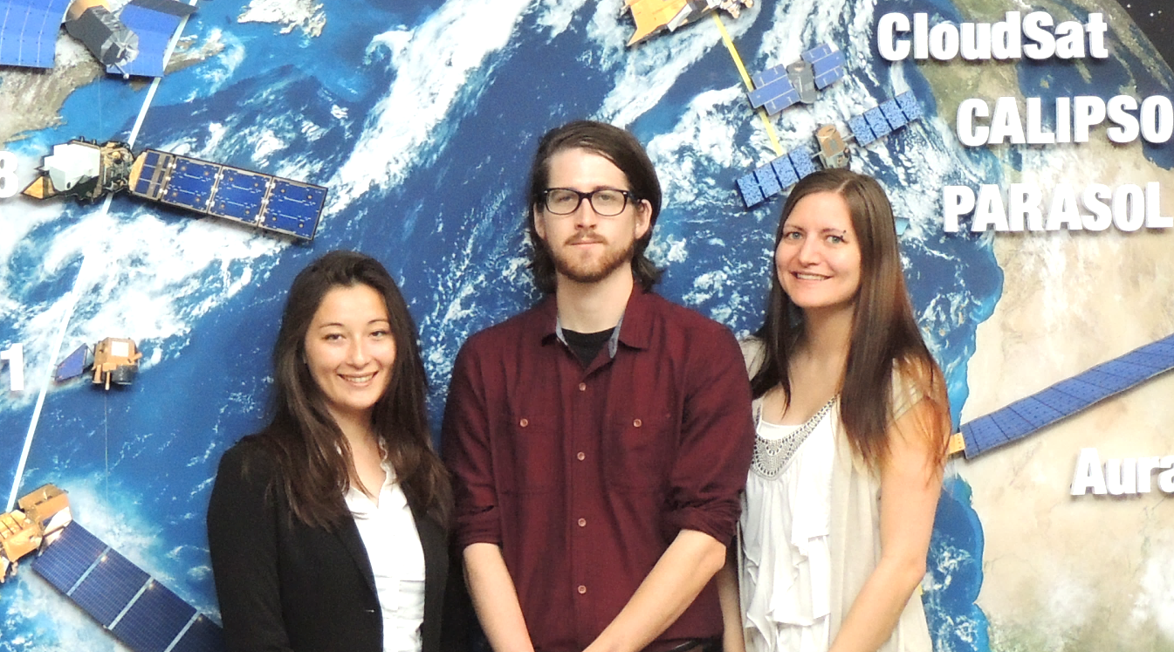
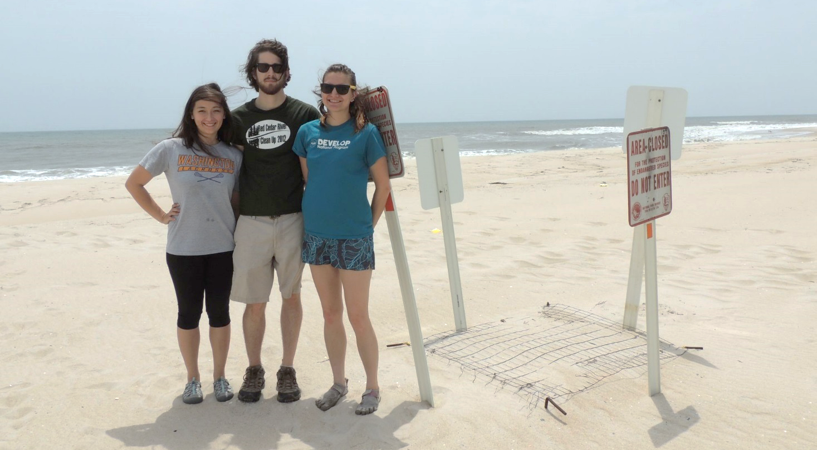
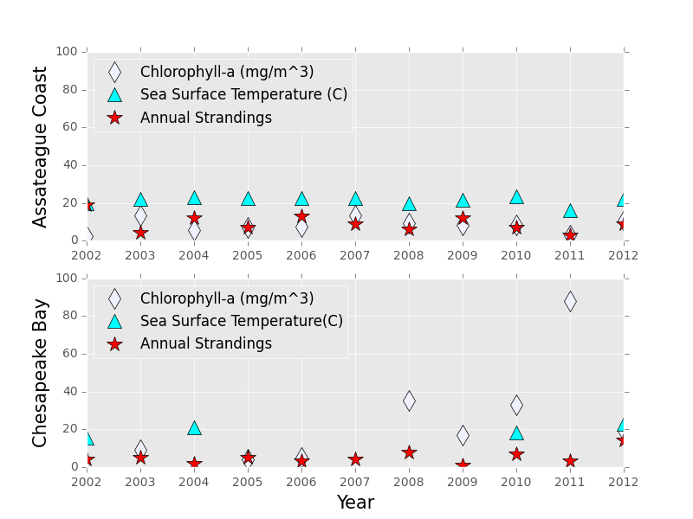
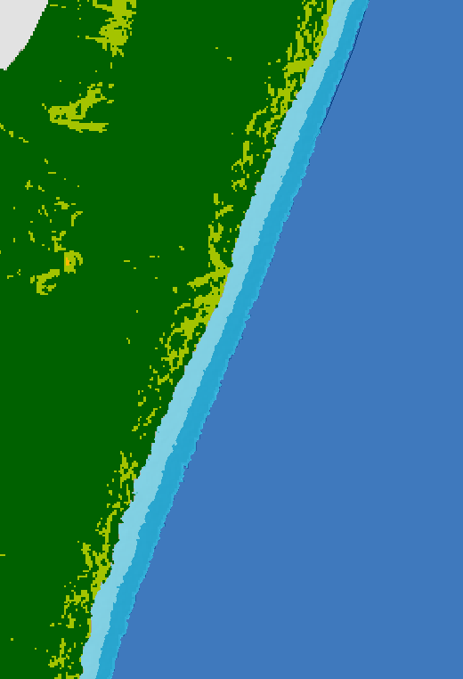
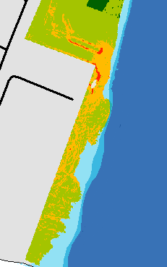
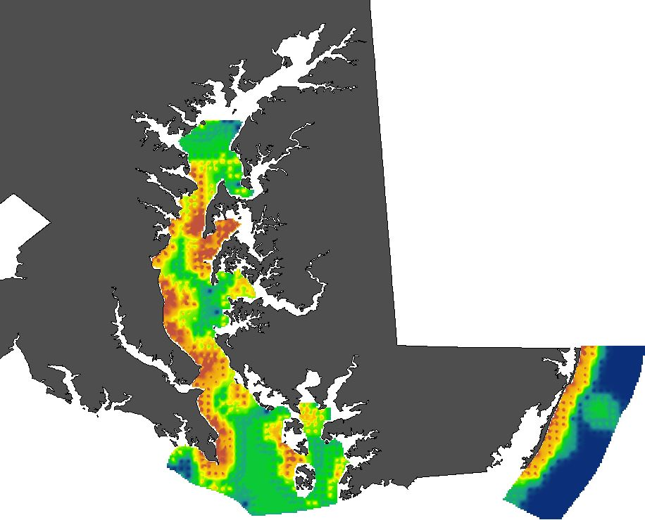
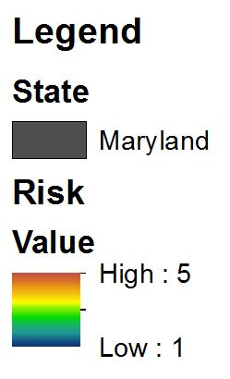
Maryland Ecological Forecasting
Utilizing NASA Earth observations to monitor and strengthen the survivorship of Maryland’s sea turtles
Chris Long (Project Lead), Erica Scaduto, Kiersten Newtoff
NASA DEVELOP National Program at NASA Goddard Space Flight Center
Abstract
Objectives
Maryland experiences dozens of sea turtle strandings every year on both the Atlantic and Chesapeake Bay coasts. The majority of these strandings are juvenile loggerhead sea turtles (Caretta caretta) that wash onshore during the late spring to early fall. Although some strandings are attributable to anthropogenic recreational activities, such as fishing and boating, most of the strandings lack a clear cause of death. Changes in sea surface temperature, algal bloom activity, and weather events can all affect the survivorship of sea turtles. Here, we analyzed correlations in loggerhead strandings with sea surface temperature and chlorophyll-a measured remotely by the Aqua and Terra Moderate Resolution Imaging Spectroradiometer (MODIS) sensor and the SeaWIFS instrument onboard OrbView-2 to understand the environmental variables affecting survivorship since 1991. The project also identified potential nesting site locations since this life cycle stage is the most sensitive. Nesting activity is limited in Maryland, but modeled climate change indicates warming along the Atlantic coastline – which will push the nesting range of loggerheads northward. Distance from human infrastructure, beach width, and beach slope were used to determine the greatest likelihood of future nesting under different climate and sea level rise scenarios using the Community Climate System Model. Findings will be used by the Maryland Department of Natural Resources to react faster and efficiently to future strandings and to conserve potential nesting site locations.
Analyze relationships between chlorophyll-a and sea surface temperatures with loggerhead strandings
Use climate models to investigate the effect of climate change on future nesting site distribution in Maryland
Identify suitable loggerhead nesting beaches along Atlantic coastline in response to sea level rise
Study Area
Methodology
Stranding
Nest Forecasting
Nesting
Data Acquisition
Data Acquisition
Data Acquisition
Maryland’s Chesapeake Bay and Atlantic coasts
Strandings (black dots) from 1991 – 2014
Community Climate System Model 3
Four International Panel for Climate Change 4 projections
g
2050: Levels constant since 2000
LiDAR Flight, Derived DEM
WV2 Imagery
TIGER Roads
Layer
Earth Observations
Sea Turtle Stranding
Sea
Surface Temp
(SST)
OrbView-2
Terra
2050: B1, declining pop., greener tech
Data Processing
Aqua
Chlorophyll-a (Chla)
Project Partner
Data Processing
2050: A1B, declining pop., lower fossil fuel use
DEM + Products, Imagery, Roads, Beach
Suitability Layers
Maryland Department of Natural Resources
Used SST and Chla 8-day composites from 1-4 days prior to strandings depending on
decomposition state
Averaged each parameter within 5 km regions of turtle stranding to account for drifting
Team Members
2050: A2, increasing pop., same fossil fuel use
Overall Suitability, Sea Level Rise Elevations
Flooded Beach, Suitability Values
Results
Stranding
Nest Forecasting
Nesting
(L to R) Erica Scaduto, Chris Long, Kiersten Newtoff
May
Suitability | Area (km²)
 | +0m | +1m | +2m
Low | 0.062 | 0.059 | 0.053
Medium | 0.795 | 0.744 | 0.697
High | 2.226 | 2.121 | 1.97
Highest | 3.663 | 3.422 | 3.276
 | 6.746 | 6.346 | 5.996
Conclusions
Current nesting temp from FL - NC
Strong, positive correlations were seen between sea surface temperature and annual stranding events in both regions from 2002-2012.
Society currently reflects the A2 scenario, which will lead to more nests by 2030 in July followed by other months in future decades.
Current suitable nesting habitat for nesting totals 6.75km², which may be reduced by 5% to 12% under estimated 1m and 2m sea level rise in. Several areas on Assateague Island provide ideal regions for future conservation efforts.
Region | Parameter | Pearson’s Correlation | P-Value | CORR
Assateague Coastline | Chla | -0.00397 | 0.991 | - None
 | SST | 0.551 | 0.098 | + Strong
Chesapeake Bay | Chla | -0.308 | 0.419 | - Mod
 | SST | 0.525 | 0.648 | + Strong
June
2015 Risk Map
Surface temperature (°C)
July
Acknowledgements
August
One of several regions of highly-suitable habitat with minimal losses from sea-level rise found throughout Assateague Island
Lower suitable habitat near Ocean City, experiencing substantial loss from sea level rise and threats of human interaction
Cindy Driscoll (MD Department of Natural Resources)
Amanda Weschler (MD Department of Natural Resources)
Gary Strand (National Center for Atmospheric Research)
Dr. John Bolten (NASA Goddard Space Flight Center)
NASA Goddard Space Flight Center

