Slide 1
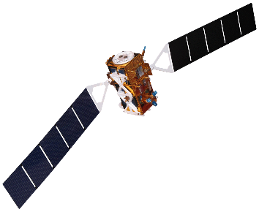
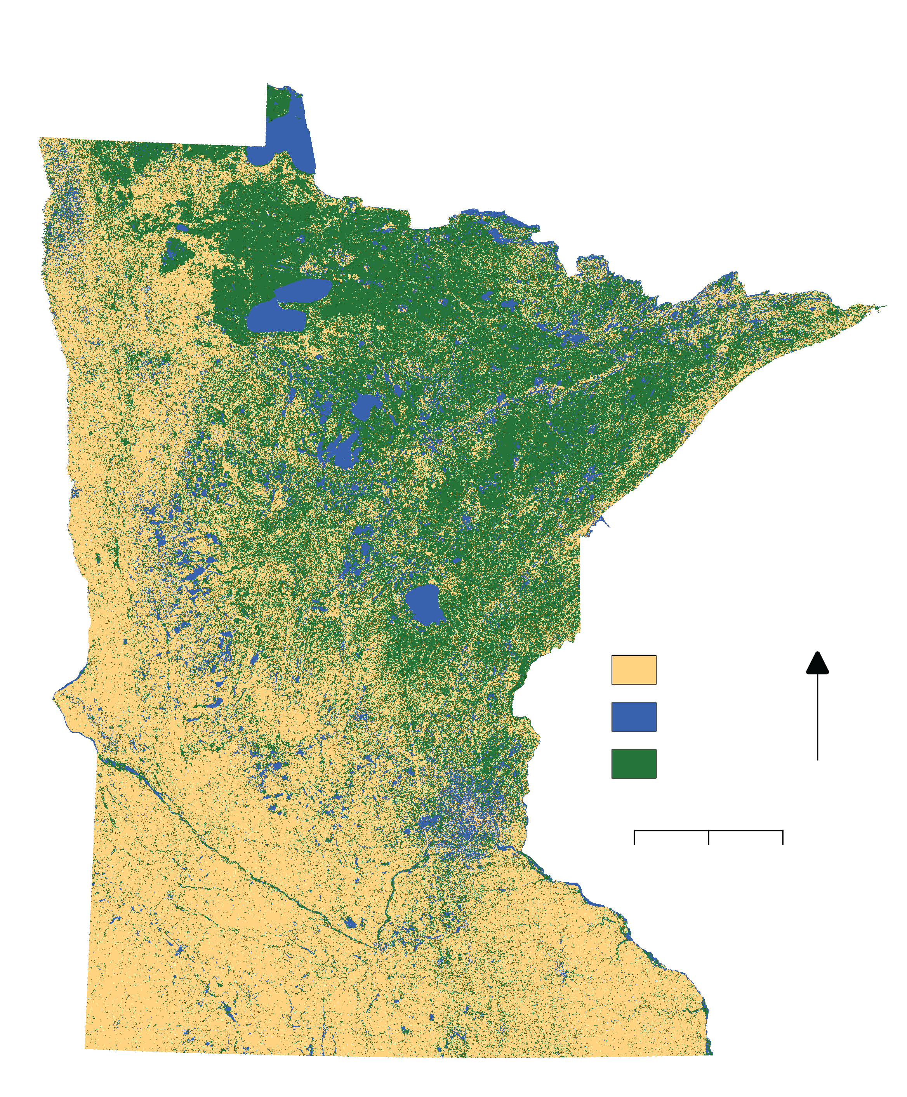
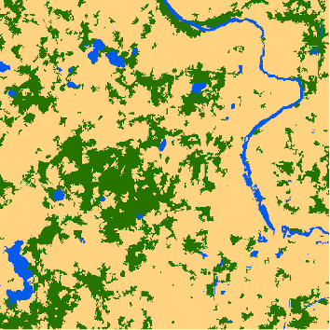
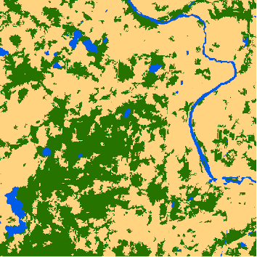
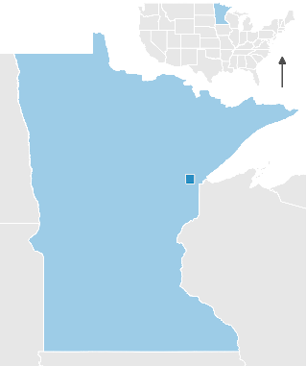
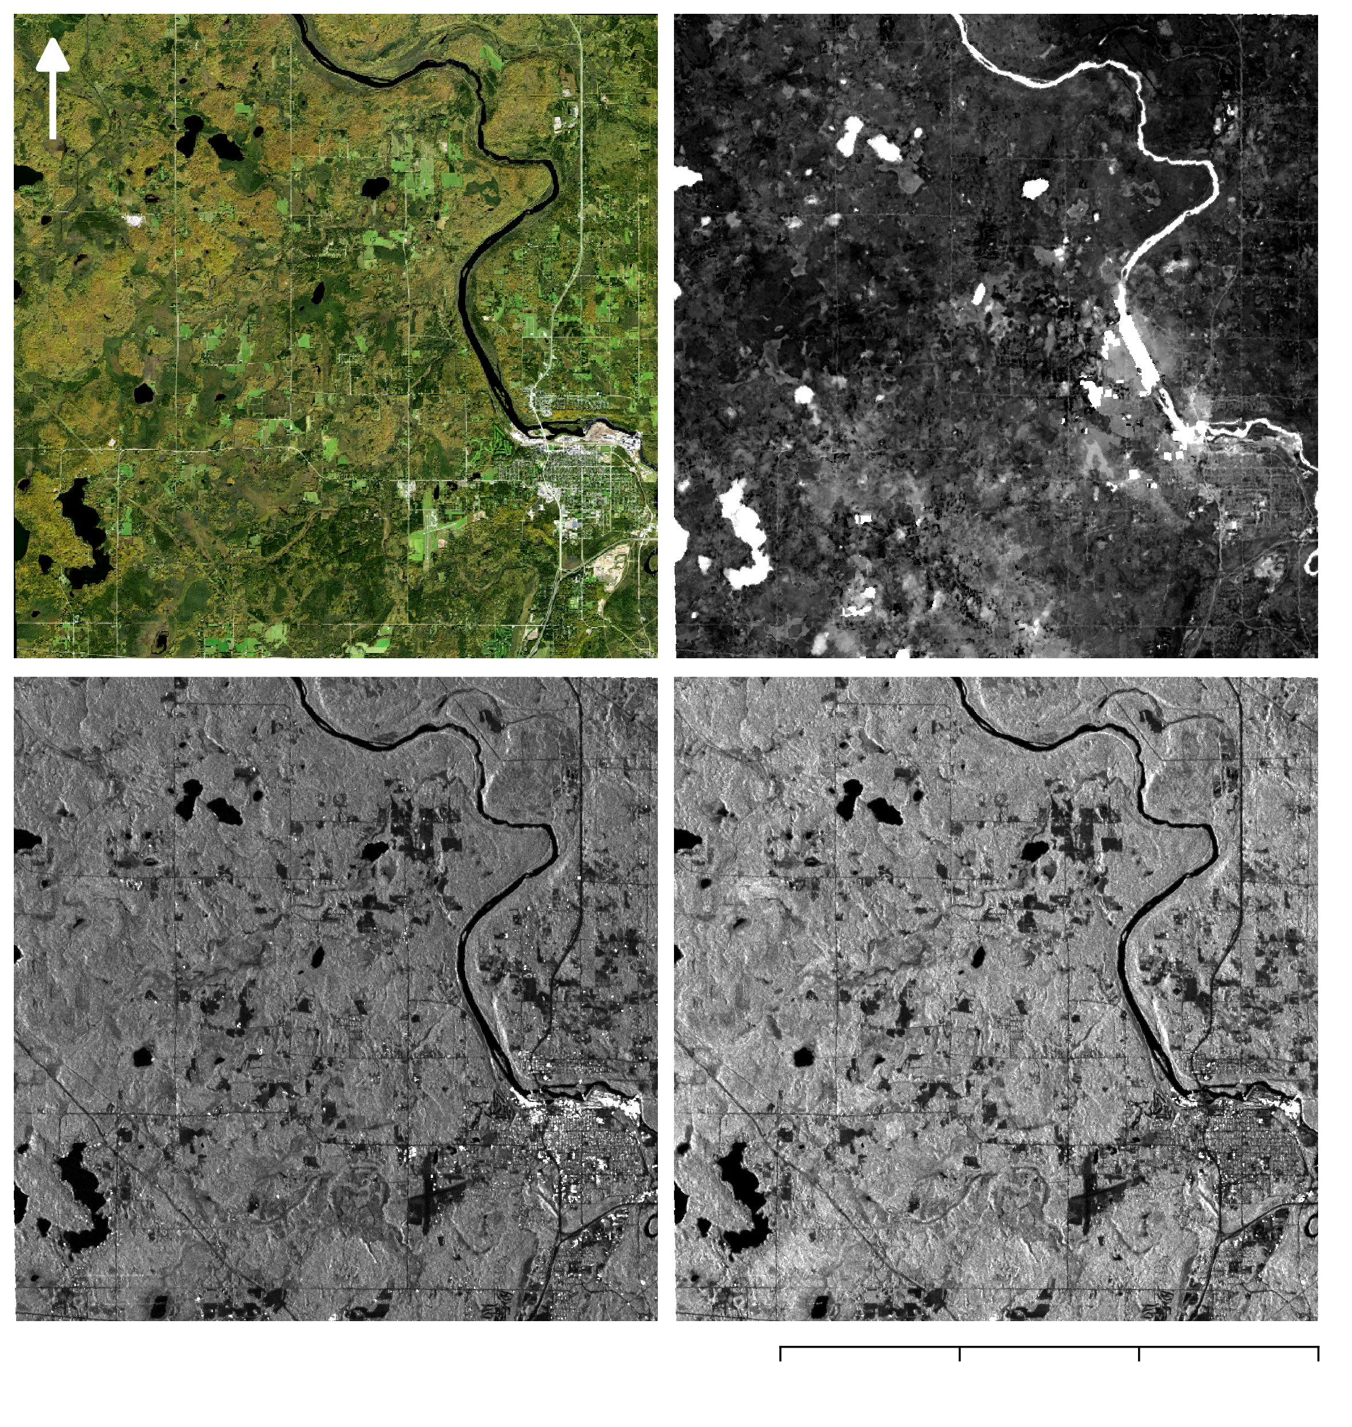
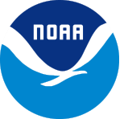
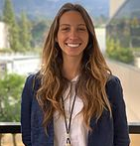
Improving Wetland Change Mapping using Optical and Radar Satellite Sensors to Assess Wetland Gain and Loss Metrics in Minnesota
Abstract
Objectives
Wetlands are a critical feature of our landscape for the ecological services they provide, including protecting water quality, providing habitat to rare species, mitigating erosion, and providing opportunities for recreation. Despite this, wetlands are facing increasing threats from a variety of anthropogenic sources, including pollution, change in climate, and commercial development. Although an accurate baseline inventory of wetland extent is essential for addressing these threats and quantifying future wetland change, traditional wetland mapping methods are time intensive, costly, and difficult to implement on a large scale. Here we show that statewide, fully-automated wetland mapping is possible to a high degree of accuracy by combining recent advances in remote sensing and cloud computing. Using a multi-source, multi-temporal, object-based random forest classification approach in Google Earth Engine, we generated 30 m resolution maps of wetland extent and change for the growing seasons (May through September) of 2017 and 2018 in Minnesota. In particular, inclusion of Sentinel-1 C-Band Synthetic Aperture Radar (C-SAR) composites, Landsat 8 Operational Land Imager (OLI) composites, and a topographically derived wetness index allowed us to achieve and overall accuracy of 87% when compared to the National Wetland Inventory. Our partners included US Fish and Wildlife Service (USFWS) National Wetlands Inventory (NWI), Minnesota Department of Natural Resources (MN DNR), Environmental Protection Agency (EPA), Ducks Unlimited (DU), National Oceanic and Atmospheric Administration (NOAA) Office for Coastal Management, and the University of Minnesota (UMN). We anticipate that our tool can be of immediate use to these end users in Minnesota who rely on accurate wetland data to inform their research, policy, and development decisions. Furthermore, these methods can quickly be applied to any region of the United States for which adequate training data exists.
Improve wetland change mapping using radar and optical datasets, including NASA Earth observations, to aid end users in assessing wetland gain and loss in Minnesota
Create an automated, multi-satellite, and seasonal approach for wetland mapping that can efficiently account for changes in wetland extent
Build our end users’ capacities to utilize radar data and the cloud computing abilities of Google Earth Engine for wetland mapping
Earth Observations
Landsat 8 OLI
Sentinel-1 C-SAR
Results
Random Forest Classification:
2017 Growing Season
Fond Du Lac Reservation:
2017 Growing Season
Methodology: Wetland Extent Tool (WET)
Filtering
Pre-Processing
Classification
Validation
Change Detection
Landsat 8 OLI
MN State
Date
Cloud Cover
Cloud Mask
Specified Thresholds
TCWGD, MNDWI
2017 Wetland Map
2018 Growing Season
Sentinel-1 C-SAR
MN State
Date
IW Swath
Mean composite
Preliminary Classified Wetland Map
Upland
Border Removal
Great Lakes Water Resources
Image Stack
SNIC Image Segmentation
2018 Wetland Map
Open Water
Convert To Natural Values
Confusion Matrix
Wetland
VV,VH
Random Forest Classification
Accuracy Assessment
0 500 1000 km
Mean Composite
(Resampled to 30 m)
Change Detection Map
LiDAR Derived TWI
(Resampled to 30 m)
Field data
Conclusions
0
2
4 km
Study Area
Fond Du Lac Reservation:
2017 Growing Season
An overall classification accuracy of 87% was achieved, when comparing the Random Forest classification to the field data points.
The Random Forest classification map validated against the field points was the most accurate result.
Additional field validation points, particularly in the open water class, are needed.
Further work can be done to investigate how accuracy changes with the inclusion of additional datasets (soil, Sentinel-2) and classification methods (pixel vs. object).
U N I T E D
S T A T E S
M I N N E S O T A
Project Partners
US Fish and Wildlife Service, National Wetland Inventory
Minnesota Department of Natural Resources
US Environmental Protection Agency, Office of Research and Development
Ducks Unlimited
University of Minnesota
NOAA Office for Coastal Management
Minneapolis
0 30 60 120 180 240
km
0
3,000 km
0 5 10 15 km
1,000
2,000
Acknowledgements
Team Members
Erika Higa, DEVELOP California – JPL Node (Center Lead), Neda Kasraee, DEVELOP California – JPL Node (Impact Analysis Fellow & Assistant Center Lead), Bruce Chapman, NASA Jet Propulsion Laboratory, California Institute of Technology (Science Advisor), Benjamin Holt, NASA Jet Propulsion Laboratory, California Institute of Technology (Science Advisor), Brian Huberty, US Fish and Wildlife Service National Wetland Inventory (US FWS NWI), Steve Kloiber, Minnesota Department of Natural Resources (MN DNR), Tom Hollenhorst, Environmental Protection Agency (EPA), Robb Macleod, Ducks Unlimited (DU), Joe Knight, University of Minnesota (UMN), Brandon Krumwiede, NOAA
This material contains modified Copernicus Sentinel data (2017-2018), processed by ESA.
Erica O’Connor
Project Lead
Melissa Ferriter
Alice Lin
Christopher Notto
California – JPL | Spring 2019

