Slide 1
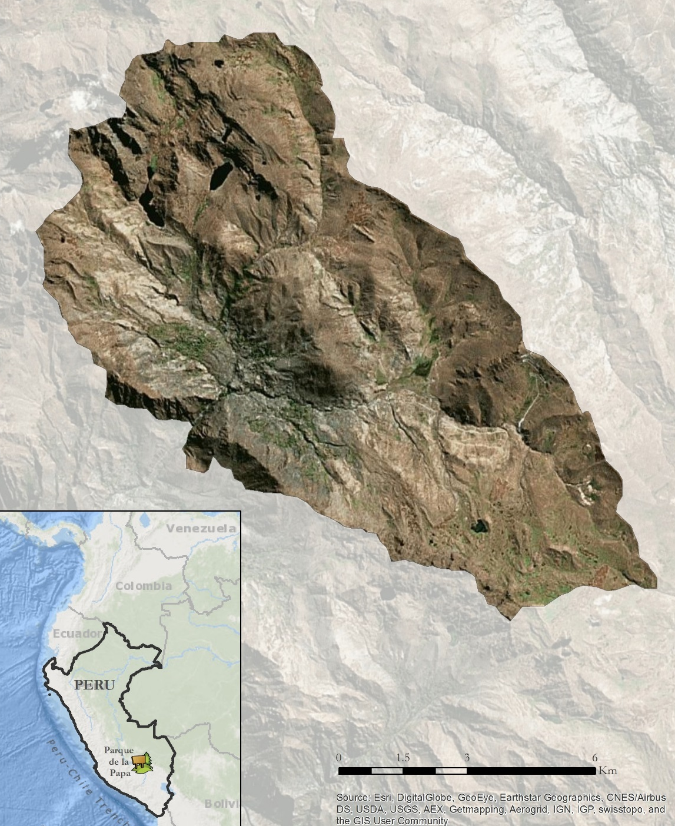
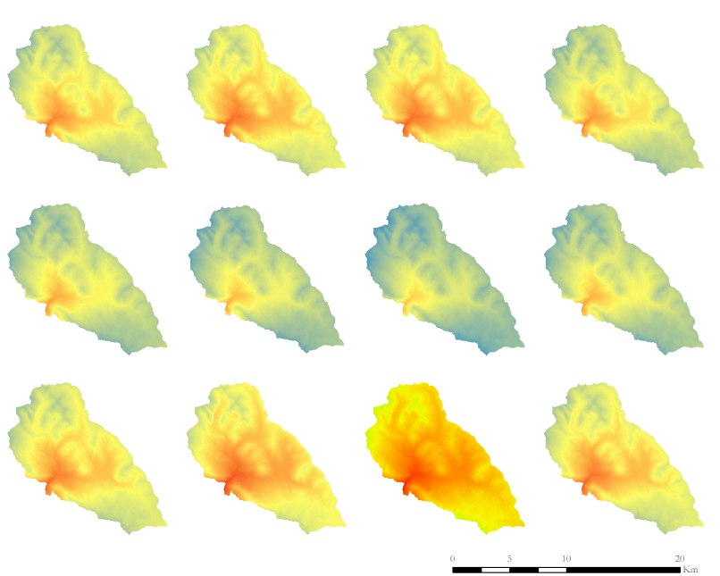
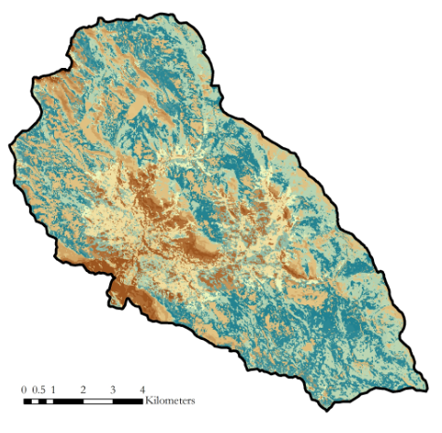
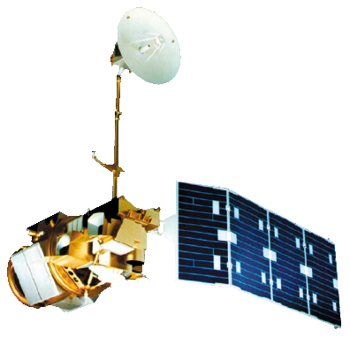
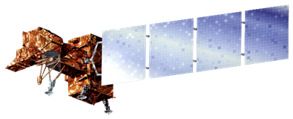
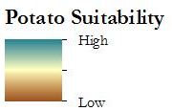
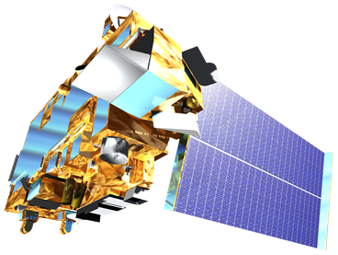
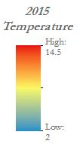
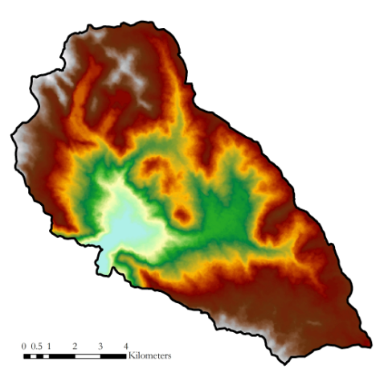
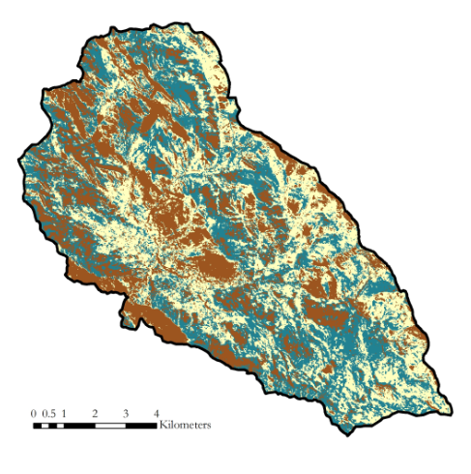
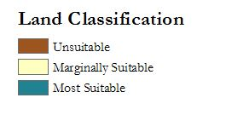
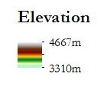
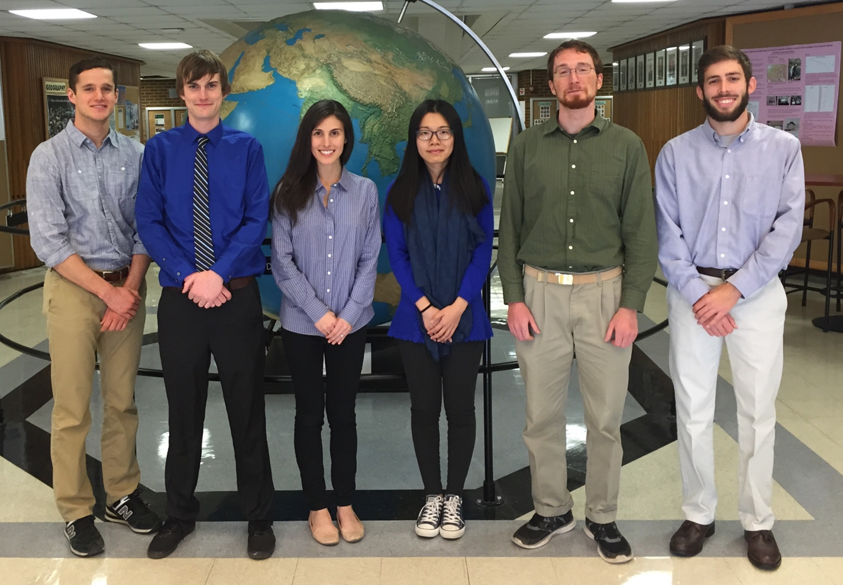
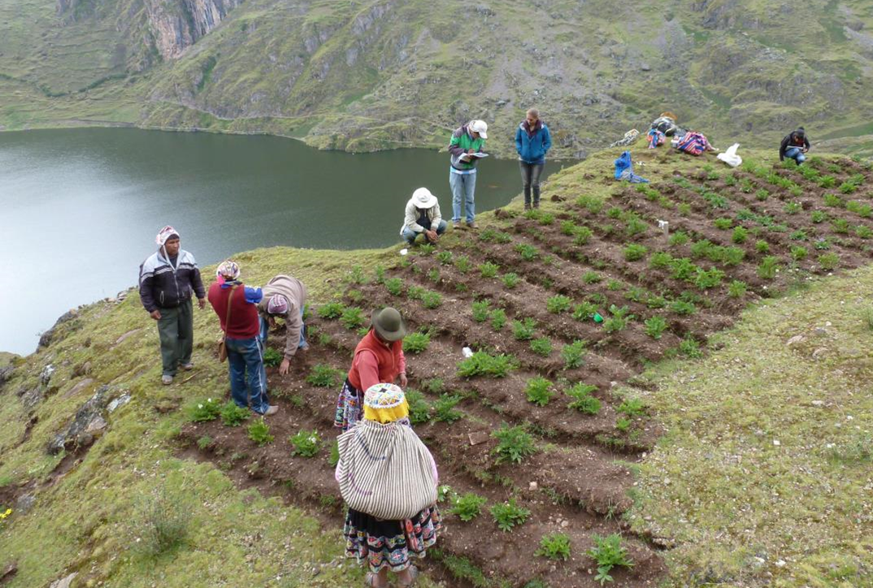
Perú Climate II
Monitoring and forecasting shifting climate and land change impacts in Perú’s Parque de la Papa for enhanced agricultural management
Caren Remillard (Project Lead), Brandon Hays, Benjamin Page, Adam Salway, Sam Weber, Xuan Zhang
DEVELOP National Program at The University of Georgia
Abstract
Objectives
Agricultural systems in tropical montane regions are particularly vulnerable in the face of global climate change. Anecdotal evidence from Parque de la Papa, located in the Perúvian Andes, indicates that farmers following traditional practices have moved potato crops to higher elevations seeking suitable growing conditions for the potato varieties they have cultivated for centuries. The primary threat to native potatoes is increased mortality rates stemming from pests and diseases. In particular, rising temperatures have led to increases in the population and habitat range of the Andean potato weevil, Premnotrypes spp. To assess support for the anecdotal evidence, we quantified changes in potato field elevation over the past three decades using Landsat imagery. This cultivation time-series analysis, slope and elevation data from ASTER, and historical changes in precipitation and temperature will all be incorporated into a crop suitability model. This model will be used to predict optimal areas for potato cultivation and will be given to the International Center for Potatoes (CIP) for use in a management plan to inform the farming efforts of the indigenous communities within Parque de la Papa.
Identify changes in growing patterns in Parque de la Papa
Quantify changes in climatic patterns in Parque de la Papa
Develop a predictive model to assess areas for optimal potato cultivation
Provide project partners with outreach materials
Aid indigenous communities in continuing to use traditional agricultural methods
Methodology
Study Area
Data Acquisition
Data Processing
End Products
DEM
Collect DEM Data
Derive Slope
Elevation &
Slope
Land Cultivation
Collect Landsat Data
Perform Atmospheric Correction
Pixel-Based Classification
Validate with QuickBird
Land Cover
Crop Suitability
Climate
Collect External Weather Data
Validate with In-situ Data
Extrapolate to Park
Temperature
Results
Earth Observations
Landsat 5, TM Landsat 7, ETM+
Landsat 8, OLI Terra, ASTER
January
February
March
April
May
June
July
August
September
October
November
December
Conclusions
Planting patterns within the park have greatly varied over the past few decades, and show a general increase in cultivated land elevation and extent
There has been approximately a one degree Fahrenheit increase in temperatures over the last 35 years
The model identified potentially suitable areas for potatoes in the Parque de la Papa that were distributed throughout the park
Team Members
Project Partners
Acknowledgements
Left to right: Sam Weber, Benjamin Page, Caren Remillard, Xuan Zhang, Brandon Hays, Adam Salway
We would like to thank our science advisors: Drs. Marguerite Madden and Kenton Ross
Great thanks are due to the members of CIP and ANDES: Genesis Abreu, Alejandro Argumedo, Noelle Barkley, David Ellis, and Rene Gomez
We would also like to acknowledge the previous work of the Perú Climate I team: Rebekke Muench, Kayla McDonald, Michael Sclater, Richard Rose, Dajon Begin
International Potato Center
Association for Nature and Sustainable Development
The University of Georgia

