Slide 1
Los Angeles Oceans II
Ground Truthing Satellite Observations of Wastewater Plumes and Their Biological Impact in Santa Monica Bay, California
Rebecca Trinh(Project Lead)
Lindsay Almaleh

Slide 2
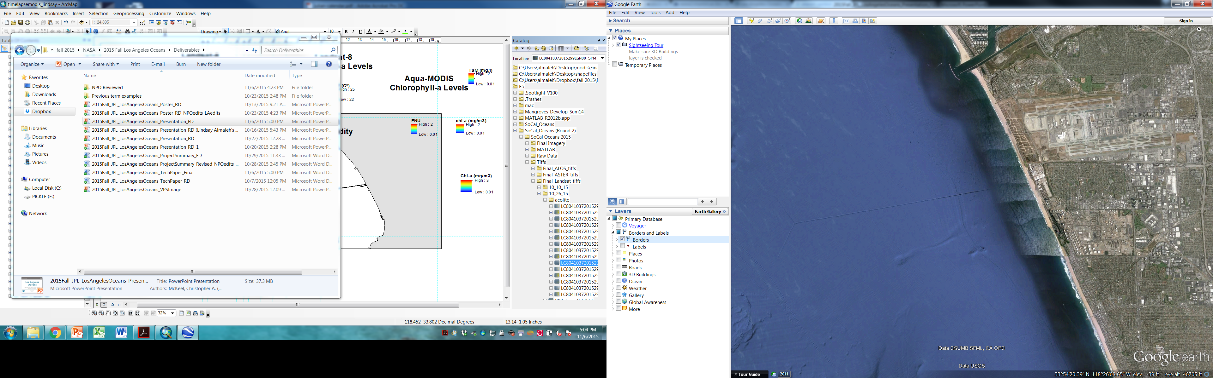

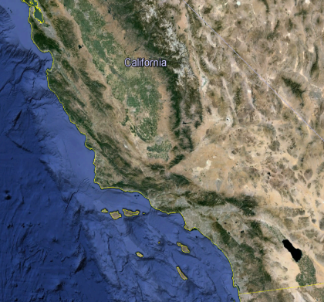
Study Area
Marina Del Rey
Santa
Monica
Bay
LAX
Hyperion
5-Mile Outfall
1-Mile Outfall
California
Los Angeles
Notes:
Our projects impact region was Los Angeles, California, and specifically focused on the waters of Santa Monica Bay. Santa Monica Bay stretches from Malibu to the Palos Verdes Peninsula. The bay is an ecologically important marine habitat and a valuable resource in terms of commercial or recreational fishing and tourism.

Slide 3
Study Period
DIVERSION
Before
After
8/26/15
9/21/15
11/2/15
11/19/15
Image Credit: Ben Holt, JPL
Notes:
The diversion just so happened to coincide with our DEVELOP term. We processed satellite imagery from August 30th to September 20th to get a pre-diversion baseline of what the ocean signatures around Hyperion’s outfall looked like. On September 21st Hyperion’s diversion was under way, and from then until November 2nd, we analyzed all the signatures from the effluent that was being emitted from the 1 mile outfall. After November 2nd until the end of the term, we analyzed imagery post-diversion to monitor ocean restoration and detect any long-term effects.
Pre-Diversion: Aug 30-Sept 20, 2015
Diversion: Sept 21-Nov 2, 2015 (12:01 am)
Post-Diversion: Nov 2-Nov 15, 2015

Slide 4
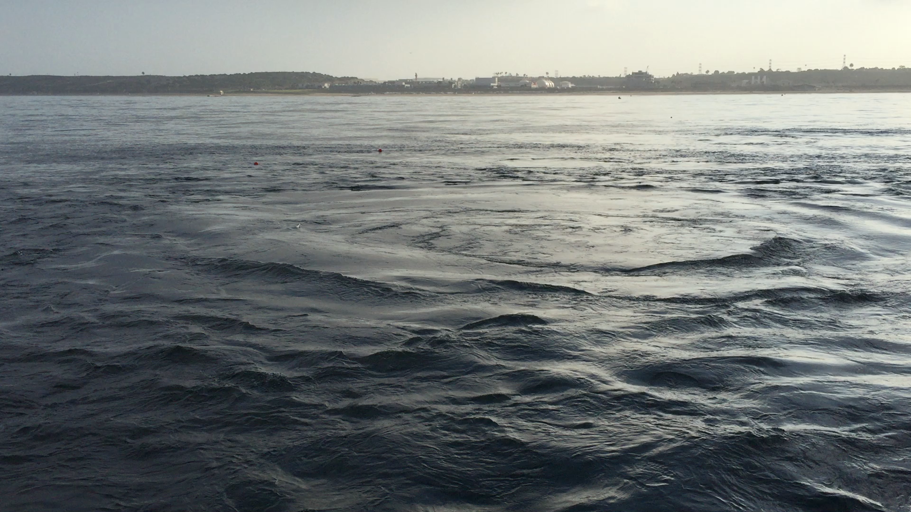
The Effluent Plume
Image Credit: Ben Holt, JPL
Notes:
The diversion just so happened to coincide with our DEVELOP term. We processed satellite imagery from August 30th to September 20th to get a pre-diversion baseline of what the ocean signatures around Hyperion’s outfall looked like. On September 21st Hyperion’s diversion was under way, and from then until November 2nd, we analyzed all the signatures from the effluent that was being emitted from the 1 mile outfall. After November 2nd until the end of the term, we analyzed imagery post-diversion to monitor ocean restoration and detect any long-term effects.
Pre-Diversion: Aug 30-Sept 20, 2015
Diversion: Sept 21-Nov 2, 2015 (12:01 am)
Post-Diversion: Nov 2-Nov 15, 2015

Slide 5
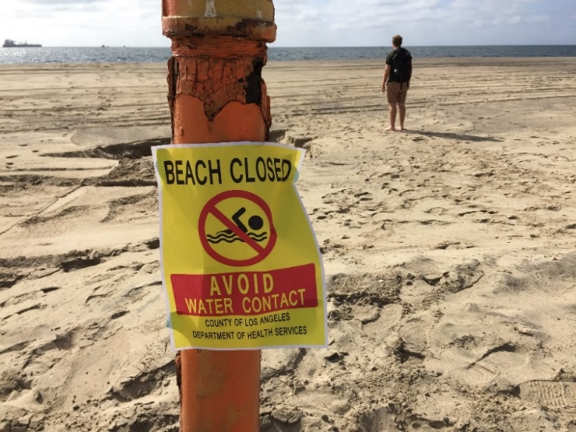
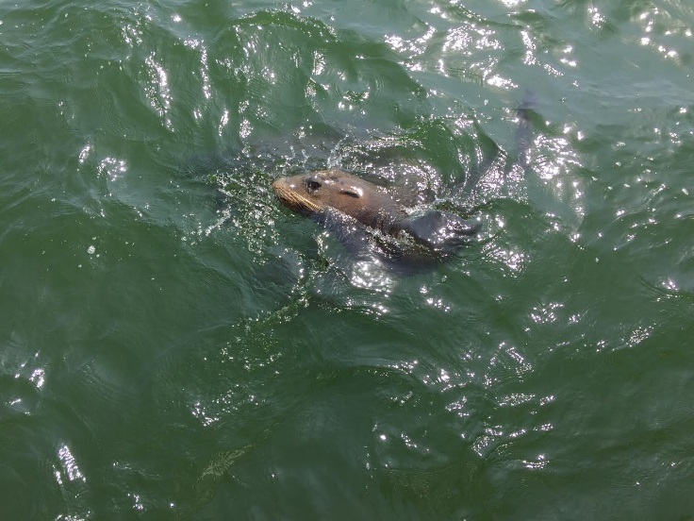
Community Concerns
Humans
Ecosystem
Polluted water for beachgoers
Negative impact on tourism/recreation
Bacterial contamination
Materials of sewage origin washing on shore
Nutrient loading
Harmful Algae blooms
Depleted oxygen levels
Disrupted food web
Image Credits: Mark Barker
Notes:
This event has raised public concerns. In terms of human impacts; commercial fishing patterns could change, tourists may be discouraged from visiting the beaches, and beachgoers may be exposed to harmful contaminants. The news media has taken a strong hold of this issue and has put pressure on scientists to analyze the diversion’s impacts. In terms of ecosystem health; algal blooms can occur due to the increased oxygen and nutrient levels that the effluent puts into the sea water, this may lead to depleted oxygen levels and light attenuation which may harm organisms. Along with the colder freshwater around the 1 mile outfall, the area also will see an increased presence of oils and organics in the ocean’s surface. All these factors may disrupt the local food web in Santa Monica Bay.

Slide 6
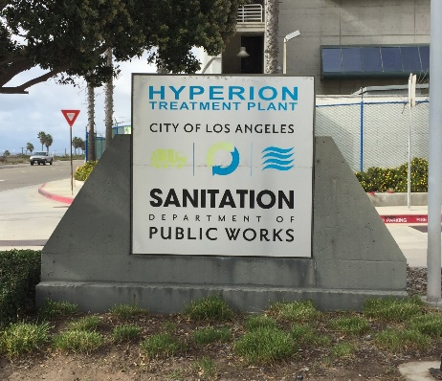
Objectives
Coordinate
with the Hyperion Water Reclamation Plant research team in obtaining in-situ readings taken in the LA Basin.
Combine and Compare
NASA Earth observations and in situ readings taken during the diversion event to determine validity.
Determine
whether the expelled effluent has negatively impacted the local ecosystem or washed ashore to potentially contaminate beaches.
Publish
results in a peer reviewed scientific journal,
and Hyperion’s technical report.
Image Credit: Ben Holt, JPL
Notes:
The diversion just so happened to coincide with our DEVELOP term. We processed satellite imagery from August 30th to September 20th to get a pre-diversion baseline of what the ocean signatures around Hyperion’s outfall looked like. On September 21st Hyperion’s diversion was under way, and from then until November 2nd, we analyzed all the signatures from the effluent that was being emitted from the 1 mile outfall. After November 2nd until the end of the term, we analyzed imagery post-diversion to monitor ocean restoration and detect any long-term effects.
Pre-Diversion: Aug 30-Sept 20, 2015
Diversion: Sept 21-Nov 2, 2015 (12:01 am)
Post-Diversion: Nov 2-Nov 15, 2015

Slide 7
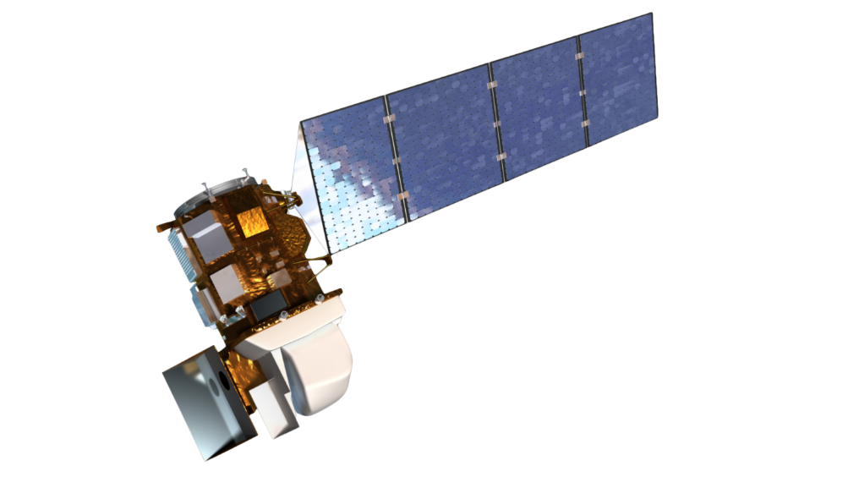


Instruments Utilized
Remote Sensing
Satellite | Landat-8 | Aqua | Terra
Instrument | OLI, TIR | MODIS | ASTER
Resolution (m) | 30 | 90 | 250
Acquisition (days) | 16 | Daily | 16
Detection | Sea surface temperature Chlorophyll-a Particulate reflectance Turbidity | Chlorophyll-a | Sea surface temperature
Notes:
Field measurements are often very labor-intensive, expensive, and limited in spatial and temporal coverage.
We have the benefit of using satellites to do Remote sensing. It is relatively inexpensive and provides much greater spatial coverage.
However, remote sensing only captures images at the surface of the sea, versus the ability to obtain data at depth when gathered in situ.
We used multiple sensors on multiple satellites to determine the best techniques of imaging the extent of these surfaced wastewater plumes. Each sensor has its own benefits an limitations, which we explored in our images.

Slide 8
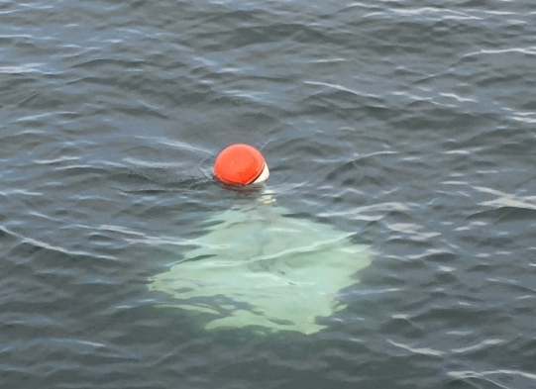
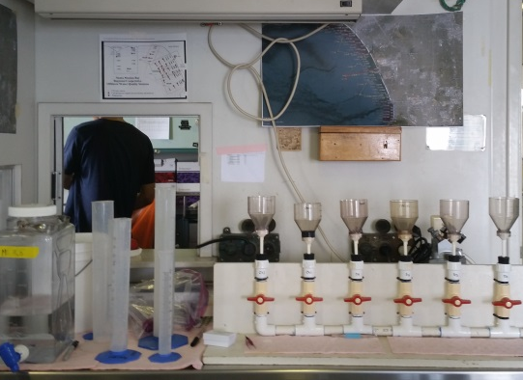
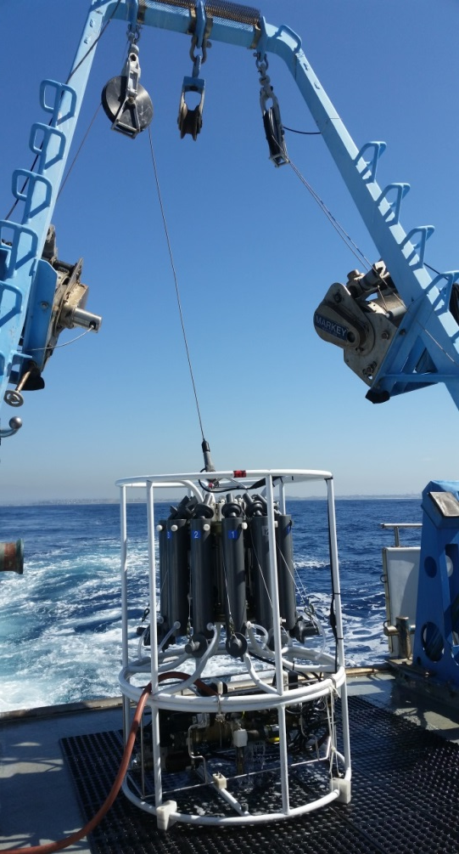
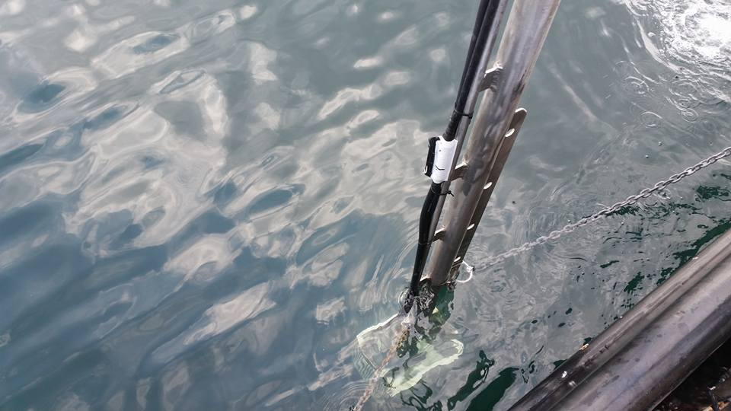
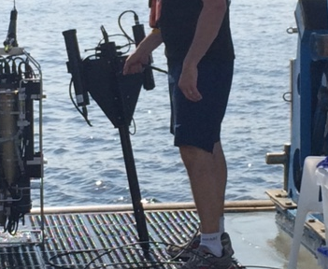
Instruments Utilized
In Situ Data Verification
Lagrangian Drifters
UCSB
Phytoplankton Water Chemistry
USC
CTD Sensor
City of LA
YSI Sensor
City of LA
Hyperspectral Instrument
JPL/NASA
Image Credits: Rebecca Trinh
Notes:
Hyperion has invited us to come aboard their 2 City of Los Angeles owned boats.
Many collaborators go out into the Santa Monica Bay several times a week to take in situ measurements of the diversion plume.
Some of the instruments used are:
Hyperion’s CTD, which stands for and measures Conductivity, Temperature, and Depth.
Hyperion’s YSI Sensor takes surface measurements such as temperature, dissolved oxygen, turbidity, and pH.
University of California Santa Barbra has installed GPS drifters in the ocean to track the plume’s movement over time.
University of Southern California uses laboratory methods to test the sea water for phytoplankton levels.
A collaborator at JPL uses his hyperspectral instrument to measure reflectance, Absorbance, chlorophyll, and CDOM.
We have access to all the results found in the field via a shared information website, and we can compare their in situ results to our remote sensing results to validate our conclusions.

Slide 9
Project Methodology
NASA Earth observations:
Chlorophyll-a
Surface Sediment
Turbidity
Landsat-8, TIR , OLI
Aqua, MODIS
Effluent
impact
on local ecosystem and human health
Spatiotemporal
Analysis of combined
datasets
Sea Surface Temperature
Terra, ASTER
In Situ Measurements
UCSB, Surface drifters
Local current direction
Chl-a. CDOM, CTD, Atmospheric aerosols
JPL, Hyperpro Instrument, Microtops
USC, Phytoplankton
Harmful algal blooms
pH, DO, salinity, TDS, optical brightness
Conductivity, temperature, depth
HWRP, YSI
HWRP, CTD
Notes:
The general signatures we are looking for in our processed satellite imagery are 1) chlorophyll-a , 2) Sea surface temperature 3) turbidity, 4) suspended solids, and 5) sea surface roughness.
Both LANSAT-8 and MODIS can detect chlorophyll, sediment, and sea surface temperature. Landsat can also detect turbidity. ASTER can also detect sea surface temperature. We used Synthetic Aperture Radars (SAR) on ALOS-2 and Sentinel-1 to give us sea surface roughness data, but the signatures were not present.
We collected and have access to in situ data to cross-reference our satellite imagery data in time and space.
Ultimately, this analysis should give us a solid platform to answer our questions and address public and ecological concerns.

Slide 10
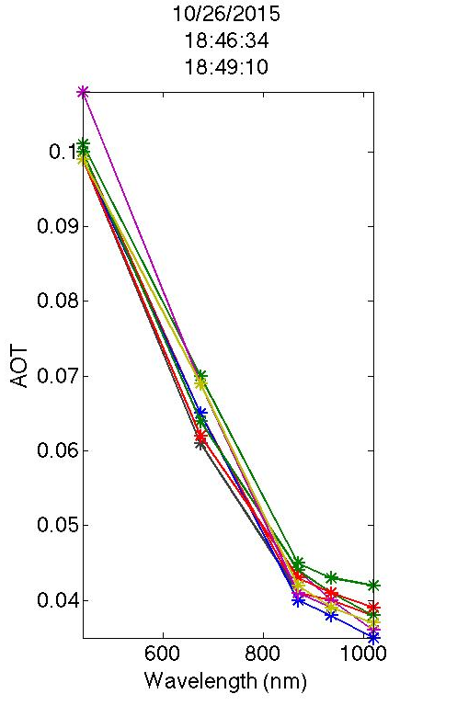
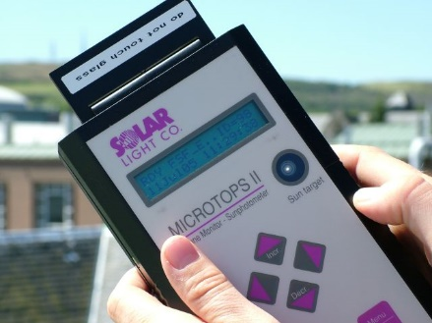
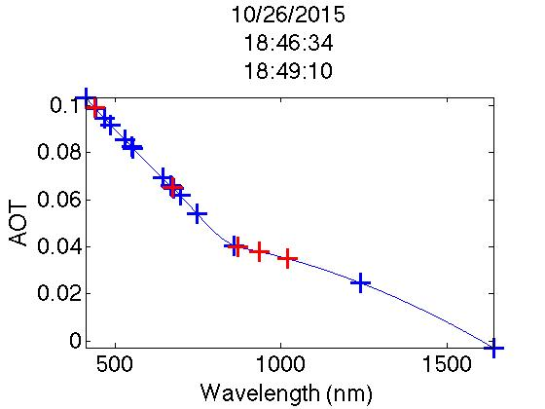
Atmospheric Correction
Field Measurement Dates
Micrtops Sensor
9-16-15
9-24-15
9-30-15
10-21-15
10-26-15
11-5-15
11-11-15
Aerosol Optical Thickness measurements from Microtops sensor
Interpolated Aerosol Optical Thickness values at different wavelengths

Slide 11
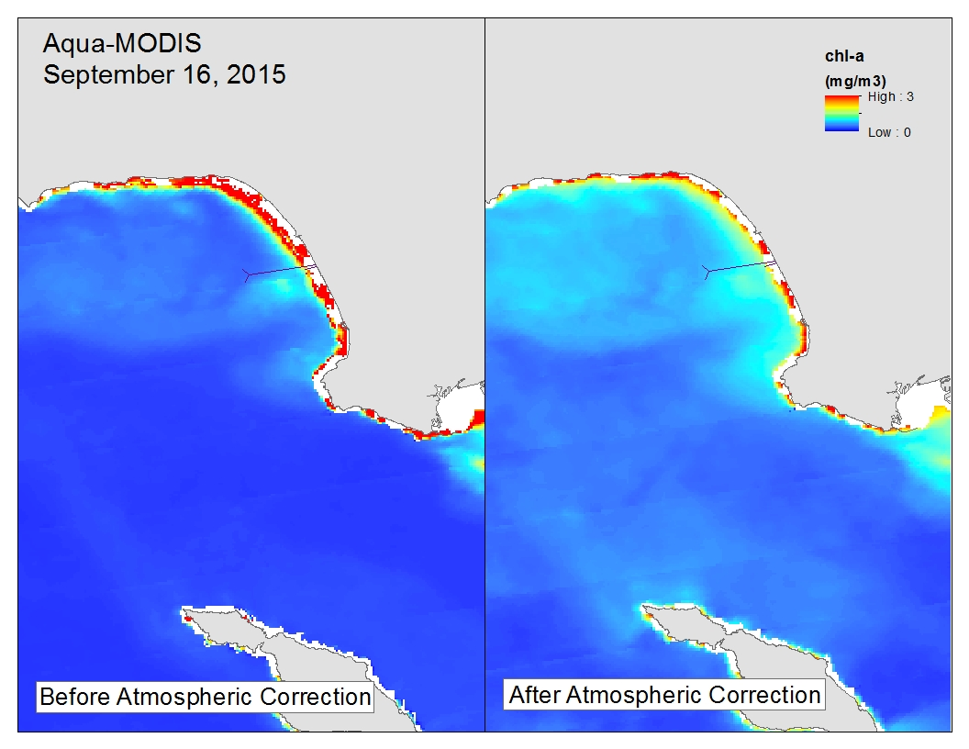
MODIS Atmospheric Correction

Slide 12
Landsat-8 Atmospheric Correction

Slide 13
ASTER Atmospheric Correction

Slide 14

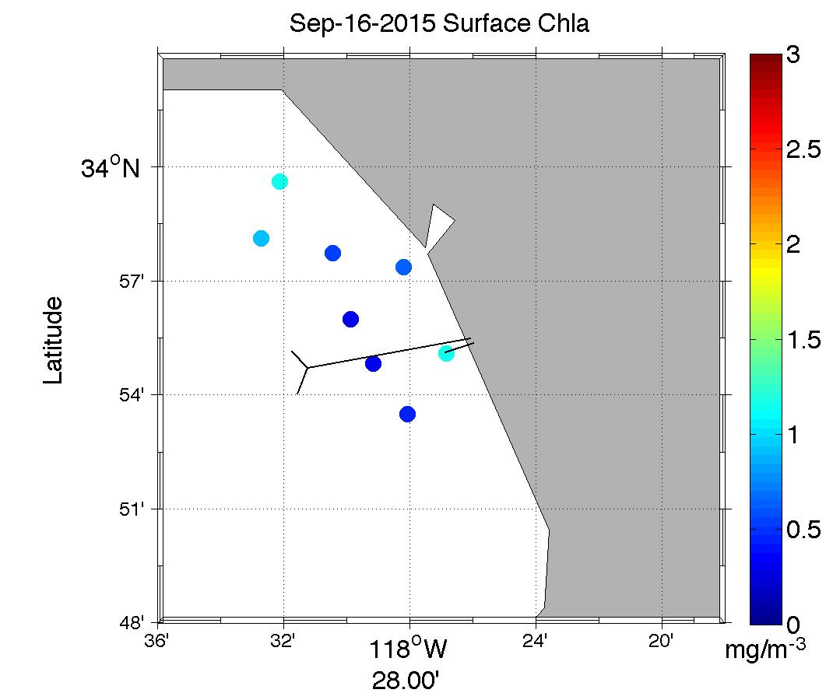
Chlorophyll Validation

Slide 15
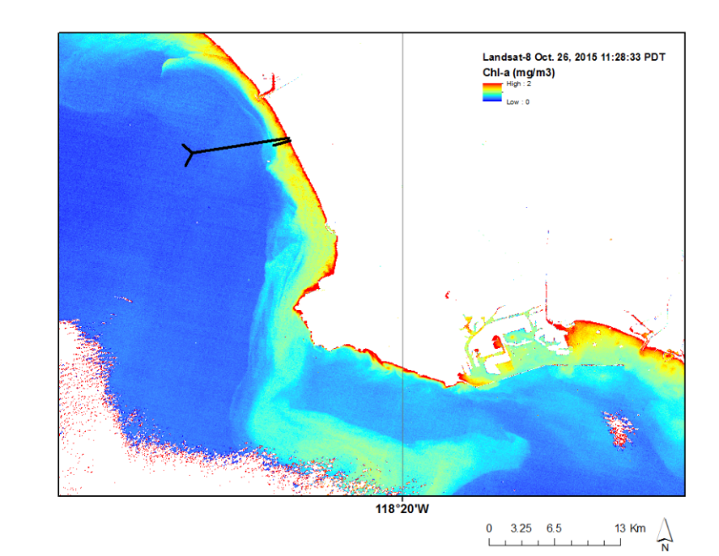
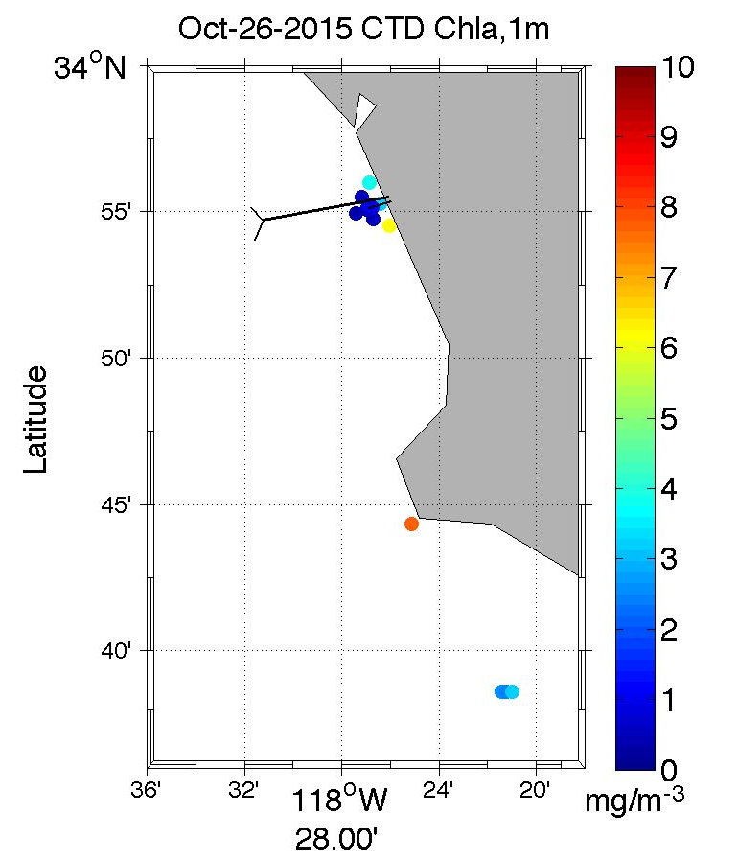
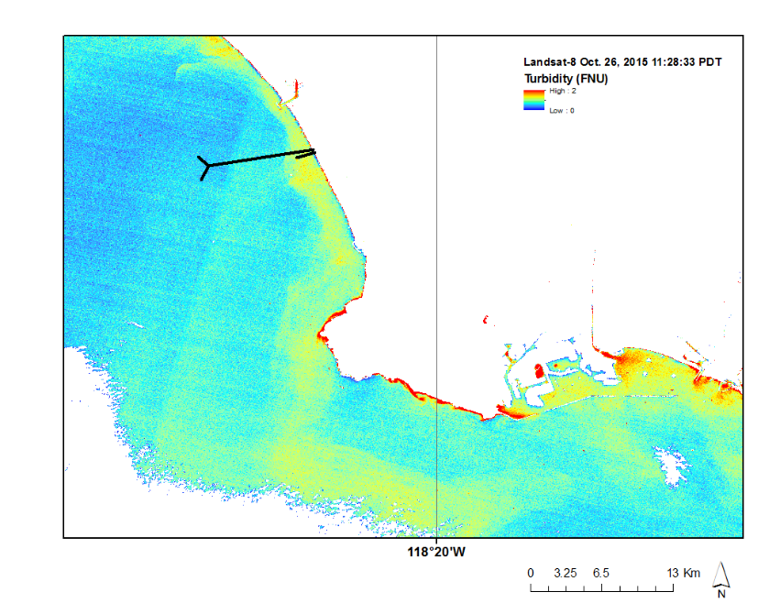
Chlorophyll Validation

Slide 16
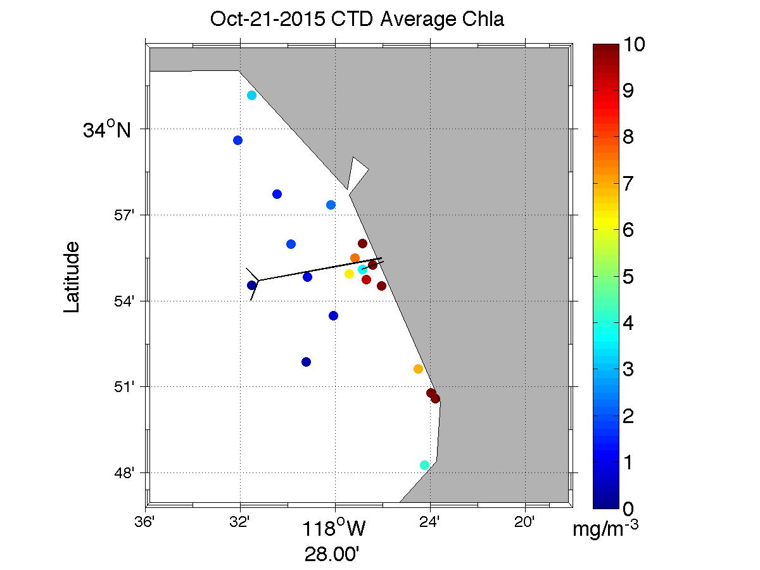
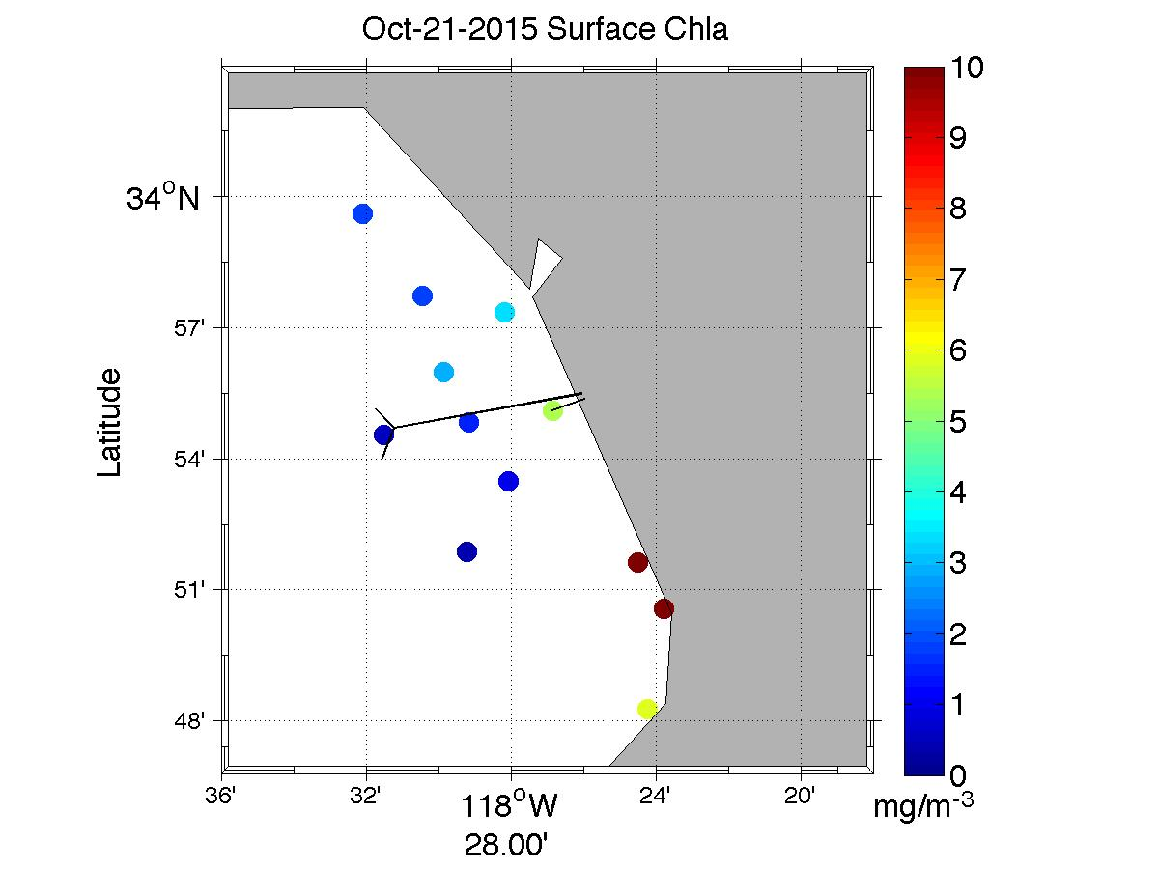
Chlorophyll Validation
Add MODIS

Slide 17
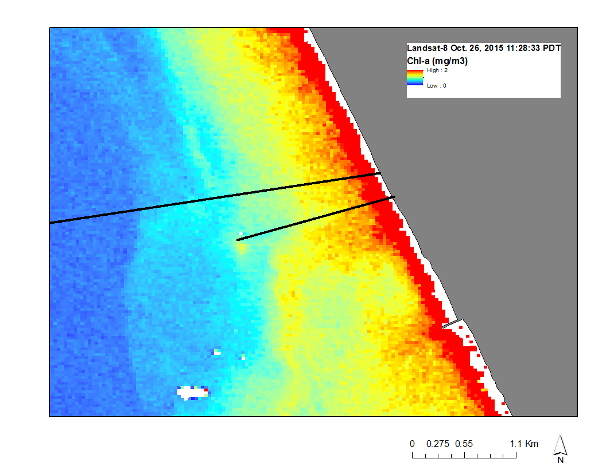

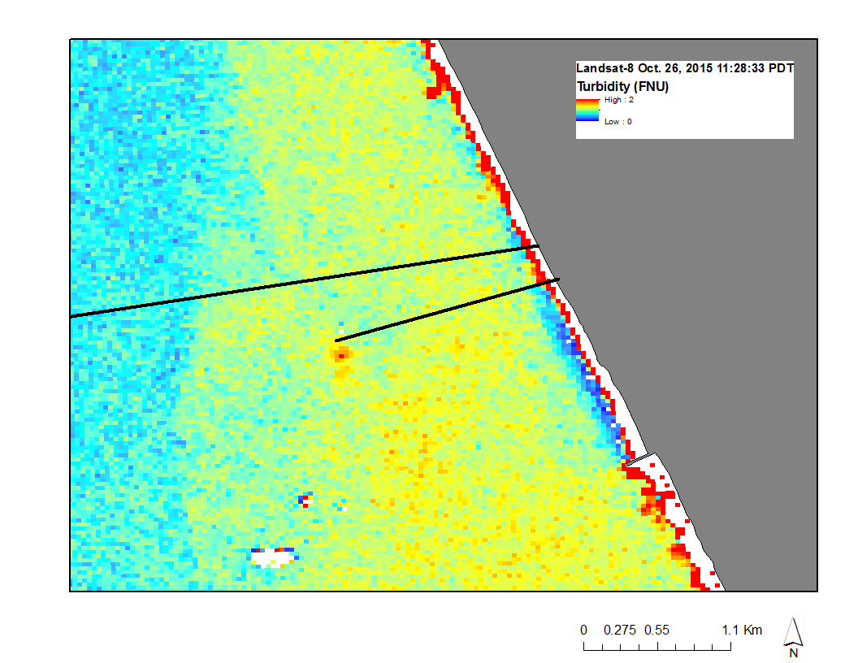
Satellite vs In Situ- Oct 28, 2015
Insert drifter, CTD, MODIS, Prism, hyper

Slide 18
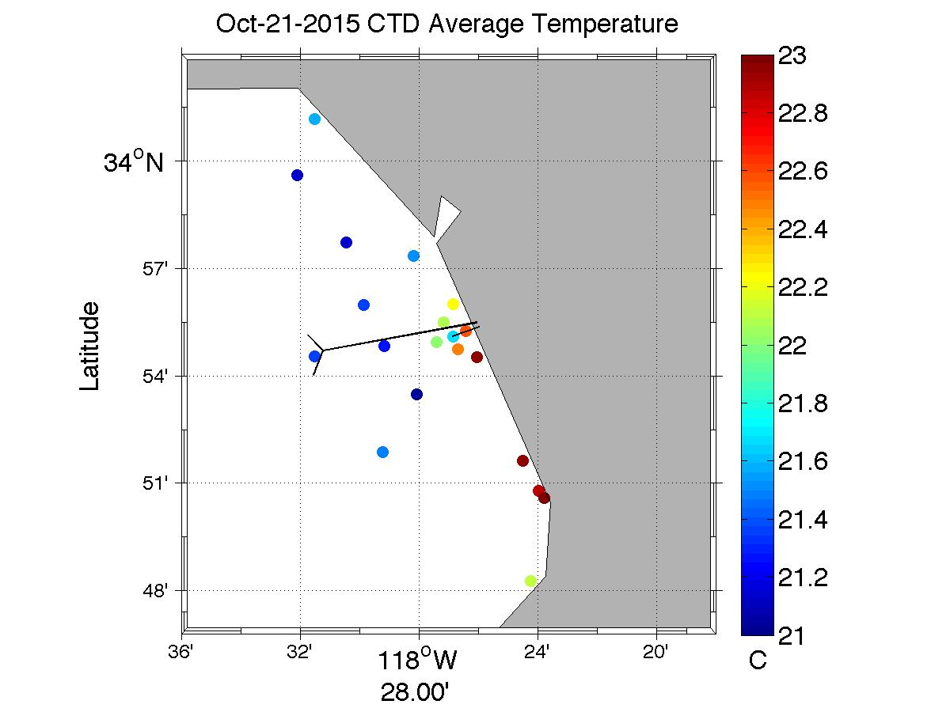
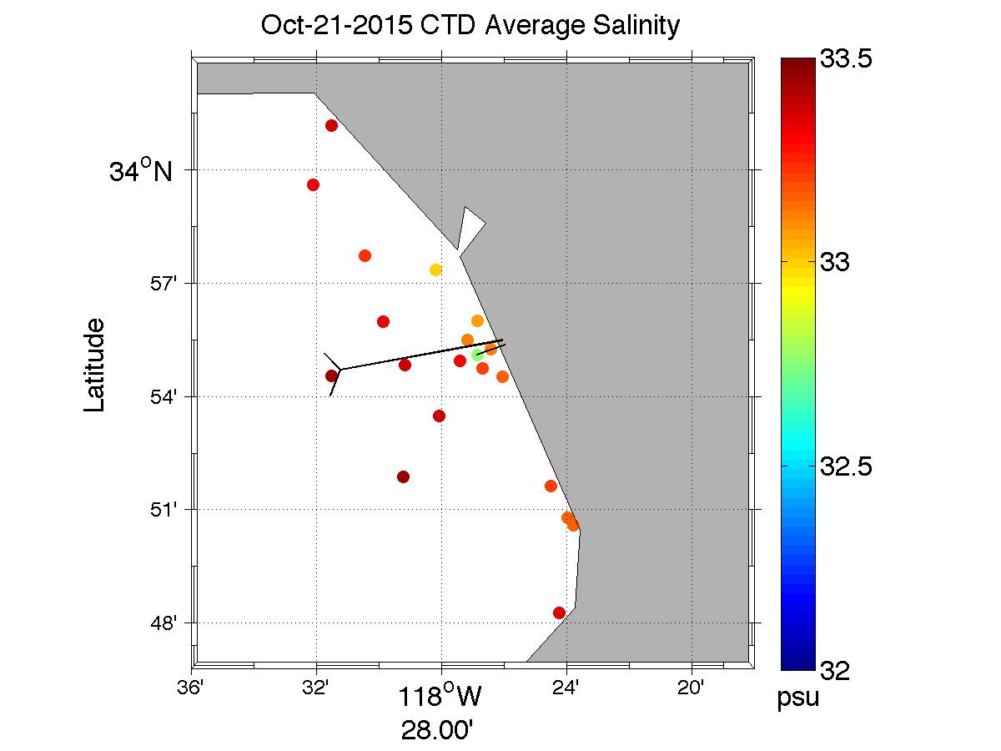
Temperature Validation

Slide 19
Plume Drift Validation

Slide 20
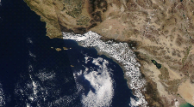
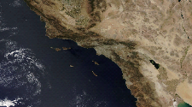
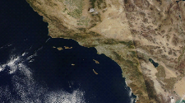
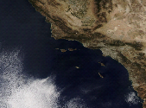
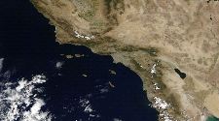
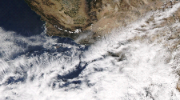
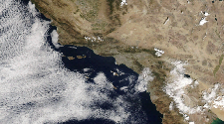
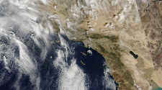
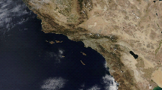
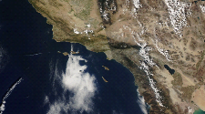
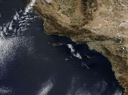
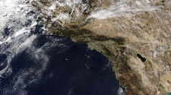
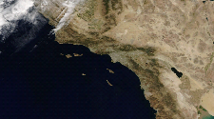
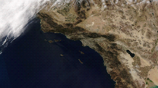
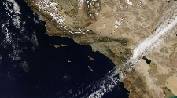
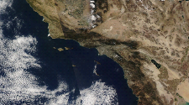
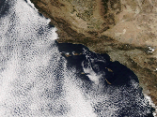
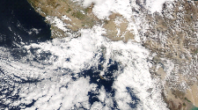
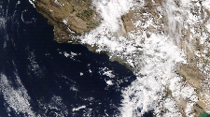
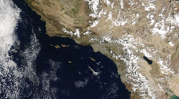
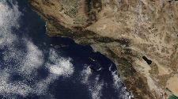
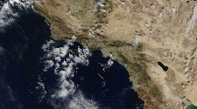
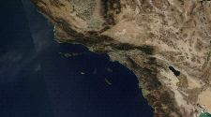
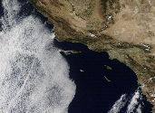



































Daily Cloud Cover
Aqua-MODIS cannot detect Earth’s surface covered by clouds.
9/16/15
9/17/15
9/18/15
9/19/15
9/20/15
9/21/15
9/22/15
9/23/15
9/24/15
9/25/15
9/26/15
9/27/15
9/28/15
9/29/15
9/30/15
10/1/15
10/2/15
10/3/15
10/4/15
10/5/15
10/6/15
10/7/15
10/8/15
10/9/15
10/10/15
10/11/15
10/12/15
10/13/15
10/14/15
10/15/15
10/16/15
10/17/15
10/18/15
10/19/15
10/20/15
10/21/15
10/22/15
10/23/15
10/24/15
10/25/15
10/26/15
10/27/15
10/28/15
10/29/15
10/30/15
10/31/15
11/1/15
11/2/15
11/3/15
11/4/15
11/5/15
11/6/15
11/7/15
11/8/15
11/9/15
11/10/15
11/11/15
11/12/15
11/13/15
11/14/15
11/15/15

Slide 21
Conclusions

Slide 22
Errors & Uncertainties

Slide 23
Future Work

Slide 24
Advisors
Ben Holt & Michelle Gierach
NASA Jet Propulsion Laboratory
Partners
Curtis Cash, Ashley Booth, & Mas Dojiri
Los Angeles City Hyperion Treatment Plant
Past Contributors
Mark Barker, Christine Rains & Jack Pan
NASA DEVELOP, NASA Jet Propulsion Laboratory
Others
Cedric Fichot, NASA Jet Propulsion Laboratory
Jayme Smith, University of Southern California
Carter Ohlmann, UC Santa Barbara

