Slide 1
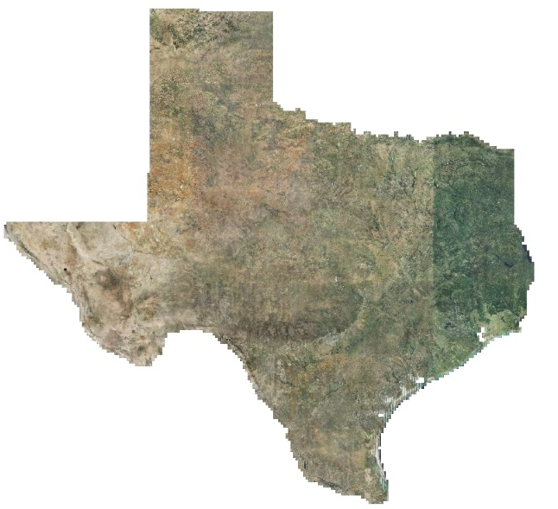
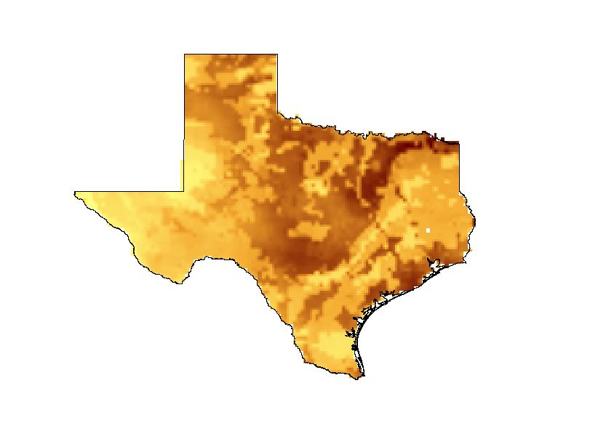

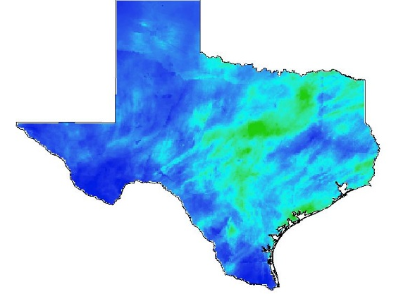
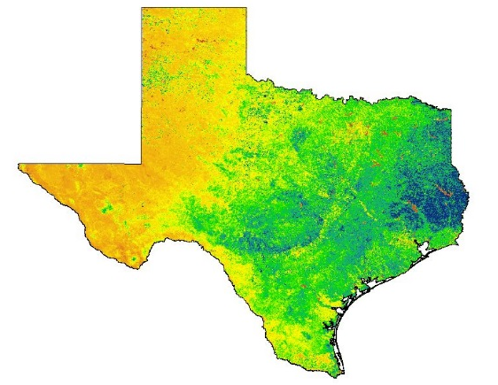
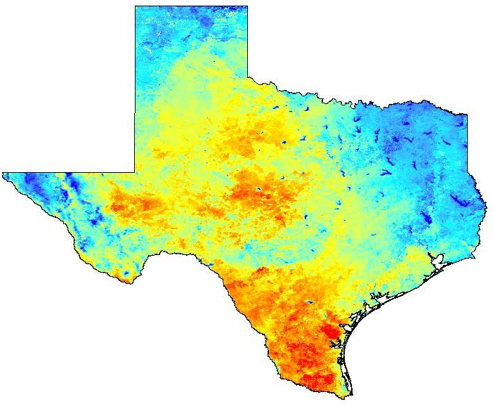


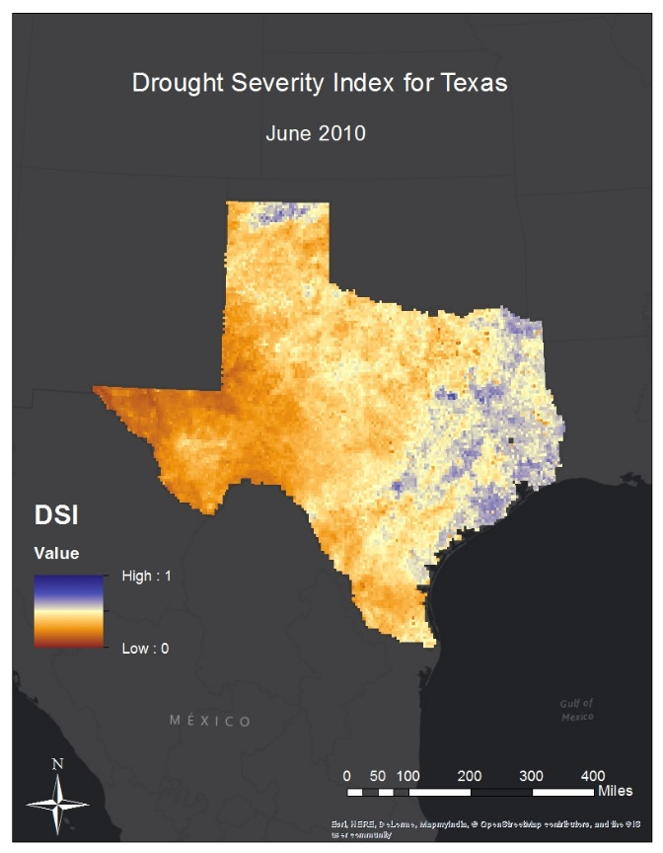
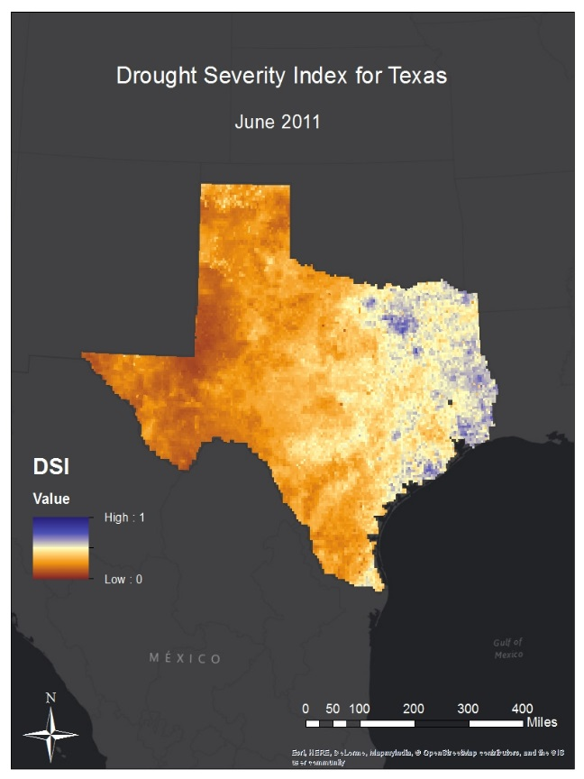
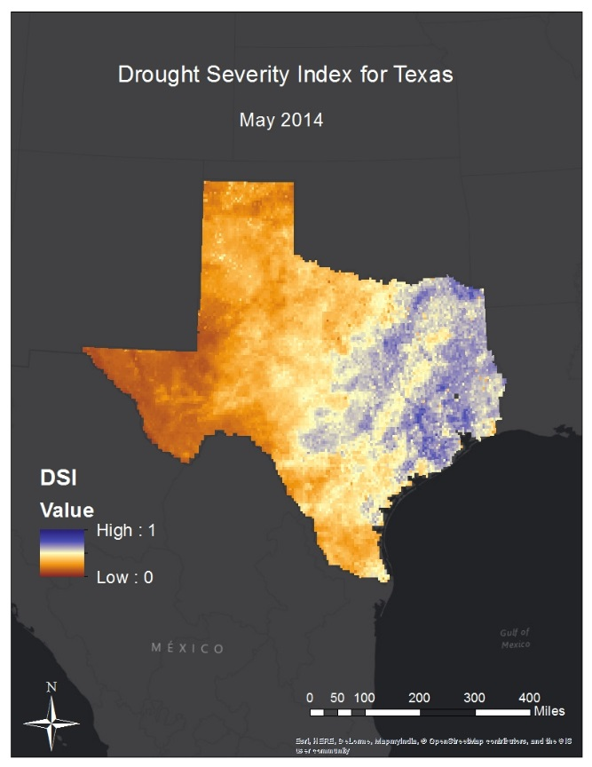
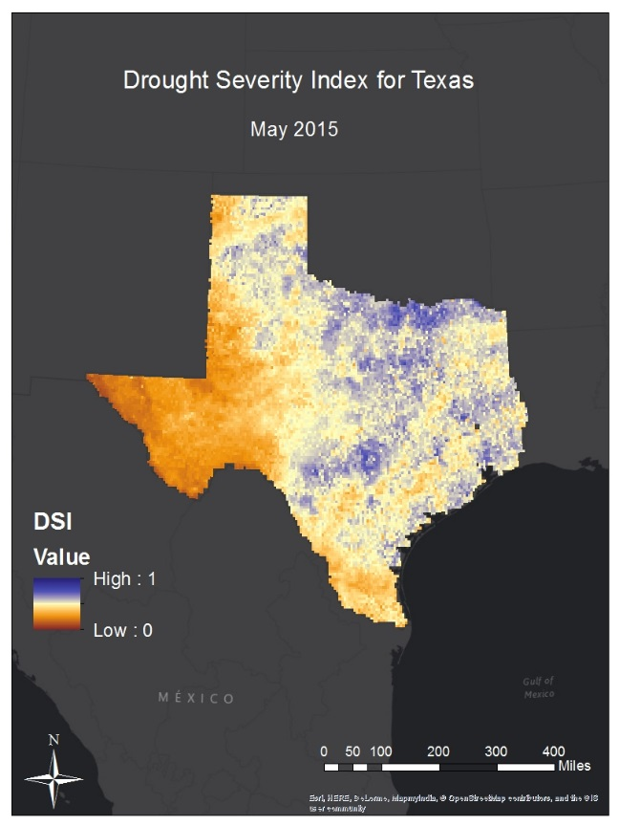
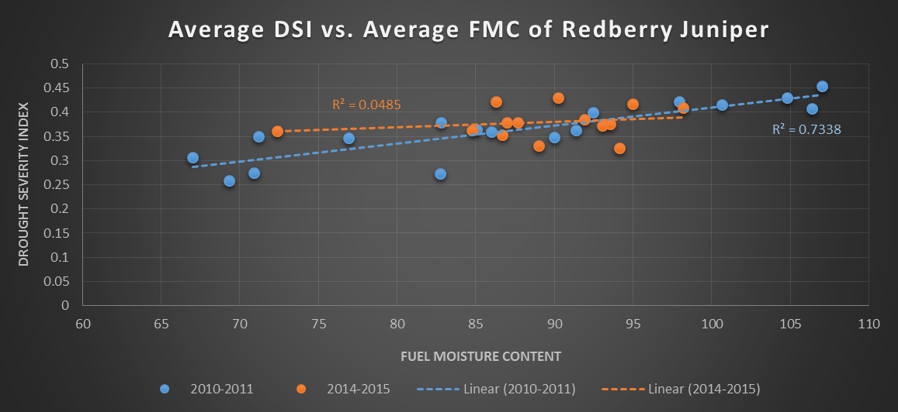
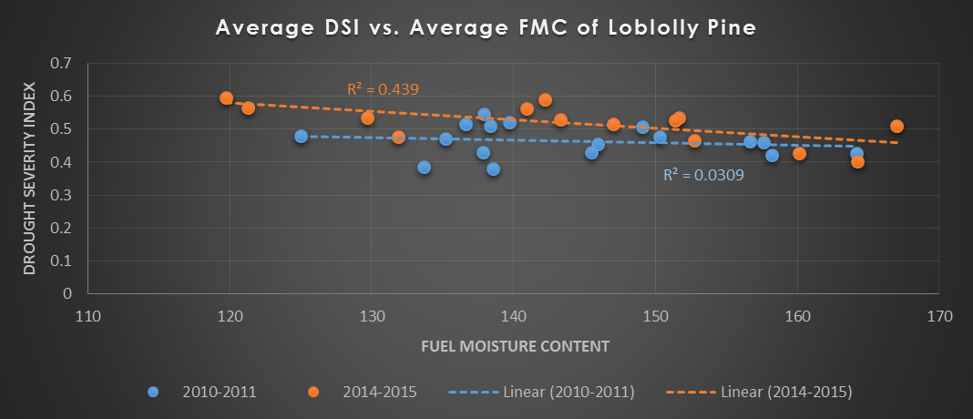
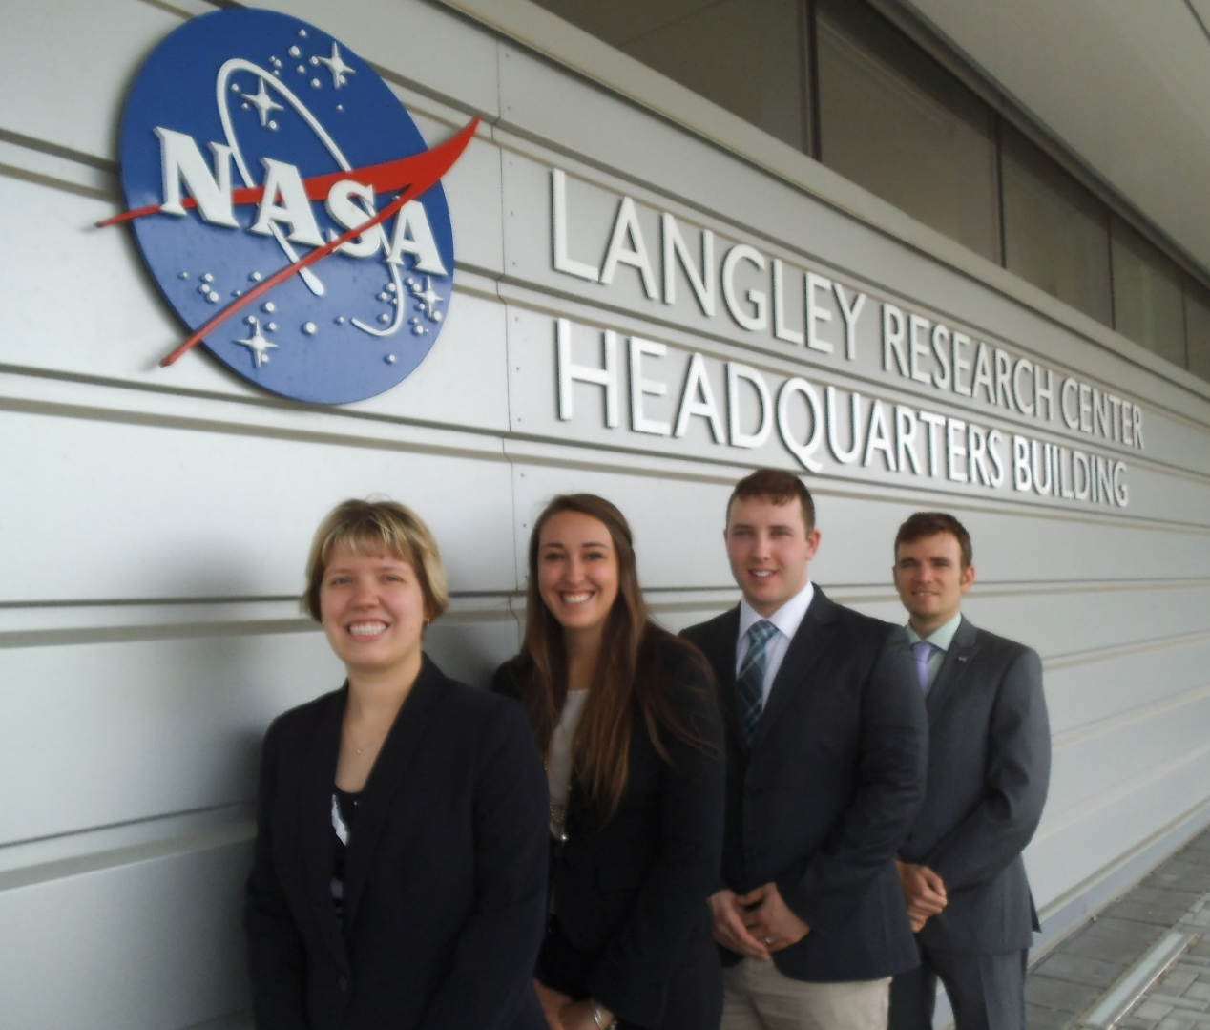
Texas Water Resources
Utilizing NASA Earth Observations to Monitor Drought Severity in Texas for Wildfire Mitigation Support
Megan Buzanowicz (Project Lead), Zacary Richards, Laura Lykens, Jeff Close
NASA DEVELOP National Program at NASA Langley Research Center
Abstract
Objectives
The 2011 wildfire season was one of the most destructive wildfire seasons in Texas history. The combination of a wet 2010 growing season, which allowed vegetation to prosper, followed by an extremely dry year in 2011 provided the worst case scenario for wildfires. The purpose of this project was to expand upon a drought severity index (DSI) created during the summer 2013 Great Plains Agriculture project. A risk map of potential wildfire areas that contain dry fuels was also created; specifically, how dry the fuels are. To accomplish this, data that measure specific factors contributing to drought conditions and dry vegetation were acquired, including land surface temperature and the Normalized Difference Vegetation Index (NDVI) from the Moderate Resolution Imaging Spectrometer (MODIS) instrument onboard the Aqua and Terra satellites, precipitation from the Multi-Sensor Precipitation Estimate (MPE), and soil moisture from the North American Land Data Assimilation System (NLDAS). Data for these four factors were compiled through ArcGIS in order to assemble a risk map. The accuracy of the DSI was correlated to live fuel moisture data supplied by the Texas Forest Service (TFS). Methods and results produced for determining drought conditions were presented to the TFS for future use throughout the state; the benefit of which was a high-resolution drought index that can be easily constructed with little cost to the end-user.
Expand upon the Scaled Drought Condition Index (SDCI) created by Rhee et al (2010) by including a soil moisture component
Design a product for the Texas Forest Service to utilize in order to identify locations within the state most prone to wildfire disasters
Correlate the Drought Severity Index with the measurements of live fuel moisture content (FMC) obtained from the National Fuel Moisture Database in order to determine its accuracy
Methodology
Study Area
Summer 2010 - Summer 2011
Summer 2014 – Summer 2015
Data Acquisition
Data Processing
Data Analysis
Texas
North American Land Data Assimilation System (NLDAS)
Noah-2.8 Model
Soil Moisture
(NLDAS – NLDAS_{min})
(NLDAS_{max} – NLDAS_{min})
ArcMap
10.3
Python
2.7
Multi-Sensor Precipitation Data (MPE)
Daily Observed Precipitation
(MPE – MPE_{min})
(MPE_{max} - MPE_{min})
Modified Drought Severity Index
scaled LST
+
scaled NDVI
+
scaled MPE
+
scaled NLDAS
Terra MODIS
MOD13Q1
Normalized Difference Vegetation Index (NDVI)
(NDVI - NDVI_{min})
(NDVI_{max} – NDVI_{min})
Earth Observations
Terra
MODIS
Aqua
MODIS
Aqua MODIS
MYD11A2
Land Surface Temperature (LST)
(LST_{max} – LST)
(LST_{max} – LST_{min})
Results
Conclusions
The DSI reflects the increase in drought conditions within the state from June 2010 to June 2011. From May 2014 to May 2015 however, the western and northern regions were greatly alleviated of their dry spell after the rainstorms that occurred during May of 2015. In consideration of these results, it is clear that the DSI mirrors the historical environmental circumstances affecting Texas.
Despite inconsistencies in the correlation graphs between the DSI and the FMC, this study has laid the foundation for forthcoming work that involve a focus on the importance of soil moisture in dry conditions and how SMAP may play a role in determining prospective trends in wildfire risk.
There are multiple weight values that could be given for each of the four variables included in the DSI, and these values should continue to be experimented with in future work.
Team Members
Project Partners
Acknowledgements
Texas Forest Service
Curt Stripling: Geospatial System Coordinator
Tom Spencer: Department Head of Predictive Service
Dr. Kenton Ross: NASA DEVELOP National Program (Science Advisor)
Lance Watkins: NASA DEVELOP National Program, Geoinformatics/Center Lead
Grant Mercer: University of Nevada – Las Vegas
Rocky Garcia: City University of New York
Tiffani Miller: NASA DEVELOP, Project Coordinator Senior Fellow
Jeff Ely: NASA DEVELOP, Geoinformatics Fellow
Summer 2015 Texas Disasters DEVELOP Team: John C. Stennis Space Center (SSC):
Megan Buzanowicz, Laura Lykens, Jeff Close, and Zacary Richards
NASA Langley Research Center

