Slide 1
Costa Rica Water Resources II
Utilizing NASA Earth Observations to
Develop a Comprehensive Water
Budget for the Arenal-Tempisque
Watershed of Costa Rica

Slide 2
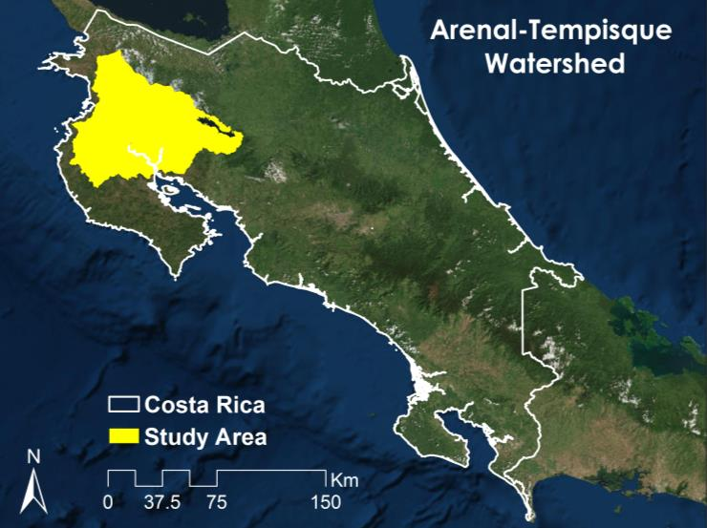
Study Area & Background
http://drawnbydawn.com/test/wpcontent/gallery/logos/proyecto_titi_foundation.jpg
http://www.nybg.org/images/science/Scientist_at_work_1.jpg
Notes:
The Arenal-Tempisque Watershed is located in the Guanacaste province of Costa Rica and is geographically located in the northwest region of the country, situated between the Pacific Coast, the Gulf of Nicoya, and Lake Arenal.
This watershed contains the largest irrigation district in the country. Its irrigation infrastructure, extending over 2800 Ha, has enabled this otherwise dry province to sustain its production of rice, sugarcane, and farm-raised Tilapia -making this region one of Costa Rica’s most economically productive.

Slide 3
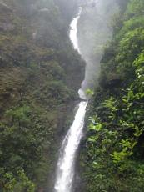
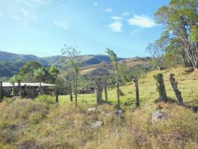
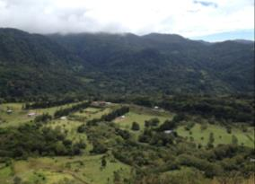
Community Concerns
The Arenal-Tempisque Watershed has experienced continual drought for the last three years, complicating the water management of agricultural practices, as well as negatively affecting the public’s consumption rate of water.
This region’s water policies impact the 1,125 agricultural families that rely on irrigation, as well as the production of a quarter of Costa Rica’s total hydroelectricity.
As rapid urbanization continues, the demand of available water resources for all uses is expected to increase by 20% by 2020.
http://drawnbydawn.com/test/wpcontent/gallery/logos/proyecto_titi_foundation.jpg
Photos by: Caren Remillard
http://www.nybg.org/images/science/Scientist_at_work_1.jpg
Notes:
If there is time : A need for a more efficient water management plan is becoming apparent.

Slide 4
Objectives
Create a SWAT (Soil and Water Assessment Tool) model to simulate and assess the local hydrological processes of the Arenal-Tempisque Watershed
Utilize Mod 16 data from Terra's MODIS sensor to supplement SWAT's evapotranspiration values
Develop tutorials for SWAT and SWAT-CUP modeling software so project partners will be able to replicate our methodology, and calibrate and validate their model’s results.
http://drawnbydawn.com/test/wpcontent/gallery/logos/proyecto_titi_foundation.jpg
http://www.nybg.org/images/science/Scientist_at_work_1.jpg
Notes:
Thus to address the issue of drought and the growing demand for water, the Costa Rica team established the following objectives. To…
These tutorials will allow project partners to continuously update their water budget, allowing them to make a more efficient water management plan.

Slide 5
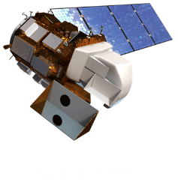
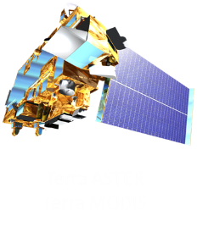
Project Partners & NASA Earth Observations
Costa Rica’s National Service of Underground Water, Irrigation, and Drainage (SENARA)
University of Georgia Costa Rica
Costa Rican Embassy to the United States
http://drawnbydawn.com/test/wpcontent/gallery/logos/proyecto_titi_foundation.jpg
http://www.nybg.org/images/science/Scientist_at_work_1.jpg
Notes:
We were able to achieve these objectives through collaboration efforts with NASA DEVELOP’s project partners (SENARA, UGA Costa Rica, and the Costa Rican Embassy to the United States) and from datasets derived from NASA Earth observations. Terra’s ASTER sensor provided the Digital Elevations Models for SWAT, while Terra’s MODIS sensor supplied MOD 16 supplementary evapotranspiration datasets. Landsat OLI images were also used to help digitalize land cover datasets for our SWAT model.

Slide 6
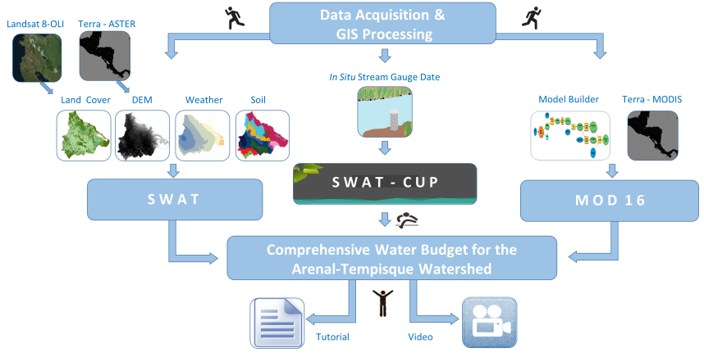
Methodology
http://drawnbydawn.com/test/wpcontent/gallery/logos/proyecto_titi_foundation.jpg
http://www.nybg.org/images/science/Scientist_at_work_1.jpg
Notes:
SWAT was chosen because it is public domain, and it only required these four datasets (point to them) to simulate the watershed’s hydrological processes.
SWAT-CUP was used to calibrate and validate the model. It required SWAT’s hydrological outputs and in situ stream discharge data for the watershed. Calibration requires adjustment of the model’s parameters to ensure that your generated SWAT outputs are feasible for your area.
Mod 16 data was processed in Model Builder to achieve monthly evapotranspiration readings, offering a more current measurements for the study area.

Slide 7
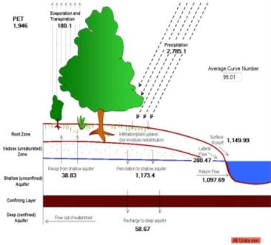
Results
SWAT Water Balance Ratios | %
Streamflow/ Precipitation | 91
Base Flow/ Total Flow | 55
Surface Runoff/ Total Flow | 45
Percolation /Precipitation | 42
Deep Recharge/ Precipitation | 2
ET/ Precipitation | 6
cms
http://drawnbydawn.com/test/wpcontent/gallery/logos/proyecto_titi_foundation.jpg
Number of Observed Months
http://www.nybg.org/images/science/Scientist_at_work_1.jpg
Notes:
Use screen shot of swat check/ 95ppu graph ?
The first image shows the final product of the SWAT-Model. It shows the water balance ratios of the watershed’s simulated hydrologic processes. Once calibrated and validated this information can be used to update a region’s water budget.
The second image shows the result of 500 calibration simulations in SWAT-CUP. SWAT-CUP picks the simulation that best correlates the observed and simulated stream discharge data and displays the result as a 95 PPU graph. Ideally both trend lines should fall within the green swath, indicating that the observed and simulated values fall within a 95% accuracy.

Slide 8
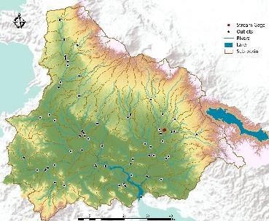
Results Continued
Notes:
However do to limited in situ stream data, we were unable to get the observed trend line to fall within the 95ppu swath or to better correlate with the simulated trend line.
Possible factors that hindered the calibration process included the location of our stream gauge and the limited years of recorded in situ data.
For the final image, we compared evapotranspiration data compiled from MOD 16 and simulated from SWAT. A general trend can be observed, but the magnitudes of the peaks and dips between SWAT and MOD16 differ. We attribute this discrepancy to the lack of calibration data for SWAT-CUP and the low resolution of MODIS.

Slide 9
Conclusions
Although there were factors that prevented us from calibrating the entire watershed in SWAT-CUP, the team was able to simulate the hydrological processes of the Arenal-Tempisque watershed in SWAT.
However, the tutorials created for SWAT and SWAT-CUP will allow project partners, who have access to more current datasets, to replicate our methodology and to calibrate and validate their model’s findings for the entire watershed. With the addition of Mod 16 evapotranspiration data, partners will be able to update the region’s water budget for future water management policies.
http://drawnbydawn.com/test/wpcontent/gallery/logos/proyecto_titi_foundation.jpg
http://www.nybg.org/images/science/Scientist_at_work_1.jpg

Slide 10
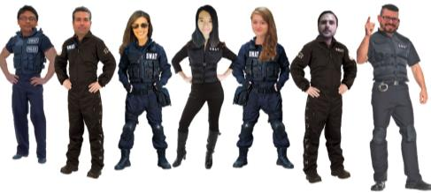
Acknowledgments
Costa Rica Water Resources Team
Steve Padgett-Vasquez
Caren Remillard
Eduardo Rendon
Kamala Kanta Sahoo
Xuan Zhang
Science Advisor
Dr. Adam Milewski
Dr. Kenton Ross
Dr. Marguerite Madden
Other Contributors
Rachel Will
Benjamin Page
Grant Bloomer
Sarah Medley
Wondwosen Seyoum
Project Partners
Javier Artiñano Guzmán
Dr. Quint Newcomer
HE Ambassador Roman Macaya
Alejandra Solano
http://drawnbydawn.com/test/wpcontent/gallery/logos/proyecto_titi_foundation.jpg
http://www.nybg.org/images/science/Scientist_at_work_1.jpg

