Slide 1
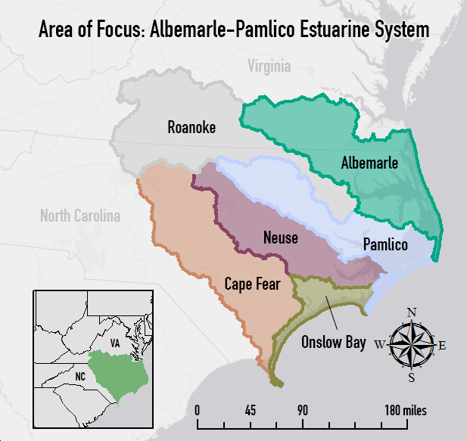
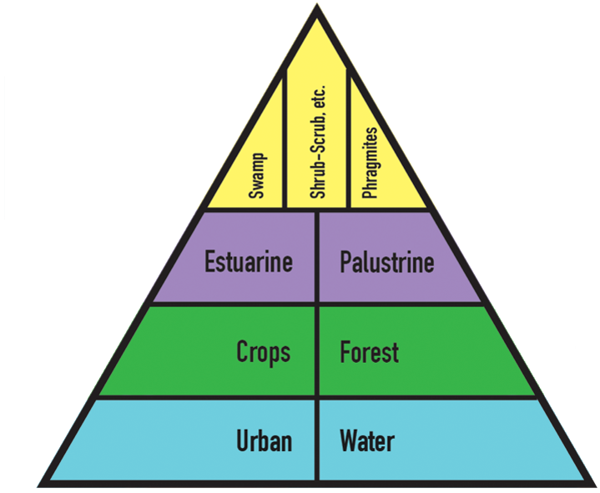


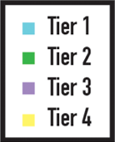
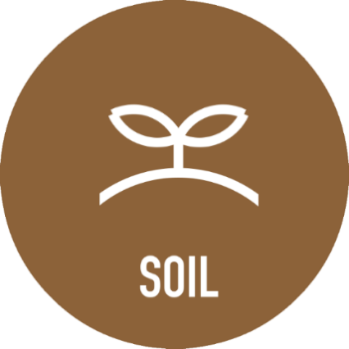
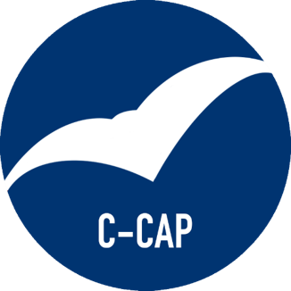
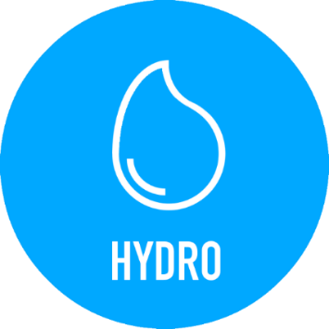

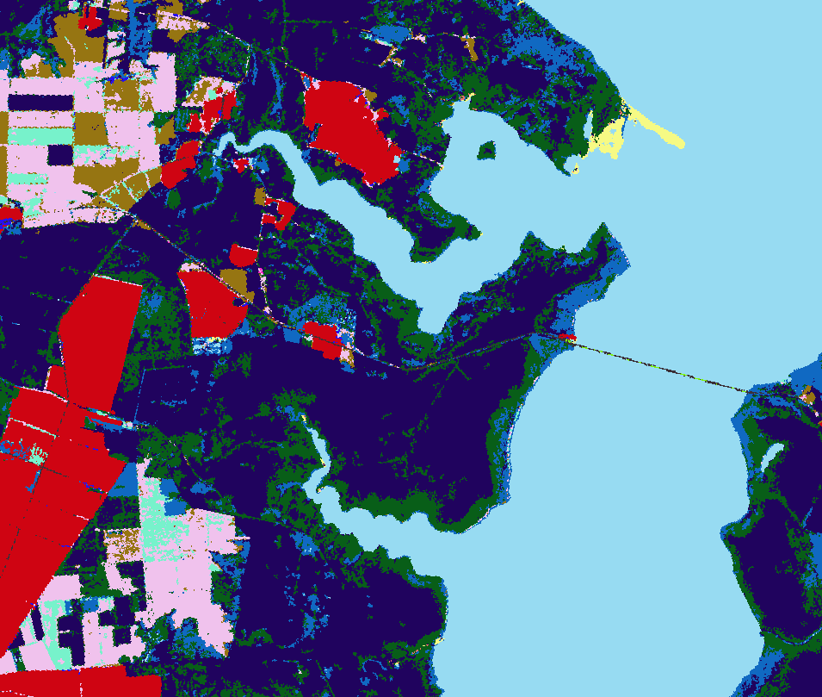
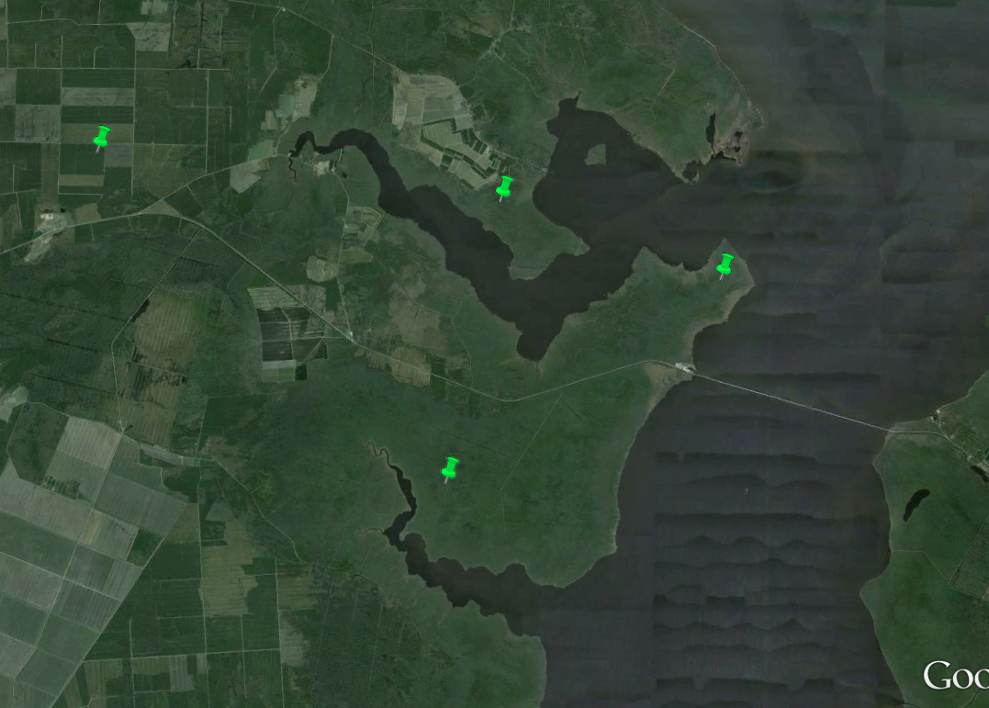
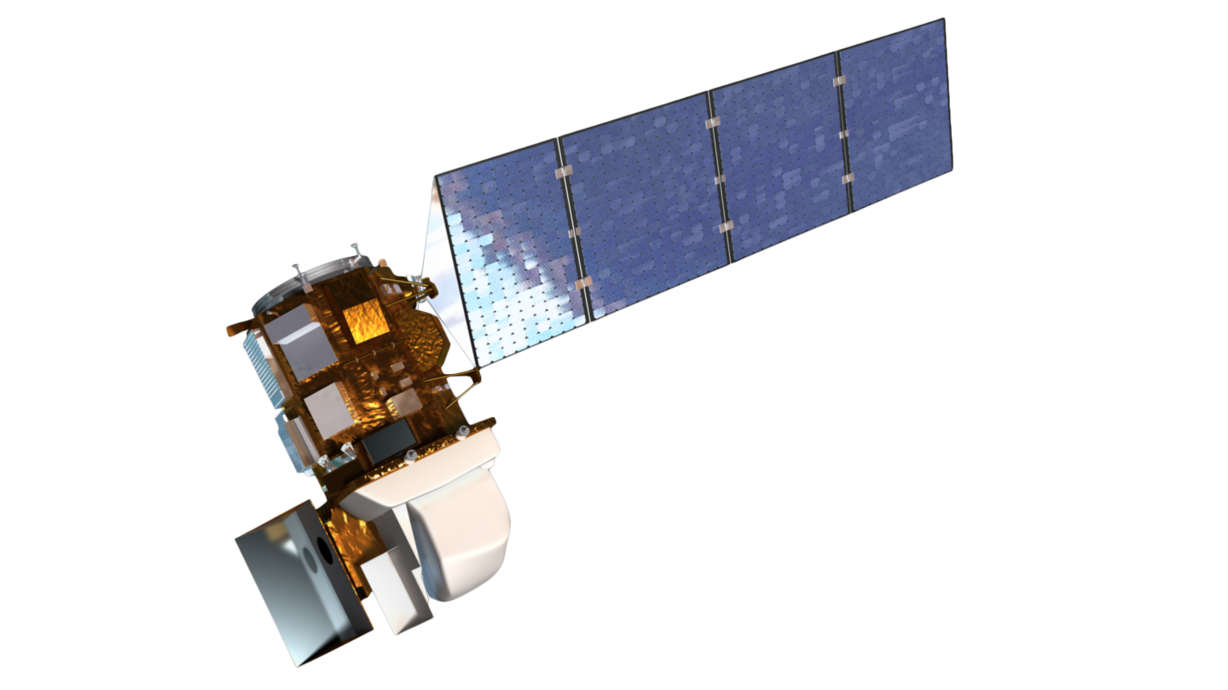
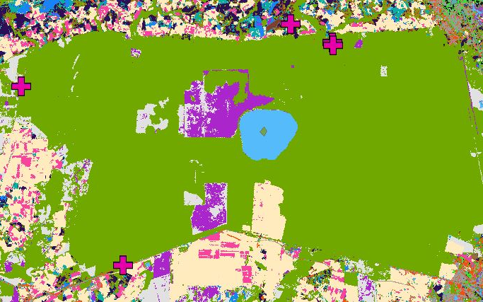
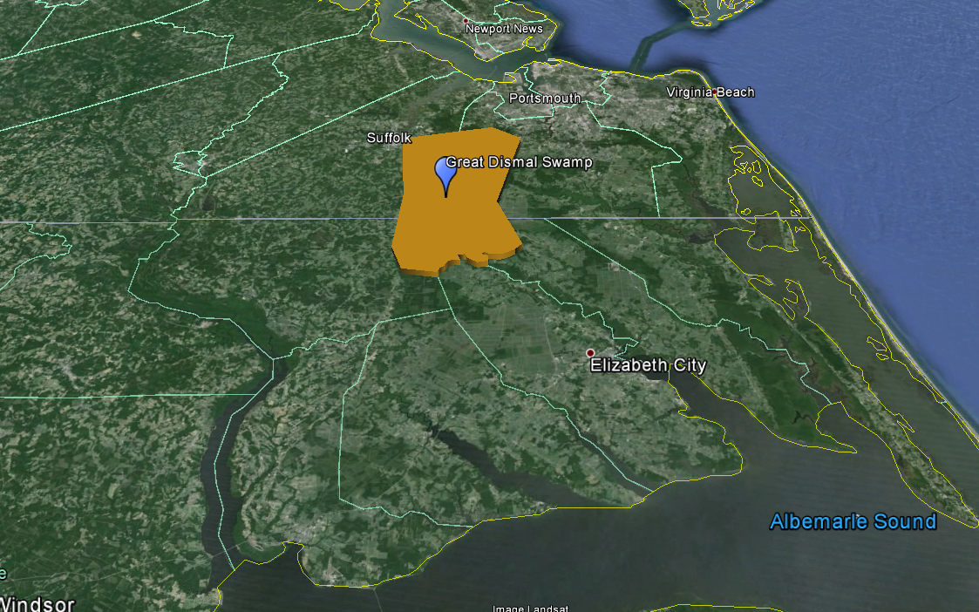
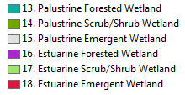


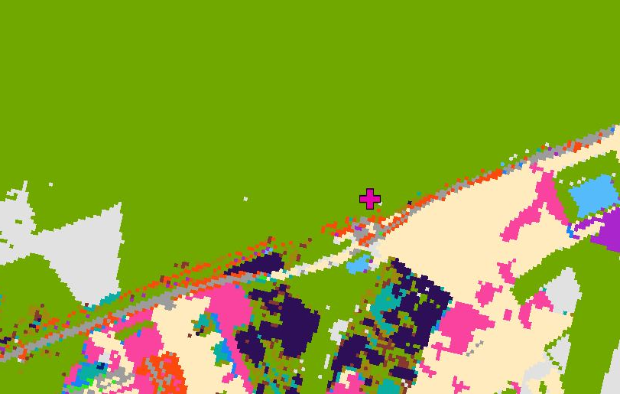
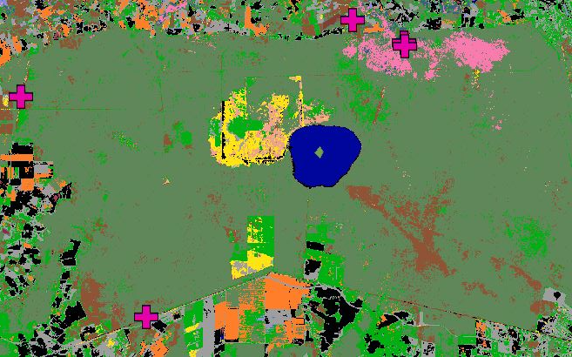
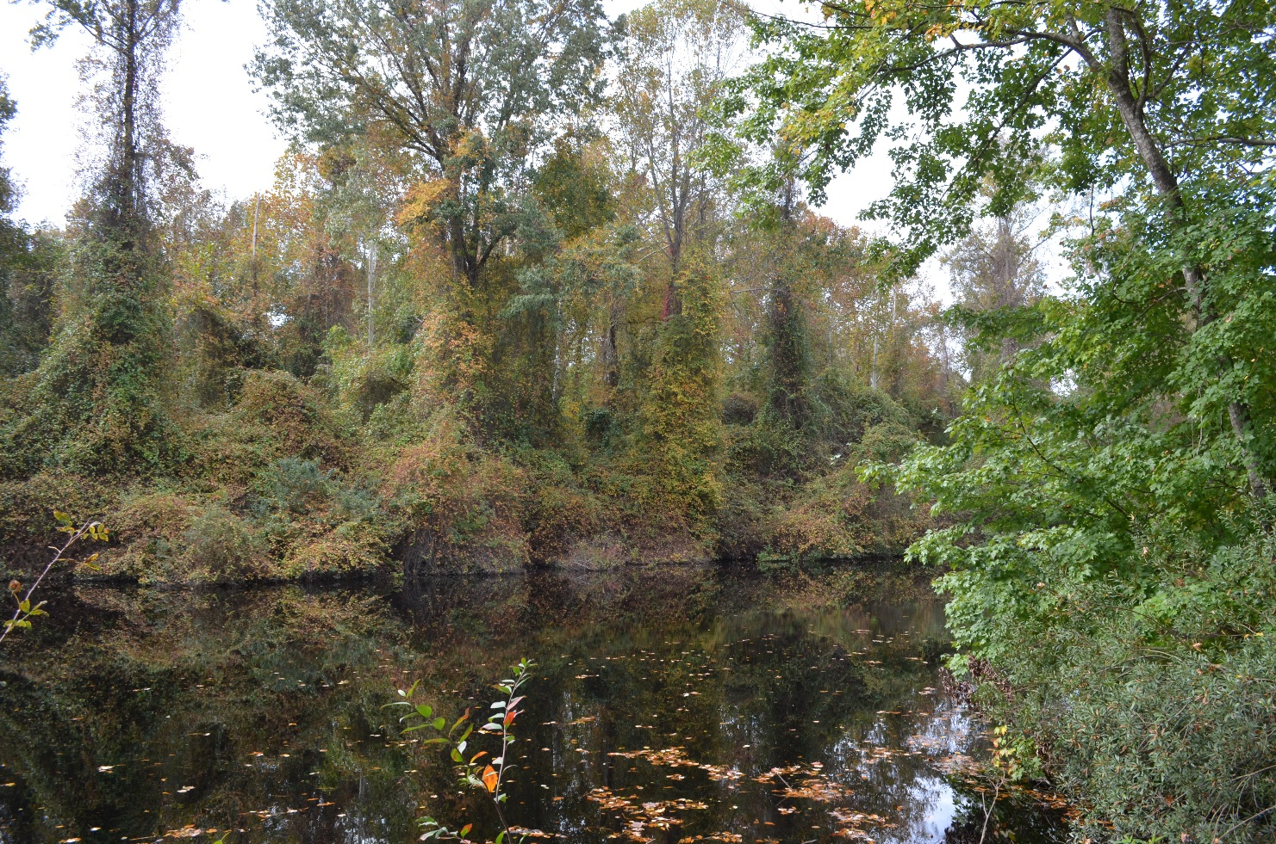
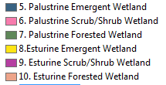
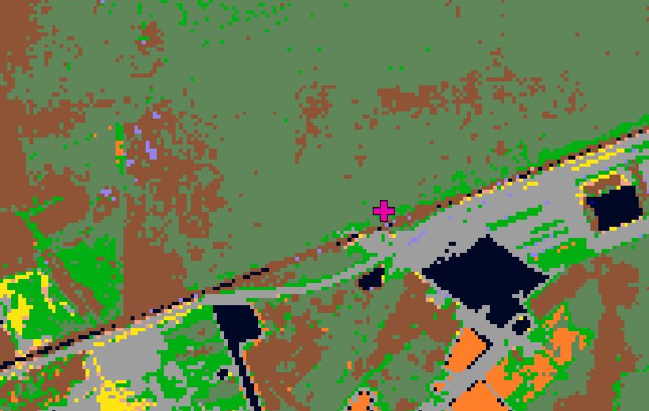
North Carolina Ecological Forecasting
Update of NOAA C-CAP wetland delineation and further disaggregation of land use classes using remote sensing
Ben Roberts-Pierel (Project Lead), Brett Buzzanga, Michelle Pasco, Jake Patrick, Benjamin Charlem, Taylor Sage
NASA DEVELOP National Program at NASA Langley Research Center
Abstract
Objectives
This project focused on ecological forecasting for wetlands in the Albemarle-Pamlico watershed in Northeastern North Carolina and Southeastern Virginia. The Albemarle-Pamlico watershed encompasses the second largest estuary system in the United States. Understanding land cover types and uses is incredibly important in managing the myriad of uses for, and stressors on, this valuable resource. In partnership with the Albemarle-Pamlico National Estuary Partnership (APNEP), this project aimed to provide an updated version of NOAA’s Coastal Change Analysis Program (C-CAP) land-use classification, with a specific focus on delineation of wetland types within this watershed. The project also further disaggregated land cover types such as crop varieties and the invasive species, Phragmites australis. The team utilized a supervised land classification methodology and cross-referenced Landsat 8 imagery with ground truth, LiDAR or Digital Elevation Models (DEM), the National Hydrological Dataset (NHD) and soil datasets to create inputs for the R classifying model. The end goal of the project was to produce maps and a methodology by which APNEP can continually update wetland types and to establish if there is a correlation between wetland type and wetland health within the watershed. This was all with the aim of helping APNEP to make informed policy and management decisions.
Aims to provide an updated classification that is tailored to the Albemarle-Pamlico Estuary with important land classes such as invasive species, Phragmites australis.
Create a replicable method so it would be possible for APNEP to update these classifications on a more regular basis than what C-CAP offers.
Study Area
Methodology
The study period is from September 2015 to November 2015. Each color on the map indicates a different river basin in the area of focus.
Earth Observations
C-CAP
Google Earth
Analyzed specific data sets and mapped out polygons using the methodology pyramid built upon Tier 1.
Conducted supervised land classification in Earth Engine and ran accuracy assessments in ERDAS Imagine.
Landsat 8 OLI/TIRS
Results & Conclusions
Team Members
N
N
Pictured above: Benjamin Charlem
Pictured to the left (from left to right): Michelle Pasco, Jake Patrick, Ben Roberts-Pierel (Project Lead), Brett Buzzanga
Not Pictured: Taylor Sage
Project Partner
Figure 1: Context map of the Great Dismal Swamp shown from Google Earth.
Figure 3: C-CAP classification of Great Dismal Swamp has Palustrine Scrub/Shrub Wetland, shown in green.
Albemarle-Pamlico National Estuary Partnership
Acknowledgements
N
Emily Adams, Langley Center Lead
Rebekke Muench, Langley Assistant Center Lead
Dr. Kenton Ross, NASA DEVELOP Science Director
Zand Bakhtiari, Previous Contributor
Stephen Zimmerman, Previous Contributor
Kayla Patel, Previous Contributor
Brad Gregory, Previous Contributor
Figure 2: Photography from the geo-referenced point show in Figures 3 and 4.
Figure 4: Our classification of Great Dismal Swamp has Palustrine Forested Wetland, shown in dark green.
NASA Langley Research Center

