Slide 1
Colorado
Ecological Forecasting
Monitoring Post-Fire Cheatgrass (Bromus Tectorum) Distribution to Inform Management Planning
Alix Bakke, Christopher Tsz Hin Choi, Alex Posen, Monika Rock, & Nikole Vannest
Colorado – Fort Collins
Notes:
Speaker: Christopher Tsz Hin Choi
Hi and thank you for joining us, the Colorado Ecological Forecasting Team, to hear about our project: Monitoring Post-Fire Cheatgrass Distribution to Inform Management Planning. My name is Chris Choi, the project lead, and I am joined by Alix Bakke, Alex Posen, Mo Rock, and Nikole Vannest. With that, I will hand it off to Alix to introduce the project.

Slide 2
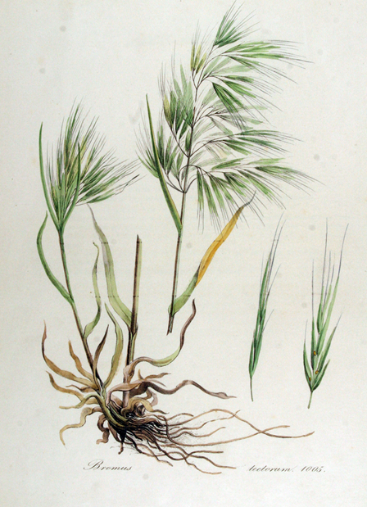
Cheatgrass
(Bromus tectorum)
Biology
Winter annual grass
Occupies a wide range of habitat
History
Origin – Eurasia
1800's – First introduced to the U.S
1900's – Established in every state
Current – covers more than 101 million acres in the West
Image Credit: Kurt Stueber
Notes:
Speaker: Alix Bakke
Cheatgrass is a winter annual which is a plant that germinates in fall, lives throughout the winter, and produces seeds then dies in the following season. This generalist plant can occupy a wide range of habitat.
It originated in regions throughout Eurasia and was first introduced to the U.S. in the 19th century to provide more resistant grazing species for rangelands. However, human dispersal of cheatgrass, such as railroad systems, allowed the invasive species to spread, and by the 20th century it was established in every state. Currently, cheatgrass covers more than 101 million acres throughout the western United States.
------------------------------Image Information Below ------------------------------
•Image Credit: Kurt Stueber
•Image Source: https://commons.wikimedia.org/wiki/File:Bromus_tectorum_%E2%80%94_Flora_Batava_%E2%80%94_Volume_v13.jpg, public domain

Slide 3
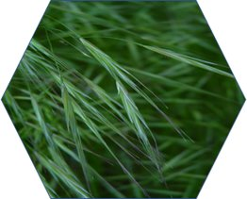
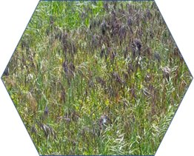
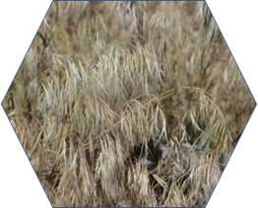
Cheatgrass
Phenology
Boot Stage
Life Stages
Boot Stage (~ May)
Purple – Red Stage (late spring to early summer)
Brown Stage (summer to fall)
Success of Establishment
Produces up to 70 million seeds per acre
Can survive on moderate winter and/or spring precipitation
Purple – Red Stage
Image Credit: Dendroica cerulea
Brown Stage
Image Credit: nature80020
Image Credit: Jennifer Strickland
Notes:
Speaker: Alix Bakke
There are three distinct life stages of cheatgrass, beginning with the boot stage in early May where cheatgrass is at its greenest . The second stage occurs once seeds are produced and is known as the purple –to red stage which happens around late spring to early summer. Lastly, as cheatgrass ages, it reaches the brown stage indicating drying out of the plant.
Cheatgrass is efficient in establishing within new areas because of its ability to produce up to 70 million seeds per acre and its ability to survive on moderate winter and/or spring precipitation
------------------------------Image Information Below ------------------------------
Image 1 Credit: Dendroica cerulea
Image 1 Source: Flickr https://www.flickr.com/photos/dendroica/34237477260/, (CC BY-NC-SA 2.0)
Image 2 Credit: nature80020
Image 2 source: Flickr https://www.flickr.com/photos/nature80020/14225726098, (CC BY-NC-SA 2.0)
Image 3 Credit: Jennifer Strickland
Image 3 Source: Flickr https://www.flickr.com/photos/usfwsmtnprairie/36940014742, (CC BY-NC-SA 2.0)

Slide 4
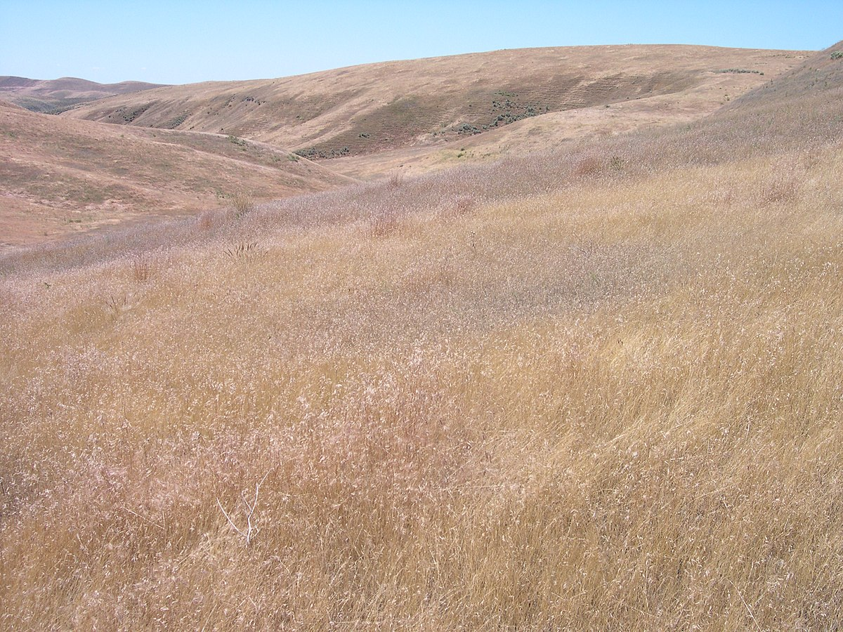
Community Concerns
Wildfire
Fire has the potential to create more cheatgrass habitat
Cheatgrass has the potential to create more frequent fires
Ungulates
Outcompetes native vegetation leading to reduced plant biodiversity
Reduced nutrient availability throughout the growing season
Documented within winter ranges
Cheatgrass
Wildfires
Image Credit: Thayne Tuason
Notes:
Speaker: Alix Bakke
Cheatgrass' early die off and efficiency in populating has created two major concerns within the community
First is the possible change in wildfire behavior. Disturbed areas such as forest fires allows for cheatgrass to spread into post-burned area. Additionally, as the plant grows then dries up and dies, there's a potential for increasing the risk of wildfires due to more fuel load on the landscape.
The second concern is food availability for ungulates (a hoofed animal). Because of its efficiency in establishment, cheatgrass often outcompetes native vegetation which reduces plant biodiversity and can create monocultures. Since cheatgrass has such a short growing timeframe before dying off, it reduces nutrient availability throughout the growing season for these ungulates. This is of particular concern where cheatgrass has been documented within an ungulates winter range.
------------------------------Image Information Below ------------------------------
Image Credit: Thayne Tuason
Image Source: https://commons.wikimedia.org/wiki/File:Cheatgrass_and_medusae_head_on_BLM_land_in_SW_Idaho.jpg

Slide 5

Partner Organizations
United States Forest Service (USFS)
USFS Concerns
Potential cheatgrass spread into post-fire montane regions
Prescribed burns potentially increases cheatgrass spread
Reduction in biodiversity by outcompeting native vegetation
Arapaho and
Roosevelt National Forests
Point of Contact: Tom Bates
Notes:
Speaker: Alix Bakke
We partnered with the United States Forest Service, specifically the Arapaho and Roosevelt National Forests who oversees and manages these public lands. Our point of contact for this organization was Tom Bates, who is a forest plant ecologist.
In addition to the community concerns discussed previously, the US Forest Service was concerned with the increased potential for prescribed burns to influence cheatgrass spread.
------------------------------Image Information Below ------------------------------
Image Credit: USDA
Image Source: https://commons.wikimedia.org/wiki/File:USDA_NIFA_Twitter_Logo.jpg

Slide 6

Key Concepts
Habitat Suitability Model (HSM)
Detection Model
Vegetation Indices
Image Credit: Andre William
Notes:
Speaker: Monika Rock
Before we dive too deep, we wanted to cover some important key concepts. The first being Habitat Suitability Model. A habitat suitability model, or HSM, quantifies preferred habitat for a species of interest. Often these use topographic and climate variables among other datasets. The second concept is a Detection model. A detection model takes spectral imagery to detect the species of interest. So ideally, a HSM is showing where a species can grow, and a Detection model is showing where it is currently growing.
Our last key term is Vegetation Indices, which is a dataset we used for the HSM. These layers modify a band using mathematic equations and transformations to highlight green vegetation. Basically, vegetation indices make it easier to see healthy vegetation on the landscape.
Topics to cover:
- HSM: quantifies preferred habitat for a species of interest
- Detection model: Locates present occurrence of species of interest
- Dispersal corridors: structures that enhance the dispersal of organisms
- Vegetation Indices: enhances vegetation properties by transforming 2 or more spectral ban
------------------------------Image Information Below ------------------------------
Image Credit: Andre William
Image Source: https://unsplash.com/photos/Dt5uJkuoSIk

Slide 7

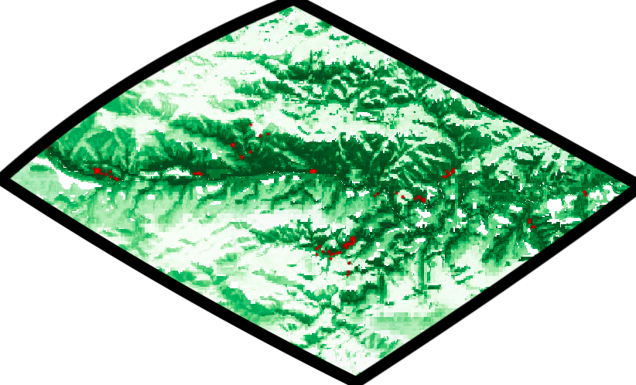

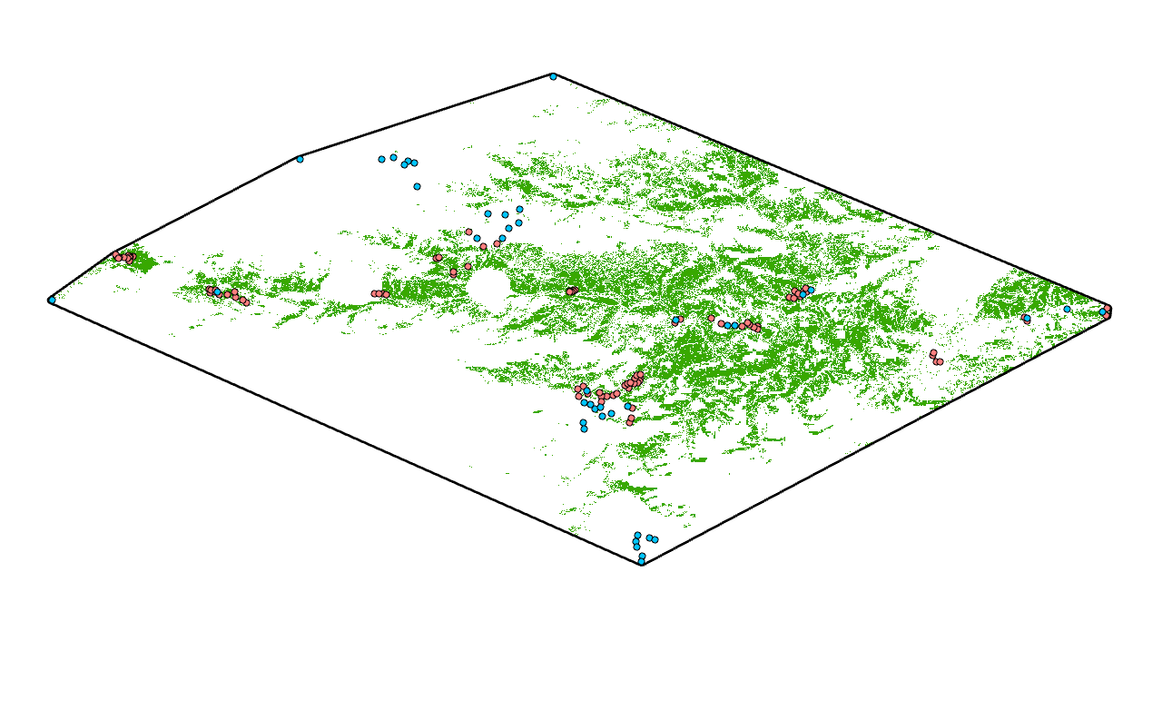

Project Objectives
1. Determine preferred post-disturbance cheatgrass growing conditions
Deliver a cheatgrass habitat suitability model and map
Image Credit: Alex Posen
2. Detect and map cheatgrass within
the predicted area of suitable habitat
Deliver a cheatgrass detection model and map
Notes:
Speaker: Monika Rock
We were tasked with two main objectives from the United States Forest Service. The first was to determine preferred post-disturbance cheatgrass growing conditions. We decided the best way to show this was though a Habitat Suitability Model.
The second objective was to detect and map cheatgrass within the predicted area of suitable habitat and provide our partners with a cheatgrass detection map.
Here you can get a preview of both our maps, which we will go into further detail later in our presentation
------------------------------Image Information Below ------------------------------
•Image Credit: PowerPoint Clipart
•Image Source: NA

Slide 8
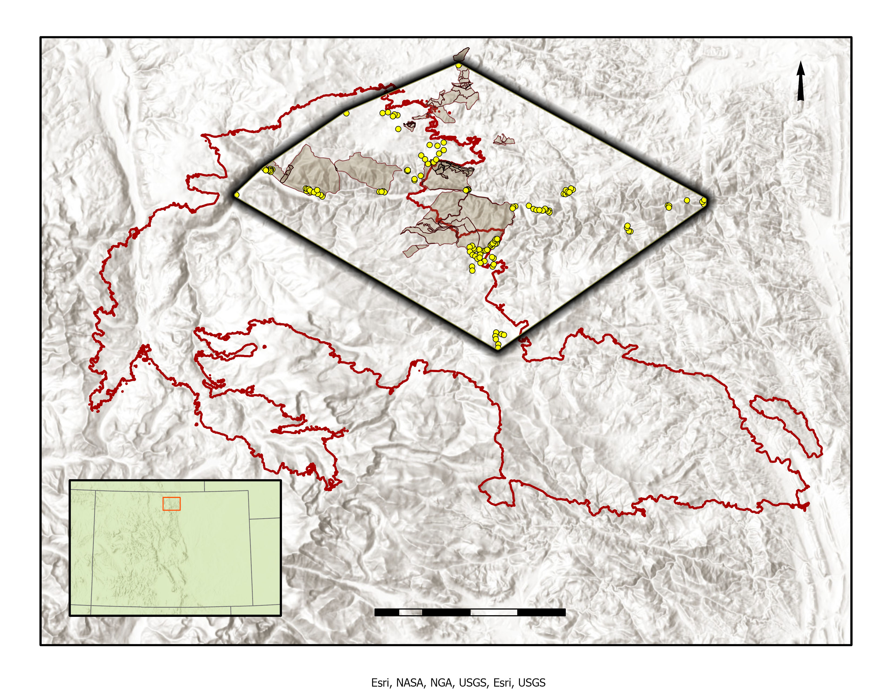


Study Area
Basemap source: Esri, NGA, NASA, USGS
Convex Polygon
  Derived from 136 field sample points
  115,978 acres within and surrounding the northeastern burn area
  Elevation – 1,735 m to 3,298 m
Cameron Peak Fire
  208,913 acres burned
  Aug 2020 – Dec 2020
  Montane ecosystem
Prescribed Burns
  182 treatments from 1993 – 2019
COLORADO
Field Samples
0
Study Area
Miles
5
10
Burn Treatments
Cameron Peak Fire
Notes:
Speaker: Monika Rock
Once we knew our project objectives, we had to create a study area that took the Cameron Peak Fire, Past Burn Treatments, and the 136 field data points that the USFS collected this year into account. These factors are important in determining the region of interest because of fires complex relationship with cheatgrass and the importance of not over projecting our model as well as balancing our partners requests. We decided to create a convex polygon with a 150 m buffer around the field sample points to create a study area that would avoid extrapolating beyond our field points.
You can see that the Cameron Peak Fire burned nearly half of our study area. It was the largest fire in Colorado State’s recorded history and the only one to burn over 200,000 acres. It also was unique in that it burned later into the year, not being fully out until December. There were 182 Prescribed burns, between 1993 and 2019 with the objective of reducing hazardous fuel loads in the forest. Both were taken into account when creating our final study area and even considered for our inputs to our models.
##Talking points to include
- explanation of why we produced a convex polygon: We wanted to make sure we didn’t extrapolate beyond our field point distribution due to the heterogeneous landscape
- Significance of the Cameron Peak Fire: Burning late into the fire season & was the largest in recorded history
- Rx Burn <- prescribed burn with the objective of reducing hazardous fuel loads

Slide 9

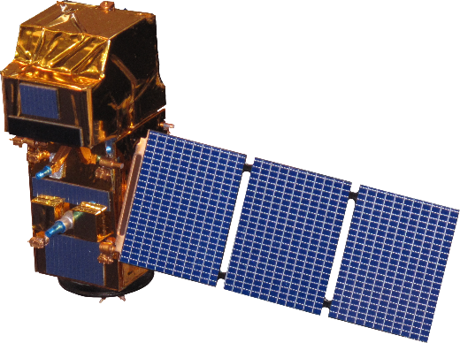

Datasets
Earth Observations Used
Sentinel-2 MSI
Vegetation
Indices
Burn
Severity
Shuttle Radar Topography Mission
Topo
Variables
Image Credit: NASA, ESA
Image Credit: NASA
Notes:
Speaker: Monika Rock
For our project we used multiple datasets pulled from different locations. First, I will go over the datasets that directly used Satellites & Sensors. We gathered Topographic Variables from Shuttle Radar Topography Mission, or SRTM, and Vegetation and Burn Severity Indices from Sentinel-2 MSI. SRTM was a unique NASA mission in partnership with other countries to create the highest resolution digital topographic database of the planet. The SRTM is an active sensor, versus other satellites, like the Sentinel-2 MSI that uses the suns energy reflecting off earth to create a spectral picture. SRTM's resolution, or how big each pixel in the picture is 30 m by 30 m. Sentinel-2 MSI was used to gather Vegetation and Burn Severity Indices which came in 10 and 30 m resolution.
------------------------------Image Information Below ------------------------------
Earth Image Credit: NASA
- https://www.nasa.gov/content/earth-day-image-gallery-celebrating-earths-beauty
Shuttle Radar Topography Mission Credit: NASA
Image Source: https://www.nasa.gov/sites/default/files/thumbnails/image/iss063e076166.jpg
Sentinel-2 MSI Credit: European Space Agency
- Image Source: https://www.devpedia.developexchange.com/dp/index.php?title=File:24_Sentinel2.png

Slide 10
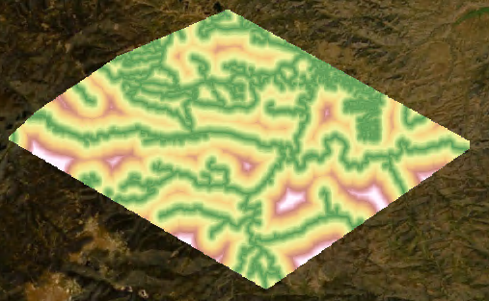
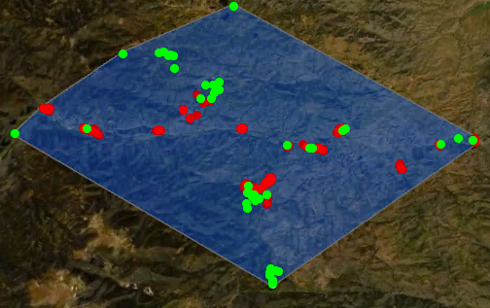
Datasets
Ancillary Sources
Field
Data
Climate
Predictors
USDA,
US Forest Service
PRISM
Climate Group
Basemap source: Esri, NGA, NASA, USGS​
Burn
Treatments
Dispersal
Corridors
NASA DEVELOP
Colorado Front Range Disasters
CO Spring 2021
US Census Bureau & Colorado Parks and Wildlife
Basemap source: Esri, NGA, NASA, USGS​
Notes:
Speaker: Monika Rock
Other datasets we used were from ancillary sources, the original data was pulled from a satellite and then modified or edited to show other factors on the landscape. These include the field data we received from the USFS (pictured above), climate predictors which were pulled from PRISM Climate Group, Burn Treatments which were taken from a previous develop project, and Dispersal Corridors (pictured above). The information on roads came from the US Census Bureau and the trail information came from Colorado Parks and Wildlife.

Slide 11
Dispersal Corridors
Methodology
Habitat Suitability Model (HSM)
Topographic
Field Validation Points
Predictor Variables
Climate
Burn
Severity
Tools:
Google Earth Engine
ArcGIS Pro
From the
US Forest Service
Software For Assisted Habitat Modeling
(SAHM)
Random Forest Model
Generalized Linear Model (GLM)
Boosted Regression Model
(BRT)
Map of Habitat
Suitability
Notes:
Nikole Vannest
*Cue first animation
The first modeling step in our project was to create a habitat suitability model that would determine a landscape where cheatgrass is likely to grow.
We received field data from the US forest service in the form of percent cheatgrass cover that we converted to presence absence points,
*Cue second animation
and extracted ecologically relevant predictor variables including dispersal corridors, topographic, climate and burn severity indices, from Google Earth Engine and ArcGIS Pro.
*Cue last animation
These datasets were plugged into VisTrails, a graphic user interface that utilizes SAHM, or software for assisted habitat modeling. We used SAHM to set up a recursive model that cleaned and aligned the data to be run though and compared across several models. The Random Forest Model, Generalized Linear Model, and Boosted Regression Model were utilized to determine cheatgrass suitability using the given predictive layers and trained using the field validation presence and absence points.

Slide 12
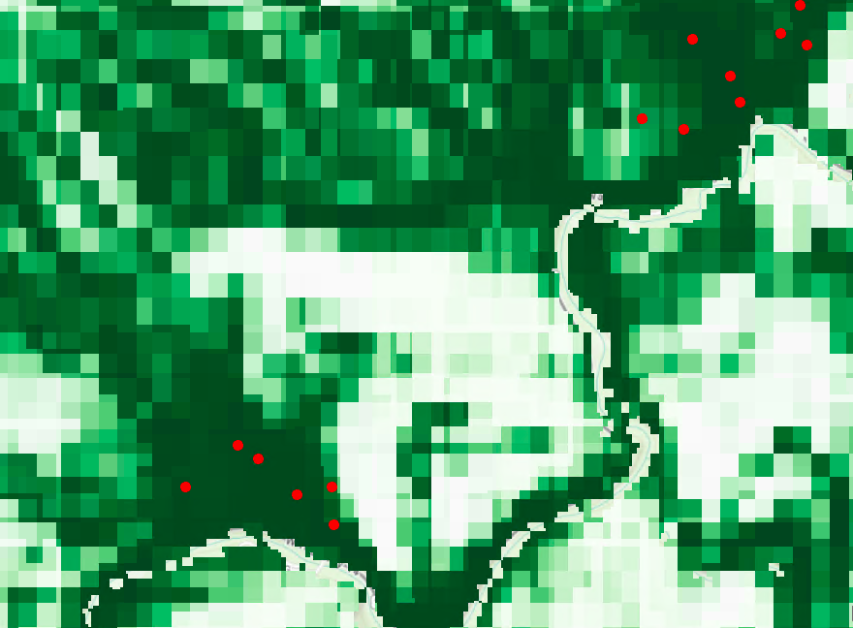
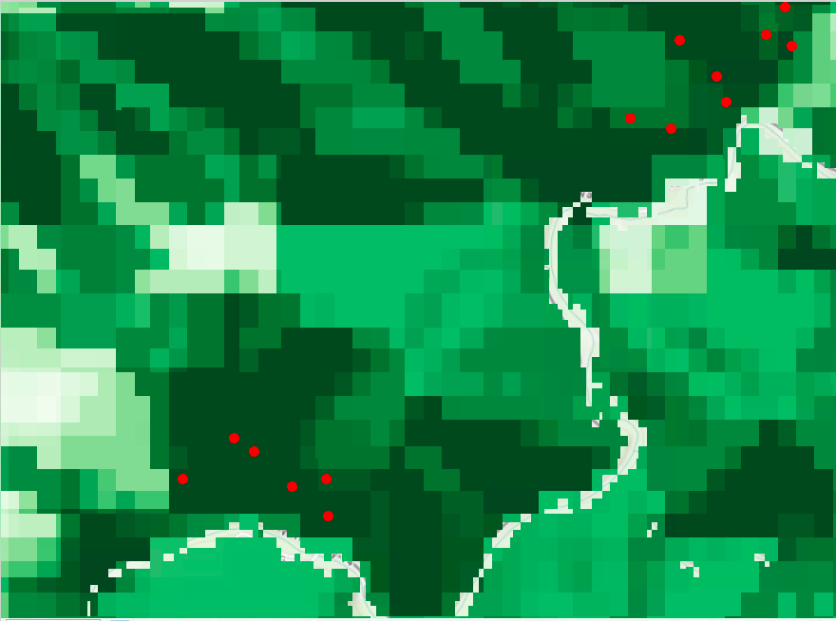
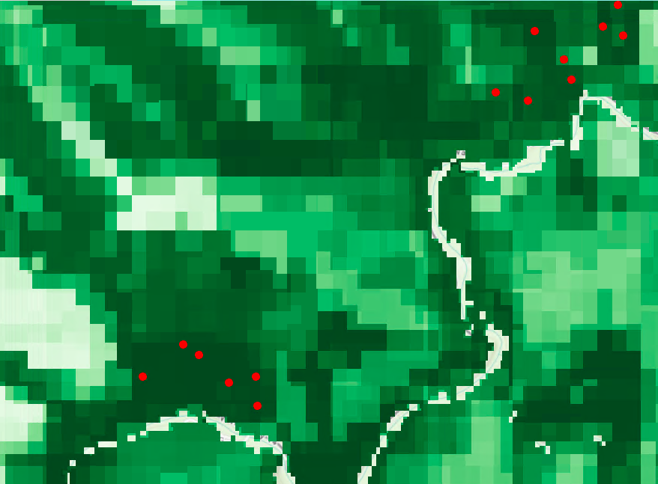
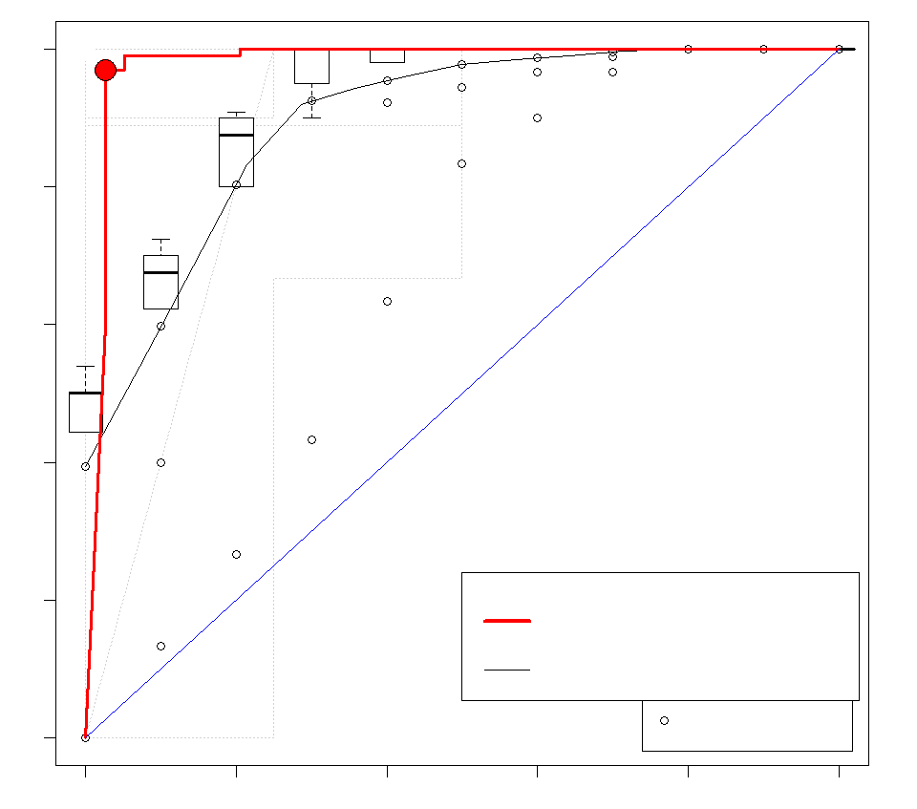
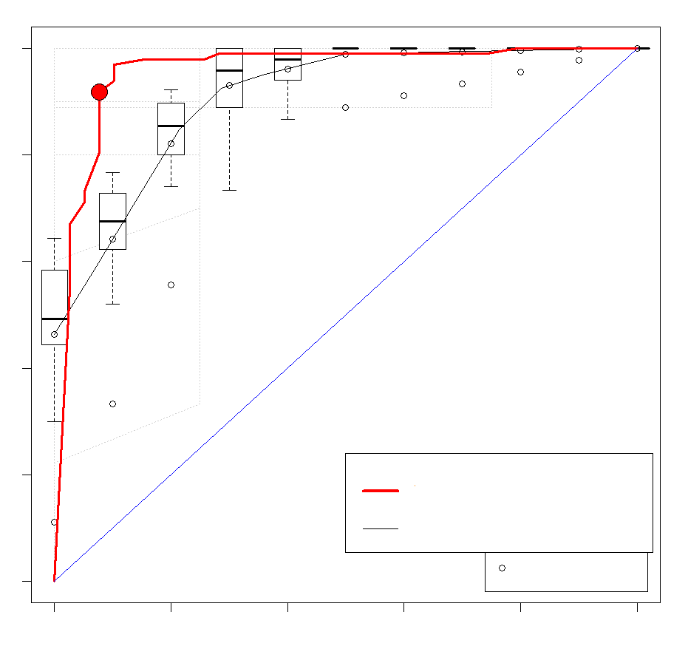
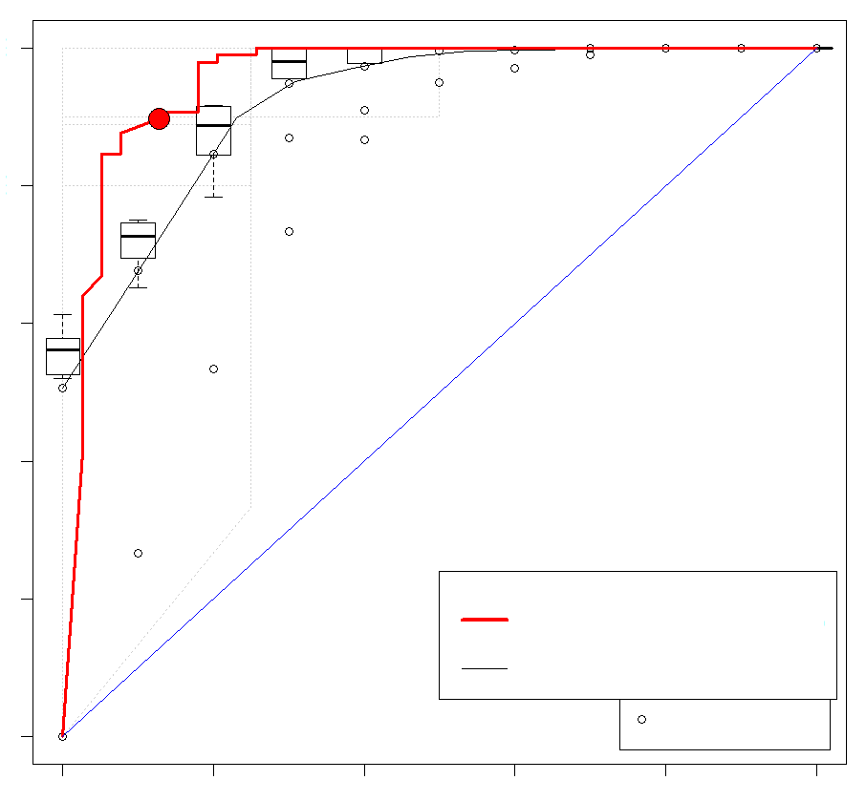
Results | Model Outputs
Random Forest
GLM
BRT
Random Forest
Probability ​
High ​
Low ​
1.0
Model Fit
Ideal
AUC
(>0.9) ​
0.68
0.7
0.76
0.8
0.6
Sensitivity (true +)
1.0
0.4
Area Under Curve
0.2
0.8
Train 0.98
Train 0.957
Train 0.954
CV 0.946
CV 0.955
CV 0.966
0.6
0.68
0.70
0.0
Threshold
0.76
Specificity (true -)
0.4
0.2
0.0
Notes:
Nikole Vannest
Each of these models has a different interpretation of what is happening on the landscape with the given input, and for our purposes we found RandomForest to be the best fitting version of cheatgrass suitable habitat. Although the Area Under the Curve statistic is above a 0.9 for all the models, there is a disparity between the training line (red line) and the cross-validation data (grey line) indicating the GLM and BRT models are a bit overfit and may not perform as well with a new set of training data.
*Cue animation
However Random Forest is more closely aligned and was the model we decided to move forward with.

Slide 13
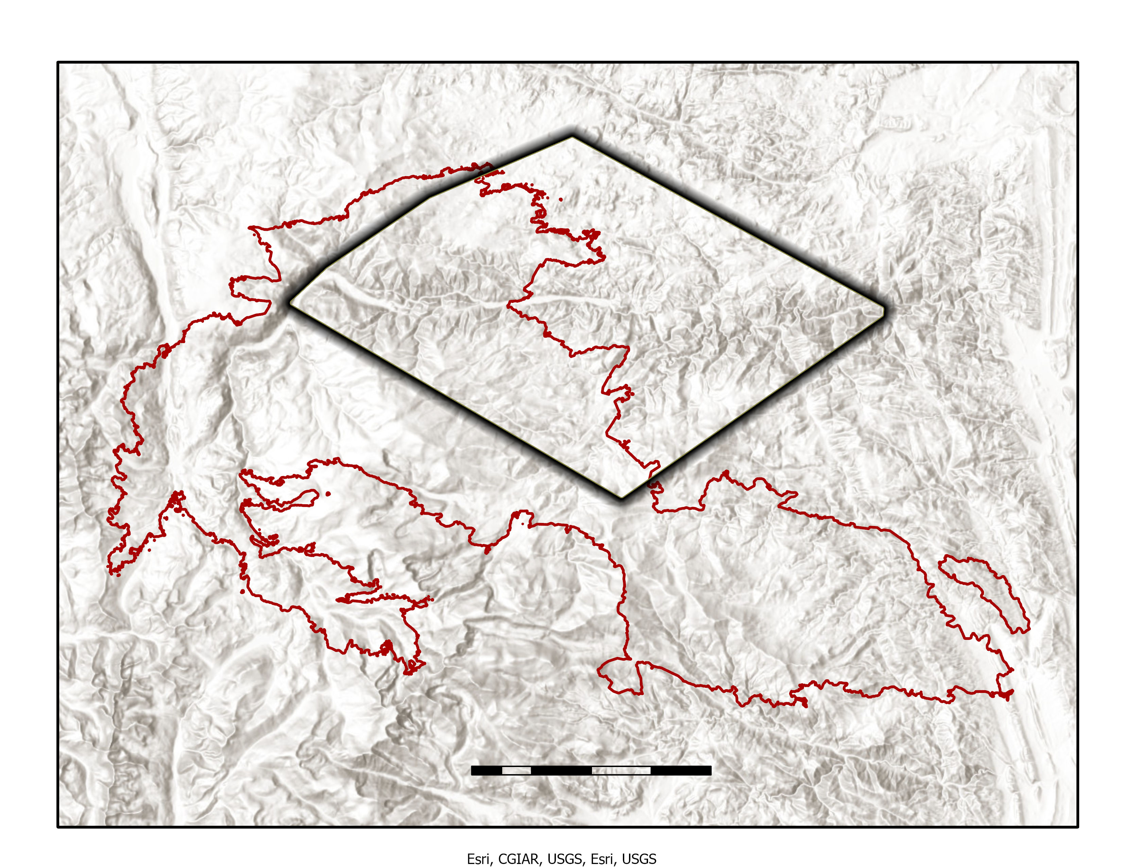
Results | Random Forest
N
Suitability ​
High ​
Study Area
0
5
10
Cheatgrass Presence
Cameron Peak Fire
Low ​
Basemap source: Esri, NGA, NASA, USGS​
Notes:
Nikole Vannest
This is the predictor map that Random forests generated using our training data and predictor variables. The map is lighter where the model predicted less suitable habitat, and darker where it predicted the landscape to be more suitable to cheatgrass growth. The red dots on the landscape indicate areas of cheatgrass presence from provided field data.
Just from looking at this output, you can tell that topography played a big role in determining suitability, with lower elevation and south facing slopes being much darker regions across the landscape. Distance to roads and trails as dispersal corridor predictors were dropped from our analyses because these variables were bounding the model too much and are also correlated to elevation. This is evident here as parts of the darker regions on this map are also near major roads and follow the Poudre river.

Slide 14
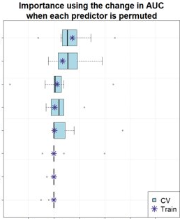
Results | Important Predictor Variables
Top 3 Predictors:
1. Northness
How north a slope is facing
2. Topographic Diversity
Diversity of temperature and moisture conditions on the landscape
3. Elevation
Northness
Drove modeled
suitable habitat
Topographic
Diversity
Elevation
Landform
Variables
mTPI
Less
important
predictors
Slope
ppt
dNBR
cv
CV
train
Train
-0.05
0.00
0.05
0.10
0.15
0.20
0.25
Importance
Notes:
Nikole Vannest
The final predictor variables we included in our model in order of importance are: Northness, Topographic Diversity, Elevation, Landform, mTPI or Multi-Scale Topographic Position Index (which distinguishes ridges from valley forms), Slope, precipitation, and dNBR or difference normalized burn ratio. This figure shows the measure of importance of each of these variables over 10 model iterations and a star indicates where the training data landed on this scale. Northness, topographic diversity, and elevation were the top three predictors and drove most of the model output.

Slide 15
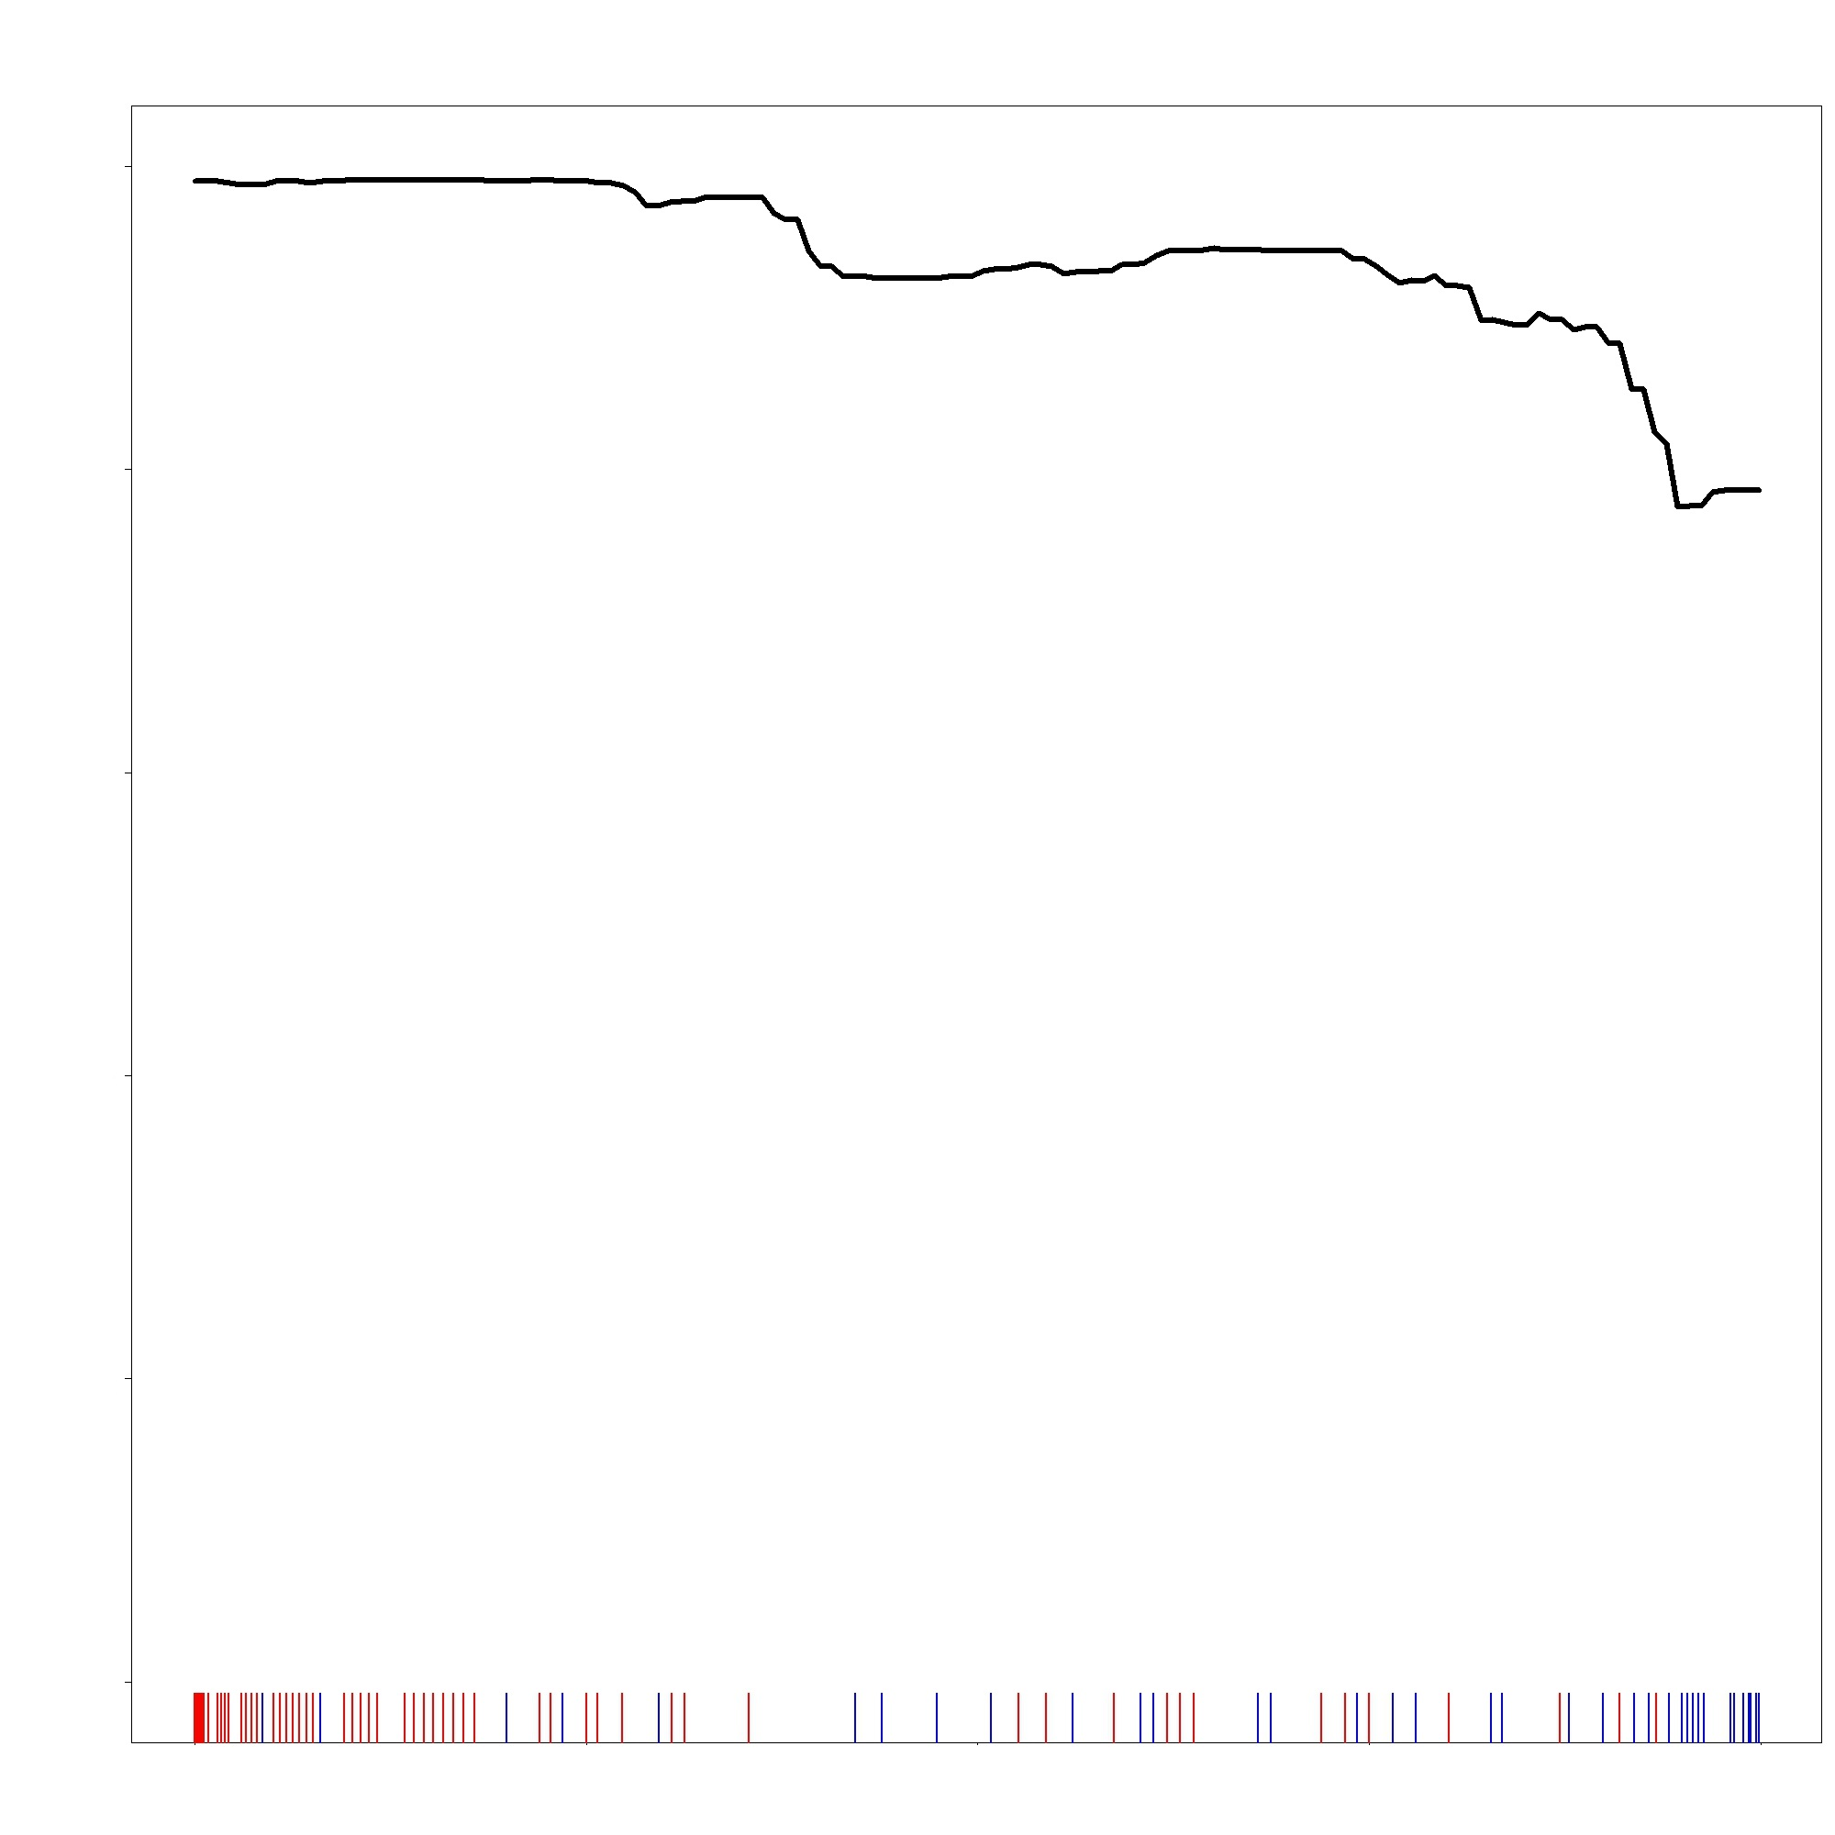
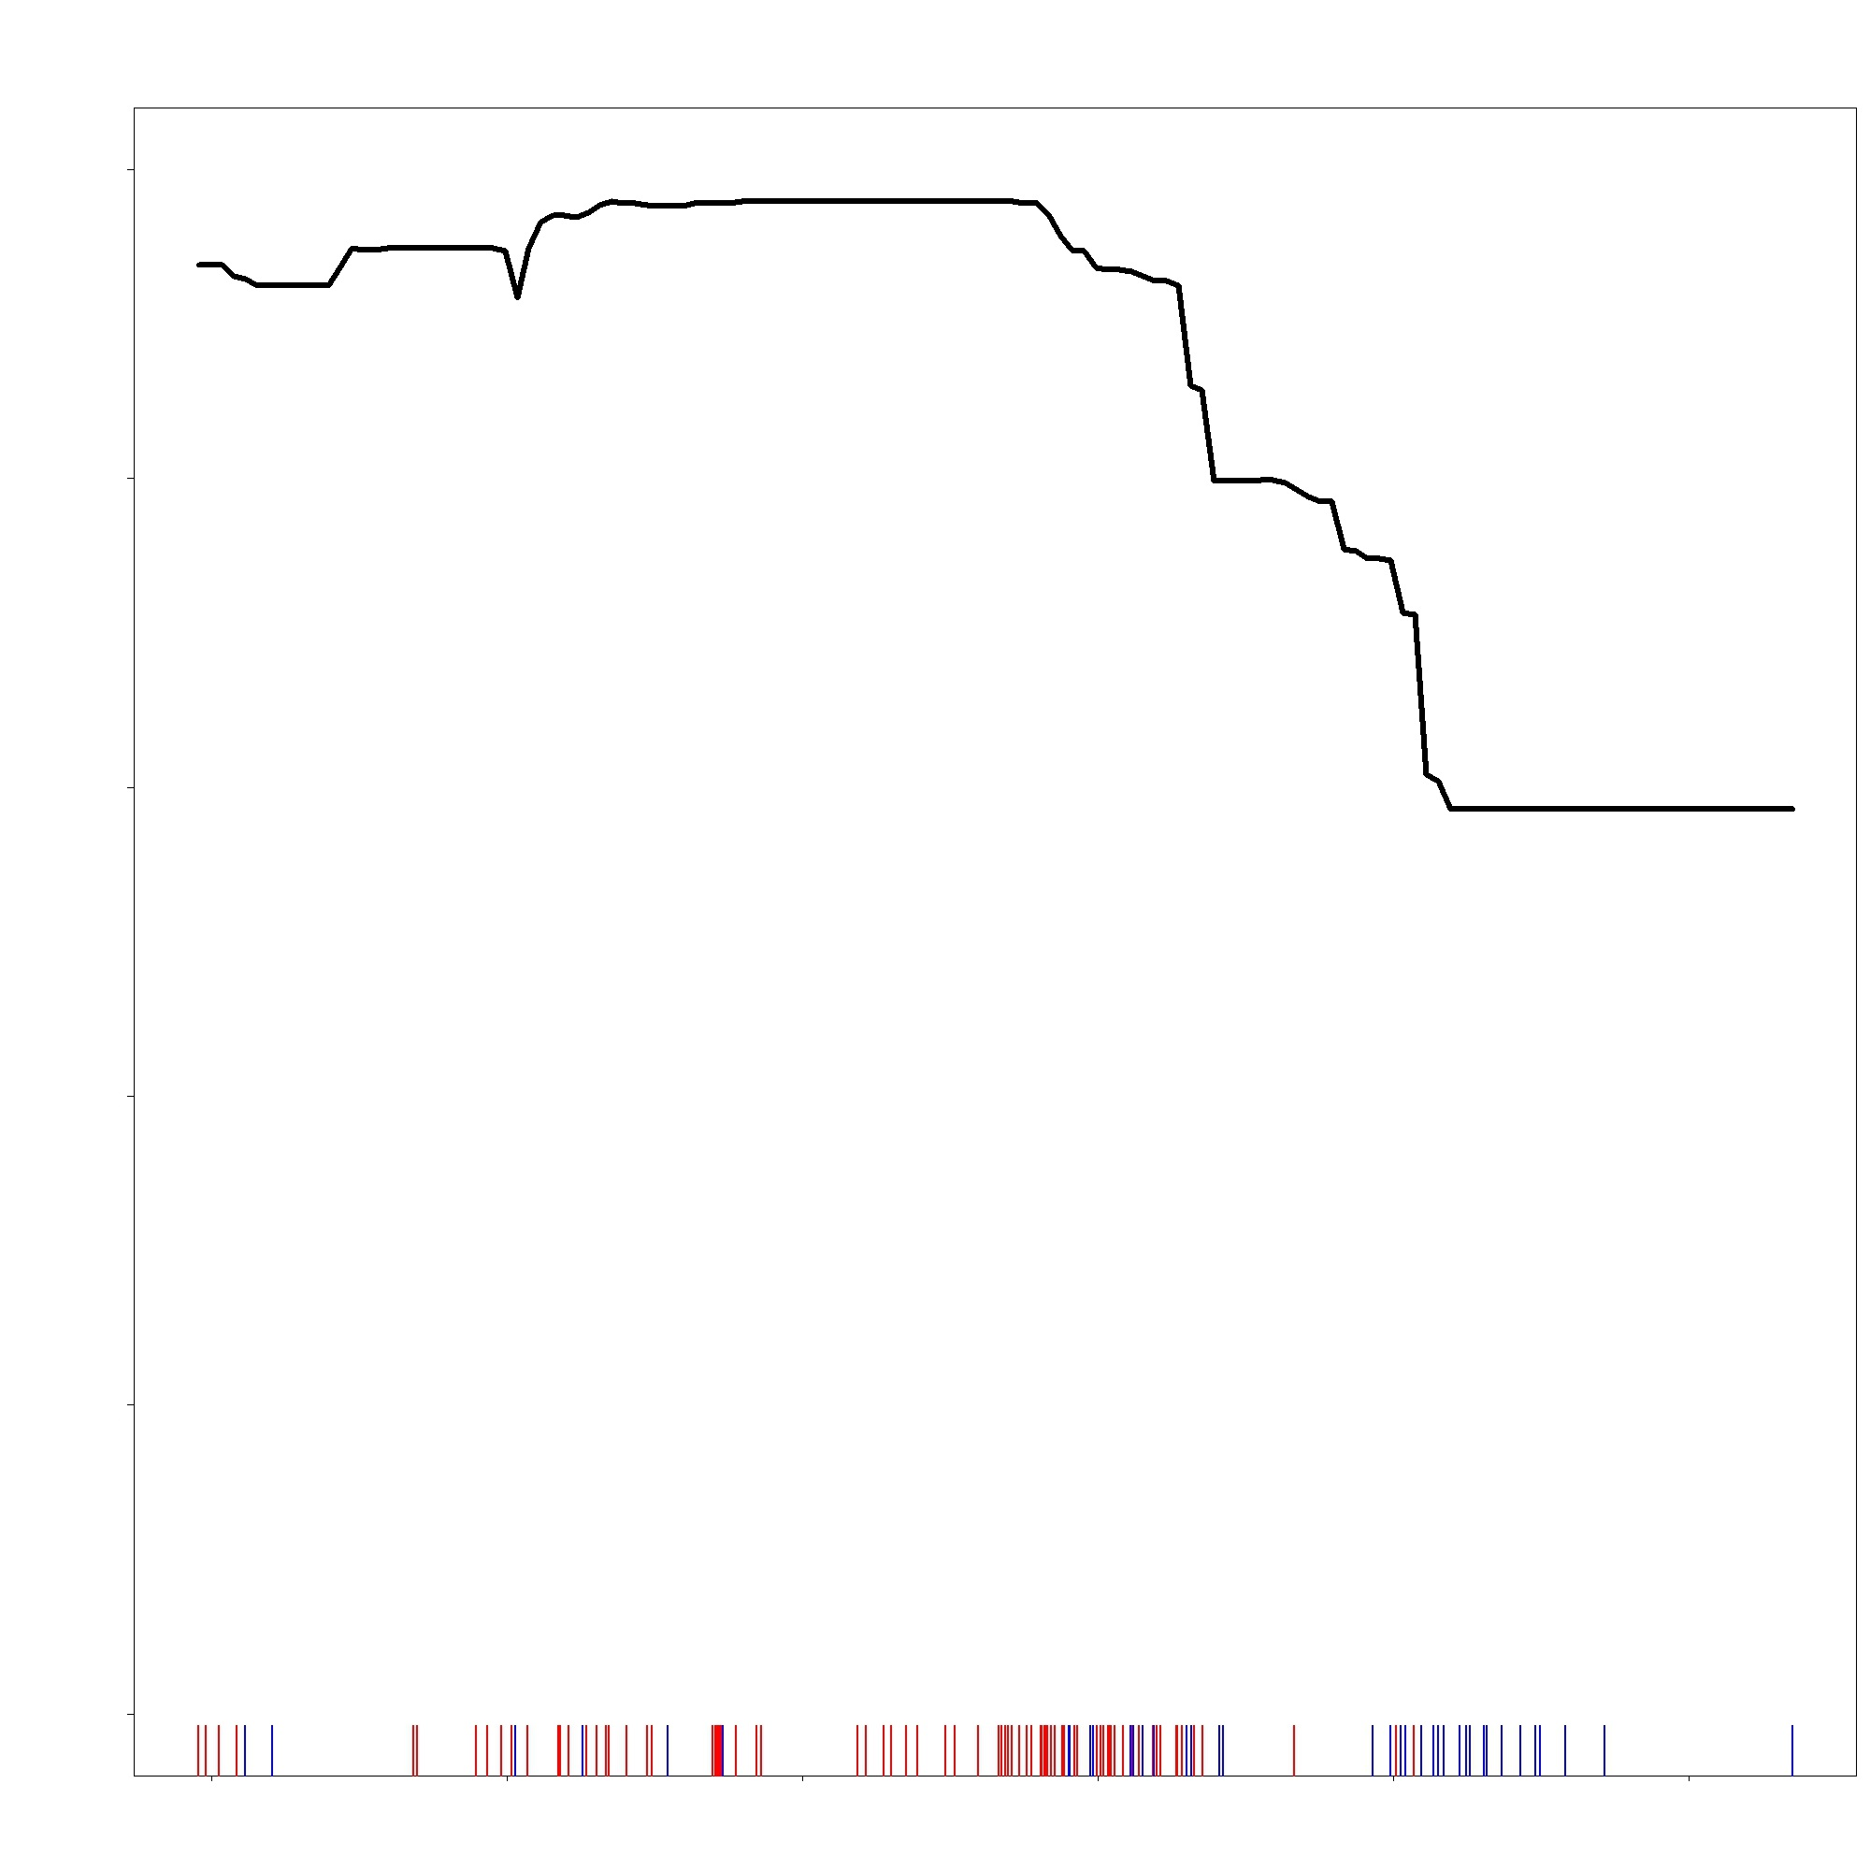
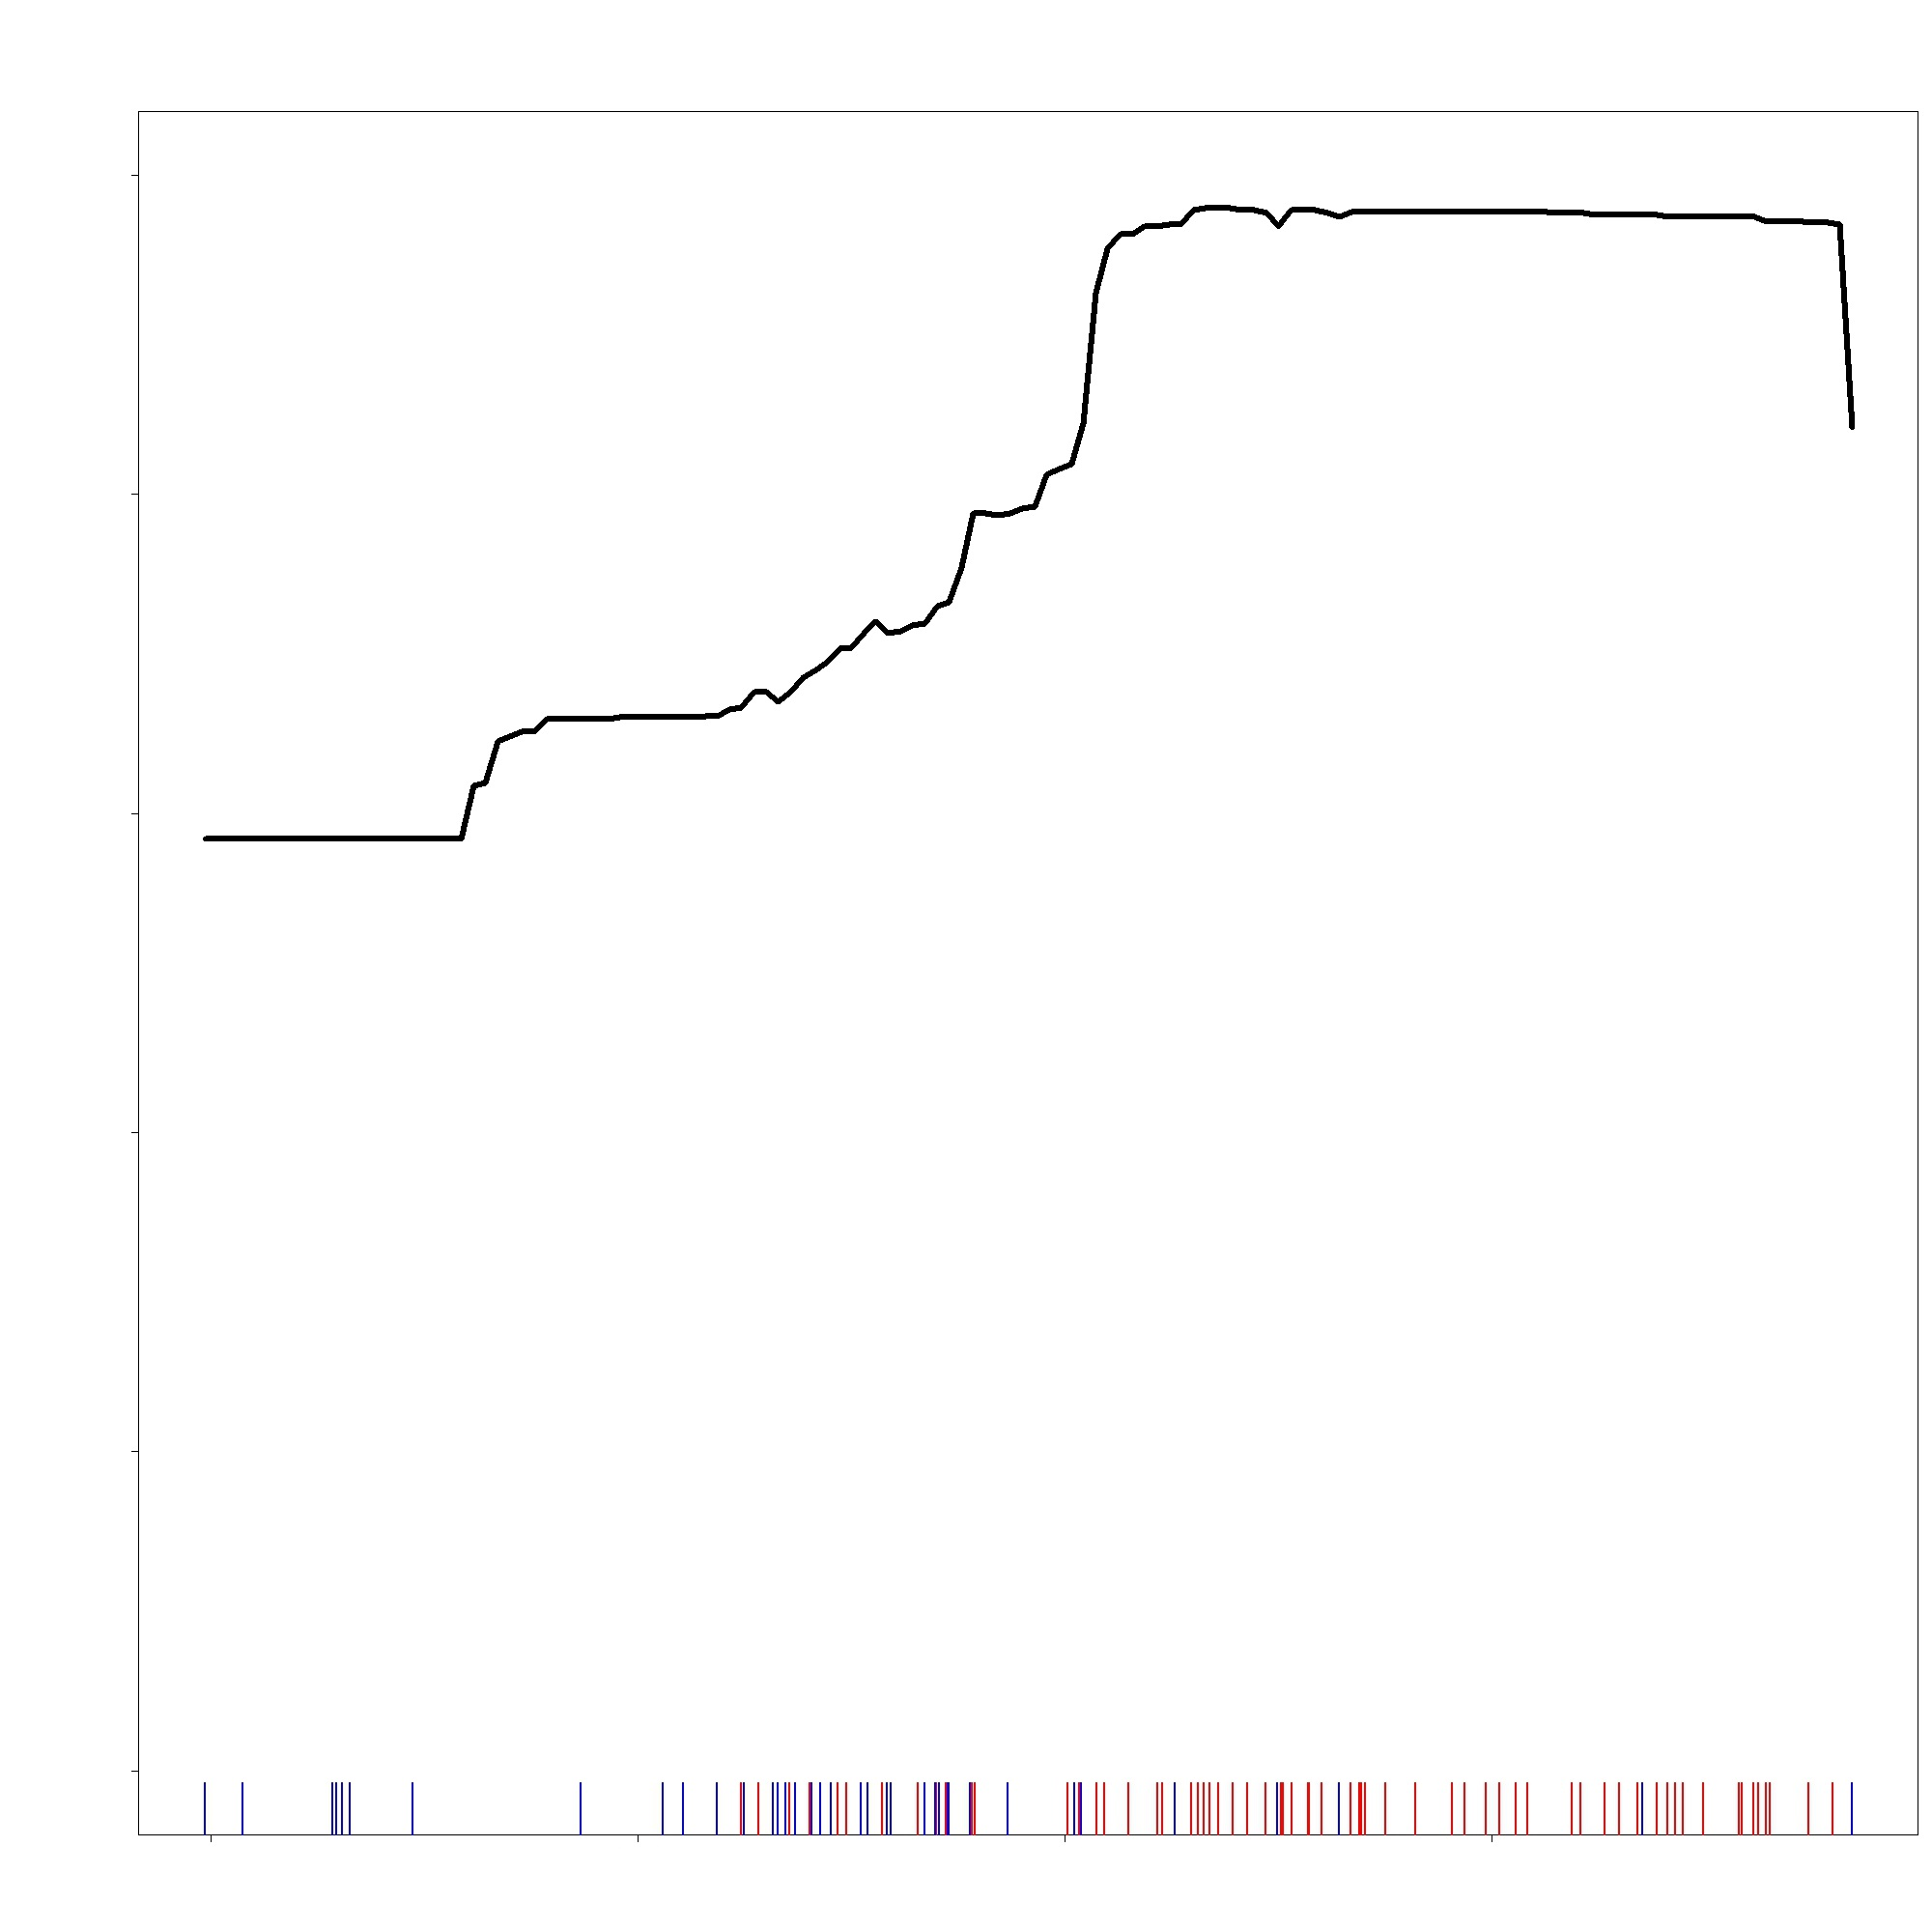
Results | HSM Response Curves
1
2
3
1.0
1.0
1.0
0.8
0.8
0.8
0.6
0.6
0.6
Predicted
0.4
1.0
0.4
0.4
8
2800
0.2
0.2
0.2
0.0
0.0
0.0
0.0
0.5
6
2400
Northness
Topographic Diversity
Elevation (m)
4
-0.5
Blue: Cheatgrass absence
from field data
Rug Plot: shows dispersal of data within a map
Red: Cheatgrass presence
from field data
2000
-1.0
2
Notes:
Nikole Vannest
Here are the response curves for the top three indicators from the suitability model. You can read these left to right, as the indicator increases across the landscape the model has its expected response. All three curves are fairly consistent with what we expected based on the literature and knowledge of cheatgrass phenology; cheatgrass prefers south-facing, dry, and low elevation slopes. So, we would expect the northness curve to decrease as northness increases, indicating a stronger preference for south facing slopes. Same can be said for Topographic Diversity, cheatgrass preferring a less diverse landscape as it is a strong invasive in post-disturbance sites. Elevation was fairly consistent, indicating here that the model predicts cheatgrass to prefers mid elevation range, dropping off after 2800 m.
*Cue animation
The rug plot at the bottom of each graph indicate how the training data was distributed. The red lines indicate field points where cheatgrass presence was recorded and blue where it was absent. The red and blue lines also distribute in accordance with what we would expect, with a higher concentration of presence at a low northness and topographic diversity, and mid elevation.

Slide 16
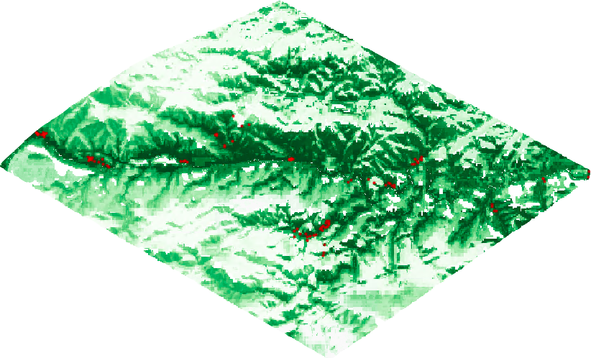
Predictor Variables (Greenness)
Methodology
Detection Model
06/15/2021
07/10/2021
Habitat Suitability Map
Date 1
Date 2
Differenced
Random Forest Model
Generalized Linear Model
Boosted Regression Model
Map of Cheatgrass
Detections
Notes:
Alex Posen
*Cue animation
In order to create our final detection model, we first started with the habitat suitability map. Using the field data, we found that among the known cheatgrass points, the lowest suitability factor was 40%. We used this as our threshold, and everything above 40% was considered suitable habitat, anything below unsuitable habitat.
*Cue animation
Next, we brought in our spectral vegetation indices. We differenced these indices across various date ranges to capture the cheatgrass life cycles. For example, NDVI (normalized difference vegetation index) was calculated for June 15th and July 10th, among other dates. These two images would be subtracted in order to emphasize the early cheatgrass green-up and die off. Remember, cheatgrass is one of the first species to green-up and die off, therefore this differencing technique is able to differentiate other vegetation from cheatgrass.
*Cue animation
We calculated a total of 7 indices, across 10 different date ranges. We inputted them into SAHM (software for assisted habitat modeling) and run through 3 machine learning algorithms. Again, random forests had the best performance.

Slide 17
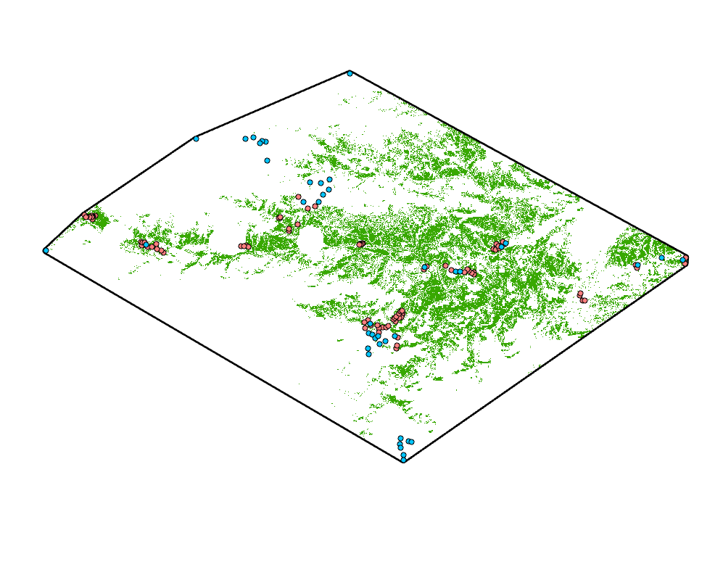

Results | Detection Map
Cheatgrass Detected
Cheatgrass Absent
0
5
10
Basemap source: Esri, NGA, NASA, USGS​
Cheatgrass Present
Notes:
Alex Posen
This is the final cheatgrass detection map predicting areas of current cheatgrass distribution. This model was thresholded at 70%, with values above considered detection, and values below considered absent. The majority of detected cheatgrass is in the eastern region of the study area with lower elevations. We also see increased detection across the Poudre river/highway 14 corridor, which runs through the center of the study area.

Slide 18
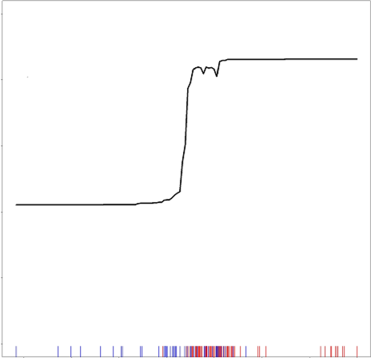
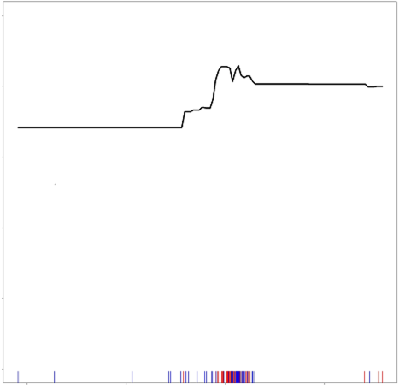
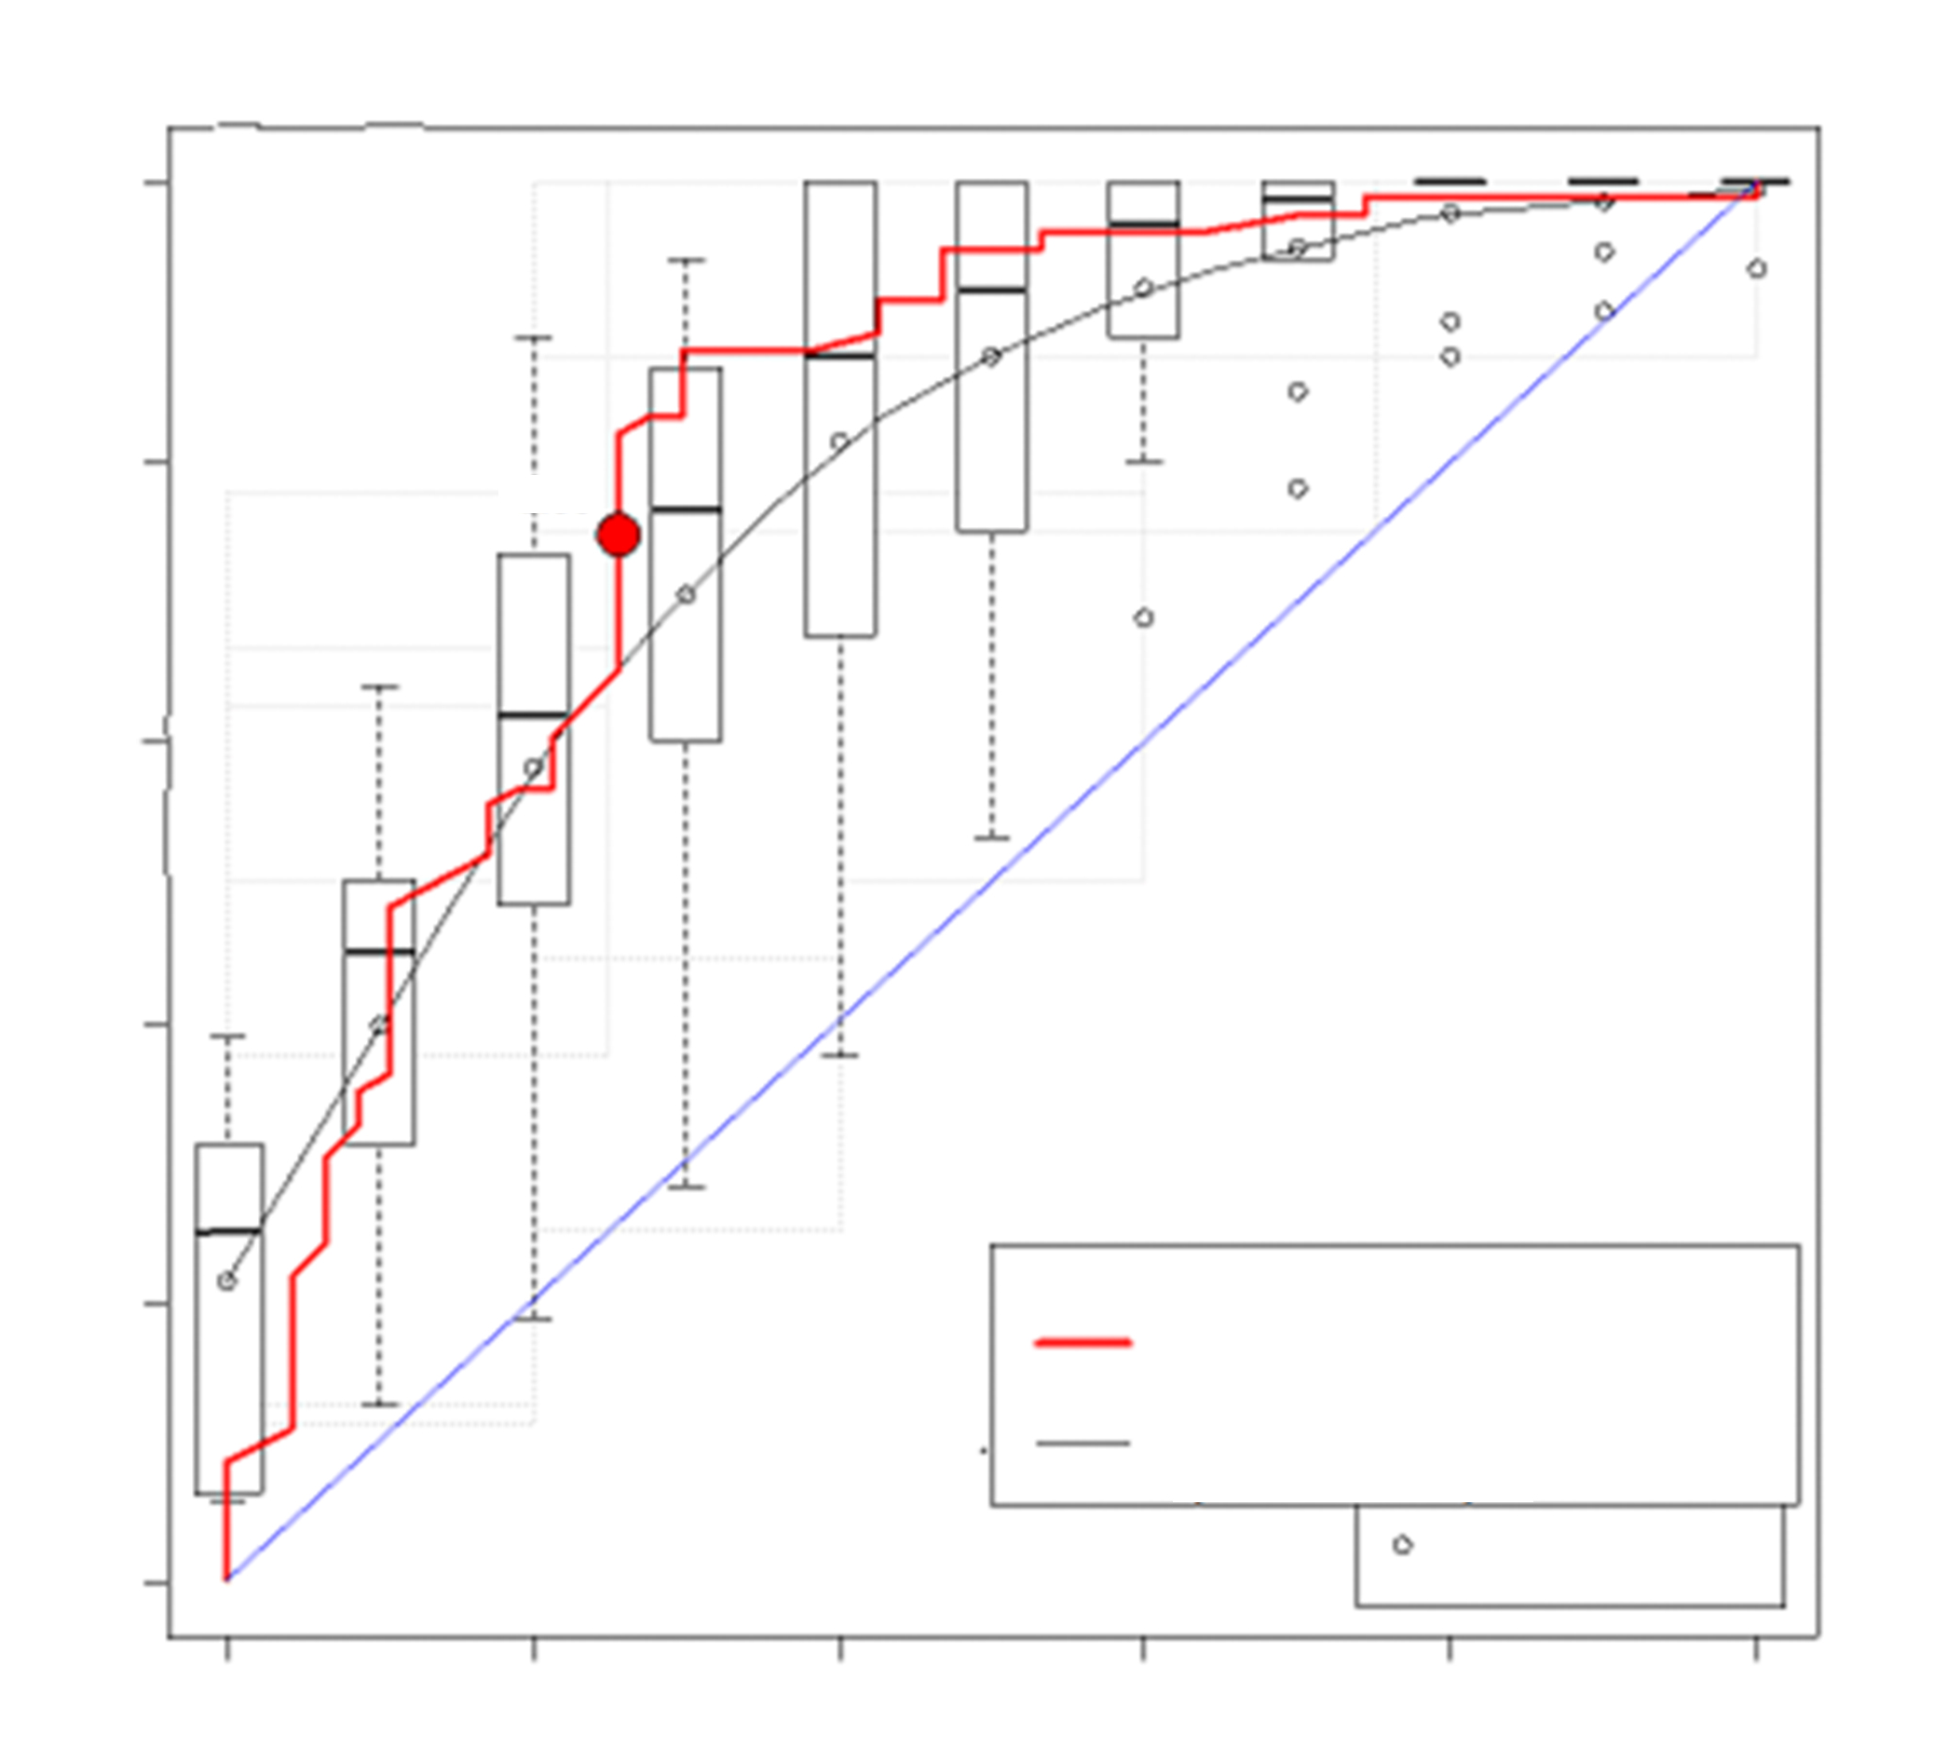
Results | Important Predictor Variables
Top Predictors:
1. Tasseled cap wetness
Soil and vegetation moisture index
2. Tasseled cap brightness
Vegetation and urban development index
3. May 6th
Best performing date, captured early green-up
Tasseled cap wetness
5/6 - 6/20
Tasseled cap brightness
5/6 - 6/10
Train 0.811
CV 0.805
0.66
Notes:
For the detection model, Tasseled cap wetness and brightness were among the most important variables for the model. These indices offer a combination of spectral bands to detect vegetation moisture and extent. Imagery captured on May 6th performed strongly, as it likely captured the cheatgrass green-up
*

Slide 19
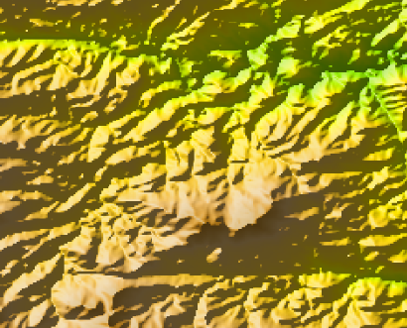
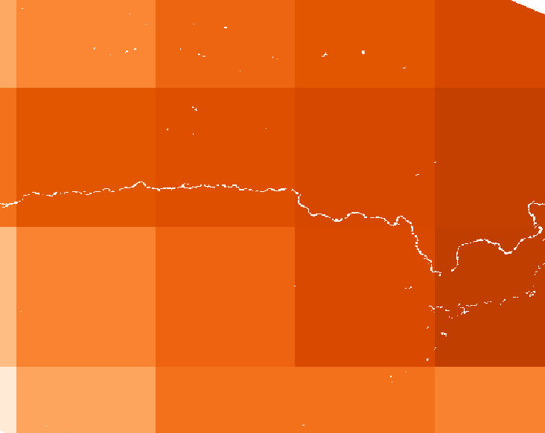
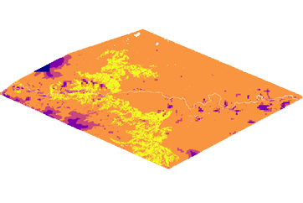
Limitations
SRTM (30 m)
PRISM (4 km)
Spatial resolution of predictor variables
  10 m to 4 km
Bias of satellite imagery to detect larger cheatgrass cover
Bias of field samples closer to roads & trails
Challenges of modeling within a varied and diverse landscape
HSM MESS Map
Notes:
Speaker: Alex Posen
There were several limitations throughout the project. Firstly, it was challenging to extract a diverse training dataset across our study area from variables that had a large spatial resolution.
Secondly, satellite imagery used in our detection model was at 10 m resolution, which prioritizes detecting large, homogenous patches of cheatgrass.
And lastly, our study area featured extremely varied topography, which meant that our extrapolated data could be uncertain at times.

Slide 20
Conclusion | Project Takeaways
  Habitat Suitability Model
  Best predictor variables – Topographic Variables
  Burn/disturbance variables weren’t as crucial within our study area
  Can help improve the detection model
  Detection Model
  Best detection variables – Tasseled-Cap using May Imagery (due to pre –boot-stage)
  Cheatgrass could be detected using the plant’s boot-stage
  Differenced indices provided a model within a short timeframe
Notes:
Christopher Tsz Hin Choi
To conclude, from our habitat suitability model we found that the best predictors were northness, topographic diversity, and elevation, which are all topographic variables. Burn and disturbance variables weren’t as crucial to determine habitat suitability within our study area. The Habitat Suitability Model also helped constrict the modeling range of the detection model and improved its accuracy
From our Detection model, we found that the best predictors were Taselled-Cap Wetness and Greenness with a model that prioritizes May dates. The reason for this is because the May imagery contrasted with later imagery which captures cheatgrass’ boot-stage. Our results also show that you can detect cheatgrass with limited imagery and a short timeframe, if you are able to capture critical life stage changes of cheatgrass, which occur at different times from most native vegetation.

Slide 21
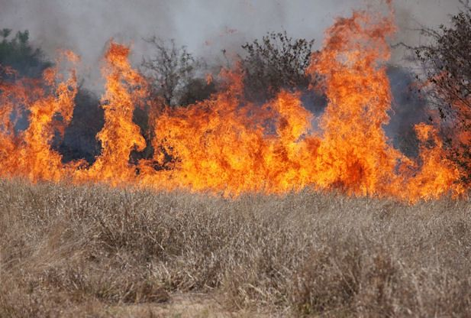
Conclusion | Management Takeaways
  Habitat Suitability Model’s useful for cheatgrass mitigation
  Post-fire detection is possible within a short time frame if changes due to boot-stage is captured
  Remote sensing provides a time and money saving method for modeling cheatgrass
Image Credit: USDA/NRCS
Notes:
Christopher Tsz Hin Choi
Through our project we found that habitat suitability models can be useful for cheatgrass mitigation, post-fire cheatgrass detection is possible soon after a fire if imagery capturing phenological changes due to the boot-stage are captured, and that remote sensing can support field observations to model cheatgrass saving both time and money.
------------------------------Image Information Below ------------------------------
Image Credit: USDA/NRCS
Image source: https://www.flickr.com/photos/usfwshq/8598789914 (CC BY 2.0)

Slide 22
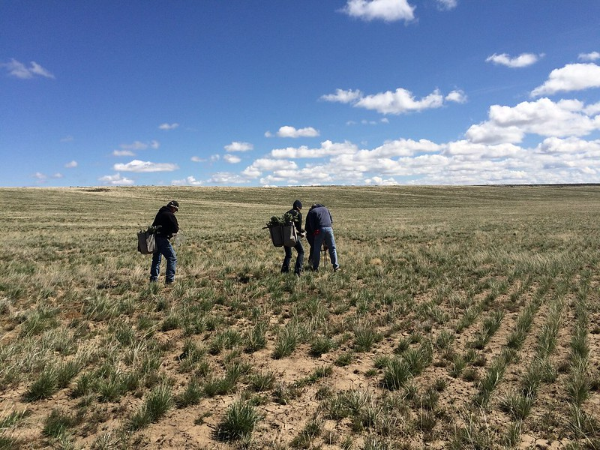
Future Work
  Models that capture varied landscape
    Specific models
    More field points
  Expand analysis temporally
    Focus on other life stages
  Address additional disturbances
    Poudre flood
Image Credit: Bureau of Land Management
Notes:
Speaker: Christopher Tsz Hin Choi
In the future, we aim to explore models that are more specific to different regions within the study area. This is due to our study area being extremely topographically heterogeneous.
An increase in field points to capture this heterogeneity would be helpful in improving the range of our training data.
Studying other cheatgrass phenological life stage changes with more imagery may improve our detection results
Flooding and flashfloods due to reduced vegetation leading to increased runoff and charred soils that are less absorbent are common post-fire disturbances. Exploring how cheatgrass responds to disturbances like these will be important in knowing how to manage cheatgrass invasions under these novel circumstances.
------------------------------Image Information Below ------------------------------
Image Credit: Bureau of Land Management
Image Source: https://www.flickr.com/photos/91981596@N06/20570187482

Slide 23
Science Advisors
Peder Engelstad, CSU, Natural Resources Ecology Laboratory
Nicholas Young, CSU, Natural Resource Ecology Laboratory
Dr. Tony Vorster, CSU, Natural Resource Ecology Laboratory
Brian Woodward, CSU, Natural Resource Ecology Laboratory
Dr. Paul Evangelista, CSU, Natural Resource Ecology Laboratory
Dr. Catherine Jarnevich, United States Geological Survey
Partner(s)
Tom Bates, USDA , US Forest Service, Arapaho and Roosevelt National Forests and Pawnee National Grassland
Special Mentions
Scott Cunningham, NASA DEVELOP National Program, Fellow
Madeleine Gregory, NASA DEVELOP National Program, Assistant Fellow
Amy Birtwistle, US Forest Service
Dr. Janet Prevéy, United States Geological Survey
This material contains modified Copernicus Sentinel data (2021), processed by ESA.
Notes:
Christopher Tsz Hin Choi
We’d like to thank our Science Advisors, partners, and everyone else who supported us over the last 10 weeks and were crucial to the success of our project.

Slide 24
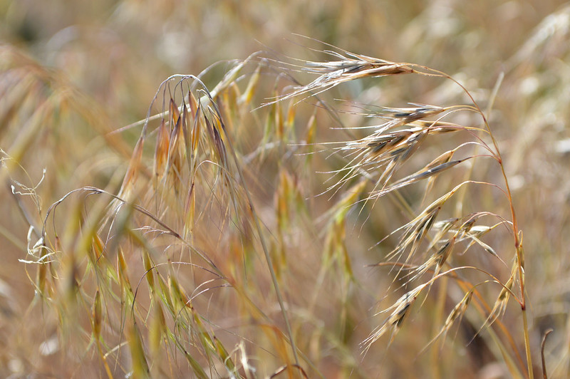
Thank You
For Listening
Questions?
Cheatgrass Team:
Alix Bakke
Christopher Tsz Hin Choi
Alex Posen
Monika Rock
Nikole Vannest
Image Credit: Jennifer Strickland
Notes:
------------------------------Image Information Below ------------------------------
Image Credit: Jennifer Strickland
Image Source: https://www.flickr.com/photos/usfwsmtnprairie/36275047894

Slide 25
References
B.A. Mealor, R.D. Mealor, W.K. Kelley, D.L. Bergman, S.A. Burnett, T.W. Decker, B. Fowers, M.E. Herget, C.E. Noseworthy, J.L. Richards, C.S. Brown, K.G. Beck, M. Fernandez-Gimenez. Cheatgrass management handbook. Managing an invasive annual grass in the Rocky Mountain region, Rocky Mountain Cheatgrass Management Project University of Wyoming and Colorado State University, Laramie, WY, and Fort Collins, CO, USA (2013)
Jarnevich, C. S., Stohlgren, T. J., Kumar, S., Morisette, J. T., & Holcombe, T. R. (2015). Caveats for correlative species distribution modeling. Ecological Informatics, 29, 6-15. https://doi.org/10.1016/j.ecoinf.2015.06.007
Morisette, J. T., Jarnevich, C. S., Holcombe, T. R., Talbert, C. B., Ignizio, D., Talbert, M. K., Silva, C., Koop, D., Swanson, A., & Young, N. E. (2013). VisTrails SAHM: visualization and workflow management for species habitat modeling. Ecography, 36(2), 129–135. https://doi.org/10.1111/j.1600-0587.2012.07815.x
Peeler, J. L., & Smithwick, E. A. H. (2018). Exploring invasibility with species distribution modeling: How does fire promote cheatgrass (Bromus tectorum) invasion within lower montane forests? Diversity and Distributions, 24(9), 1308–1320. https://doi.org/10.1111/ddi.12765
Prevéy, J. S., & Seastedt, T. R. (2015). Effects of precipitation change and neighboring plants on population dynamics of Bromus tectorum. Oecologia, 179(3), 765–775. https://doi.org/10.1007/s00442-015-3398-z
West, A. M., Evangelista, P. H., Jarnevich, C. S., Kumar, S., Swallow, A., Luizza, M. W., & Chignell, S. M. (2017). Using multi-date satellite imagery to monitor invasive grass species distribution in post-wildfire landscapes: An iterative, adaptable approach that employs open-source data and software. International Journal of Applied Earth Observation and Geoinformation, 59(135-146), 135–146. https://doi.org/10.1016/j.jag.2017.03.009

