Slide 1
Great Lakes
Water Resources II
A Google Earth Engine Tool to Automate Wetland Mapping Using Optical and Radar Satellite Sensors in the Great Lakes Basin for Wetland Management and Monitoring
Vanessa Valenti, Katie Lange, Erica Carcelen, & Nicholas Russo
California – JPL
Notes:
Welcome to the Great Lakes Water Resources II presentation, thank you everyone for being here. Today we’re going to summarize our project’s methodology, results, analysis, and conclusions.

Slide 2
Great Lakes Basin
Canada
Lakes
Great Lakes Basin
Minnesota
Quebec
Ontario
Wisconsin
Michigan
New York
Illinois
Pennsylvania
Indiana
Ohio
0 400 800 1,200 mi
0 150 300 600 800 mi
Image Credit: Esri “Terrain” Layer Package
Notes:
The Great Lakes Basin is one of the world’s largest surface freshwater ecosystems (EPA). Spanning 8 US states and one Canadian province, the region holds 84% of North America’s surface freshwater and provides over 30 million people with water for consumption, transportation, power, and recreation. (EPA). A defining characteristic of the basin is the wetlands. The Great Lakes Basin harbors more than 200,000 acres of wetlands (EPA). These wetlands offer a variety of environmental and ecological functions..
Map Source: NASA DEVELOP JPL Great Lakes Water Resources II Team
Base Layer Source: ESRI Terrain Layer Package, ArcMap

Slide 3
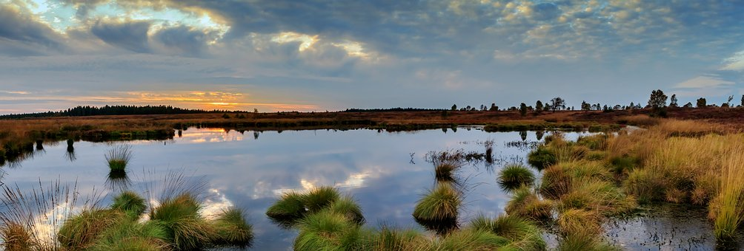
Wetlands Ecosystem
“Wetlands are among the most productive ecosystems in the world, comparable to rain forests and coral reefs.” US EPA
What is a wetland?
Ecosystem Functions
 Year-round or seasonally wet transition zones between land and water
 The flow of water, cycling of nutrients, and solar energy produce an ecosystem characterized by unique hydrology, soils and vegetation
Water filtration
Floodwater storage
Provide fish and wildlife habitats
Maintain surface water flow during dry season
Image credit: herbert2512
Notes:
Wetlands represent one of the most productive ecosystems in the world, in the same realm as famously productive rain forests and coral reefs. As transition zones between land and water, the flow of water, cycling of nutrients and sunlight produce an ecosystem that is highly productive and supports many species of wildlife and fish. Wetlands can be wet year-round, or seasonally wet, and some ecosystem functions of wetlands include filtration of water, mitigating floods, and maintain surface water during a dry season.
Image source: https://pixabay.com/photos/panorama-moor-swamp-2802329/

Slide 4
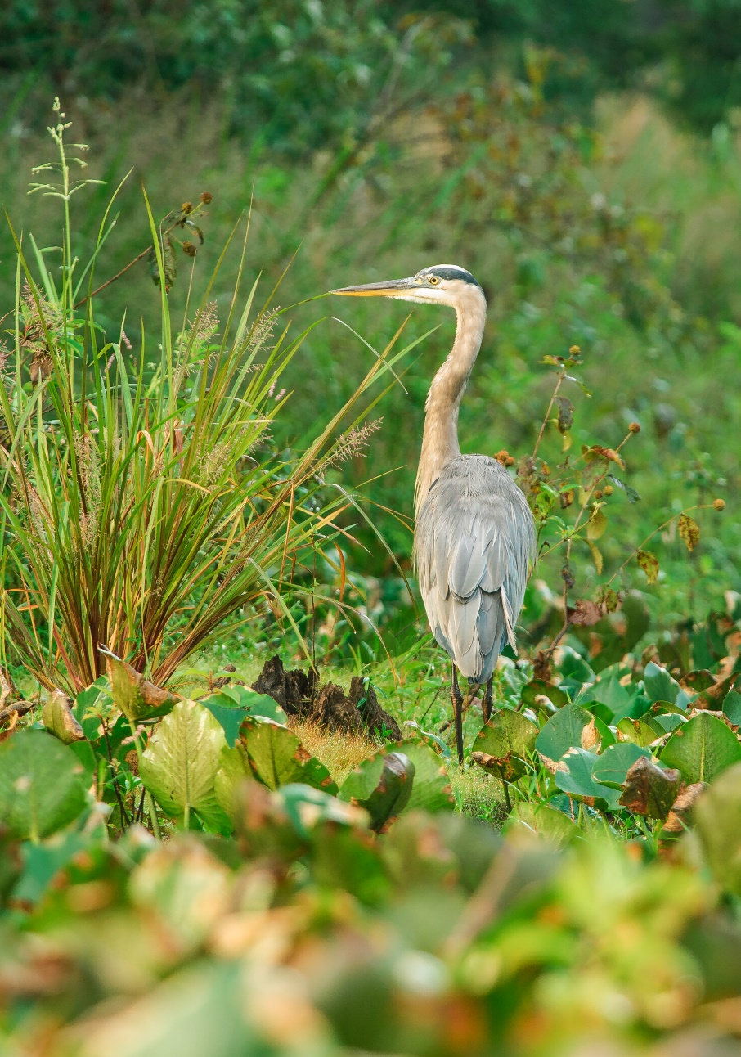
Community Concerns
Wetlands mitigate floods, provide critical habitat for wildlife, and support recreation and industry
Degradation of wetland ecosystems and disappearance due to habitat conversion harms wildlife and communities
Current methods of monitoring wetlands are costly and labor-intensive
Image source: Peter Hawman, NASA DEVELOP
Notes:
Worldwide wetlands support and protect communities as they alleviate flood impacts, provide critical habitat for endangered wildlife, and support community recreation and industries like fishing. The degradation and disappearance of wetlands therefore harms both communities and wildlife and necessitates the need to effectively manage and conserve these ecosystems. Unfortunately, current methods of monitoring wetlands are so costly and labor-intensive that comprehensive wetland monitoring and management is impossible with current methods.
Image source: DEVELOP Creative Commons https://www.flickr.com/photos/nasa_develop/16257742578/in/album-72157648318032603/

Slide 5
Project Objectives
Develop a user interface for WET 2.0 that enables user-specified and user-drawn geometries for analysis
Classify and map wetlands extent and type in the entire Great Lakes Basin in WET 2.0
Improve accuracy and validation of wetland classification
Notes:
In order to monitor wetlands extent and function, our project has set out to classify and map wetland extent in the entire Great Lakes Basin through the Google Earth Engine Wetland Extent Tool (WET) 2.0. We aim to develop a user interface that allows for user-specified analysis to, and improve the accuracy of wetland classification outputs compared to field validation data.

Slide 6
Project Partners
End Users
US Fish & Wildlife Service
US Environmental Protection Agency
Minnesota Department of Natural Resources
Ducks Unlimited
Collaborators
University of Minnesota
Michigan Technological University
National Oceanic and Atmospheric Administration
Natural Resources Canada
Notes:
To achieve this, we partnered with the US Fish and Wildlife Service, the US Environmental Protection Agency, the Minnesota Department of Natural Resources, and Ducks Unlimited; we further collaborated with the University of Minnesota, Michigan Technological University, the National Oceanic and Atmospheric Administration, and Natural Resources Canada.

Slide 7
Study Design
Study Period
Lake
Subbasin
January 2016 – December 2019
Additional years incorporated as they become available in GEE
Study Location
Great Lakes Basin subbasins
188 separate subbasins as units of analysis
0 150 300 mi
Notes:
We focused our study between 2016 and 2019. Current and future data will be incorporated into WET 2.0 automatically as it becomes available in GEE. We conducted our study analysis at the Great Lakes Basin sub basins level, with 188 separate sub basins units of analysis.
Map Source: NASA DEVELOP JPL Great Lakes Water Resources II Team

Slide 8
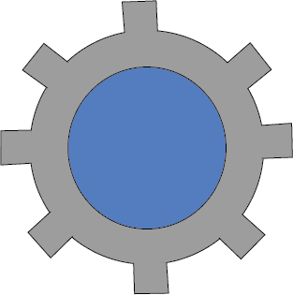
Methodology: Wetland Extent Tool (WET) 2.0
Optical
Sentinel-2 MSI
Landsat 8 OLI
Radar
SRTM DEM
Sentinel-1 C-SAR
Ancillary
Field Data
Landcover
Parameters
NDVI
MNDWI
TCGWD
DSWE
VV
VH
VV/VH
Pre-processing
Acquisition & Correction
Google Earth Engine
Classification
User Inputs
Area of Interest
Date Range
Output
Wetland
Extent Map
OUTPUT
Notes:
Our methodology was entirely implemented within our tool in GEE.
We broke up our workflow into 3 main stages, which we will go into further detail in the following slides:
Overall the tool functions by first acquiring and pre-processing data, based on the user inputs, that is either preloaded in the tool or accessed from the GEE data collection. Next, it processes the data to create the 7 input parameters for our classification algorithm, and lastly runs an object-based classification. The tool outputs a classified map identifying inundated wetland, open water, and upland that represents the AOI and date range input by the user.
The tool stops running after this point, but because the tool is hosted in GEE the user can change the inputs to re-run the analysis and get maps representing another time period or in other locations.

Slide 9
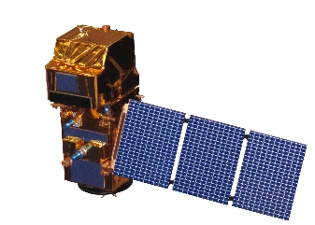
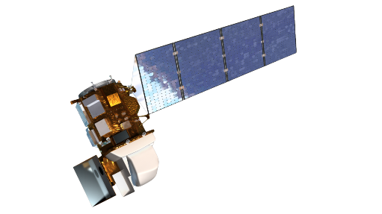
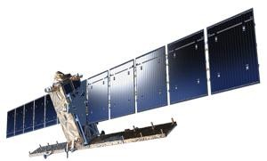
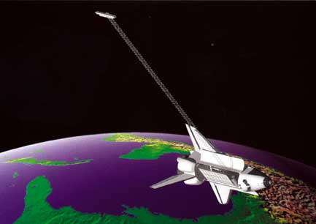
Data Acquisition & Correction
Sentinel-2
MSI TOA
Atmospheric Correction
Surface Reflectance
(R, G, B,
NIR, SWIR1, SWIR2)
Cloud Masking
Landsat 8
OLI SR
Filter by User Inputs
&
Align
Convert to Natural Values
Backscatter Intensity
(VV, VH)
Sentinel-1
C-SAR GRD
SRTM DEM
Elevation
Notes:
The first stage of our workflow was data acquisition and correction.
We used 2 optical datasets in blue (Sentinel-2 MSI Level 1 TOA and Landsat 8 OLI Level 2 SR), 1 radar dataset in yellow (Sentinel-1 CSAR Level 2 GRD), and a void-filled SRTM dem in orange.
All datasets were first filtered/clipped by the user input aoi and dates and then reprojected to ensure they aligned.
We chose to use the Level 1 Sentinel-2 product due to backlogs in the GEE data catalog, so we had to apply an atmospheric correction (thinking DOS right now...still tbd) for the Sentinel-2 data only. Optical data can be impacted by cloud cover, so we used the L8 and S2 respective QA bands to mask out clouds, and obtain SR values for the R,G,B,NIR, SWIR1, and SWIR2 bands.
The radar data is a level 2 product, which has already been corrected and converted to dB in GEE. The only additional processing we did was convert values from dB back to natural values to obtain backscatter values for the VV and VH bands.
The SRTM is a pre-processed, void filled product and no additional processing was completed.

Slide 10
Classification Parameters
NDVI
MNDWI
DSWE
NIR – Red
Green – SWIR 1
Assigns pixel as:
1. Not water
2. Water (high confidence)
3. Water (moderate confidence)
4. Potential wetland
5. Water or wetland (low confidence)
NIR + Red
Green + SWIR 1
TCWGD
Tasseled cap transformations to:
Red
Green
Blue
NIR
SWIR 1
SWIR 2
Ratio
Wetness – Greenness
VV
VH
VV
VH
Notes:
In the next stage, the tool processes the radar, optical, and elevation data to create the 7 parameters, 4 of which are based mostly on optical data, show in blue, and 3 based on radar data, shown in yellow.
Here we have the equations for NDVI and MNDWI, which highlight vegetation and water features respectively with high values.
The TCWGD also helps to identify wetlands by taking the difference of wetness and greenness. Wetness and Greenness are calculated by applying the TC transformations developed by Kauth and Thomas to the R,G,B, NIR, SWIR1, and SWIR2 bands. These 3 indices were calculated using S2, which has better temporal coverage and resolution.
DSWE is the only parameter that the previous term of this project did not explore. DSWE is meant to capture the dynamic nature of water features, even at the sub-pixel level, by incorporating hydrological and terrestrial information that can be calculated frequently with topographic information that tends to be more static. In the algorithm, 5 optical indices, hillshade, and slope are first calculated and then used within 5 decision rule-based diagnostic tests to classify the pixel as 1 of 5 classes. DSWE was developed for Landsat 8, so only the L8 data was used to calculate DSWE.
We used 3 radar parameters with the S1 data: VV band alone, VH band alone, and the VV/VH ratio.

Slide 11
Random Forest Classification
Wetland Extent Map
Classification
Training
Random Forest Algorithm
Extract variable importance
Validate with 50% field data
Temporal Composition
Create training image stack for entire basin
Train with 50% field data
Average values over date range
Stack composited parameters
Notes:
The final stage is to run the object-based classification.
First, the parameters are composited to create 1 image for each parameter with the average value over the date range. These images are then stacked to undergo classification.
The next step in the classification was training. We wanted to create an image stack for the entire great lakes basin, in order to allow for classification of areas with and without field data. Half of the field data were used for training, while the other half was reserved for validation. After training, a random forest classifier was employed to create a preliminary wetland map. The preliminary map is then masked to remove urban landcover and reduce class confusion. The resulting wetland classification was validated with the reserved 50% field data and variable importance for the classification model was extracted.The final output is a wetland extent map with 3 classes: wetland, open water, and upland, which can be used to identify wetland locations, compare with field data, and monitor changes over time.

Slide 12
Results
Wetland Classification
May – August 2019
Overall classification accuracy of 78.4% achieved
Upland
Open Water
Wetland
 | Upland | Open Water | Wetland
Upland | 0 | 0 | 29
Open Water | 0 | 311 | 10
Wetland | 0 | 22 | 151
0 100 150 250 400 mi
0 100 150 250 400 mi
0 100 150 250 400 mi
0 100 150 250 400 mi
0 100 150 250 400 mi
0 100 150 250 400 mi
0 100 150 250 400 mi
0 100 150 250 400 mi
0 100 150 250 400 mi
0 100 150 250 400 mi
Notes:
Our tool is able to classify anywhere in the GL basin
To test our tool, we focused on a location in northern MI which had a concentration of field data points.
This classification represents the 2019 summer months, which had a high overall accuracy of 78%.
The table shows the confusion matrix for this result. The rows indicates the class output by the random forest classifier and the columns indicate the class of the validation field data. The green boxes indicate correctly classified polygons. Upland has 0 correctly classified polygons, which is likely due to the limited number of upland field polygons. Wetlands has the higher number of polygons classified by the output, indicating the wetland class was overestimated.

Slide 13
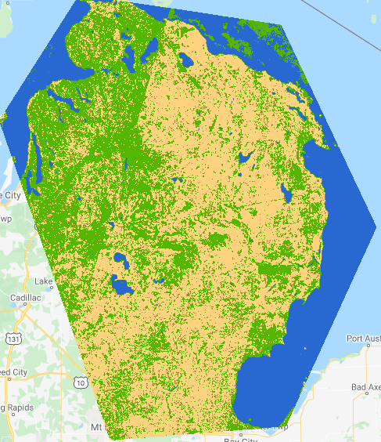
Results
Wetland Classification
Upland
September – December 2019
Overall classification accuracy of 88.3% achieved
Open Water
Wetland
 | Upland | Open Water | Wetland
Upland | 0 | 0 | 92
Open Water | 0 | 318 | 6
Wetland | 0 | 15 | 92
0 100 150 250 400 mi
Variable Importance in Random Forest Model
Variable Importance in Random Forest Model
120 -
120 -
100 -
100 -
80 -
80 -
Importance
Importance
60 -
60 -
40 -
40 -
20 -
20 -
0 -
0 -
DSWE
MNDWI
NDVI
TCWGD
VH
VV
VV/VH
DSWE
MNDWI
NDVI
TCWGD
VH
VV
VV/VH
0 100 150 250 400 mi
Notes:
Same location, fall/winter months(sep-dec)
This classification had overall accuracy of 88%
Higher accuracy could be due to greater overestimation of wetlands. Soils also likely more wet during these months

Slide 14
Results
Variable Importance in Random Forest Model
120 -
100 -
80 -
60 -
Importance
40 -
20 -
0 -
DSWE
MNDWI
NDVI
TCWGD
VH
VV/VH
VV
Variable Importance in Random Forest Model
Variable Importance in Random Forest Model
Variable Importance in Random Forest Model
120 -
120 -
120 -
100 -
100 -
100 -
80 -
80 -
Importance
80 -
Importance
60 -
Importance
60 -
60 -
40 -
40 -
40 -
20 -
20 -
20 -
0 -
0 -
0 -
DSWE
MNDWI
NDVI
TCWGD
VH
VV
VV/VH
DSWE
MNDWI
NDVI
TCWGD
VH
VV
VV/VH
DSWE
MNDWI
NDVI
TCWGD
VH
VV
VV/VH
0 100 150 250 400 mi
Notes:
Variable importance graph for the classifications we showed.
Output from the RF classifier that evaluates each input variable by calculating the decrease in accuracy when each variable is removed.
Y-axis shows importance and x-axis has each input used in our RF classification model
The most important variables were MNDWI and NDVI. VV and VH were similarly important. The VV/VH ratio is often used to identify wetlands, but surprisingly it had a lower importance than the VV. VH bands alone.
DSWE, which was a new topographic input this term was testing, was least important
Could be because it is a categorical variable, which may be more useful for post-processing rather than an input in RF

Slide 15
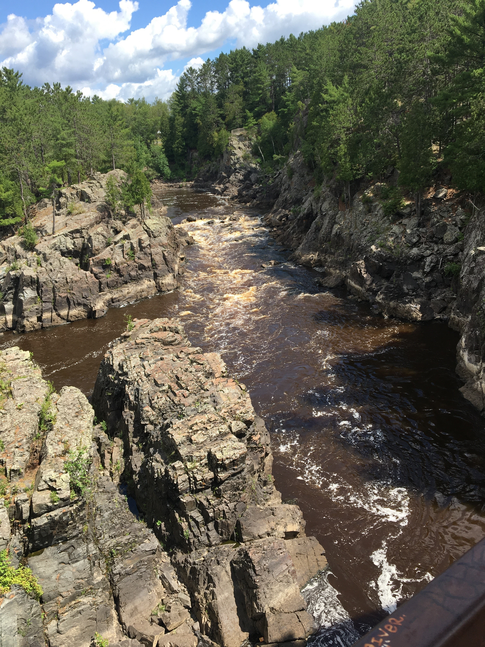
Conclusions
WET 2.0 can classify throughout the entire Great Lakes Basin
A test site in Northern Michigan was classified with an average overall accuracy of 83.37%
Wetland class overestimated, particularly during Fall/Winter of 2019
Most important variables were MNDWI and NDVI, while the least important was DSWE
Image source: Steve Kloiber, MN DNR
Notes:
Image Credit: Steve Kloiber
Successfully trained WET 2.0 to classify anywhere in GL, regardless of whether there is training polygons in that aoi
Test site in MI produced promising results, with a high overall accuracy of 83%
While able to achieve high accuracy, wetland class is overestimated. Could be due to class confusion with classes that have similar signatures (agriculture) or due to an unequal distribution of field data among the 3 classes. This overestimation was more evident during the fall/winter of 2019, which could be due to wetter soils. The variable importance graphs indicated MNDWI and NDVI were most important for classifying wetlands, while DSWE least important. This is important information to refine classification methods and produce highly accurate wetland maps for our partners.

Slide 16
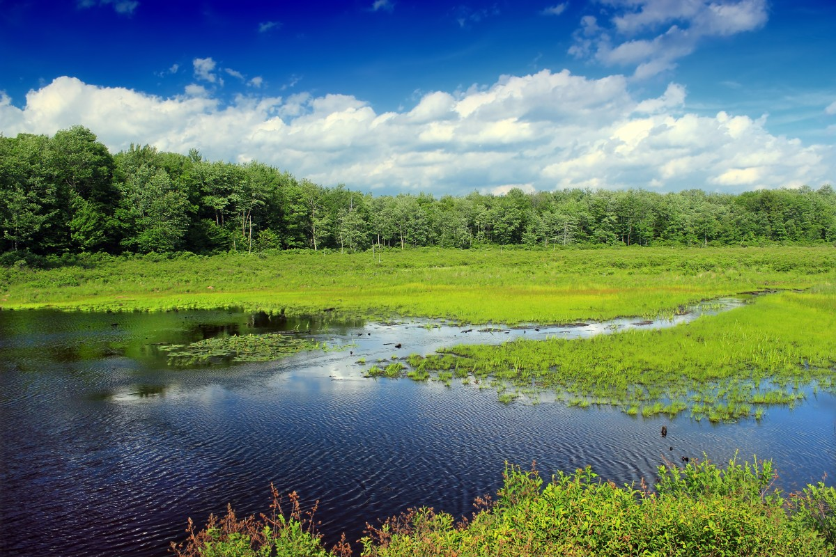
Errors and Uncertainties
Image composites lead to loss of information
Wetland class over-represented in field data
Unable to carry out image segmentation due to GEE processing limitations
Large area and date selections can lead to computation time-out in GEE
Image source: pxhere
Notes:
Our tool composites the input datasets, taking an average which can lead to loss of information. The wetland class was also significantly over-represented in our field data, which may have led to over estimations of wetland extent in the tool. In addition, due to the processing capacities of Google Earth Engine, we were unable to carry out an object based image classification as was originally intended, which may have helped reduce pixel noise in the results. When using the tool, very large user-drawn geometries or long time periods may cause GEE to time out.
Image source: https://pxhere.com/en/photo/500671

Slide 17
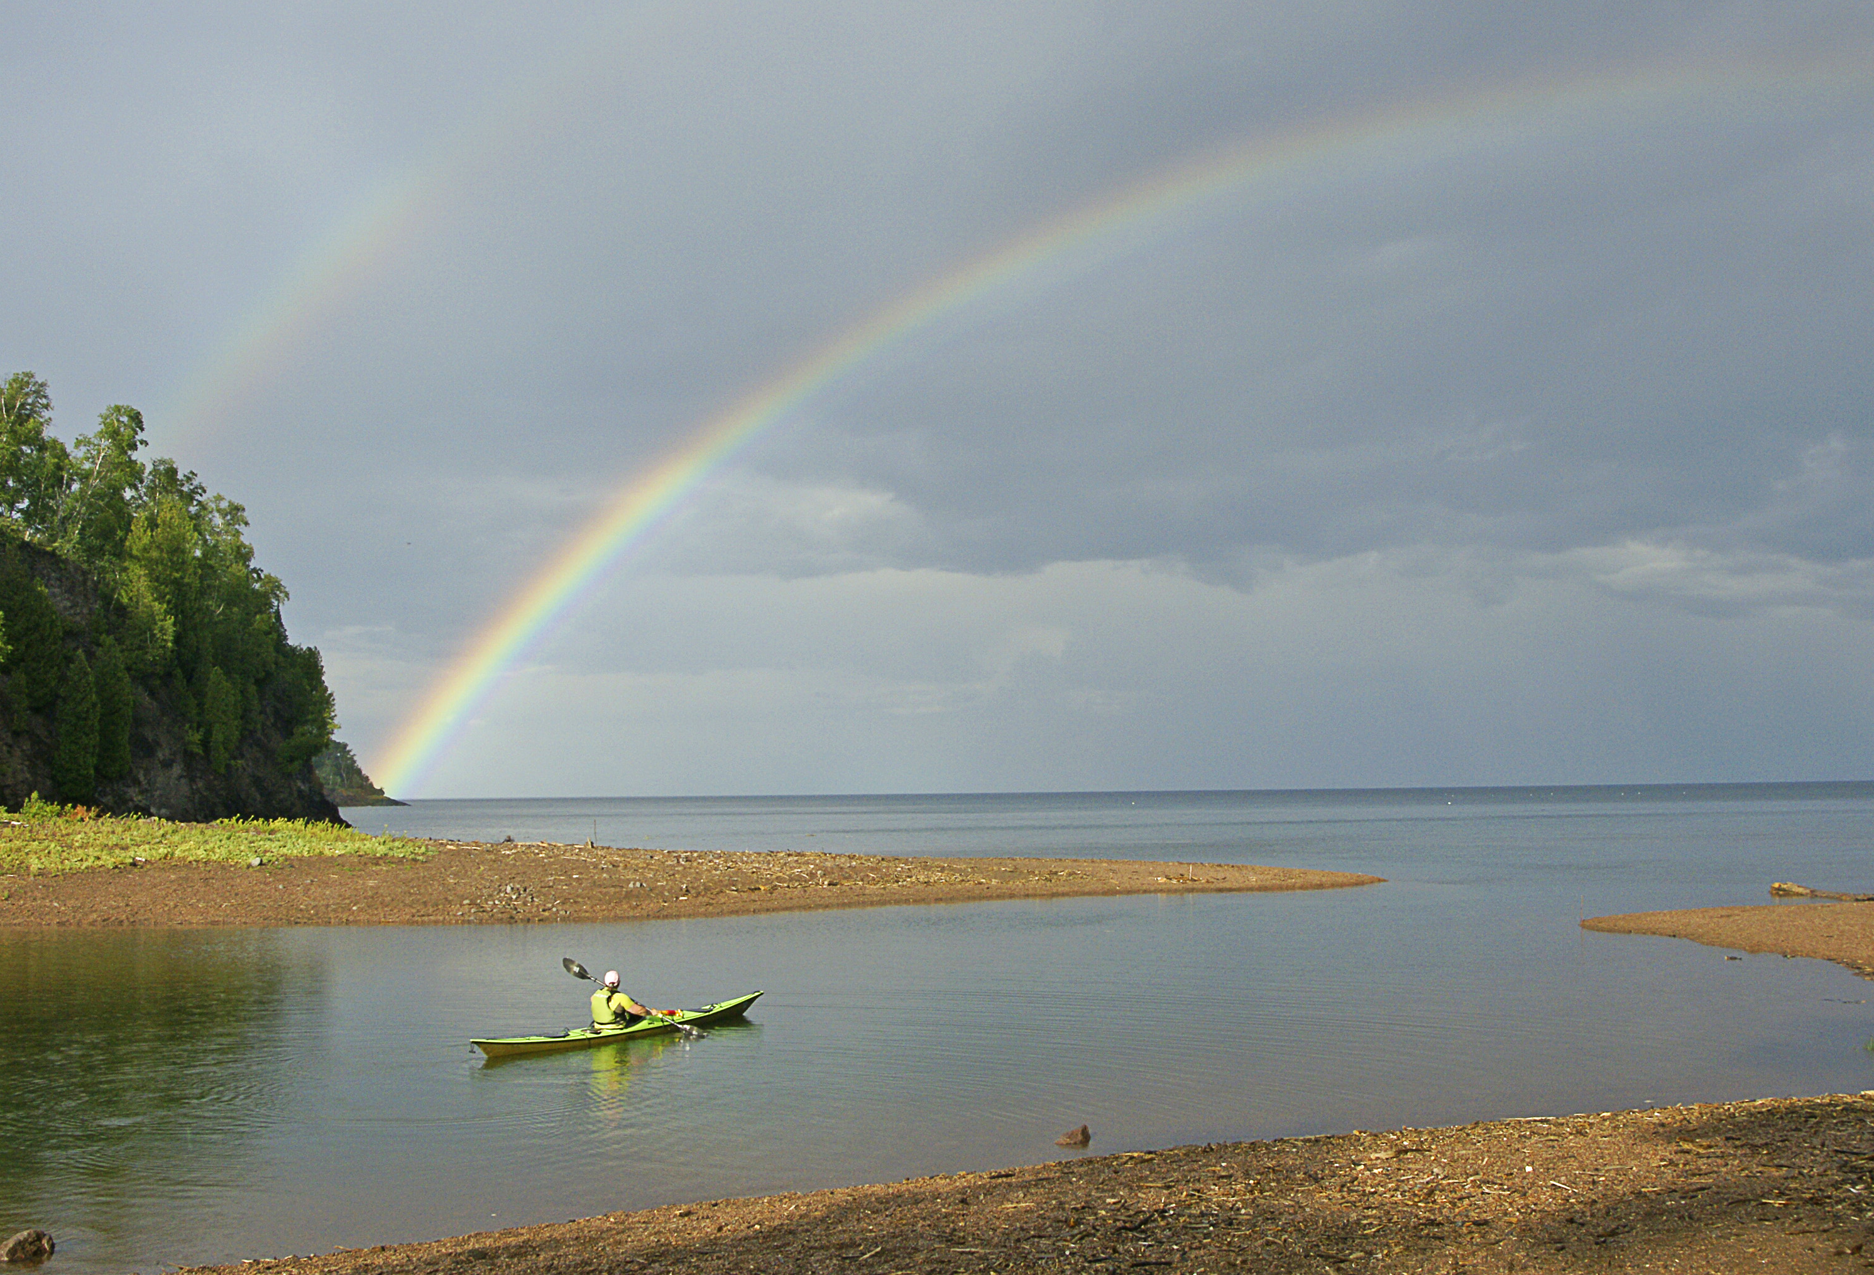
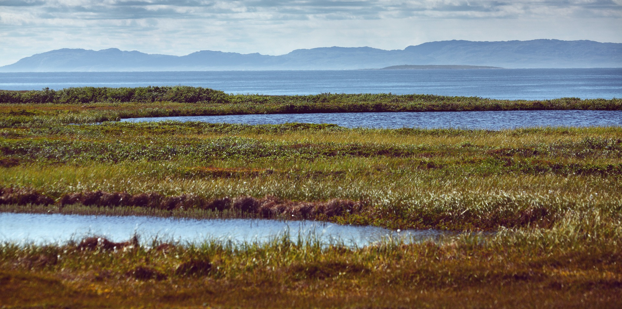
Future Work
Further delineate wetland classes with higher resolution optical data sets
Improve validation of wetland areas with greater in situ data coverage
Incorporate L-Band SAR to improve delineation of forested wetlands
Expand study period to improve wetland change detection
Image source: Steve Kloiber, Minnesota DNR; Pixabay
Notes:
The Great Lakes Water Resources II team accomplished a great deal in the 10 week term. However, the project could be improved with continued research. The first way we feel we could improve the tool is to further identify specific wetland classes, such as bog, fen, swamp, etc. In order to do this for the entire Great Lakes Basin, additional in situ validation points would be needed to train and test the tool. In addition, we feel the tool’s capability to identify inundated areas and forested wetlands would be greatly improved with the utilization of L-Band SAR data. Lastly, future studies should expand the study period to include past dates would improve wetland change detection and analysis.
Image Source: Steve Kloiber, Minnesota Department of Resources(top); Pixabay https://pixabay.com/photos/lake-marsh-water-landscape-nature-828939/

Slide 18
Partners
Science Advisor
Megan Lang (US Fish & Wildlife Service)
Jennifer Corcoran (Minnesota Department of Natural Resources)
Tom Hollenhorst (US EPA)
Robb Macleod (Ducks Unlimited)
Brandon Krumwiede (NOAA)
Laura Borgeau-Chavez (Michigan Technological University)
Brian Brisco (Natural Resources Canada)
Dr. Bruce Chapman (NASA Jet Propulsion Laboratory)
Past Contributors
Erica O’Connor
Melissa Ferriter
Alice Lin
Christopher Notto
Additional thanks to Cecil Byles, NASA DEVELOP Fellow, and Benjamin Holt (NASA Jet Propulsion Laboratory)
This material contains modified Copernicus Sentinel data (2016-2019), processed by ESA.

