Slide 1
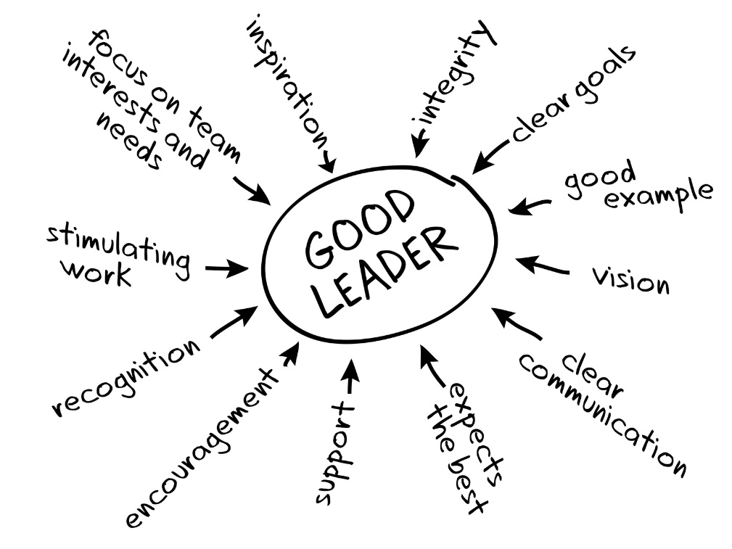
Leadership & Management
Orientation for Center LeadersHIP

Slide 2
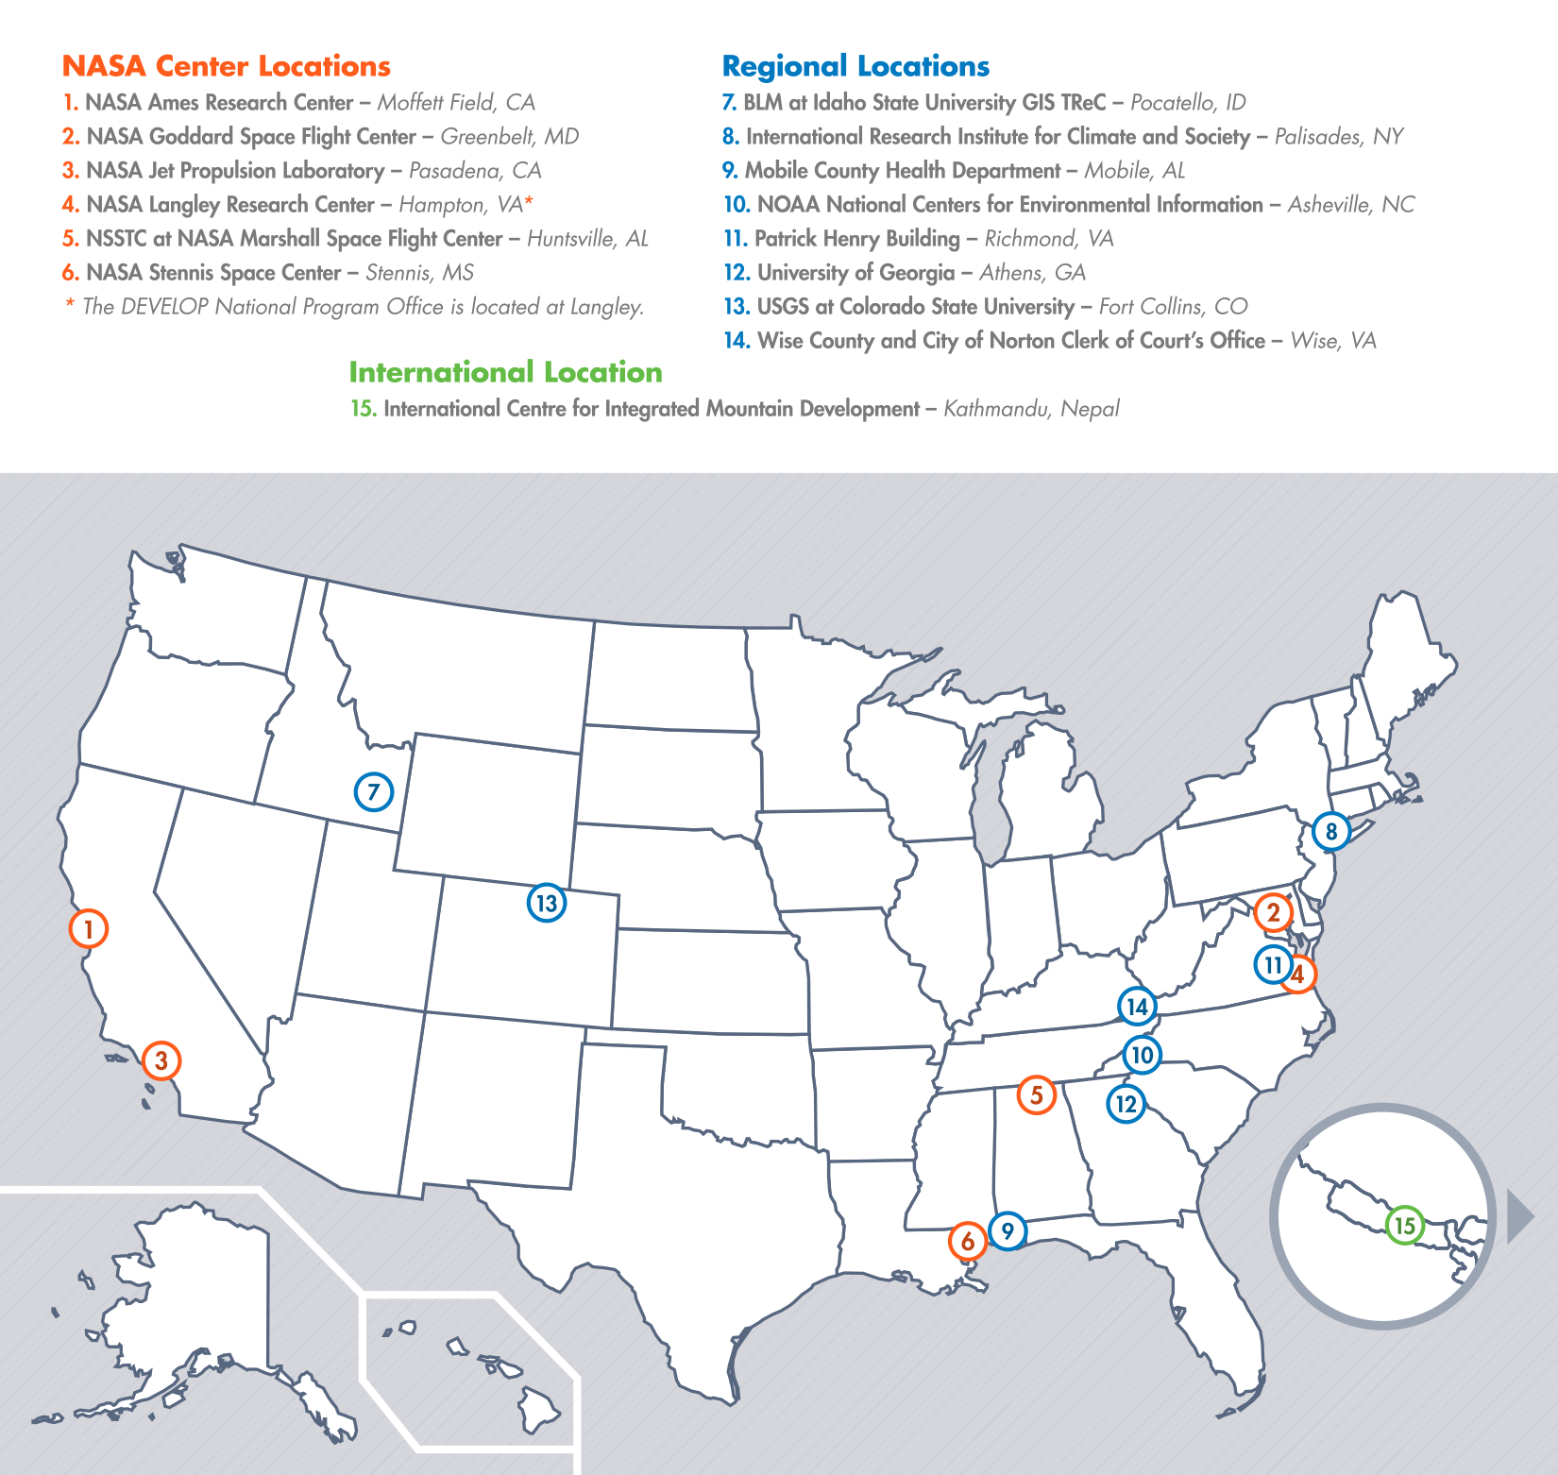
DEVELOP Locations
Newest Node Opening:
Pocatello, Idaho
NASA Center Locations
Can only accept US citizens (exception: MSFC)
Contracted through SSAI, Inc.
Regional Locations
Can accept foreign nationals (exception: NCEI)
Contracted through Wise County, VA
Please Note:
Locations evolve

Slide 3
National POCs
Karen Allsbrook
Mike Bender
Lauren Childs-Gleason
Jamie Favors
Lindsay Rogers
Dr. Kenton Ross
Mike Ruiz
Jennifer Tindell
DEVELOP
Senior Fellows
Beth Brumbaugh
Jeff Ely
Chris McKeel
Tiffani Miller
Merna Saad
DEVELOP
NPO
DEVELOP
Fellows
Amber Brooks (ARC)
Georgina Crepps (MCHD)
Amberle Keith (MSFC)
Peter Hawman (UGA)
Daniel Jensen (JPL)
Chippie Kislik (ARC)
Jerrod Lessel (IRI)
Christine Rains (JPL)
Lance Watkins (NCEI)
Ames
Andrew Nguyen (CL)
Chippie Kislik (ACL)
IRI
Jerrod Lessel (CL)
Alex Sweeney (ACL)
Mobile
Georgina Crepps (CL)
UGA
Caren Remillard (CL)
Peter Hawman (ACL)
DEVELOP Node Leadership
Goddard
Kiersten Newtoff (CL)
Amanda Rumsey (ACL)
Marshall
Leigh Sinclair (CL)
Amberle Keith (ACL)
Stennis
Ross Reahard (CL)
Wise County
Jordan Bates (CL)
BLM-ISU
Jeff May (CL)
JPL
Gwen Miller (CL)
Christine Rains (Co-ACL)
Daniel Jensen (Co-ACL)
NOAA NCEI
Lance Watkins (CL)
Fort Collins
Brian Woodward (CL)
Steve Chignell (ACL)
Langley
Emily Adams (CL)
Daniel Wozniak (ACL)
Richmond
Cassandra Morgan (CL)

Slide 4
Communication
Weekly reporting through National Telecons and Quadcharts
Serve as the liaison to NPO, Advisors/Mentors, partner organizations, other nodes
Oversee publication writing and submission
Please be sure that if your node is publishing an article, that it has been reviewed by NPO ahead of time. Send a copy of the final draft to Tiffani Miller and Lauren Childs-Gleason before submitting. Listing a publication in your quadchart or mentioning it on the national telecon does not count as NPO review.
Consider ways to involve location alumni and keep them informed of current activities
Provide material to NPO for social media/website
Respond to information requests from NPO/NASA HQ/Advisors/Mentors
Newsletter info
Proposal writing

Slide 5
DEVELOP Email Signature
Please use the standard DEVELOP Email Signature:
Name
YP Position | Center Position
NASA DEVELOP National Program – funding mechanism (SSAI or Wise County)
Node Name
Office: XXX-XXX-XXXX
Colors, fonts, etc. are up to you, but the above information and basic format should be used.
Ex.
Tiffani Miller
Project Coordination Senior Fellow
NASA DEVELOP National Program – SSAI
Langley Research Center
757.864.3762 Office

Slide 6
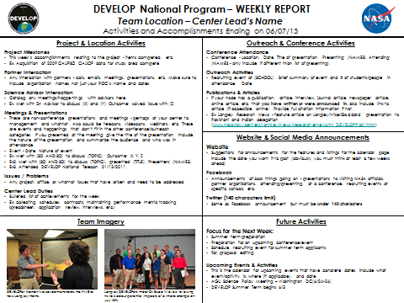
Reporting
National Telecons
Weekly phone call with all the domestic locations
Report high level activities, important project breakthroughs, exciting opportunities, partner interactions of importance, any issues or questions, and anything else you deem worthy/important for the national audience
Questions and concerns (issues with data/analyses, etc.)
Thursdays at 2pm Eastern – 1 (844) 467-6272 / pc: 220588
Quadcharts
Weekly reports with in depth details
Supplements telecon reporting
Due every Friday by COB
Email to:
Lauren.M.Childs@nasa.gov
Tiffani.N.Miller@nasa.gov
Beth.Brumbaugh@nasa.gov
Emily.A.Kislik@nasa.gov

Slide 7
Communication w/ NPO
Always feel free to email or call NPO
Lauren: (757)864-4204, Lauren.M.Childs@nasa.gov
Jamie: (804)692-0136, James.E.Favors@nasa.gov
Karen: (757)864-1276, Karen.N.Allsbrook@nasa.gov
Mike: (757)864-5552, Michael.R.Bender@nasa.gov
Lindsay: (757)864-7283, Lindsay.M.Rogers@nasa.gov
Dr. Ross: (757)864-3595, Kenton.W.Ross@nasa.gov
For important or time sensitive items don’t wait until the national telecon
Don’t worry about asking a lot of questions!
If new opportunities arise regarding DEVELOP, get the NPO involved early on
Personnel issues – don’t email, call!
Contact Sheet: updated draft on Exchange & emailed out each term

Slide 8
Question? Contact…
Contracts & Payroll
Status Reports / Invoices
Applications
SSAI Personnel Issues
Travel
Deliverables & Deadlines
Quadcharts & Telecons
Conferences & Close Outs
Software & Website
Wise Personnel Issues
International Activities
Govt./Legislative Affairs
Project Hand-Offs
Project Ideas/Requests
Project Proposals
Contact
Karen Allsbrook
Contact
Lauren Childs-Gleason
Contact
Jamie Favors
Poster and PPT Templates
DEVELOP Logos
Recruiting Materials
Designing Anything
Imagery
Partner History/Analyses
Node Tracking/Reporting
Social Media & Podcasts
VPS/Videos & Transcripts
Ambassador Corps
Publications
Newsletter
Recruiting/Outreach
Project Tracking/Archiving
Alumni Survey
Contact
Chris McKeel
Contact
Beth Brumbaugh
Contact
Tiffani Miller

Slide 9
Office Management
Review applicants, conduct interviews, make selections, and submit to NPO for review
Give orientation to incoming participants each term
Ensure that all participants read their handbook, sign forms
Collect and submit contracts, invoices and status reports to NPO
Enforce office rules and regulations (dress code, computer policies, etc.)
Conduct performance reviews with all participants at your node (mid-term and exit)
Lead the planning of close out events
Serve as calendar keeper and updater
Compile the FY Proposal
Complete tracking metrics

Slide 10
Participant Selection
Review applications of eligible applicants through the online application system.
Make a list of applicants you would like to interview and schedule interviews.
Interview candidates.
Make selections, along with alternates in case people do not accept their position. Send your selections to Karen, along with your list of those not being accepted and your justification. NPO will review and follow up with a confirmation to you before notifications go out.
Karen sends notifications to all applicants notifying them whether they are accepted or not accepted. Prospective participants have a specific period in which to respond and accept their position.
After a participant accepts the position, they have a deadline to submit their schedule to you.

Slide 11
Archiving & Troubleshooting
Archiving
Maintain tracking metric spreadsheets for your location
Keep track of alumni when possible
PSI scoring is based off a series of questions – make sure to track useful information for each project at your node
Exchange: make sure there is a final-final draft of each deliverable
Troubleshooting
Troubleshoot software and computer issues with team members as arise
Work with participants as personnel issues may arise

Slide 12
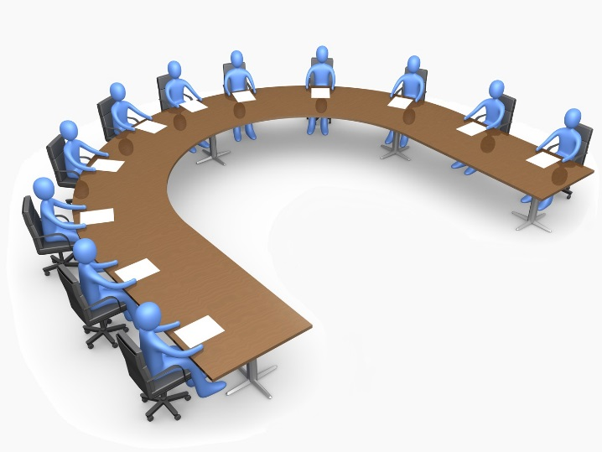
Conference and Closeout Planning
Propose potential conference submissions to NPO – email Karen & Lauren with information regarding the event, justification for attending, and a preliminary cost estimate
If approved by NPO, next step is to submit official travel requests
Work within your location’s travel budget
Coordinate the creation, collection and review of all conference materials – don’t forget everything needs to go through NPO before submission!
Plan a closeout event for your node each term
Collect, compile, and submit material to NPO for the Annual Earth Science Applications Showcase at NASA HQ (July 30)

Slide 13
Recruiting Guidelines
Actively recruit new candidates
Lead recruiting efforts for your location
Direct all interested individuals to apply through the DEVELOP website. We do not accept DEVELOP applications through any other source.
Do not list DEVELOP on any third party website or list without prior approval.

Slide 14
Building Teams & Capacity
Team Building
Set the team dynamic for your location
Lead team building exercises & planning of activities
Ensure that project teams are functioning well
Make everyone as comfortable as you can!
Capacity Building
Lead personal development activities (personality typing, networking opportunities, etc.)
Lead professional development activities (presentation practices, resume writing, GIS 101, etc.)

Slide 15
Dealing w/Personnel Issues
Things will arise!
#1 – Don’t put anything in writing. Should a personnel issue arise, immediately and verbally communicate the situation up the chain
Do not send emails about the situation - remember that NASA emails are NOT private.
Maintain a positive work environment where participants feel comfortable coming to you with issues they are having with other DEVELOPers
If someone up the chain is the issue, skip that link in the chain
If you need counseling for how to respond to a specific situation talk to NPO
You or the person having the issue can also drop a note in the anonymous dropbox (http://developexchange.com/dropbox.html)
NPO
Center Lead
Project Lead
Team Member

Slide 16
Dealing w/Personnel Issues
If you need counseling for how to respond to a specific situation call NPO.
You can (and should) inform mentors/advisors regarding any issues; however, they cannot make decisions regarding action. That must come from your contracting organization’s representative.
SSAI-Contracted Participants
Wise-Contracted Participants
Karen Allsbrook
757.864.1276
Lauren Childs-Gleason
757.864.4204
Center Lead
Center Lead
Project Lead
Project Lead
Team Member
Team Member
Again - Do NOT send emails about personnel issues. Call!

Slide 17
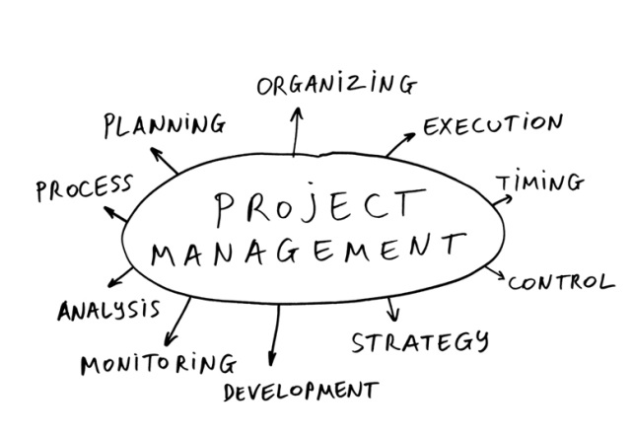
Project Management
Select which participants will be on which team
Prepare materials to share with team
Meet with project teams at least weekly
Ensure projects maintain scientific integrity
Make sure the right templates are used
Enforce proper file storage and nomenclature
Maintain awareness of deliverables deadlines
Coordinate the submission of all deliverable drafts by the deadline
Proposal Writing (spring, summer, fall) – work with advisors/mentors and partners to get ideas. The CL/ACL should be the voice of the node in proposing projects, and as such they have a significant amount of control over what is proposed. Don’t feel that you have to put a project forward that you don’t think fits the DEVELOP model. Discuss with the NPO if you have questions.

Slide 18
Proposal Process
Gather Ideas
Open Communication Lines with Potential Partners
Information to NPO about Planned Proposals, International Checklists for International Projects (due 8/28 for spring proposals)
Proposal Writing and Node Review
Submission to NPO (spring proposals due 9/25)
NPO Review and Feedback Returned to Nodes
Nodes Review Feedback and Submit Final Version
NPO Final Edits and Compilation
NPO Submits to NASA HQ ASP Program Managers
NASA HQ ASP Program Managers Review and Give Feedback
NPO Takes Approved Projects and Assesses Funding Available
Team Portfolio Finalized

Slide 19
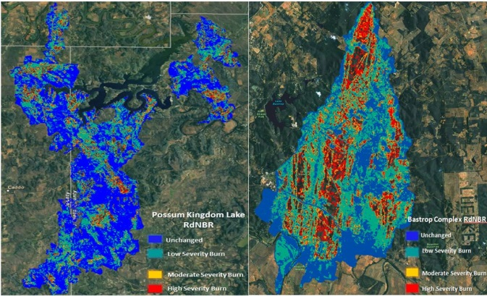
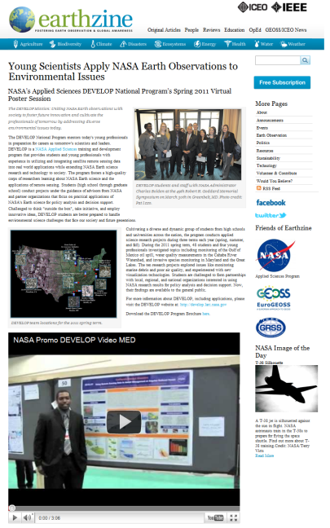
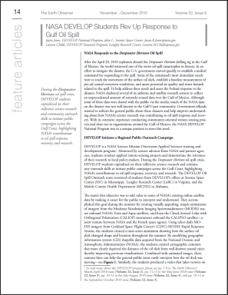
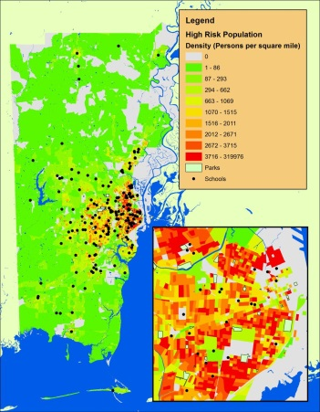
Deliverables
Required Deliverables
Technical Paper
PPT Presentation
Poster
Project Summary
VPS Video and Transcript
Imagery
Optional Deliverables
Brochure
Tutorial / Hand-Off Materials
ArcGIS Online Input

Slide 20
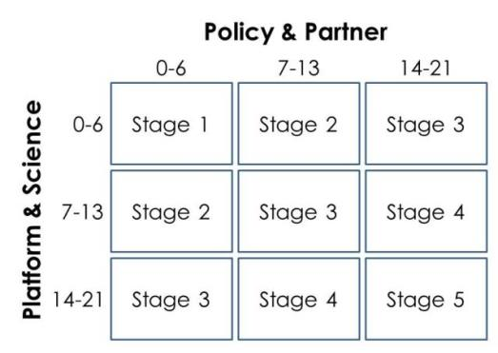
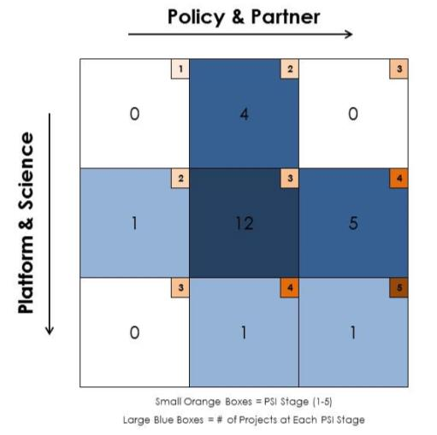
DEVELOP Project Strength Index
DEVELOP projects have consistently improved and matured over the Program’s last 15+ years. A means of assessing project progression and comparing project success has, to date, been subjective. This project strength index provides DEVELOP a means of objectively evaluating projects and tracking progress.
A series of questions are answered earning a total of 21 points in two sections: 1. Policy & Partner and 2. Platform & Science. The score for each category is then placed on the index to receive the project’s current stage (1 to 5).
Stage 1: Basic Research
Stage 2: Application Concept Complete
Stage 3: Application Demonstration Successful
Stage 4: Application Verified / End-User Engaged
Stage 5: Transition to End-User / Decision Enhanced

Slide 21
Fellows & Senior Fellows
The YP and Associate classes have evolved over the past few years, and have been renamed “Fellows” and “Senior Fellows” for FY 16. It is CL/ACLs duty to communicate the opportunity to participants, as well as potentially seek it out for themselves.
What is a Fellow (YP)?
A recent college/university graduate who spends one year with DEVELOP growing both personally and professionally, and contributing to the program as a whole. Each Fellow serves in a dual-role, splitting their time between their node and NPO-related tasks.
Positions vary year to year based on needs defined by NPO
After a Fellow year, an individual is only eligible to remain with DEVELOP in two cases – 1) they compete for and are awarded a Senior Fellow position, or 2) they enroll in a new degree program and apply as a currently enrolled student.
What is a Senior Fellow (Associate)?
A Fellow that is competitively selected to spend one year up to three years with DEVELOP supporting the NPO and contributing to the program as a whole. All Senior Fellow positions are located at Langley.
Eligibility Requirements:
Graduated w/minimum 3.0 cumulative GPA (Degrees acceptable - AA, Undergrad, Graduate, PhD)
Participation in at least one summer term with DEVELOP (two or more preferable, one of which must be a summer)
Ability to begin in September with the class of Fellows

Slide 22
First Week of the Term
First Week
Give orientation
Ensure handbooks are read, forms signed, and returned to NPO
Teach and be the beacon of knowledge regarding NASA organization & personnel, DEVELOP elevator speech, DEVELOP history, DEVELOP organization & personnel, project characteristics & execution timeline
Lead ice breaker activities for your teams
Have teams take the personality type tests, discuss the importance and usefulness of these tests (great ice breaker!)
Be familiar with the national project portfolio, tell teams about similar projects and make connections
Serve as the liaison to NPO, advisors, partners, other nodes
Be calm and organized (at least seem like you are)
Make others feel welcome and comfortable!

Slide 23
Year Overview
January: Annual Retreat, Spring Preview, Spring Term Begins
February: Spring Term
March: Spring Term, Summer Applicant Review & Selections
April: Spring Term, Spring Close Outs, Fall Proposals, FY Proposals, Spring PSI Scores, Senior Fellow Applications
May: Tracking Metrics, Fall Proposal Edits, Summer Preview, Summer Prep
June: Summer Term, Fellow Applications, FY Proposal Feedback
July: Summer Term, Fellow Selections, Summer Close Out Prep, Fall Applicant Review
August: Summer Term, Summer Close Outs, Tracking Metrics, Summer PSI Scores, Fall Applicant Selection
September: Fall Preview, Fall Term, Spring Project Proposals
October: New FY Begins, Fall Term
November: Fall Term, Fall Close Outs, Fall PSI Scores, Spring Applicant Review
December: Tracking Metrics, Retreat Prep, Spring Applicant Selection, Summer Project Proposals

Slide 24
Web Resources
DEVELOP Website - http://develop.larc.nasa.gov/
DEVELOPedia – http://www.devpedia.developexchange.com/
DEVELOP Exchange - http://files.developexchange.com/
DEVELOP Anon. Dropbox - http://developexchange.com/dropbox.html
GitHub - https://github.com/nasa/dnppy
Geoinformatics Team – DEVELOP.Programming14@gmail.com
Project Coordination Team – DEVELOP.ProjectCoordination@gmail.com
NASA Applied Sciences - http://appliedsciences.nasa.gov/index.html
Data Sources:
GloVis - http://glovis.usgs.gov/
WIST/ECHO - http://reverb.echo.nasa.gov/
PO.DAAC - http://podaac.jpl.nasa.gov/
LPDAAC - https://lpdaac.usgs.gov/
NSIDC - http://nsidc.org/
NASA DATA - http://data.nasa.gov/
NASA Organization - www.nasa.gov/about/org_index.html
NASA Administrator - www.nasa.gov/about/highlights/bolden_bio.html

Slide 25
DEVELOPedia
DEVELOPedia is an internal wiki intended to serve three purposes:
Enhance project workflow
Capture lessons learned and make them available to future project teams
Record data required for operational metrics
DEVELOPedia is a collaborative effort whose utility is directly related to the efforts of previous DEVELOP participants.
DEVELOPedia is a living document, constantly adapting to meet the needs of the NASA DEVELOP National Program and the people that make the program great. (That’s you!)
http://www.devpedia.developexchange.com
Notes:
Initial program release for Summer Term 2015
Historical content still being added

Slide 26
Final Notes
Reapplication: CLs/ACLs must reapply each term, so be aware of deadlines
Exception: If the individual is part of the Fellows/YP class
Handbooks: Make sure participants read thoroughly, sign, and submit to NPO by the appropriate deadlines. Many questions/concerns that arise in the exit survey would have been answered if the participant read the handbook.
Transition Planning: CLs/ACLs should have a plan for their replacement if for some reason they were to be gone tomorrow (got a new job, sudden personal issue, etc.). Discuss your transition plan with the NPO to make sure everyone is aware of it.
Support: The NPO is here to help you, your mentors/advisors are here to help you, and don’t be afraid to delegate within your node. There’s a lot to do, divided it’s a lot less!
Appreciation: Know that the NPO is thankful for all your hard work, and don’t forget to let your team know how appreciative of them you are!

Slide 27
THANK YOU!
Have a Great Term!

