Slide 1
DEVELOP National Program
East Africa disasters
NASA Marshall space flight center
Summer 2015
Final Imagery

Slide 2
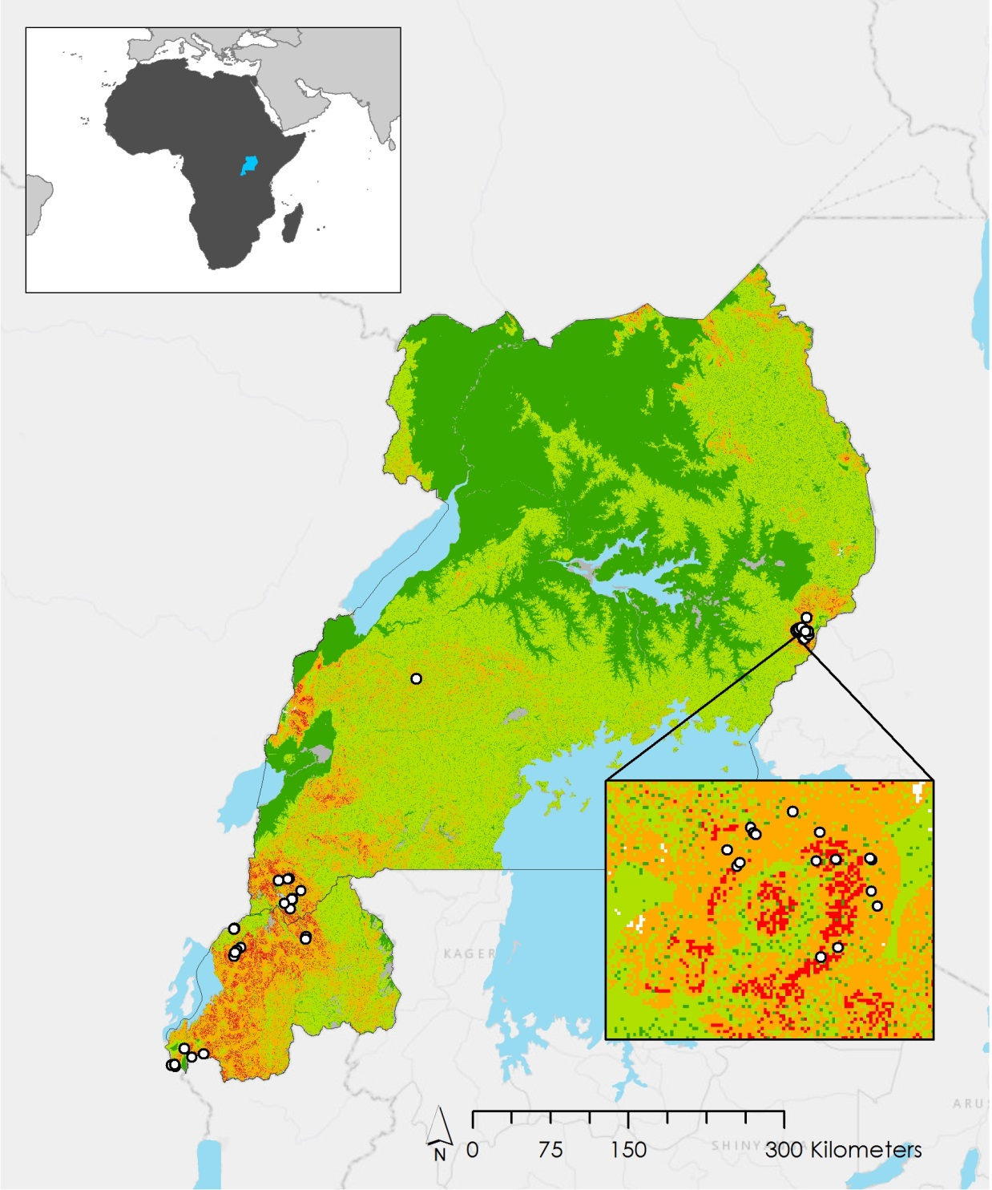



NASA Marshall Space Flight Center
East Africa Disasters
This is a Landslide Susceptibility Map for the countries of Uganda and Rwanda. Nine of the ten variables that went into the making of this map were derived solely or in part from NASA’s Shuttle Radar Topography Mission Version 2 (SRTM-V2) C-band digital elevation data. SRTM-V2 data was collected over an 11 day period in February of 2000. The variables derived from SRTM-V2 include elevation, slope, plan curvature, profile curvature, distance from streams, distance from ridge, Topographic Wetness Index, and terrain roughness. Known landslide locations are displayed for validation. This map can be used by decision makers in Uganda and Rwanda to implement more effective hazard risk management.

Slide 3
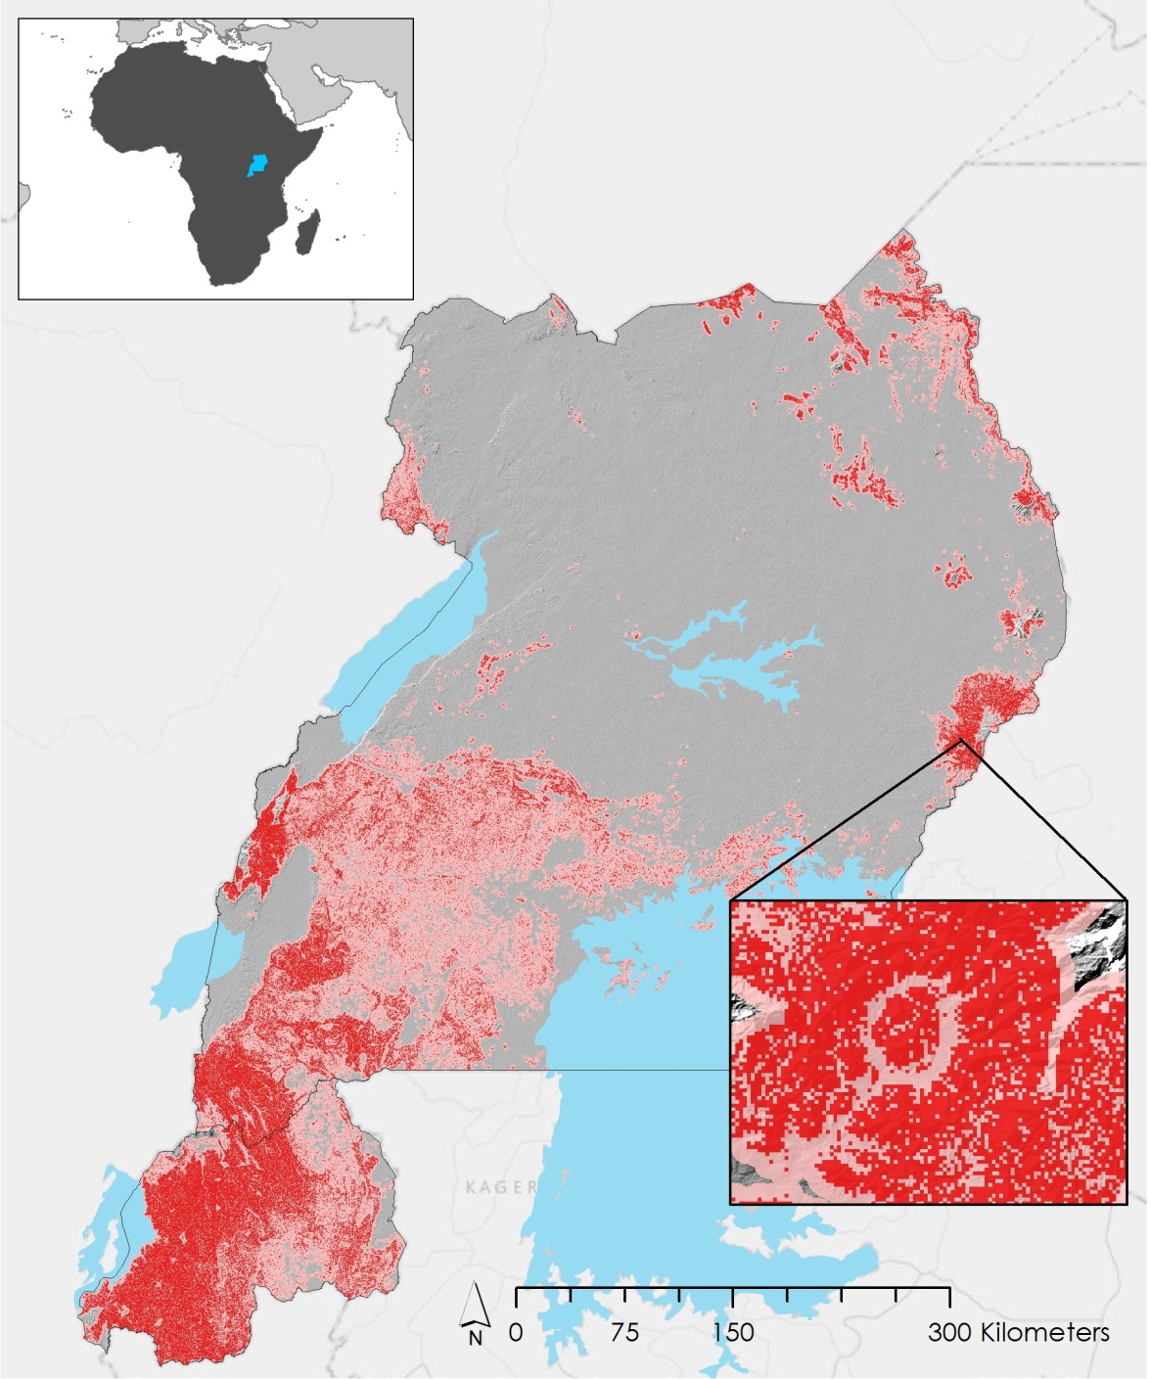

NASA Marshall Space Flight Center
East Africa Disasters
This is a Landslide Susceptibility Map for the countries of Uganda and Rwanda. Nine of the ten variables that went into the making of this map were derived solely or in part from NASA’s Shuttle Radar Topography Mission Version 2 (SRTM-V2) C-band digital elevation data. SRTM-V2 data was collected over an 11 day period in February of 2000. The variables derived from SRTM-V2 include elevation, slope, plan curvature, profile curvature, distance from streams, distance from ridge, Topographic Wetness Index, and terrain roughness. This map can be used by decision makers in Uganda and Rwanda to implement more effective hazard risk management.

Slide 4
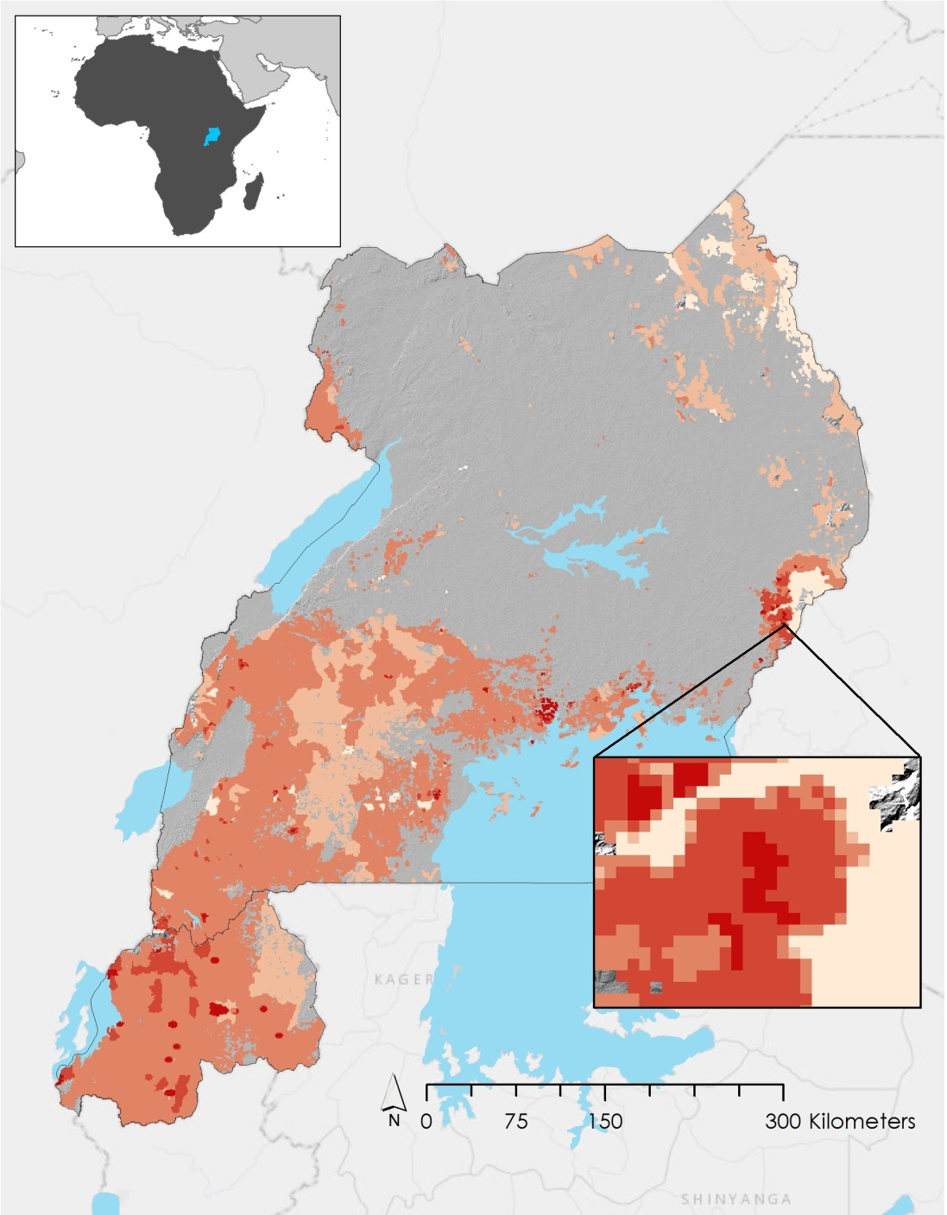


NASA Marshall Space Flight Center
East Africa Disasters
This is a Landslide Hazard Map for the countries of Uganda and Rwanda. Variables that went into the making of this map were derived solely or in part from NASA’s Shuttle Radar Topography Mission Version 2 (SRTM-V2) C-band digital elevation data. SRTM-V2 data was collected over an 11 day period in February of 2000. Areas highly susceptible to landslides were intersected with SEDAC’s Global Rural-Urban Mapping Project, Version 1 (GRUMPv1) population density grid data. This analysis revealed that approximately 16 million people live in landslide prone regions. This map can be used by decision makers in Uganda and Rwanda to implement more effective hazard risk management.
Center for International Earth Science Information Network - CIESIN - Columbia University, International Food Policy Research Institute - IFPRI, The World Bank, and Centro Internacional de Agricultura Tropical - CIAT. 2011. Global Rural-Urban Mapping Project, Version 1 (GRUMPv1): Population Density Grid. Palisades, NY: NASA Socioeconomic Data and Applications Center (SEDAC). http://dx.doi.org/10.7927/H4R20Z93. Accessed 29 July 2015.
Balk, D.L., U. Deichmann, G. Yetman, F. Pozzi, S. I. Hay, and A. Nelson. 2006. Determining Global Population Distribution: Methods, Applications and Data. Advances in Parasitology 62:119-156. http://dx.doi.org/10.1016/S0065-308X(05)62004-0.

