Slide 1

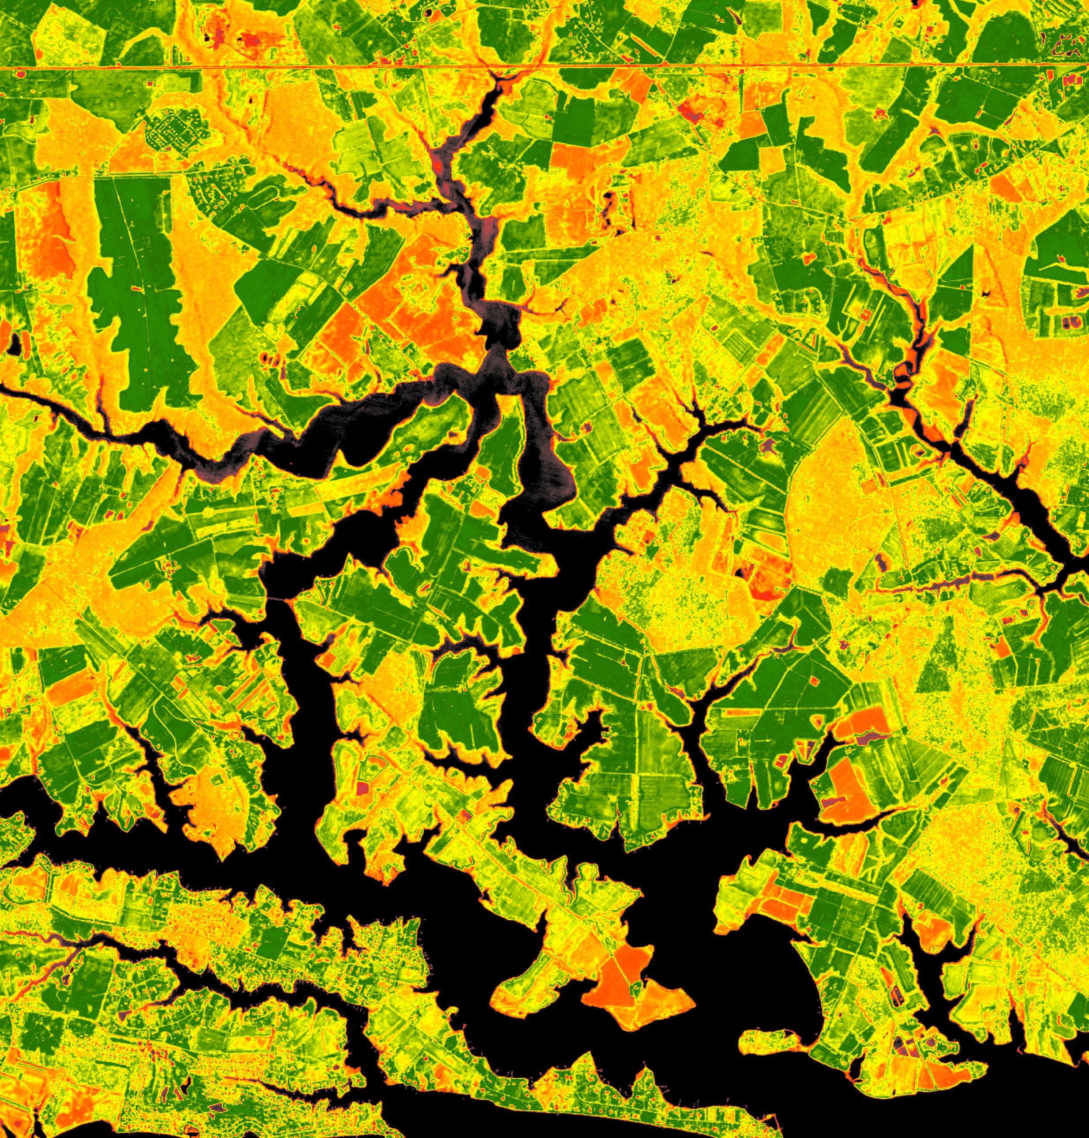
Sunita Yadav (Project Lead)
John Fitz
CHESAPEAKE BAY AGRICULTURE
Sean McCartney
Using NASA Earth Observations
to Map Winter Cover Crop
Conservation Performance in the
Chesapeake Bay Watershed
Perry Oddo
Alison Thieme
NASA Goddard Space Flight Center
2017 Spring
Notes:
We are the Chesapeake Bay Agriculture Team at Goddard Space Flight Center.
*Each Team Member introduces himself/herself*
Our project is focused on quantifying winter cover crop performance in the Chesapeake Bay.
This project came about when one of our partners at the USDA-ARS reached out to DEVELOP to collaborate on research they have been doing with the Maryland Department of Agriculture.
Image credit:
European Space Agency, Sentinel-2 Image via USGS Earth Explorer
(http://earthexplorer.usgs.gov/)

Slide 2
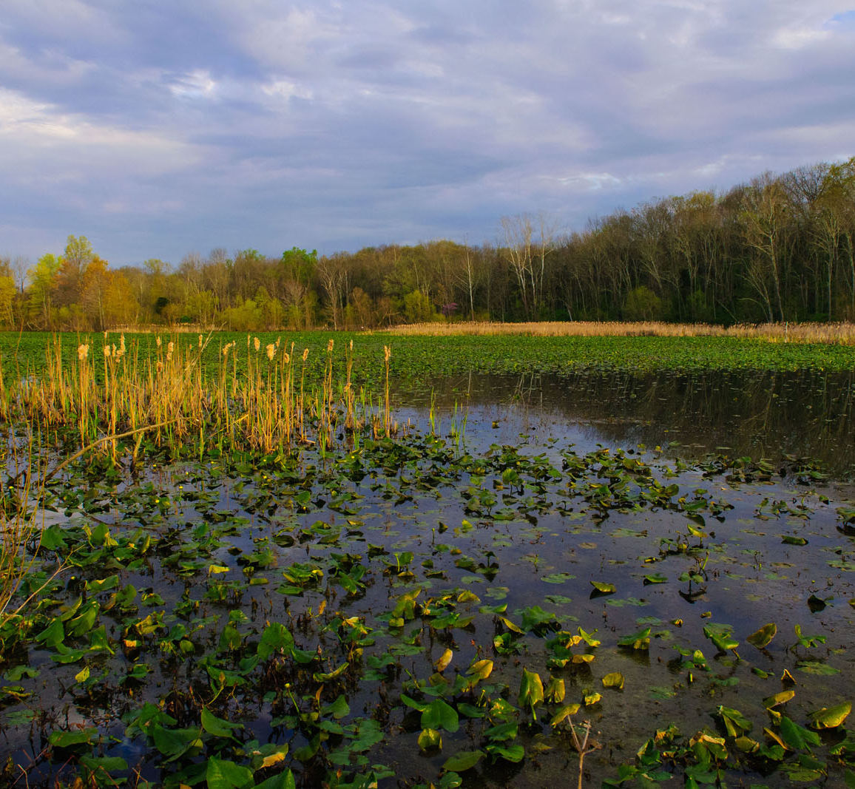
Community Concerns
Water quality in the Chesapeake Bay
Long-term soil health
Threats to biodiversity
Image Credit: US EPA
Notes:
The Chesapeake Bay is the largest estuary in North America, encompassing an area the size of California. The bay provides water, food sources, and recreation for over 17 million people. The bay suffers from nutrient and sediment runoff, largely from agricultural production.
Increased concentrations of nutrients like nitrogen has led to harmful algal blooms, which deplete the waters of oxygen and threaten much of the Bay’s marine life through eutrophication that will further degrade marine biomass and biological diversity.
Image Credit:
“Wetland area in the Chesapeake Bay” by USEPA Environmental-Protection Agency available under a Public Domain license at
https://www.flickr.com/photos/usepagov/15011160418/

Slide 3
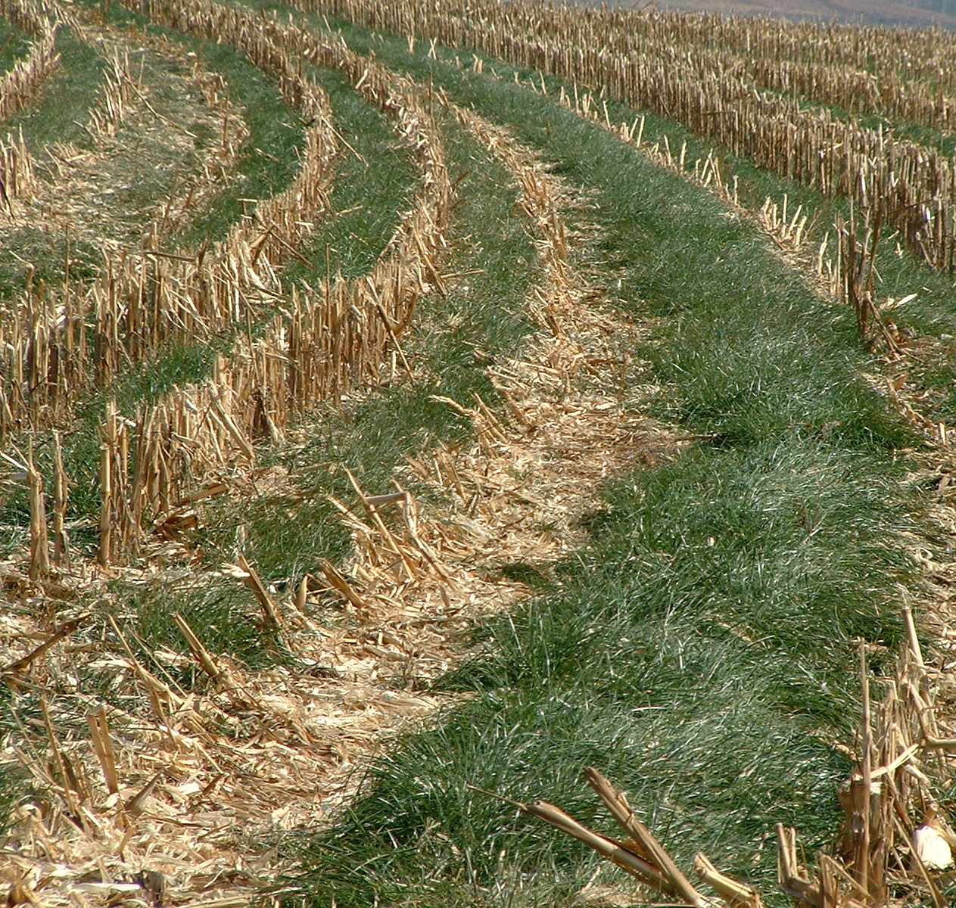
Winter Cover Crop Program
Started Maryland Department of Agriculture in 2005
Pays farmers to plant cover crops
Pay scale based on estimates of Nitrogen uptake depending on:
  Planting date
  Planting method
  Species
Image Credit: Alan Manson
Notes:
Cover crops have proven to be an effective way to absorb excess nitrogen and reduce erosion.
In response to the water quality concerns in the Chesapeake Bay, the Maryland Department of Agriculture created a program to limit the effects of agricultural pollution.
The Maryland Agricultural Water Quality Cost-Share (MACS) Program provides cash incentives for farmers to grow winter cover crops between primary planting seasons.
It is still unclear, however, just how effective the winter cover crops have been at accomplishing their goal.
Image Credit:
“Italian ryegrass cover crop” by Alan Manson available under Creative Commons Attribution-Share Alike 3.0 Unported license at
https://commons.wikimedia.org/wiki/File:2004_0609_Italian_ryegrass_cover_crop.jpg

Slide 4

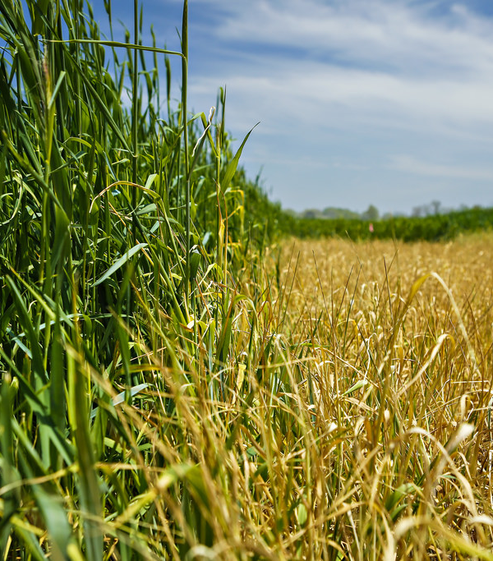



Partner Organizations
USGS Eastern Geographic Science Center
USDA – Agricultural Research Service
Maryland Department of Agriculture, Office of Resource Conservation
EPA Chesapeake Bay Program
Image Credit: CAFNR
Notes:
Our team is working with researchers from these organizations to assess the performance of winter cover crops using NASA Earth observations.
From 2006-2012 the USDA-ARS collected calibration data from participating winter cover crop fields. This data includes biomass, nitrogen content, and percent groundcover.
Image Credit:
University of Missouri College of Agriculture, Food and Natural Resources (CAFNR), available under a Creative Commons noncommercial license at:
https://www.flickr.com/photos/cafnr/14277609456/

Slide 5
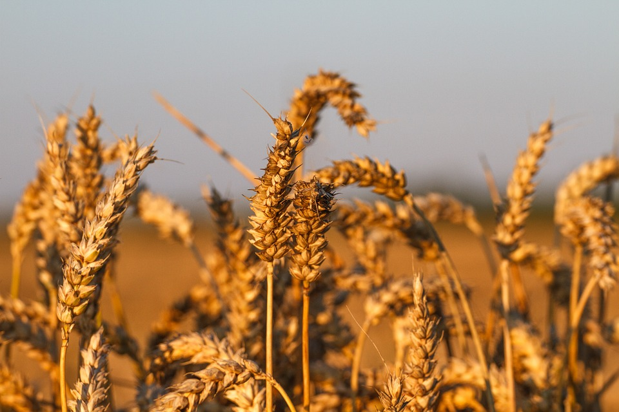
Image Credit: Colliefreund
Objectives
Measure winter cover crop performance within four Maryland counties
Evaluate estimated nitrogen uptake by quantifying above-ground biomass, nitrogen content, and percent nitrogen
Provide vegetation metrics to the MDA to improve crop adaptive management practices
Notes:
Our goals were to help our project partners assess the effectiveness of the Maryland Winter Cover Crop Program. To do this, we developed three objectives:
1. Measure winter cover crop performance within four Maryland counties
2. Evaluate estimated nitrogen uptake by quantifying above-ground biomass, N content, and percent nitrogen
3. Provide vegetation metrics to the MDA to improve crop adaptive management practices
Image Credit:
“Wheat Field” by Colliefreund available under a CCO Public Domain License at: https://pixabay.com/en/wheat-field-rye-grain-agriculture-404142/

Slide 6
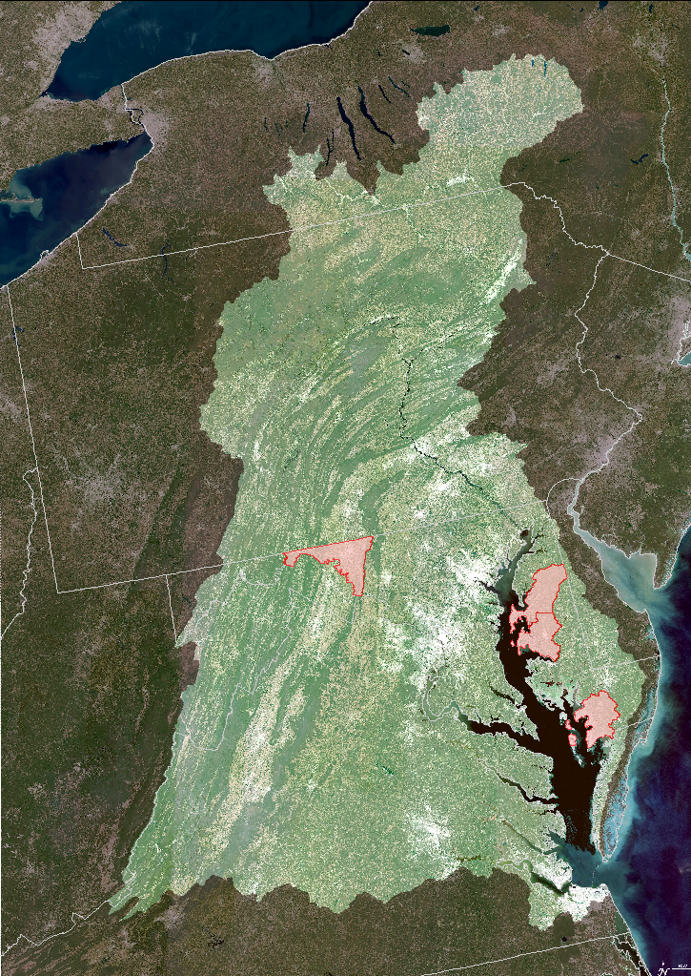
Study Area & Study Period
Chesapeake Bay Watershed
We focus on four test counties within the Maryland section:
  Washington
  Queen Anne’s
  Talbot
  Somerset
Study Period: 2006-2016
  Winter (December 15 – January 31)
  Spring (March 1 – April 15)
Study Area Counties
NY
PA
NJ
MD
DE
WV
VA
0
75
150
300
Kilometers
Credit: Taylor & Estrada, 2015
Notes:
In order to align with current work of the Maryland Department of Agriculture we are focusing on the Maryland portion of the watershed, and specifically within four test counties.
The Study Period included the years from 2006-2016 for two seasons per year: winter (December 15 – January 31), and spring (March 1 – April 15).
This aligns with the 2006 to 2012 calibration data from the USDA-ARS as well as the MDA field enrollment data from 2014 to 2016.
Image Credit:
Adapted from “The Chesapeake Bay in 661 Million Pixels”, Taylor & Estrada, 2015 https://svs.gsfc.nasa.gov/4366

Slide 7
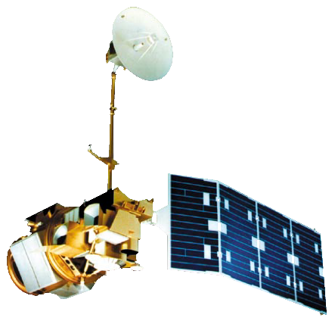

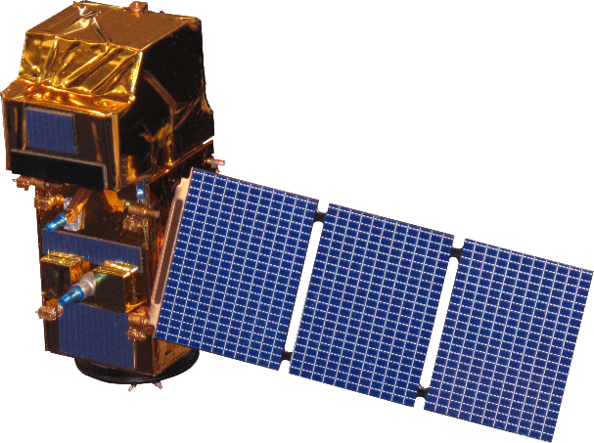
NASA Satellites/Sensors Used
Landsat 5
Thematic Mapper
Landsat 8
Operational Land Imager
European Space Agency
Sentinel - 2
Image Source: NASA
Notes:
The USDA-ARS has previously analyzed the relationships between SPOT data and the calibration data. Since Landsat has a long historical dataset and is publicly available, we are comparing Landsat 5 data to the calibration dataset to see if a similar relationship can be established.
Landsat 8 and 5 are collected with the same spatial resolution, we are applying models from the Landsat 5 and calibration data to Landsat 8 data.
We utilized ESA’s Sentinel-2 satellite for potential future studies of nitrogen content.
Landsat 5: http://www.devpedia.developexchange.com/dp/images/6/69/01_Landsat5.png
Landsat 8: http://www.devpedia.developexchange.com/dp/images/c/c2/03_Landsat8.png
Sentinel-2:
http://www.devpedia.developexchange.com/dp/images/d/dd/24_Sentinel2.png

Slide 8
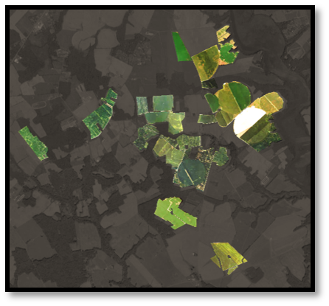
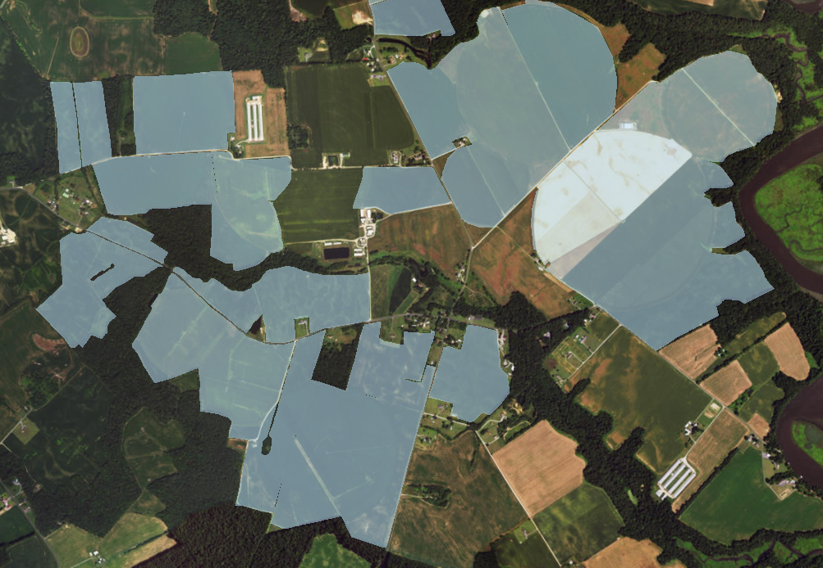
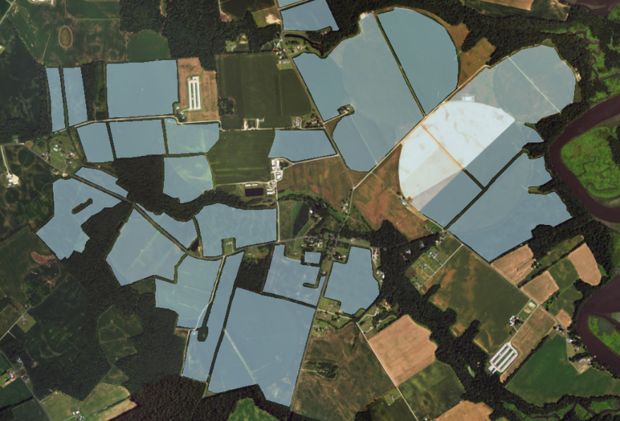
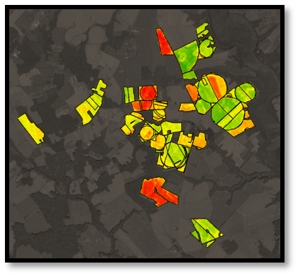
Methodology
Imagery Data
(winter/spring 2006-2016)
Landsat 5
Landsat 8
Sentinel-2
Google Earth Engine
Surface Reflectance
Masking
NDVI
Calibration
Biomass
Percent Ground Cover
Percent Nitrogen
Percent Residue Cover
Ancillary Data
MDA Cover Crop Enrollment
Agronomic Data
Field Boundaries
GIS Processing
Organize data into three regions
15-meter buffer into field
Convert to Fusion Table
Performance Measures
Output tables
Field performance maps
15-meter
Interior buffer
Notes:
The MDA winter cover crop enrollment data was processed to buffer field boundaries by 15 m to remove edge effects
Field boundaries were imported into GEE as fusion tables
Using surface reflectance data for Landsat 5, Landsat 8, and Sentinel-2 we applied cloud, cloud shadow, water and snow masking and extracted NDVI values.
For each season, all available imagery was used and the NDVI was averaged within the field boundaries. The maximum of these values in the date range was used.
Images were calibrated by year and season for years where field data were available (2006-2012), and model applied to entire image.
The average model by season (winter or spring) was applied for years from 2013-2016
Vegetation metrics for each field were extracted and exported to a table that will be incorporated into the MDA database for future analysis

Slide 9
Methodology
Goodness of fit (r2) values between vegetation indices and biomass
No transformation | NDVI | GNDVI | SR | SAVI (L = 0.5) | G − R | EVI | TVI | NGRD | VARI | NDREI
All sampling dates | 0.37 | 0.39 | 0.32 | 0.37 | 0.26 | 0.33 | 0.37 | 0.28 | 0.28 | 0.40
Early sampling dates | 0.59 | 0.60 | 0.74 | 0.60 | 0.64 | 0.65 | 0.84 | 0.70 | 0.69 | 0.65
Log transformation | NDVI | GNDVI | SR | SAVI (L = 0.5) | G − R | EVI | TVI | NGRD | VARI | NDREI
All sampling dates | 0.61 | 0.63 | 0.38 | 0.61 | 0.44 | 0.50 | 0.57 | 0.40 | 0.40 | 0.58
Early sampling dates | 0.86 | 0.84 | 0.63 | 0.86 | 0.84 | 0.78 | 0.86 | 0.74 | 0.74 | 0.80
Source: Kusuma Prabhakara, W. Dean Hively, Gregory W. McCarty
Notes:
Our partners at the USGS and USDA tested different indices and found that NDVI has a strong relationship with biomass following a log transformation. Therefore, we used NDVI to estimate vegetation metrics.
Source: Evaluating the relationship between biomass, percent groundcover and remote sensing indices across six winter cover crop fields in Maryland, United States by Kusuma Prabhakara, W. Dean Hively, Gregory W. McCarty
http://dx.doi.org/10.1016/j.jag.2015.03.002

Slide 10
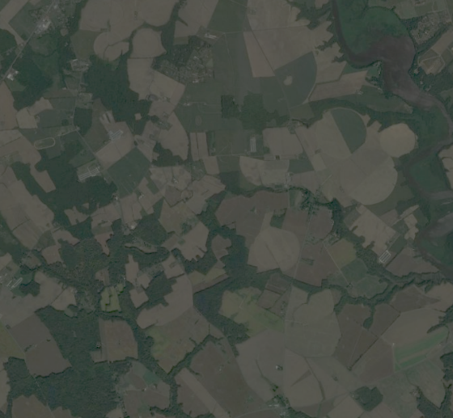
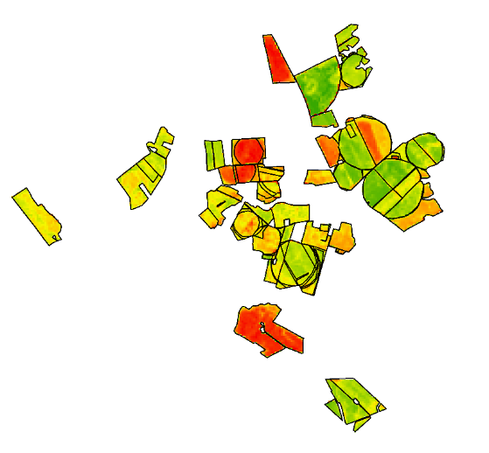
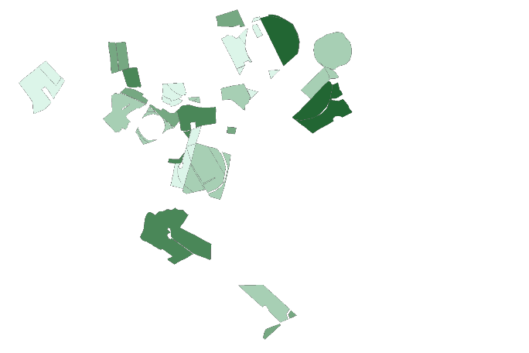
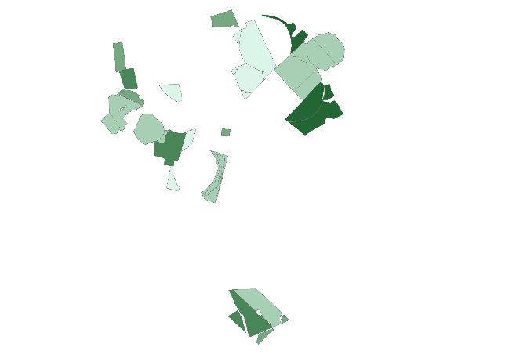
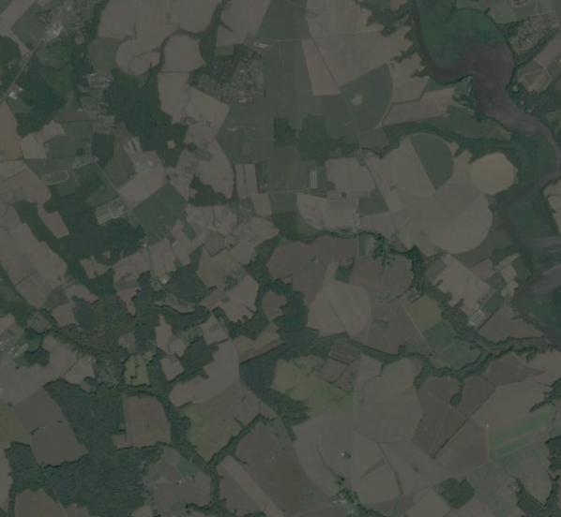
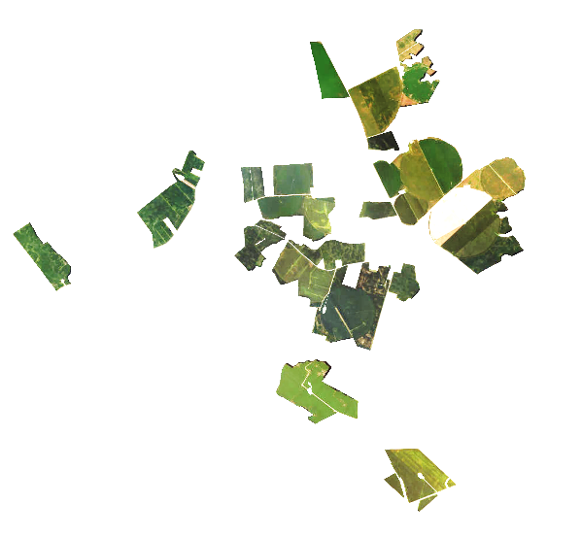
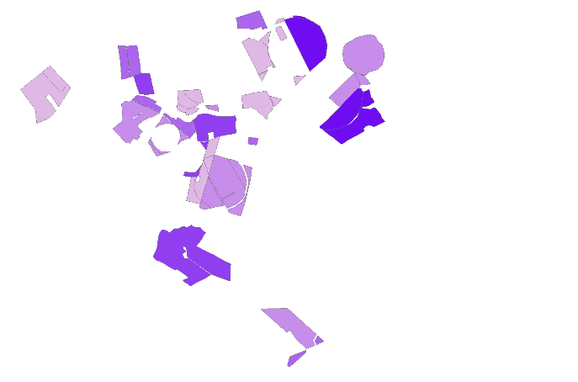
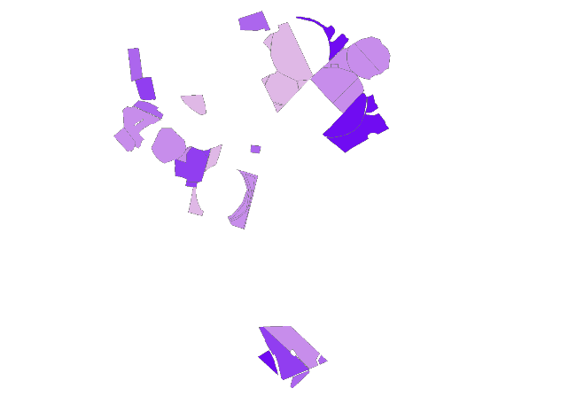
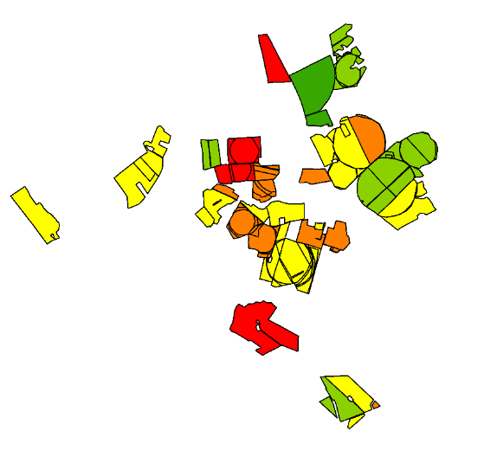

Results
NDVI
Spring 2015 Wheat
Spring 2015 Barley
±
R² = 0.33
±
Satellite Imagery
Biomass (kg/ha)
Biomass (kg/ha)
0 - 285
0 - 285
286 - 487
286 - 487
488 - 705
488 - 705
706 - 1090
706 - 1090
2
1091 - 2541
2
1091 - 2541
0
1
3
Km
0
1
3
Km
averaged NDVI
(max value in time period)
±
R² = 0.002
±
Nitrogen Content
(kg/ha)
Nitrogen Content
(kg/ha)
0 - 9.42
0 - 9.42
9.43 - 14.73
9.43 - 14.73
14.74 - 21.16
14.74 - 21.16
2
21.17 - 32.00
2
21.17 - 32.00
0
1
3
Km
32.01 - 74.45
0
1
3
Km
32.01 - 74.45
Notes:
The first script selects all the imagery within a time period, then NDVI is calculated, from which the maximum NDVI is selected by field ID. Another script then runs the calibration model on each dataset to calculate biomass, N%, and N content. Finally, crop performance metrics are then associated with the field ID’s provided by the MDA for a particular year to produce winter cover crop maps by season.
The R2 for the model predicting biomass is reasonable, but not so for Nitrogen. Our partners plan to use our scripts to extract additional indices for estimating Nitrogen such as red-edge for Sentinel-2.
These maps will be useful to assess varying rates of biomass accumulation by crop species and other metrics.

Slide 11
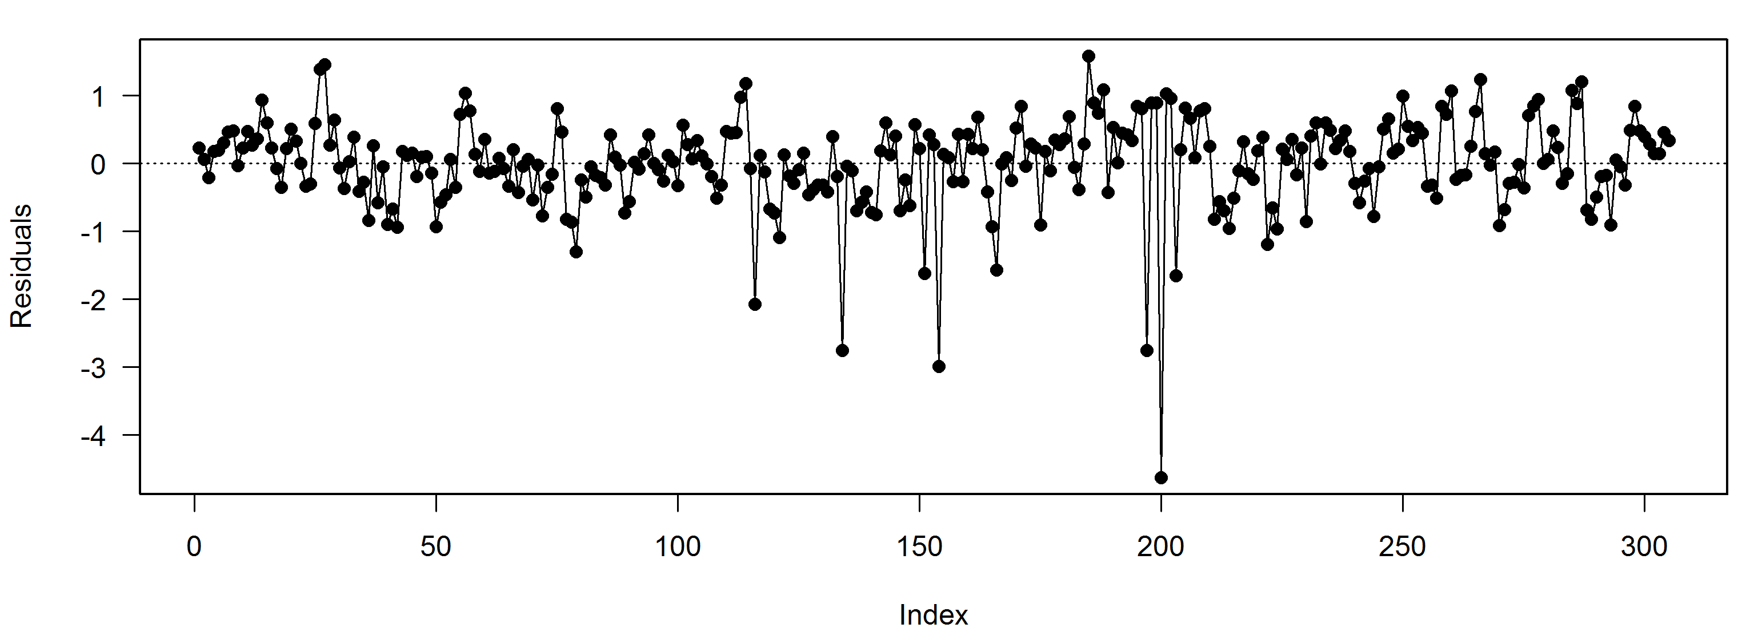
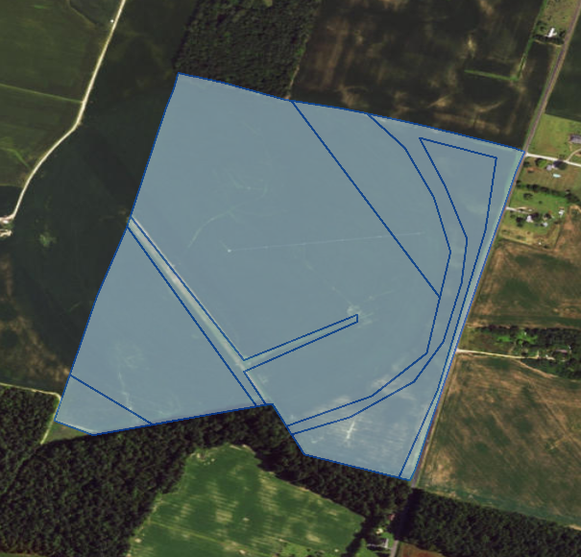
Errors and Uncertainties
Models developed here are proof of concept; they need much more time to be fully analyzed
Duplication of records in agronomic database
log(Biomass) ~ NDVI
Overlapping fields
Perry Oddo
Notes:
There are a number of errors and uncertainties associated with this project. The models developed here are a proof of concept but could benefit from additional data collection and model development. As the cover crop program continues to collect field data, and as new remote observations are built in, the calibration between biomass and NDVI should become more established. In addition there were a number of programmatic errors, including overlapping field boundaries that resulted from duplicate records in the MDA agronomic database. We have communicated these discrepancies to our project partners and as their digital management of field data improves we can be sure we are looking at the most accurate and up-to-date information possible.

Slide 12
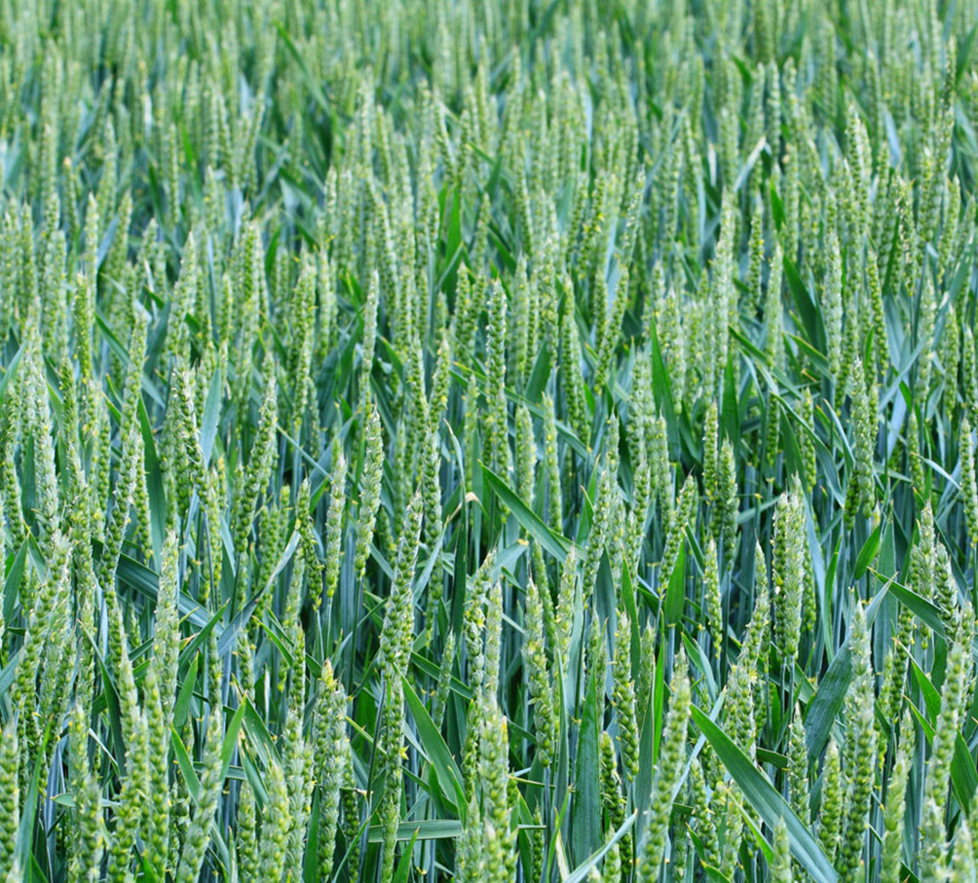
Conclusions
Image Credit: Petr Kratochvil
Automated the image search in Google Earth Engine to find the image with maximum NDVI within a time period
Predict biomass from NDVI to assess cover crop performance by individual field boundaries
Allow for more efficient monitoring and assessment of winter cover crops
Image Credit: Monet
Notes:
As the first in a potentially multi-term project, many of the insights from this work are methodological. We found that utilizing the processing power of platforms like Google Earth Engine gives our project partners an efficient way to automate many of the processes that previously took a great deal of resources. This will allow the MDA to rapidly find clear imagery and extract NDVI information according to individual field boundaries, and to use that information to assess cover crop performance. Moving forward, this project will allow for even more efficient monitoring by allowing MDA staff to assess program compliance remotely instead of spending time physically traveling to individual farms.
“Green Wheat Field” by Petr Kratochvil available under a Public Domain license at
http://www.publicdomainpictures.net/view-image.php?image=3066

Slide 13
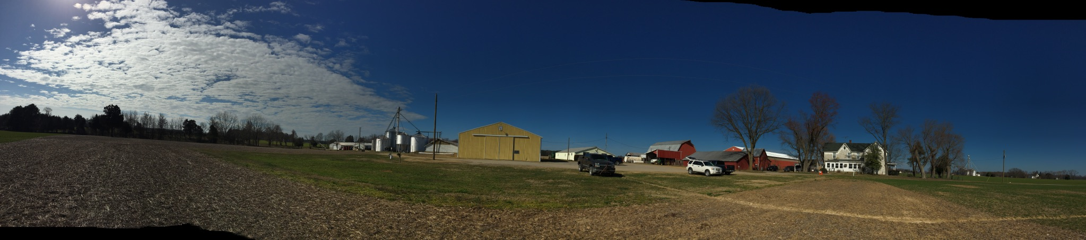
Image Credit: Sunita Yadav
Future Work
Collect more calibration data to relate Sentinel-2 red edge to nitrogen content
Extend methodology to entire state of Maryland
Work with state agencies in nearby states (VA, PA, NY, DC, WV) to implement winter cover crops on a regional scale
Notes:
In terms of future work, there are plans to collect additional calibration data for use with Sentinel-2 imagery. The addition of red edge bands will allow for a more precise understanding of the relationship between remote observations and nitrogen content. Finally, this project was a feasibility study that used four test counties in Maryland however the methodology established here will allow the MDA to scale up the analysis to the entire state. Similar assessments could be established throughout the Chesapeake Bay Watershed in neighboring states like Pennsylvania and Virginia, which would require increased communication and interstate cooperation.
Image Credit:
“Hutchinson Brothers Farm,” by Sunita Yadav. Used with permission of owner.

Slide 14
Advisors
USGS Eastern Geographic Science Center:
Dr. W. Dean Hively
USDA-ARS:
Dr. Greg McCarty
Center Lead
Sean McCartney
Partners
Maryland Department of Agriculture:
Jason Keppler
Alisha Mulkey
EPA Chesapeake Bay Program:
Richard Batiuk
GSFC Science Advisor
Dr. John Bolten
USGS Eastern Geographic Science Center:
Dr. W. Dean Hively
LeeAnn King
USDA-ARS:
Dr. Greg McCarty

