Slide 1
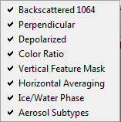
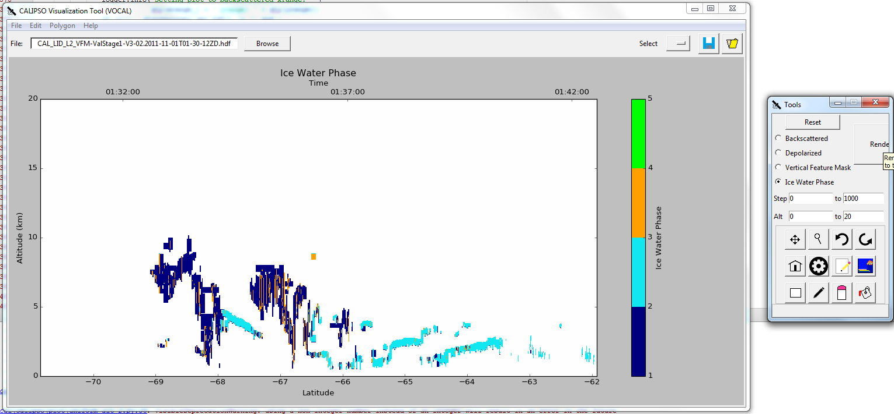
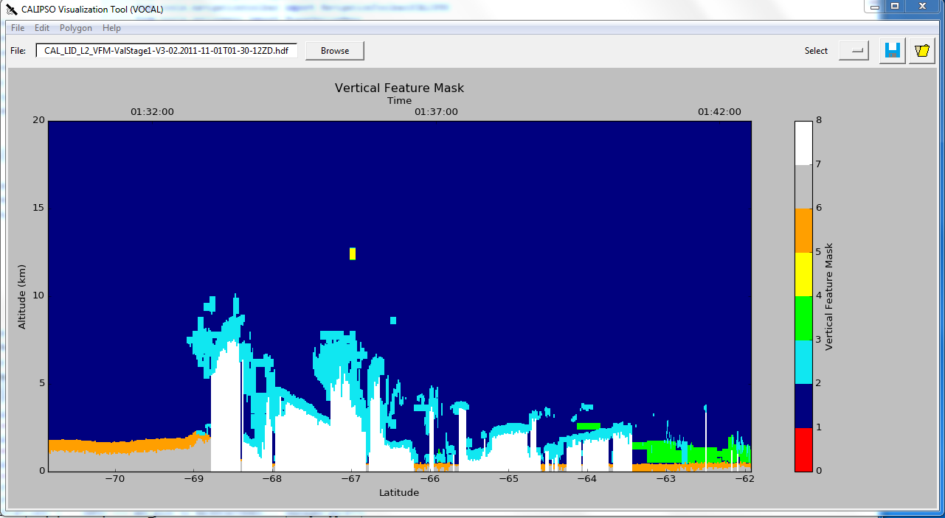
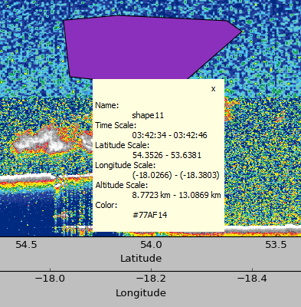
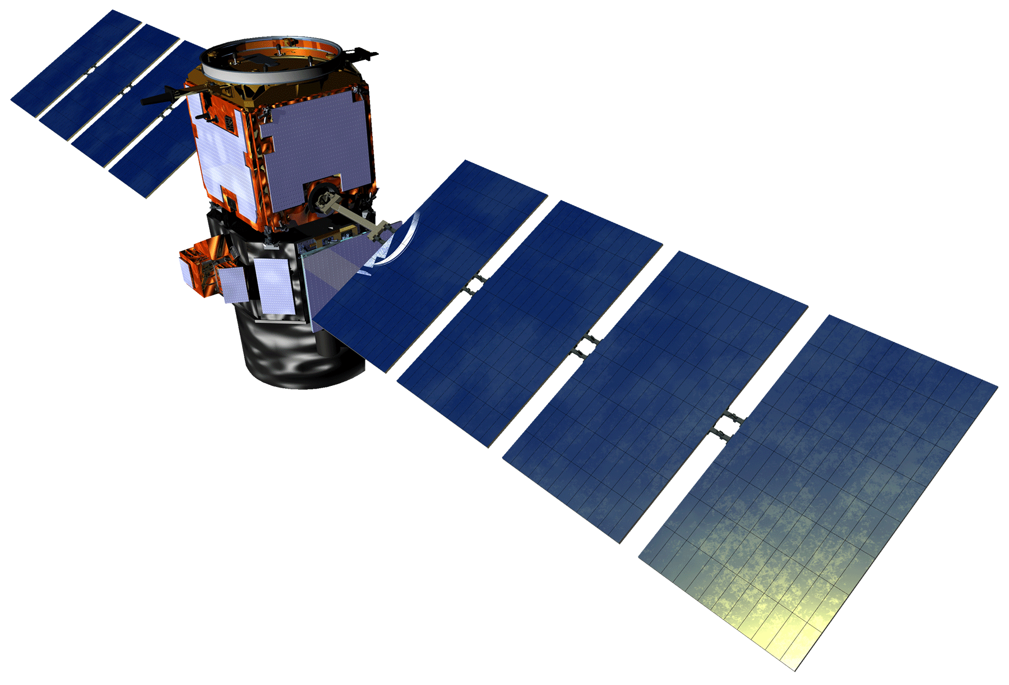
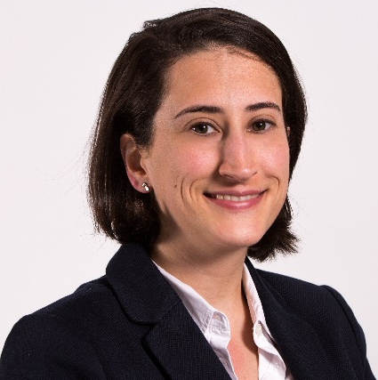
Enhancing the Usability of Visualization of CALIPSO (VOCAL) Through a Test Case-Driven Approach
Abstract
Results
The relationship that exists between cloud nuclei and aerosols plays a vital role in Earth’s climate system. For the purposes of detection, the Cloud-Aerosol Light Detection and Ranging (LiDAR) and Infrared Pathfinder Satellite Observations (CALIPSO) satellite offers scientists the ability to better understand the relationship between clouds, aerosols, and climate by measuring the backscatter created by embedded atmospheric aerosols. The standard visualizer for CALIPSO satellite data is limited in its extensibility by the proprietary programming language in which it is written. Hence, development of a new, enhanced visualizer, Visualization of CALIPSO (VOCAL), has been in development by NASA DEVELOP teams since spring 2015. Written in Python, VOCAL displays CALIPSO curtain Hierarchical Data Format (HDF) files for both backscattered and depolarized Level 1, Version 3 data. In addition, the user can draw polygons overlaying the displayed data, to mark potential regions-of- interest. Subsequently, these regions can be tagged with attributes and notes. VOCAL can export to a database or to JavaScript Object Notation (JSON) files any shapes that the user may want to save. This term, the CALIPSO Cross-Cutting team added support for the newest CALIPSO data product (Version 4), alternative graphical user interface (GUI) viewing options for the data in VOCAL, as well as a suite of use-cases for the software.
Visualized new data levels and versions available as CALIPSO data products
Paired longitude, along with latitude, on the x-axis of plots visualizing the different CALIPSO datasets
Annotated aerosols with an easier sketching mechanism
Displayed various CALIPSO datasets in a tabbable format where each tab visualizes one specific CALIPSO dataset
Integrated a drop down menu to show/hide the newly implemented tabs
Converted annotated shapes into ESRI’s shapefiles
Added polygon coordinates in the database as exportables JSON, text, and CSV files
“(03:42:28, 13.476), (03:42:35, 13.476), (03:42:35, 8.222), (03:42:28, 8.222)”
Objectives
The user can now export (time, altitude) coordinates.
Evaluate the current version of VOCAL through rigorous use-case scenarios
Enhance data visualization and improve aerosol shape identification
Extend VOCAL’s compatibility to multiple satellite data product levels and versions, as well as to the Mac OS X operating system
Add the functionality to export the shapes into .shp files to visualize in ESRI, QGIS and other GIS software
The tab feature allows for easier display of datasets
Methodology
Preliminary Testing
Software Development
Visualization
CALIPSO Cross-Cutting
Visualization of ice/water phase
Distinguishes water phase of clouds
Draw lines while sketching
Right-click to close polygons
Study Area
Earth Observations
Visualization of vertical feature mask
Subtypes atmospheric features
Longitude properties are available in the database
Conclusions
The range of the CALIPSO satellite is virtually global; it covers paths 80° North to 80° South and all longitudes.
Cloud-Aerosol Lidar and Infrared
Satellite Observation (CALIPSO)
VOCAL now allows end users to make more efficient scientific analysis of aerosol features using the different CALIPSO datasets.
Data storage, GUI enhancements, and improved functionality have been implemented in the new version of VOCAL.
In the future we expect VOCAL to evolve from a desktop to a web application/virtual globe viewer connected to an online database (e.g. PostGIS-PostgreSQL), where end users can share data access.
In addition, we anticipate more output formats from VOCAL including GeoJSON and KML.
Project Partners
Dr. Charles “Chip” Trepte, NASA LaRC CALIPSO Science Team
Team Members
Acknowledgments
Dr. Charles “Chip” Trepte, NASA Langley Research Center
Grant Mercer, NASA DEVELOP LaRC, Summer 2015
Dr. Kenton Ross, NASA DEVELOP National Program
Michael Bender, NASA DEVELOP National Program
Jordan Vaa, NASA DEVELOP LaRC Fellow
Nathan Qian, NASA DEVELOP LaRC, Summer 2015
Ashna Aggarwal, NASA DEVELOP LaRC, Spring 2015
Courtney Duquette, NASA DEVELOP LaRC, Summer 2015
Kathleen Moore
Co-Project Lead
Ahmad Aburizaiza
Co-Project Lead
Adama Ba
Andrea Martinez
Joseph Driscoll
Any opinions, findings, and conclusions or recommendations expressed in this material are those of the author(s) and do not necessarily reflect the views of the National Aeronautics and Space Administration. This material is based upon work supported by NASA through contract NNL11AA00B and cooperative agreement NNX14AB60A.
NASA Langley Research Center – Summer 2016

