Slide 1
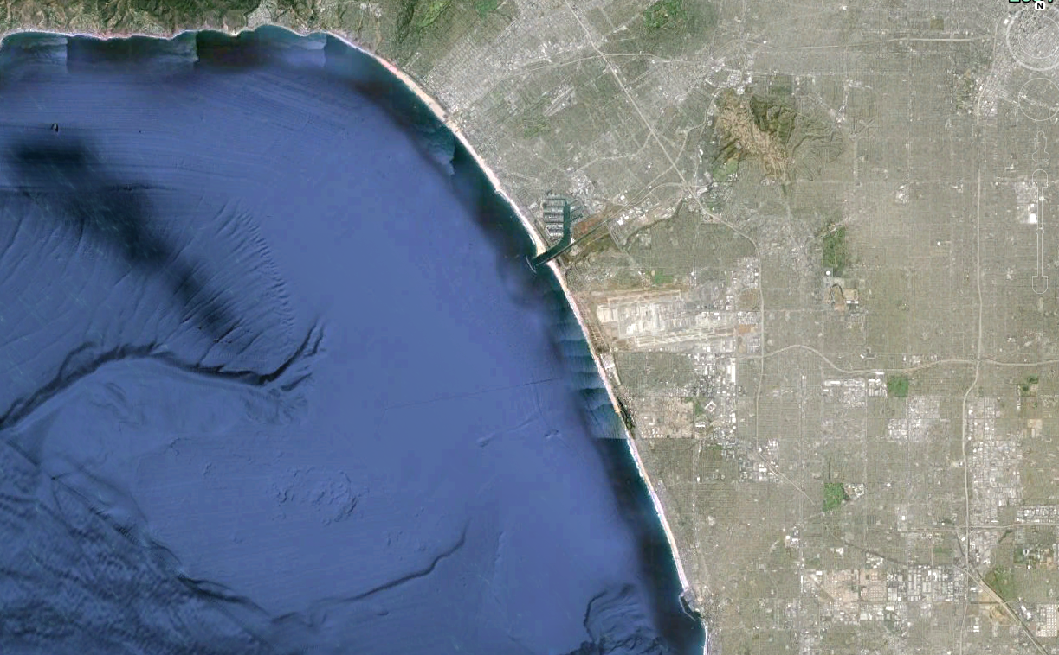
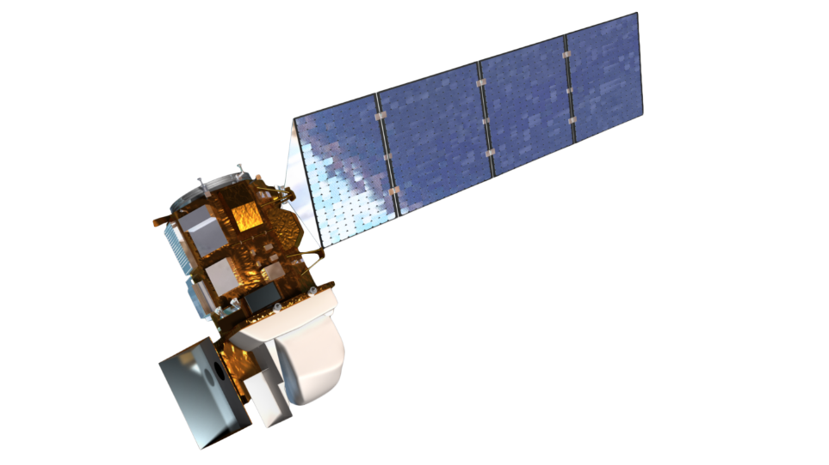


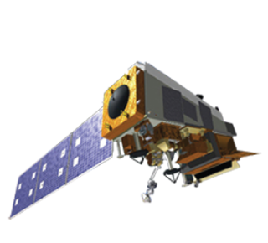
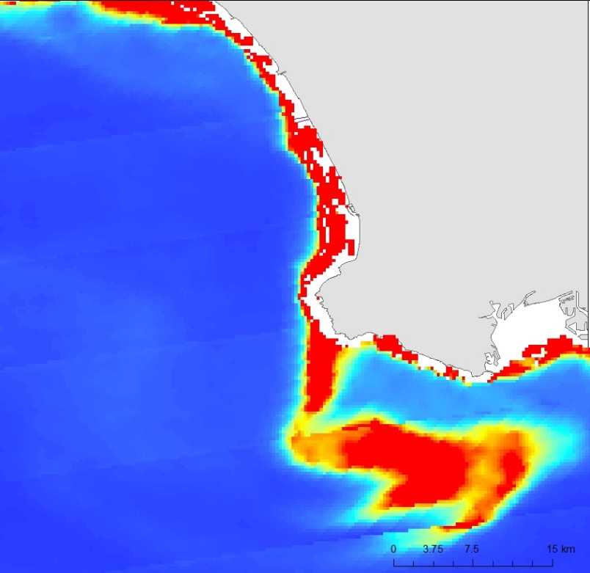
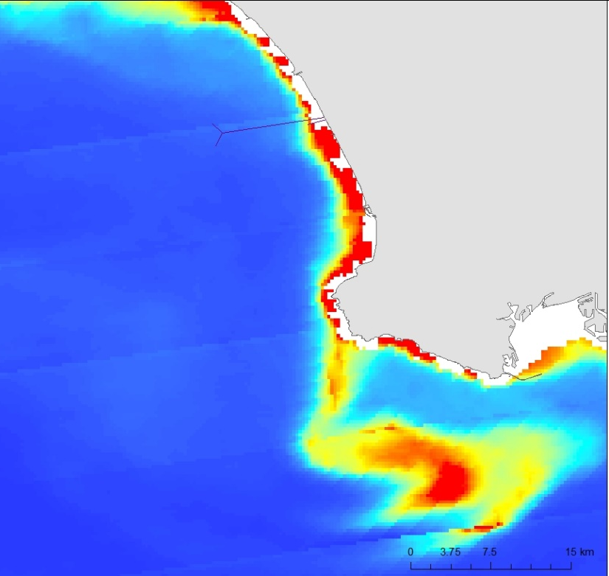
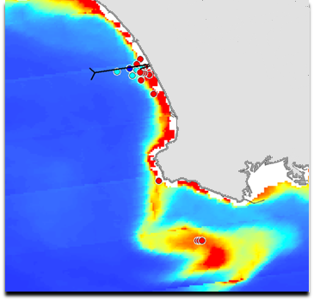
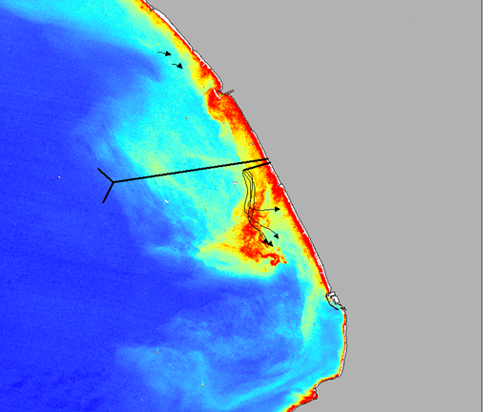
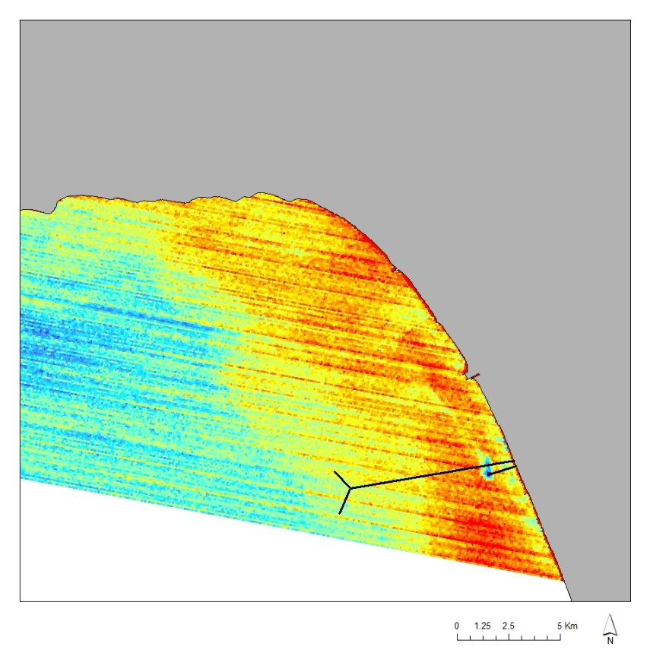
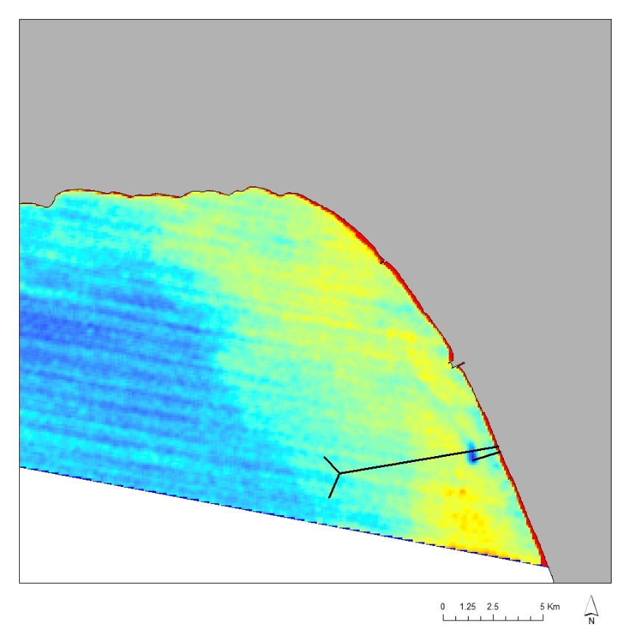
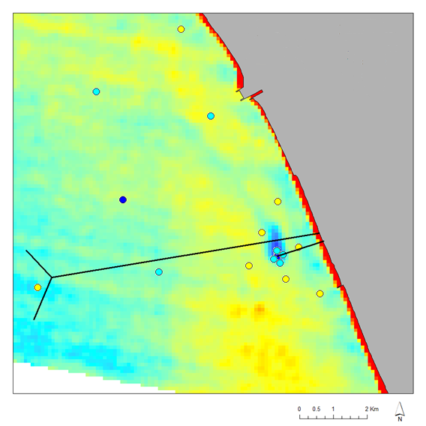
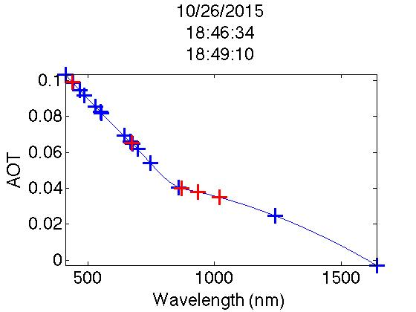
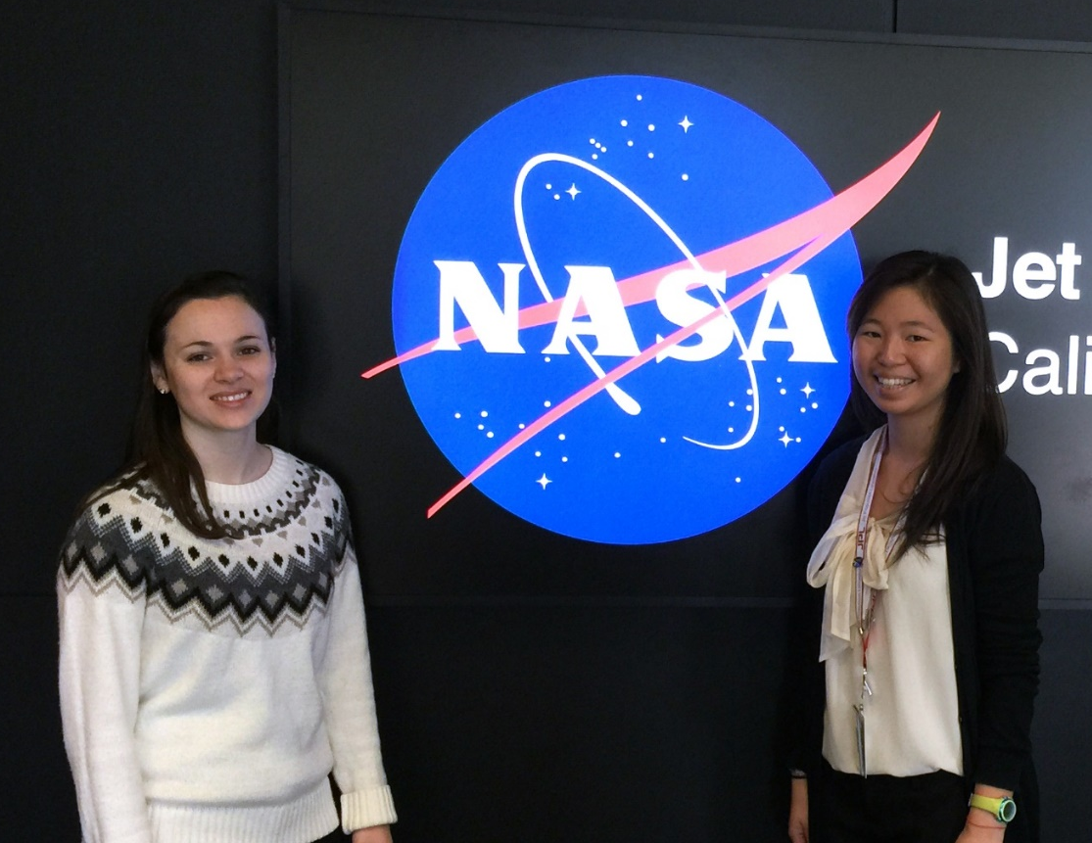
Los Angeles Oceans II
Validating Satellite Observations of Wastewater Plume Biological Impacts in Santa Monica Bay, California
Rebecca Trinh (Project Lead), Lindsay Almaleh
DEVELOP National Program at NASA Jet Propulsion Laboratory
Abstract
Objectives
The Hyperion Water Reclamation Plant is one of the largest wastewater treatment plants in the western United States. Treated sewage is generally released at depths of approximately 60 m through 8.05 km outfall pipes into a deep marine canyon in the Santa Monica Bay. In times of repair and maintenance, services on the main outfall pipe are temporarily suspended and require the plant to divert treated sewage to a shorter 1.6 km pipe that extends into shallow coastal zones. These shallow zones make it possible for the buoyant freshwater plumes to reach the surface, potentially contaminating the local environment. A six-week diversion event occurred at HWRP from September 21 to November 2, 2015. This project plans to integrate previously obtained NASA satellite images and ancillary data collected by other scientists. By combining remotely-sensed observations with GPS-equipped drogue surface drifters and in situ readings of temperature, salinity, atmospheric aerosols, and chlorophyll-a florescence, an accurate assessment of the full impact and extent at which these effluent plumes affected the Los Angeles Basin is possible. The outcome of this study can aid in developing proper methods to avoid harmful outcomes during similar diversion events in the future.
Coordinate with the Hyperion Water Reclamation Plant research team in obtaining in situ data taken in the Santa Monica Bay.
Validate NASA Earth observations and in situ data taken during the diversion event.
Determine whether the expelled effluent has negatively impacted the local ecosystem or washed ashore to potentially contaminate beaches.
Publish results in a journal and Hyperion’s technical report.
Methodology
Study Area
NASA Earth Observations:
Terra, ASTER
Sea surface temperature
Landsat-8, OLI/TIRS
Santa Monica
Bay
Chlorophyll-a
surface sediment
turbidity
LAX
Aqua, MODIS
Hyperion
Treatment
Plant
Suomi NPP, VIIRS
Spatiotemporal
analysis of combined
datasets
In Situ Measurements
Atmospheric correction
Microtops, JPL
Atmospheric aerosols
Study Period: August 31 – November 20, 2015
Drifters, USCB
Local current direction
Earth Observations
Phytoplankton,USC
Algal blooms
Landsat-8
Aqua, MODIS
CTD, HWRP/UCSB
Salinity, temperature, chlorophyll-a
Results
Terra, ASTER
Suomi NPP, VIIRS
Atmospheric Correction
In Situ Comparison
MODIS
CTD
Landsat-8
Oct. 10, 2015
Conclusions
In situ Atmospheric Aerosol Thickness can be used to atmospherically correct satellite images.
Freshwater and cold sea surface temperature signatures from the effluent are validated via temperature and salinity from Conductivity, Temperature, Depth instrument (CTD).
Algal blooms seen on remote sensed images are validated by in situ chlorophyll-a data from CTD and water chemistry.
Obtaining data using multiple methods can help validate all measurements.
Drifter
Direction
BEFORE
AFTER
Temperature
ASTER
Extrapolated Aerosol Optical Thickness (AOT)
BEFORE
AFTER
Acknowledgements
Team Members
Science advisors: Ben Holt and Michelle Gierach, NASA JPL
Project partners: Curtis Cash, Ashley Booth, and Mas Dojiri, Hyperion Water Reclamation Plant
Cedric Fichot, NASA JPL
Jayme Smith, USC
Carter Ohlmann, UCSB
NASA DEVELOP National Program
Previous Contributors: Mark Barker, Christine Rains, and Jack Pan
AOT
Wavelength (nm)
Project Partners
Hyperion Water Reclamation Plant,
City Of Los Angeles
Lindsay Almaleh and Rebecca Trinh
NASA Jet Propulsion Laboratory

