Slide 1
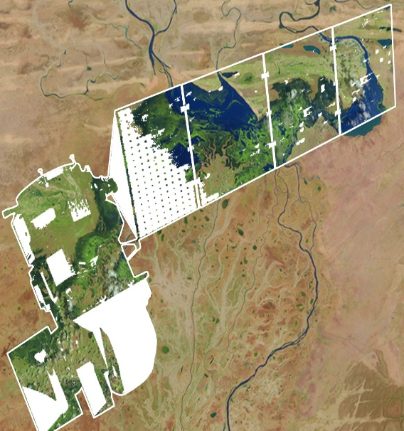
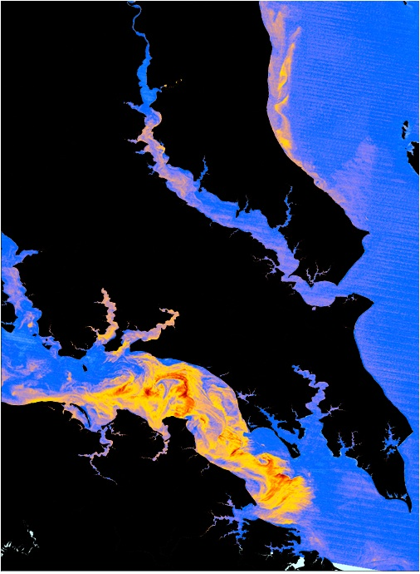
DEVELOP National Program
DEVELOP Projects & Partners:
Project Execution, Partner Engagement, Performance Metrics, Communicating results

Slide 2
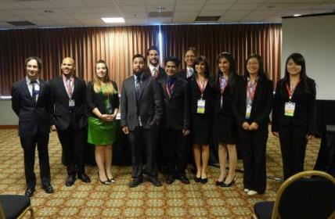
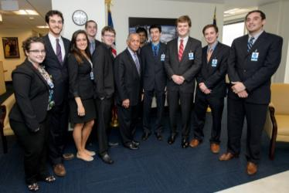
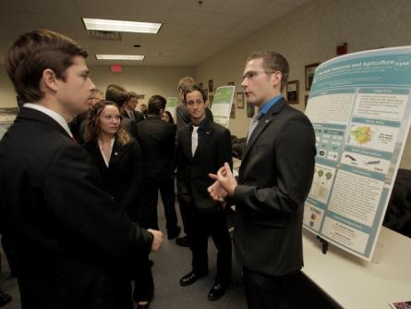
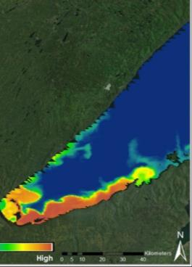
FY 2016 Project Stats
Fall 2015
109 Participants working on
27 Projects with
63 Partners & End-Users
Spring 2016
107 Participants working on
26 Projects with
57 Partners & End-Users
Summer 2016
138 Participants working on
30 Projects with
70 Partners & End-Users

Slide 3
Fall 2016 Stats

Slide 4
Project Lifecycle
Science
National Science Objectives
Program Managers
Science Advisors
Decadal Survey
Partners / End-Users
Community Demand
Local Policy Makers
State Governments
Federal Agencies
Applied Sciences Program
Project Execution
Partner with stakeholder
Support from science advisors
Data acquisition, processing, analysis
Creation of deliverables
Outreach
Present at Science & Policy conferences
Virtual Poster Session (VPS)
Recruiting events
Publications
Capacity Built:
Future Workforce
Capacity Built:
Partner Organizations
Capacity Built:
State/Local/Federal
Governments
Capacity Built:
General Public

Slide 5
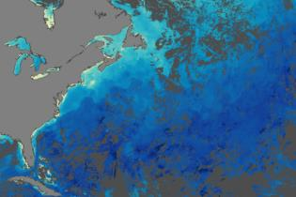
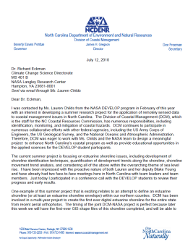
Project Characteristics
80+ projects take place each year - at their core they share these characteristics:
Highlight the applications and capabilities of NASA Earth observations
Address community concerns relating to decision-making for real-world environmental issues
Partner with organizations who can benefit from using NASA Earth observations to enhance decision making by providing decision support tools
Align with at least one of the nine NASA Applied Sciences Program’s National Application Areas
Research is conducted by teams with diverse backgrounds under the scientific guidance of Science Advisors and mentors from NASA and partner organizations

Slide 6
2016 Fall Portfolio
Ethiopia Disasters (FC)
Mississippi River Basin Disasters (MSFC)
Navajo Nation Climate III (ARC)
Rocky Mountain National Park Climate (FC)
Glacier National Park Climate (LaRC)
Levant-Central America Climate (NCEI)
Elkhorn Slough Eco II (ARC)
Kenya Eco (GSFC)
Southern Arizona Eco (JPL)
Everglades Eco II (LaRC)
Eastern India Eco (UGA)
Maricopa County Health & AQ (AZ)
Costa Rica Ag II (JPL)
North Carolina Water (GSFC)
Southeastern Idaho Water (MCHD)
Western US Water II (LaRC)
Southeastern Arizona Water (MCHD)
Lake Victoria Water III (MSFC)
Atlanta Water III (UGA)
Northern Great Plains Water II (WC)
Grand Canyon Water (WC)

Slide 7
Project Team Responsibilities
Set goals and work towards them.
Complete all mandatory deliverables and weekly updates, as well as any optional deliverables the team decides.
Please respect the chain of command within the team - project team members report to Project Leads, who report to Center Leads, who report to NPO. However, don’t feel bogged down by the chain of command - DEVELOP fosters open communication between all levels!
Leave organized documentation of all research and contacts so the project and/or communication with end-users may be continued in following terms.
Cleanup team rooms and office space daily (common areas, etc.) – respect your office mates and stay orderly.
Look at what else needs to be done when you have completed the tasks your Project Lead(s) and Center Lead(s) have assigned. Take initiative!
Have an open mind & learn from each other!

Slide 8
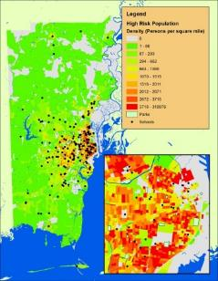
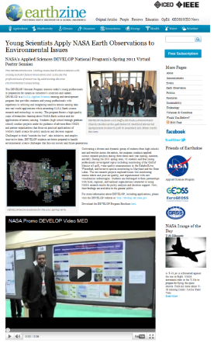
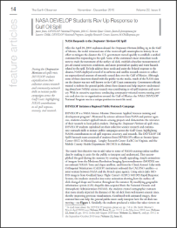
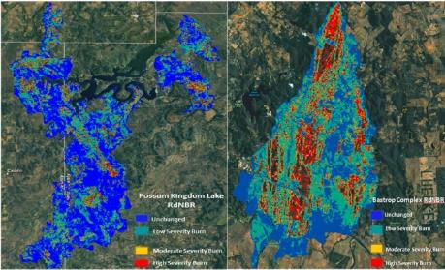
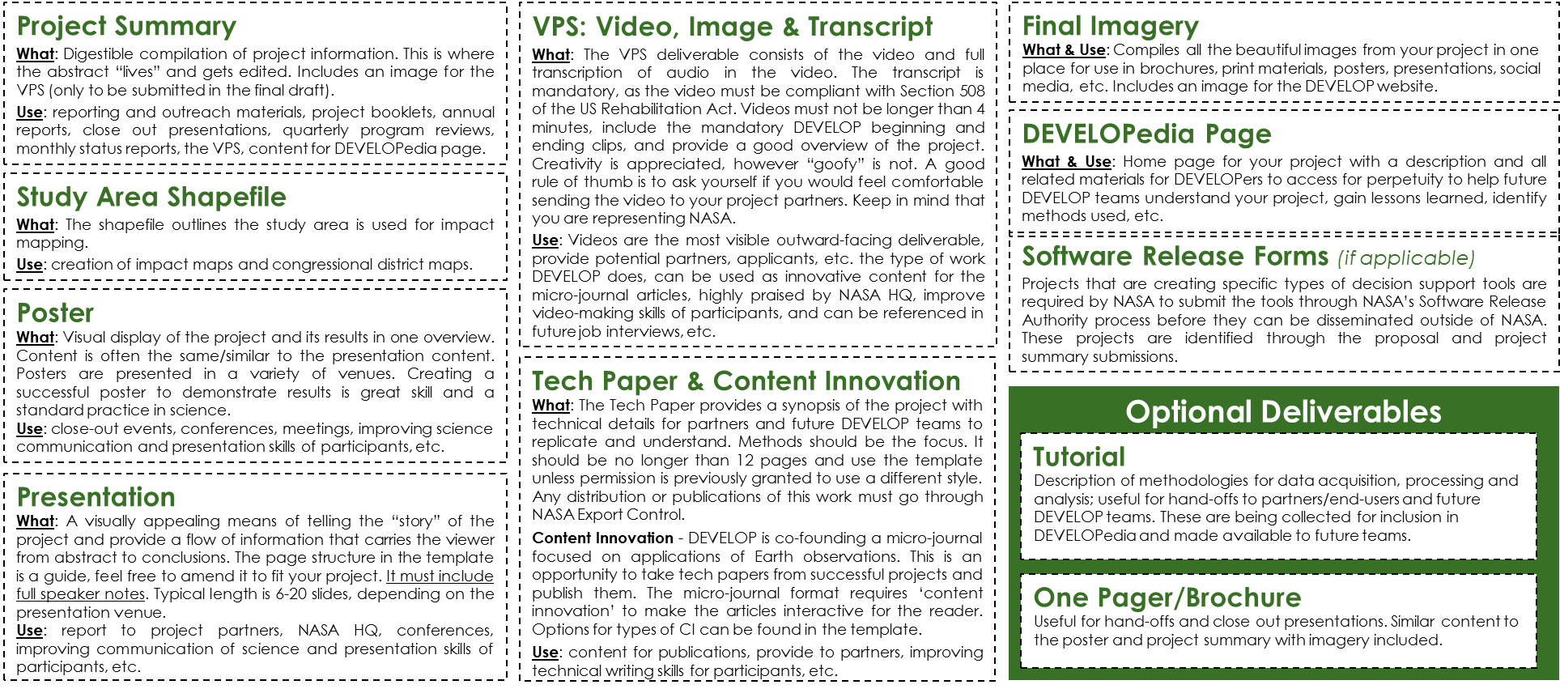
Mandatory Deliverables

Slide 9
Deliverable Submission Process
1. Template
Make sure you are using the right template and the template font and formatting is intact (especially if your team used Google Docs to collaborate on the text)!
2. Nomenclature
YearTerm_Node_Team_Deliverable_Draft
Use this for EVERYTHING! (all deliverables and any separate attachments - images, etc.)
Examples: 2016Fall_LaRC_NorthCarolinaWater_Poster_FD
2016Fall_LaRC_NorthCarolinaWater_Imagery_legend
3. Center Lead & Science Advisor Review
Center Leads and Science Advisors should review and approve prior to submitting to NPO
Work in time for this! They are busy people!
4. Submit:
Submit deliverables by emailing them to Tiffani & the DEVELOP Project Coordination gmail.
There is a 20MB limit, so use NASA’s Large File Transfer System or Google Drive to share larger files.
If there are any issues or delays, email the PC Team at DEVELOP.ProjectCoordination@gmail.com.
5. Archive:
All teams should ensure that a final, clean set of all deliverables is archived locally at their node.

Slide 10
Deliverable Submission
Email
Tiffani.N.Miller@nasa.gov
DEVELOP.ProjectCoordination@gmail.com
Too large for email? Send through NASA LFT or Google Drive
Nomenclature
YearTerm_Node_Team_Deliverable_Draft
Ex. 2016Fall_LaRC_NorthCarolinaWater_Poster_FD
Node Acronyms:
ARC, AZ, FC, GSFC, ID, JPL, LaRC, MCHD, MSFC, NCEI, UGA, WC
App Area Shorthand:
Ag, Climate, Disasters, Eco, HealthAQ, Water

Slide 11
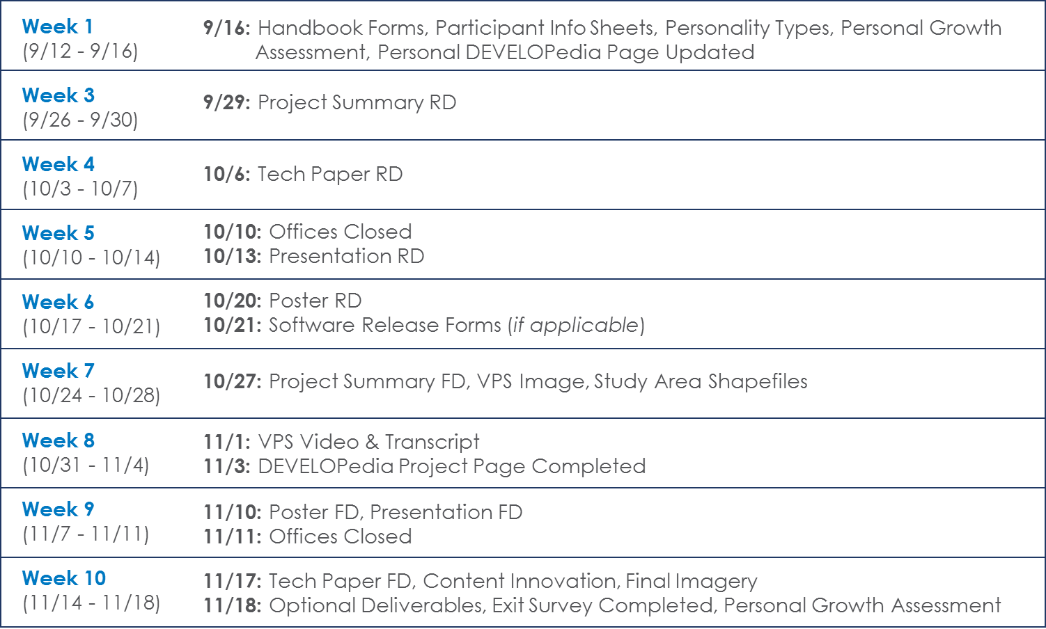
Deliverable Deadlines to NPO

Slide 12
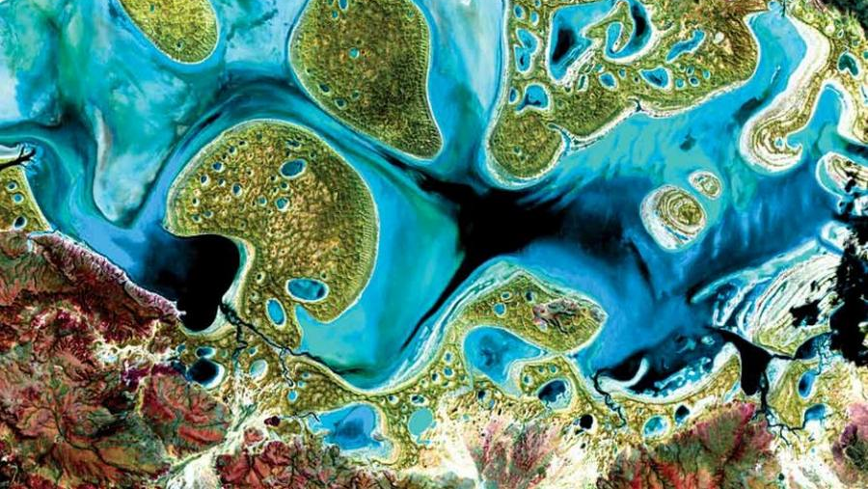
Required Legal Statements
All deliverables/products created by teams need to include this short paragraph of legal statements:
This material is based upon work supported by NASA through contract NNL11AA00B and cooperative agreement NNX14AB60A. Any mention of a commercial product, service, or activity in this material does not constitute NASA endorsement. Any opinions, findings, and conclusions or recommendations expressed in this material are those of the author(s) and do not necessarily reflect the views of the National Aeronautics and Space Administration and partner organizations.

Slide 13
Scientific Integrity
“The iconic success of NASA is planted firmly on three foundational elements: innovation, inspiration, and integrity. While innovation and inspiration are visible through our endeavors and successes, it is our integrity – how we work, and our commitment to excellence and openness – that earns us the trust of the public and ensures our continued ability to inspire and innovate. Integrity is woven throughout the fabric of NASA. It has always been there. And each and every day, we recommit ourselves to keeping it there.”
Dr. Waleed Abdalati
Former NASA
Chief Scientist
NASA SI Policy: http://www.nasa.gov/pdf/611201main_NASA_SI_Policy_12_15_11.pdf

Slide 14
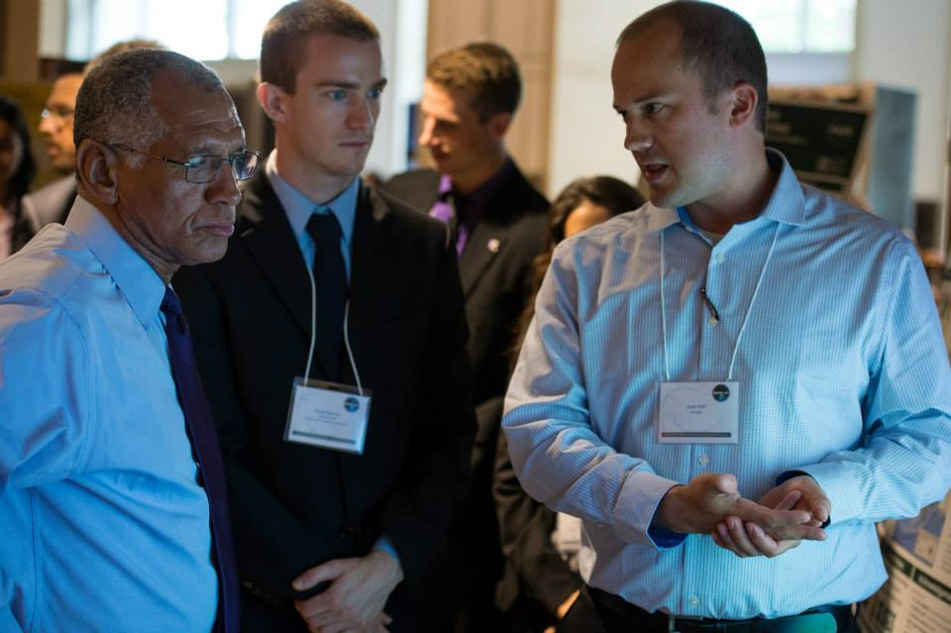
Partner Types: Definitions
Often, DEVELOP teams use the terms ‘partner’ and ‘end-user’ interchangeably. However, there are some distinct differences relating to these terms, and thus the standardized definitions of typical DEVELOP partners are provided.

Slide 15
Partner Types: Definitions
Partner: Umbrella term for any outside organization DEVELOP engages with through projects, nodes, or other activities
Types of Partners
End-User: Organization or individual that receives results and methodologies from DEVELOP (either directly from a DEVELOP project team or through a collaborator/boundary organization) and can use the project’s products or methodologies to make a decision or policy. They may also provide some kind of resources (advising, data, model, software, funding, etc.), but it is not required.
Ex. The Texas Forest Service’s Predictive Services that can use the products/methodologies from the DEVELOP project in their risk mapping creation.
Collaborator: Organization or individual that works directly with a DEVELOP project team and provides some kind of leveraged resource (advising, data, model, software, funding, etc.), but are not actually using the project’s products or methodologies to make a decision or policy.
Ex. A researcher from a university who provides a team with an ancillary dataset to validate their results.
All partners are either end-users (using the results or products to make a decision) or collaborators (not using the results or products to make a decision).

Slide 16
Partner Types: Definitions
Partner: Umbrella term for any outside organization DEVELOP engages with through projects, nodes, or other activities
Types of Partners
Both end-users and collaborators can also be boundary organizations.
Boundary Organization: Organization or individual that disseminates the project’s results to other end-users, decision-makers, policy-makers, etc. The Applied Sciences Program defines a boundary organization as “an organization outside of your own that broadens your reach across the boundary into the operational domain (i.e. policy-makers, decision-makers, and other key stakeholders).”
Ex. The Smithsonian Conservation Biology Institute works with local groups in Myanmar and helped DEVELOP disseminate results from the Myanmar Ecological Forecasting project to those in-country groups.
All Partners
Collaborators
End-Users
Boundary Organizations

Slide 17
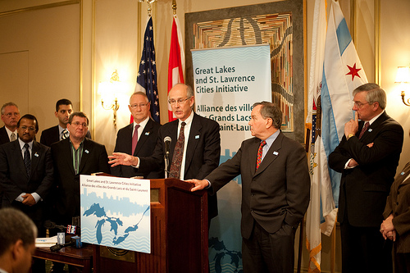
Partner Engagement & Communication
A cornerstone of DEVELOP projects is the engagement of management and policy makers who can benefit from the integration of NASA Earth observations in their decision making process. All DEVELOP projects strive to engage at least one decision-making organization to hand off project results and methodologies to.
The FY15 Project Coordination Fellows created a DEVELOP Partner Engagement Manual to further bolster this process.
Communication Strategies Commonly Employed:
Open communication lines with your partners, see what their needs and meeting abilities are, devise a plan, then be flexible!
Team-Partner greeting telecon during the first or second week
Weekly or bi-weekly telecons & emails with status updates
Hand-off event at the end of the term

Slide 18
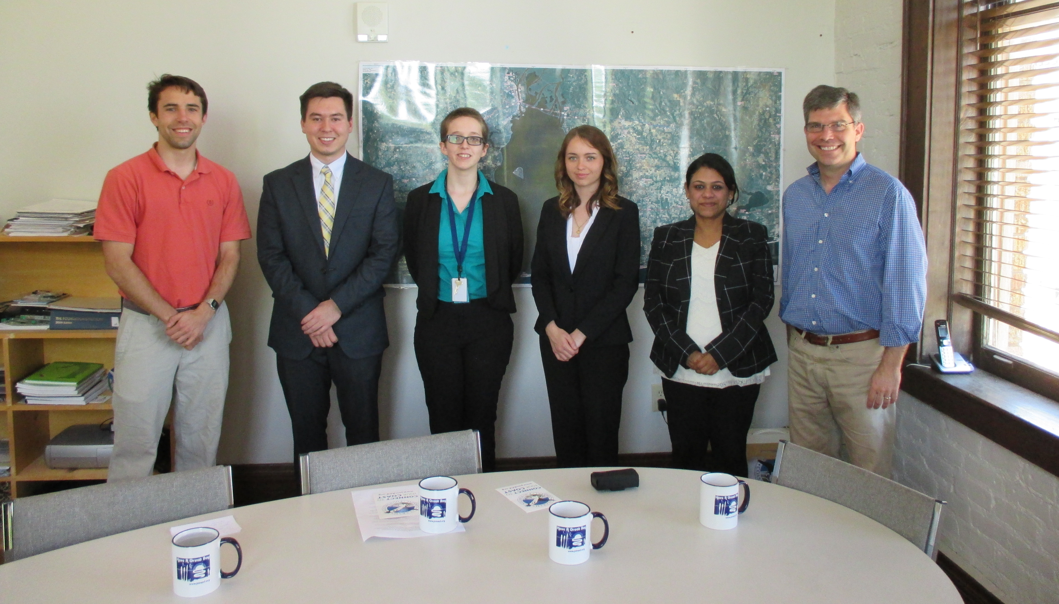
Partner Communication – Best Practices
Dependability – If you say you are going to call them Thursday at 1 PM, then be sure to call them at 1 PM on Thursday. If you say you are going to find them a piece of information, then be sure to find it and send it to them.
Honesty – Being candid with your partner is critical to gaining their trust. We all like sharing good news, but bad news is important in a partnership, too. Don’t omit information just because you feel that it won’t please the partner to hear. Don’t mask the truth just to paint the picture you think they want to see.
Passion – Show your enthusiasm for your work and their partnership. If they believe you are personally invested in the project and them as a partner, then they are much more likely to put their trust in you.

Slide 19
Checklist: Working with Partners
Ensure professionalism in all interactions - you are representing yourself, your team, your advisors, your node, DEVELOP, Applied Sciences, and NASA!
Have a plan and schedule.
Be realistic in what you promise and the expectations of the partner, in fact don’t “promise” anything, but ensure the plan you are working to is clear and that there is a healthy understanding of challenges and potential obstacles/risks.
Keep in mind the limitations of resolution (spatial and temporal) of NASA data and work within them.
Understand the partner’s needs - what kind of data/tools are useful, what software do they have access to, what tutorials or products would be helpful?
Keep communication lines open and ensure the team follows through. Generally speaking, the Project Lead should be the POC for communicating with a partner unless it is specifically delegated to another team member.
All emails to partners should be approved by the Center Lead, and you should always CC the Center Lead.
Include your project’s Science Advisor in partner communication as much as is possible per your advisor’s availability

Slide 20
Pre- and Post-Project Partner Forms
A Pre-Project Partner Form was sent out before the term to gather information about partner needs and expectations. A Post-Project Partner Form will follow the completion of the term to collect information regarding the perceptions of success of collaborating with DEVELOP.
Were the project results and methodologies useful?
Was the experience a good one?
Is the partner using the results or methodologies in their decision-making process?
Timeline: Center Leads sent out the Pre-Project survey link a couple weeks before the beginning of the term. The Post-Project survey link will be sent to partners at the end of the term. In case of a project that has multiple terms, the survey goes out following the project’s final term.
Please communicate to your partners that DEVELOP will stay in touch and send a brief survey at the end of the project’s final term.

Slide 21
Understanding Partner Needs
Prepare for your first team communication with your partner by compiling questions relating to the following areas. Discuss this with CLs, look at responses to the pre-project form, and build off previous conversations with the partner. The following questions can guide you in understanding your partner’s needs:
Community Concern or Policy
Background, current policies, and upcoming/ongoing decisions relating to the issue at hand
Economic impact (ex. cost of fighting a wildfire or drought impacts to crops in a region)
Technology
Do they currently use GIS and/or remote sensing?
What data types are they familiar with?
Do they have access to Arc/ENVI/Matlab/etc. or whatever software you will use? If not, would they be able to purchase it? (this can guide the team’s use of open source software)
Partnership and Transition
Clarify expected level of involvement - how much can the partner interact with the team?
What organizations do they partner with?
What tutorials would be of use? What format should end-products be in to be useful?
What is the best transition approach? Email, telecon, videocon, in-person (consider distance for this one - if you’re 3000 miles apart choose a different option unless the partner can fund)

Slide 22
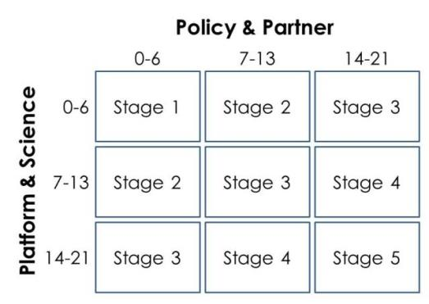
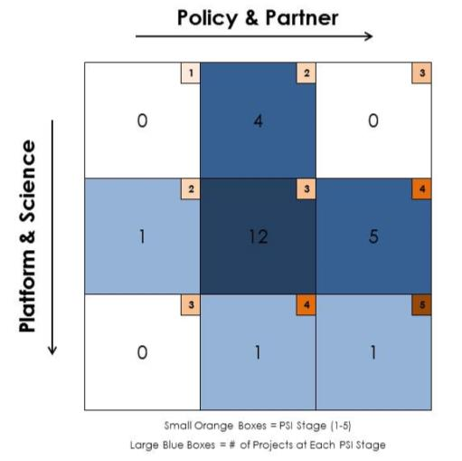
DEVELOP Project Strength Index (PSI)
DEVELOP projects have consistently improved and matured over the Program’s last 15+ years. A means of assessing project progression and comparing project success has, to date, been subjective. This project strength index provides DEVELOP a means of objectively evaluating projects and tracking progress.
A series of questions are answered earning a total of 21 points in two sections: 1. Policy & Partner and 2. Platform & Science. The score for each category is then placed on the index to receive the project’s current stage (1 to 5).
Stage 1: Basic Research
Stage 2: Application Concept Complete
Stage 3: Application Demonstration Successful
Stage 4: Application Verified / End-User Engaged
Stage 5: Transition to End-User / Decision Enhanced

Slide 23
Presenting & Publishing DEVELOP Work
For purposes of ensuring appropriate export control review, performance metric tracking, and reporting to NASA HQ, any and all presentations or publications related to DEVELOP (projects or the program in general) must be communicated to, and content shared with, the NPO before submission of the presentation or publication.
Submitting work for presentation or publication is encouraged; however, ALL research is the property of NASA and therefore, you must have permission prior to submitting your research anywhere. Also, to minimize duplication of effort, the NPO oversees all publications and presentations.
Coordinate with your Center Lead and, if approved at your node, send a simple email with your ideas before the presentation or publication to Karen.N.Allsbrook@nasa.gov and Lauren.M.Childs@nasa.gov with the following information:
Description of the activity - conference, presentation to a class, publication, etc.
Timeline for the activity - when the event is or deadline for publication, etc.
A copy of the material/content (because often presentations can be large, a PDF is good enough for a quick review)
Cost estimate
Thank you for your consideration and help with this!

Slide 24
NASA’s Export Control
What is a Export Control?
The NASA Export Control Program is based on the philosophy: “We want to maximize the benefits of our international efforts while ensuring that we comply with U.S. export control laws and regulations”. This is the personal responsibility of each employee or contractor to pursue appropriate international activities involving transfers of technologies, software, and commodities. The Agency’s Export Control Program is the mechanism that provides checks and safeguards at key steps to help manage international activities and ensures that NASA works within Export Administration Regulations (Department of Commerce) and the International Traffic in Arms Regulations (Department of State), which could result in criminal, civil, or administrative enforcement actions against NASA, individual employees, and/or private contractors.
NASA Administrator’s Export Control Policy:
"As a U.S. Government Agency on the forefront of technological development and international cooperation in the fields of space, aeronautics, and science, the National Aeronautics and Space Administration will strive to fulfill its mission for cooperative international research and civil space development in harmony with the export control laws and regulations of the United States. Due to heightened proliferation challenges facing the United States and the world, including risks posed by the spread of missile technologies and weapons of mass destruction, and in view of the significant criminal, civil, and administrative penalties that may affect the Agency and its employees as a result of a failure to comply with U.S. export control laws and regulations, it is the responsibility of every NASA official and employee to ensure that the export control policies of the United States, including nonproliferation objectives, are fully observed in the pursuit of NASA's international mission."

Slide 25
Export Control & Designated Countries
What is a Designated Country?
This list of “Designated Countries” is a compilation of 41 countries with which the United States has no diplomatic relations, countries determined by Department of State to support terrorism, countries under Sanction or Embargo by the United States, and countries of Missile Technology Concern.
What does this mean to me?
It means that for any project deliverables, products, decision support tools, etc. to be transferred to any partner (domestic or international) a review must take place first. The NPO ensures that DEVELOP works within NASA Export Control guidelines. The NPO must be made aware of any presentations, publications, or information transfer that take place before they occur. A transfer can be an email, publication, presentation, telecon, webinar, etc. Communication with partners in designated countries has restrictions, so coordinate with NPO ahead of opening communication lines.
But my partner is domestic/not in a designated country?
While your project partner may be in the United States or not on the designated country list, the assumption is that anything that leaves the Agency/DEVELOP could be in turn transferred to any individual or organization anywhere and thus we must ensure that all material is appropriate for a global audience.
Questions? Contact Lauren.M.Childs@nasa.gov
NASA Export Control: http://oiir.hq.nasa.gov/nasaecp/index.html

Slide 26
NASA’s Software Release Authority
What is NASA’s Software Release Authority? NASA’s process for formally giving approval for software and tools to be released to the public for marketing, distribution, and use. All new “software” developed by NASA-funding must be made available through the Software Release Process, which coordinates export control review, intellectual property review, commercialization assessment, and software release actions and determines if it meets NASA policies and guidelines.
Process involved:
Identify which projects are creating the types of tools that must go through SRA by means of the proposal and project summary deliverables
To review the full process and steps involved - visit: www.devpedia.developexchange.com/dv/index.php?title=Open_Source_Software_Development_and_Release
Other considerations:
All software released through NASA DEVELOP will be released open source.
All software released through NASA DEVELOP will be distributed through the NASA DEVELOP GitHub account after Software Release Approval. Caution partners that this may not occur during the term.
For questions about this form, refer to DEVELOPedia: Open Source Software Development and Release or contact Katie Moore at Kathleen.D.Moore@nasa.gov
You cannot handoff any coding tools/short scripts the team created to a partner until the software release process has been completed
You cannot include any lines of code in presentations or videos, even after completing SRA

Slide 27
Interacting w/ the Media
NPO and NASA Public Affairs must be involved with all media interaction from the beginning.
If you are interested in working with the media, contact NPO first.
If someone from the media reaches out to you, contact NPO about a response or connect them with NPO directly.
NPO POC – Lauren Childs-Gleason
Lauren.M.Childs@nasa.gov

Slide 28
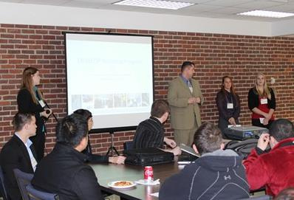
Hand-Offs
Hand-offs are an important step in transitioning results and methodologies to end-users, and working towards the goal of the end-user integrating NASA Earth observations in their decision making process.
Commonly Used Hand-off Styles
Email of deliverables (tech paper, tutorials, presentation, etc.)
Teleconference or videoconference presenting the results and methodologies
In-person presentation of results and methodologies
Get creative in how and what you hand-off. Interesting idea? Speak to your Center Lead about it!
Depending on what you are handing off, be cognizant that you must get them approved by NASA prior to handoff.

Slide 29
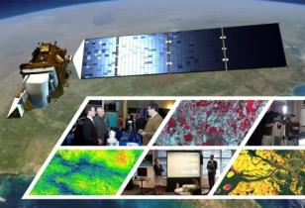
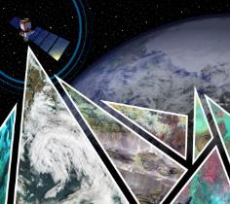
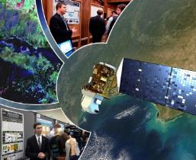
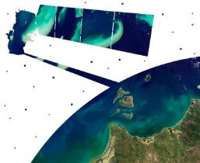
Virtual Poster Sessions
What is a Virtual Poster Session?
Since 2011, DEVELOP has regularly collaborated with IEEE’s Earthzine to showcase the work of participants through a series of ‘virtual poster sessions’ or VPS. Each VPS includes an impressive array of abstracts, videos, and other material on each DEVELOP project. A blogging period with question-and-answer discussion allows the teams to interact with the global community and share their work.
Thousands of people from around the world participate in the VPS – For example, the 2015 Spring VPS had visitors from 87 different counties with 3500 video views!
Key Dates:
VPS Video and Transcript – due Week 8
VPS Launch – Week 10
Bonus: The winning team receives a prize package from VPS sponsors (geospatial software)
DEVELOP VPS Archive: www.earthzine.org/vps-archive/

Slide 30
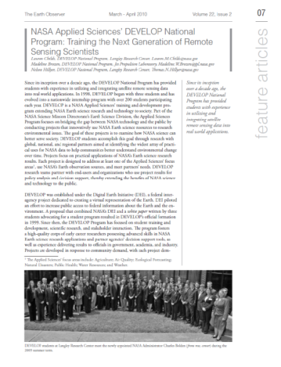
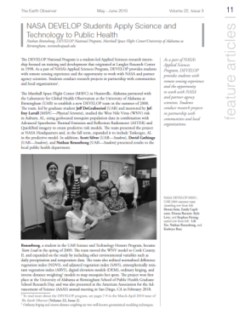
Publications
Publications are a huge avenue for getting the word out about the great research you are a part of with DEVELOP!
DEVELOP has a handful of peer-reviewed publications to date.
Currently, DEVELOP publishes frequently in Earthzine, Directions Magazine, and The Earth Observer
If you are interested in working your project toward a potential publication, contact your Center Lead, Lauren & Carrie.
Reminder: All publications must be approved by NPO and NASA’s Export Control process before submission!

Slide 31
Publication Process
Coordinate with your Center Lead first
Contact Lauren & Carrie with initial interest
Select publication venue and draft article
If this happens during the term, the article draft can replace the tech paper. Email the Project Coordination Team if you plan to do this.
Submit draft to NPO for review before submitting to the journal
Comm team and project team go back and forth with edits to create a final submission
NPO submits final version into export control - NASA Export Control takes about 2-3 weeks.
Once approved, the content can be submitted to publication venue
Keep Lauren in the loop with any and all edits from venue
The final-final version must be resubmitted to NASA Export control
Submitting work for presentation or publication is encouraged; however, ALL research is the property of NASA and therefore, you must have permission prior to submitting your research anywhere. Also, to minimize duplication of effort, the NPO oversees all publications and presentations.
Step by Step Publishing Process
Initiate Communication w/NPO
Send Manuscript to NPO for Review Feedback & Edits
Write Manuscript & Review at Node (Includes Advisor)
Node Creates Final Version, Returns to NPO
NPO Submits to Export Control & Gains Approval
Node Submits to Publisher
Back & Forth Edits w/Publisher
Publisher Approves & Article Published
Following NPO Approval, Pursue Communication w/Publisher

Slide 32
DEVELOPedia
DEVELOPedia is an internal wiki intended to serve three purposes:
Enhance project workflow
Capture lessons learned and make them available to future project teams
Record data required for operational metrics
DEVELOPedia is a collaborative effort whose utility is directly related to the efforts of previous DEVELOP participants.
DEVELOPedia is a living document, constantly adapting to meet the needs of the NASA DEVELOP National Program and the people that make the program great. (That’s you!)
http://www.devpedia.developexchange.com
POC – Jordan Vaa

Slide 33
Resources
DEVELOP Handbook: Given to each participant at start of term, also on DEVELOPedia
DEVELOPedia: http://www.devpedia.developexchange.com/
You should have received information about your account just before the beginning of the term.
DEVELOP Website: http://develop.larc.nasa.gov/
Need Help?
Geoinformatics Team: DEVELOP.Geoinformatics@gmail.com
Project Coordination Team: DEVELOP.ProjectCoordination@gmail.com
Communications Team: DEVELOP.Communications@gmail.com
Graphic Design Team: DEVELOP.GraphicDesign@gmail.com
NPO-level questions - refer to the questions page in the About DEVELOP section and email the appropriate contact, unsure who? Ask your Center Lead.

Slide 34
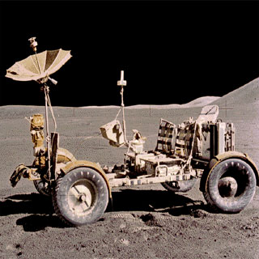
THANK YOU!
A lot goes into every DEVELOP project. What will your project’s legacy be?

