Slide 1

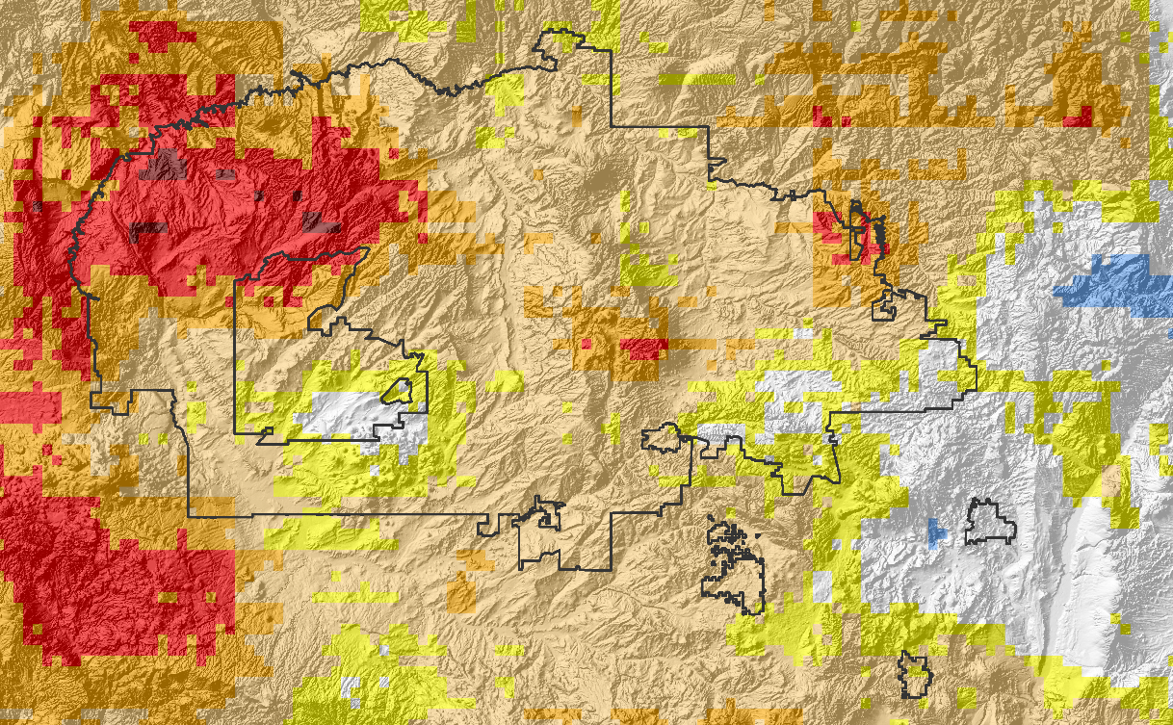
Lauryn Gutowski
NAVAJO NATION CLIMATE III
Madison Davis
Spatial and Inter-annual Variability of Drivers of Drought in the Navajo Nation
Christina Zapata
Notes:
This is the third and final term of the Navajo Nation Climate project. This term, the team members include Lauryn Gutowski, Madison Davis, and Christina Zapata. We looked at spatial and inter-annual variability of drivers of drought in the Navajo nation.

Slide 2
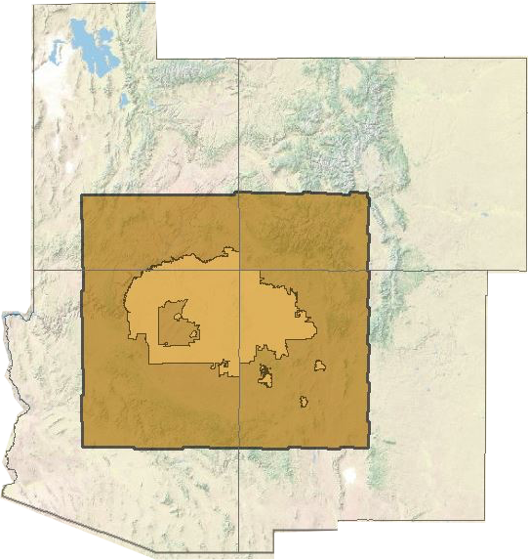
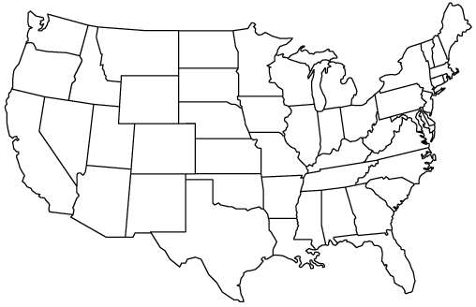
Study Area – The Navajo Nation
Study Period: August 1981 – August 2016
Notes:
Our study area is the Navajo Nation, located at the intersection of Arizona (AZ), New Mexico (NM), and Utah (UT). Our study period was chosen from the Climate Hazards Group InfraRed Precipitation with Station data (CHIRPS) timeline, August 1981 to August 2016.

Slide 3



Community Concerns
Decreasing Precipitation
Increasing Temperatures
1/3 of the population (~70,000 residents) are without water
Image Credit: Julle Edgly
Notes:
The climate in the Navajo Nation is inherently arid and dry. On top of that, climate change is projected to continue to decrease precipitation, increase temperatures and aridity, and exacerbate drought in the Navajo Nation.
The drought has lead to many impacts including rapid decline in range conditions, poorer crop yield, and shifting of plant ranges used for ceremonial and medicinal plants, seasonal dust storms creating infrastructure damage, seasonal dust storms
70,000 people, about 1/3 of the population are without direct access to public water systems and rely heavily on groundwater sources, which are failing to recharge due to prolonged drought.
Severe economic challenges will require that short-term water resource funds be allocated cautiously for anticipated and on-going long-term drought issues.
The Navajo Nation currently relies on an SPI calculation from the Western Regional Climate Center (WRCC) to monitor drought, however, these values are not provided at a spatial resolution fine enough to examine differences in drought severity across the entire Nation.

Slide 4
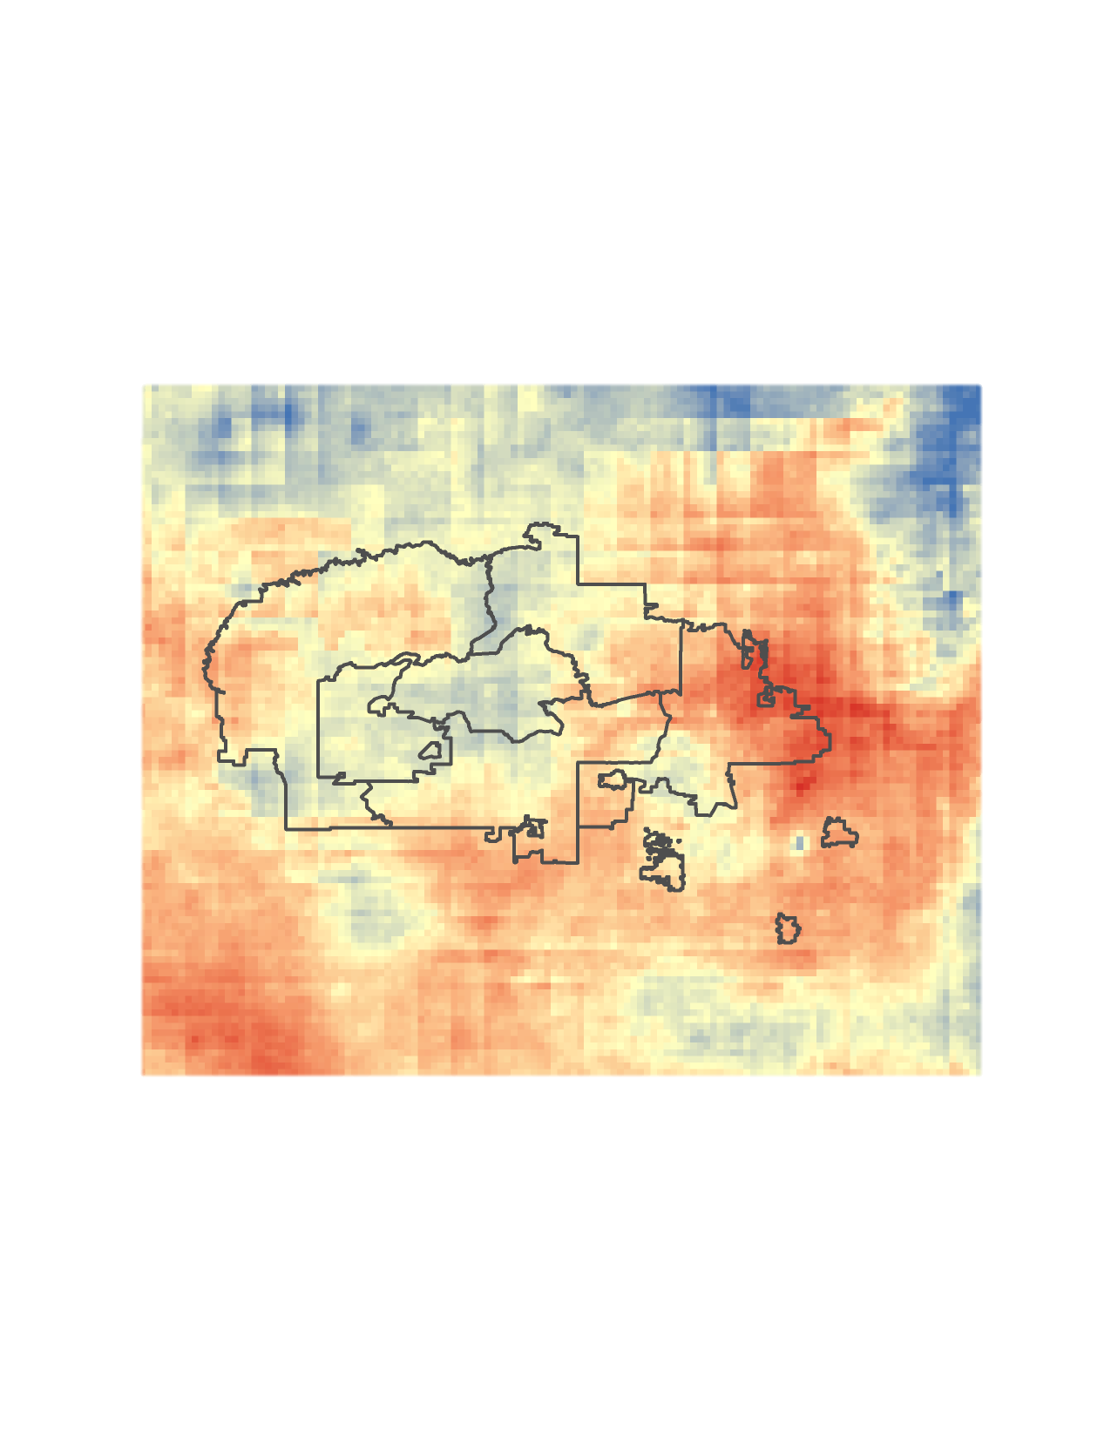
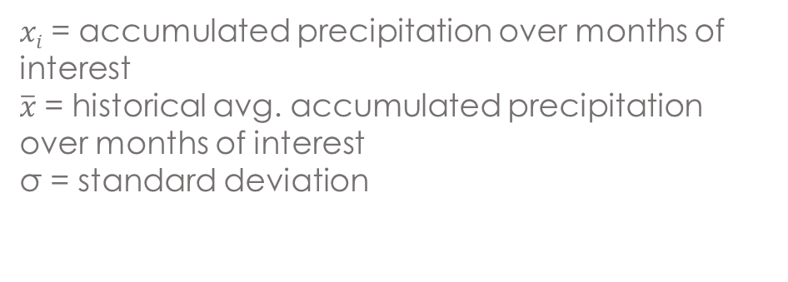
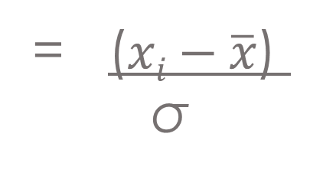
Standardized Precipitation Index
Standardized Precipitation Index
A probability based indicator of abnormally wet or dry time periods based on historical precipitation trends specific to the area.
SPI
= ($xi−\overline{x}$)
σ
$xi$ = accumulated precipitation over months of interest
$\overline{x}$ = historical avg. accumulated precipitation over months of interest
σ = standard deviation
Notes:
It is calculated by comparing precipitation at a given time of interest to historical avg. precipitation
the Navajo Nation uses the SPI to make monthly drought reports – indicating which areas are experiencing the most severe drought.

Slide 5
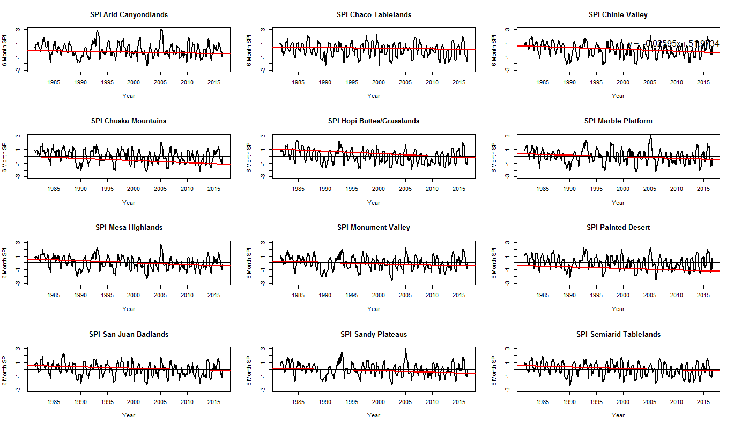
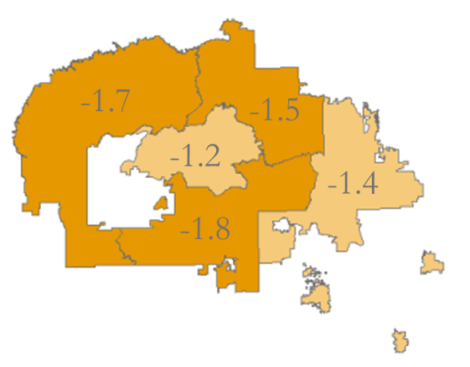
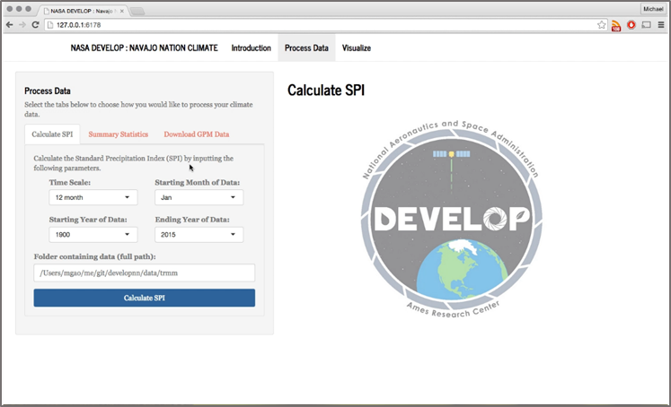
NASA DEVELOP & Navajo Nation
SPI
Methods
Term 1
Spring 2015
Historical
Geodatabase
Drought Severity Assessment Tool
(DSAT)
Term 2
Summer 2015
Produces an average SPI over a user specified area
Compare drought intensity over time
Drought analysis and statistics
Term 3
Fall 2016
Introduction of :
SNODAS, GRACE, & Terra MODIS
Tool validation with in situ rain data
Notes:
The DEVELOP Ames Navajo Nation Climate I and II teams created a decision support tool called the Drought Severity Assessment Tool 2.0 (DSAT 2.0) to improve visualization of user-specified zonal SPI statistics using (CHIRPS data). However, high annual and seasonal variation make it difficult to assess whether increasing drought trends are significant.
This term, the our team aimed to determine whether there are significant temporal and spatial trends of SPI from DSAT2.0,, and, additionally, sought to analyze other drought indicators such as root zone soil moisture, land surface temperature, and snow water equivalent.
The hope is to enable enhanced decision-making capacity regarding imminent economic and agricultural impacts from water resources scarcity in the NN.

Slide 6
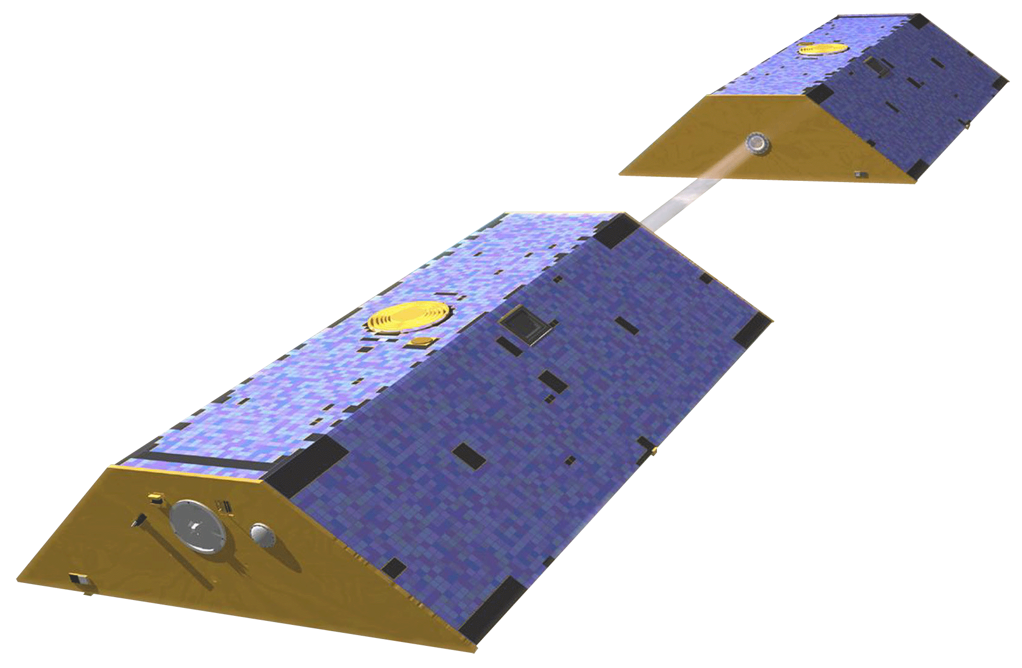

Term 3 Goals and Objectives
Validate DSAT2.0 CHIRPS data with rain gauge data
2. Analyze statistical trends and relationships within and across
  CHIRPS precipitation
  DSAT 2.0 Standard Precipitation Index (SPI)
  Assimilated GRACE - Root Zone Soil Moisture (RZSM)
  Terra MODIS Land Surface Temperature (LST)
  SNODAS Snow Water Equivalent (SWE)
3. Determine what historical trends are likely to inform us about ongoing drought conditions
Notes:
The prevailing objectives we had for this term were to:
1) validate DSAT 2.0 by comparing SPI values with observed precipitation measurements and recorded drought anomalies
2) identify spatial and temporal trends in each of the drought variables we studied
3) and from these analyses, draw conclusions about ongoing drought conditions in the Navajo Nation, in a historical context
And now I’ll hand off to Christina who will speak more about the observations we used

Slide 7
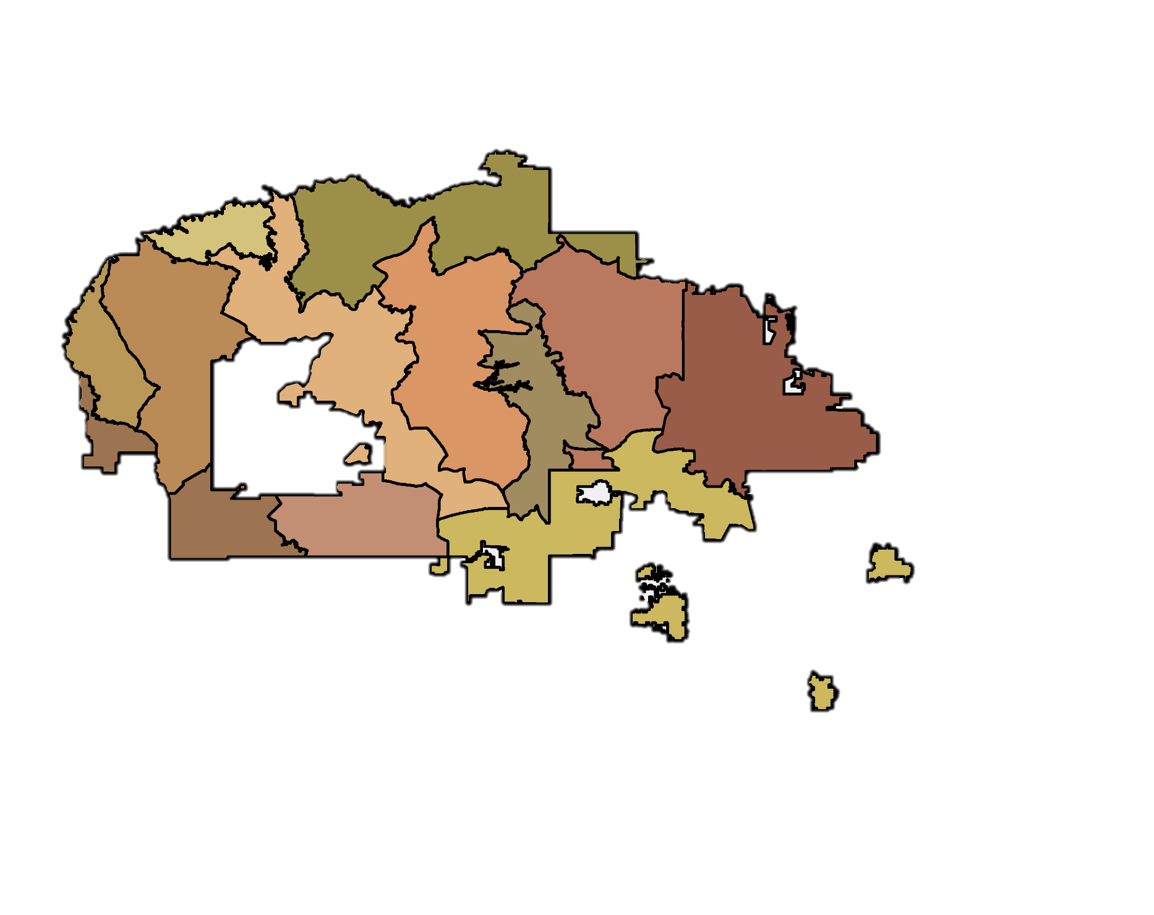
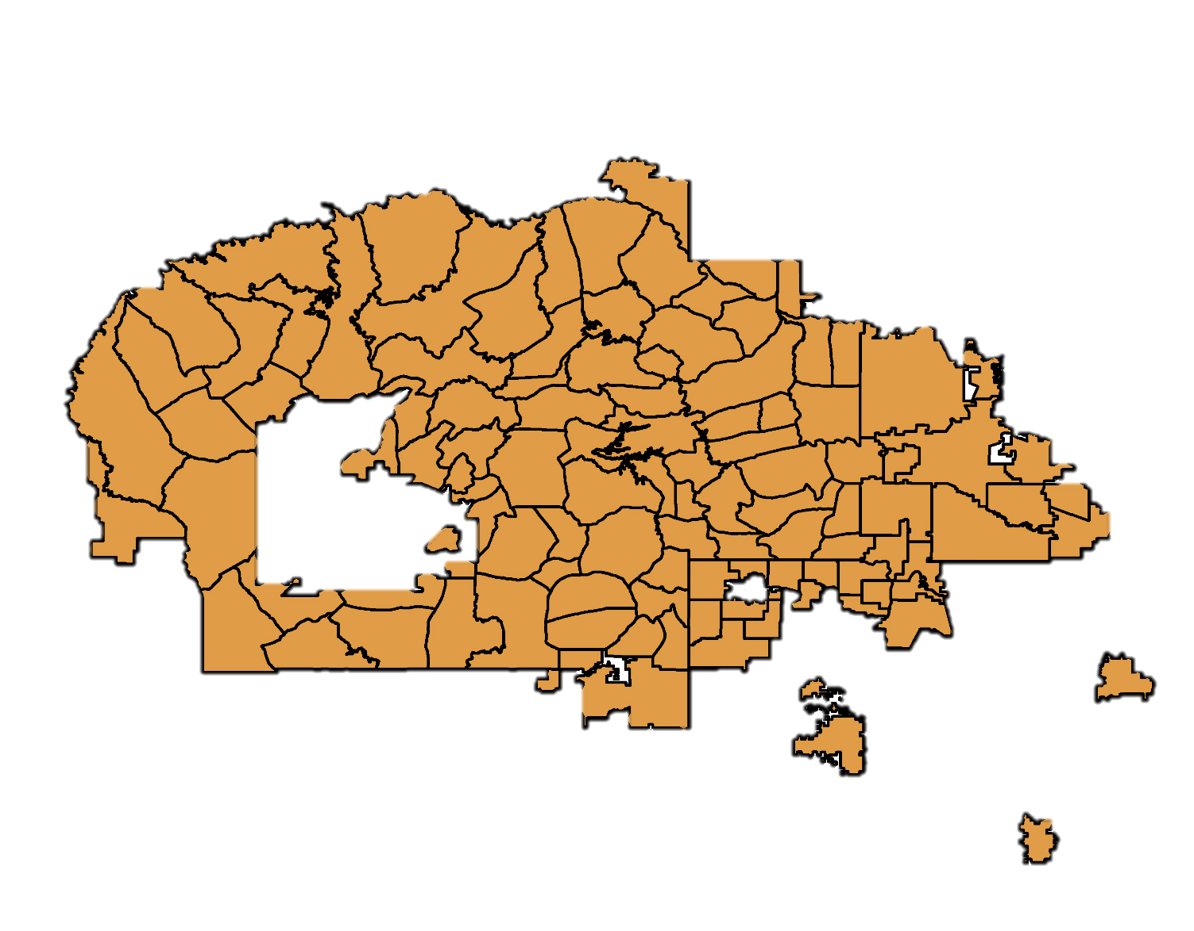
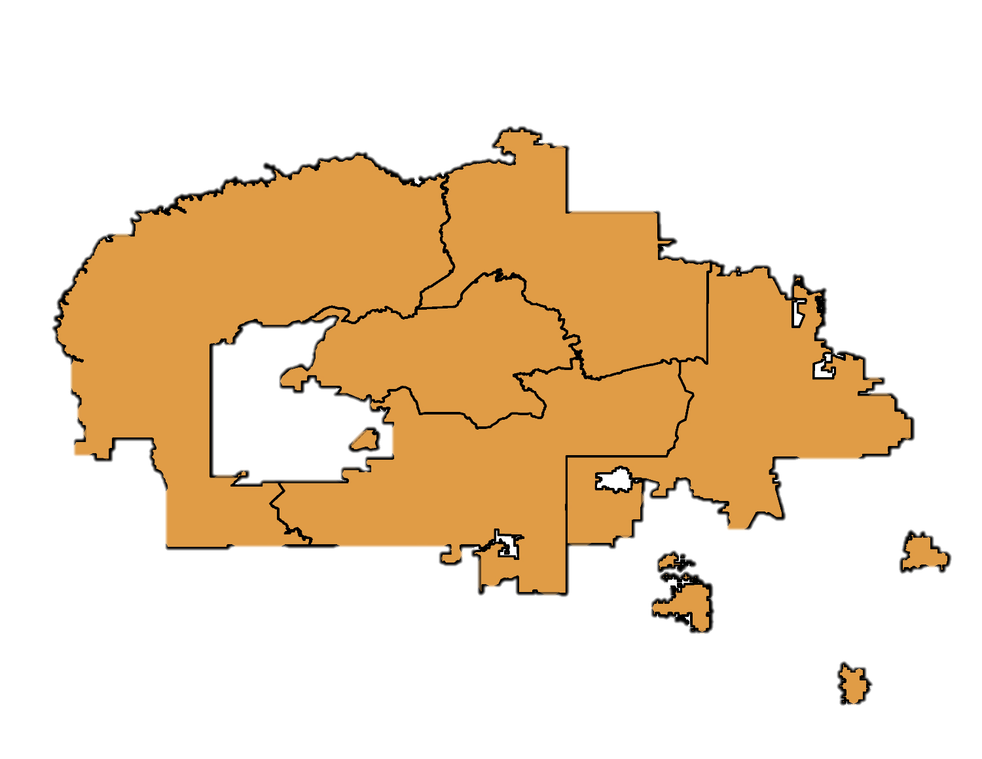
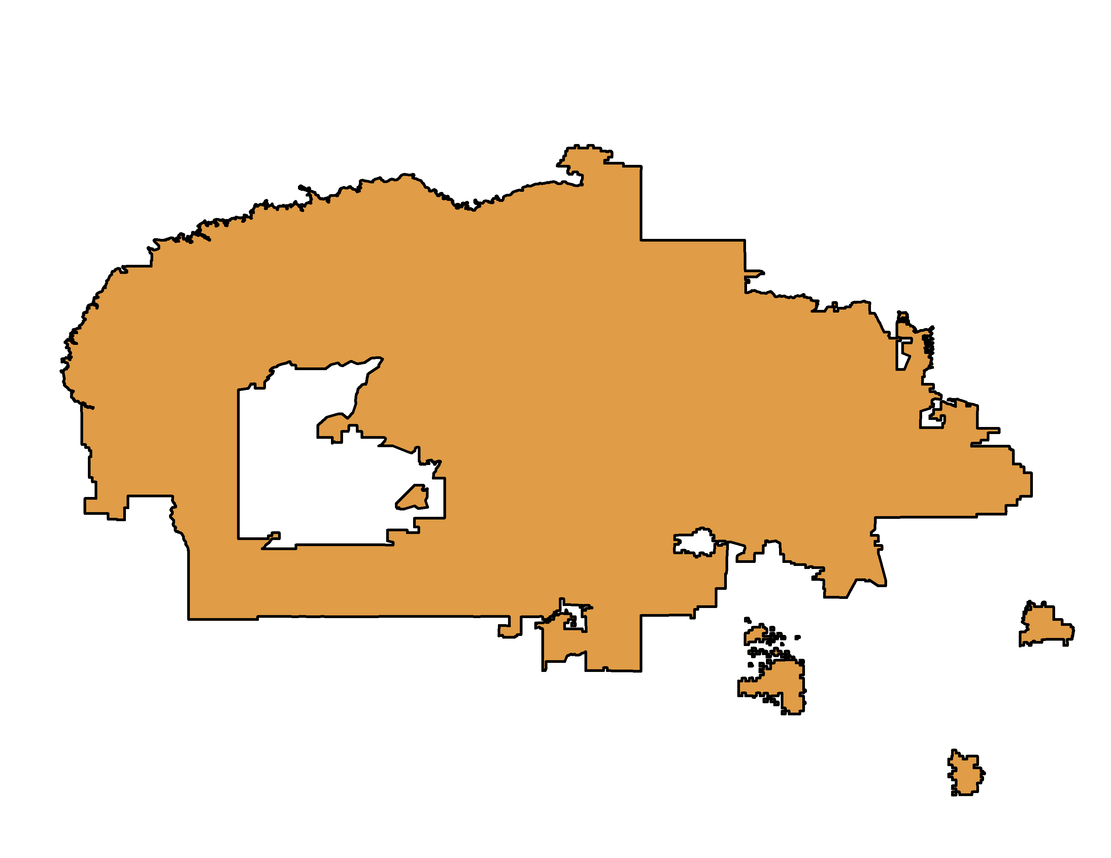
Drought in the Navajo Nation
Agency Boundary
Utah
Chapter Boundary
Our Climate Zones
New Mexico
Arizona
Notes:
The Nation, located at the 4 corners, is divided into agencies
and chapters for administrative purposes. However, the varying climatic and eco-regions that fall within each agency make this unit of analysis too large and diverse for our study, but the sheer number of chapters (110), make this unit of analysis too small, so, for the first part of our project, our team created regions on which to base our statistical analysis.
We followed chapter boundaries, grouping chapters together by similar climates, precipitation, and elevation. We have 12 regions, which allows for a more targeted analysis of drought trends, given the similarity in weather patterns among grouped regions.

Slide 8
Earth Observations & Parameters
PARAMETERS
O
B
S
E
R
V
A
T
IO
N
S
Root Zone Soil Moisture (RZSM)
Tropical Rainfall Measuring Mission (TRMM)
+
precipitation climatology (CHPClim)
+
thermal infrared observations (NOAA)
+
atmospheric model rainfall fields (NOAA)
Land Surface Temperature (LST)
Satellite data (GOES, AVHRR, SSM/I, MODIS)
+
Airborne Snow Survey Program
+
Ground station data (SNOTEL & others)
Snow Water Equivalent (SWE)
Terra MODerate Resolution Imaging Spectroradiometer (MODIS)
Gravity Recovery and Climate Experiment (GRACE)
Precipitation
Standardized Precipitation Index (SPI)
Model Outputs:
SNODAS
Model Outputs:
CHIRPS
Notes:
We have several datasets from which we obtain our drought indicators.
We use ASSIMILATED Gravity Recovery & Climate experiment, or GRACE for root zone soil moisture, RZSM, which are in units of mass of water per top m3.
Terra Moderate resolution Imaging spectroradiatometer Terra MODIS, for land surface temperature, LST, roughly in Kelvin
Satellite data, airborne, and ground data used to update snow and mass energy balance and snow forecasts in SNOw Data Assimilation System (SNODAS) ~1 km, available at daily snapshots from October 1, 2003 to August 31, 2016. Units are in mm of water.
NASA and NOAA satellite, in-situ data are used to update precipitation forecasts in Climate Hazards Group InfraRed Precipitation with Station data (CHIRPS) at 0.05° resolution. Precipitation is used to calculate a moving average or normalized standardized precipitation index (SPI).

Slide 9
Methodology
PARAMETERS
Root Zone Soil Moisture (RZSM)
Validate DSAT 2.0 and calculate SPI statistics
Land Surface Temperature (LST)
Analyze trends over time (yearly, monthly, seasonal) and how they relates to drought
Snow Water Equivalent (SWE)
Precipitation
Standardized Precipitation Index (SPI)
Examine SWE time series where ground observations are unavailable
Notes:
First we validated DSAT 2.0 using ground weather station precipitation data from ground weather stations.
We then explored for significant interannual and spatial drought trends.
Finally we examined how SWE is changing temporally for locations where ground observations are unavailable.

Slide 10
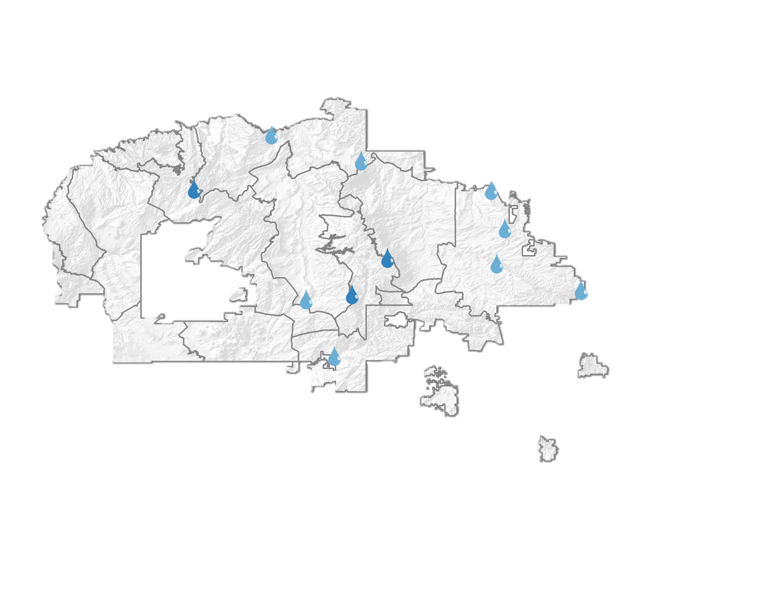
Results – Validating DSAT 2.0
The 11 Remote Automated Weather Stations used to verify DSAT 2.0
Õ
Rain Gauge Analysis Site (COOP Network)
Õ
Rain Gauge Analysis Site (RAWS Network)
Notes:
In order to validate the Navajo Nation Climate I and II’s DSAT 2.0 tool, we acquired precipitation data from 11 rain gauge analysis sites, from the remote automated weather stations (RAWS) and the national weather service cooperation observer programs network (COOP).

Slide 11
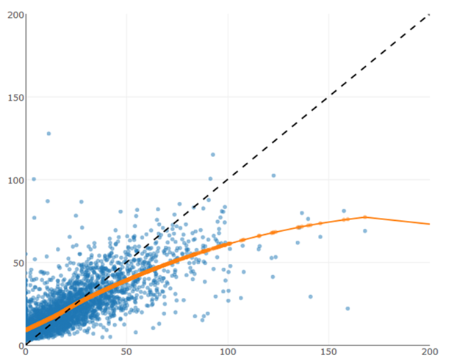

Results – Validating DSAT 2.0
Predicted from CHIRPS
Precipitation
Loess Smoother
1-to-1 Line
Observed from Weather Stations
Notes:
The rain gauge data networks were used to validate monthly total precipitation produced from CHIRPS used for DSAT2.0’s SPI calculation.
This plot shows the 1 to 1 ratio of the 11 Observed weather station precipitation data and the precipitation predicted from chirps.
CHIRPS was found to have higher mean and median precipitation than observed by 2.5 mm. Chirps was also found to have a smaller range and standard deviation than observed. As you can see there are high precipitation events that CHIRPS underestimates.
Overall however, the r2 was found to be fair at 0.687.

Slide 12

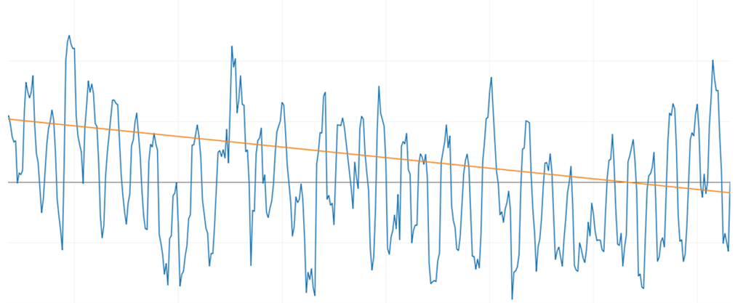
Results - SPI
SPI values for Hopi Buttes/Grasslands Climate Zone
Time Series
6-month SPI
Sen’s Slope Line
2
1
0
-1
-2
Y = -0.0349x + 70.30
1985 1990 1995 2000 2005 2010 2015
Year
Notes:
This time series plot shows the 6-month SPI calculation from 1981 to 2016. This is specifically for our climate zone of Hopi Buttes and grasslands, which showed the steepest SPI decline amongst the climate zones. The orange line shows the trend line with a sen’s slope, or the median slope or -0.0349. The Hopi Buttes experienced every month with significant precipitation declines as well, but the highest decline occurring during March.

Slide 13
Results - SPI
Notes:
This heatmap shows the Standardized Precipitation Index is increasing or decreasing over time for the climate zones defined. Where color and bold cells indicate statistically significant with p-value <0.05. 95% Confidence. These Sen’s slope indicate a median-based monotonic trend.
A negative Sen’s slope indicates a declining trend in SPI over time, essentially drying, decrease of precipitation, is occurring in nearly every climate zone and almost all months.
There is a significant drying trend in the last 35 years nearly everywhere and every season.

Slide 14
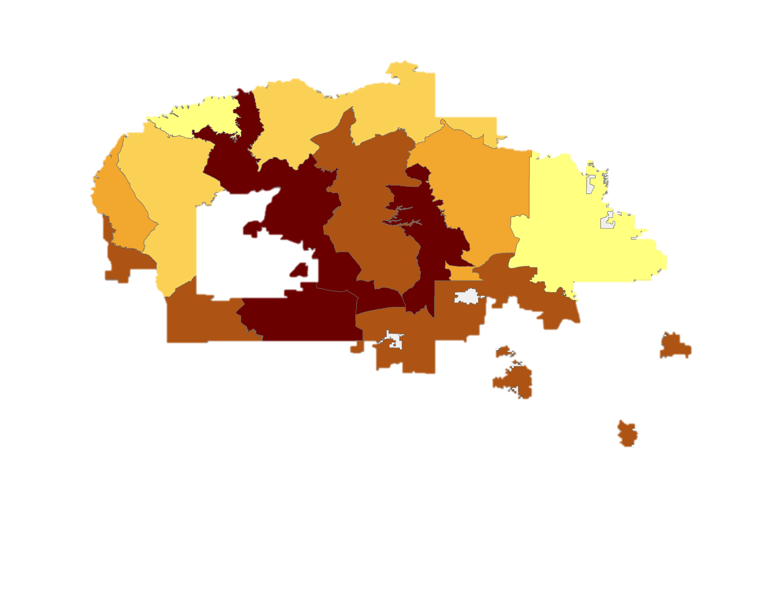
Results - SPI
Arid
Canyonlands
Monument
Valley
Sandy
Plateaus
San Juan
Badlands
Marble
Platform
Chinle
Valley
Mesa
Highlands
Chuska
Mountains
Chaco
Tablelands
Sen's Slope for SPI
Painted
Dessert
Hopi Buttes/
Grasslands
Semiarid
Tablelands
-0.0350 to -0.0280
-0.0279 to -0.0230
-0.0229 to -0.0223
-0.0222 to -0.0180
-0.0179 to -0.0093
Notes:
Every climate zone is getting dryer, according to significant declining precipitation trends from 1981-2016.
The top locations with the most rapid decline in precipitation are:
Hopi Buttes/Grasslands
Chuska Mountains
Mesa Highlands
Which makes sense as these are the areas that use to have the most precipitation in the nation are now having the greatest decline.

Slide 15
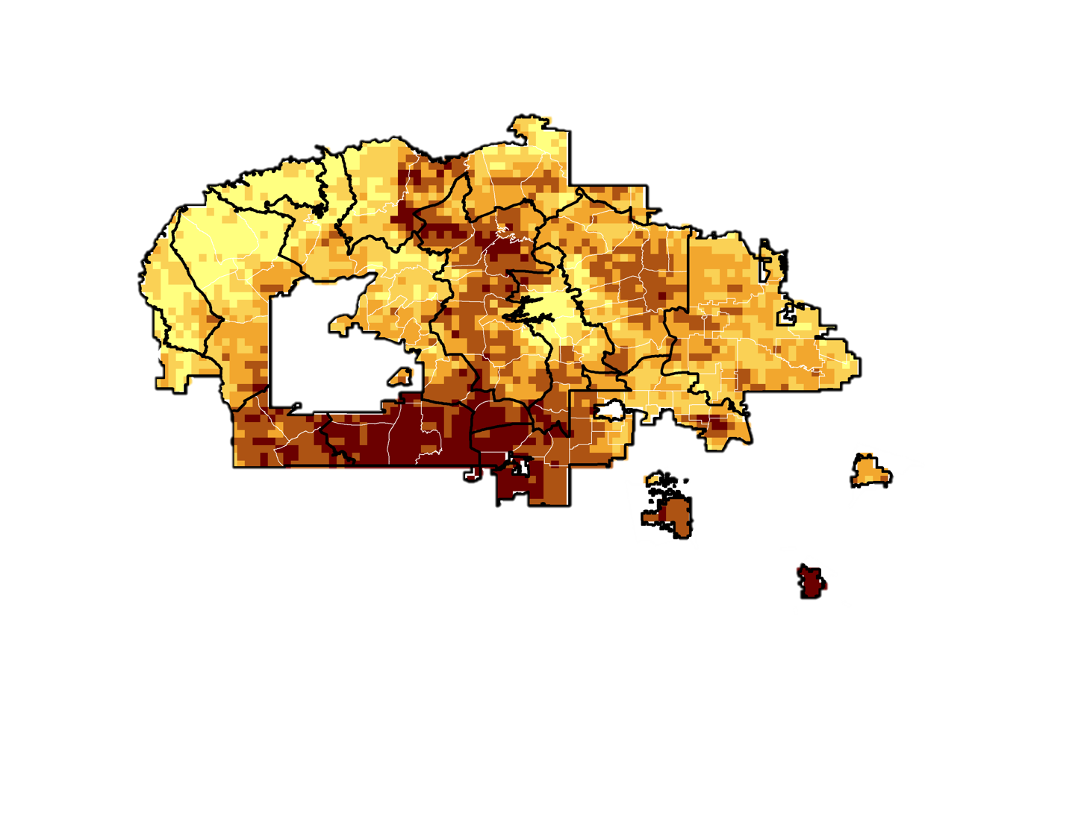
Results - SPI
Frequency of Moderate to Exceptional Drought
Number of Events
77 - 87
88 - 93
94 - 98
99 - 104
105 - 115
SPI Value | Drought Intensity Interpretation
-0.4 to 0.5 | Near Normal
-0.5 to -0.7 | Abnormally Dry
-0.8 to -1.2 | Moderate Drought
-1.3 to -1.5 | Severe Drought
-1.6 to -1.9 | Extreme Drought
≤-2.0 | Exceptional Drought
Number of months from August 1981 – August 2016
(421 Months)
Notes:
Another visualization we created to present our analysis is this frequency map showing the number of drought events that fall in the United States Drought Monitor Classifications of Moderate to Severe Drought, which is having an SPI value of -0.8 or less. Each pixel on the map depicts the number of months throughout the study period of 421 months that the area experienced a classification of moderate drought or worse for that month.
You can see that areas in the south of the nation, located around the Hopi Buttes and in the Greasewood and St. Michael’s area, shows the highest frequency, with the largest spatial intensity. You can also see higher frequencies scattered throughout the Chuskas, and as far north and east as Monument Valley.
(To give some perspective about the magnitude of drought, in the darker areas, this shows that in the last ~35 years, these areas have been experience drought nearly a quarter of the time throughout that period.)

Slide 16
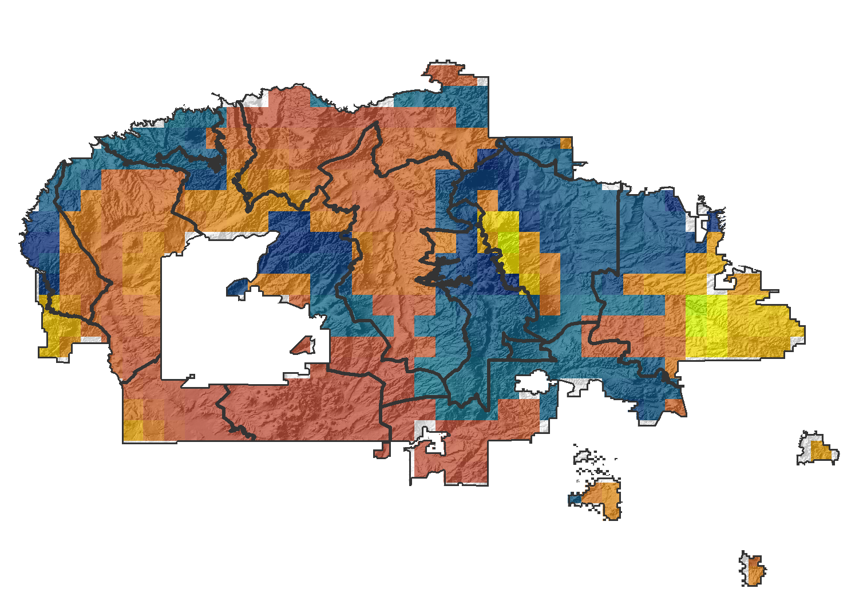
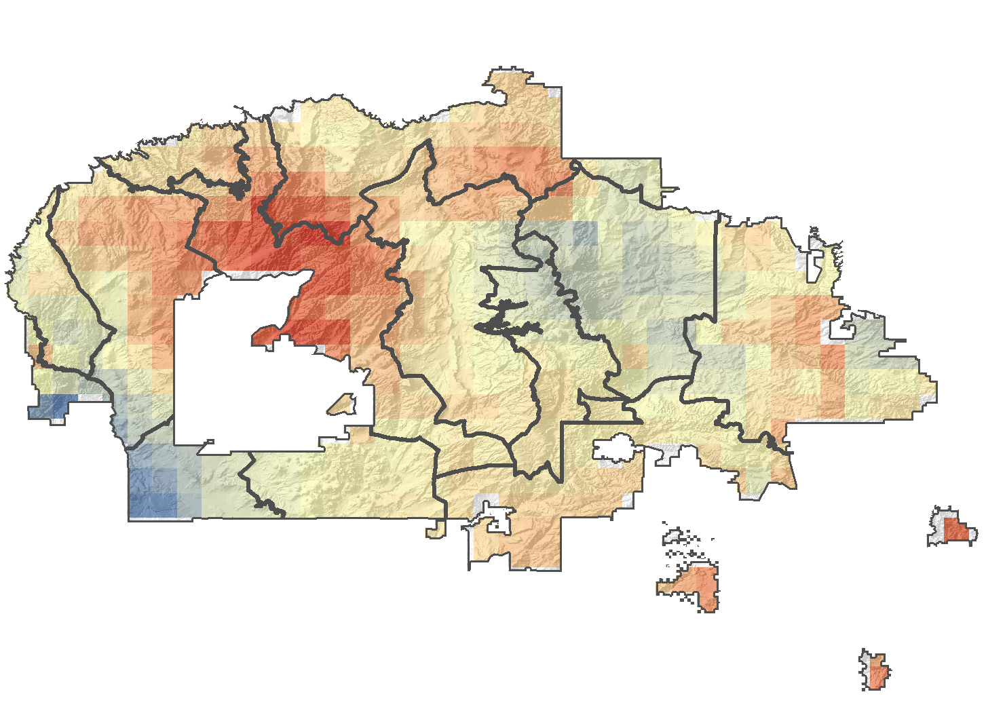
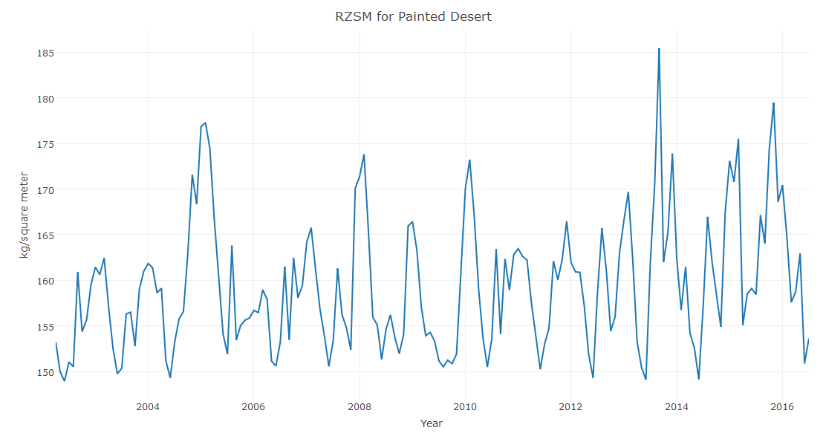
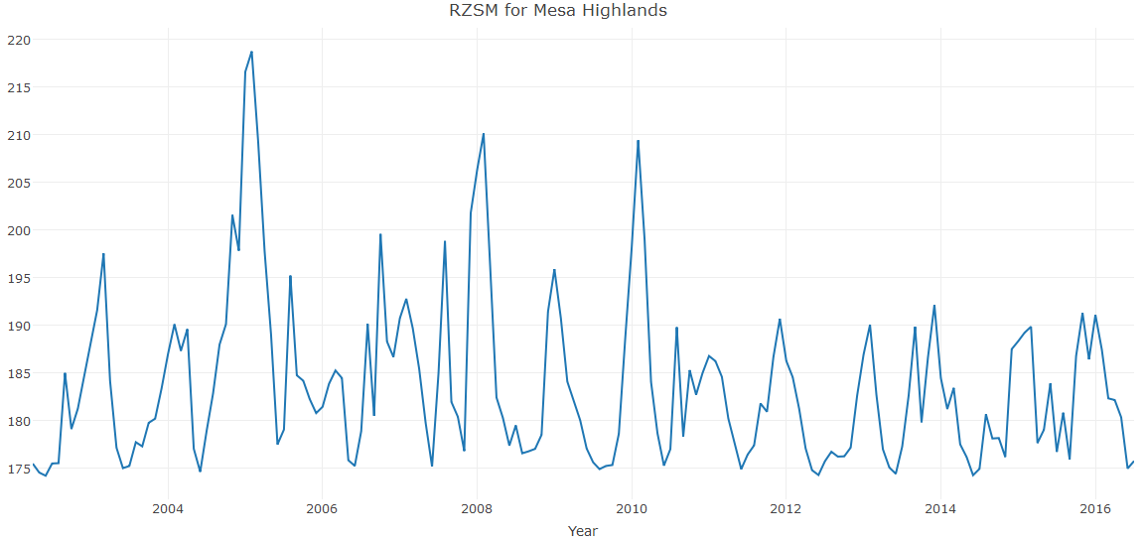
Results - RZSM
Historical Average 2002-2016
Deviation in recent 7 years (since 2009)
RZSM values
Deviation from Mean
Mesa Highlands: Sen’s Slope of -0.2049
Painted Desert: Sen’s Slope of 0.2898
(kg m⁻²)
(kg m⁻²)
High : 223
High : 4
Low : 150
Low : -4
Notes:
Shifting gears to another variable we looked at, Root Zone Soil Moisture, using the assimilated data from GRACE, we were able to find a historical average (2002-present), which is shown here. We found expected patterns in root zone soil moisture, for example, values are higher near bodies of water such as the San Juan river in the north, and near mountains where precipitation and snow melt runoff collect and flow, such as the Chuskas near the Chaco River, and in the West near the Chinle wash.
Then, one analysis we performed was taking the historical mean and comparing it with the mean value for the last 7 years, which is roughly one ENSO cycle, to see how RSZM has changed in recent years. This plot on the right shows the deviation from the mean. The red are areas where it is getting drier and blue more moist.
Finally, we found zonal statistics for each climate zone and plotted time series for each. The time series plot for the Mesa Highlands zone shows the high seasonal variability of RZSM, but it can be noted that there are clear recent declines from the years of 2011-2016.
The only other climate zone that was found to have a statistically significant annual trend was the Painted Desert zone, which we actually found to show increasing soil moisture, but keep in mind that these results are for a relatively short climatic time period.

Slide 17
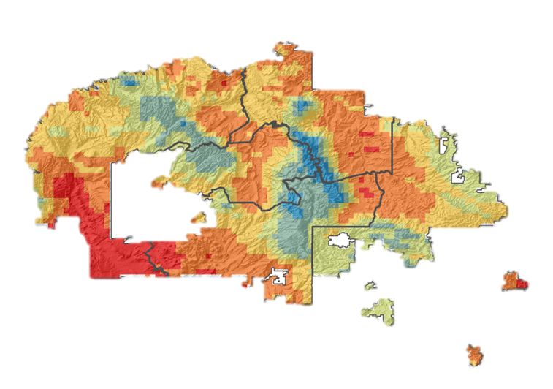
Results - LST
Monthly Average Daytime LST (◦C)
Land Surface Temperature average
March 2000 – September 2016
Temperature is based on elevation
No significant trends
12.4 – 18.6
18.7- 22.4
22.5- 25.3
25.4 -27.6
27.7 – 30.1
30.2 – 36.1
Notes:
Similar to RZSM, we found a historical mean for land surface temperature for the time period from 2002-2016. It is pretty evident from the map of the results that LST shows patterns based on elevation. You can see the temperatures are coolest higher up in the Chuskas and around the Black Mesa, and the hottest temperatures in the lower valleys and deserts, such as the Painted Desert and the San Juan Basin.
LST was found to fluctuate seasonally, but was fairly uniform spatially.
We did not observe any significant annual trends for LST, most likely due to the short 16-year time span.

Slide 18
Results
 | SPI | RZSM | LST
Arid Canyonlands | -0.0128 | -0.0427 | -0.0155
Chaco Tablelands | -0.0093 | -0.0797 | -0.0251
Chinle Valley | -0.026 | -0.0162 | -0.0529
Chuska Mountains | -0.0305 | 0.0363 | -0.0072
Hopi Butte/Grasslands | -0.035 | -0.0076 | -0.072
Marble Platform | -0.0223 | 0.1431 | -0.0479
Mesa Highlands | -0.0281 | -0.2049 | -0.0332
Monument Valley | -0.018 | -0.1373 | -0.0574
Painted Desert | -0.023 | 0.2898 | -0.0081
San Juan Badlands | -0.0223 | 0.1274 | -0.0214
Sandy Plateaus | -0.0203 | -0.0536 | -0.0272
Semiarid Tablelands | -0.0243 | -0.0918 | 0.0241
Table showing significance of Annual Sen’s Slope:
Negative slopes show drier conditions over time
Notes:
This table shows a summary of our time series analysis results.
SPI shows dryer trends for every single location, with largest precipitation declines in the southern region of NN and at locations that historically received more precipitation (Chuska Mountains and Mesa Highlands).
RZSM and LST may not have shown many significant trends due to the short record of last 14 or 16 years (30 years is the typical minimum record length for climate analysis).

Slide 19
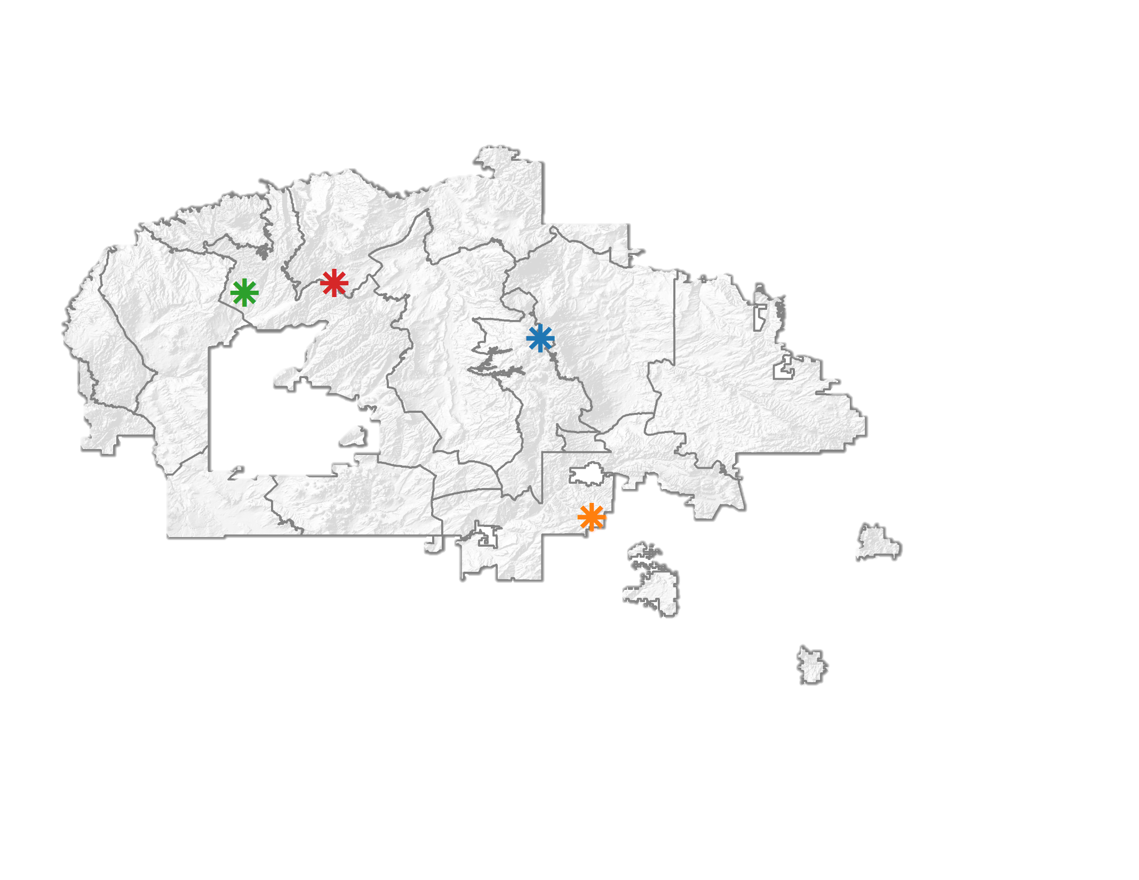
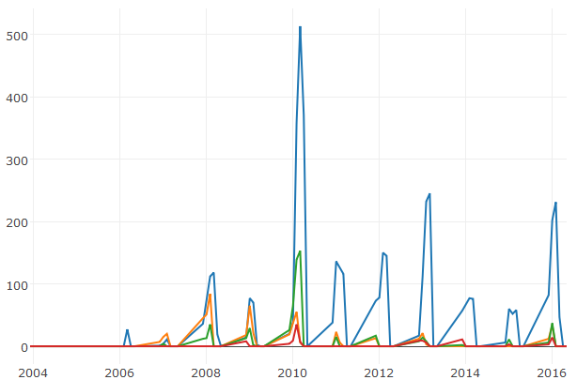

Results - SWE
SWE (mm)
Beaver Springs
Vanderwagen
Inscription House
Black Mesa
Year (Dec-May)
These stations have experienced maximum of SWE of 37 mm SWE since 2009-2016 relative to 2007-2010 where it reached as much as 153 mm SWE in 2010
Notes:
The Snow water equivalent was analyzed at 4 points in the NN.
A few of the top locations that had significant snow (besides the Chuska Mountains) where snow survey and SNOtel data is not collected are the Black Mesa (in red), Inscription house (in green), and Vanderwagen (in orange). And you all can see their locations on the map.
Between 2009-2016, these stations had a maximum SWE amount of 37 mm. In 2010, SWE reached as much as 153 mm.
In general, we found that these plateaus generally build SWE in December and January, with no SWE in February since 2010.

Slide 20
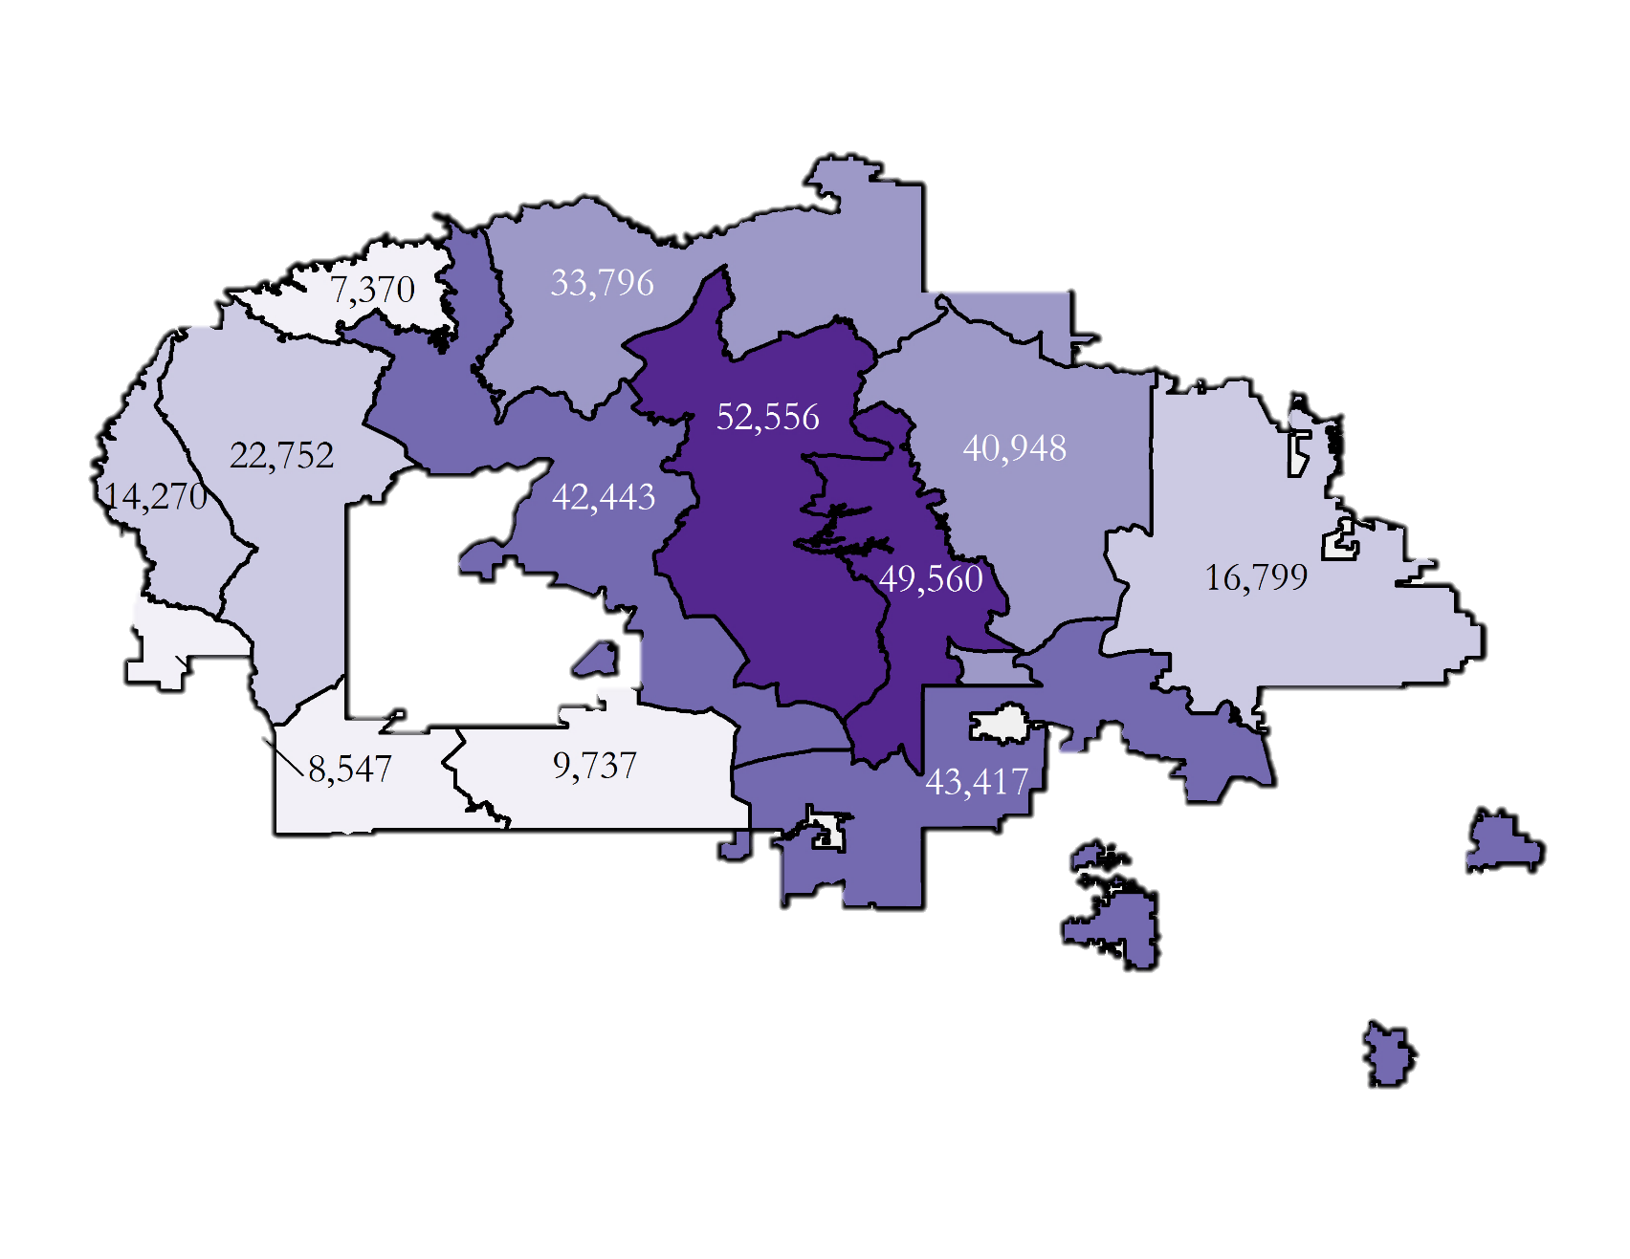
Conclusions - population
Drought Event Frequency
Population
Notes:
To give some context of how many communites may be impacted by drought, we mapped the population. According to a NN 2010 census, climate zones with the highest population are near the center of the NN, at Chinle Valley, Chuska Mountains, and the Semiarid Tablelands.
If we look at where drought frequently occurs, many drought prone areas are located where large fraction of the Navajo nation people live.
Hence, we recommend resources to be distributed to both high drought frequency and population, mainly southern, central regions in the NN.

Slide 21
Errors & Uncertainty
Limited time scales for LST, RZSM, and SWE
Summer monsoons and extreme rainfall events may be under predicted by CHIRPS
Future studies could include an in depth comparison of the relationships between these drought indicators, and add other variables such as:
vegetation
ground water
reservoir storage
stream flows
Notes:
With any study, there are errors and uncertainties that should be taken into account when interpreting the results. Some that we experienced are:
Limited time scales for LST, RZSM, and SWE
We found that short periods of high-intensity precipitation, such as summer monsoons and extreme rainfall events may be under predicted by CHIRPS, as these are harder to capture because the occur in a short bursts of time.
Additionally, because the nature of our program is a fast-paced projects in 10-weeks, we concluded that there are plenty of topics related to our project that could be investigated further, such as comparison between the drought variables we investigated, as well as investigation of additional variables, such as vegetation, ground water, reservoir storage, and stream flow.

Slide 22
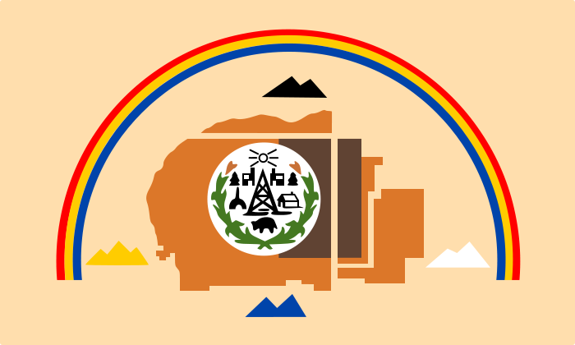
Conclusions
DSAT 2.0 is validated and ready to use
Earth observations offer:
  low-cost
  easy to implement method of collecting data
  increased coverage of precipitation and SWE where there are no ground stations
  additional drought driven variables (RZSM, LST) and measurements that are not currently available in the Navajo Nation
  This project, over 3 terms, contributed to the growing evidence that drought severity has been worsening in the last 35 years in the Navajo Nation
Notes:
To conclude, the main takeaways from our project are that
1) The DSAT tool is validated and water managers in the Nation’s Water management branch can be confident in its outputs and begin to implement it in reporting and monitoring drought
2) there are many benefits to incorporating earth observations in efforts to monitor and mitigate the impacts of drought in the Nation, some of them being:
-that using earth observations is a relatively low-cost and easy-to-implement method of collecting data
-they can provide increased spatial coverage of precipitation and SWE where there are no ground stations
-and they can provide data for addition drought driven variables such as RZSM and LST, which are measurements that are currently not available
And, finally, we would like to conclude that this project, over three NASA DEVELOP terms since 2015, has contributed to the growing evidence that drought severity has been worsening in the Nation over the last 35 years.

Slide 23
Project Partners: Terms I, II, III:
Carlee McClellan, Senior Hydrologist, Navajo Nation Department of Water Resources
Robert Kirk, Principal Hydrologist, Navajo Nation Department of Water Resources
Mariah Ashley, Intern, Navajo Nation Department of Water Resources
Maurice Upshaw, GIS Supervisor, Navajo Nation Department of Water Resources
Dr. Venkat Lakshmi, South Carolina University
Amber Jean Kuss, Bay Area Environmental Research Institute (BAERI) Cindy Schmidt, Bay Area Environmental Research Institute (BAERI)
Special Thanks To:
Victoria Ly, former NASA DEVELOP Navajo Nation Climate participant
Brittany Zajic, NASA DEVELOP National Program
Jenna Williams, NASA DEVELOP National Program
Notes:
We would like to thank everyone who participated in making the this project such a success over the past three terms.

