Slide 1
Northwest United States Agriculture III
Assessing Current and Future Plant Hardiness Zones for Apple Production in Washington State using Climate Models and NASA Earth Observations
Madeline Ruid (Team Lead)
Teresa Fenn
Matthew Mullen
Sarah Philbrick
James Hendrickson

Slide 2
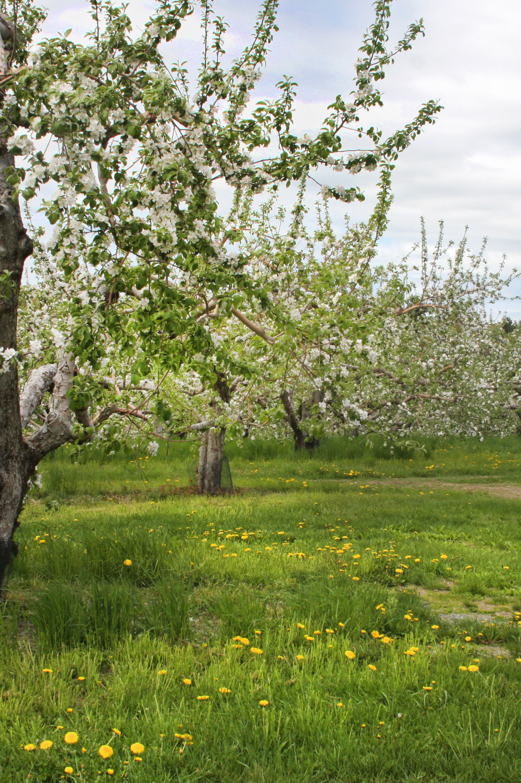
Community Concerns
Washington climate is currently well-suited to apple production
Produces 65% of the nation’s apples, adds $2.2 billion to economy
Future climate change may result in a shift of these ideal locations
Image Source: Liz West, Flickr
Image Credit: NRCS

Slide 3
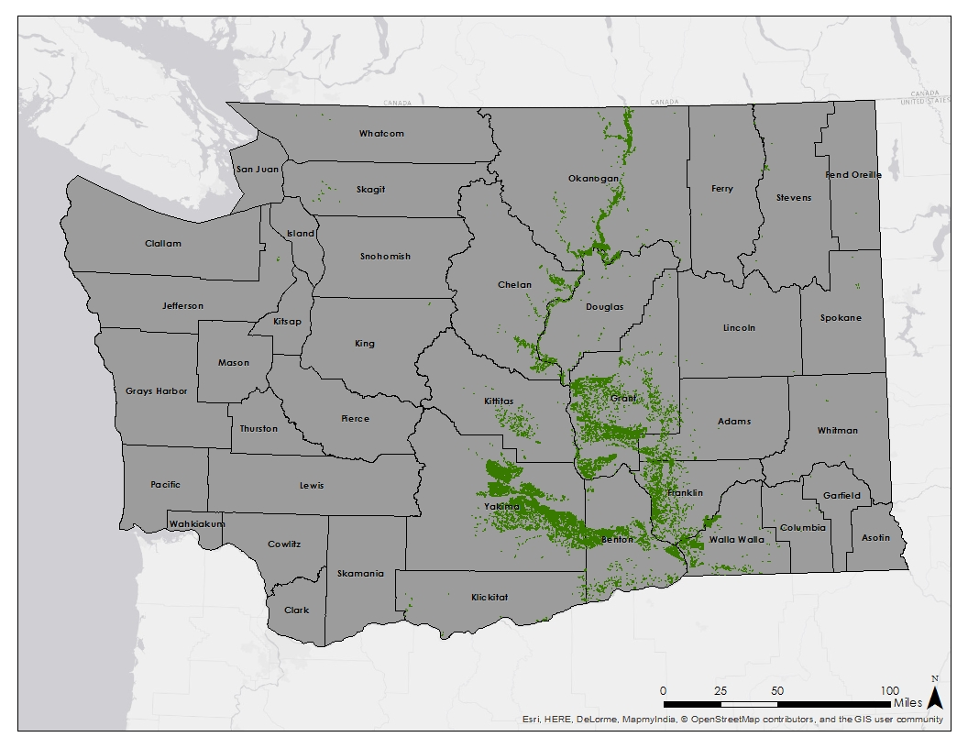
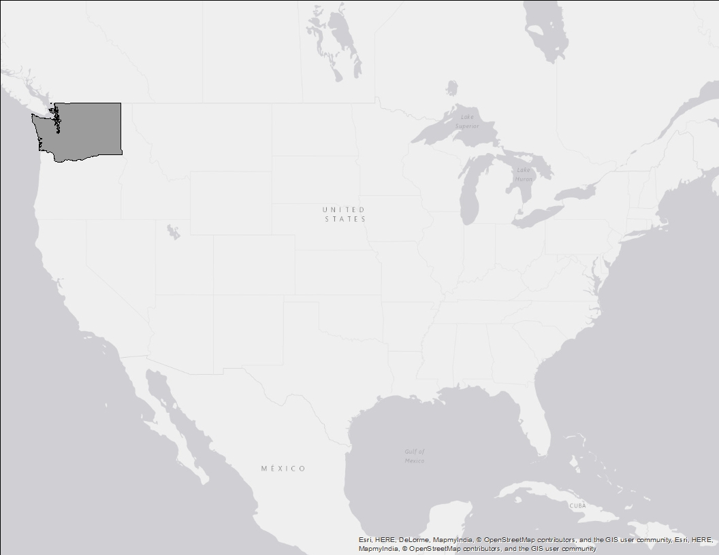
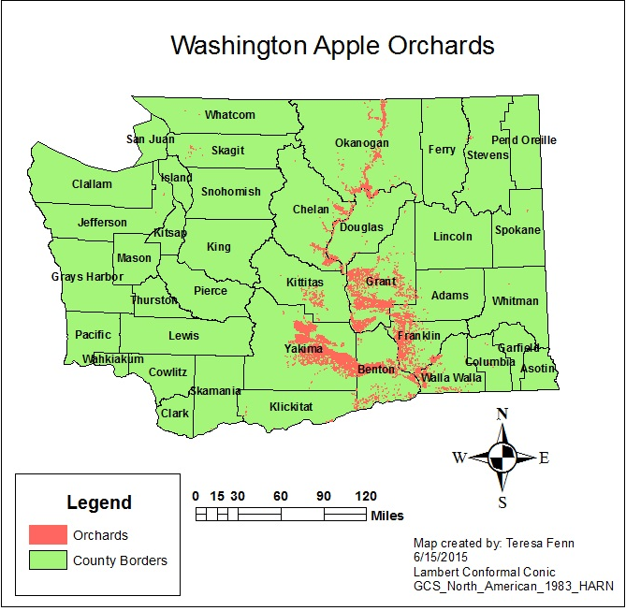
Study Area: Washington, USA
Study Period:
Current
  2002-2015
Future
  2045
  2065
  2095
Apple Orchards in Washington State

Slide 4
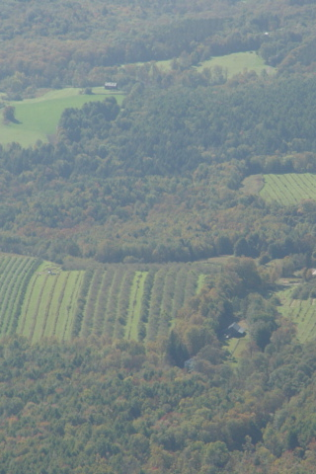
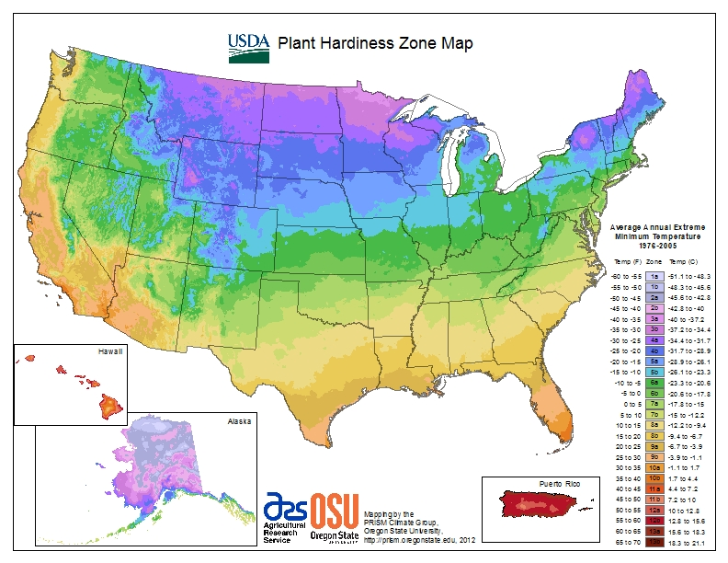
Plant Hardiness Zones
Guide as to which plants will thrive at a given location
Based on annual extreme minimum temperature
Divided into 10 degree Fahrenheit zones
Apples grow best in zones 5 and 6
Image Source: Placeuvm, Flickr

Slide 5
Apple Suitability
Plant Hardiness Zones
Based on average annual extreme minimum temperature
Growing Degree Days
Heat accumulation formula:
([Tmax + Tmin]/2) - 5 °C
Growing Season Temperature
Ideal average temperature of 19 °C
Notes:
Make sure notes explain why PHZ are based off of min temp. All crops, not just apples

Slide 6

Objectives
Project Partner
Map Plant Hardiness Zones
  Current
  Forecasted (2045, 2065, and 2095)
Map areas suitable for apple growth
  Current
  Forecasted (2045, 2065, and 2095)
Dr. Michael Glen, Ph.D. United States Department of Agriculture

Slide 7
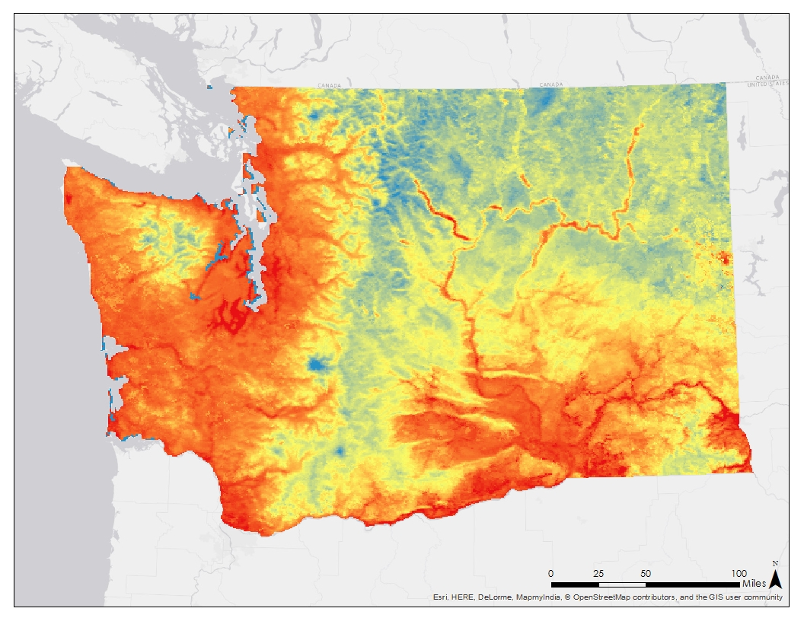
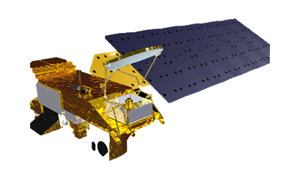
Earth Observations
MODIS Land Surface Temperature in Washington State
Aqua

Slide 8
Project Methodology
 | Plant Hardiness Zones Suitability Maps
 | Accuracy Assessment Future Change Analysis
Pre-Processing
Download MODIS LST Data
Mosaic images
Estimate air temp from LST
Remove outliers
Create rolling averages
Mask to study area
Convert K to C
Project data
Download Climate Model Data
Data Analysis
Four time periods (present day, 2045, 2065, 2095)
Find minimum value per year for each pixel and average from 2002-2015
Calculate GDD
Calculate avg temp
Import PHZ
Classify into PHZ
Apply weights and classify into Suitability Regions
Post Analysis
Compare MODIS produced PHZ maps to current PHZ maps
Use Cropscape data to find which present day land covers will be most suitable for apple orchards in the future
Test climate model used against historical data

Slide 9
Project Methodology
 | Plant Hardiness Zones Suitability Maps
 | Accuracy Assessment Future Change Analysis
Pre-Processing
Download MODIS LST Data
Mosaic images
Estimate air temp from LST
Remove outliers
Create rolling averages
Mask to study area
Convert K to C
Project data
Download Climate Model Data
Data Analysis
Four time periods (present day, 2045, 2065, 2095)
Find minimum value per year for each pixel and average from 2002-2015
Calculate GDD
Calculate avg temp
Import PHZ
Classify into PHZ
Apply weights and classify into Suitability Regions
Post Analysis
Compare MODIS produced PHZ maps to current PHZ maps
Use Cropscape data to find which present day land covers will be most suitable for apple orchards in the future
Test climate model used against historical data

Slide 10
Project Methodology
 | Plant Hardiness Zones Suitability Maps
 | Accuracy Assessment Future Change Analysis
Pre-Processing
Download MODIS LST Data
Mosaic images
Estimate air temp from LST
Remove outliers
Create rolling averages
Mask to study area
Convert K to C
Project data
Download Climate Model Data
Data Analysis
Four time periods (present day, 2045, 2065, 2095)
Find minimum value per year for each pixel and average from 2002-2015
Calculate GDD
Calculate avg temp
Import PHZ
Classify into PHZ
Apply weights and classify into Suitability Regions
Post Analysis
Compare MODIS produced PHZ maps to current PHZ maps
Use Cropscape data to find which present day land covers will be most suitable for apple orchards in the future
Test climate model used against historical data
Notes:
Make sure notes explain what cropscape is and that it comes from USDA

Slide 11
Results (maps current)

Slide 12
Results (maps 2045)

Slide 13
Results (maps 2065)

Slide 14
Results (maps 2095)

Slide 15
Conclusions

Slide 16
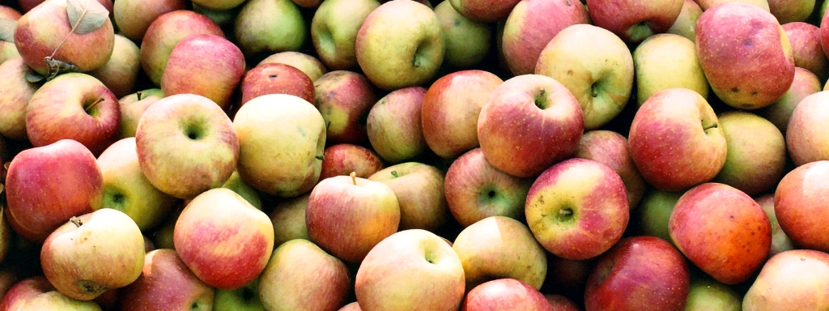
Future Work
Interactive program to allow for analysis of other crops
Incorporate precipitation and wind data
Image Source: John Chamberlain, Flickr

Slide 17
Advisors
Dr. Kenton Ross, NASA DEVELOP National Program Science Advisor
Dr. Noelle Baker, NASA Postdoctoral Program Fellow
Jeffry Ely, NASA DEVELOP Geoinformation Scientist
Partners
Dr. Michael Glenn, USDA-ARS Appalachian Fruit Research Station
Others
Northwest United States Agriculture I, Fall 2014
Northwest United State Agriculture II, Spring 2014

