Slide 1
Thailand Disasters
Monitoring Risk and Extent of Drought for Enhanced Decision Making and Resource Allocation in the Kingdom of Thailand
Sean McCartney (Project Lead)
Srisunee Wuthiwongyothin
Nobphadon Suksangpanya
Sahakait Benyasut
Chisaphat Supunyachotsakul
Thanapat Vichienlux

Slide 2
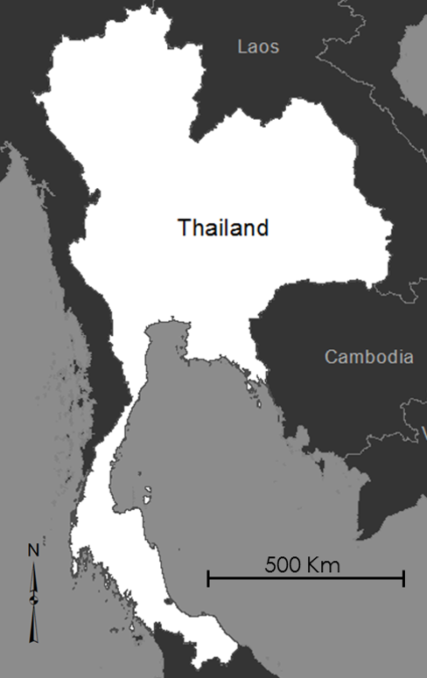
Study Area
Kingdom of Thailand
513,115 km²
66 million population
One of the top three rice exporting nations in the world
47% of area is for agriculture
Notes:
The kingdom of Thailand is approximately 3-quarter the size of Texas and has roughly 66 million people.
Thailand is one of the top three rice exporting countries in the world.
47% of the total area in the country is dedicated for agriculture.

Slide 3
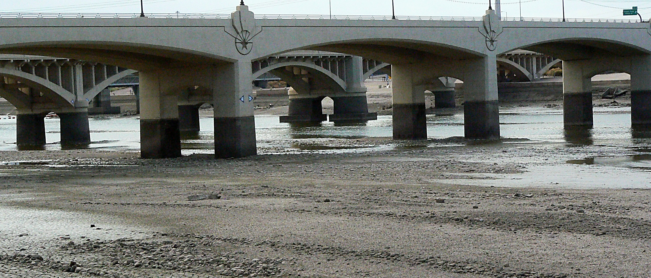
Credit: Xomiele
Drought is a major and common disaster in Thailand.
Drought greatly affects agriculture, economy, and livelihoods of citizens.
Government policies and expenditures are based on drought monitoring and assessment.
Community Concerns
Notes:
Image Source: https://farm5.staticflickr.com/4118/4825328806_289e43da00_o_d.jpg
Thailand is frequently affected by drought due to the variability of monsoon rains as well as other unfavorable meteorological conditions.
Moreover, drought has major impacts on agriculture, environment, economy, and livelihoods of citizens.
The most recent drought in 2015 is considered the worst drought in 15 years.
The Office of Agricultural Economics (OAE) of Thailand estimated the 2015 drought will reduce Thailand’s off-season crops export by higher than 30%.
During a drought, the Thai government needs to monitor and assess the risk and then enact policies to conserve and provide water for agriculture and the welfare of the people.

Slide 4
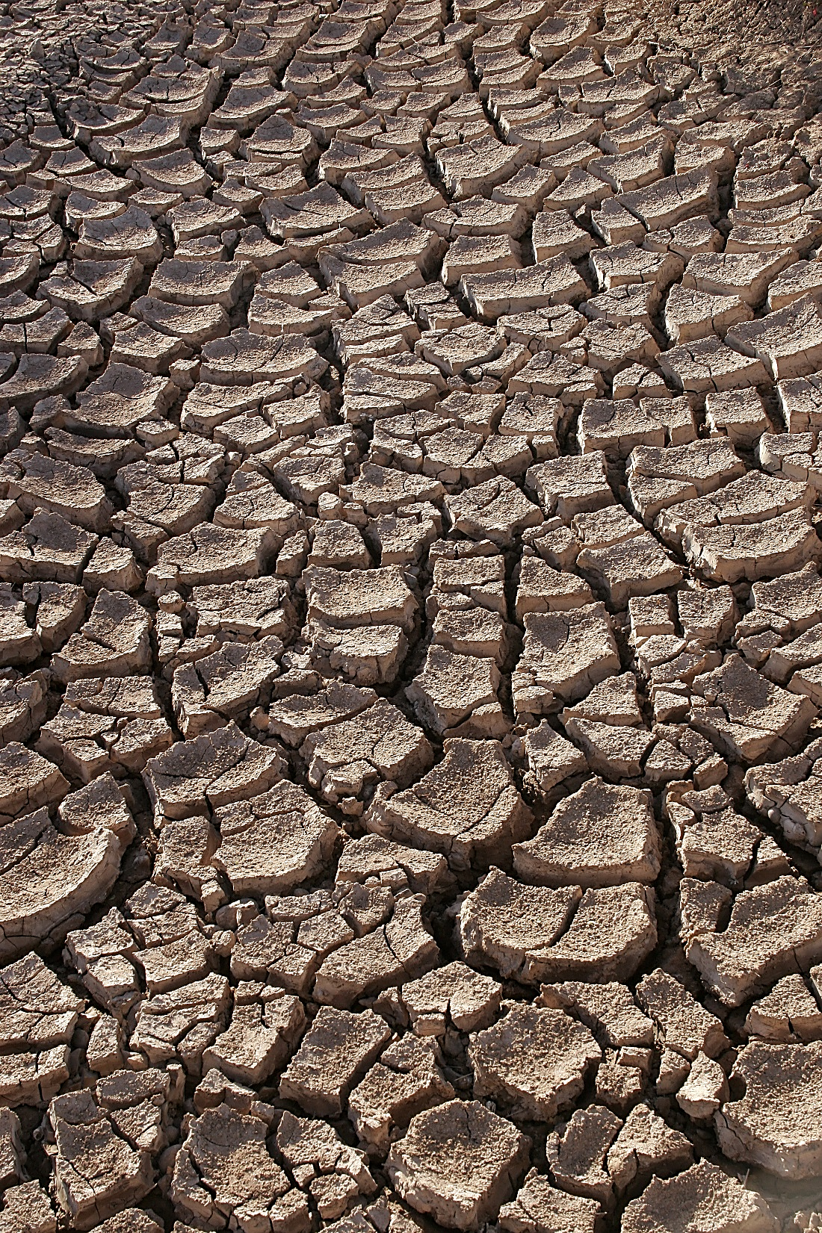
Objectives
Use 3 different drought indices to monitor meteorological, hydrological and agricultural drought in Thailand to assist in drought management and mitigation
Identify extreme drought anomalies based on a climatological baseline
Credit: Tomas Castelazo
Notes:
Image Source: https://upload.wikimedia.org/wikipedia/commons/e/e1/Drought.jpg
The objectives of this project are:
To use 3 different drought indices to monitor meteorological, hydrological and agricultural drought in Thailand to assist in drought management and mitigation.
To identify extreme drought anomalies based on a climatological baseline.

Slide 5
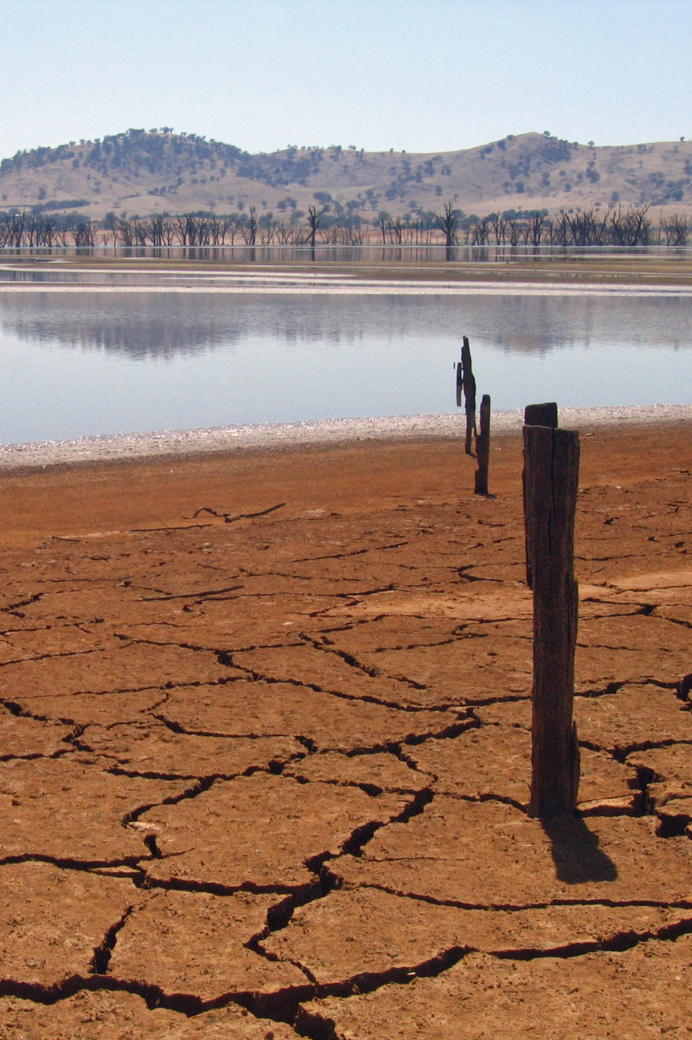
Project Overview
Analyze 3 types of drought
(1-month temporal resolution):
Meteorological Drought:
Standardized Precipitation Index (SPI)
Hydrological Drought:
Stream-Flow Drought Index (SDI)
Agricultural Drought:
Scaled Drought Condition Index (SDCI)
Credit: suburbanbloke
Notes:
Image Source: https://upload.wikimedia.org/wikipedia/commons/e/ee/Lac_Hume.jpg
In this project, we analyze cause and effects of drought based on Meteorological, Hydrological, and Agricultural droughts.
The Standardized Precipitation Index or SPI is used to monitor Meteorological drought.
The Stream-Flow Drought Index or SDI is used to monitor Hydrological drought.
Finally, the Scaled Drought Condition Index or SDCI is used to monitor Agricultural drought.

Slide 6
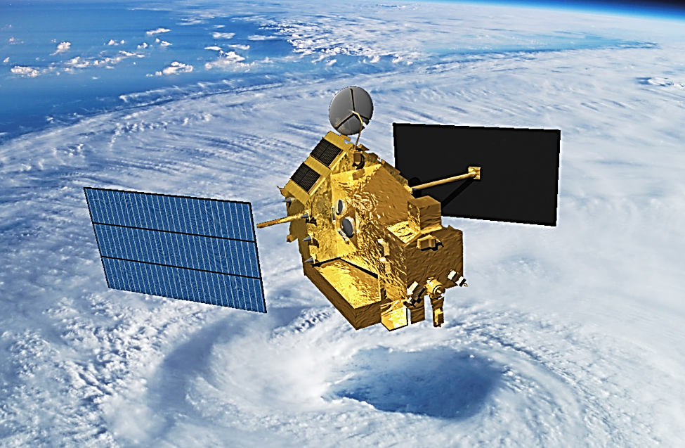
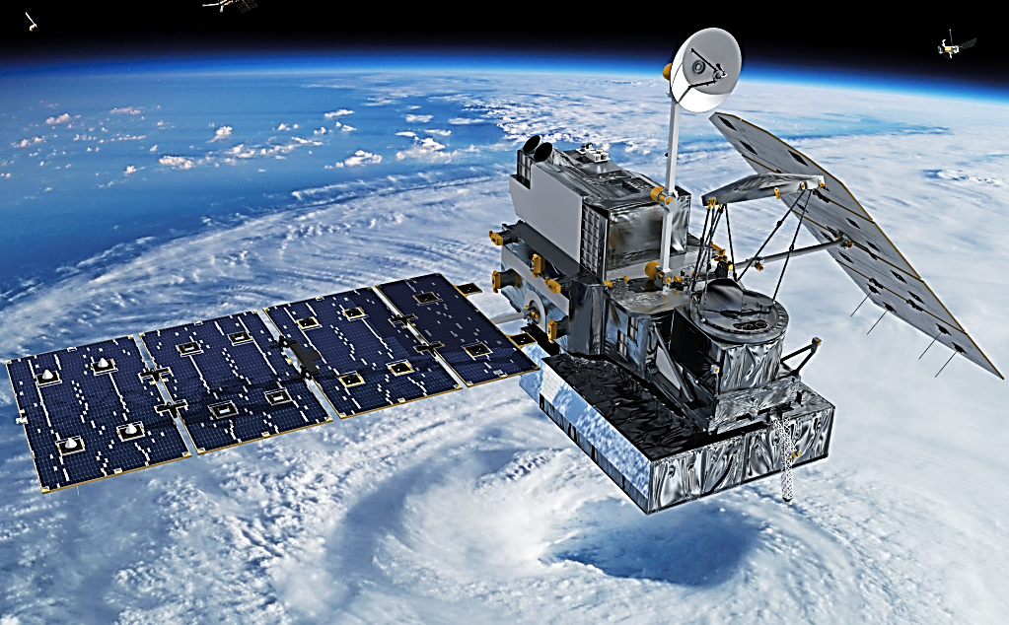
Earth Observations & Parameters
Precipitation
TRMM – TMI
Tropical Rainfall Measuring Mission
TRMM Multi-Satellite Precipitation Analysis (TMPA)
January 1998 – February 2015
GPM – GMI
Global Precipitation Measurement
Integrated Multi-satellite Retrievals for GPM (IMERG)
March 2015 – Present
Credit: NASA
Credit: Britt Griswold, NASA
Notes:
There are several Earth Observing Satellites (EOS) used in this project.
First, The Tropical Rainfall Measuring Mission or TRMM and Global Precipitation Measurement or GPM are used to obtain precipitation over Thailand extent.
TRMM provides us the precipitation based on the TMPA algorithm from January 1998 to February 2015
GPM uses the IMERG algorithm to create a continuous data set with TRMM providing precipitation from March 2015 to present.

Slide 7
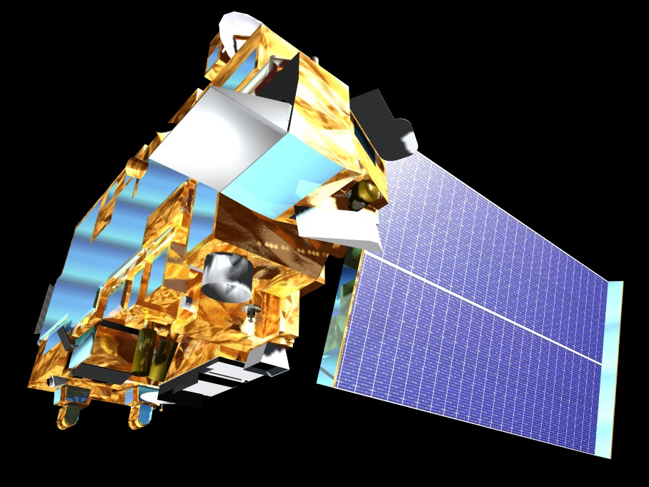
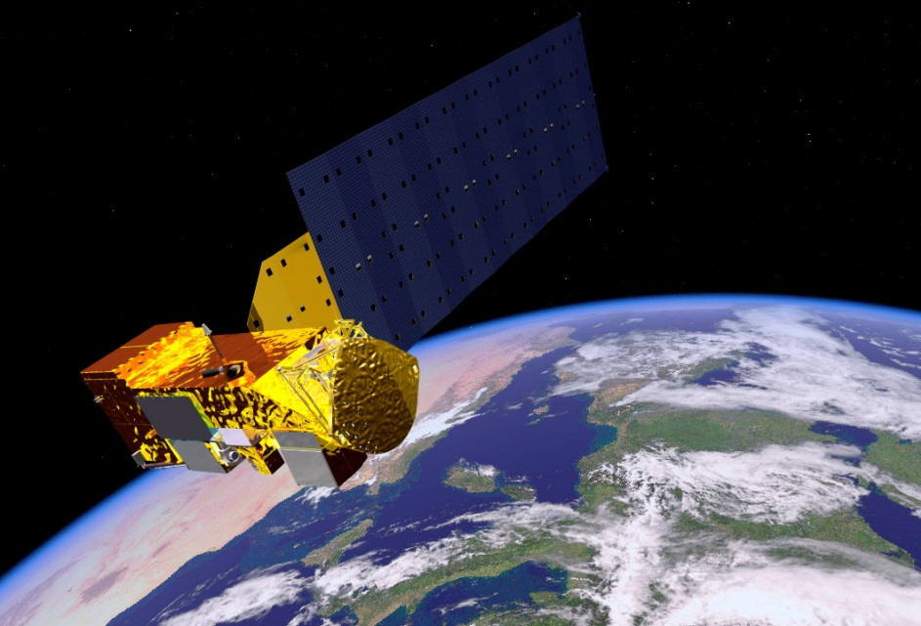
Earth Observations & Parameters
Land Surface Temperature (LST) &
Vegetation Index (NDVI)
TERRA & AQUA
– Moderate Resolution Imaging Spectroradiometer (MODIS)
February 2000 – Present
TERRA
AQUA
Credit: NASA
Credit: NASA
Notes:
Next, we need Land Surface Temperature and a Vegetation Index for calculating SDCI which is obtained from the MODIS sensor on board the TERRA and AQUA platforms.
The data is available from February 2000 to present.

Slide 8
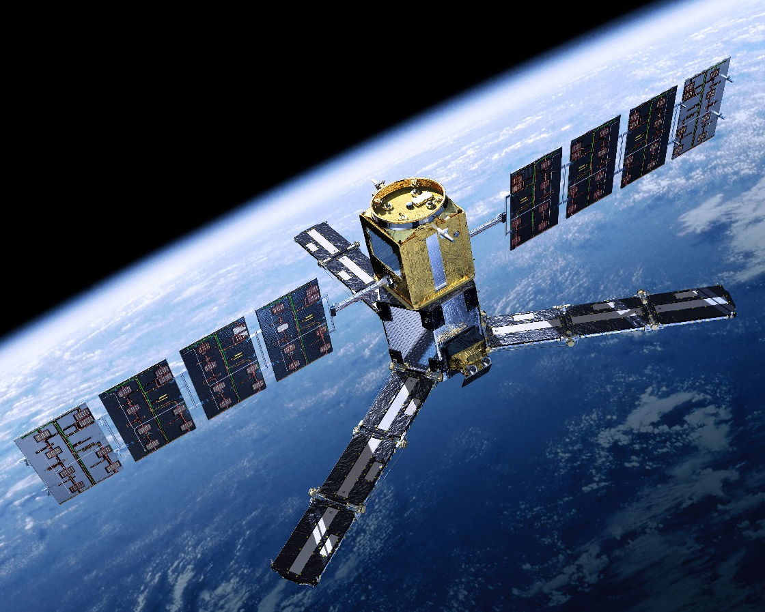
Earth Observations & Parameters
Soil Moisture
SMOS
Soil Moisture and Ocean Salinity
Derived from Palmer Model
January 1st, 2003 – May 9th, 2015
(Obtained soil moisture product from Dr. John Bolton, NASA DEVELOP Science Advisor at GSFC)
Credit: ESA/AOES Medialab
Notes:
Additionally, we obtained a Soil Moisture product from Dr. John Bolton which is derived from the MIRAS sensor on board the Soil Moisture and Ocean Salinity platform based on the Palmer model.
The soil moisture product is compared with 3 drought indices.

Slide 9
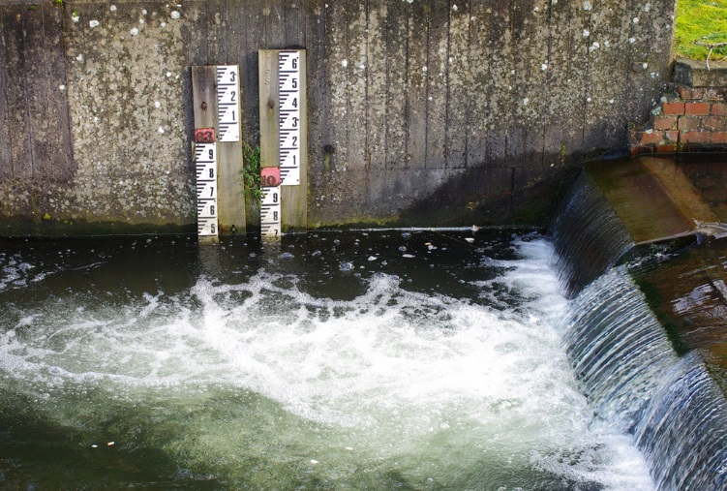
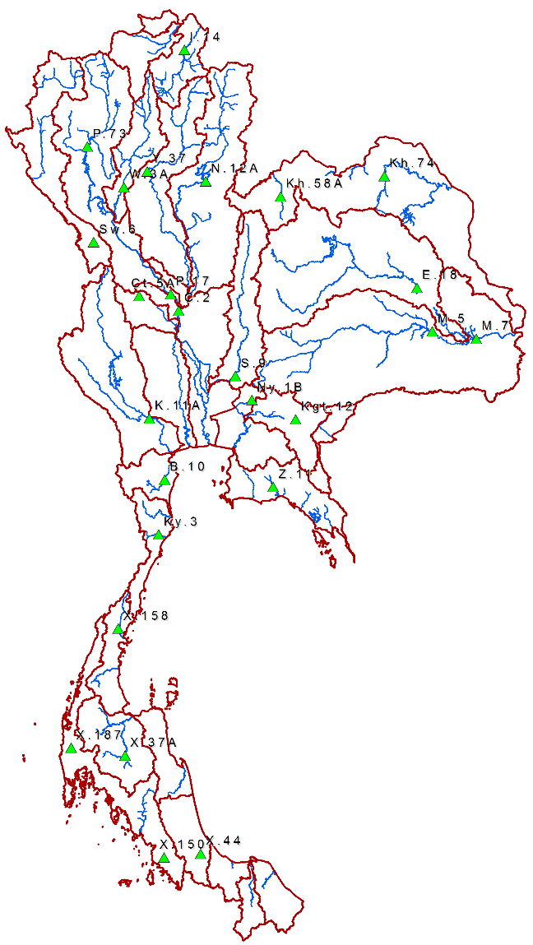
Earth Observations & Parameters
Streamflow
Credit: Julian Osley
Royal Irrigation Department, Thailand
26 Ground-based Stations:
In situ stream-flow measurements
April 1998 – March 2014
Data Source: Department of Water Resources, Thailand
Notes:
Image Source (left): http://www.geograph.org.uk/reuse.php?id=3870652&download=85af8db1&size=original
Finally, the in-situ stream-flow data is obtained from 26 ground-based stations located on the main streams and rivers in Thailand. These are shown as green triangles in the map on the right.
This stream-flow measurement is used for calculating Stream-flow Drought Index.

Slide 10
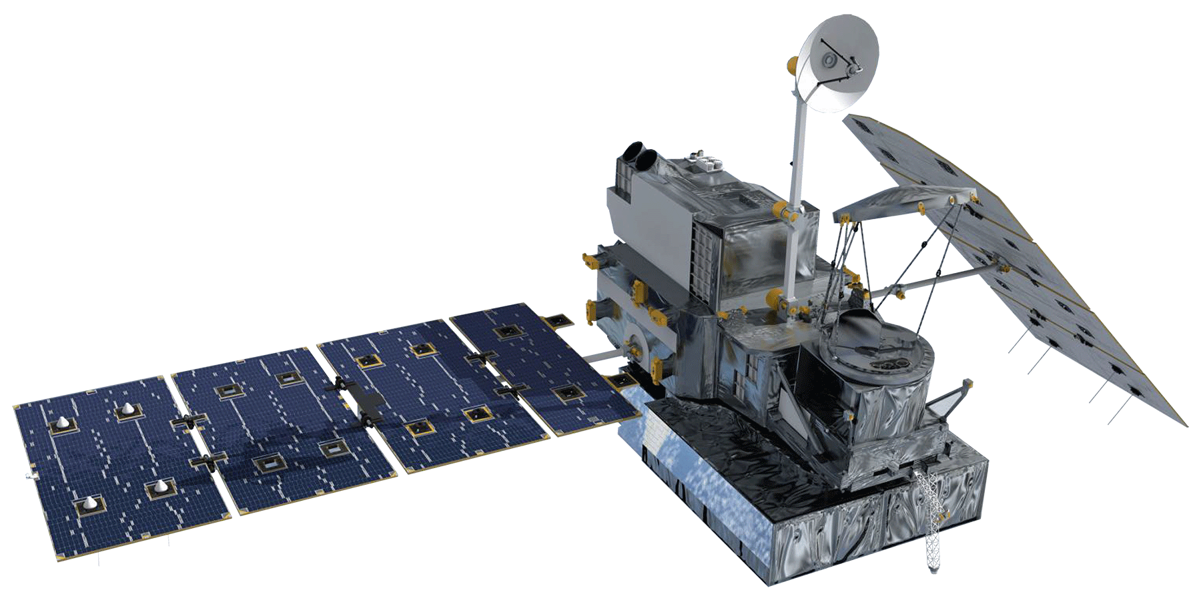
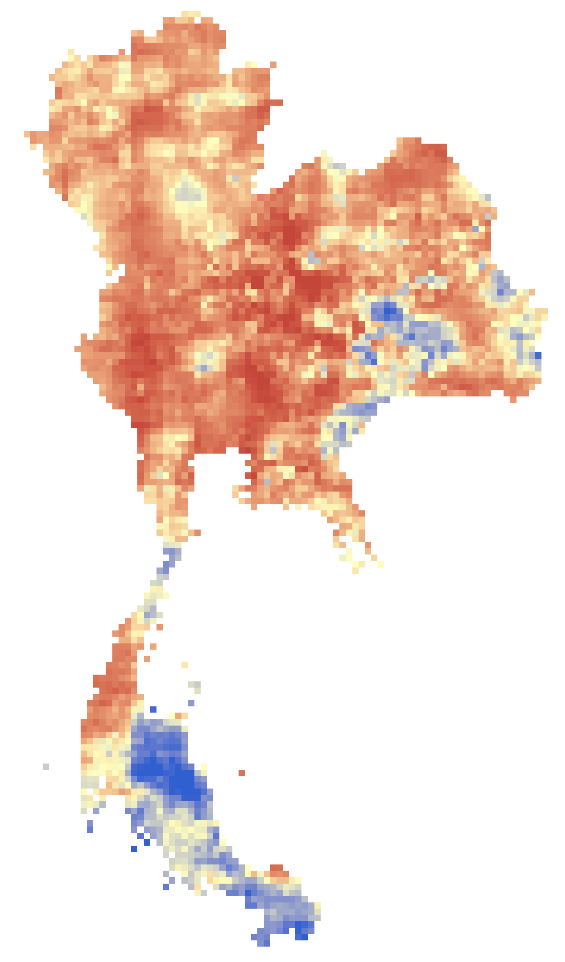
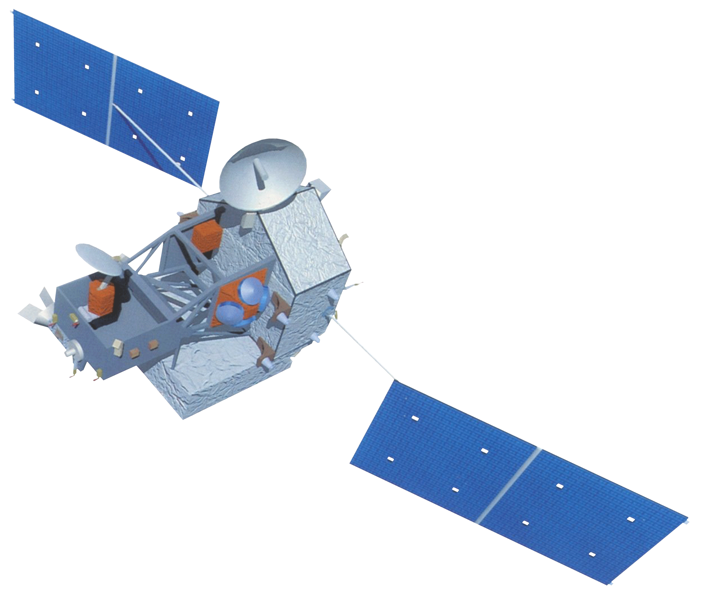
Methodology: SPI
(Standardized Precipitation Index)
GPM – GMI
30-min precipitation rate (mm/hr)
0.1°-Spatial Resolution
IMERG Level 3 product
Monthly Precipitation
Resampled to
0.1°-spatial resolution
MATLAB Script
SPI
1-month temporal resolution
05/2015
TRMM – TMI
Daily precipitation (mm)
0.25°-Spatial Resolution
3B42 Level 3 product
Notes:
To calculate the Standardized Precipitation Index, we obtained precipitation data from TRMM and GPM.
However, they have different temporal and spatial resolutions.
So, firstly, the spatial resolution of TRMM was upsampled to match GPM’s resolution.
The upsampling was done by area-based linear interpolation.
Then, the precipitation of GPM and TRMM was summed to a monthly temporal resolution.
Finally, the monthly precipitation is further calculated by statistical methods to determine the Standardized Precipitation Index. This process was written in a MATLAB script and the SPI was then automatically generated from the monthly precipitation.

Slide 11
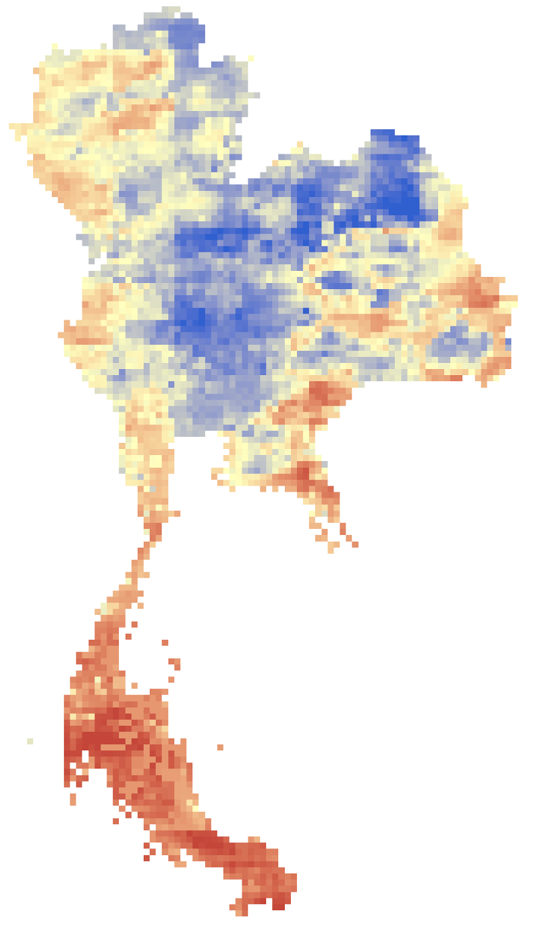
Methodology: SDI
(Streamflow Drought Index)
Streamflow Records
26 ground-based stations on the main streams and rivers
Monthly streamflow (m³)
04/1998 to 03/2014
SDI
1-month temporal resolution
Streamflow (m³)
Time (month)
MATLAB
Script
Notes:
Next, the Stream-flow Drought Index was calculated from the monthly stream-flow data measured from ground-based stations on the main streams and rivers in Thailand.
A MATLAB script was also written to automatically calculate the Stream-flow Drought Index.

Slide 12
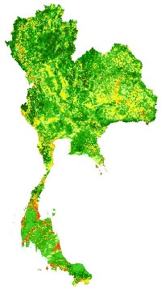
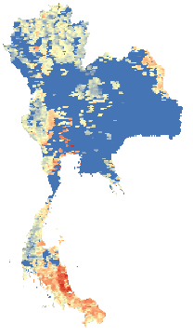
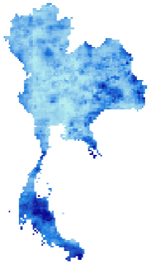
Methodology: SDCI
(Scaled Drought Condition Index)
NDVI
0.01°-spatial resolution
MOD13A3 and MYD13A3 products
SDCI
0.01°-spatial resolution
1-month temporal resolution
LST
0.05°-spatial resolution
MOD11C2 and MYD11C2 products
R-Script
Monthly Precipitation
0.1°-spatial resolution
Notes:
Finally, the Scaled Drought Condition Index is based on 3 parameters which are NDVI, LST, and precipitation.
These data sets are in different spatial resolutions. So the spatial resolutions of LST and precipitation were upsampled to match the finest spatial resolution which is the 0.01 degree from the MODIS NDVI product.
Also, the data sets were summed to be monthly temporal resolution.
Finally, each data set was scaled and processed to determine the Scaled Drought Condition Index. This process was written by an R-script to automatically determine the Scaled Drought Condition Index.

Slide 13
Results & Discussions
February 2015 raster images of SPI, SDI, SDCI, and Soil Moisture over the Kingdom of Thailand
SPI
SDI
SDCI
SOIL MOISTURE
FINAL IMAGE#1

Slide 14
Results & Discussions
FINAL IMAGE#2
Show plots of SPI, SDI, SDCI, and Soil Moisture at a specific region over time in each index and find drought anomalies to determine the cause and effects of drought.
SPI
SDI
SDCI
SOIL MOISTURE

Slide 15
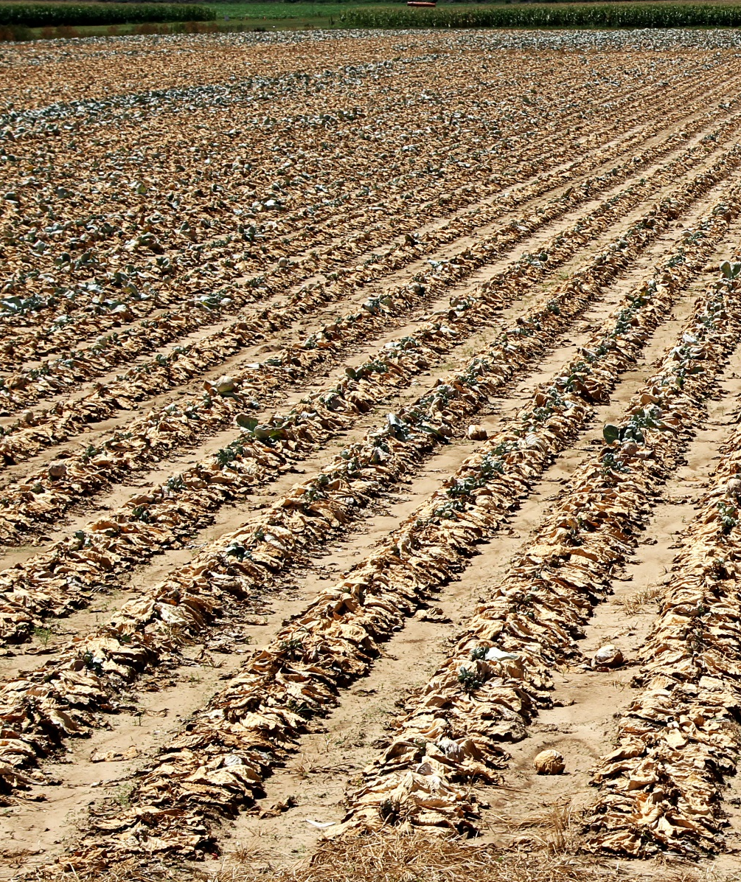
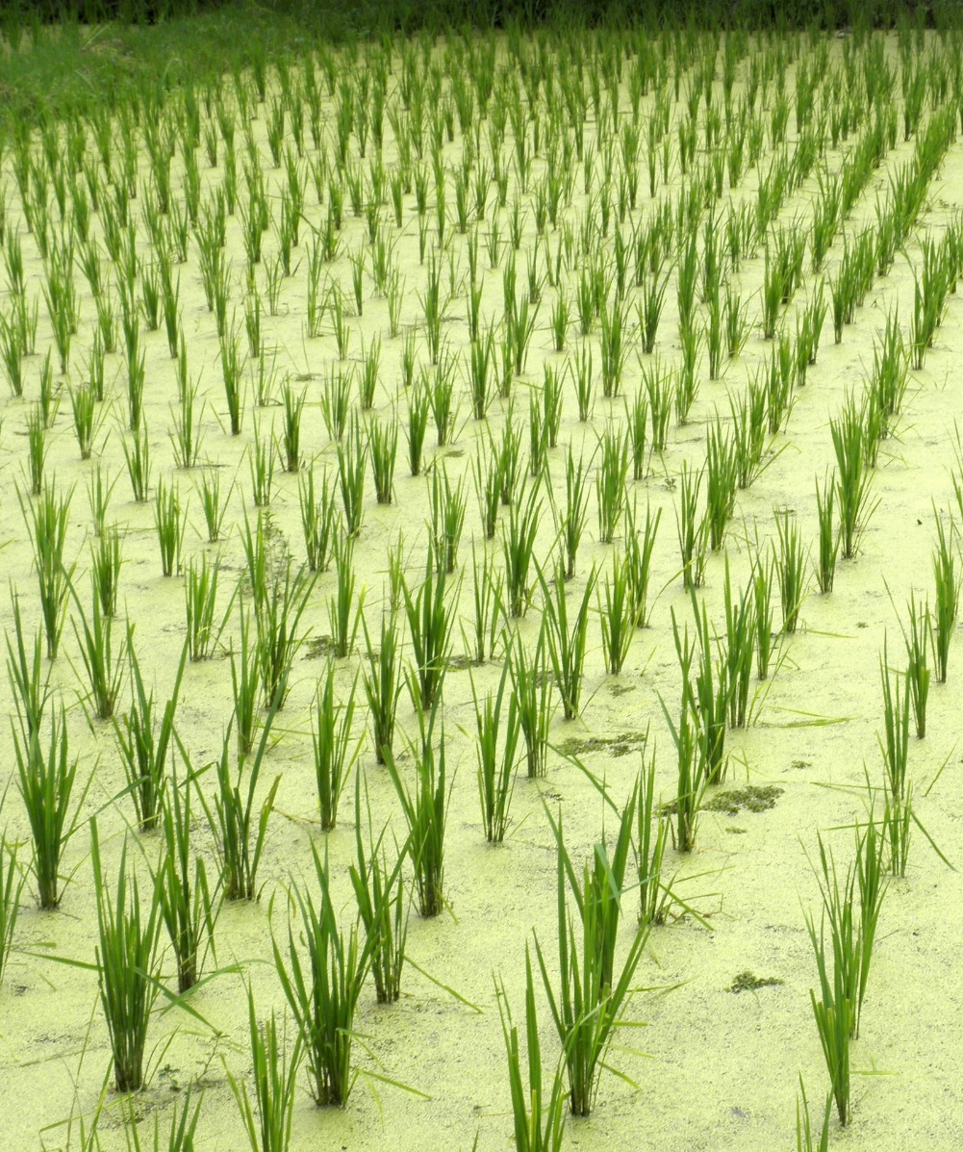
Future Work
Create a near-real time drought monitoring tool that will aid in mitigating risk and improve resource allocation in the country
Credit: U.S. Department of Agriculture
Credit: Quentar
Notes:
Image Source (left): https://farm6.staticflickr.com/5463/9018906362_be8656b61e_o_d.jpg
Image Source (right): https://upload.wikimedia.org/wikipedia/commons/0/07/Langkawi-pantai_cenang-rice-field.JPG
For the future work, the tools we created in this project will be extended into a Near-Real Time web-based service which can automatically monitor and analyze drought in 1-month temporal resolution.

Slide 16
Advisors
Dr. John Bolten, NASA GSFC
Colin Doyle, NASA GSFC
Partners
Royal Thai Embassy
POC: Bunyakiat Raksaphaeng
Asian Disaster Preparedness Center/SERVIR Mekong
POC: Pete Cutter
Thai Department of Disaster Prevention and Mitigation
National Safety Council of Thailand

Slide 17
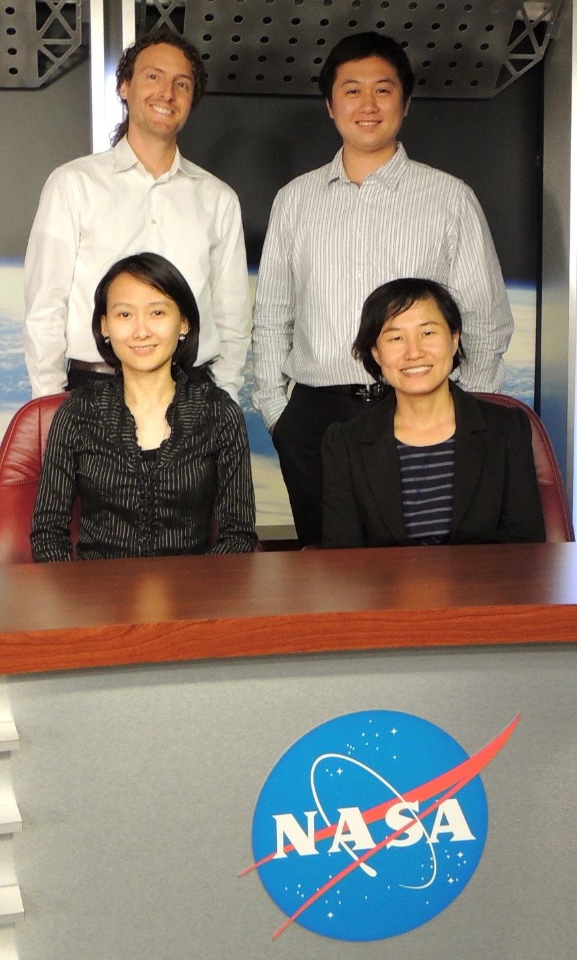
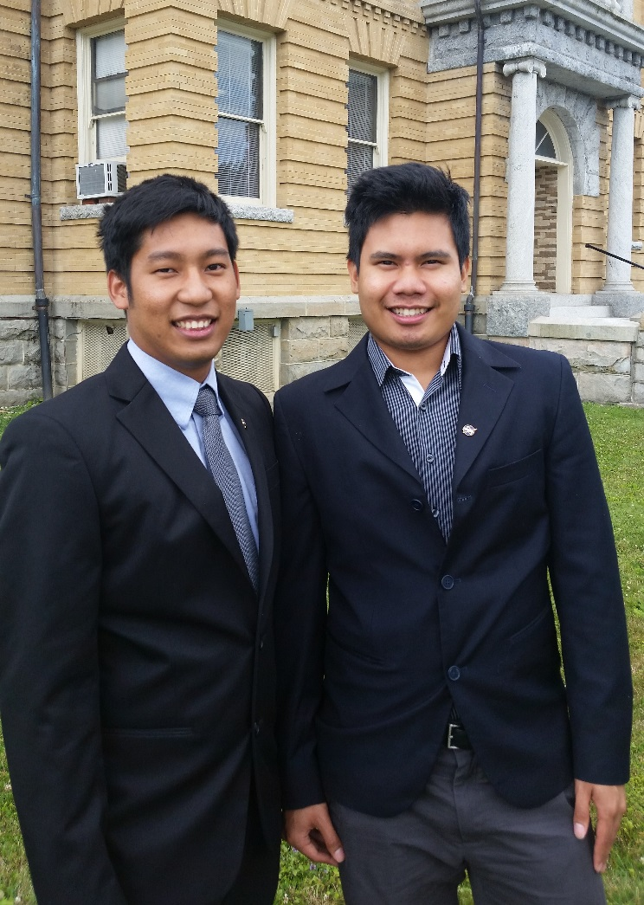
Thailand Disaster Project Team
Left: Thanapat Vichienlux
Right: Sahakait Benyasut
Top Left: Sean McCartney
Top Right: Nobphadon Suksangpanya
Bottom Left: Chisaphat Supunyachotsakul
Bottom Right: Srisunee Wuthiwongyothin

