Slide 1
Wichita
Climate II
Quantifying and Mapping Urban Heat to Inform Equitable and Sustainable Urban Planning Initiatives in Wichita, Kansas
Ritisha Ghosh (Project Lead)
Richard Kirschner
Raina Monaghan
Ria Mukherjee
Virtual Environmental Justice | Fall 2022

Slide 2
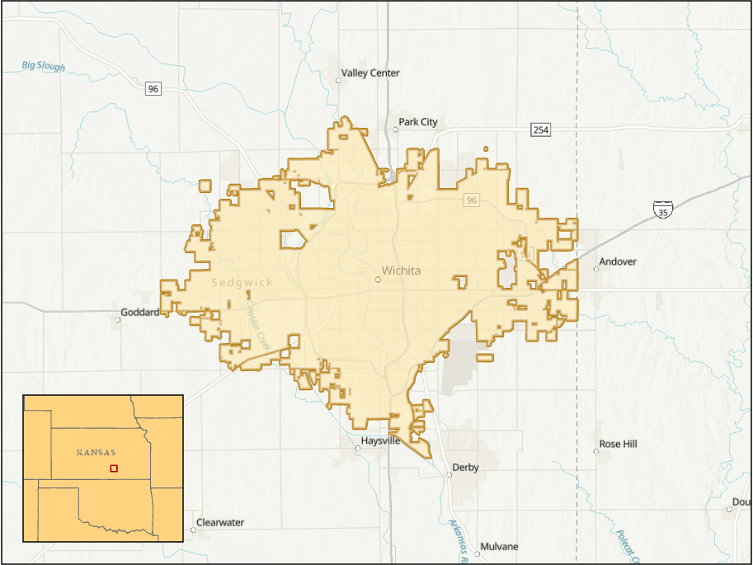
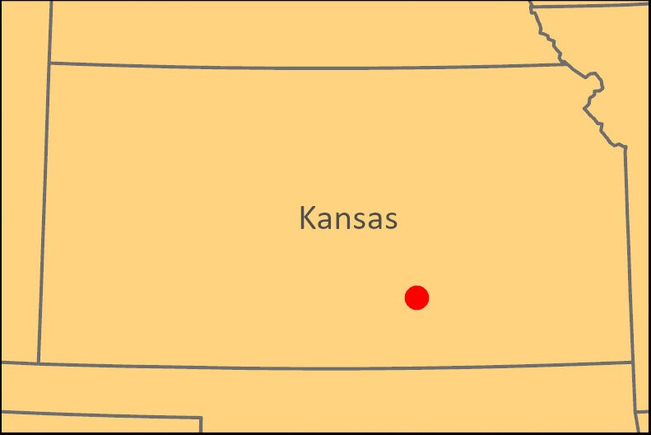
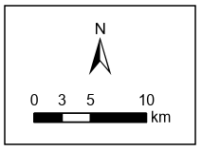
Study Area & Period
Wichita, Kansas City Boundary
Populated Area:
Wichita, Kansas, USA
Population ~ 395,699
Predominately White population, with large Black/African American, Asian and Latino/Hispanic populations
Study Period:
2017 - 2022
Wichita
Base map credits: Esri, HERE, Garmin, SafeGraph, FAO, Meti/NASA, USGS, EPA, NPS, NGA
Notes:
Our study area is the City of Wichita, located in Kansas, USA. The study period is a 5-year span beginning in 2017 and ending in 2022, with urban heat analysis incorporating only the summer months.
Basemap credits: Esri, HERE, Garmin, SafeGraph, FAO, Meti/NASA, USGS, EPA, NPS, NGA

Slide 3
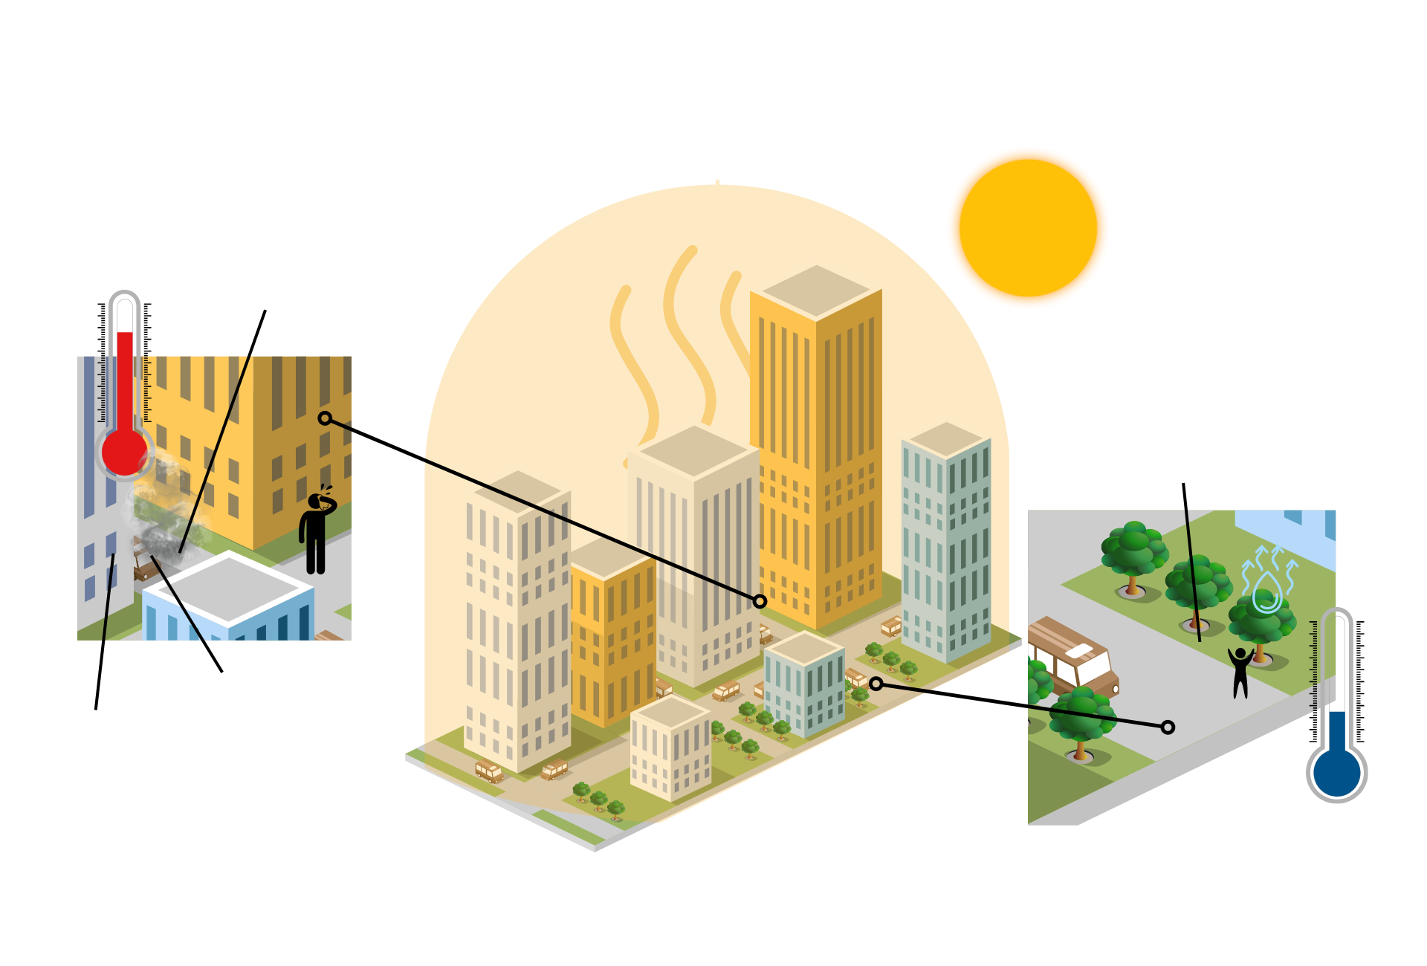
Background: Urban Heat Islands & Climate Mitigation
Inter-structure canyons retain heat
Lack of green infrastructure or trees for shade and evapotranspiration
Impervious, dark surfaces absorb and trap heat
Waste heat from vehicles and machinery
Image Credit: Skechtify, Alexel, Pesky, Viktor Morozuk, Leremy Gan, gstudioimagen, and vectorwin
Notes:
Extreme heat is the deadliest weather-related event in the United States, as well as one of the least discussed. Climate change has raised the frequency, intensity, and duration of severe heat events. The built, urban environment is often hotter than neighboring rural areas due to a denser concentration of pavement, metal and other building materials absorbing and retaining heat, as well as a low amount of vegetation – creating a phenomenon commonly known as the urban heat island effect. This effect contributes to a wide range of public health issues, associated with heat strokes, dehydration, loss of work productivity, decreased learning, respiratory difficulties, and heat-related mortality. The average summer temperature in Wichita has increased 1.3 degrees (F) since 1970, and the number of days over 100 degrees (F) has historically increased, from 40 days in 1934 to 53 days in 2011.
Image Credit: Created on canva by team member -, Elements from Skechtify, Alexel, Pesky, Viktor Morozuk, Leremy Gan, gstudioimagen, and vectorwin: Fee Media License

Slide 4
Background: Heat Vulnerability
While all Wichita residents are impacted by extreme heat in some way, the impacts are not equitably distributed.
Exposure:
Weather patterns, and natural and built environments in certain neighborhoods influence levels of exposure to heat
Adaptive Capacity:
One's ability to prepare or cope with high temperatures and access to social, economic or political resources for cooling varies
Sensitivity: Demographic, physiological and health-based indicators can predispose one to greater risk of adverse effects from heat
Image Credit: ivector, Skechtify, Rahardi Creative
Notes:
Heat risk varies widely from city to city and is not experienced equally within communities . Structural racism, income inequality, and historical discriminatory practices such as segregation and redlining lead to underinvestment in neighborhoods of color and low income, leading to fewer green spaces and a higher concentration of heat-absorbing infrastructure in these areas. This can lead to higher temperatures and less access to cooling for these marginalized populations. Certain populations are more vulnerable to the health impacts of heat as well, such as children, the elderly, unsheltered individuals, outdoor workers, and people with pre-existing medical conditions, illuminating the need to focus on equity when addressing extreme heat in cities, such as Wichita. Heat Vulnerability is a combination of one's exposure to heat, sensitivity to heat based on one's unique risk of adverse heat effects, and one's adaptive capacity, or ability to cope with high temperatures through access to resources for cooling.
Image Credit: CC- Created on Canva by team member – elements from ivector, Sketchify and Rahardi Creative; Free Media License

Slide 5
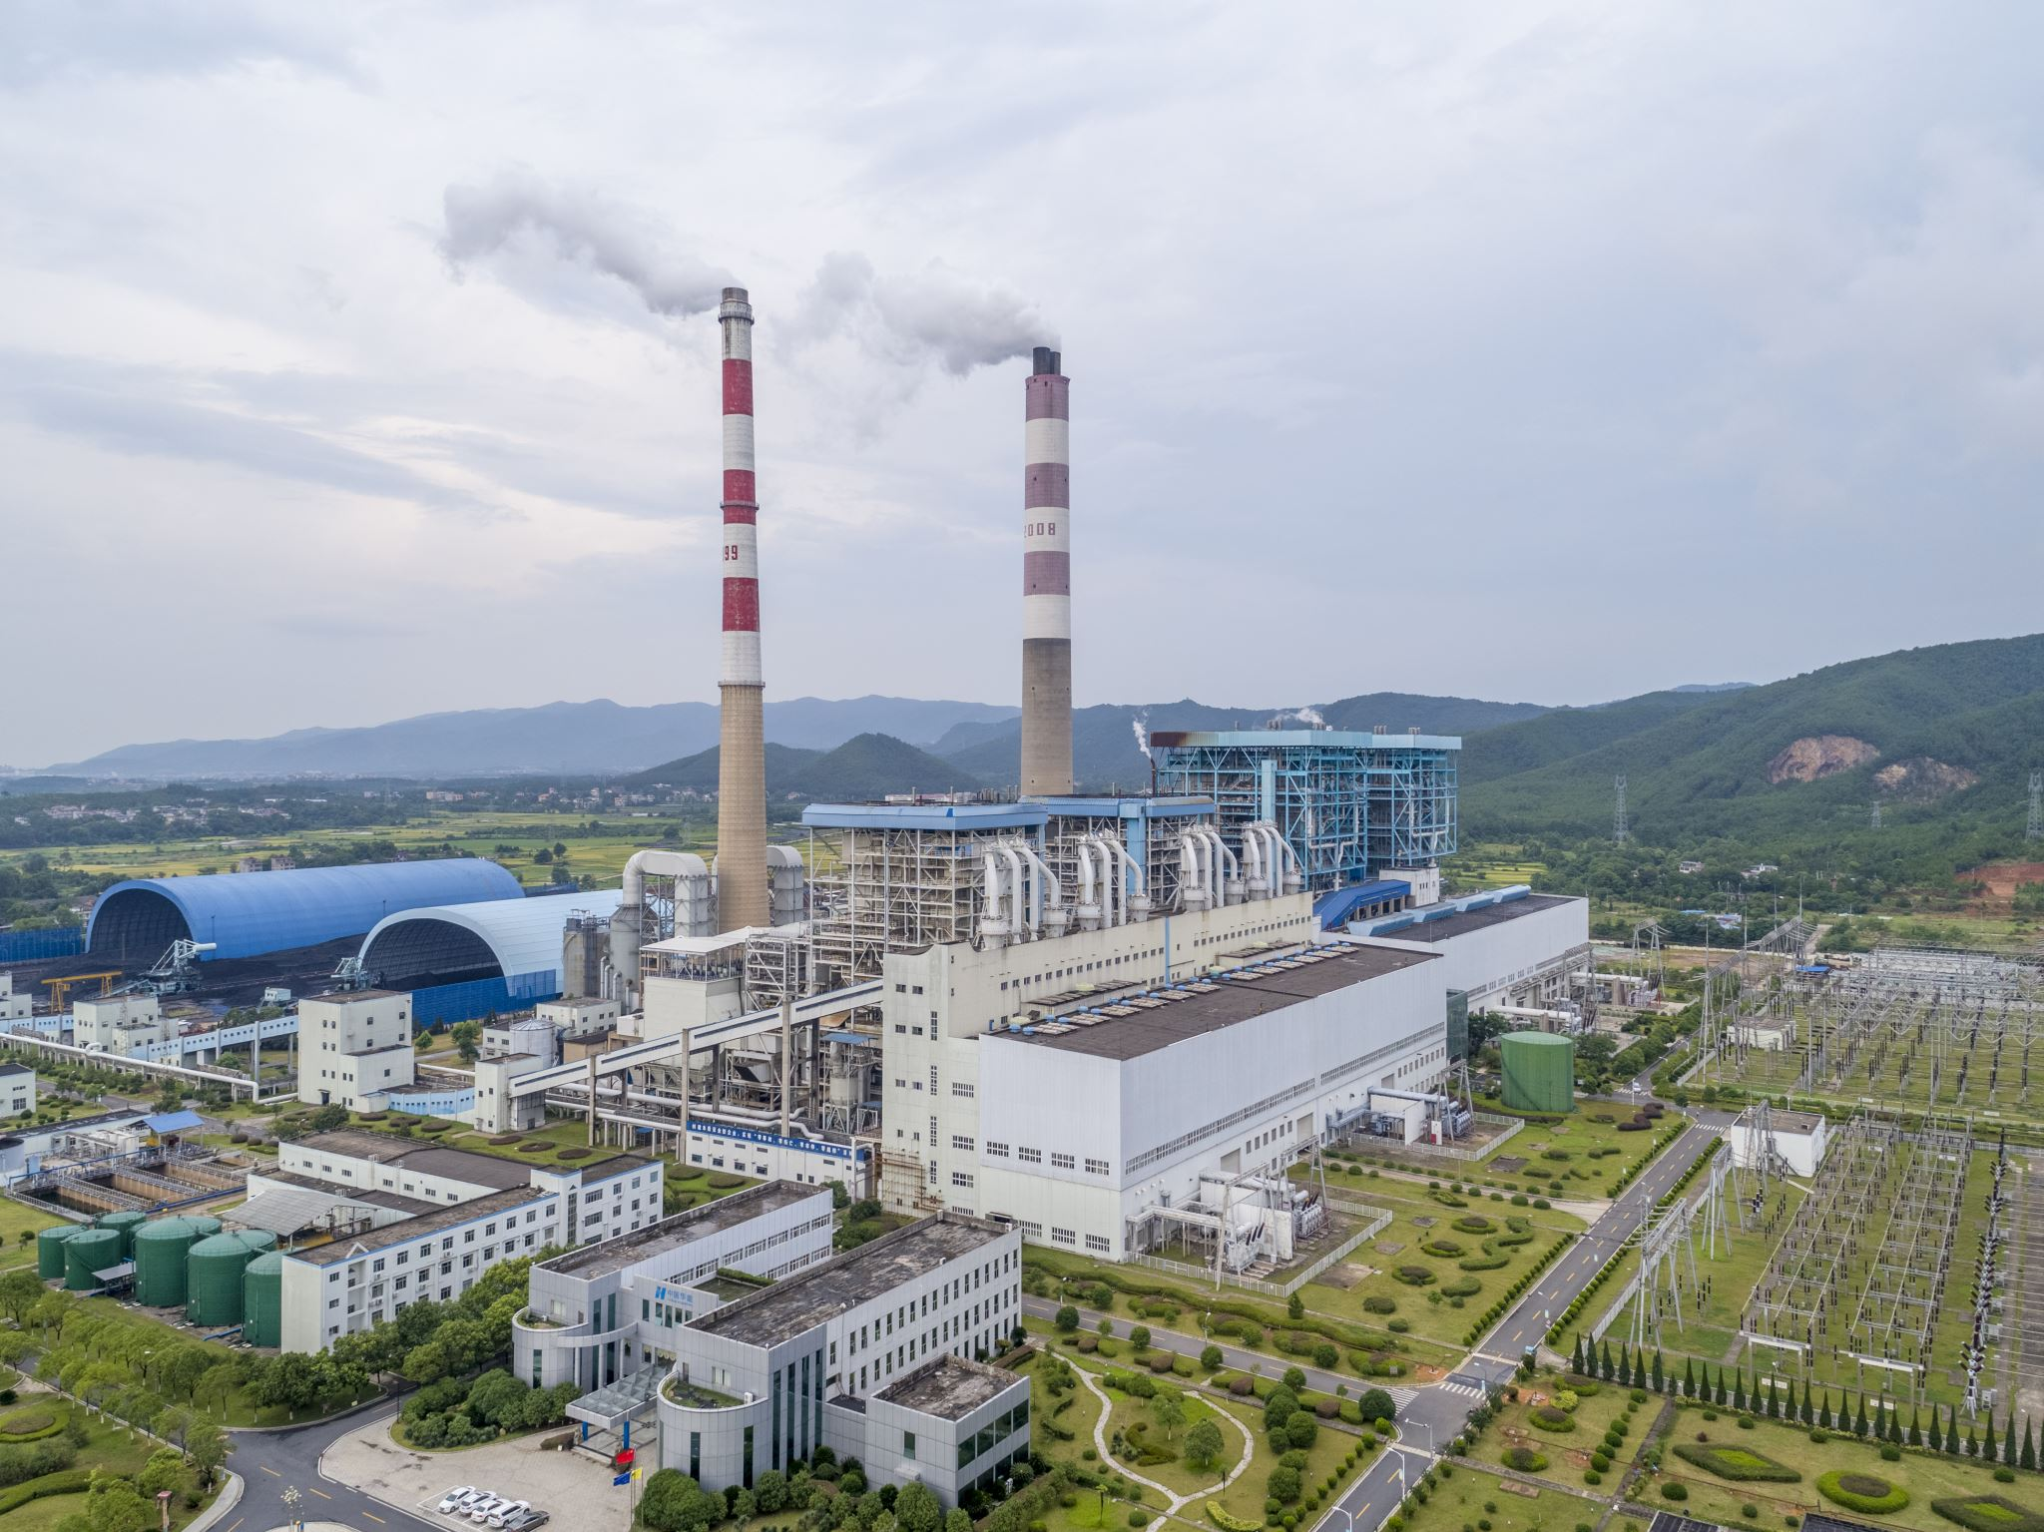
Objectives
Integrate ancillary data
Sociodemographic data
Air quality indicators
Health indicators
Integrate NASA Earth observations
Tree canopy cover
Urban heat islands
Heat mitigation capacity
Cooling capacity
Inform the City's urban heat mitigation initiatives through an Environmental Justice (EJ) lens
Tree planting
Cooling centers
Disparities in heat impact
Image credit: Office365
Notes:
Our objective is to drive insights and analysis through an Environmental Justice lens to aid the City of Wichita's urban heat mitigation and climate resilience initiatives. We plan to integrate sociodemographic data, air quality and health indicators as measures of vulnerability alongside remote sensing analysis that harnesses tree canopy, urban heat, heat mitigation and cooling capacities to ultimately empower the City of Wichita's informed decision-making capacity to mitigate heat overall, with a direct and optimized benefit to historically marginalized communities through a proposed Climate Adaptation & Mitigation Plan.
Image credits: stock photos from Microsoft

Slide 6
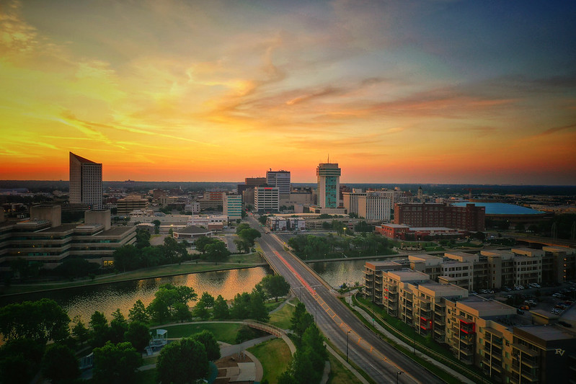
Project Partner and Community Concerns
Project Partner:
City of Wichita
Increased Urban Heat
Higher temperature and extreme heat events
Loss in Tree Canopy
Increased heat burden with loss of trees due to diseases
Need for Data + EJ
Visual and quantitative data to guide Climate Adaptation and Mitigation Plan, and to understand which vulnerable populations disproportionately experience high urban heat
Image Credit: City of Wichita
Notes:
For our project, we partnered with the City of Wichita and Nina Rasmussen from the city has been our point-of-contact. As mentioned earlier, our objective is to assist them with their heat mitigation strategies and the Climate Adaptation and Mitigation plan.
The city has been concerned with increased urban heat. Higher temperature and extreme heat events affects health, quality of life, energy burden and air quality.
Loss in tree canopy has also been a concern in the recent years in Wichita. Wichita is losing trees to diseases which is increasing heat burden. As noted before, the heat burden and canopy loss is not distributed equitably due to differences in heat exposures and social vulnerability.
Our project will visualize heat islands, tree canopy cover and heat vulnerability through maps, which will assist city will be able to use this to prioritize areas for mitigation. We will also be able to provide quantitative relationship between impacts of heat and indices of social vulnerability. These can be used to inform residents of Wichita and work towards climate resiliency.
Image Credit: City of Wichita

Slide 7
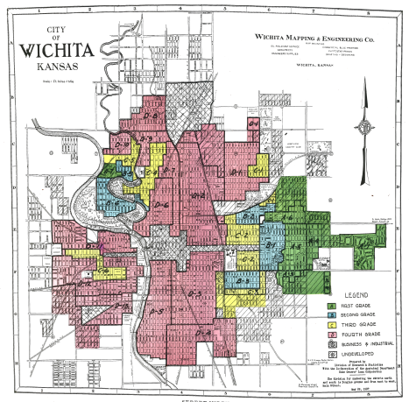
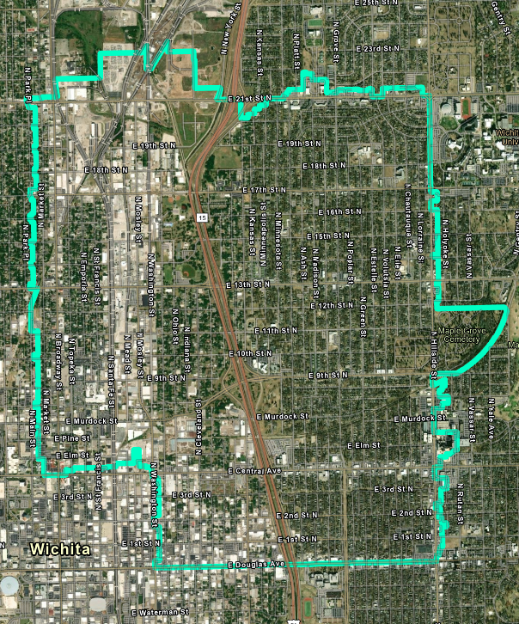
67214 and Environmental Justice
Historical Redlining
Image Credit: “Mapping Inequality” American Panorama
Notes:
After discussing with our project partners, we took a look at zip code 67214 as a priority area and dug deeper into the sociodemographics of this area through an environmental justice lens. Through comparison, we see that this area was historically redlined. Areas were graded "red" by the Home Owners Loan Corporation to reflect their low mortgage security and were deemed "hazardous". These grades were assigned based on quality of housing and crucially, the racial and ethnic identity as well as the class of residents living in that area. Immigrants and communities of color were mostly given D grades. Redlining directed public and private investment away from African American and immigrant families and towards native-born white families, and have been a significant contributor to the wealth inequality we see today in the US today.
Redlining Image Credit: Robert K. Nelson, LaDale Winling, Richard Marciano, Nathan Connolly, et al., “Mapping Inequality,” American Panorama, ed. Robert K. Nelson and Edward L. Ayers, accessed November 3, 2022, https://dsl.richmond.edu/panorama/redlining/
This work and its data are licensed under a Creative Commons Attribution-NonCommercial-ShareAlike 4.0 International License

Slide 8
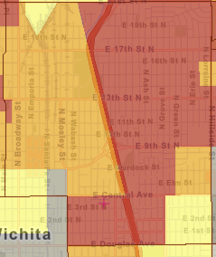
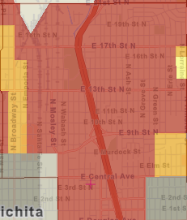
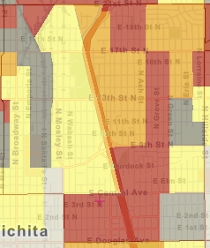
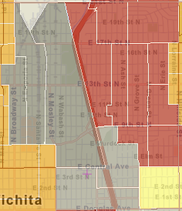
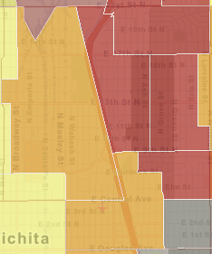
67214 and Environmental Justice
EPA EJScreen
Ozone Level (Compared to National Averages)
% people of color (Compared to State Averages)
% low income (Compared to State Averages)
% with less than a high school education (Compared to State Averages)
Asthma prevalence among adults 18+(Compared to State Averages)
95-100 percentile
90-95
percentile
80-90
percentile
70-80
percentile
60-70
percentile
50-60
percentile
Open-source satellite data can help us analyze the impact of urban heat on these vulnerable communities.
Notes:
We found zip code 67214 experiences high levels of heat, but wanted to know more about the heat vulnerabilities of its residents. Using the EPA EJ Screen we found that this area has a high level of ozone pollution, a large population of color, is largely low income with a low education attainment, and had a high asthma prevalence as well.
The percentiles here indicate that scores here are higher than the national/state averages by that percent, so for example the ozone levels highlighted in red indicate the levels at these locations were equal or higher than what 95-100% of the national average is.
*what are the EJ implications of these results? How does canopy cover increase in this heat vulnerable area help? (are race income etc. affecting sensitivity or adaptive capacity?)
Open source data can help us analyze the impact of urban heat on these communities
(links between heat and increased asthma symptoms https://www.aafa.org/weather-triggers-asthma/#:~:text=Hot%2C%20humid%20air%20can%20cause,the%20air%20irritate%20sensitive%20airways.)

Slide 9
NASA Satellites & Sensors
International Space Station
ECOSTRESS
70m resolution, temporal revisitation 1-7 days
Thermal Infrared Sensor - TIRS
100m spatial resolution (LST product gridded at 30m), temporal revisitation 16 days
Landsat 8 & 9
Image Credit: NASA
Notes:
Here are two of the Satellites and Sensors that our team used throughout the project. The first is the ECOsystem Spaceborne Thermal Radiometer Experiment on Space Station – ECOSTRESS. This sensor is not geostationary or sun synchronous as it’s on board the ISS and has a temporal revisitation period of 1-7 days. ECOSTRESS has a 70m. For our project we utilized analysis ready evapotranspiration and nighttime land surface temperature data for input into our environmental modeling.
Another sensor the team used is the Thermal InfraRed Sensor that’s on the Landsat 8 platform. This sensor has a 100m resolution with the LST product re-gridded at 30m. L8 is sun synchronous and has a temporal revisitation of 16 days. We used Landsat 8 & 9 land surface temperature data and albedo as additional layers into the Natural Capital Project’s InVEST Urban Cooling Model.
Image Credit: CC - PowerPoint, NASA

Slide 10
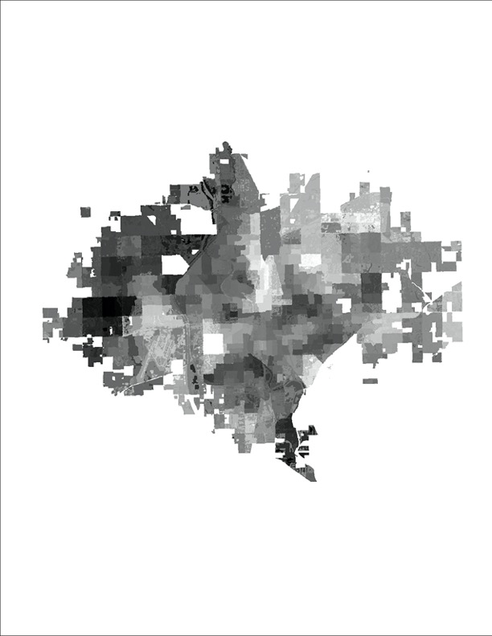
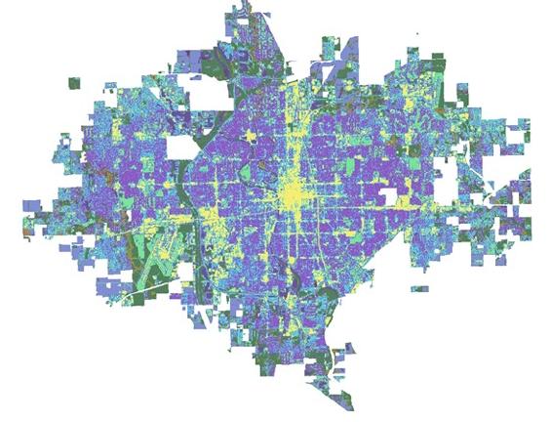
InVEST Urban Cooling Model
Albedo
Land Cover
Cooling Capacity
Shade
Evapotranspiration
Notes:
Images created by the team in ArcGIS Pro
To understand the effect of vegetation on the urban thermal landscape in Wichita, our team ran the Natural Capital Project’s InVEST urban cooling model. This model calculates multiple indices of heat mitigation based on albedo, shade, landcover, evapotranspiration, and distance from cooling islands like large green spaces.
Albedo – how well a surface reflects solar radiation
Shade – proxy for tree canopy cover
Landcover – what type of land cover class each pixel has – ex. Low density urban, deciduous forest, water
Evapotranspiration - Evapotranspiration is the sum of all processes by which water moves from the land surface to the atmosphere via evaporation and transpiration. (https://www.usgs.gov/special-topics/water-science-school/science/evapotranspiration-and-water-cycle)
Cooling Capacity - The index is used to estimate a temperature reduction by vegetation (https://invest-userguide.readthedocs.io/en/latest/urban_cooling_model.html)
All of these inputs are used in confluence to yield a cooling capacity index for each pixel. Here you can see each layer before and after its calculated into a cooling capacity index. Higher index values indicate that these pixels mitigate urban heat well. Conversely, lower values show that more mitigation is needed. This model requires both input layers and a biophysical attribute table to connect the physical attribute of the urban landscape to different landcover types.

Slide 11
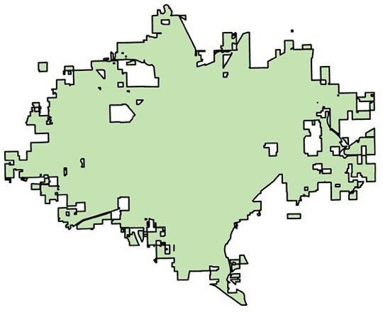
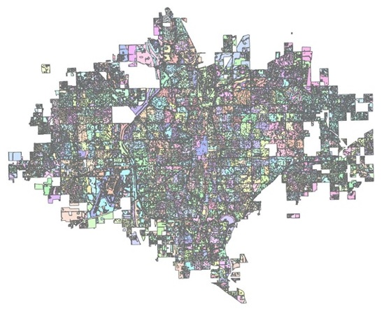
InVEST Hack
Land cover averages over Wichita
Land cover averages by census block group
Notes:
Images created by the team in ArcGIS Pro
The InVEST model uses averages for of input layers such as shade and albedo by landcover type across the study area. However, to make our results more nuanced, the team followed the ABQ Urban Development InVEST hack from summer 2022. Here, we calculate mean shade and albedo for each landcover type within a census block group. This allows for the team and project partners to change albedo and shade metric in targeted areas and run multiple heat intervention scenarios.

Slide 12
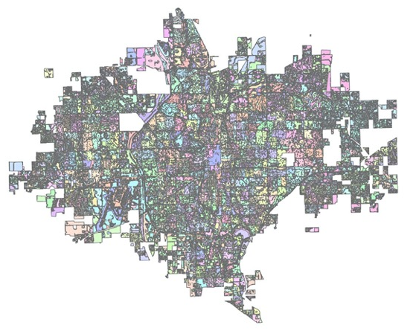
InVEST Hack
Land cover type per census block group
Census block groups
Land cover type
Notes:
Images created by the team in ArcGIS Pro
Here is how we ran the hack. First we took NLCD landcover types across the city and used the raster calculator function to multiply them by 100,000. This results in each landcover type having five trailing zeros. Next We extracted unique values for each census block group and used the raster calculator to add these to the landcover type. The result is a unique value for each landcover type within each census block group

Slide 13
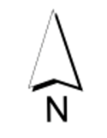
Biophysical Table: Albedo
Narrowband to Broadband Conversions of Land Surface Albedo (Liang, 2001)
Landsat 8 Top-of-Atmosphere values
Input for 'albedo' variable in biophysical table
2.98
0.0
Notes:
Albedo was calculated for local cloud-filtered and masked Landsat 8 TOA values by adapting Liang's formula for narrowband to broadband conversions of land surface albedo for Landsat 8.
Images created by the team in ArcGIS Pro – Icons: CC – Microsoft PowerPoint
Another layer in the biophysical attribute table is albedo – for our project (XYZ)

Slide 14
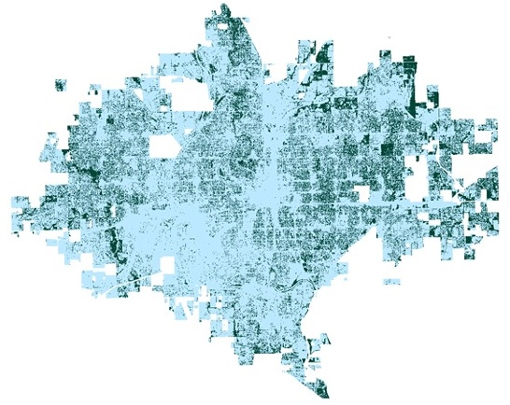
Biophysical Table: Current Tree Canopy Cover
Binary tree cover raster by Wichita Climate I
Tree cover as proxy for shade
Input for 'shade' variable in biophysical table
No Trees
Trees
Notes:
Images created by the team in ArcGIS Pro
Another layer in the Biophysical attribute table is shade. Our team utilized the Wichita Climate I teams tree canopy classification output which is a binary raster of tree canopy throughout Wichita. This raster was used in our analysis to determine percent shade per land cover type, per census block group. Having a fine resolution allows us to manipulate the data to simulate canopy interventions in different land cover classes.

Slide 15
Evapotranspiration (ET)
ET daily data from ISS ECOSTRESS
Composite Image from 2018-2022
Filtered to daytime ET for peak time data
Manual inspection for quality
Unit conversion to mm/day from W/m²
13.17
0.0
Notes:
ISS ECOSTRESS data for daily ET was acquired through AppEARS for Wichita for summer months between 2018-2022. All acquired geotiff files were pre-processed through Python, including filtering the files to obtain peak daytime data when heat stress is maximum. The filtered and cloud-masked files were further inspected for highest coverage and reasonable values and then a composite mean of the remaining images was produced. To be used in the InVEST model for calculating HMI, the units were converted from the W/m2 to mm/day. The summertime ET during peak heat stress was calculated to be between 7-14 mm/day within the city.

Slide 16
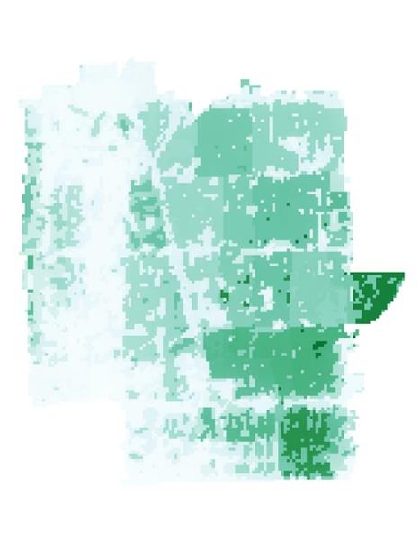
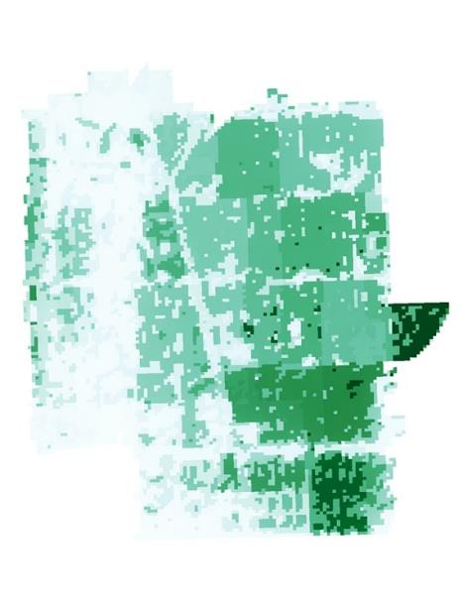
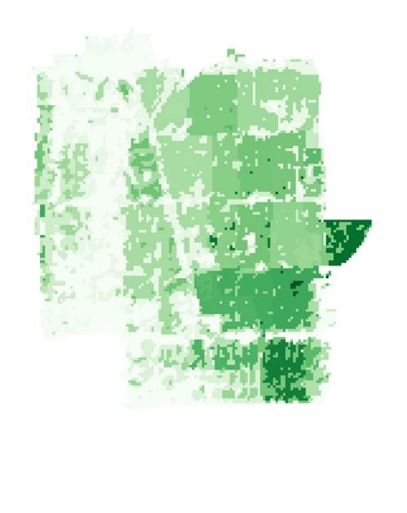
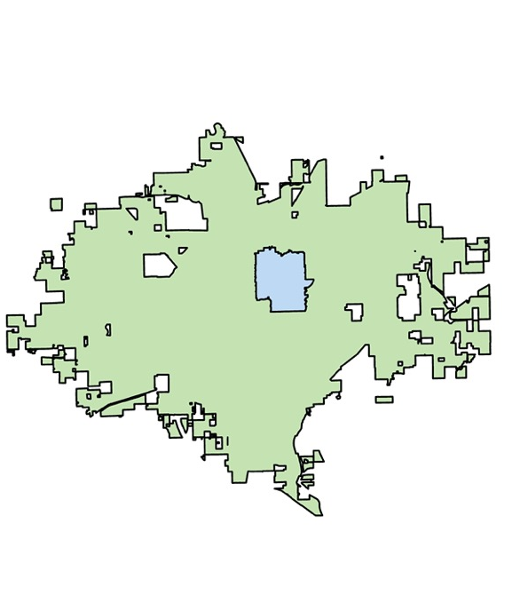
Example Usage: Cooling Capacity
0%
30% Increase
Difference (30%-0%)
67214 zip code
.77
.18
.77
.18
.13
0.0
Notes:
Here is an example of how the team can simulate targeted canopy interventions with the InVEST model. In the 67214-zip code, we demonstrate how increasing the tree canopy by 30% increases the cooling capacity for most cells in our target area. We demonstrate the difference between the too, noting that some cells experience an increase of 0.13 when compared to the baseline values. This methodology of targeted simulations and comparison to baseline values enables our partners to run multiple canopy adaptation scenarios and compare the results.

Slide 17
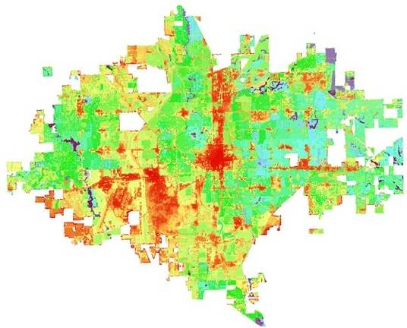
InVEST Outputs: Cooling Capacity Index
Cooling Capacity: BAU
Intermediate layer showing how much each pixel can mitigate heat – can inform project partners which areas of the city to prioritize for cooling interventions.
This index takes all variables put into the model into account, besides the distance from large green spaces.
The cooler purple and blue values indicate those pixels are efficiently mitigating urban heat while the warmer yellows and reds indicate that these areas are less able to.
.85 (higher cooling capacity)
.07
Notes:
Images created by the team in ArcGIS Pro
Talk about what cooling capacity is without reading off the slide. Define how the Cooling Capacity Index differs from the Heat Mitigation Index (accounting for distance from large green spaces)

Slide 18
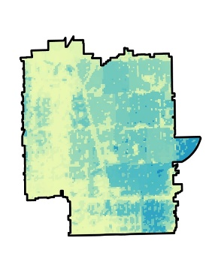
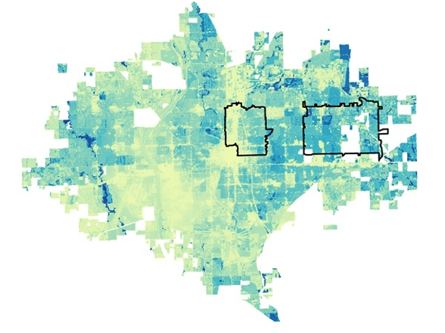
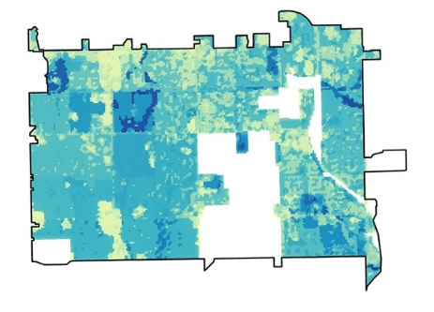
InVEST Output: Heat Mitigation Index
Sociodemographic Characteristics as a Potential Predictor of Heat Mitigation:
Zip Code 67214: Low Heat Mitigation
Sociodemographic Snapshot
(compared to National Averages)
% Low Income
% People of Color
% Less than High School Education
92 %ile
86 %ile
70 %ile
Zip Code 67204: High Heat Mitigation
Sociodemographic Snapshot
% Low Income
% People of Color
% Less than High School Education
4 %ile
23 %ile
11 %ile
0.98 (higher ability to mitigate heat)
0.07
Notes:
The main output from InVEST is a heat mitigation index. This index is almost the exact same as cooling capacity, but as we already stated, the heat mitigation index accounts for green areas that are larger than 2 hectares. Our team wanted to explore the potential connection of sociodemographic variables as a predictor of heat mitigation capacity. To do so, we selected our target area, the 67214 zip code and used the HMI to select an area for comparison. We landed on the neighboring 67204 zip code, that was not historically redlined. Utilizing the EPA’s EJ Screen tool, we can compare the two zip-codes sociodemographic snapshots finding that 67204, with higher heat mitigation values, is more affluent, has a population with higher educational attainment, and has a smaller population of people of color.
Images made by the team with InVEST and ArcGis Pro, Demographic data retrieved from EPA EJ Screen

Slide 19
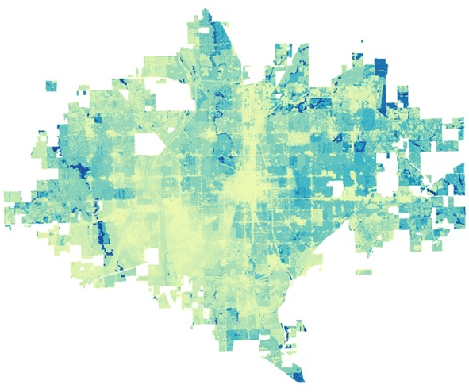
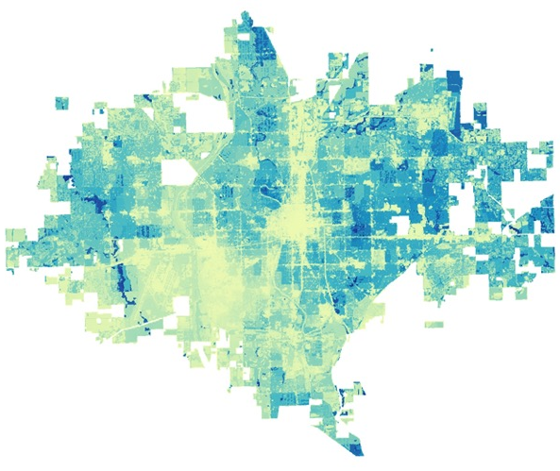
Tree Canopy Manipulation
Scenarios Generated: Heat Mitigation Index
Worst-Case Scenario: Rapidly Decreasing Tree Canopy | Business-as-Usual: No Change in Rates of Increase or Decrease | Best-Case Scenario: Increasing Tree Canopy
0.98
0.07
0.98
0.07
0.98
0.07
Notes:
Here we have three scenarios of tree canopy manipulation to simulate what different adaptation metrics could look like.
On the left, we have a worst case scenario where there is a rapidly decreasing tree canopy. To simulate this, our team decreased shade metric in the biophysical attribute table by 10% as a proxy for canopy decrease. The result is that across Wichita, the city has less capacity to beat the heat. In the map, this is represented by the increase in yellowish pixel values.
In the middle we have a Business-as-Usual scenario where there is no changes to canopy. This is primary used as a baseline metric to understand how increasing or decreasing canopy will effect the spatial distribution of heat burden. As you can tell from the map, central and southwest Wichita currently have the most trouble in mitigating heat.
On the right is our Best-Case Scenario. Here we increased the shade metric by 30%. This resulted bluer pixel values indicating that the city has a greater capacity to increase urban heat.

Slide 20
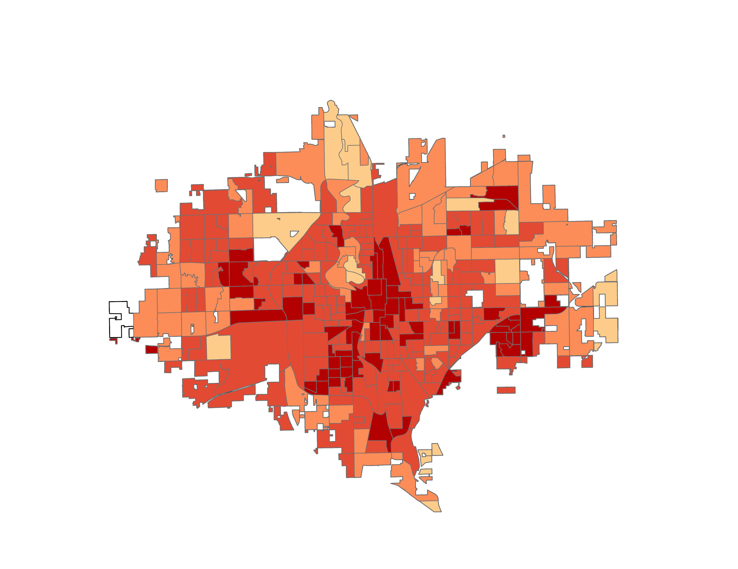
Land Surface Temperature - Daytime
Mean Daytime Land Surface Temperature (°F)
Landsat 8 TIRS-2 and Landsat 9 TIRS-2 LST data
Zonal Statistics
Mean Daytime LST
0
2
4
6
Miles
98-100
100-104
104-107
107-111
111-118
Notes:
Landsat data for average daytime LST was acquired through Google Earth Engine for the time-period between 2017-2022 during the summer months.
May 1st- August 30 were considered summer months. Mean daytime LST per census block group was calculated using zonal statistics as table tool in ArcGIS Pro.
Images created by the team in ArcGIS Pro.
Most heat concentrated near the downtown, in the southeastern regions and west-SW near the airport.

Slide 21
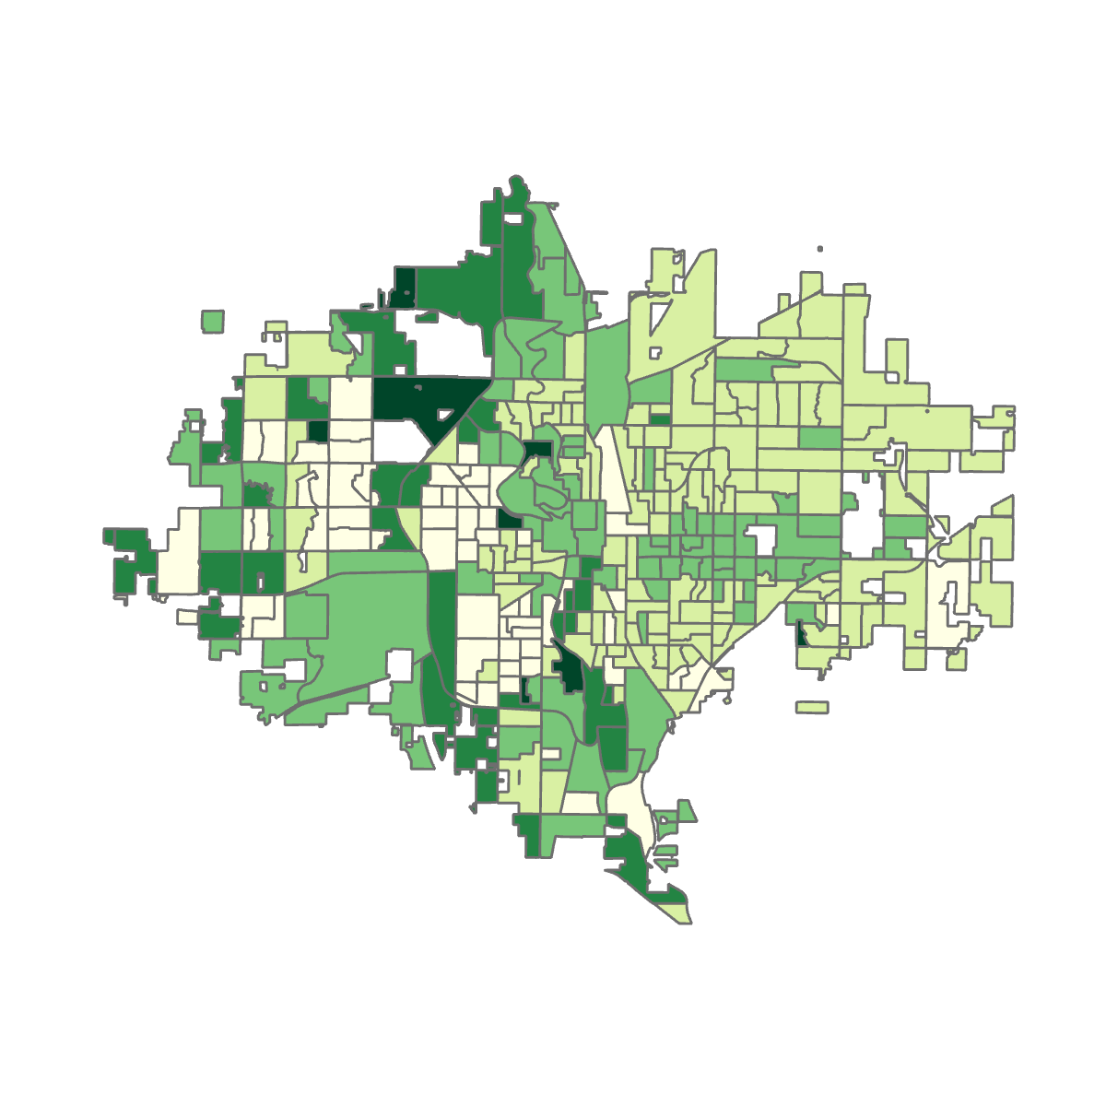
Land Surface Temperature – Nighttime
Mean Nighttime Land Surface Temperature (°F)
ECOSTRESS ECO2LSTE
Zonal Statistics
Nighttime LST
0
2
4
6
Miles
46-47
47-48
49-50
51-52
53-56
Notes:
Nighttime land surface temperature was retrieved and cloud-masked through the ECOSTRESS Land Surface Temperature (ECO2LSTE) product in Python, and then employed the same processing steps as for daytime land surface temperature: mean zonal statistic in ArcGIS Pro per census block group in Wichita. [Map created with one ECO2LSTE image. Final output will vary, but we expect trends similar to the daytime land surface temperature: heat concentrated in downtown Wichita.]

Slide 22
Heat Vulnerability Index (HVI)
How does Heat Vulnerability align among other Census Tracts?
Exposure
Daytime Land Surface Temperature
Normalized Difference Vegetation Index (NDVI)
Sensitivity
Asthma Prevalence
Coronary Heart Disease Prevalence
Adaptive Capacity
Less than a high school education
Unemployment
Nighttime Land Surface Temperature
Normalized Difference Water Index (NDWI)
Normalized Difference Built-Up Index (NDBI)
Stroke Prevalence
Children under 5
Adults over 65
Below poverty level
English as a second language
Adults over 65 w/o health insurance
Ozone
PM 2.5
Disability Prevalence
Heat Vulnerability Index
+
+
=
Notes:
After digging into the characteristics of zip code 67214 from a social vulnerability standpoint, we wanted to create a Heat Vulnerability Index to recognize other heat vulnerable populations among Wichita census tracts, to see which areas are should be prioritized in mitigating extreme heat. We wanted to ensure this definition was thoroughly nuanced with as many characteristics of heat exposure, sensitivity, and adaptive capacity included. To measure heat exposure, we decided to use both daytime and nighttime land surface temperature, NDVI, NDWI and NDBI to understand the vegetation, water bodies and built-up area of our census tracts. To measure sensitivity to heat, we looked at three health indicators: asthma, coronary heart disease, and stroke, all of which are conditions that are exacerbated by high heat. Young children and the elderly are also particularly susceptible to adverse effects from extreme heat. Those with low-income may be at higher sensitivity of experiencing extreme heat due to their living or working conditions. We also looked at ozone and PM 2.5 as measures of poor air quality, as there has been evidence stating that heat islands contribute to higher air pollution levels, which in turn contribute to heat mortality and illness, as well as general discomfort and respiratory difficulties (EPA.gov) . In terms of adaptive capacity, those who are disabled, speak English at a lower proficiency, are unemployed and have less than a high school education may have a more difficult time adapting to high heat due to a lack of resources, knowledge, accessibility and ability. Older adults without health insurance may be less likely to access care during an episode of high heat due to financial constraints. Together, these variables of exposure, sensitivity and adaptive capacity can be combined to create a heat vulnerability index.

Slide 23
Heat Vulnerability Index
Principal Component Analysis – Dimension Reduction
Principal Component 1
Stroke
Adult over 65 w/o health insurance
Principal Component 2
Children under 6
Adults over 65
Principal Component 6
NDBI
NDWI
Principal Component 3
Principal Component 4
Principal Component 5
Unemployed
Asthma
Coronary Heart Disease
Racial minority
NDBI
Daytime Land Surface Temperature
PM 2.5
Racial minority
Racial minority
Over 65 w/o health insurance
English as a second language
Less than a high school education
Adults over 65 w/o health insurance
Unemployed
Adults over 65 w/a disability
Less than a high school education
English as a second language
Notes:
In order to conduct heat risk by creating a heat vulnerability indicator, we conducted exploratory analysis through Geographic Weighted Regression, Exploratory Regression, data visualizations such as boxplots, and correlation matrices. Combined with expect advice, we conducted principal component analysis to create our index and assign a local heat risk to census block groups. PCA is a dimension reduction technique that can take a large dataset of potentially correlated social, environmental and health variables, like the ones we wanted to include in our index, and combine them into new constructs or components that are smaller than the number of variables in the original data set. Here, we applied a PCA reduction technique which grouped our variables into 6 components

Slide 24
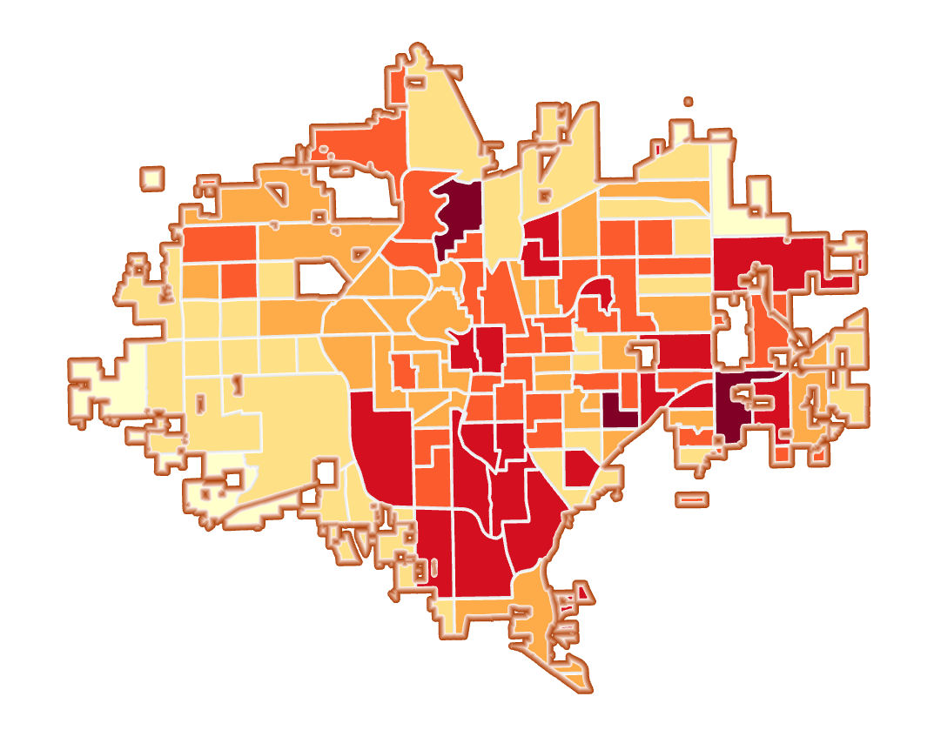
Heat Vulnerability Index
Map
City of Wichita Boundary
City Census Tracts
-6.1 to -4.3 (low vulnerability)
-4.2 to -1.4
-1.3 to 0.1
0.2 to 1.8
1.9 to 4.4
4.5 to 8.0 (high vulnerability)
0
2
4
6
Miles
Notes:
After running our PCA and plotting our HVI, we can see that the center of Wichita has a high heat vulnerability based on our exposure, sensitivity and adaptive capacity factors. Having this index can help with policy, *continue discussing implications*

Slide 25
Conclusion
Heat Inequity
Canopy Adaptation
Inform
The spatial distribution of urban heat in Wichita disproportionately burdens historically redlined neighborhoods and vulnerable populations, a relationship shown through our HVI.
A prime example is the 67214:
Low heat mitigation
High heat vulnerability
Through the InVEST Urban Cooling Model, multiple canopy adaptation scenarios can be simulated in silico.
Increasing tree canopy cover by 30% decreased the heat burden in our simulation area through natural processes, such as evapotranspiration and shade.
With the aid of satellite data, the delineation of neighborhoods that face an inequitable heat burden can be integrated into decision-making. This can inform the roll-out of heat mitigation efforts, such as:
Tree planting
Cooling centers
Educational resources regarding urban heat
Notes:
Through our analysis we were able to determine that the spatial distribution of urban heat islands in Wichita aligns with zip-codes that were historically redlined. The 67214 zip code is a key example of this. Further, through our research we were able to determine that socio-demographic indicators of vulnerability are correlated with different areas ability to mitigate heat as we demonstrated through the comparison of the 67214 and 67206 zip codes.
However, we also found that through canopy adaptation initiatives, neighborhoods that experience disproportionate heat burden can increase their localized ability to mitigate heat, mainly through the evapotranspiration and shade processes.
Finally, our team was able to successfully demonstrate that open-source earth observation data can be used to delineate neighborhoods that experience heat vulnerability. This can assist the city of Wichita’s Sustainability Integration Boards efforts to determine where to allocate funds and initiate targeted heat mitigation efforts.

Slide 26
Limitations, Errors & Uncertainties
Spatial and Remote Sensing Analysis
Loss of detail and natural trends: zonation effect and MAUP
Possible undetected processing errors with satellite imagery
Reduction of human experience through data analysis
Heat Risk and Vulnerability
Exclusion of unidentified variables of interest that may have influenced output
Error in inferring a variable of interest by proxy
Discrimination and underrepresentation of underserved communities in data collection
Modeling Heat Mitigation and Cooling Capacity Indices
Possible processing errors undetected in inputs
Reference areas which may not be an ideal representation of natural land

Slide 27
Future Work
Community Engagement
Develop a nuanced definition of vulnerability founded in community input
Work with local organizations to understand health implications of Urban Heat through an EJ lens
Facilitate education on the impact of urban heat and how communities can address it
Urban Heat Mitigation
Collaborate with the Sustainability Integration Board
Quantify benefits of increasing ecosystem services in Wichita
Identify opportunities to increase tree planting initiatives
Notes:
Due to the time constraints associated with the DEVELOP term and the scope of our project, there is more work to be done in Wichita regarding heat and vulnerability. Creating space for community engagement would allow future teams to work with affected parties on developing a nuanced definition of vulnerability that is specifically tailored to their concerns. Teams can also work with local organizations to quantify the costs of urban heat on those communities that are disproportionately affected by it. In addition, through community engagement, more work can be done to create opportunities to engage and educate affected communities on the impact of urban heat and what they can do to combat it.
For heat mitigation, future teams can also perform additional in-depth statistical analyses to look at the relationship between heat, and socio-economic or health variables, such as equity or healthcare costs. Further, the development of a cost-benefit analysis to asses the benefits stemming from increased ecosystem services in Wichita may help inform decision makers. Finally, future teams and the city of Wichita can work in collaboration to delineate areas for increased tree canopy intervention programs.

Slide 28
Advisors, Mentors, & Fellows
Lauren Childs-Gleason (NASA Langley Research Center)
Dr. Kenton Ross (NASA Langley Research Center)
Julianne Liu (NASA DEVELOP Virtual Environmental Justice Node)
Project Partners & Collaborators
Nina Rasmussen(City of Wichita, Department of Health and Environment)
Foundational Project Work
Wichita Climate I: Brooke Laird, Melissa Ashbaugh, Muskaan Khemani, Sadie Murrary, Remi Work, Marco Vallejos (former Fellow)
Additional Support
Lance Watkins (Arizona State University)
Akshay Agarwal (UCSB Data Science)

Slide 29
Land Acknowledgement
Our team acknowledges the significance of the history of the Indigenous land our project covered. The land of Wichita belonged to the Osage, Kiowa, Wichita, and Sioux people before being stolen and unjustly divided by the colonists.
The inequities observed in this project are a consequence of such colonial era policies as well as the discriminatory governmental policies that followed.
Additionally, we would also like to acknowledge the Indigenous land our team members worked from:
Ithaca, NY- land of the Gayogo̱hó:nǫ (the Cayuga Nation), part of the Haudenosaunee Confederacy
Washington D.C.- land of the Nacotchtank, Anacostan and Piscataway people
Mahomet, Illinois- land of the Sioux, Cherokee, and Iroquois people
Lawrence, Kansas- land of the Kaw/Kansa, Osage, and Shawnee people
Our team acknowledges the hardships and respects the perseverance of Indigenous people.

